Slide 1
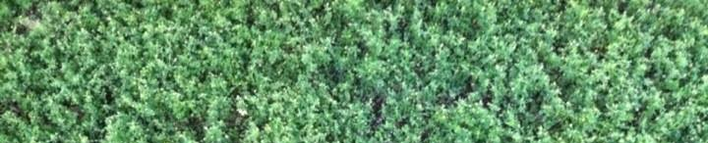
Invasive populations of Medicago polymorpha rely less on co-evolved rhizobia
Katherine J. Wozniak*, Maren L. Friesen
Dept. of Plant Biology
Michigan State University
*Undergraduate presenter
Notes:
Katie, senior microbio student from MSU. Today I’ll be talking to you about my research in the Friesen lab investigating if invasive pops of M pol rely less on co-evolved rhizob

Slide 2
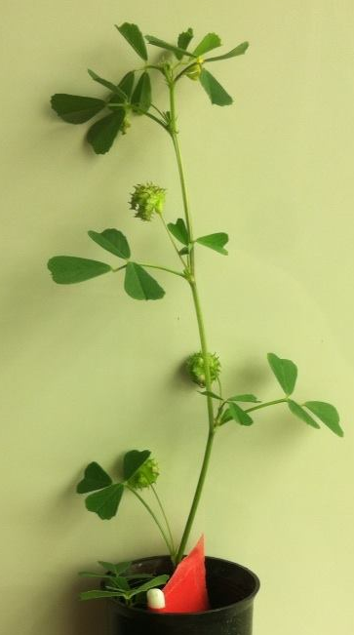
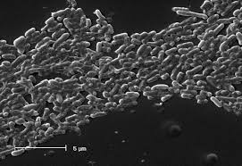
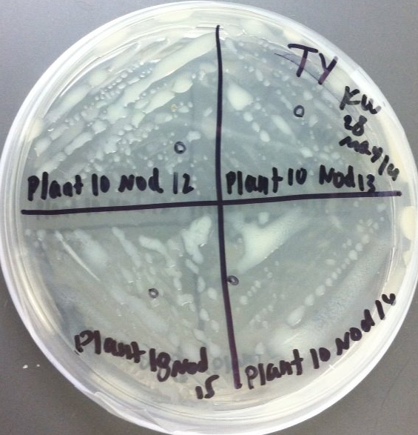
Medicago polymorpha-Ensifer medicae
Standardsingenomics.org

Slide 3
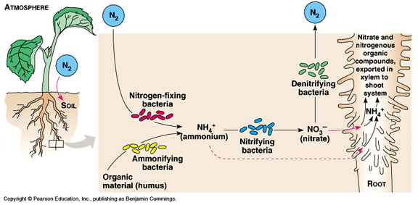
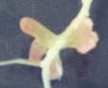
Mutualistic Relationship
K. Wozniak
Pearson, from http://www.bio.miami.edu/dana/226/226F08_22print.html
Notes:
Explain N and C interplay which creates this mutualistic symbiosis

Slide 4
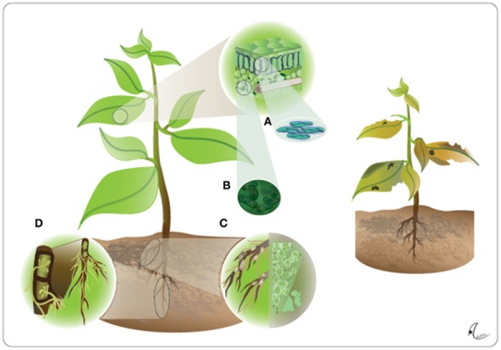
Mutualism and Pathogenicity
Methods of initial infection similar
Do non-co-evolved (naïve) microbes have a pathogenic effect?
http://journal.frontiersin.org/article/10.3389/fpls.2011.00100/full
Notes:
B. Rhizobia
C. Endophytes
D. Fungi

Slide 5
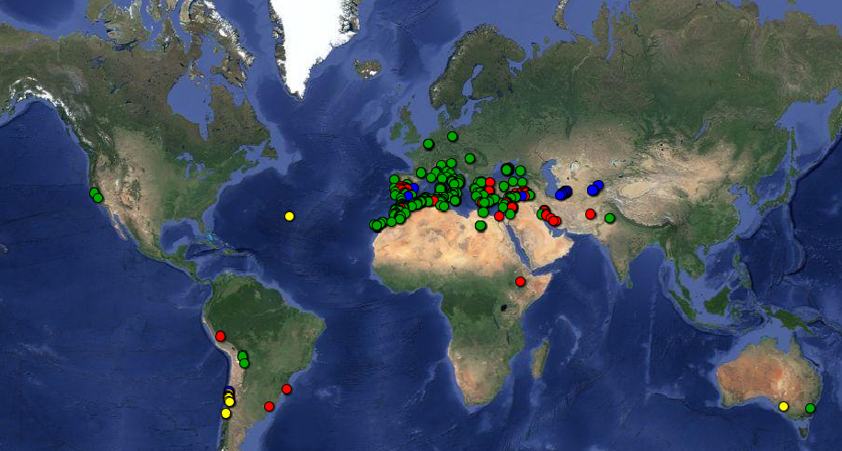
Evolving in Different Regions
USDA
Notes:
As I said; legume evolved from these ranges. Relationship has changed over time and in different regions. Data suggesting that invasives are less dependent on partner, which is interesting bc how do they get their N in new lands?

Slide 6
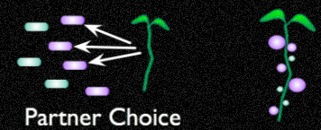
General Questions
How do mutualisms evolve across regions?
Are bacterial associations different in different regions?
What about dependence on “partners”?
Notes:
My overarching Qs about this mutualism is….

Slide 7
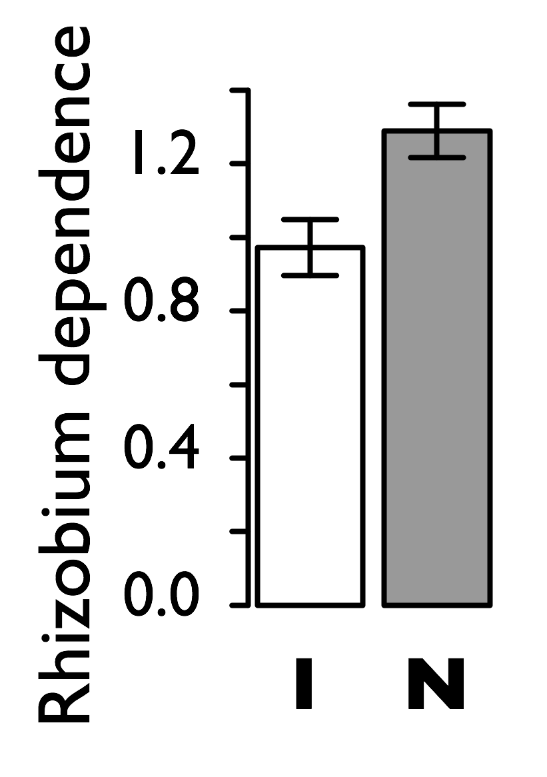
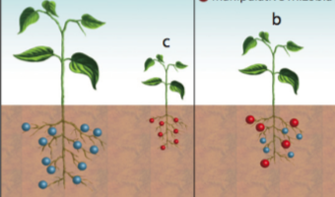
Native vs. Invasive Genotypes
NATIVE
Portugal genotype
INVASIVE
Florida genotype
S. Porter, in prep
Notes:
Back story about plant behavior. Native=choosy, highly evolved, assoc with 1 or few efficient rhizobia. Invasive=generalist; less picky, assoc with any beneficial microbes. Used PT and FL genotype with soils from both ranges.

Slide 8
Experimental Questions
Do microbes in the rhizosphere influence fitness of Medicago polymorpha?
What is the effect of co-evolutionary history on plant fitness?
Notes:
This exp Q=

Slide 9
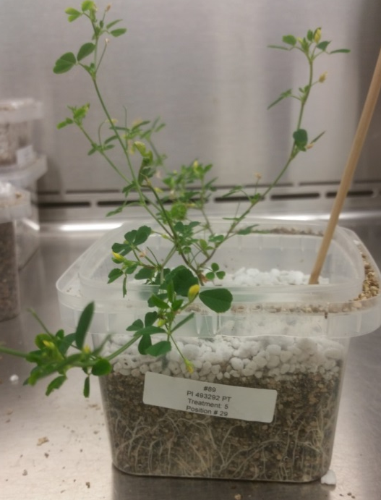
Layout
20 plants/genotype
10 treatments
 | Native soils | Invasive soils
Native genotype | X | X
Invasive genotype | X | X
10⁵ cfu/mL 10¹⁰ cfu/mL Low:WSM High:WSM
Notes:
Large amount of death in this experiment due to exploration of new growth conditions. Had both N and I genos with matched and unmatched soils. Treatments depicted by plates: dilute soil, concentrated soil, dilute with WSM and concentrated with WSM. This was done for soils from both regions.

Slide 10
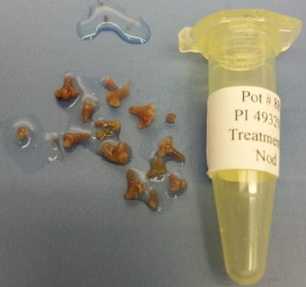
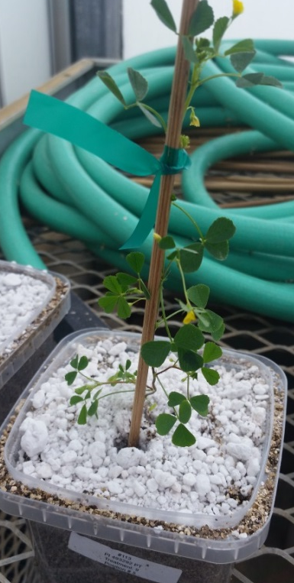
Measurements
1. Nodule number
Assess if mutualism is fostered
2. Root weight
Assess if root biomass contributes to association with different microbes
3. Shoot weight
Above-ground biomass as a measure of general fitness
Notes:
What I measured and why

Slide 11
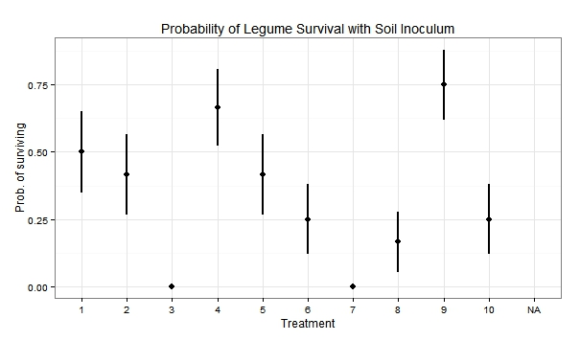
Mortality in High Soil Concentrations

Slide 12
Explanation of Invasion
Increasing Biomass
PT legume;
PT soil
PT legume; FL soil
FL legume; FL soil
t = -1 t = 0 t = 1

Slide 13
Nodule Number Result vs. Expectation
Number of nodules
PT legume;
PT soil
PT legume; FL soil
FL legume; FL soil
t = -1 t = 0 t = 1

Slide 14
Root Weight Result vs. Expectation
Root weight (g)
PT legume;
PT soil
PT legume; FL soil
FL legume; FL soil
t = -1 t = 0 t = 1

Slide 15
Shoot Weight Result vs. Expectation
Shoot weight (g)
PT legume;
PT soil
PT legume; FL soil
FL legume; FL soil
t = -1 t = 0 t = 1

Slide 16
Conclusions
Native
Outperformed FL genotypes overall
Does well with [low] co-evolved microbes+rhizobia
Higher investment into nods
Invasive
Highest root weight during initial invasion
Recovers after evolving with microbes
Less investment into nods
Notes:
WSM incr biomass: Plant and rhizobia has beneficial effect
Dilute soil: Low conc microbes facilitates benefit. Could be antagonism between rhiz and conc microbes.
Tells us _________??

Slide 17
Future Research
Larger experiment with more replication and optimized growth conditions
Crush and plate nodules, sequence to assess species in nodules
Q-PCR to quantify number of each strain in nodules
Root analyses

Slide 18


Acknowledgements
DEB-1354878 to ML Friesen
Friesen Laboratory
Dr. Maren Friesen & Dr. Stephanie Porter
Dr. Chandra Jack (Post-doctoral Fellow)
Alita Burmeister (PhD candidate, Lenski Lab)
Dean’s Research Scholars Program
College of Natural Science, MSU
Notes:
Thanks to my research mentor, Dr. Maren Friesen, postdoc Chandra Jack and Friesen Lab, also DRS Program for funding and GCURS for allowing me to be here today.

