Slide 1
CAPSTONE PROJECT - CAR ACCIDENT REPORT
MARIA RENEE CARRASCO

Slide 2
INTRODUCTION
A car accident is an unplanned event that sometimes has inconvenient or undesirable consequences. There are too many situations that can cause an accident, some of them are our responsibility but others not.
1
There are too many situations that can cause an accident, some of them are our responsibility but others not.
2
3
The Seattle government is interested to develop an algorithm that could help to avoid car accidents, considering many variables that could affect the prediction like Weather, Road conditions and light conditions.

Slide 3
EXPLORATORY DATA ANALYSIS
194,673 rows
37 ATTRIBUTES
4 LEVELS OF SEVERITY
UNBALANCED DATA

Slide 4
ATRIBUTTES
SEVERITYCODE
WEATHER
ROADCOND
LIGHTCOND
Independent Variable
Dependent Variable
Dependent Variable
Dependent Variable

Slide 5
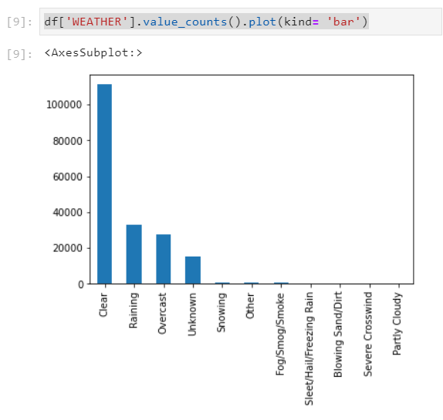
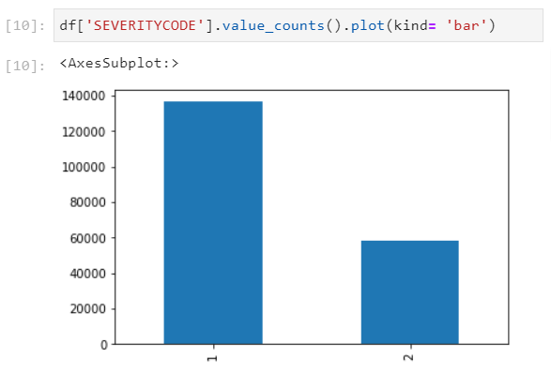
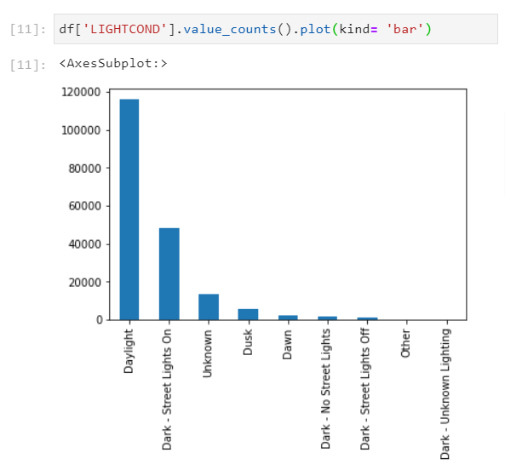
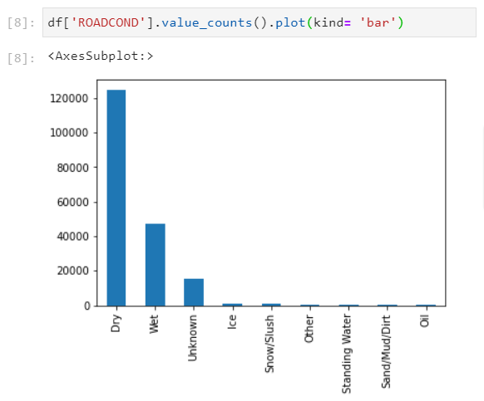
WEATHER
SEVERITYCODE
LIGHTCOND
ROADCOND

Slide 6
METHODOLOGY
01
02
03
K-NEAREST NEIGHBOR
KNN
DECISIÓN TREE
LOGISTIC REGRESSION

Slide 7
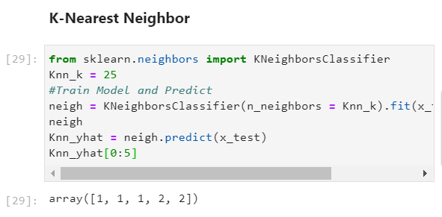
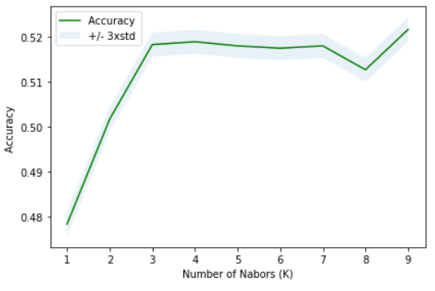
K-NEAREST NEIGHBOR (KNN)
01

Slide 8
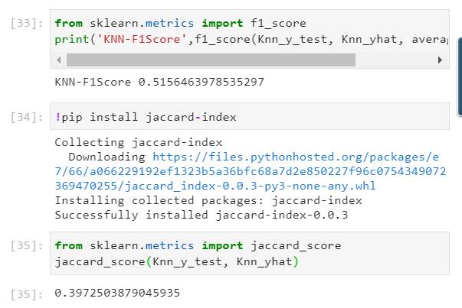
K-NEAREST NEIGHBOR (KNN)
01

Slide 9
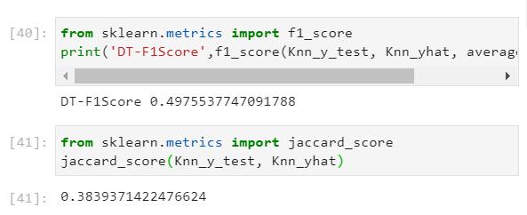
DECISIÓN TREE
02
Decision trees are built are built using recursive partitioning to classify the data. For that, it is necessary to splitting the training set into distinct nodes, where one node contains all of most of one category of the data.

Slide 10
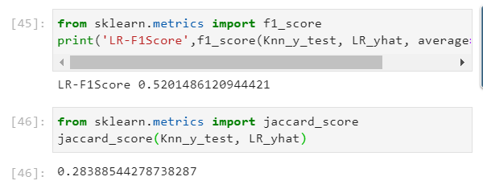
LOGISTIC REGRESSION
03
The dependent variable (“SEVERITYCODE”) is finite or categorical. Logistic regression has been applied to understand the relationship between dependent variable (“SEVERITYCODE”) and other attributes (“WEATHER”, “ROADCOND”, “LIGHTCOND”). In this way, it is possible to predict the car accident severity according to the variable selected to be analyzed.

Slide 11
CONCLUSION
Based on the data, it is possible to conclude that particular conditions have impact at a different scale that could result in property damage or injury. The following table shows that the model classification KNN is the best model to predict car accident.
MODEL | F1 SCORE | JACCARD SCORE | ACCURACY
KNN | 0.52 | 0.40 | 0.51
Decision Tree | 0.50 | 0.38 | 0.56
Logistic regression | 0.52 | 0.28 | 0.53

