Slide 1

(4-2) Selection Structures in C
H&K Chapter 4
Instructor - Andrew S. O’Fallon
CptS 121 (February 2, 2016)
Washington State University
Notes:
C. Hundhausen, A. O’Fallon

Slide 2
Control Structures
Recall that algorithms are composed of three different kinds of statements:
  Sequence: the ability to execute a series of instructions, one after the other.
  Conditional: the ability to execute an instruction contingent upon some condition.
  Iteration: the ability to execute one or more instructions repeatedly.
This week, we'll learn about conditionals: the ability to execute some code IF some condition is true.
C. Hundhausen, A. O’Fallon
Notes:
C. Hundhausen, A. O’Fallon

Slide 3
Conditions (1)
Conditional statements rely on a Boolean condition, which evaluates to either true or false
In C, the true and false values are actually represented numerically:
  False: 0
  True: any number except 0 (usually 1)
Relational operators are used to build Boolean conditions:
  < (less than), > (greater than), <= (less than or equal to), >= (greater than or equal to), == (equal to), != (not equal to)
C. Hundhausen, A. O’Fallon
Notes:
C. Hundhausen, A. O’Fallon

Slide 4
Conditions (2)
Examples
  Assume x = 3, y = 4, max = 100, min = 0, and ch = 'c'
  Then what do the following evaluate to?
    x <= 0
    x == y
    max >= min
    ch < 'a'
    max
    min != 0
    max == 99 + 1
    min – 50 < 0
C. Hundhausen, A. O’Fallon
Notes:
C. Hundhausen, A. O’Fallon

Slide 5
Conditions (3)
Logical operators
  We can combine relational operators with logical operators to construct general Boolean expressions in C:
    AND: && (A single '&' is different.)
    OR: || (A single '|' is different.)
    NOT: !
  Examples
    Assume that temp = 50, MAX_TEMP = 90, precip = 2.0, num_votes = 20, votes_needed = 20, and elected = 0;
    Then evaluate these:
      (temp < MAX_TEMP) && (precip > 0)
      (num_votes >= votes_needed) || (!elected)
C. Hundhausen, A. O’Fallon
Notes:
C. Hundhausen, A. O’Fallon

Slide 6
Conditions (4)
Operator precedence
  Just like numeric operators (+, -, /, *), logical operators have precedence rules that determine order of evaluation
  From highest to lowest, the precedences are as follows: [Most are left-to-right; but not assignment]
    function calls (highest)
    !, +, -, & (unary operators)
    *, /, %
    +, -
    <, <=, >=, >
    ==, !=
    &&
    ||
    = (assignment) (lowest)
C. Hundhausen, A. O’Fallon
Notes:
C. Hundhausen, A. O’Fallon

Slide 7
Conditions (5)
Operator precedence (cont.)
  When in doubt, parenthesize!
    How will the expression
    x + y < z – a
    evaluate?
    Answer: (x + y) < (z – a)
    Nonetheless, it's a good idea to parenthesize as above in order to make the order of evaluation clear
    However, over-parenthesizing may decrease code readability
C. Hundhausen, A. O’Fallon
Notes:
C. Hundhausen, A. O’Fallon

Slide 8
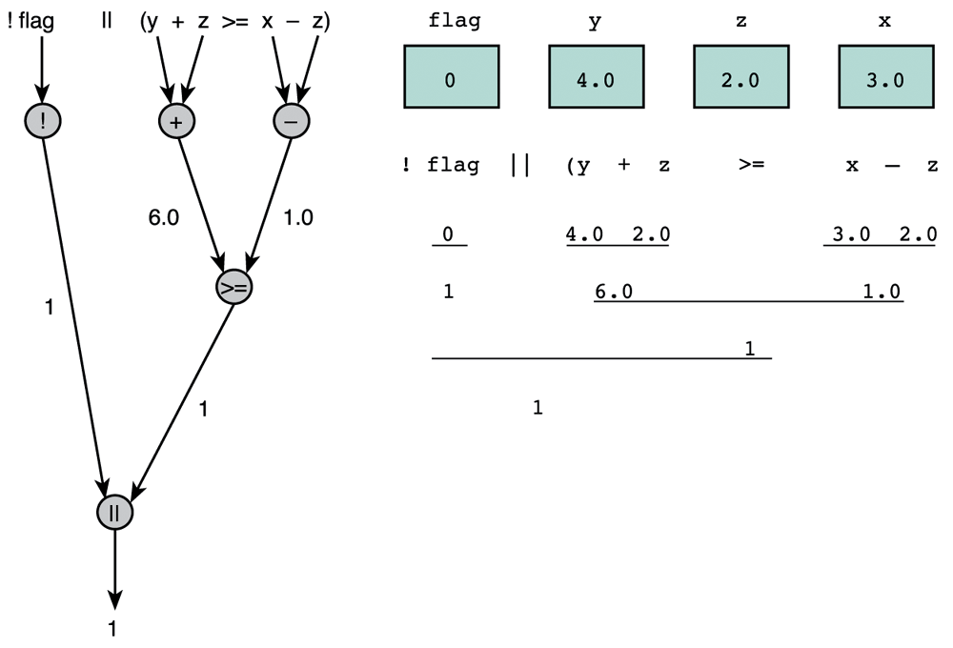
Conditions (6)
Operator precedence (cont.)
  Consider the expression
  !flag || (y + z >= x – z)
  Here's how it's evaluated, assuming
  flag = 0, y = 4.0, z = 2.0, and x = 3.0:
C. Hundhausen, A. O’Fallon
Notes:
C. Hundhausen, A. O’Fallon

Slide 9
Conditions (7)
Short-circuit evaluation
  Notice that, in case of && (and), if the first part of expression is false, the entire expression must be false
    Example: (5 < 3) && (4 > 3)
  Likewise, in case of || (or), if the first part of expression is true, the entire expression must be true
    Example: (4 > 2) || (2 > 3)
  In these two cases, C short-circuits evaluation
    Evaluation stops after first part of expression is evaluated
C. Hundhausen, A. O’Fallon
Notes:
C. Hundhausen, A. O’Fallon

Slide 10
Conditions (8)
Logical assignment
  It is possible to assign a logical expression to an int variable
  Example:
  int temp; /* input, the current temperature */
  int below_freezing /* temperature state */
  scanf("%d",&temp);
  below_freezing = (temp < 32); /* Sets temperature
  state variable */
  The below_freezing variable can then be involved in logical expressions, for example:
  below_freezing && (dew_point < 32)
C. Hundhausen, A. O’Fallon
Notes:
C. Hundhausen, A. O’Fallon

Slide 11
Conditions (9)
Complementing conditions
  The complement of a condition can be obtained by applying the ! operator
  Example: The complement of temp > 32 is
  !(temp > 32), which can also be written as temp <= 32
  Example: The complement of temp == 32 is !(temp == 32), which can also be written as (temp != 32)
C. Hundhausen, A. O’Fallon
Notes:
C. Hundhausen, A. O’Fallon

Slide 12
Conditions (10)
Complementing conditions (cont.)
  Use DeMorgan's laws to complement compound logical expressions:
    The complement of X && Y is !X || !Y
    The complement of X || Y is !X && !Y
    Example:
    (temp > 32) && (skies == 'S' || skies == 'P')
    would be complemented as follows:
    (temp <= 32) || (skies != 'S' && skies != 'P')
    Assuming that 'S' stands for sunny and 'P' stands for partly cloudy, the original condition is true if the temperature is above freezing and the skies are either sunny or partly cloudy. The complemented condition is true if the temperature is at or below freezing, and the skies are neither sunny nor partly cloudy.
C. Hundhausen, A. O’Fallon
Notes:
C. Hundhausen, A. O’Fallon

Slide 13
The if Statement
The if statement supports conditional execution in C:
if <test>
{
<body>
}
<test> must be an expression that can be evaluated to either true or false (non-zero or zero)
<body> is one or more C statements.
Although it is not required in cases where body has exactly one statement, it is better style to always enclose <body> in curly braces
C. Hundhausen, A. O’Fallon
Notes:
C. Hundhausen, A. O’Fallon

Slide 14
The if-else statement
C also defines an ‘if-else’ statement:
if <test>
{
<body-if-test-is-true>
}
else
{
<body-if-test-is-false>
}
Note that only one of the two <body> blocks can be executed each time through this code. In other words, they are “mutually exclusive”.
Also note else has no <test> condition.
C. Hundhausen, A. O’Fallon
Notes:
C. Hundhausen, A. O’Fallon

Slide 15
Modeling
A large part of software engineering is modeling
We will define modeling as the practice of abstracting details to make software development more comprehendible
Helps with designing and quality
Models are usually visual/diagrams
A flowchart is a model representing a process
C. Hundhausen, A. O’Fallon
Notes:
C. Hundhausen, A. O’Fallon

Slide 16
Flowcharts (1)
Diagram that uses boxes and arrows to show the step-by-step execution of a control structure
Diamond shapes represent decisions
Always one path into a decision and two going out
  The paths are a result of false and true conditions
We should construct flowcharts as part of our design of algorithms before implementation
C. Hundhausen, A. O’Fallon
Notes:
C. Hundhausen, A. O’Fallon

Slide 17
Flowcharts (2)
Below is an example of a flowchart:
Temperature > 32?
No or F
Yes or T
Display “It’s freezing out!”
Display “It’s warm out!”
C. Hundhausen, A. O’Fallon
Notes:
C. Hundhausen, A. O’Fallon

Slide 18
Flowcharts (3)
What does the associated C code look like for the previous flowchart?
…
if (temperature > 32)
{
printf (“It’s warm out!\n”);
}
else
{
printf (“It’s freezing out!\n”);
}
C. Hundhausen, A. O’Fallon
Notes:
C. Hundhausen, A. O’Fallon

Slide 19
You Try It
What does this do? (Careful!) The condition is always evaluated to 3. We want x == 3!
int x = 0;
if (x = 3)
{
printf(“x is small\n”);
}
What does this do?
int x = y = z = 0;
y = y + 4;
z = z * x;
if (z > y)
{
printf(“Z: %d.\n”, z + 1);
}
else
{
printf(“X: %d.\n“, x - 1);
}
C. Hundhausen, A. O’Fallon
Notes:
C. Hundhausen, A. O’Fallon

Slide 20
Example Application (1)
Build a payroll system that
  prompts for employee pay rate,
  prompts for first week’s work hours,
  prompts for second week’s work hours,
  prompts for third week’s work hours, and
  displays the employee’s paycheck amount
  Special conditions:
    Overtime (> 40 hours) is time-and-a-half.
    Issue warning whenever prior two weeks’ overtime exceeds 30 hours.
C. Hundhausen, A. O’Fallon
Notes:
C. Hundhausen, A. O’Fallon

Slide 21
Example Application (2)
Example execution
Enter hourly pay rate: 8.00
Enter week1 hours: 40
Paycheck is: 320.00
Enter week2 hours: 60
Paycheck is: 560.00
Enter week3 hours: 60
Paycheck is: 560.00
Warning! Overtime is: 40
C. Hundhausen, A. O’Fallon
Notes:
C. Hundhausen, A. O’Fallon

Slide 22
Example Application (3)
Analysis/Data Requirements
  Inputs:
    hourly_rate (double)
    week1_hours (double)
    week2_hours (double)
    week3_hours (double)
  Outputs
    Paycheck_amount
    Warning if two consecutive weeks’ overtime hours exceed 30
C. Hundhausen, A. O’Fallon
Notes:
C. Hundhausen, A. O’Fallon

Slide 23
Example Application (4)
Design
  Initial algorithm
    Get employee pay rate and weekly hours
    Calculate paycheck amount
    Display paycheck amount
    Display warning
  Refined algorithm
    Get employee pay rate and weekly hours
    For each week of pay
      Calculate paycheck amount
        If hours > 40
        overtime = hours – 40
        else
        overtime = 0
        If overtime = 0 then
        pay = pay_rate * hours
        else
        pay = pay_rate * 40 + (1.5 * pay_rate * overtime)
      Display warning
        If overtime for two consecutive weeks > 30 then
        display warning
C. Hundhausen, A. O’Fallon
Notes:
C. Hundhausen, A. O’Fallon

Slide 24
Example Application (5)
Structure chart
Compute pay amount of an employee
Get employee data
Compute pay amount
Display paycheck amount
get_payrate
get_hours
compute_paycheck_amount()
compute_overtime()
display_paycheck_amount()
display_warning()
C. Hundhausen, A. O’Fallon
Notes:
C. Hundhausen, A. O’Fallon

Slide 25
Example Application (6)
/*** Computes the paycheck amount of an employee. ***/
#include <stdio.h> /* printf, scanf defs */
/*** Function prototypes ***/
double get_employee_payrate(void); /* prompts and reads in payrate */
double get_employee_hours(int) /* prompts and reads in weekly hours */
double compute_paycheck_amount(double, double); /* computes weekly pay */
double compute_overtime(double); /* computes hours of overtime */
void display_paycheck_amount(double); /* displays the pay amount */
void display_warning(double); /* displays a warning message if */
/* overtime exceeds 30.0 hours */
int main(void)
{
char *name;
double pay_rate, hours1, hours2, hours3, overtime1, overtime2, overtime3,
pay1, pay2, pay3;
overtime1 = overtime2 = overtime3 = 0.0;
pay_rate = get_payrate();
hours1 = get_hours(1);
pay1 = compute_paycheck_amount(hours1,pay_rate);
overtime1 = compute_overtime(hours1);
display_paycheck_amount(pay1);
C. Hundhausen, A. O’Fallon
Notes:
C. Hundhausen, A. O’Fallon

Slide 26
Example Application (7)
hours2 = get_hours(2);
pay2 = compute_weekly_pay(hours2,pay_rate);
overtime2 = compute_overtime(hours2);
display_paycheck_amount(pay2);
display_warning(overtime1 + overtime2); // displays warning only
// if overtime exceeds 30
hours3 = get_employee_hours(3);
pay3 = compute_weekly_pay(hours3,pay_rate);
overtime3 = compute_overtime(hours3);
display_paycheck_amount(pay3);
display_warning(overtime2 + overtime3); // displays warning only
// if overtime exceeds 30
}
/*** Your function definitions go here ... ***/
C. Hundhausen, A. O’Fallon
Notes:
C. Hundhausen, A. O’Fallon

Slide 27
Common Mistakes with if Statements
Using = (assignment) instead of == (logical equality)
  The compiler will NOT catch this mistake!
Using if-else when if-if should be used
  Remember else does not have an explicit condition associated with it
Using logical AND (&&) instead of logical OR (||) and vice versa
  Also single & and | will perform bitwise operations!
C. Hundhausen, A. O’Fallon

Slide 28
Next Lecture…
Nested if-else statements
switch statements
Another example
C. Hundhausen, A. O’Fallon
Notes:
C. Hundhausen, A. O’Fallon

Slide 29
References
J.R. Hanly & E.B. Koffman, Problem Solving and Program Design in C (8th Ed.), Addison-Wesley, 2016
P.J. Deitel & H.M. Deitel, C How to Program (7th Ed.), Pearson Education , Inc., 2013.
C. Hundhausen, A. O’Fallon
Notes:
C. Hundhausen, A. O’Fallon

Slide 30
Collaborators
Chris Hundhausen
C. Hundhausen, A. O’Fallon
Notes:
C. Hundhausen, A. O’Fallon

