Slide 1

HOW TO SELL UKAY VIA ONLINE SELLING?
2022/09/24
GLORY (PHILIPPINES), INC.
GROUP 2

Slide 2
‘’It’s not about expensive brands,
It’s about style’’

Slide 3
TRAINING OUTLINE
Know your target costumer and product
How to avoid scammer
Online flat forms
Shop rules
Style / Design, Posting, Teaser and Sale

Slide 4
KNOW YOUR TARGET COSTUMER AND PRODUCT
It’s necessary to identify your costumer before to start a business.
Male: Sell T-shirt or over size shirt
Female: Sell the latest or trending cloths

Slide 5
HOW TO AVOID SCAMMER?
Always check the legitimacy of your supplier
Always ask the brands and codes
Always check reviews and comments
Always check the prices

Slide 6
ONLINE FLAT FORM
Facebook personal account
Facebook page
Tiktok
Shopee
Lazada

Slide 7
SHOP RULES AND REMINDERS
Top 4 rules
Mine means yours
Payment first policy
No cancellation of orders
No return, No exchange

Slide 8
REMINDERS TO COSTUMERS
Expectation
Manage your expectation since these are all pre-loved / thrifts item.

Slide 9
Sizes and Color
All item are manually measured using tape measure.
Sizes are indicated in each photo
Color might be lighter or darker in actual due to lighting.

Slide 10
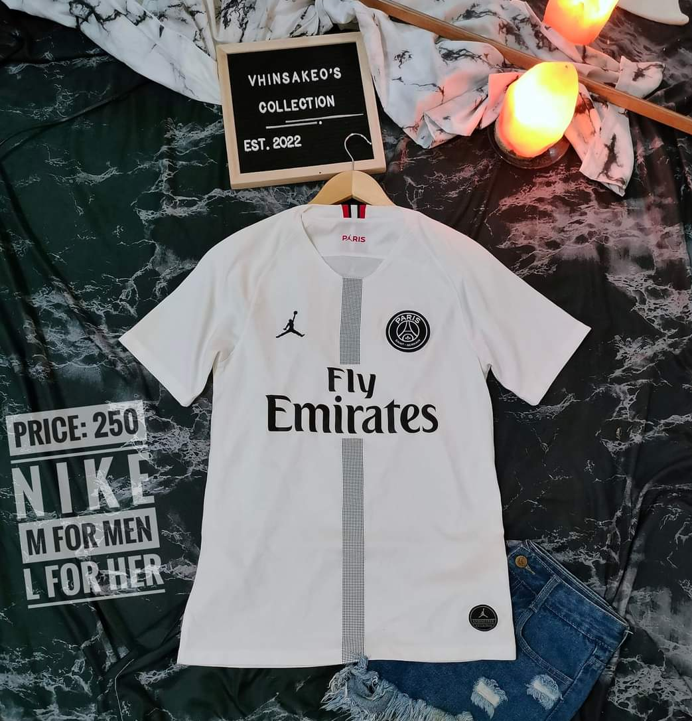
STYLE
How to attract your
costumer?
Design
Edits
Details
Always mentioned your shop

Slide 11
TEASER
Teaser is one of the most important part of online selling.
Time, date and day
Product
Details

Slide 12
Hello Ladies,
‘’We will be posting Skinny Jeans on Sept. 24, 2022 at exactly 7:00pm.”
What to expect?
High waist
Low waist
Mid wait

Slide 13
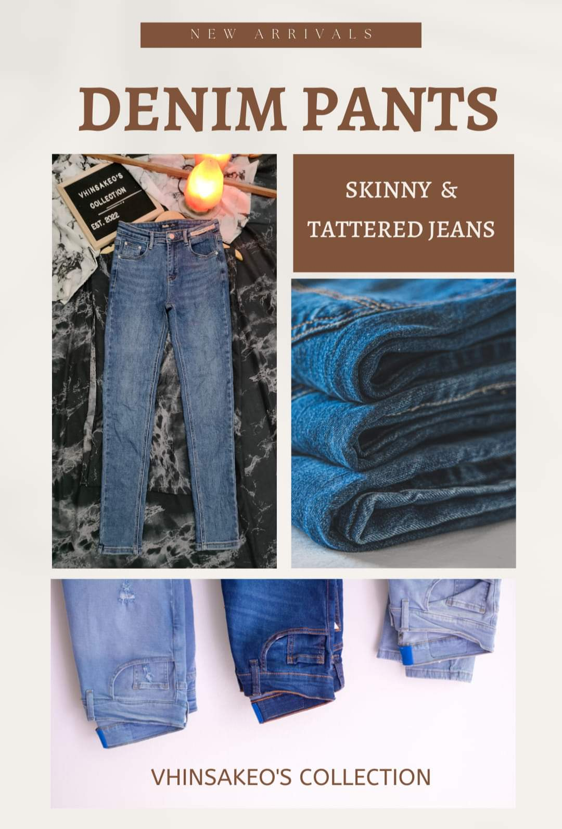
Title
Product Sample
Product variant
Over all design and color

Slide 14
TIME OF POSTING / SELLING
It’s important to know the free time of your costumer.
Time
Date
Ex. 7:00pm Saturday

Slide 15
“Why do stores sometimes have 50% off sale and sometimes, have a buy 1 get 1 free sale?’’

Slide 16
To get rid of old inventory to make room for new product.
They are trying to attract more costumers. As these type of sales tend to do, and those people will hopefully buy other products.

Slide 17
HOW TO SELL CLOTHES WITH STAIN?
Make it presentable
Wash
Dye
Liquid Detergent

Slide 18
RECOMMENDATION
Sample of Brand and Codes
VIP T32 – Mens T-shirt
VIP 030 – Ladies skinny Jeans
VIP JP 48 – Sexy Short
BEA C63 – Mens T-shirt
KING BALES K050 – Mix dress

Slide 19
WORDS Of ENCOURAGEMENT
Never give up!
As long as you have one buyer, keep going.
Strategy is the key!
Always dream big, you are not always a retailer you can be a supplier someday.

Slide 20
‘’Ukay is Risky!!!

Slide 21
THANK YOU FOR LISTENING!!!

