Slide 1
Egg Hunt
Erik Maresia, Jaakko Lankila, Florian Brandsma

Slide 2
What we wanted to do:
A simple game
Discoverable area/ map
Keyboard controlled
MMO (Mini Multiplayer Online)

Slide 3
Demo

Slide 4
Tools, Languages and Libraries Used
Atom and Visual Studio Code
HTML/CSS
Javascript
jQuery
PHP
MySQL
CodeIgniter
REST API
Chrome and Firefox debuggers
Photoshop

Slide 5



Sprite
Sheets

Slide 6
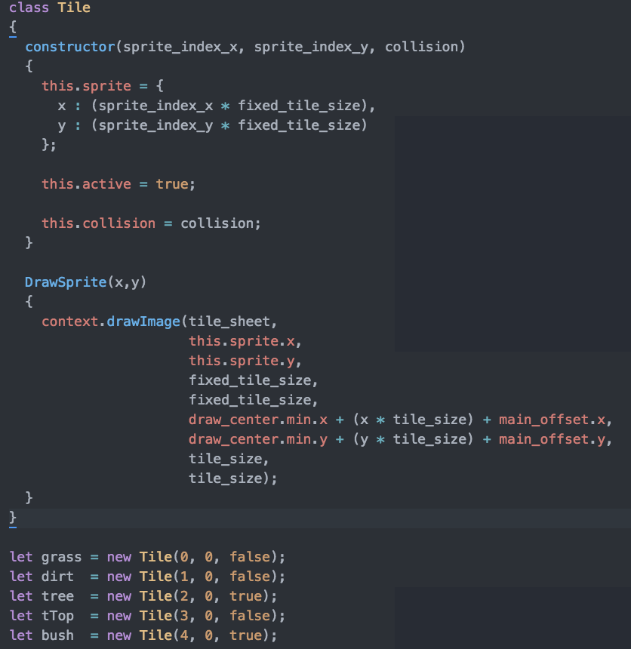

Slide 7
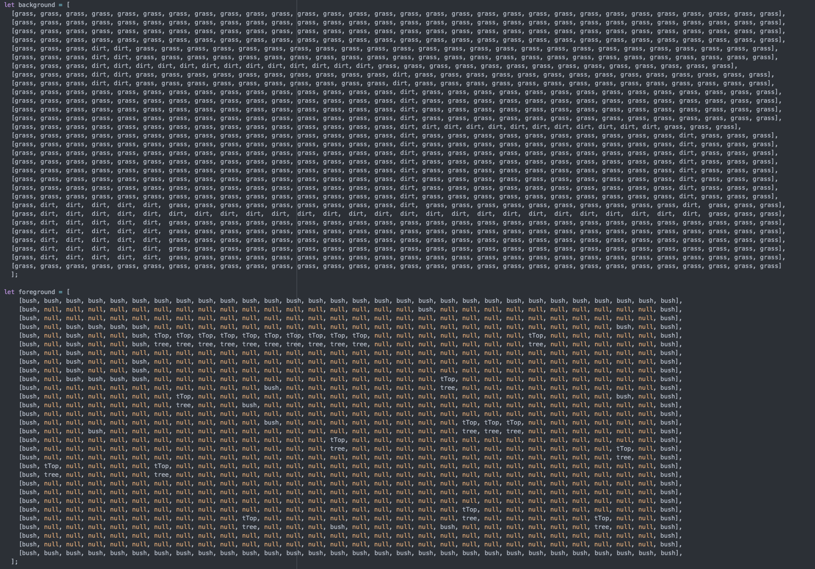

Slide 8
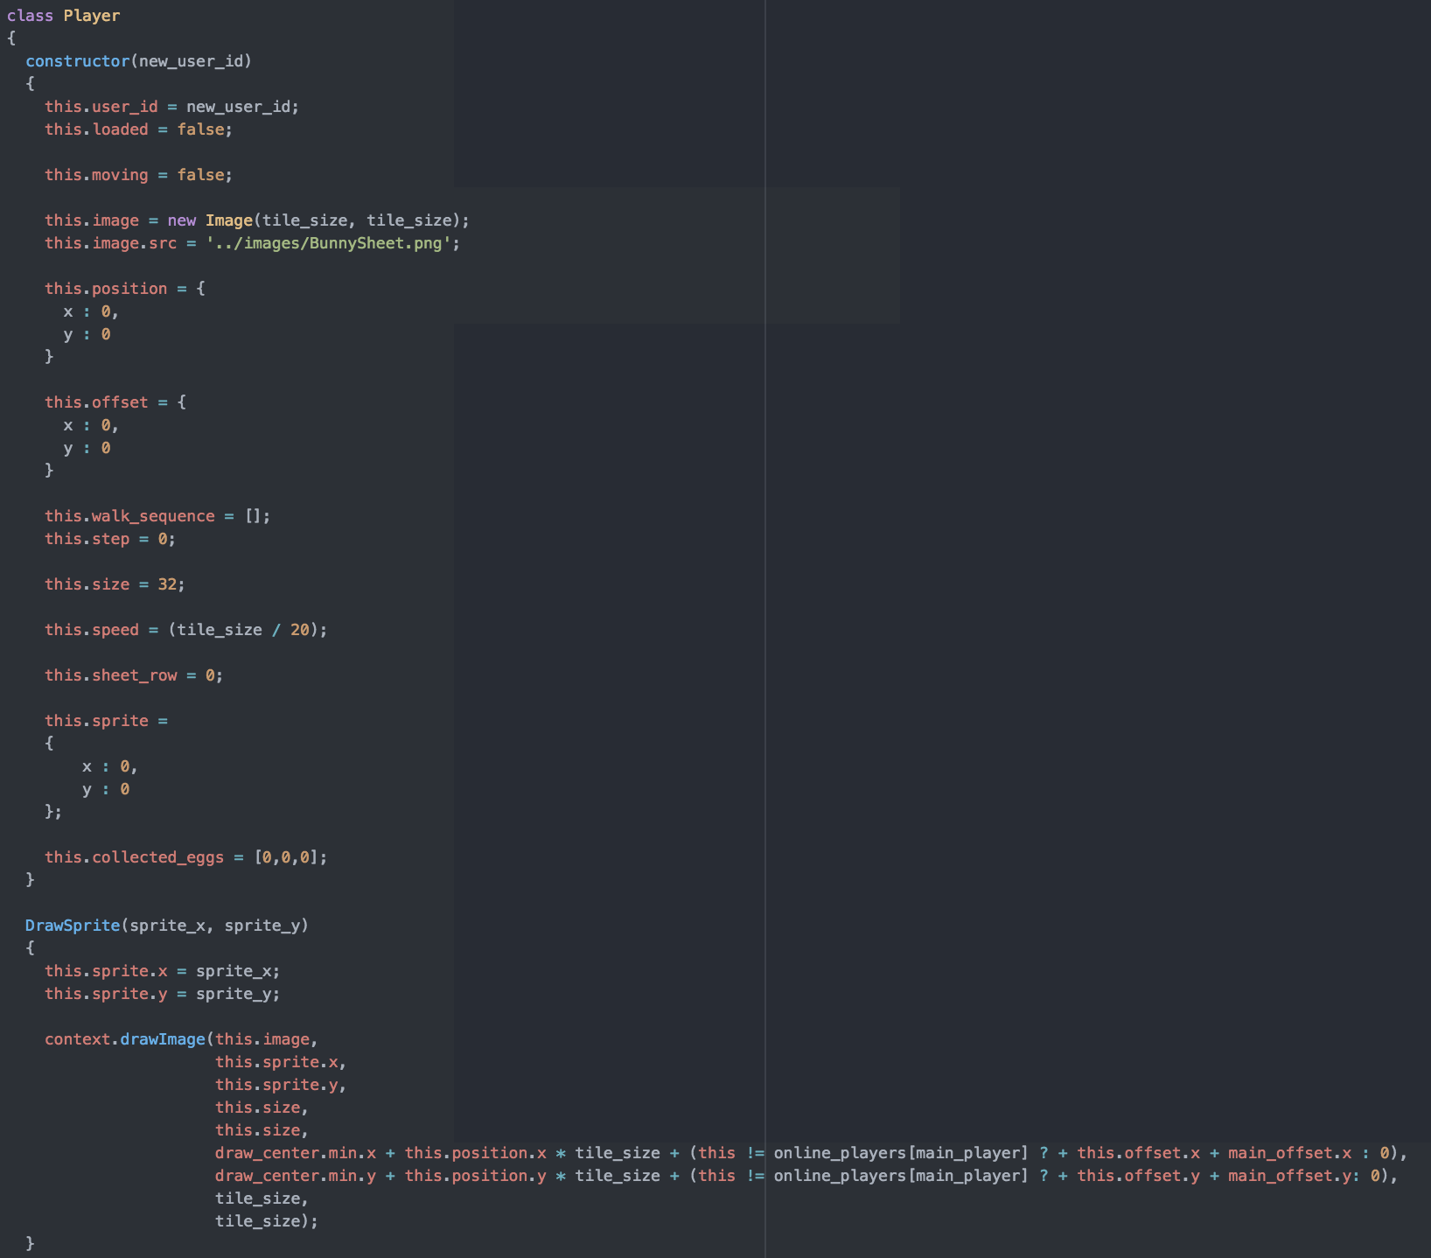

Slide 9
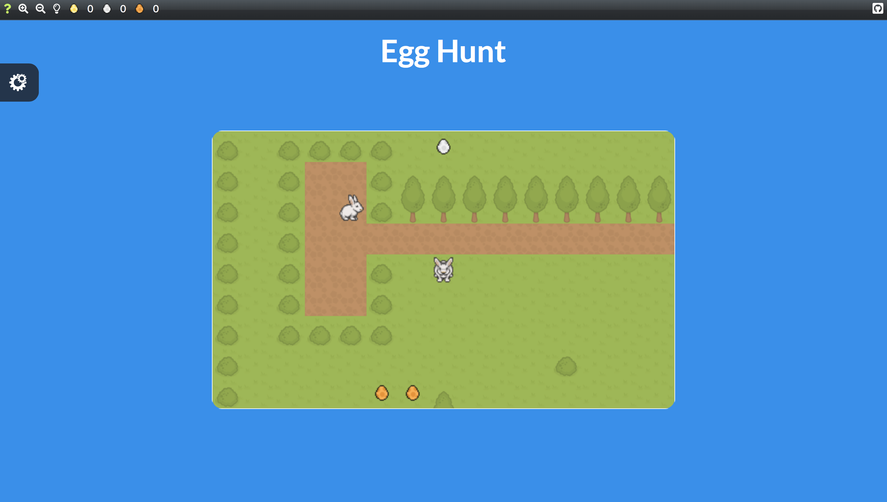

Slide 10
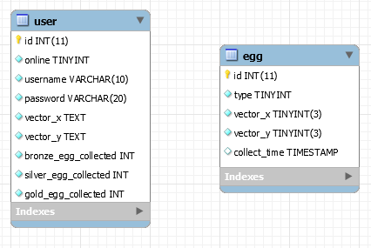

Slide 11
Struggles
How should we do it?
Many different approaches
Getting multiplayer features to work
Hosting limitations

Slide 12
Main Areas of Our Project
World building
Player managment
Egg managment
Backend integration
Frontpage layout

Slide 13
Did We Reach Our Goal?

Slide 14
Try it yourself!

