Slide 1
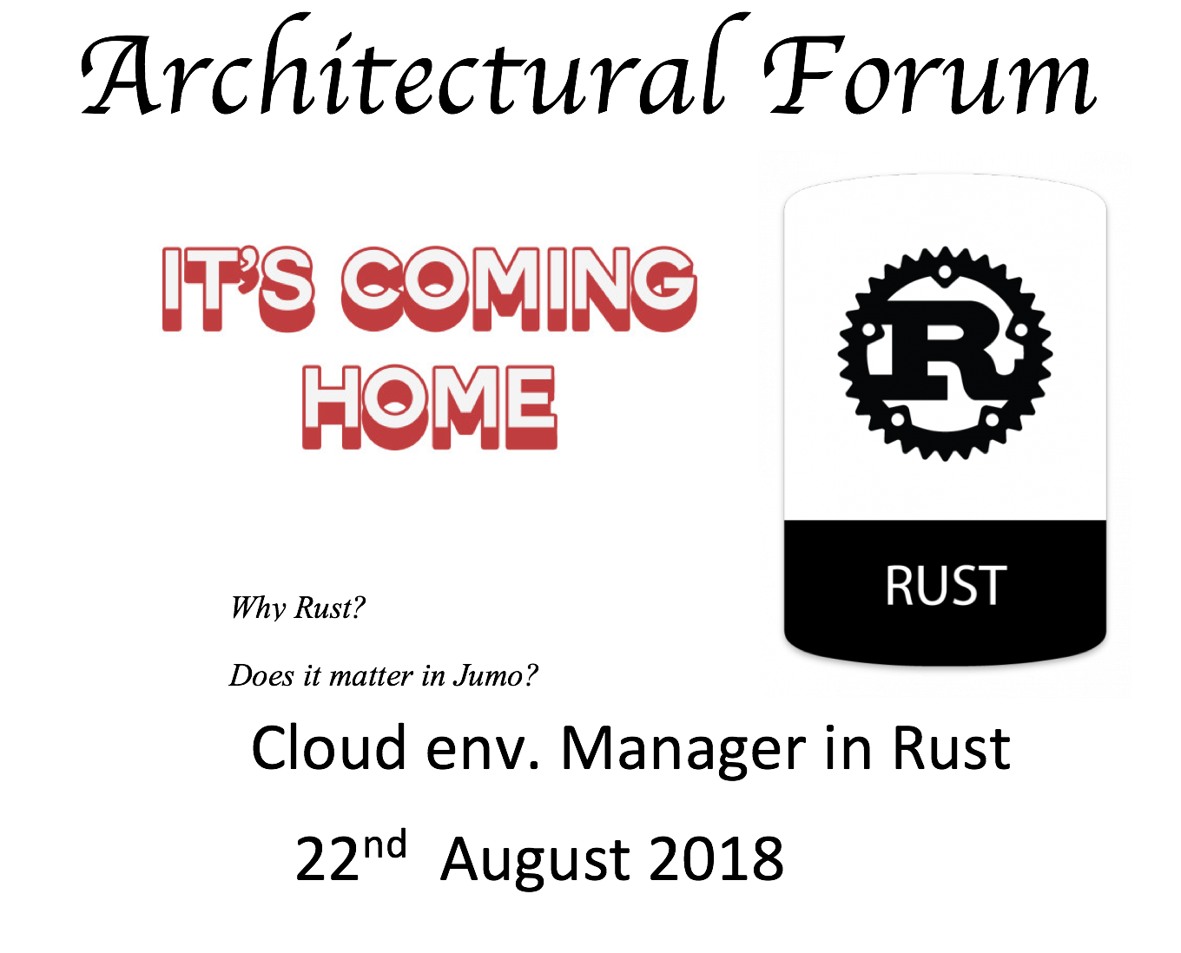

Slide 2
Table of content
What is Rust?
Why Rust?
What Rust has built?
Cloud environment manager
What holds for the future at Jumo?
Who is using Rust?
What’s next?
Q & A

Slide 3
History
Mozilla starts sponsoring Rust in 2009
Post 1.0.0 (2015-)
> 11K crates - libraries
>1,852 contributors on Github.
Big areas: game dev, operating systems, web development, block chain

Slide 4
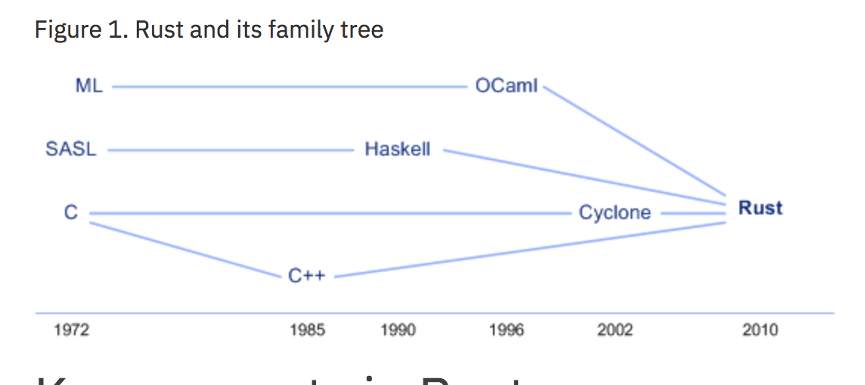
What is Rust?
Systems programming language
Trifecta – Speed, concurrency and Safety
Rust is considered a C-like language with more features – advantage

Slide 5
What is Rust?
Rust is a systems programming language that runs blazingly fast, prevents segfaults, and guarantees thread safety. (safety, concurrency, and speed)
It’s a programming language founded by Mozilla research.
Rust
Javascript
D
C++
Java
Perl
Scala
Python
C#
Haskell
Ruby
PHP
C
Notes:
It gives us control, we know what will run on our machines

Slide 6
What Rust has to offer
We can organize these languages in a linear spectrum
JS
Haskel
Python
D
Java
Scala
Ruby
C
C++
Control
Safety
RUST

Slide 7
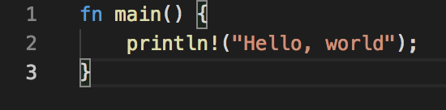

What is Rust? – canonical hello world
Main method as entry point
Runs blazingly fast
Runs without stdlibs
Feature concepts:
- modules for reusability,
- memory safety and guarantees
(safe vs. unsafe operations),
unrecoverable and recoverable error handling features,
- support for concurrency, and complex data types (called collections).

Slide 8
Speed?
No Garbage Collection - Rust uses the Resource Acquisition Is Initialization (RAII) technique - object lifetime
LLVM - is a compiler infrastructure
Zero Cost Abstractions - What you don’t use, you don’t pay for
Minimal Runtime – No GC, can compile without stdlib

Slide 9
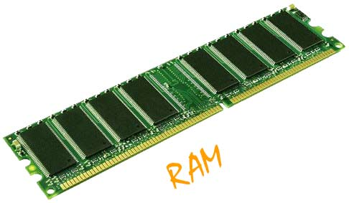
What is Control?
Rust gives the developer fine control over the use of memory

Slide 10
Control? - Stack and heap
Use box construct
let y = Box::new(10);
println!(“y = {}”, *y);
10
RAM
1
Heap : long term
2
3
let z = vec![1,2,3];
z
y
Stack : short term
32
let x = 5; //i32
5
fn inc(x:i32){x+1}
inc(32);
Playground link

Slide 11
What is Safety?
void example(){
vector<string> vector;
…..
auto& elem = vector[0];
vector.push_back(some_string);
…..
}
Data
[0]
String
{
[1]
Length
Vector
Capacity
Heap
elem
Stack

Slide 12
What is Safety?
Mutation: vector freed old contents
void example(){
vector<string> vector;
…..
auto& elem = vector[0];
vector.push_back(some_string);
cout << elem;
…..
}
[0]
[1]
[2]
Data
[0]
String
{
[1]
Length
Heap
Vector
Capacity
Dangling Pointer : pointer to freed memory
elem
Stack

Slide 13
What is Safety?
Mutation: vector freed old contents
void example(){
vector<string> vector;
…..
auto& elem = vector[0];
vector.push_back(some_string);
cout << elem;
…..
}
[0]
[1]
[2]
Data
[0]
String
{
[1]
Length
Heap
Vector
Capacity
Aliasing: more than one pointer
to the same memory
elem
Stack

Slide 14
Garbage Collection?
Downside:
No Low level control
GC pauses -- suspension time
requires runtime

Slide 15
Rust Solution
Ownership / borrowing
No need for
runtime
Memory Safety
Data Races
freedom
C++
GC

Slide 16
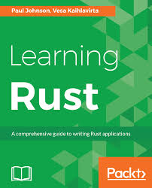
Ownership
Aliasing + Mutation
Owner
Give the book

Slide 17
Ownership
Owner
New Owner
Take the book

Slide 18
Ownership
The owner decides to go away
Take the book

Slide 19
Ownership
The new owner goes away
Destroy the book

Slide 20
Compiler enforces ownership
fn give(){
let mut vec = Vec::new();
vec.push(1);
vec.push(2);
take(vec);
vec.push(3);
}
fn take(vec: Vec<i32>) {
println!("{:?}", vec);
}
error[E0382]: use of moved value: `vec`
Data
1
2
Length
Capacity
Playground link

Slide 21
Compiler enforces ownership
fn give(){
let mut vec = Vec::new();
vec.push(1);
vec.push(2);
take(vec);
}
fn take(vec: vec<i32>) {
println!("{:?}", vec);
}
Data
1
2
Length
Data
Capacity
Length
Shallow copy

Slide 22
Rules of Ownership
Each value has its owner.
There can only be one owner at a time.
When the owner goes out of scope, the value will be dropped.

Slide 23
Borrowing (Shared Borrowing(&T))
Aliasing + Mutation
Owner
Give the book

Slide 24
Borrowing (Mutable Borrowing(&mut T))
Aliasing + Mutation
Owner
Give the book

Slide 25
Borrowing (Mutable Borrowing(&mut T))
Aliasing + Mutation
Owner
Give the book

Slide 26
Shared borrow (&T)
Shared reference to &vec<i32>
fn lender(){
let mut vec = Vec::new();
vec.push(1);
vec.push(2);
user(&vec);}
fn user(vec: &vec<i32>) {
println!("{:?}", vec);
}
Loan out the vec
Data
1
2
Length
Capacity
vec
Playground link
Raw pointer

Slide 27
Shared borrow
fn lender(){
let mut vec = Vec::new();
vec.push(1);
vec.push(2);
user(&vec);}
fn user(vec: &vec<i32>) {
println!("{:?}", vec);
}
End forget about the vec
Data
1
2
Length
Capacity
vec
Playground link
Raw pointer

Slide 28
Shared reference are immutable
fn user(vec: &vec<i32>) {
vec.push(1);
vec.push(2);
}
Error : cannot mutate shared references
Aliasing + Mutation

Slide 29
What Rust has built? / who is using Rust?
Wasm – editors, browser game engines, https://www.figma.com https://www.youtube.com/watch?v=ysFJHpS-O08
Games - https://www.amethyst.rs/ -https://kripken.github.io/BananaBread/cube2/bb.html
Block chain – etherium, exonum, crytape
Friends of Rust - https://www.rust-lang.org/en-US/friends.html
Jumo – cloud env manager

Slide 30
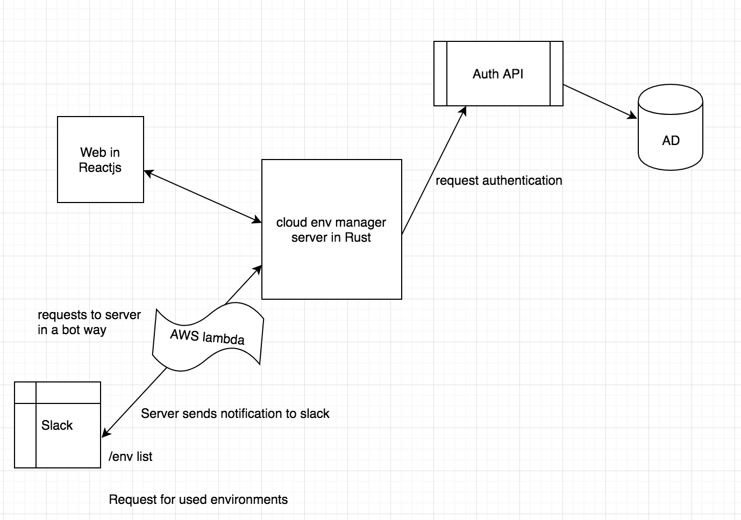
Cloud Environment Manager

Slide 31
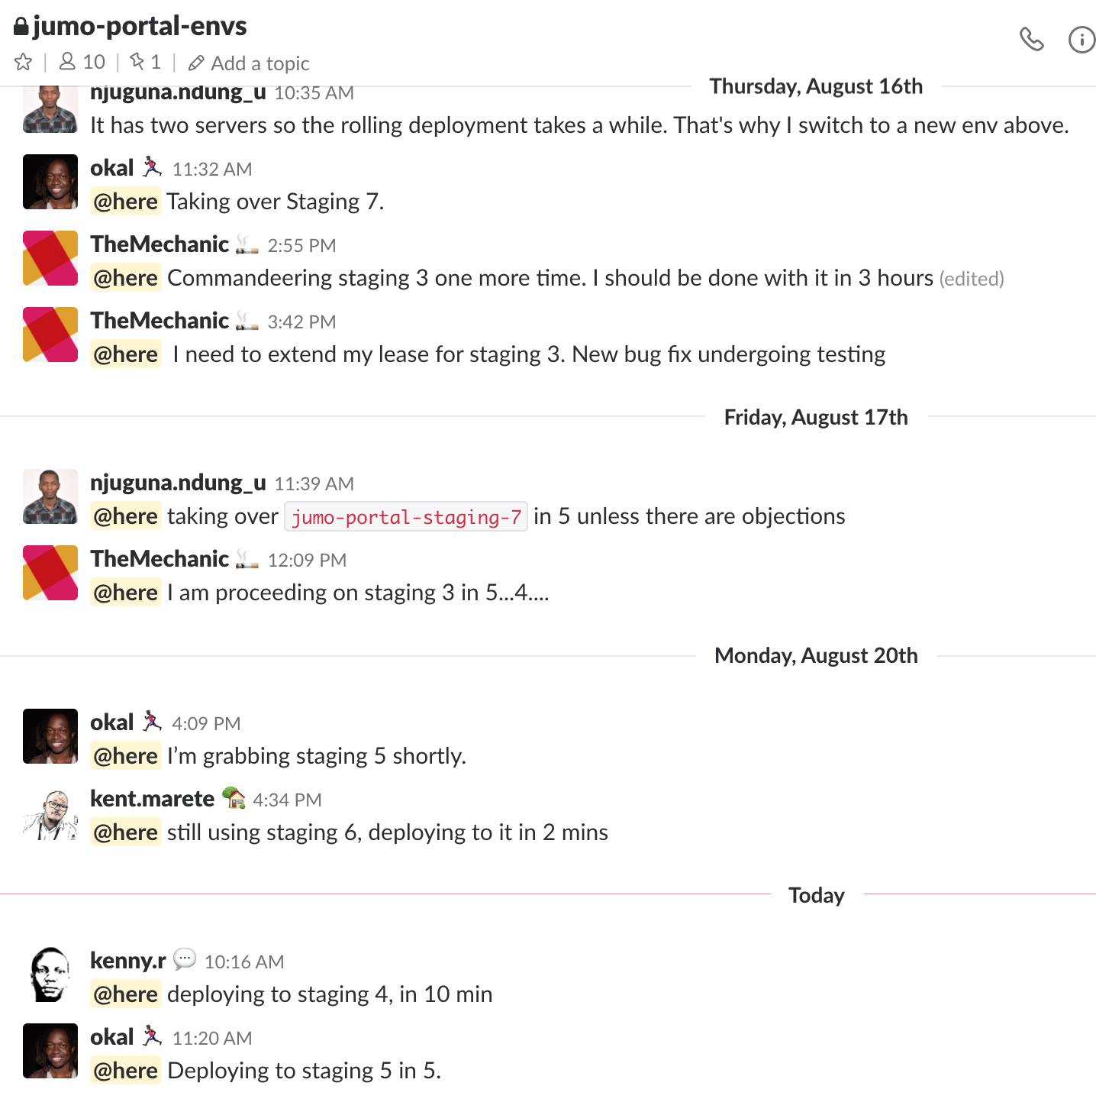
Problem statement
Stack unused – wasted resources
Guys stepping on each others toes
People forgetting to delete their
unused stacks

Slide 32
How to use
Slack /env list
Jumo Staging 1
Jumo Staging 2
Hermes-pesa Telenor
Web Interface
Action 1. deploy
2. terminate

Slide 33
Demo

Slide 34
What holds for the future at Jumo?
Data engineering
10X
Bottle necks
Automating devops

Slide 35

Who is using Rust?
https://www.rust-lang.org/en-US/friends.html
http://lucumr.pocoo.org/2015/5/27/rust-for-pythonistas/

Slide 36
What’s next?
Complete Cloud env. Manager
Add Tests
Link with Auth and Auth
Production

Slide 37
Q & A?

Slide 38
END

