Slide 1
PoC for International Market Expansion
Marc Wittlinger
5. November 2021

Slide 2
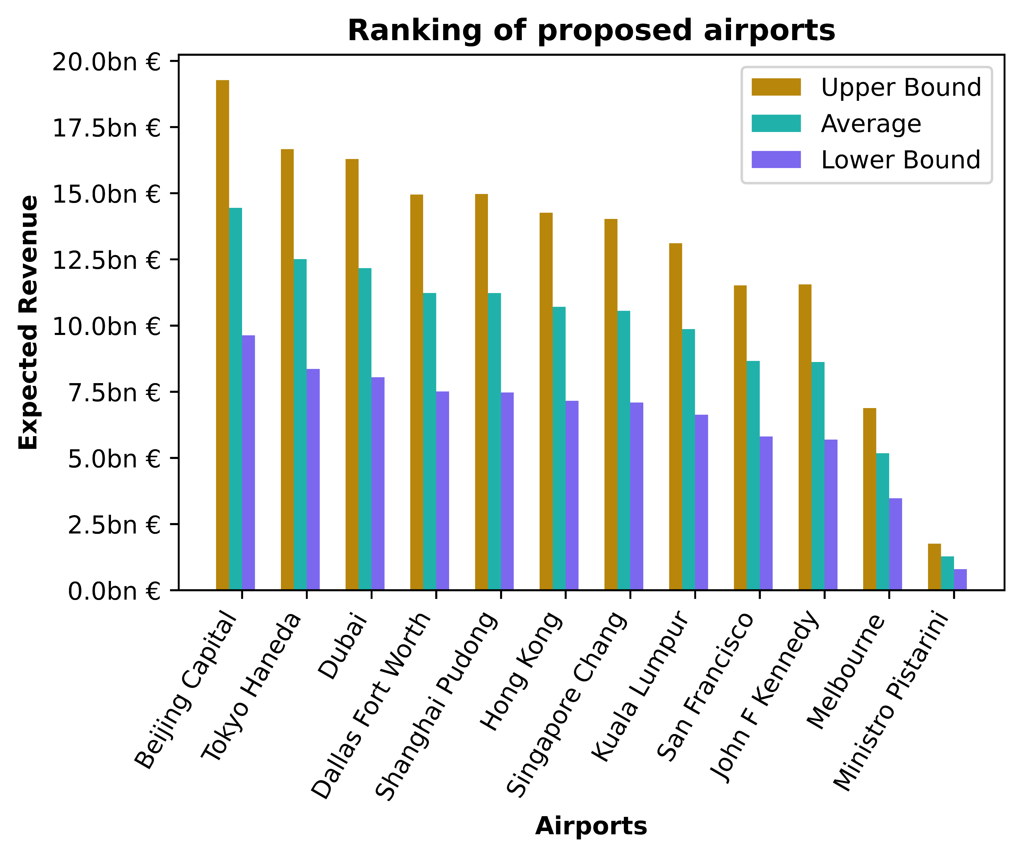

Slide 3
Approach
Data exploration & preprocessing
Training and validation of two classification models
Multinominal logistic regression
Neural network
Applying trained model to non-EU data to predict customer categories
Gather passenger traffic from web
Estimation of revenue
Ranking airport regarding expected revenue

Slide 4
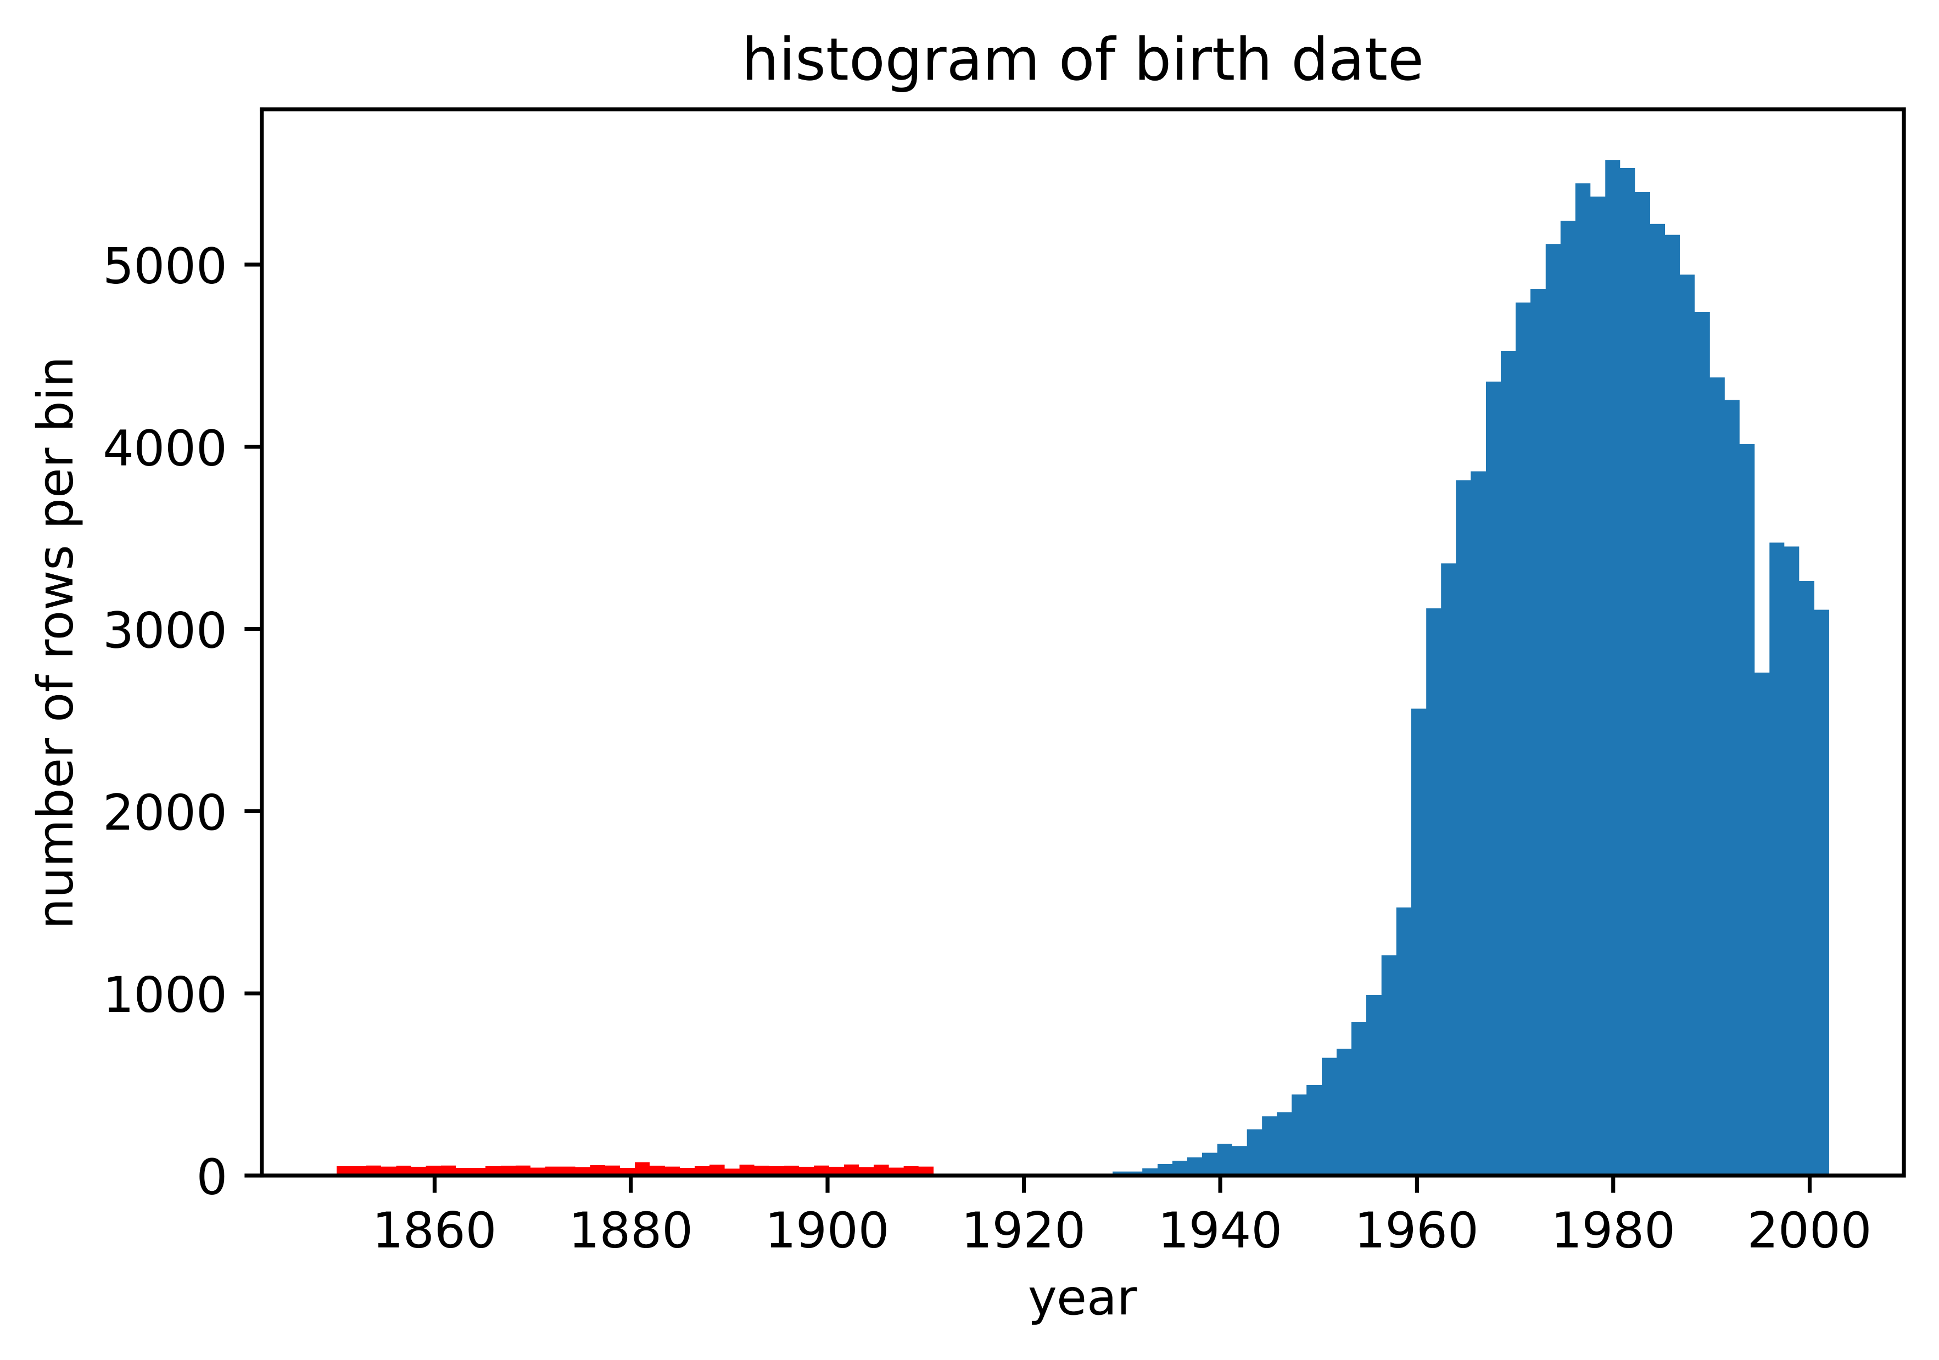
Exploration & Preprocessing
Assumptions:
No significant shift in customer behavior due to Covid-19
Amounts in customer categories are distributed symmetrically inside of each category
Monthly rents for proposed stores are given in EUR
Conspicuities:
Population of interviewees in existing airports (customers) is unequal to population in proposed airports (passengers)
Extremely small sample size in WW for all airports (best case: EZE 4 out of 10.000 passengers were asked)
Data inconsistencies:
5.374 duplicates in non-EU data
2.024 interviewees with birth date before 1920
14.144 interviews are conducted outside of customers’ flight scheme
8.056 missing values in destination 1 & departure 2
category 3 (≤ 300 EUR) and category 4 (300 EUR ≤ ) are overlapping
Built features: Luggage type, Luggage size, Age, shopped_at_stage
unrealistic
Notes:
(The stores are located before check-in, so the type and size of luggage may play a role in deciding whether to make a purchase.)
EZE = Ministro Pistarini International Airport
Balanced data

Slide 5
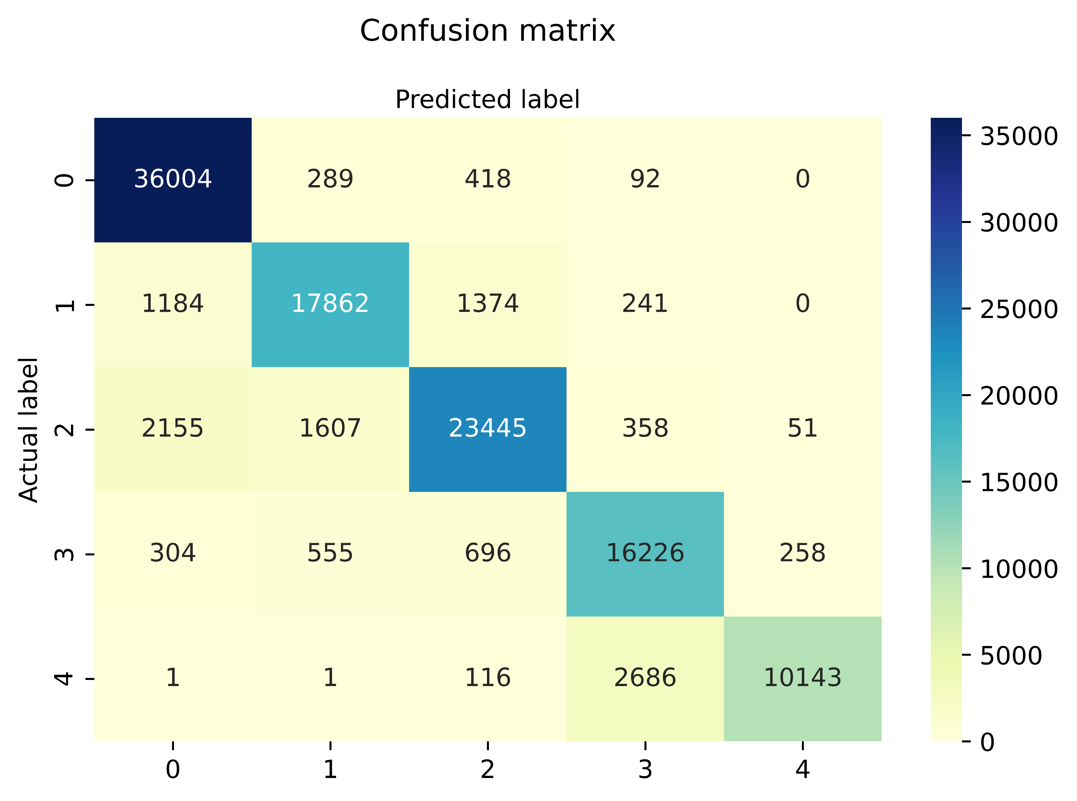
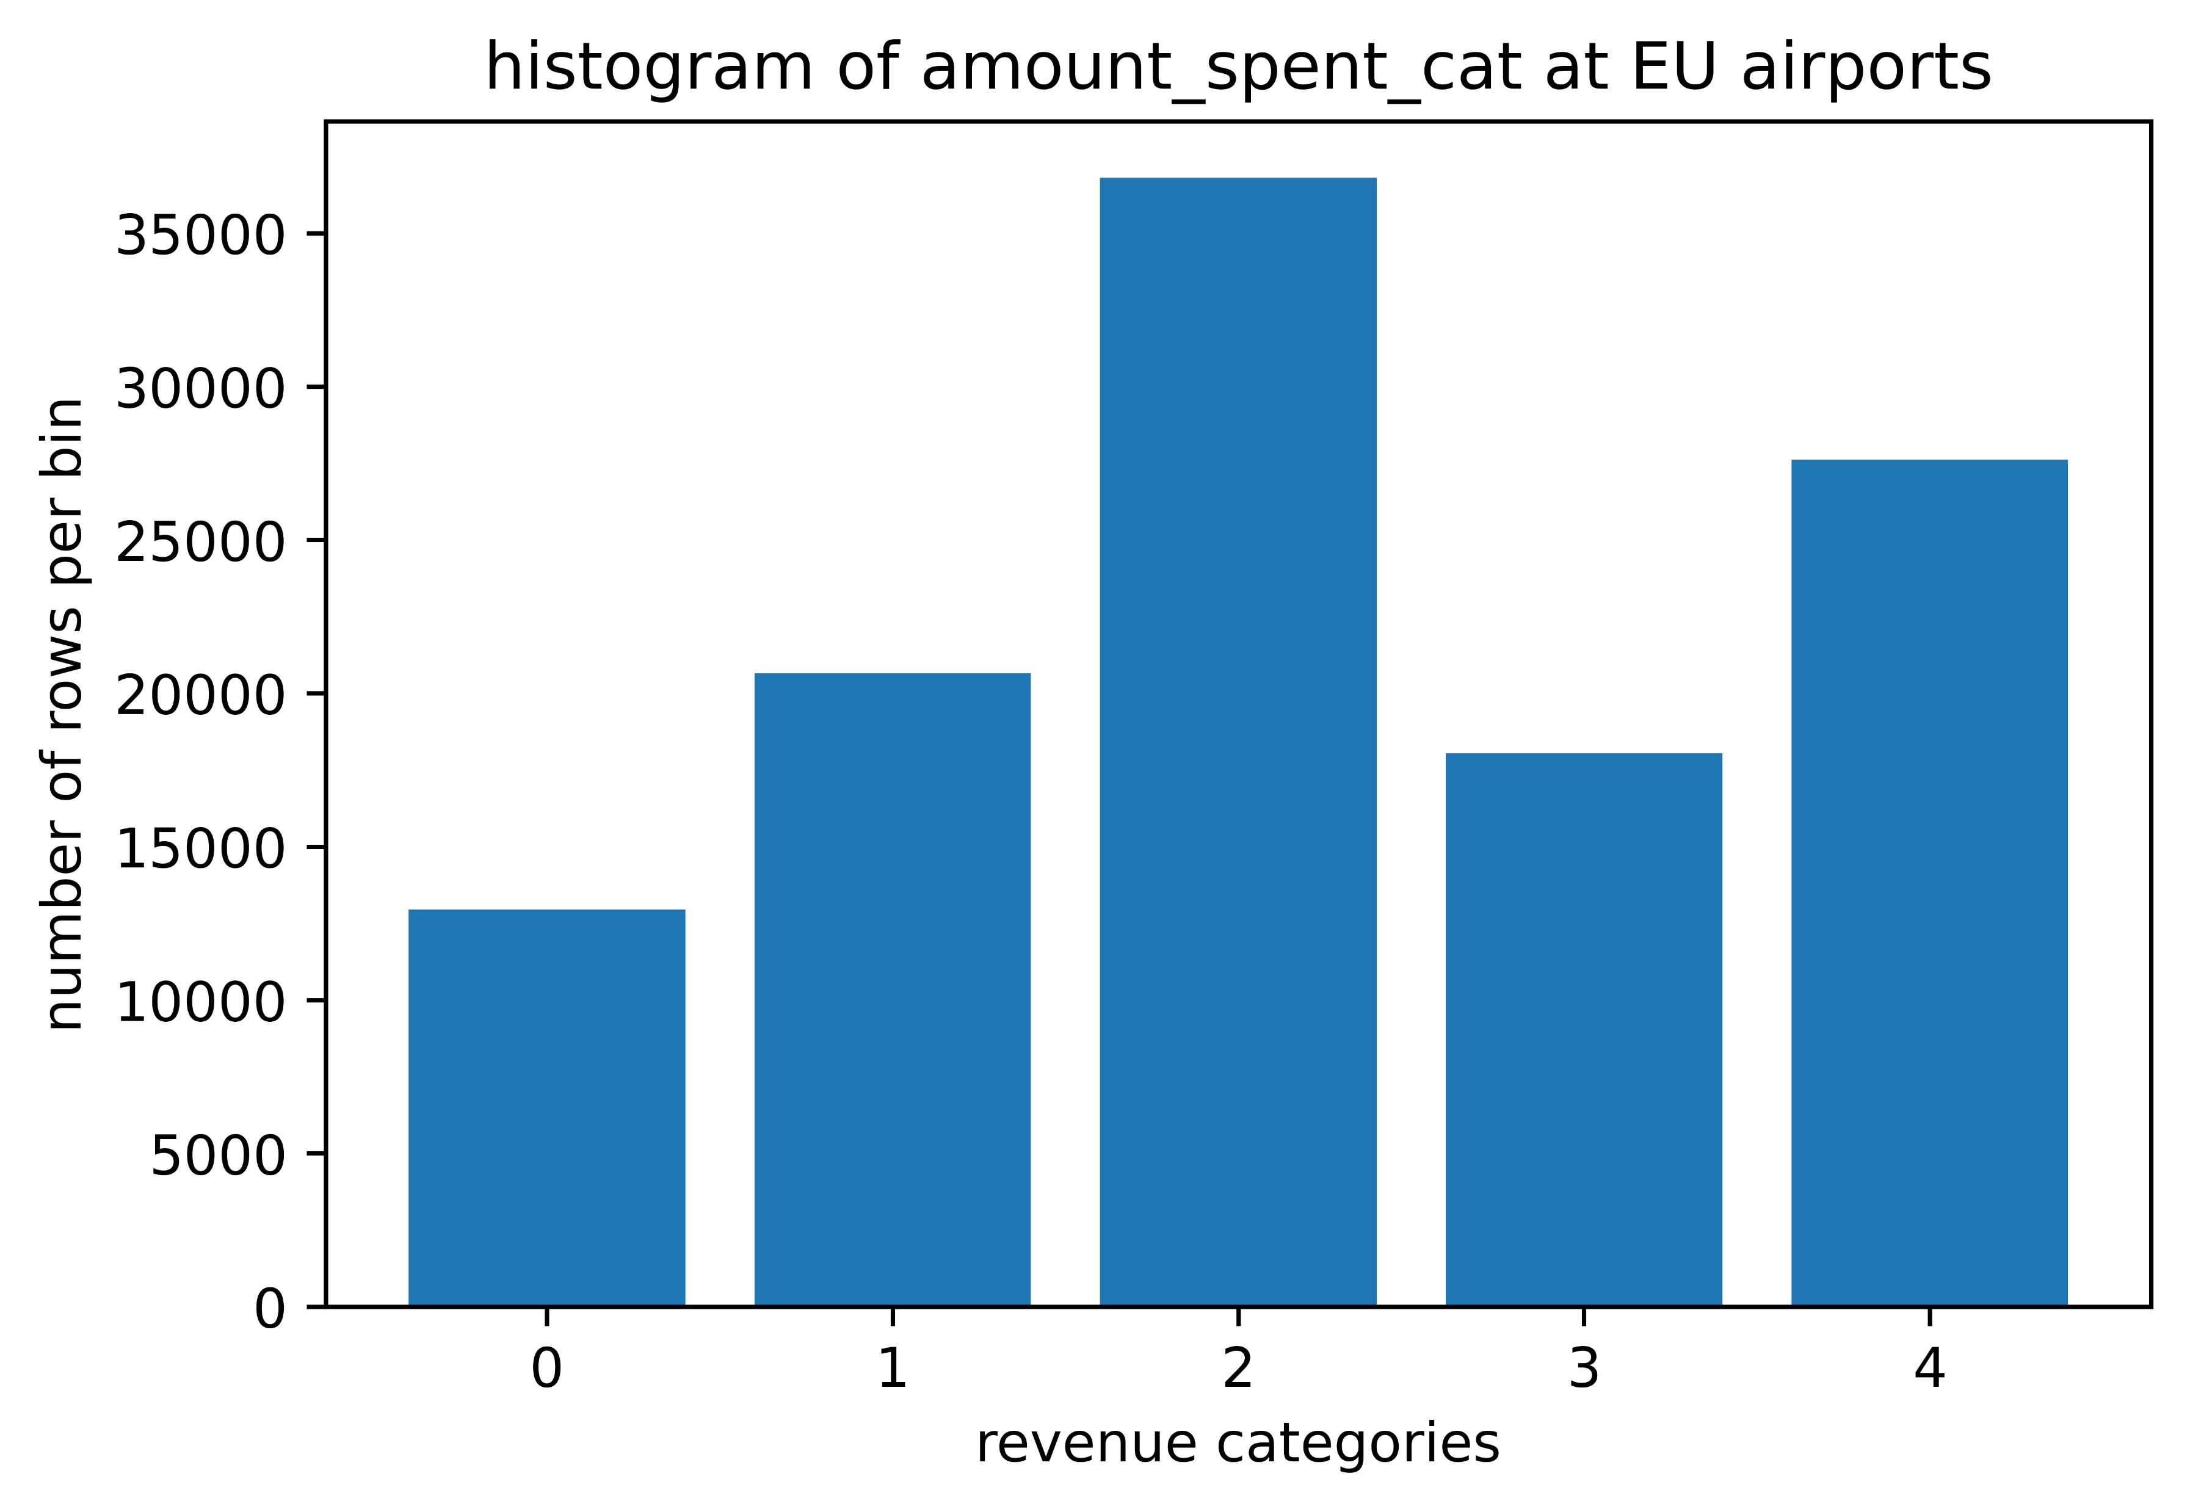
Classification model
Two algorithms applied:
Multinominal logistic regression (OvR)
Feed-forward neural network
Loss metrics: multi-label (mean) accuracy & categorical cross entropy
10-fold cross validation (stratified & repeated 3 times)
Validation metrics: precision, recall, F1-score (weighted average), AUROC
F1-score | 0,89
Precision | 0,90
Recall | 0,89
AUROC | 0,9899
Notes:
Log. Reg.:
F1-score = 0.81
Precision = 0.81 (Spalte)
Recall = 0.81 (Zeile)
AUROC = 0.9646

Slide 6
Estimation of revenue
No costs included and just expected revenue was calculated
Estimation approach:
Apply neural network classification model to non-EU airports to predict customer category
Calculate revenue per non-EU airport
Calculate sample size for each non-EU airport
Divide revenue by sample size
➔ Maximal expected revenue by airport in 2019

Slide 7
Further ideas to improve estimation
Draw larger sample at non-EU airports
Gather more details about cost structure
Feature engineering:
Use IATA airline designator from flight_number
Use country info for shopped_at like wealth of country
Use coordinates to distinguish warm, cold, humid and dry regions
Fill empty fields in flight scheme with common connection
Extensive hyperparameter tuning for existing models
Model evaluation to gain further insides

Slide 8
Summary
Beijing Capital is airport with highest estimated revenue
Ministro Pistarini is airport with lowest estimated revenue
Best model performance:
Precision = 0.90
Recall = 0.89
Possible next steps:
Check whether assumptions made are correctly
Validate conspicuities and correct if necessary
Prioritize ideas to improve estimation
F1-score = 0.89
AUROC = 0.9899

Slide 9
Tools and Methods
Jupyter Notebooks in VS Code
Python 3.8.5 in conda env: pandas, numpy, scikit-learn, keras, matplotlib, seaborn, beautifulsoup

Slide 10

Flight scheme
Flight 1
Flight 2
Departure 1
Destination 1 /
Departure 2
Destination 2

Slide 11
Additional information
In EU: 5.800 – 6.100 interviews conducted per airport
In WW: 4.700 – 7.700 interviews conducted per airport
1 person interviewed twice in EU: Luca Herz born 1973-06-02
No person got interviewed in EU and in WW

Slide 12
Web crawling
Gather passenger traffic from Wikipedia
Estimation for Melbourne Airport due to FY representation

