Slide 1
Geant4 Simulation for Neutron Transmission Experiment
Supervisor: Michael Bacak
Giorgi Asatiani

Slide 2
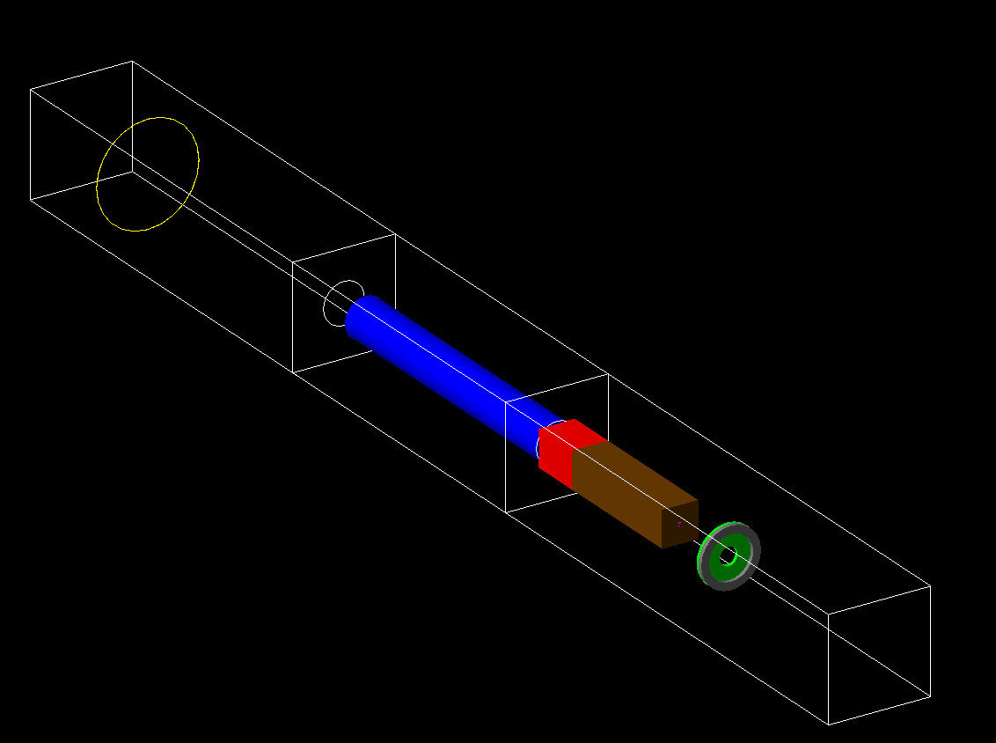
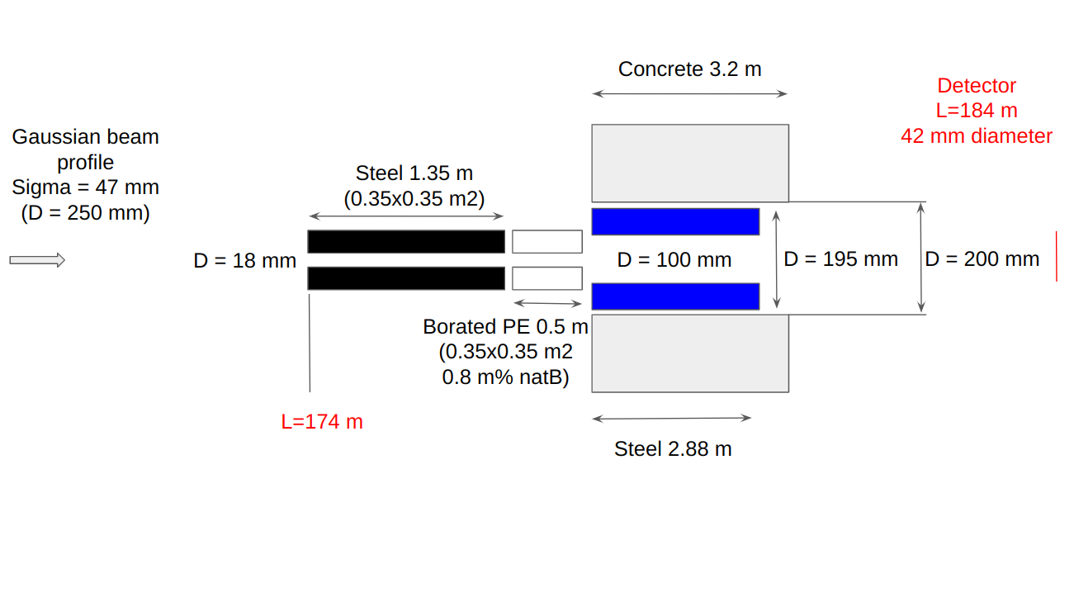
Simulated Geometry (n_TOF EAR1 2nd collimator)
Beam energy is sampled from EAR1 experimental Flux
D=90mm
~3m
D=218mm
Steel 66mm
70cm
2.3 m
Registered Physics:
G4EmStandardPhysics
G4HadronElasticPhysicsXS
G4HadronPhysicsFTFP_BERT_HP
G4HadronPhysicsQGSP_BIC_HP
G4HadronPhysicsQGSP_BERT_HP

Slide 3
Detected Neutrons

Slide 4
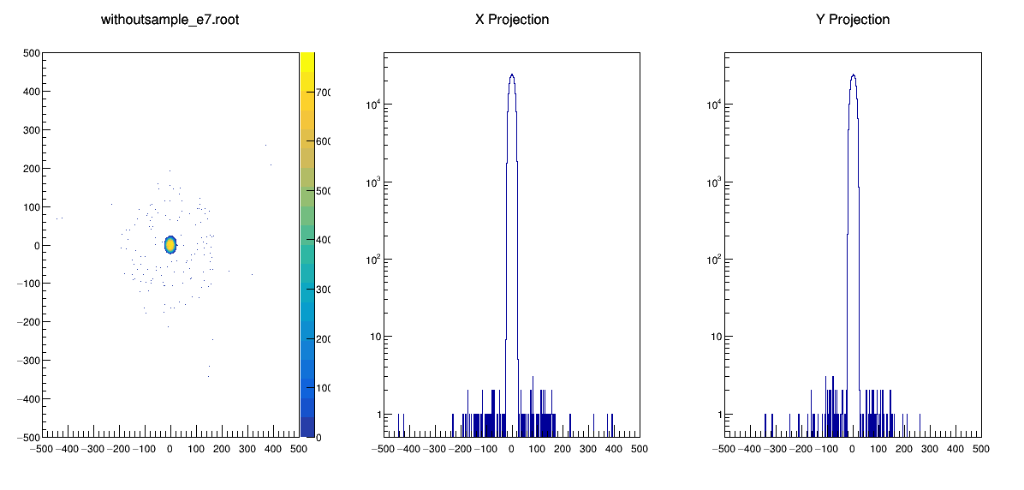
Spatial Distribution(Empty)

Slide 5
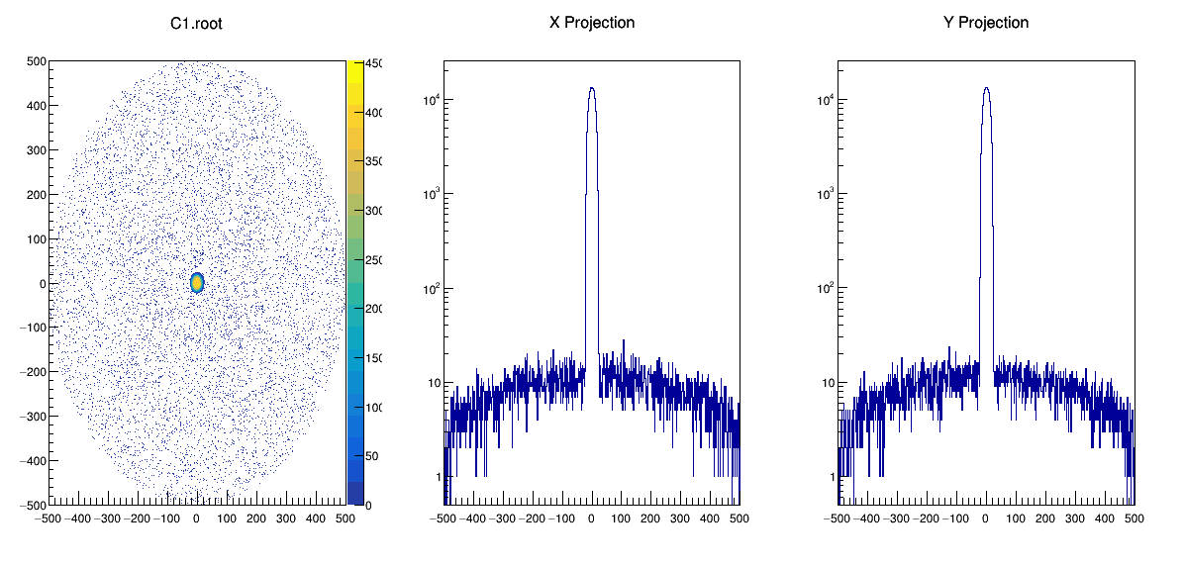
Spatial Distribution(Graphite –D=10cm width =1cm)

Slide 6
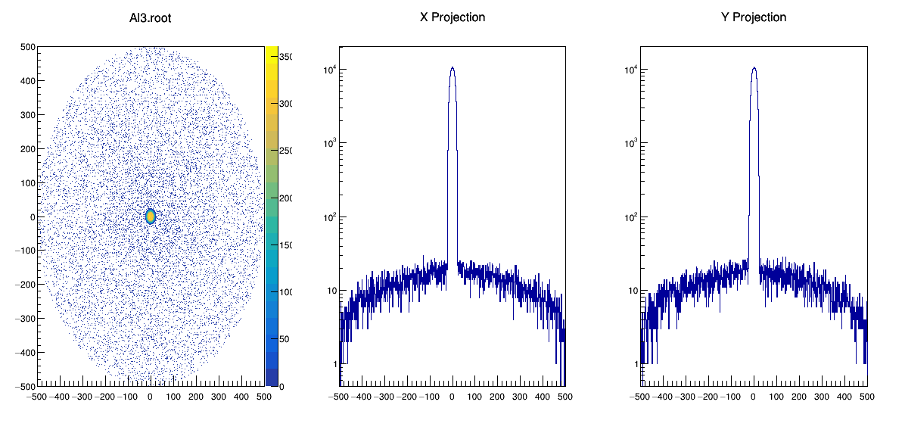
Spatial Distribution(Al – D=10cm, width=3cm)

Slide 7
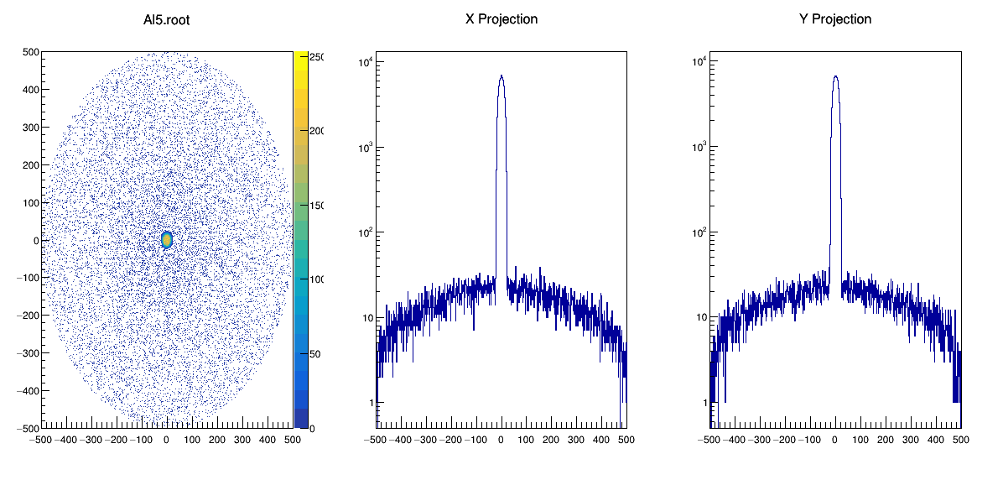
Spatial Distribution(Al – D=10cm, width=5cm)

Slide 8
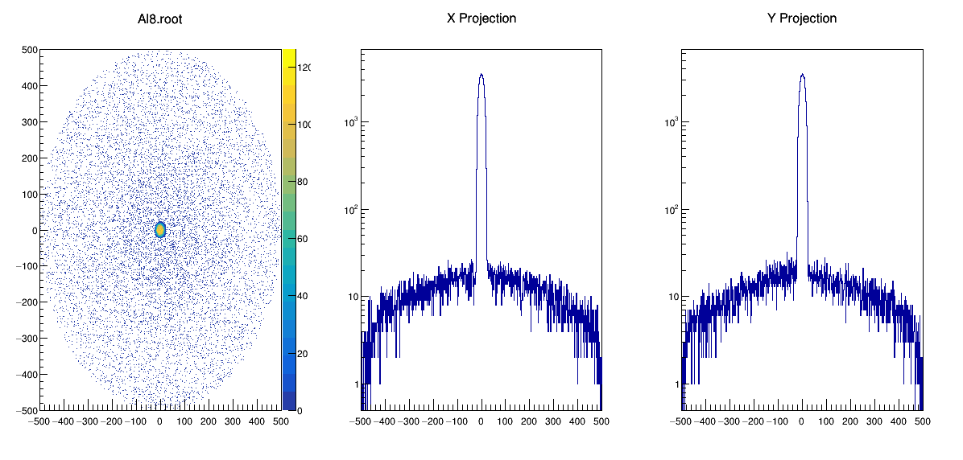
Spatial Distribution(Al – D=10cm, width=8cm)

Slide 9
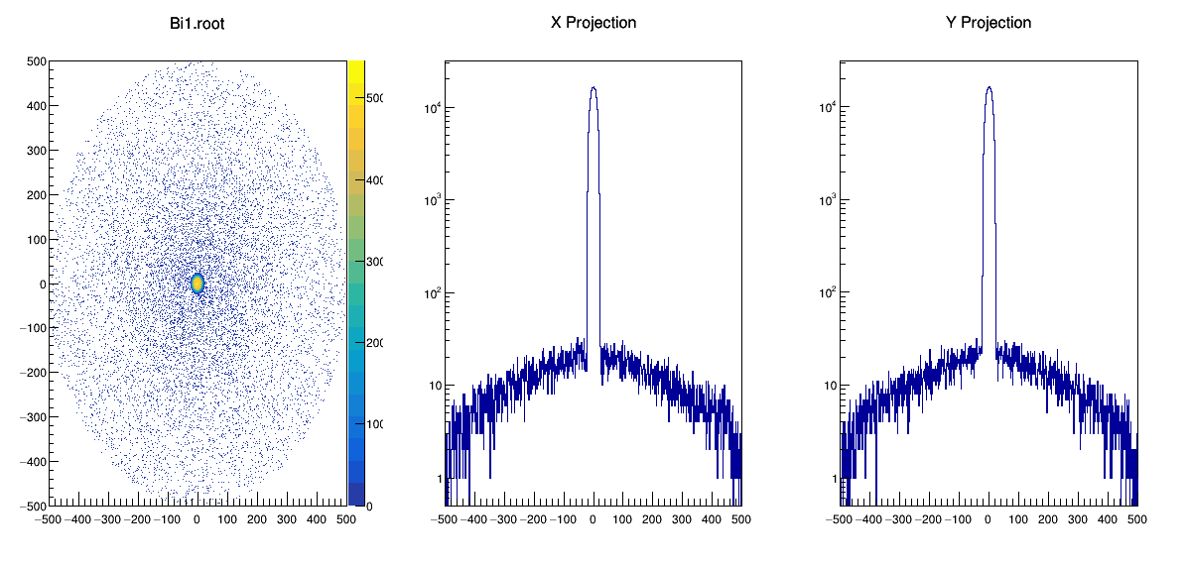
Spatial Distribution(Bi – D=10cm, width=1cm)

Slide 10
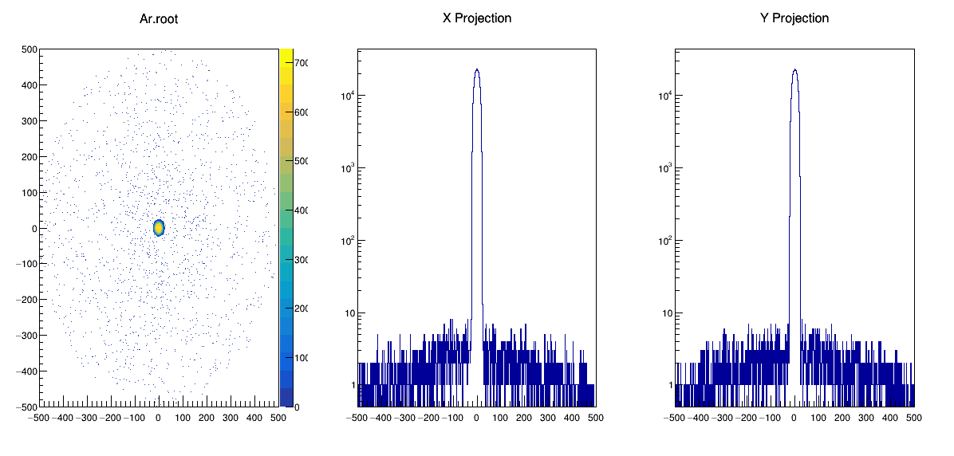
Spatial Distribution(ArgonGas– D=10cm, width=10cm, Pressure 200 bars)

Slide 11
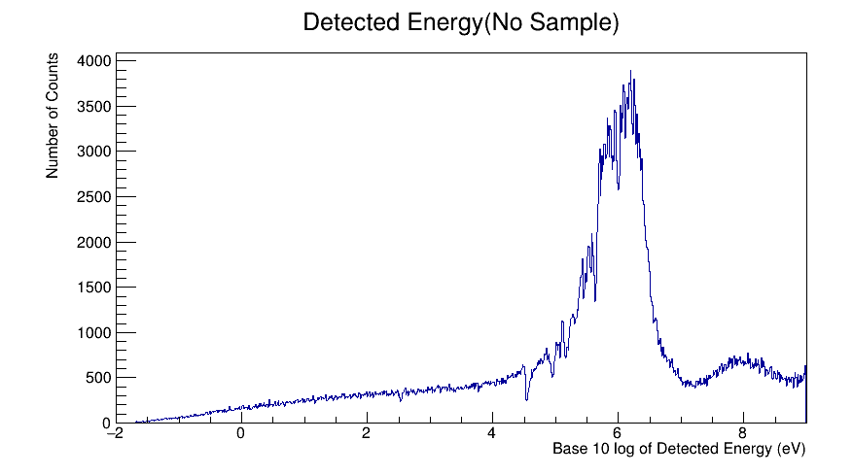
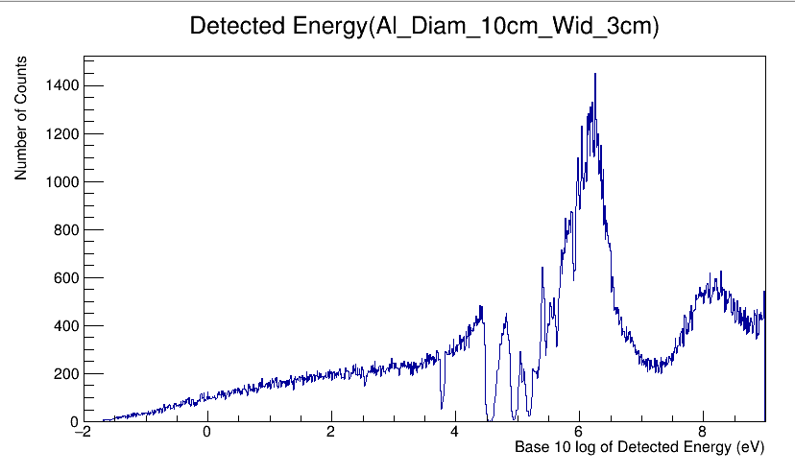
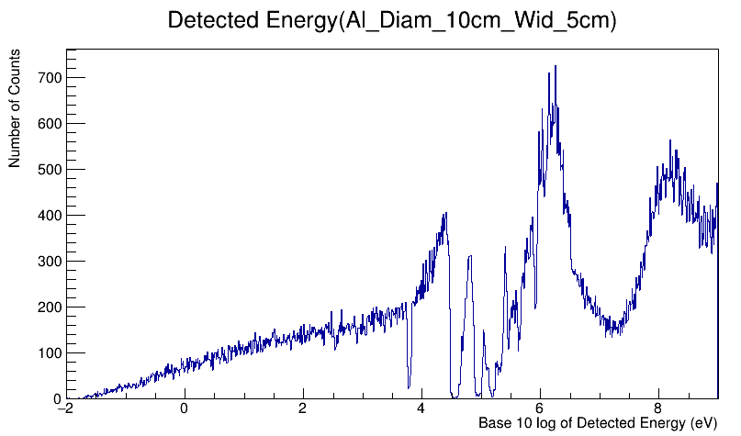
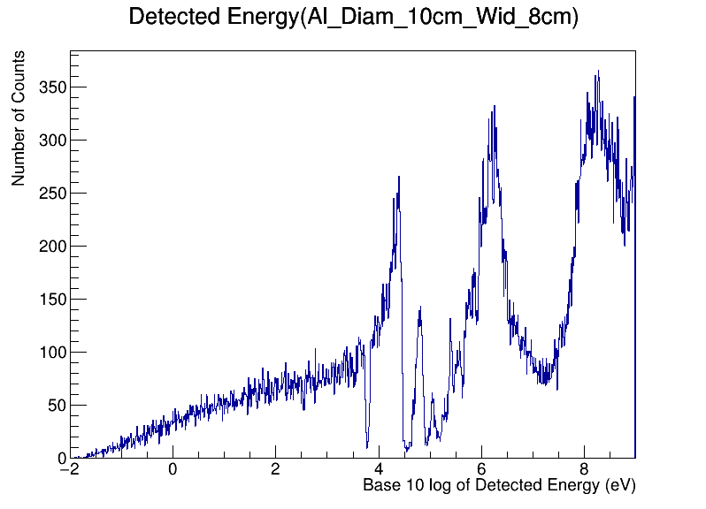
Detected Energies:

Slide 12
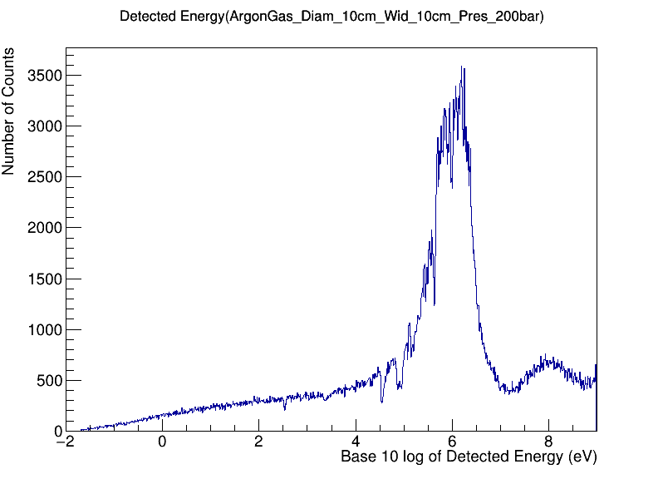
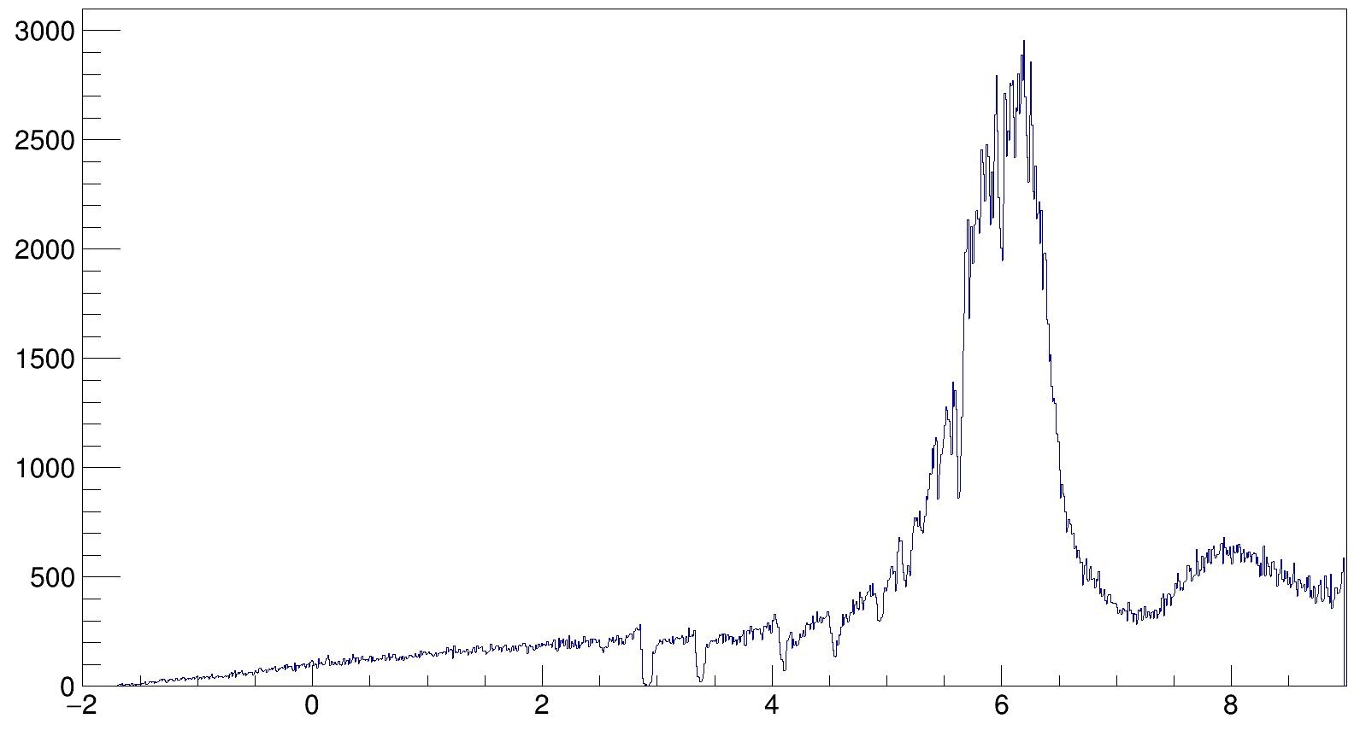
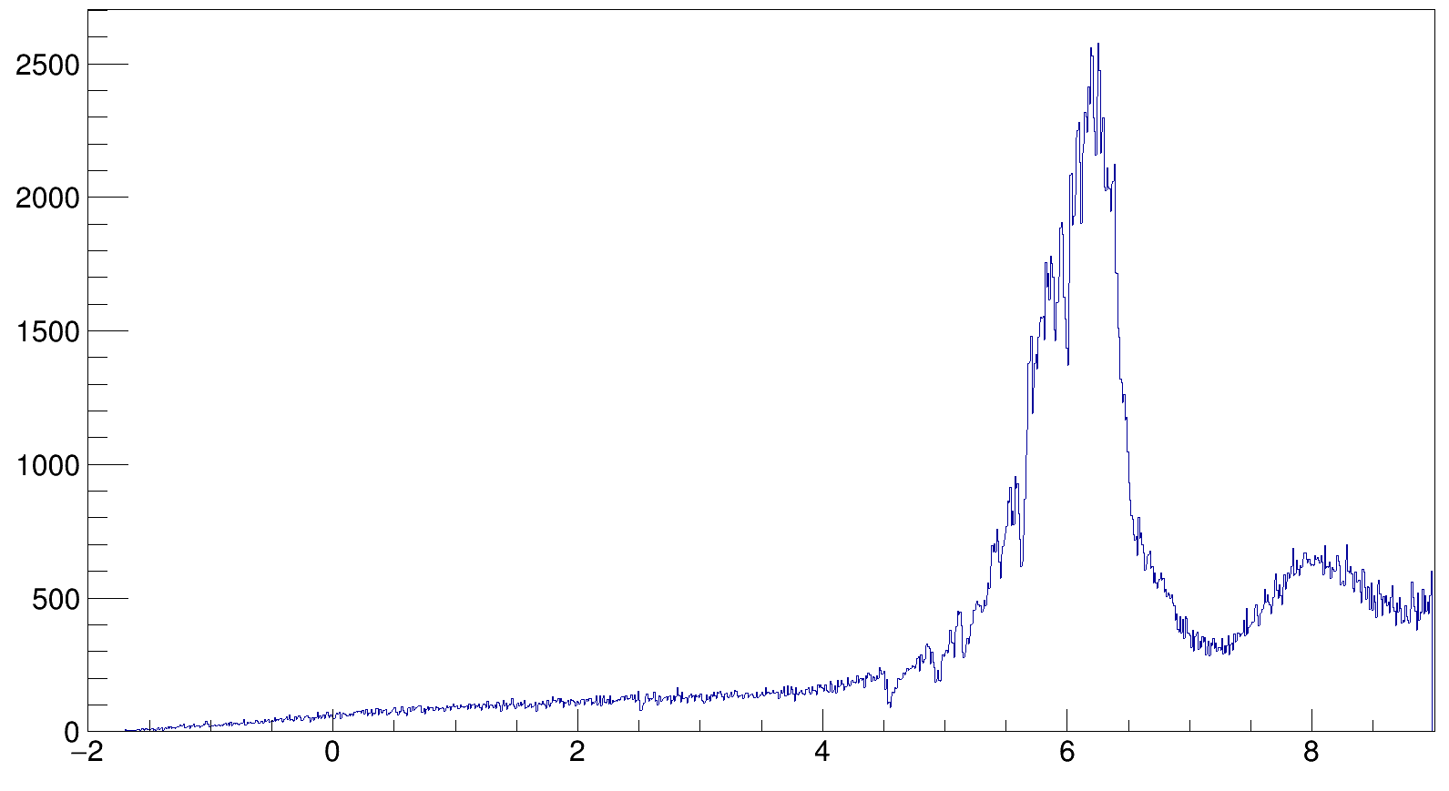
Detected Energies
Bi. Diam=10cm width=1cm
Graphite. Diam=10cm width=1cm

Slide 13
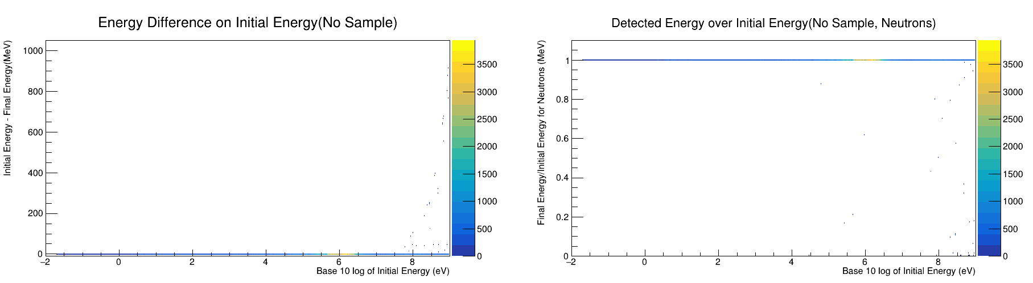
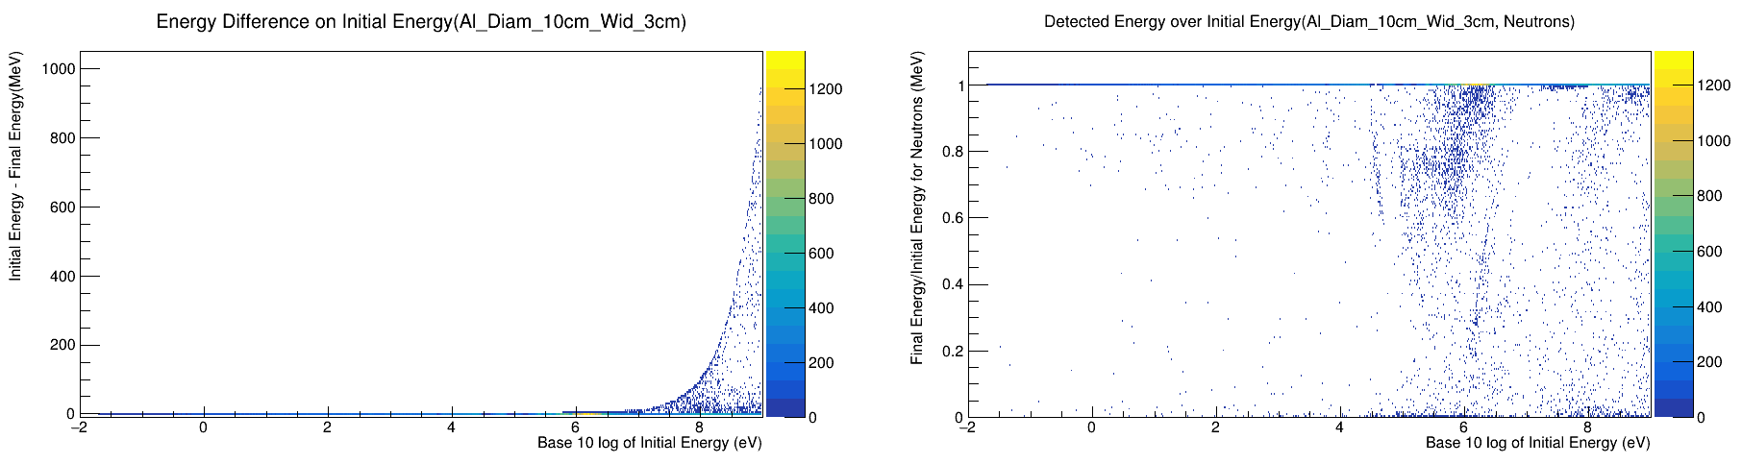
Initial and final Energy Comparison

Slide 14
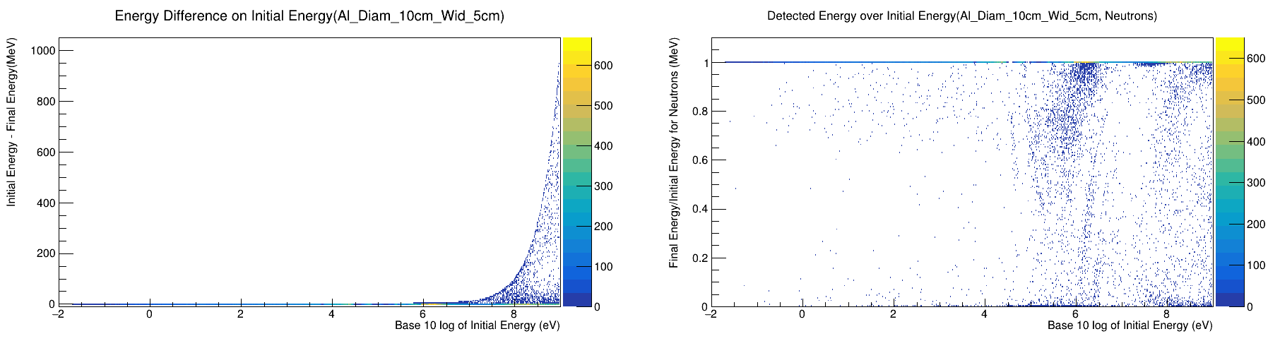
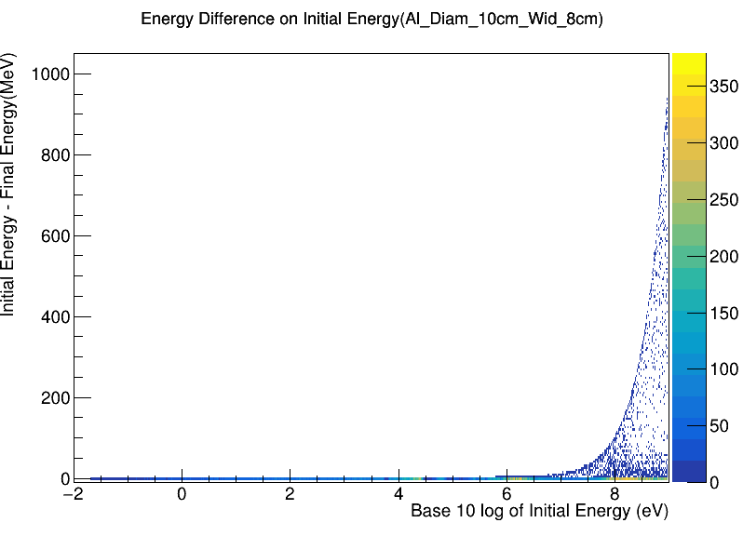
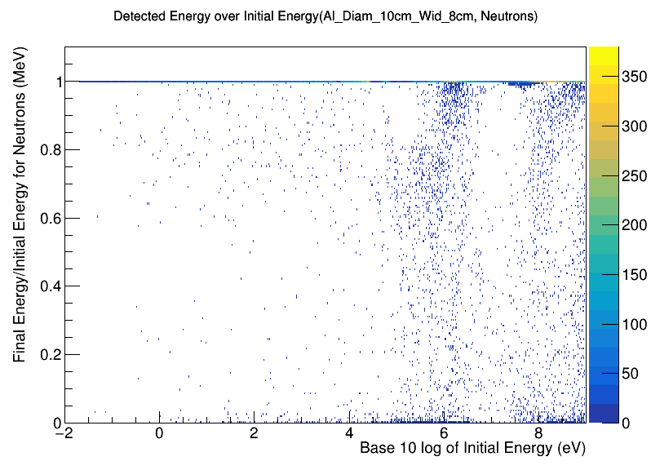
Initial and final Energy Comparison

Slide 15
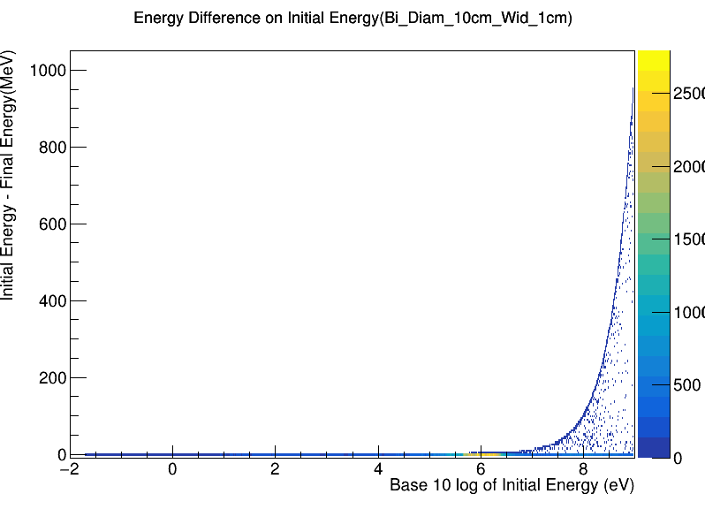
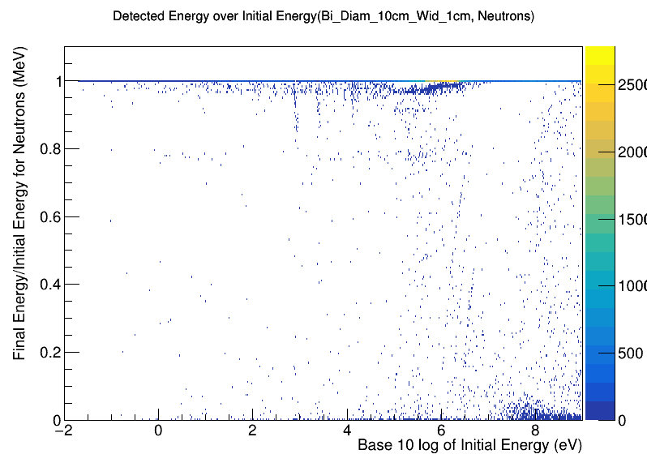
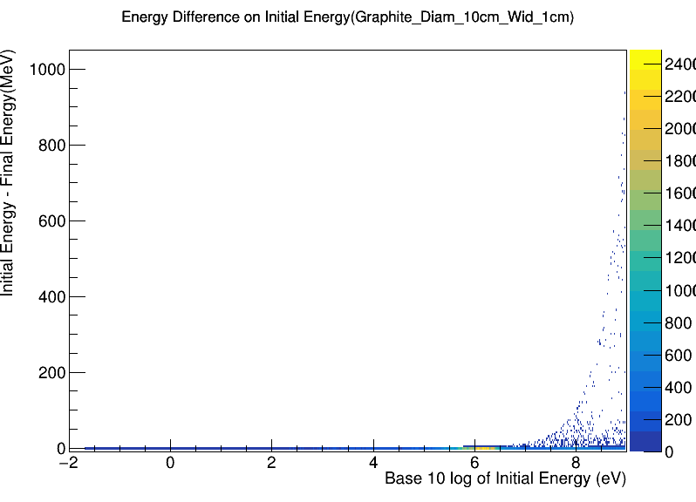
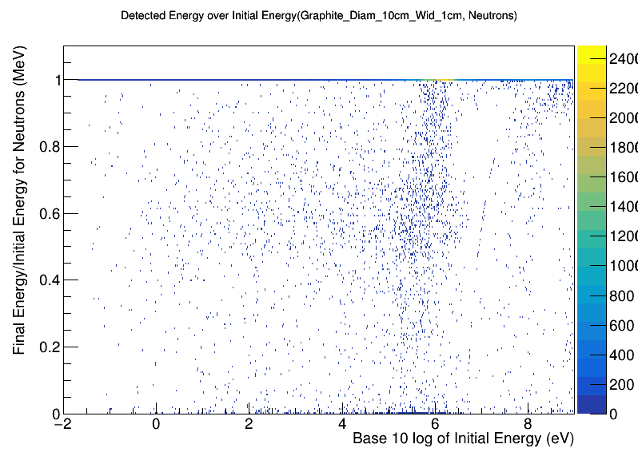
Initial and final Energy Comparison

Slide 16
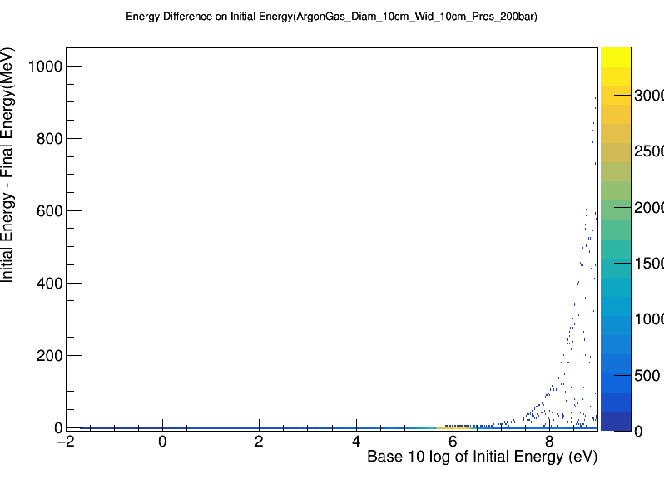
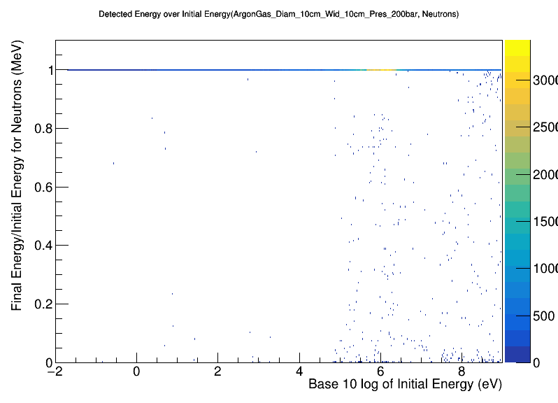
Initial and final Energy Comparison
 | Al(3cm) | Al(5cm) | Al(8cm) | Bi(1cm) | Graphite(1cm) | ArgonGas(10cm)
Percentage of Interactions | 4.04 | 7.40 | 10.40 | 2.44 | 2.21 | 0.28

Slide 17
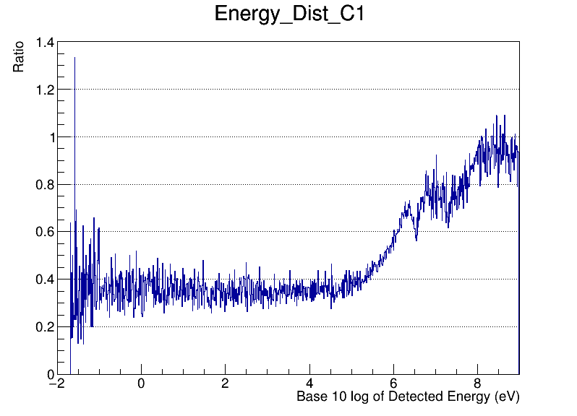
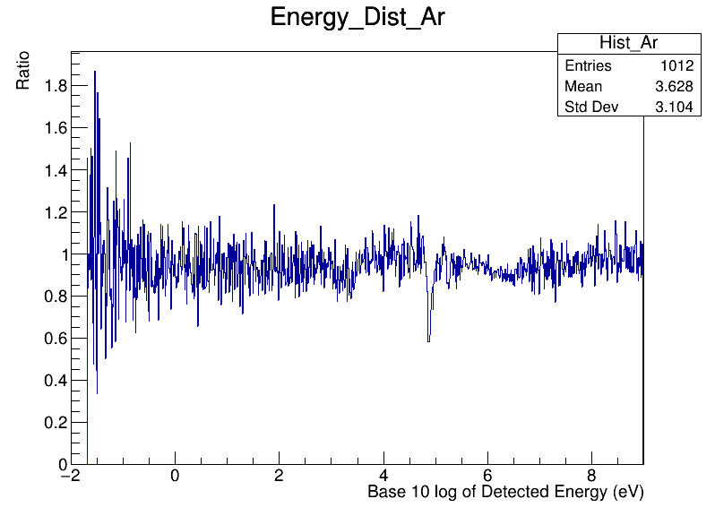
Transmission

Slide 18
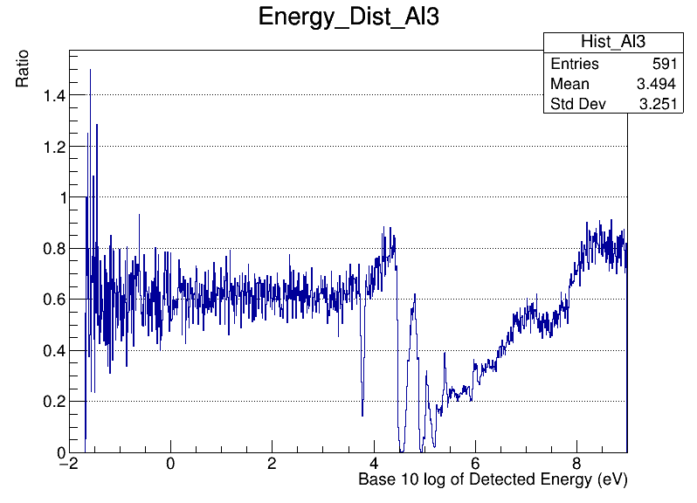
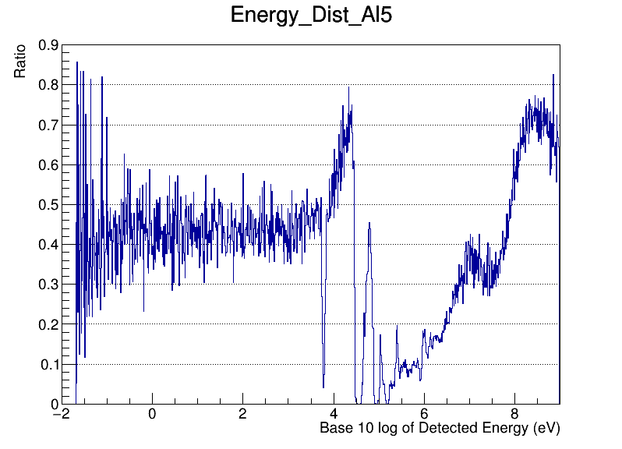
Transmission

Slide 19
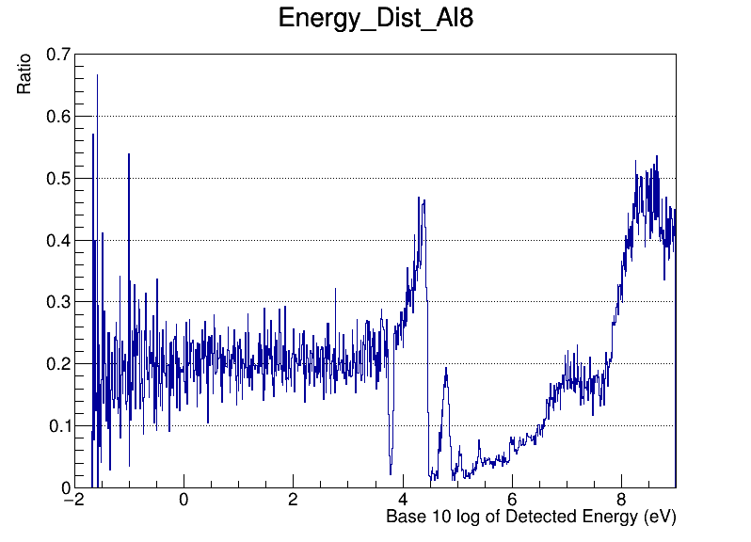
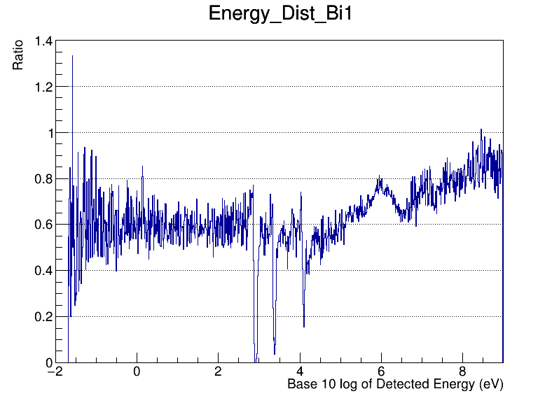
Transmission

Slide 20
Detected Gammas

Slide 21
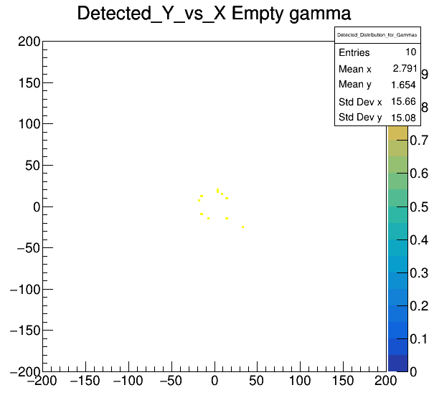
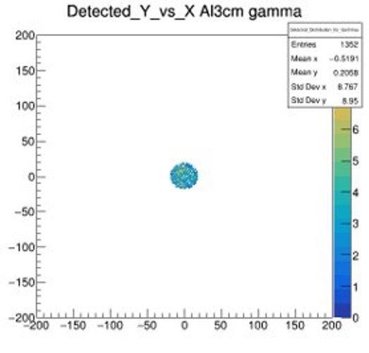
Spatial Distribution

Slide 22


Spatial Distribution

Slide 23
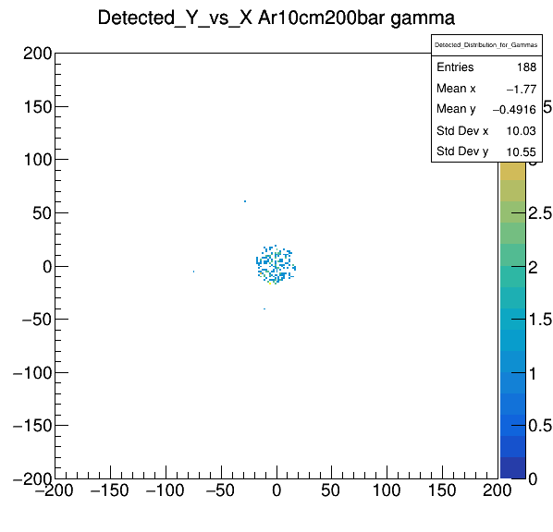
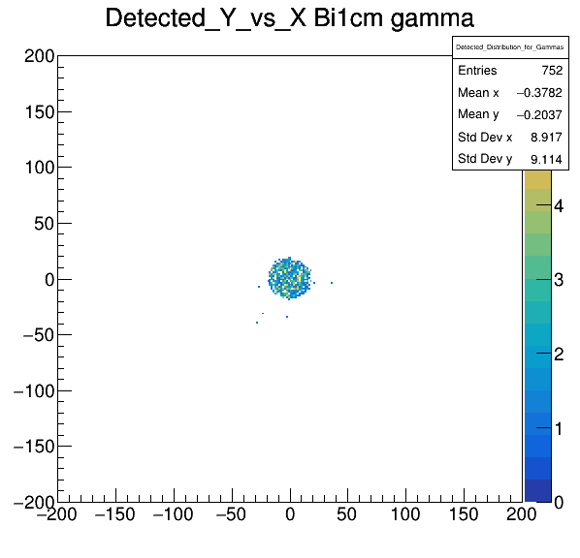
Spatial Distribution

Slide 24

Spatial Distribution

Slide 25
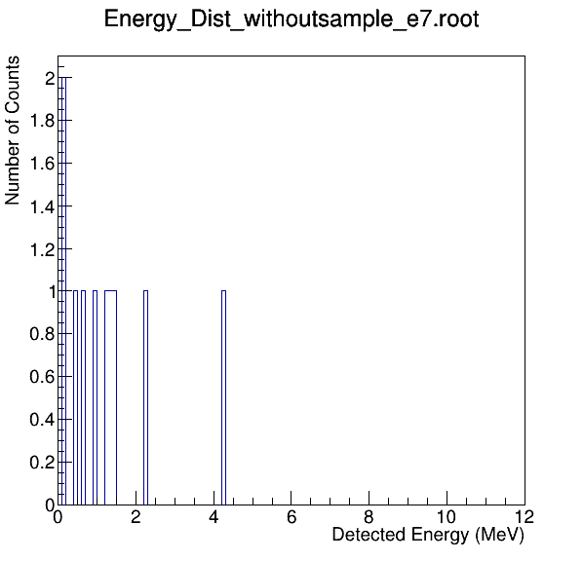
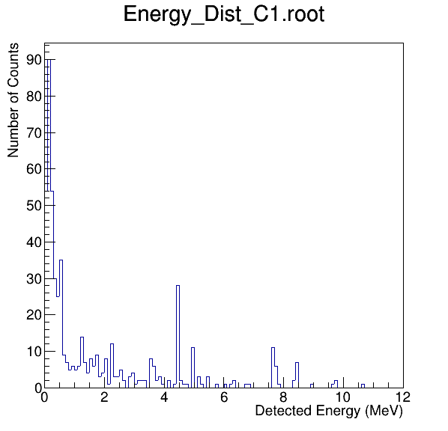
Energy Distribution
Energy_Dist_Empty
Energy_Dist_Graphite_1cm

Slide 26
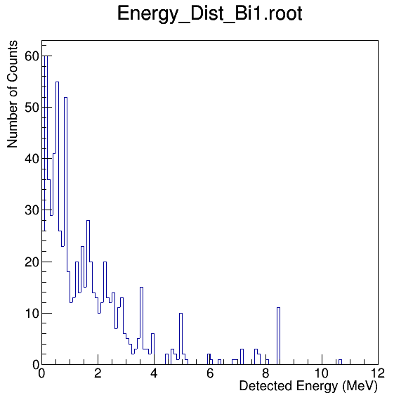
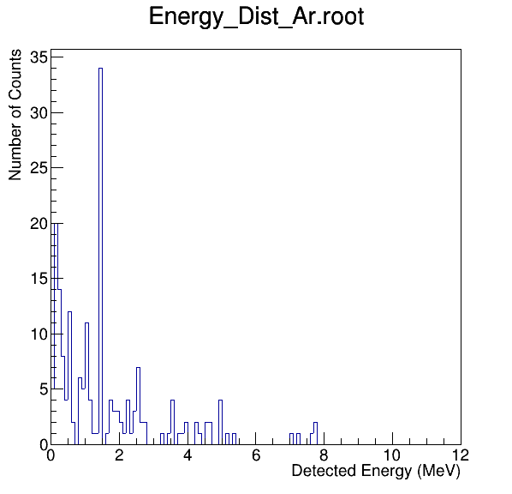
Energy Distribution
Energy_Dist_Bi_1cm
Energy_Dist_Ar_10cm

Slide 27
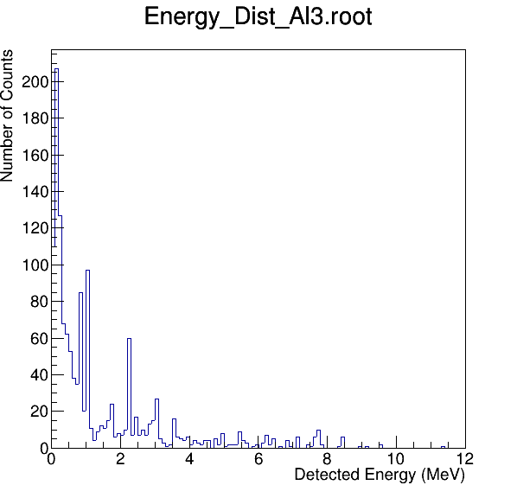
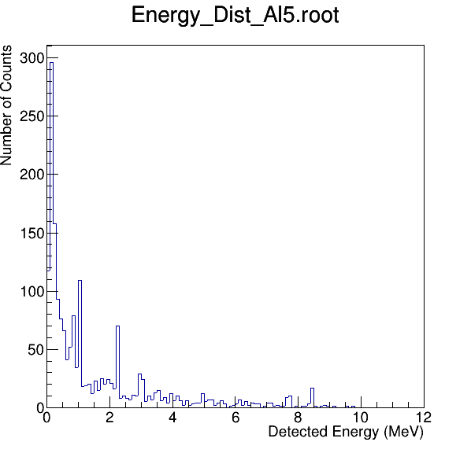
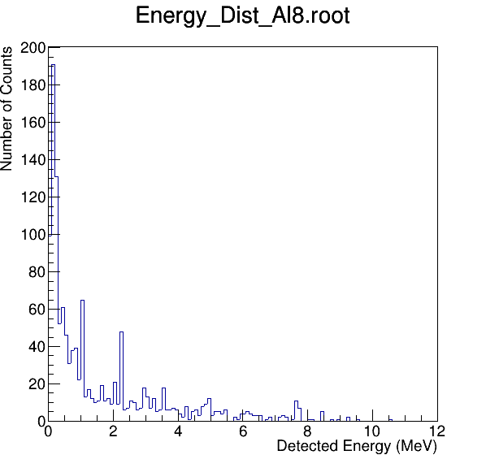
Energy Distribution

