Slide 1
COMP9820 Week 3

Slide 2
本节班课内容
Outline
Key Principles: Software Architecture and Design
软件架构与设计的核心原则
How engineers think about and communicate design
工程师怎么思考设计、怎么用图来沟通设计
Agile design: connecting principles to architecture
敏捷设计：把敏捷原则落到架构上
Web application components: front end, API, back end and data
Web 应用的四块：前端、API、后端、数据
Design principles for non-functional requirements / qualities
面向非功能需求（安全、性能、可维护…）的设计原则
Typical Software Architectural Patterns
常见架构模式：分层、MVC、微服务（事件驱动一页课上跳过了）
Design decisions within Scrum and CI/CD
在 Scrum 和 CI/CD 里怎么做设计决策（垂直切片）
Architecture and design choices and its implications
架构选择的取舍和后果
Project Work – Sprint 1 Assessment
Sprint 1 评估：下周 Demo + 三份报告的要求（本周必看）

Slide 3
Software Architecture and Design
软件架构与设计：核心原则
这章讲清"架构、设计、模式、代码"各是什么层级的事——本 Sprint 不评估设计与架构，但要带着这套思维做项目
讲师的定位：这个主题本身可以是一门课，今天只是让你们"接触"这些概念，不指望在项目里大量应用
设计与架构在 Sprint 1 不评估（讲师认为 Sprint 2、3 也不会），但 COMP9900 的 proposal / final report 会大比重考

Slide 4
Software architecture, design and patterns
架构、设计与模式：同一个推理过程的不同层级
Different levels of the same reasoning process
Architecture — Major parts of the system and their relationships.
架构：系统由哪几大块组成、它们怎么连接（比如前端 / API / 数据库）
Application design — Responsibilities, modules, interfaces and dependencies.
应用设计：每块负责什么、模块怎么划分、接口和依赖是什么
Design patterns — Reusable structures for recurring design problems.
设计模式：针对反复出现的问题的"现成套路"（讲师的例子：登录 / 认证，不必重新发明轮子）
Implementation — Functions, classes, data structures, code and tests.
实现：真正写出来的函数、类、数据结构、代码和测试
The boundary is not rigid.
这几层的边界不是死的
Architecture focuses on the decisions that are expensive or risky to change later. Design continues inside those architectural boundaries.
架构 = 决策而不只是图，早期决策会跟很久——讲师举例：Facebook 信息流撑不住后被迫根本性重构架构

Slide 5
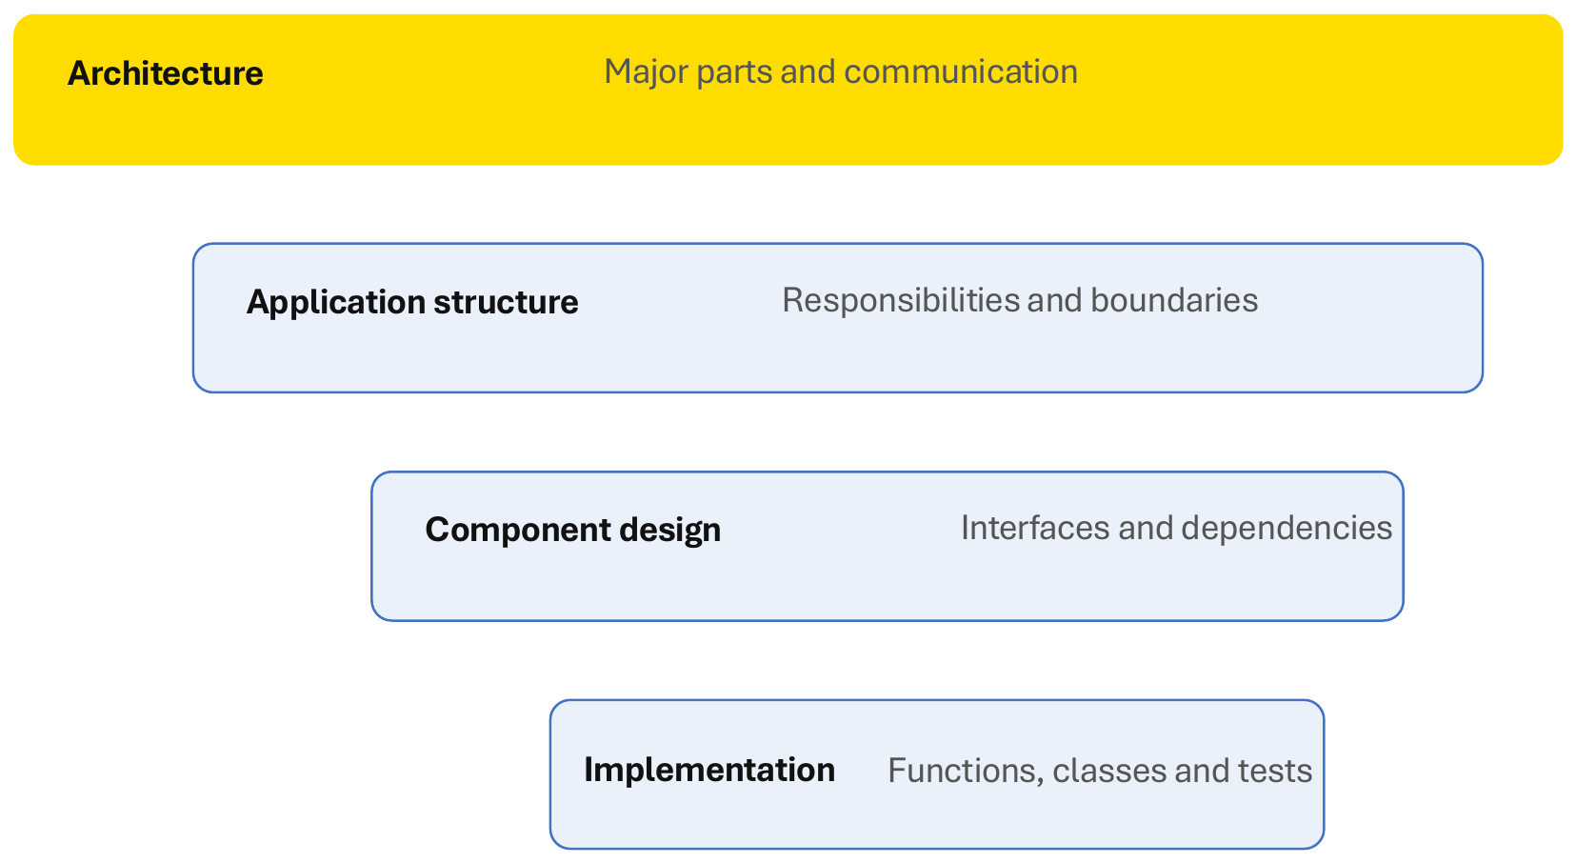
Design operates at different levels
设计在不同层级上进行
Architecture — Major parts and communication
最上层：大块划分及它们之间怎么通信
Application structure — Responsibilities and boundaries
应用结构：职责与边界
Component design — Interfaces and dependencies
组件设计：接口与依赖
Implementation — Functions, classes and tests
最底层：函数、类、测试
Move between levels as needed. Do not start with code-level detail when the system boundary is unclear.
按需在层级间切换；系统边界还没定清楚之前，别急着抠代码细节

Slide 6
How software engineers think about design
工程师思考设计时会问自己的 6 个问题
What problem are we solving?
我们到底在解决什么问题？（先回到用户故事）
What must change later?
以后哪些地方可能会变？（要给它留改动空间）
What belongs together?
哪些东西应该放在一起？（高内聚）
What should stay separate?
哪些应该分开？（低耦合、关注点分离）
How will we test it?
怎么测试？（设计时就要考虑可测试性，第 4 周 TDD 会用到）
What could fail?
哪里可能出错？（依赖挂了、用户乱输入怎么办）

Slide 7
Architecture diagrams support communication
架构图是用来沟通的，图不等于架构：C4 模型的 4 个层级
1 Context — Who uses the system?
语境图：谁在用这个系统、跟哪些外部系统打交道
2 Containers — What applications and data stores exist?
容器图：有哪些应用和数据存储（前端、API、数据库）
3 Components — What responsibilities sit inside an application?
组件图：一个应用内部有哪些职责模块
4 Flow — How does a request move through the system?
流程图：一个请求怎么在系统里流转
Tools: whiteboard • diagrams.net • Mermaid • PlantUML • C4-based tools
工具随便选：白板、diagrams.net、Mermaid、PlantUML；别陷进工具里把图做得完美——决策才重要

Slide 8
How software engineers think about design
从需求出发：先定职责，再定边界
Start from a need, then assign responsibilities and boundaries
User story — What value must we deliver?
用户故事：要交付什么价值
Responsibilities — What must the system do?
职责：系统必须做什么
Components — Where should each responsibility live?
组件：每个职责放在哪个模块
Interfaces — How do components communicate?
接口：组件之间怎么通信
Quality checks — Will it remain secure, testable and changeable?
质量检查：是否安全、可测试、可修改
Example user story: As a group member, I want to record an expense so that the group knows who paid and what everyone owes.
示例故事（就是你们的 Shared Expense Splitter）：作为群组成员，我想记录一笔开销，让大家知道谁付了钱、每人欠多少

Slide 9
From Agile to Design
从敏捷到设计
先做个课堂活动、回顾敏捷宣言，再看第 9 / 10 / 11 条原则怎么变成"技术设计责任"

Slide 10
From Agile to Design – Class Activity
课堂活动：先想两个问题
What guides Agile teams in creating software architecture and design?
什么在指导敏捷团队做架构和设计？（提示：敏捷宣言的 4 条价值观和 12 条原则）
How does the Agile methodology approach software architecture and design?
敏捷方法怎么对待架构和设计？（提示：不是一开始画完整蓝图，而是每个 Sprint 迭代演进）
课堂答案：学生答"简单"和"软件架构师"；讲师：架构师牵头但不单干——客户带来领域知识（股票交易要事件驱动的例子）
讲师提醒：面试被问"怎么看设计和架构"时，就引用这 4 条价值观和 12 条原则

Slide 11
Agile Manifesto – Values
敏捷宣言：4 条价值观（第 2 周讲过，快速回顾）
“We are uncovering better ways of developing software by doing it and helping others do it. Through this work we have come to value:”
我们在实践中总结出更好的开发方式，并看重下面 4 点
Individuals and interactions over processes and tools
人和沟通 > 流程和工具
Working software over comprehensive documentation
能跑的软件 > 大而全的文档
Customer collaboration over contract negotiation
和客户合作 > 合同谈判
Responding to change over following a plan
响应变化 > 死守计划
The items on the left are more valued than those at the right
右边的也有价值，只是左边更重要——本周的设计原则就是从这 4 条推出来的
Agile Manifesto: http://agilemanifesto.org/ © 2001, the above authors. This declaration may be freely copied in any form, but only in its entirety through this notice.

Slide 12
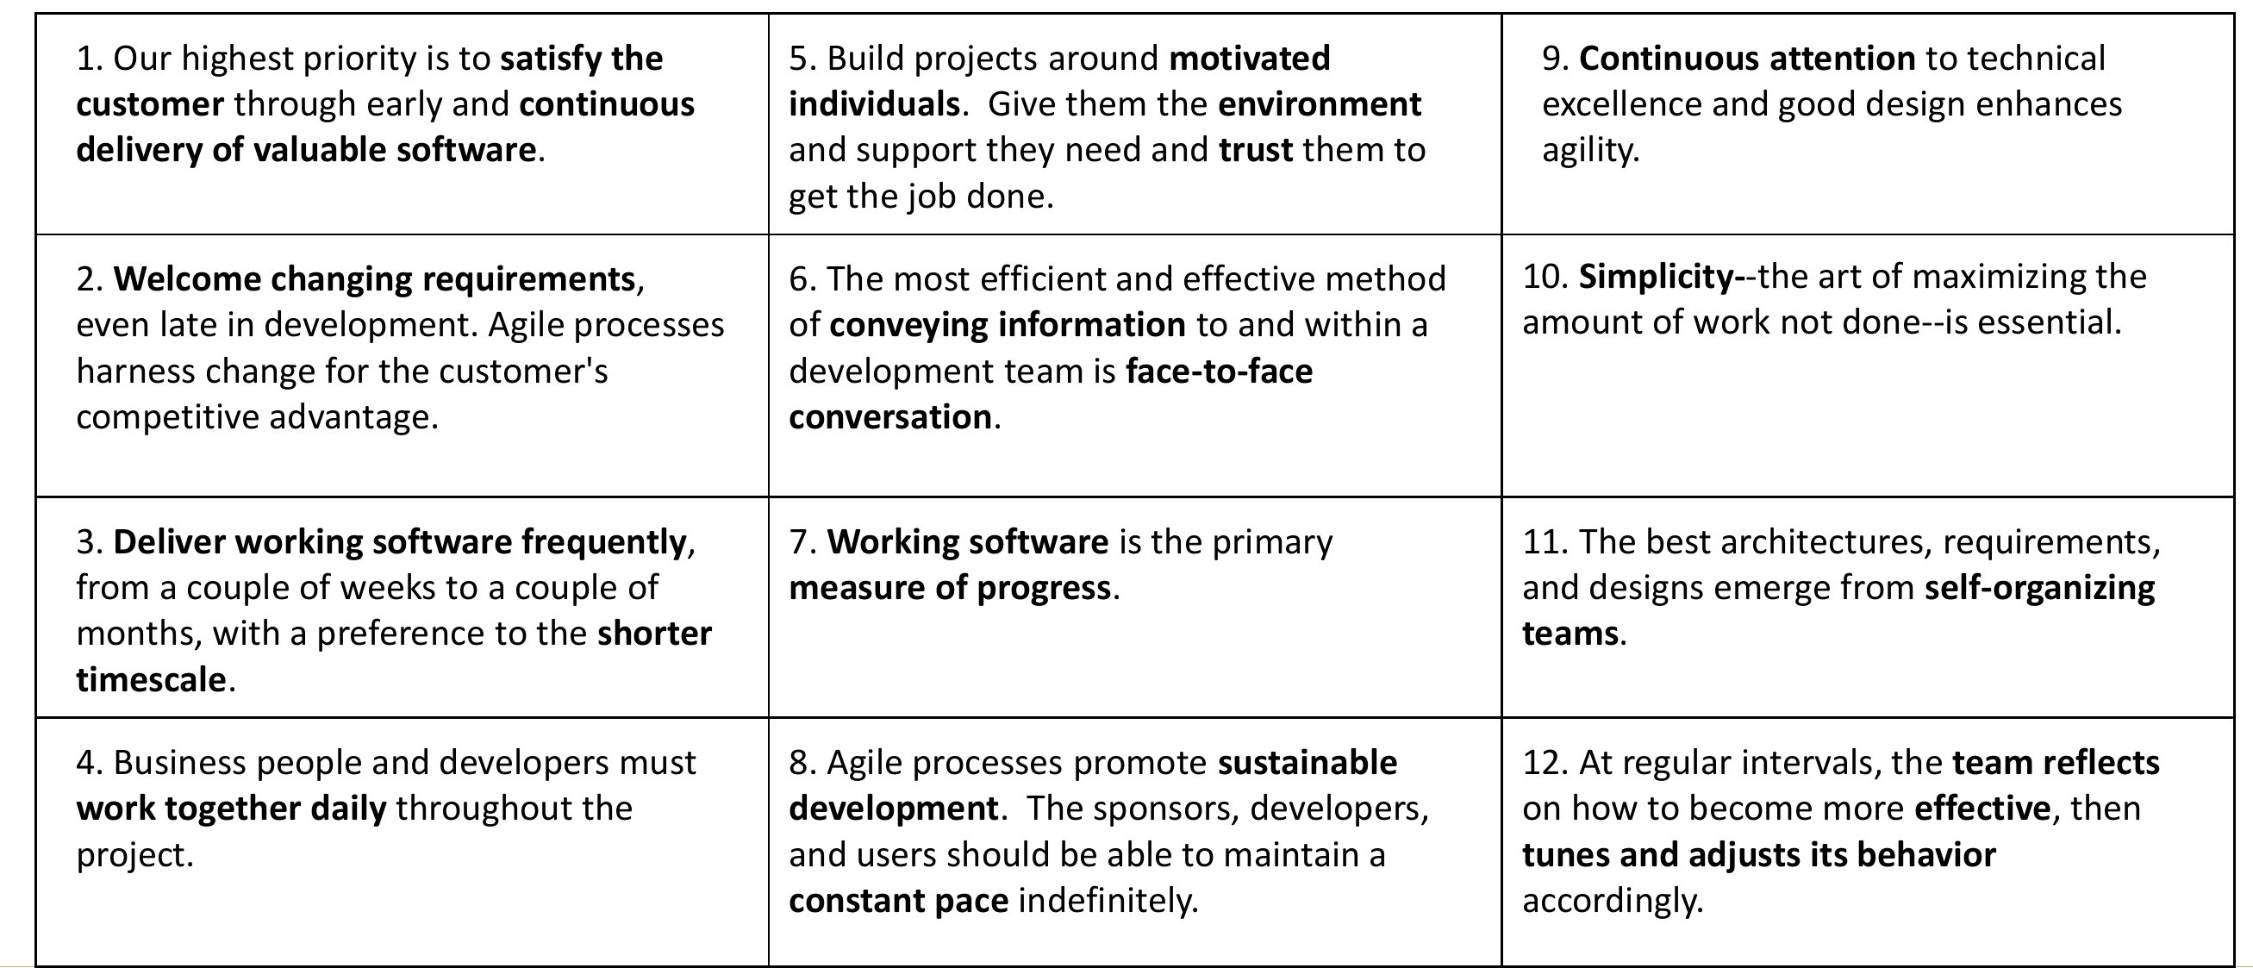
Agile Principles
敏捷 12 原则：本周只盯跟"设计"直接相关的三条
9. Continuous attention to technical excellence and good design enhances agility.
第 9 条：持续关注技术卓越和好设计——这是本周整节课的出发点
10. Simplicity – the art of maximizing the amount of work not done – is essential.
第 10 条：简单——别为想象中的需求造复杂架构（后面讲的 YAGNI）
11. The best architectures, requirements, and designs emerge from self-organizing teams.
第 11 条：好架构是团队自己"长"出来的（涌现式架构）；课上学生答出第 9 条，第 11 条是讲师补的
Agile Alliance: http://www.agilealliance.org
完整 12 条的逐条解释见第 2 周课件

Slide 13
Agile values and design decisions
敏捷价值观 → 设计决策
Agile principles create technical design responsibilities
敏捷原则会带来技术设计责任
Working software → Design enough structure to deliver a usable increment
能跑的软件：设计"刚好够"的结构来交付一个可用的增量，不多不少
Responding to change → Keep responsibilities and dependencies easy to change
响应变化：让职责和依赖容易改
Technical excellence → Use testing, refactoring and clear interfaces to sustain speed
技术卓越：靠测试、重构、清晰的接口来保持长期开发速度
Customer collaboration → Use feedback to validate both behaviour and priorities
客户协作：用反馈验证功能对不对、优先级对不对
The technical choices behind an increment affect how easily the team can respond to change
每个增量背后的技术选择，决定了团队以后响应变化有多容易

Slide 14
From Agile to Software Design & Architecture
从敏捷到软件设计与架构：三步桥梁
Agile → Scrum: User stories, acceptance criteria, Sprint planning, iterative delivery.
敏捷 → Scrum：用户故事、验收标准、Sprint 计划、迭代交付（第 2 周）
Design → Architecture: Translate stories and quality needs into components, responsibilities and boundaries.
设计 → 架构：把故事和质量要求翻译成组件、职责、边界（本周）
Build quality in → Software Features: Build, Test, Integrate, Refactoring, Deployment (DevOps).
内建质量 → 软件功能：构建、测试、集成、重构、部署（第 4–6 周）
Turning Agile planning into technical design decisions, and software features to be delivered and deployed
一句话：把敏捷计划变成技术设计决策，再变成能交付、能部署的功能
Agile principles make the bridge explicit:
敏捷原则把这座桥说得很明白：
Continuous attention to technical excellence and good design enhances agility.
Simplicity helps teams avoid unnecessary work.
Architectures and designs can emerge through collaboration and feedback.

Slide 15
What you should be able to learn
本周学完你应该能做到的 6 件事
Identify the main components of a web application
说出一个 Web 应用的主要组成部分
Explain the difference between architecture, design principles and design patterns
分清架构、设计原则、设计模式的区别
Draw a simple architecture or request-flow diagram
画一张简单的架构图或请求流程图（简单就好，你们的应用本来就简单）
Use separation of concerns, cohesion and coupling to discuss a design
用关注点分离、内聚、耦合这些词来讨论一个设计
Relate design decisions to maintainability, testability and extensibility
把设计决策和可维护、可测试、可扩展联系起来
Explain how design evolves within Scrum and CI/CD
解释设计在 Scrum 和 CI/CD 里是怎么一步步演进的

Slide 16
How to draw architecture
怎么画架构图：画到能回答问题就够，不用画全部细节
Draw enough to answer a question, not every detail
A useful zoom model
一个有用的"缩放模型"（C4）
1. Context — Who uses the system? What external systems matter?
谁在用、跟哪些外部系统有关
2. Containers — Web app, API, database, worker, external service.
有哪些可部署的部分
3. Components — Modules and responsibilities inside an application.
应用内部的模块和职责
4. Code — Classes/functions only when that detail adds value.
类 / 函数级别，只在有价值时才画
Tools: Whiteboard, diagrams.net, Lucidchart, Miro, Mermaid, PlantUML, Structurizr
工具：白板或任何画图工具都行，Mermaid 可以直接写在 GitLab 的 Markdown 里
For most student web projects, a context diagram + a container diagram is usually enough to start.
你们的项目：一张 Context 图 + 一张 Container 图就够起步了——全组动手前画这两张对齐边界即可
Reference: C4 model for visualising software architecture (Simon Brown)
参考：Simon Brown 的 C4 模型

Slide 17
Design in an Agile development
敏捷开发中的设计：从用户故事到 Web 应用组件
From a user story to Web application components——你们 Sprint 1 的每个故事都会走一遍这条路

Slide 18
Agile design is iterative and incremental
敏捷设计是迭代、增量的
User need → Small design → Working slice → Feedback → Evolved design
用户需求 → 小设计 → 能跑的切片 → 反馈 → 演进后的设计——一个 Sprint 转一圈
Design decisions become more reliable when the team tests them through working increments.
设计决策经过"能跑的增量"验证后才更可靠——不要纸上谈兵
Good design is not a document handed to developers. It is a set of decisions that makes change safer, clearer and cheaper.
好设计不是一份交给开发的文档，而是一组让改动更安全、更清楚、更便宜的决定

Slide 19
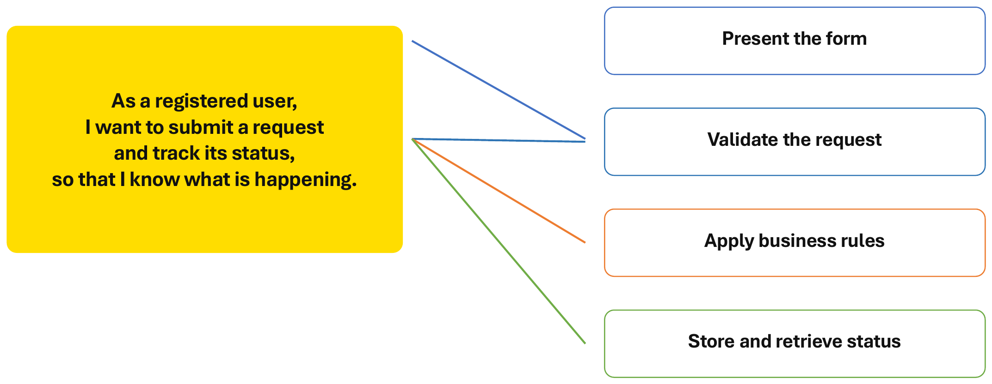
A user story becomes a set of responsibilities
一个用户故事 = 一组职责
As a registered user, I want to submit a request and track its status, so that I know what is happening.
故事：作为注册用户，我想提交一个请求并跟踪它的状态，以便知道进展
Present the form
展示表单（前端）
Validate the request
校验请求（后端）
Apply business rules
应用业务规则（后端）
Store and retrieve status
存储与读取状态（数据层）

Slide 20
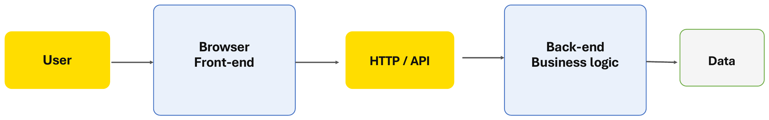
Basic web application architecture
Web 应用的基本架构
A browser communicates with server-side software through HTTP
浏览器通过 HTTP 和服务器软件通信
User → Browser Front-end → HTTP / API → Back-end Business logic → Data
用户 → 浏览器前端 → HTTP / API → 后端业务逻辑 → 数据
The boundary is also a responsibility boundary: the server must enforce rules and protect data.
这条边界也是职责边界：规则必须由服务器强制执行、数据由服务器保护——浏览器里的检查随时可以被绕过

Slide 21
Class Activity: Front-end or back-end?
课堂活动：下面 10 条职责，哪些属于前端、哪些属于后端？
Classify front-end and back-end responsibilities
把它们分成前端 / 后端两类
Validates requests and permissions
校验请求和权限
Applies business rules
应用业务规则
Reads and writes persistent data
读写持久化数据
Integrates external services
对接外部服务
Returns useful responses and errors
返回有用的响应和错误
Displays information and accepts input
显示信息、接收输入
Manages interaction and client-side state
管理交互和客户端状态
Calls the back end through an API
通过 API 调用后端
Provides immediate feedback
给用户即时反馈
Handles loading, error and empty states
处理加载中 / 出错 / 空数据状态

Slide 22
Front end and back end have different responsibilities
答案：前端和后端的职责不同
Front-end
前端（浏览器里跑的）
Displays information and accepts input
显示信息、接收输入
Manages interaction and client-side state
管理交互和页面状态
Calls the back end through an API
通过 API 调用后端
Provides immediate feedback
即时反馈——前端校验是为了体验：省一次网络往返
Handles loading, error and empty states
处理加载 / 出错 / 空数据
Back-end
后端（服务器上跑的）
Validates requests and permissions
再校验一次——为了安全：黑客能绕过前端校验、注入内容
Applies business rules
应用业务规则（比如分账怎么算）
Reads and writes persistent data
读写数据库
Integrates external services
对接外部服务（邮件、支付…）
Returns useful responses and errors
返回结构化的响应和错误
校验要做两次、理由不同；把后端的职责做进前端 = 违反设计原则，会出大问题

Slide 23
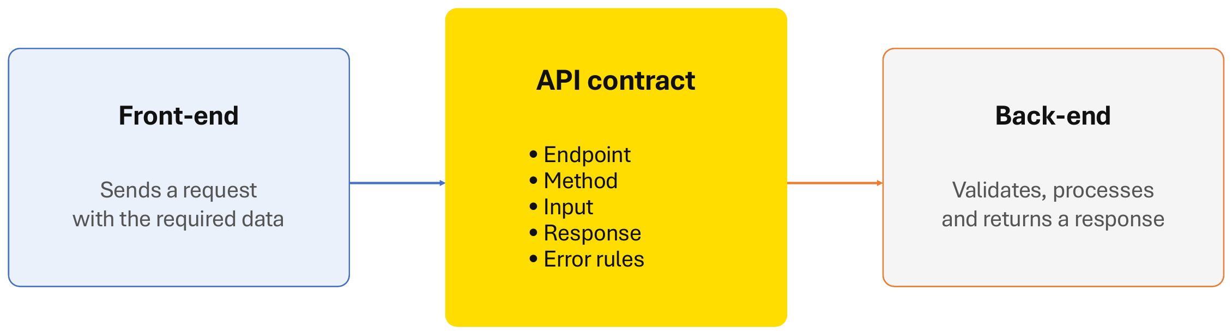
The API is a contract between components
API 是组件之间的"合同"
Front-end: Sends a request with the required data
前端：带上需要的数据发请求
API contract: Endpoint • Method • Input • Response • Error rules
合同的五样东西：端点、方法、输入、响应、错误规则——前后端先把这五样约定好，就能并行开发
Back-end: Validates, processes and returns a response
后端：校验、处理、返回响应

Slide 24
Design Principles
设计原则
Good structure can help to make better changes——好的结构让下一次改动更容易；Sprint 2 起你们自己加功能时会体会到
讲师题外话：业界说"初级工程师不再需要，AI 能写代码"——需要的是懂设计 / 架构决策、能判断 AI 代码好坏的人
"一切看起来能跑"，规模上去就挂；引导 AI agent 的人必须懂设计原则、也懂好代码
架构师的成长路径：初级 → 高级 → 架构师，靠大量开发经验才知道早期决策怎么影响后来

Slide 25
Core design principles
8 条核心设计原则：每个 Sprint 都值得对照一遍
Separate concerns — Different responsibilities should not be tangled together.
关注点分离：不同职责别缠在一起
Encapsulation — Hide internal details behind a clear interface.
封装：把内部细节藏在清晰的接口后面
High cohesion — Keep closely related behaviour together.
高内聚：相关行为放一起，把变化局部化（散开就要改多处、每处重测）
Low coupling — Minimise how much one part must know about another.
低耦合：耦合不可能避免，只能最小化——所以叫低耦合不叫解耦
Simple dependencies — Make dependency direction visible and predictable.
简单依赖：依赖方向要看得见、可预测
Design for change — Isolate likely sources of change.
为变化设计：把可能变的地方隔离出来
YAGNI* / simplicity — Do not build complexity for imagined future needs. (* You aren’t gonna need it)
YAGNI / 简单：别为想象中的未来需求堆复杂度；讲师还提了 KISS（Keep it simple, stupid）
Refactor continuously — Improve the design as understanding grows.
持续重构：理解加深了就顺手改善设计

Slide 26
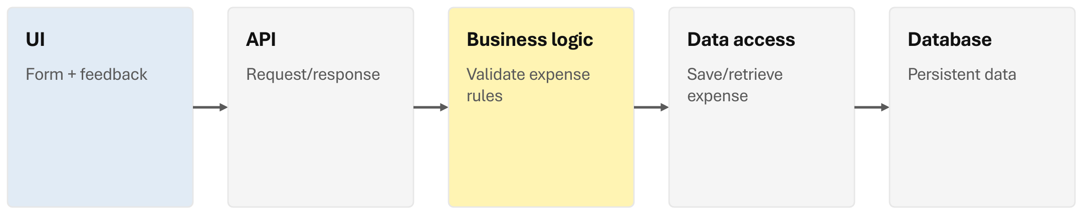
Separation of concerns
关注点分离：一个功能可以穿过多层，但各层职责不混
One feature can cross layers without mixing responsibilities
UI (Form + feedback) → API (Request/response) → Business logic (Validate expense rules) → Data access (Save/retrieve expense) → Database (Persistent data)
"记一笔开销"穿过 5 层：表单 → 请求 / 响应 → 校验分账规则 → 存取 → 数据库
Same user story, distinct responsibilities
同一个用户故事，职责却分得清清楚楚
A change to the screen layout should not require rewriting persistence. A change to the database should not change the user story.
改页面布局不该动到存储；换数据库也不该影响用户故事

Slide 27
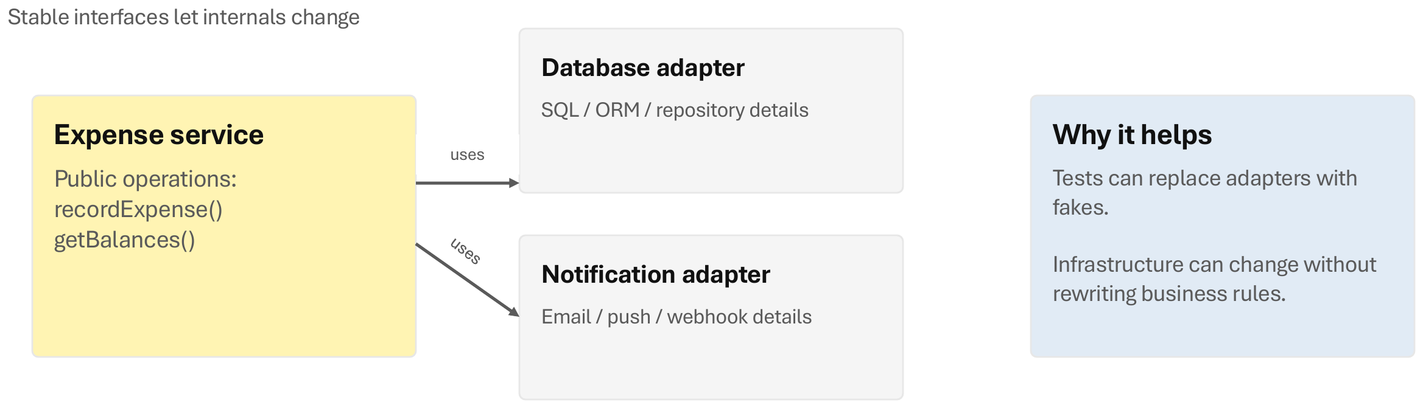
Encapsulation and dependency direction
封装与依赖方向：接口稳定，内部随便换
Stable interfaces let internals change
Expense service — Public operations: recordExpense(), getBalances()
对外只暴露两个操作
uses → Database adapter (SQL / ORM / repository details)
数据库细节藏在适配器里
uses → Notification adapter (Email / push / webhook details)
通知方式也藏在适配器里
Why it helps: Tests can replace adapters with fakes. Infrastructure can change without rewriting business rules.
测试时可以用假的适配器；换基础设施不用重写业务规则
The goal is not “more layers”. The goal is explicit boundaries and fewer surprises.
目标不是"层数更多"，而是边界明确、少踩坑
给你们的建议：先做前端，后端可以先用"假服务"（比如读文件返回字符串）mock 掉——但要放在单独的适配器 / 组件里

Slide 28
Separation of concerns and encapsulation
关注点分离与封装：缠在一起 vs 分开
Tangled responsibility
缠在一起的职责（反例）
One module
一个模块什么都干：
renders the form
validates permissions
calculates fees
writes to the database
sends email
画表单、验权限、算费用、写数据库、发邮件——改任何一样都可能弄坏别的
Separated responsibility
分开的职责（正例）
Form / view
表单 / 视图
Business service
业务服务
Data access
数据访问
Notification adapter
通知适配器——每块只管一件事

Slide 29
Cohesion and coupling
内聚与耦合：相关的放一起，不必要的依赖分开
Keep related things together; keep unnecessary dependencies apart
High cohesion + low coupling
高内聚 + 低耦合（正例）
Expense module: create expense • validate split • calculate balances
开销模块只管开销相关的三件事
Notification module: email • push notification
通知模块只管通知
Low cohesion + high coupling
低内聚 + 高耦合（反例）
UtilityManager: expense calculations • email • database queries • authentication • report formatting • UI helpers
一个"万能工具类"什么都塞：算钱、邮件、查库、登录、报表、UI——谁都依赖它，谁都不敢改它
Design question: “If I change this responsibility, how many unrelated places must I understand and modify?”
设计时问自己：改这一个职责，我得先看懂、再改动多少不相干的地方？——越少越好

Slide 30
Design for change – Class Activity
课堂活动：两种架构你选哪个？为什么？（Simplicity, YAGNI and design for change）
Architecture 1 — Do not build this on Sprint 1…
架构 1：Sprint 1 千万别这么搞
Speculative architecture
"投机式"架构：
12 services
3 message brokers
custom plugin platform
global multi-region replication
“because we may need it later”
12 个服务、3 个消息队列、自研插件平台、全球多区域复制——理由只是"以后可能用得上"
Architecture 2 — Prefer this…
架构 2：推荐这个
Simple, modular starting point
简单、模块化的起点：
One deployable web app
clear modules
well-defined API boundaries
automated tests
room to extract a service later if evidence appears
一个可部署的 Web 应用、模块清楚、API 边界明确、有自动化测试，以后有证据再拆服务
Which Architecture would you choose? Why? (Simplicity, YAGNI and design for change)
Design for change means isolating known instability, not predicting every future feature.
课堂答案：选 2（"可工作的软件"），架构 1 是没证据的投机；为变化设计 = 隔离已知会变的地方，不预测未来功能

Slide 31
Architecture of Web applications
Web 应用的架构
A browser click becomes a chain of responsibilities across the front end, network, back end, data and external services——点一下按钮，背后是一连串职责

Slide 32
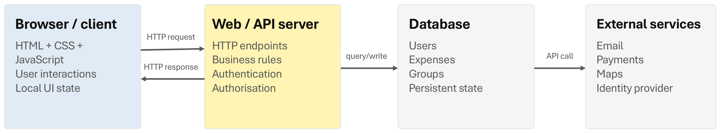
The simplest useful web architecture
最简单但够用的 Web 架构：Client → server → data
Browser / client: HTML + CSS + JavaScript, User interactions, Local UI state
浏览器：页面、交互、本地界面状态
Web / API server: HTTP endpoints, Business rules, Authentication, Authorisation
服务器：接口、业务规则、认证（你是谁）、授权（你能干什么）
Database: Users, Expenses, Groups, Persistent state
数据库：用户、开销、群组——持久化状态
External services: Email, Payments, Maps, Identity provider
外部服务：邮件、支付、地图、第三方登录
The browser is not “the application”. It is one part of a larger system. (Reference: MDN “How the web works”)
浏览器不等于"整个应用"，它只是大系统里的一部分

Slide 33
Front-end: what belongs in the browser?
前端：浏览器里该放什么？——负责展示和交互，不是可信的业务权威
Presentation and interaction, not trusted business authority
Render the interface and data
渲染界面和数据
Collect user input
收集用户输入
Manage UI state
管理界面状态
Provide immediate validation feedback
即时校验反馈（格式对不对）
Call back-end APIs
调用后端 API
Handle loading, errors and empty states
处理加载 / 出错 / 空状态
Support accessibility and responsive layout
无障碍和响应式布局
Example: “Record expense” form
例子：记账表单
The browser can check that amount looks numeric and show errors instantly.
浏览器可以先检查金额是不是数字、立刻报错
But the server still validates
但服务器仍然要再校验一遍
A user can bypass JavaScript or call the API directly. Business rules and authorisation must be enforced server-side.
用户可以绕过 JavaScript 直接调 API，所以业务规则和权限必须在服务器端把关——Demo 时 tutor 可能会问这个

Slide 34
Back-end: what belongs on the server?
后端：服务器上该放什么？——业务行为、安全、持久化、集成
API boundary — Receive HTTP requests; return structured responses.
API 边界：收请求、返回结构化响应
Validation — Check required data and domain rules.
校验：必填项和业务规则
Authentication — Establish who the user is.
认证：确认你是谁
Authorisation — Decide what that user is allowed to do.
授权：决定你能做什么
Business logic — Calculate splits, balances and other domain behaviour.
业务逻辑：算分账、算余额
Persistence — Read/write durable data through a data access layer.
持久化：通过数据访问层读写数据
Integration — Call external services through controlled adapters.
集成：通过适配器调外部服务
Observability — Log important events and failures.
可观测：记录重要事件和失败日志

Slide 35
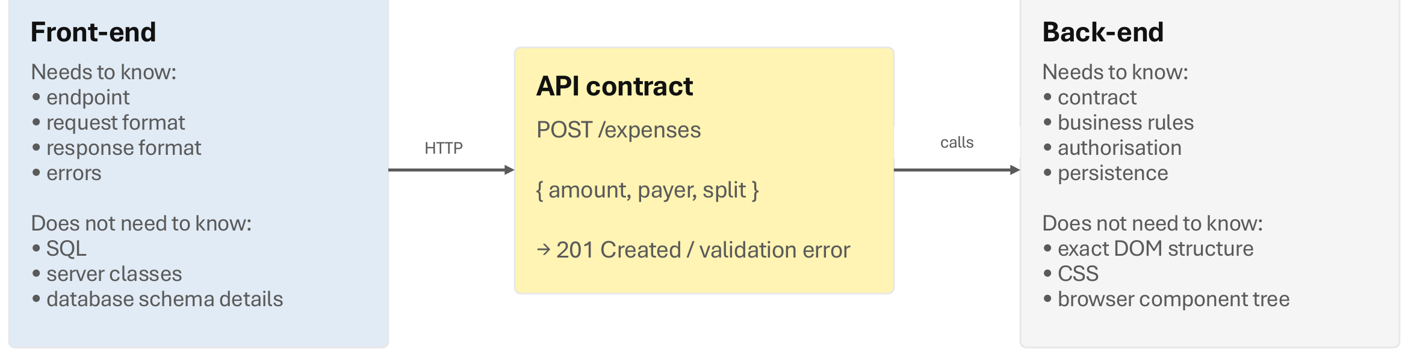
The API is a contract
API 是合同：前后端各自只需要知道合同，不用知道对方内部
Front-end needs to know: endpoint, request format, response format, errors. Does not need to know: SQL, server classes, database schema details
前端只需知道接口长什么样，不用管 SQL 和表结构
API contract: POST /expenses { amount, payer, split } → 201 Created / validation error
合同示例：往 /expenses 发 POST，带金额、付款人、分账方式；成功返回 201，失败返回校验错误
Back-end needs to know: contract, business rules, authorisation, persistence. Does not need to know: exact DOM structure, CSS, browser component tree
后端只需知道合同和业务，不用管页面 DOM 和 CSS
Good contracts reduce coupling. They do not eliminate coordination.
好合同减少耦合，但不等于不用沟通——前后端还是要先坐下来把合同定了，写进 Issue

Slide 36
Typical Architectural Patterns
常见架构模式
分层、MVC、微服务、事件驱动：都是"工具"不是"规则"——你们的项目用分层 / MVC 就够了

Slide 37
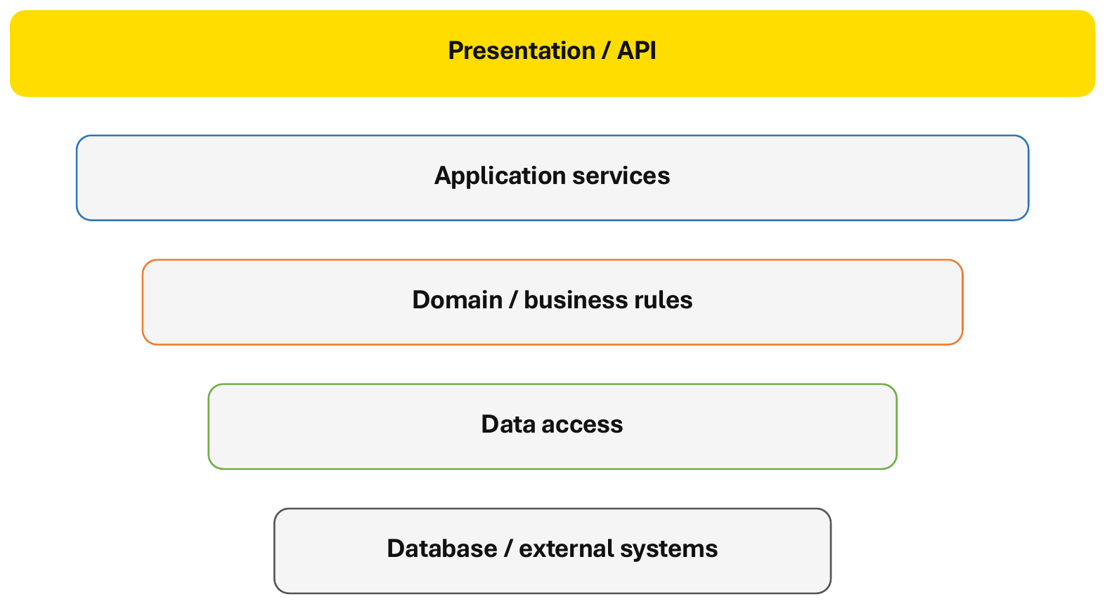
Layered architecture
分层架构：每层一个主要职责（Each layer has a primary responsibility）
Presentation / API
表现层 / API：接收请求、返回响应
Application services
应用服务：编排一个用例的步骤
Domain / business rules
领域 / 业务规则：核心逻辑
Data access
数据访问：读写数据
Database / external systems
数据库 / 外部系统
A request usually moves downward, while a response moves back upward.
请求往下走，响应往上回
展示层不能直接碰数据库，必须逐层经过——安全也来自这一点
逻辑分层 ≠ 物理部署：各层可以各在一台服务器，也可以全在一台

Slide 38
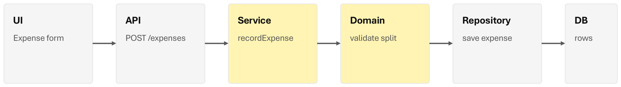
Layered architecture: one user story end to end
分层架构：一个用户故事从头走到尾
“Record an expense” as a vertical slice
"记一笔开销"作为一个垂直切片
UI (Expense form) → API (POST /expenses) → Service (recordExpense) → Domain (validate split) → Repository (save expense) → DB (rows)
表单 → 接口 → 服务 → 领域规则 → 仓库 → 数据库表
Tests can exist at several seams:
测试可以插在好几个"缝"上（第 4 周会讲怎么写）：
Domain unit tests for split calculations
分账计算的单元测试
Service tests with a fake repository
用假仓库测服务层
API integration tests
API 集成测试
Small browser/end-to-end tests for critical user journeys
关键用户路径的少量端到端测试

Slide 39
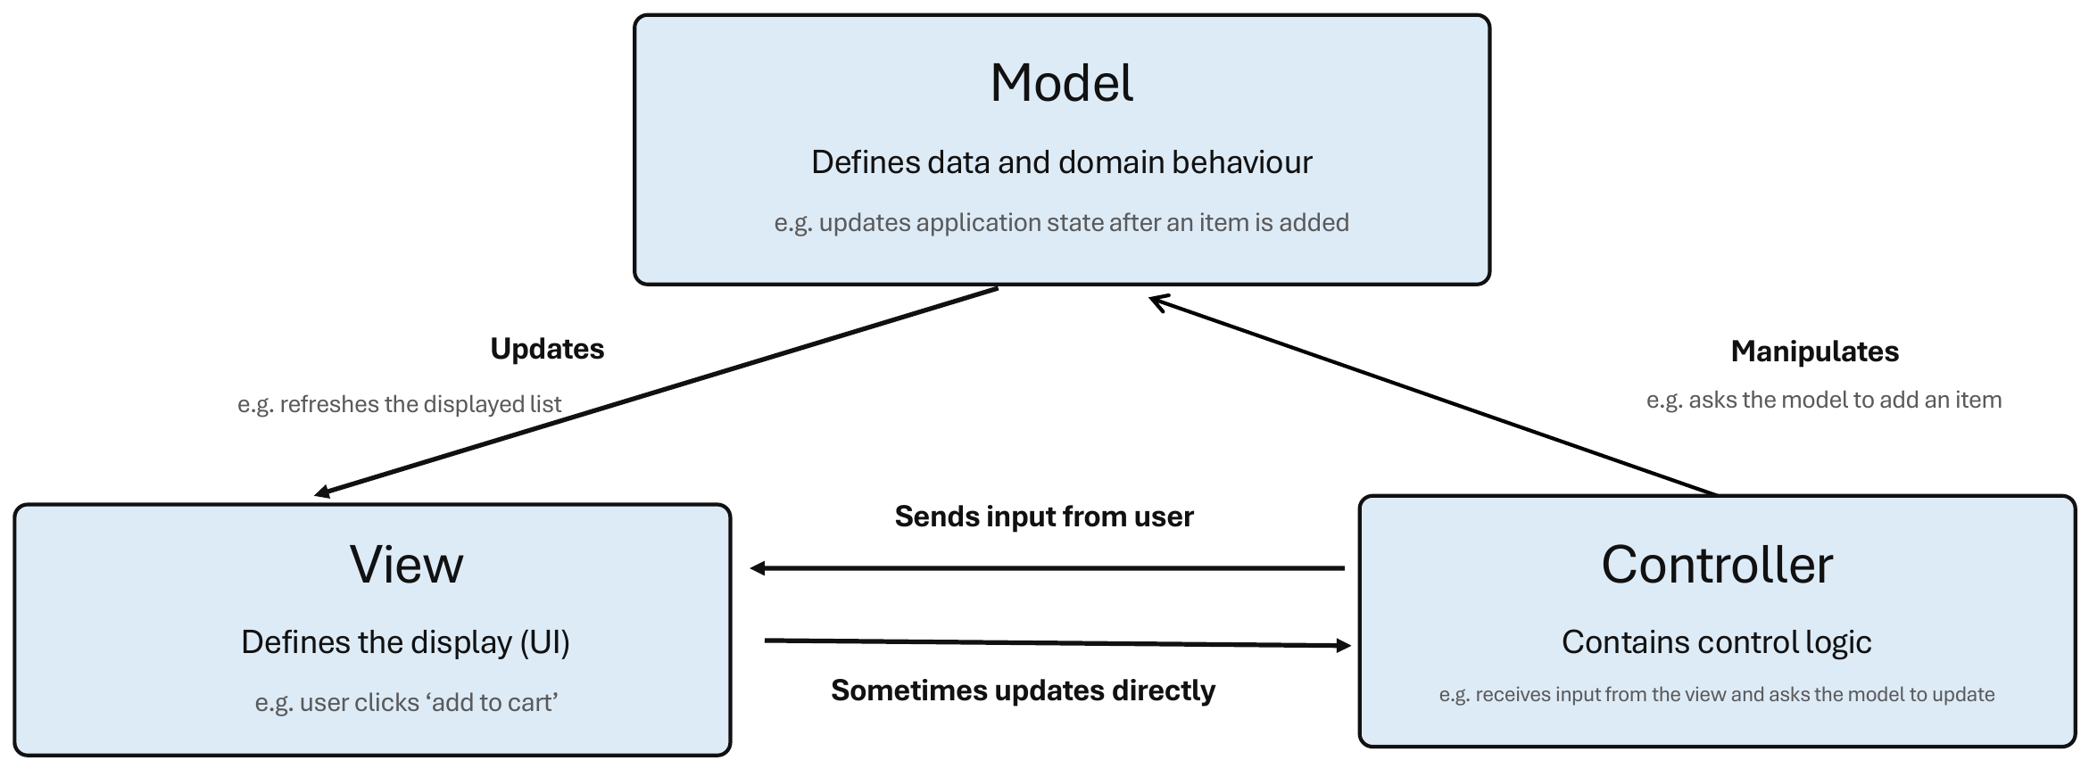
Model-view-controller (MVC)
MVC：把数据、展示、请求协调三者分开
A pattern for separating data, presentation and request coordination
Model — Defines data and domain behaviour (e.g. updates application state after an item is added)
模型：数据和业务行为，比如加了一项后更新状态
View — Defines the display (UI) (e.g. user clicks ‘add to cart’)
视图：界面，用户在这里点按钮
Controller — Contains control logic (e.g. receives input from the view and asks the model to update)
控制器：接收视图的输入，让模型去更新
View → Controller: Sends input from user • Controller → Model: Manipulates • Model → View: Updates • Sometimes updates directly
箭头方向：视图把输入给控制器，控制器操作模型，模型更新视图

Slide 40
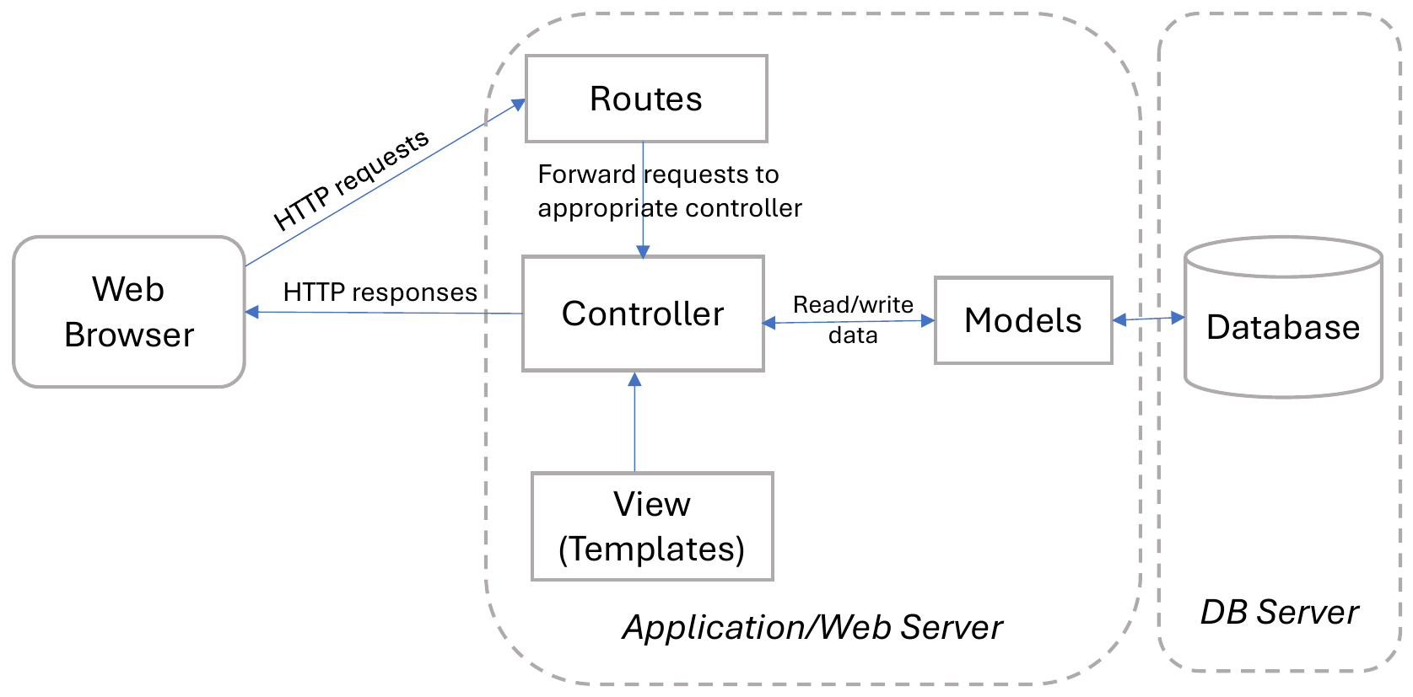
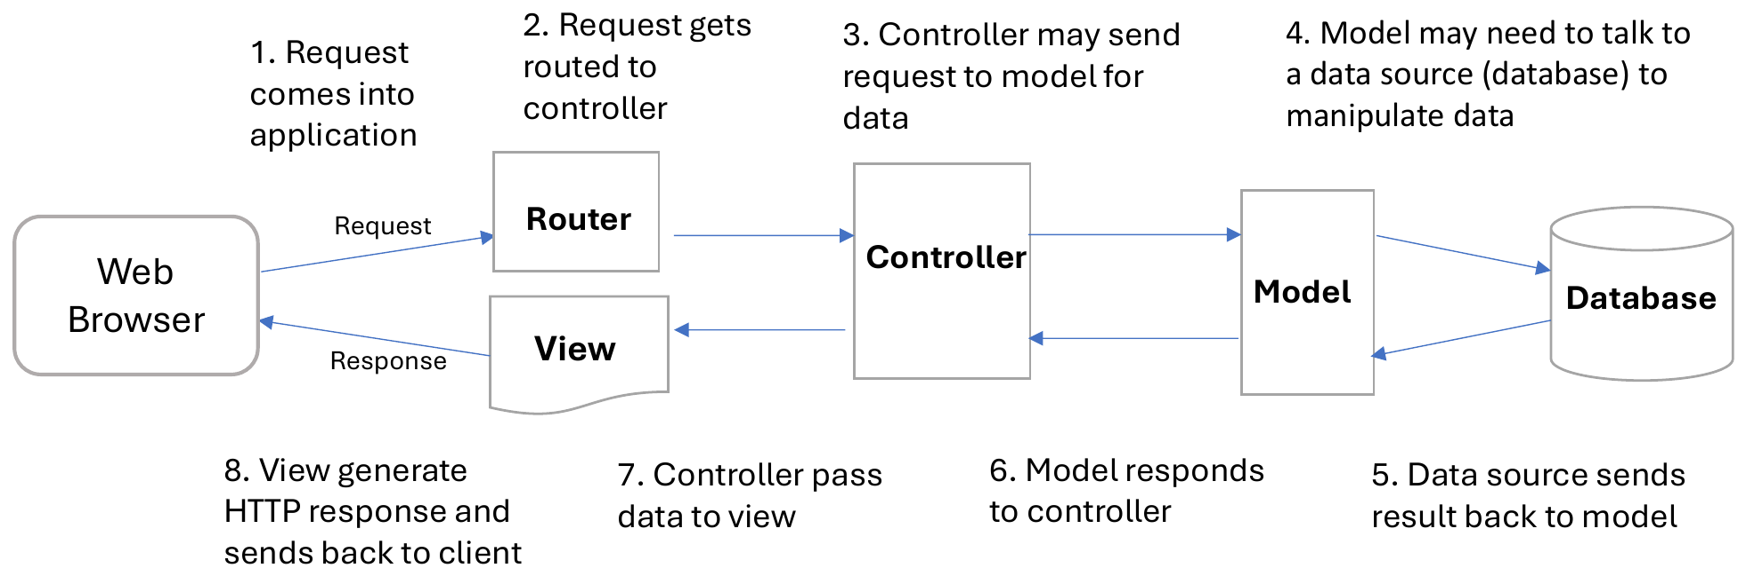
Model-view-controller (MVC) – Web Application
MVC 在 Web 应用里的样子：请求流转 8 步
Web Browser → HTTP requests → Routes (Forward requests to appropriate controller) → Controller → Read/write data → Models → Database; View (Templates) → HTTP responses
1 请求进来 → 2 路由到控制器 → 3 控制器找模型要数据 → 4 模型访问数据库 → 5 数据库返回 → 6 模型返回控制器 → 7 控制器把数据给视图 → 8 视图生成响应发回浏览器
Database related code should be put in model layer
数据库相关代码只放在模型层
Controller should not have knowledge about the actual database
控制器不应该知道用的是什么数据库
Modularity allows easy switching between technologies (e.g. different view templates, different database management systems)
模块化让换技术很容易：换模板引擎、换数据库都不用动其他层

Slide 41
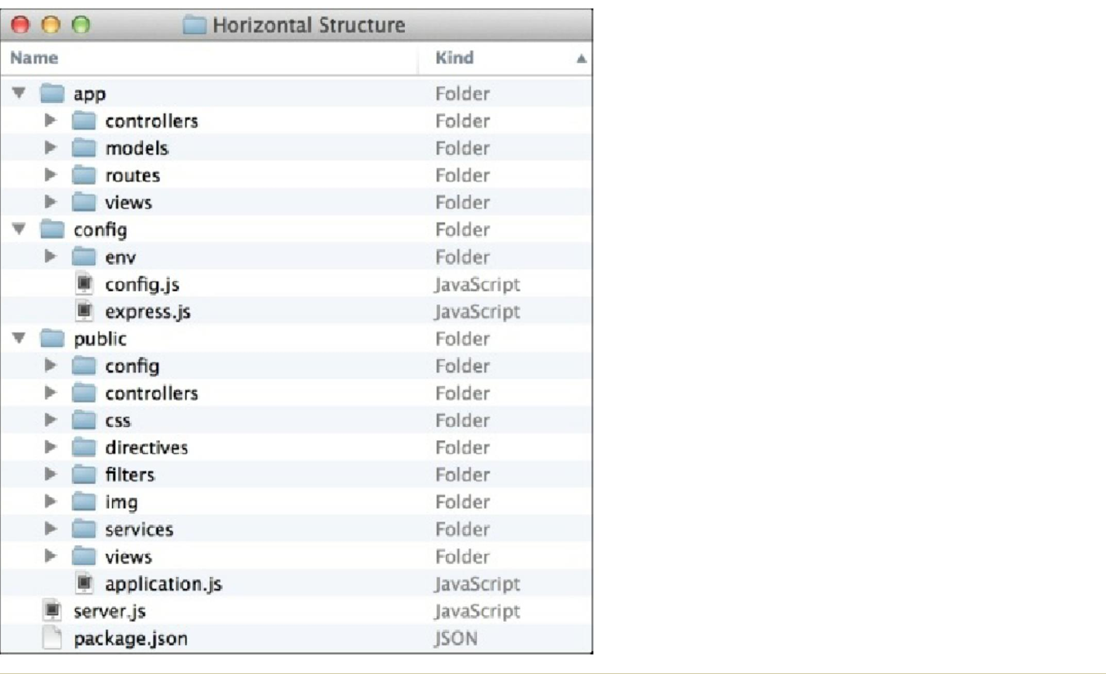
Model-view-controller (MVC) – Web Application
MVC 项目的目录结构长这样（Node / Express 例子）
app/ — controllers, models, routes, views
后端 MVC 三件套 + 路由
config/ — env, config.js, express.js
配置：环境变量、框架设置
public/ — config, controllers, css, directives, filters, img, services, views, application.js
前端静态资源（这是一个 Angular 风格的前端）
server.js, package.json
入口文件和依赖清单
Tip for your project
你们的 Shared Expense Splitter 也建议按 routes / controllers / models 分目录，Demo 时 tutor 一眼能看懂

Slide 42
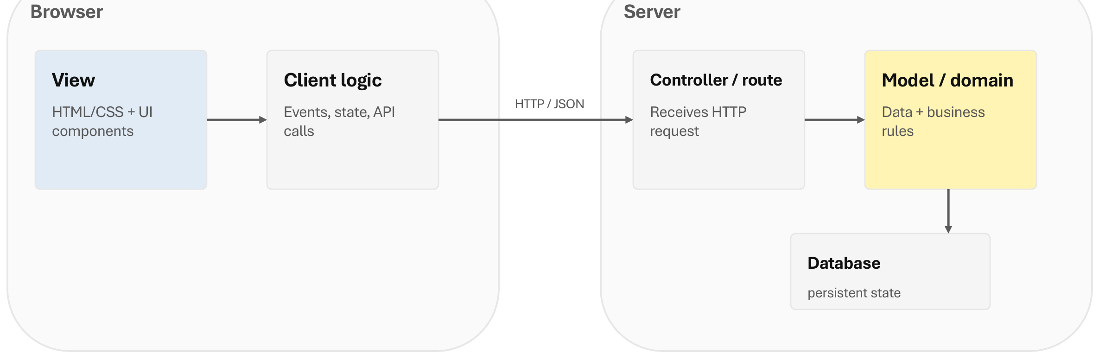
MVC in modern Web app
现代 Web 应用里的 MVC：职责拆到浏览器和服务器两边
The responsibilities may be split across browser and server
Browser: View (HTML/CSS + UI components) • Client logic (Events, state, API calls)
浏览器端：视图 + 客户端逻辑
HTTP / JSON
Server: Controller / route (Receives HTTP request) • Model / domain (Data + business rules) • Database (persistent state)
服务器端：控制器 / 路由 + 模型 + 数据库
Python example: Django describes its approach as Model–Template–View (MTV), similar in style to MVC.
Python 的 Django 叫它 MTV（模型–模板–视图），本质和 MVC 一样
References: MDN MVC; Django documentation glossary

Slide 43
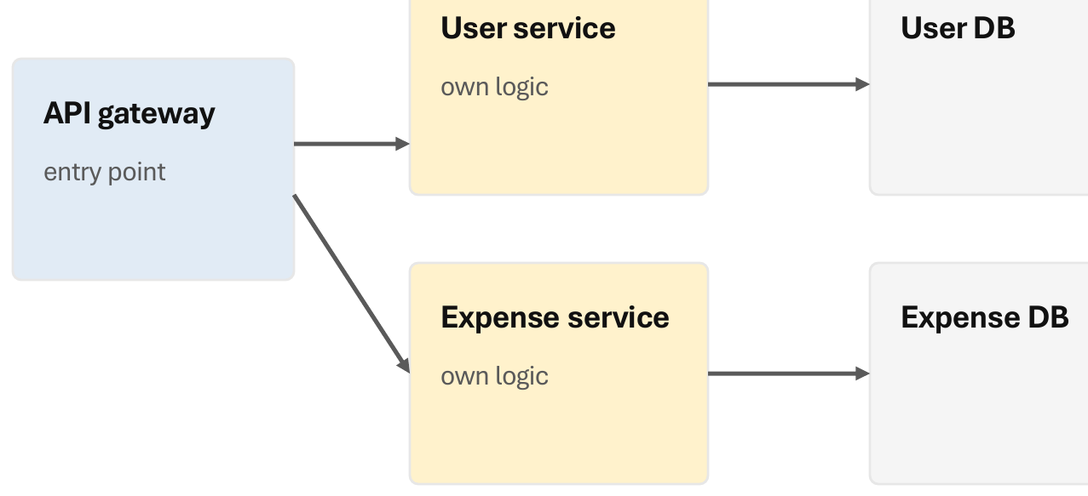
Microservices Architecture
微服务架构：每个服务独立部署、独立数据库
API gateway (entry point) → User service (own logic) → User DB; Expense service (own logic) → Expense DB
网关统一入口；每个服务有自己的"微数据库"，用户服务不访问开销库
Potential benefits: Independent deployment and scaling • Clear service ownership • Fault isolation when designed well
好处：只扩展瓶颈组件（开销服务每秒上千请求就只把它部署到多台）、故障隔离、安全隔离
New complexity: Network failures + latency • Distributed tracing • Data consistency • More CI/CD + operations • Harder cross-service refactoring
代价：网络故障和延迟、分布式追踪、数据一致性、更多运维、跨服务重构更难
Do not choose microservices because they “sound scalable”. Choose them when the benefits justify the operational complexity.
"没有银弹"，延迟敏感的应用不适合；你们 6 人 10 周的项目用单体就好
Independent deployment can help, but distribution has a price. (References: Martin Fowler microservices guide; “Monolith First”)
独立部署有用，但"分布式"是有价格的——Fowler 的建议：先单体

Slide 44
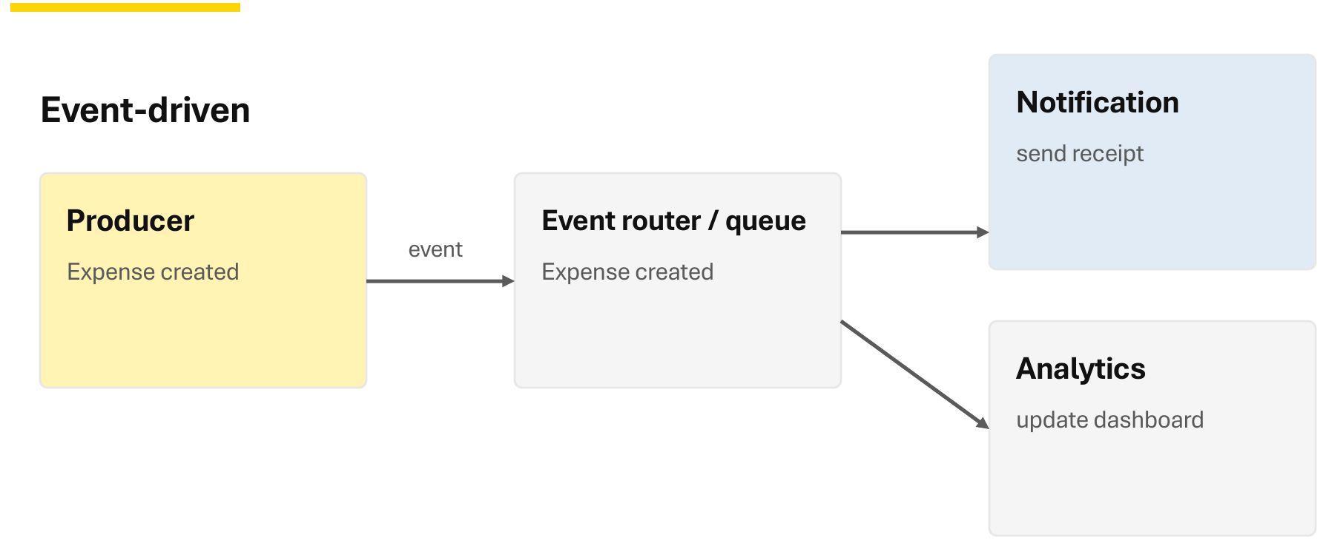
Event-driven and serverless patterns
事件驱动与无服务器模式（原课件附录页，课上未讲，自学即可）
Event-driven: Producer (Expense created) → event → Event router / queue → Notification (send receipt) • Analytics (update dashboard)
生产者发出"开销已创建"事件，队列转发给通知和分析两个消费者
Serverless idea: Run small functions or managed services on demand rather than managing long-running servers. Useful for event-triggered tasks, APIs and variable workloads.
无服务器：按需跑小函数，不用自己养服务器；适合事件触发的任务和波动大的负载
Useful when work is asynchronous, bursty or naturally triggered by events
适用：异步、突发、天然由事件触发的工作
Trade-off: asynchronous systems can be harder to trace, test and reason about.
代价：异步系统更难追踪、测试和推理
References: AWS event-driven architecture and serverless documentation

Slide 45
Architecture Decisions
架构决策
Making architecture choices and trade-offs——架构选择都是取舍，没有标准答案，关键是说得出"为什么"

Slide 46
Architecture choices involve trade-offs
架构选择的 5 个问题，以及它为什么重要（Question → Why it matters）
What is changing? → Separate likely points of variation
什么会变？→ 把可能变的地方分开
How large is the team? → Avoid operational overhead the team cannot support
团队多大？→ 别选团队撑不起的运维复杂度（你们 6 个人）
What must scale? → Scale the relevant component or workload
什么需要扩展？→ 只扩展相关的部分
How will we deploy? → Keep the architecture compatible with CI/CD
怎么部署？→ 架构要和 CI/CD 配得上（第 4、6 周）
How will we test failures? → Prefer boundaries the team can observe and verify
怎么测失败？→ 选团队能观察、能验证的边界

Slide 47
Architecture also supports non-functional properties
架构还要支撑非功能属性
Performance — Where might time or resources be spent?
性能：时间和资源可能花在哪——全放一台服务器最快，但安全就差（取舍）
Scalability — What grows: users, requests, data or integrations?
可扩展性：100 个用户 600 ms，到 1,000 / 10,000 个用户还成立吗
Reliability — What happens when a dependency fails?
可靠性：依赖挂了会怎样——要有 failover，自动切到另一台，用户无感
Security — Who can perform this action? How is data protected?
安全：谁能做这个操作、数据怎么保护
Others — Based on the application domain and stakeholders’ needs
其他：看应用领域和干系人的需求

Slide 48
Design for non-functional properties
面向非功能属性的设计：设计问题 → 典型应对（原课件附录页）
Security — Where are trust boundaries? Who can access what?
信任边界在哪、谁能访问什么
Server-side authorisation, least privilege, secure defaults
服务器端授权、最小权限、默认安全
Scalability — What may grow independently?
什么会独立增长
Stateless APIs, caching, queues, selective decomposition
无状态 API、缓存、队列、有选择地拆分
Performance — Where is time spent?
时间花在哪
Fewer network calls, efficient queries, caching
少网络调用、高效查询、缓存
Reliability — What happens when dependencies fail?
依赖挂了怎么办
Timeouts, retries, graceful failure, observability
超时、重试、优雅降级、可观测
Maintainability — How local is a change?
一次改动影响范围多大
Clear modules, low coupling, automated tests
清晰模块、低耦合、自动化测试
Deployability — Can changes move safely?
改动能安全上线吗
Small increments, configuration, CI/CD-friendly boundaries
小增量、配置化、对 CI/CD 友好的边界
Architecture is where many quality trade-offs become visible
架构就是这些质量取舍变得看得见的地方

Slide 49
What “good design” buys an Agile team
好设计给敏捷团队带来的 6 种质量属性——不是最后再加的装饰
Maintainability — Change code without widespread rework.
可维护：改代码不用大面积返工
Understandability — A teammate can locate and reason about the right place to change.
可理解：队友能找到该改哪
Testability — Behaviour can be verified automatically and in isolation.
可测试：行为能自动、独立地验证
Modularity — Work can be divided into meaningful units with clear ownership.
模块化：工作能拆成有明确负责人的单元（分 Issue 也方便）
Extensibility — New behaviour can be added without rewriting unrelated code.
可扩展：加功能不用重写无关代码
Deployability — Changes can move through CI/CD with predictable impact.
可部署：改动能顺着 CI/CD 走，影响可预测
Quality attributes are not decorations added at the end
These qualities reinforce each other: Clear modules are easier to understand, test, refactor and deploy.
这些质量互相加强：模块清楚了，就更容易理解、测试、重构、部署

Slide 50
How do we choose an architecture?
怎么选架构？看约束和证据，不看潮流（原课件附录页）
Product — What are the highest-value user journeys?
产品：最有价值的用户路径是什么
Change — Which parts may evolve independently?
变化：哪些部分会独立演进
Operations — How much deployment and monitoring complexity can we support?
运维：我们撑得起多复杂的部署和监控
Team — What can this team understand, test and operate?
团队：这个团队能理解、测试、运维什么
Quality — Which non-functional properties matter now?
质量：现在哪些非功能属性最重要
Evidence — What have we learned from previous increments?
证据：前几个增量教会了我们什么
Use constraints and evidence, not fashion
For a small Agile web project, start with the simplest architecture that preserves clear boundaries.
小型敏捷 Web 项目：从"最简单但边界清楚"的架构开始——这就是对你们项目的建议

Slide 51
Design in Scrum
Scrum 里的设计
Design decisions are part of the sprint——设计决策是 Sprint 的一部分，不是 Sprint 之前单独的"设计阶段"

Slide 52
A vertical slice connects design to delivery
垂直切片：把设计和交付连起来
User story → UI interaction → API endpoint → Business rule → Data access → Automated test → CI check
一个故事 = 界面交互 + API 端点 + 业务规则 + 数据访问 + 自动化测试 + CI 检查，一条线全打通
Each sprint can deliver a small end-to-end capability instead of a disconnected technical layer.
每个 Sprint 交付一个小而完整的端到端功能，而不是"这周只做数据库"

Slide 53
Sprint Design and Development – Class Activity
课堂活动：按组件做还是按垂直切片做？
Vertical slices: design for incremental delivery
Component design and development
按组件分 Sprint（Avoid component-only planning）
Sprint 1 — database components (database only)
第 1 轮只做数据库
Sprint 2 — Back-end design and development (back end only)
第 2 轮只做后端
Sprint 3 — Front-end design and development (front end only)
第 3 轮只做前端——前两轮什么都演示不了
Vertical Slice Design and Development
按垂直切片分 Sprint（Prefer vertical increments）
Story A — UI → API → rule → DB → test → CI
每轮做完整的一个故事
Story B — UI → API → rule → DB → test → CI
每轮都能演示、都能测——一个故事 = 穿过整个架构的一条细细的、能跑的路径
Story C — UI → API → rule → DB → test → CI
这就是你们 Sprint 1 Demo 应该有的样子
As Agile Teams, which design and development approach would you follow? Why? Why? Every Sprint produces integrated, testable behaviour and exposes architecture problems early.
A story should become a thin, working path through the architecture.
选右边（课堂一致）；左边就是 capstone 常见的"后端组 / 前端组最后再集成"= 大爆炸集成（big bang integration），要避免

Slide 54
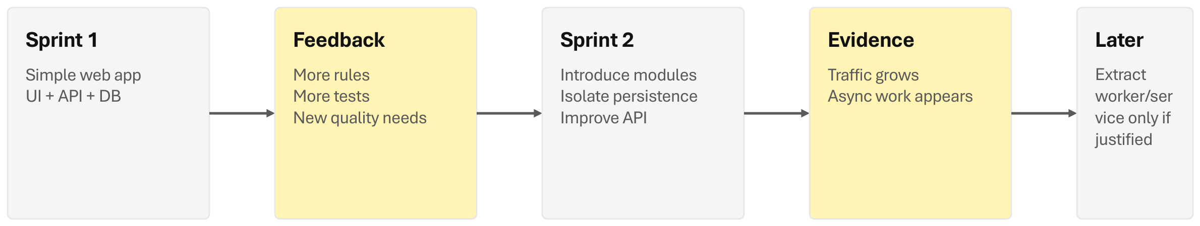
Emergent architecture in Scrum
Scrum 里的涌现式架构：Emergent ≠ accidental（涌现 ≠ 随意）
Sprint 1 (Simple web app: UI + API + DB) → Feedback (More rules, more tests, new quality needs) → Sprint 2 (Introduce modules, isolate persistence, improve API) → Evidence (Traffic grows, async work appears) → Later (Extract worker/service only if justified)
第 1 轮做最简单的 UI + API + DB → 收到反馈 → 第 2 轮拆模块、隔离存储、改进 API → 有了证据 → 以后才考虑拆出 worker / 服务
Architecture still needs intentional decisions, tests, refactoring and team communication. The difference is that decisions are revisited as evidence grows.
架构仍然需要有意识的决策、测试、重构和沟通；区别在于决策会随着证据增加被重新审视
Design enough now, learn from the increment, then improve the structure
现在设计够用就好，从增量里学习，再改善结构；Sprint 结束 ≠ 开发结束
Reference: Agile Manifesto principle 11; Scrum inspection and adaptation
讲师："不要求你们展示设计和架构，但希望这种思维指导你们怎么拆职责、组件放在哪"

Slide 55
Applying the ideas to your COMP9820 project
把这些想法用到你们的 COMP9820 项目里：5 个时间点
1 Before implementation — Agree on a simple system boundary and initial architecture
动手前：全组先定一个简单的系统边界和初始架构（一张 Container 图）
2 During the sprint — Keep design decisions visible in issues, merge requests and documentation
Sprint 中：设计决策写在 Issue、MR 描述和文档里，别只在脑子里
3 Before merging — Check responsibility boundaries, tests and integration
合并前：Code review 时看职责边界、测试和集成
4 During review — Demonstrate working behaviour and collect stakeholder feedback
评审时：演示能跑的功能，收集反馈（就是下周的 Demo）
5 During retrospective — Record design or process improvements for the next sprint
回顾时：记下下个 Sprint 要改进的设计或流程（写进 Team Report 的 Retro 部分）

Slide 56
Key takeaways (1)
本周要点（1）
Architecture should make the next change easier, not merely look sophisticated
架构应该让下一次改动更容易，而不是看起来更高级
Architecture organises the major parts of a system.
架构负责组织系统的大块
Design principles help teams control responsibility and dependencies.
设计原则帮团队管住职责和依赖
Web applications separate front-end, API, back-end and data concerns.
Web 应用把前端、API、后端、数据分开
MVC and layered architecture are useful patterns, not universal rules.
MVC 和分层是好用的模式，不是万能规则
Agile architecture evolves through increments, feedback and refactoring.
敏捷架构靠增量、反馈、重构一步步演进
Good design makes software easier to understand, test, maintain and extend.
好设计让软件更容易理解、测试、维护、扩展

Slide 57
Key takeaways (2)
本周要点（2）：6 句话
1 Agile still needs design — Design happens continuously and evolves with feedback.
敏捷不是不设计，而是持续设计、随反馈演进
2 Start with responsibilities — Separate UI, business rules, persistence and integration concerns.
从职责开始：界面、业务规则、持久化、集成分开
3 Keep boundaries clear — Cohesion, low coupling and encapsulation improve changeability.
边界清楚：内聚、低耦合、封装让改动更容易
4 Patterns are tools — Layered architecture and MVC are useful starting points; modern patterns add trade-offs.
模式是工具：分层和 MVC 是好起点，新模式各有取舍
5 Quality drives architecture — Security, testability, scalability and maintainability shape decisions.
质量驱动架构：安全、可测、可扩展、可维护决定选择
6 Prefer simple evolution — A modular starting point can evolve when evidence justifies more complexity.
简单演进：模块化起点，有证据了再加复杂度
Good architecture supports working software today and safe change tomorrow.
好架构 = 今天软件能跑，明天改动安全

Slide 58
Sprint 1 Assessments
Sprint 1 评估：下周 Demo + 三份报告
占总成绩 30%；今天是 10 月 1 日，Demo 就在下周 Lab（10 月 7–9 日），本周末必须把功能收尾
Demo 的目的是让你们开口沟通自己的工作；互评要给建设性反馈，不是指责弱点；个人报告是反思自己的贡献

Slide 59
Sprint 1: what’s due and when
Sprint 1 交什么、什么时候交
Demo (10%): live in your Week 4 lab (7–9 October); recording due Sunday 11 October, 9 pm
Demo 占 10%：第 4 周 Lab 现场演示（10 月 7–9 日）；录屏 10 月 11 日周日晚 9 点前交
Team Report (15%): Sunday 11 October, 9 pm, one submission per team via Turnitin
团队报告占 15%：10 月 11 日周日晚 9 点，每队交一份，走 Turnitin
Peer Evaluation (1%): opens Wednesday of Week 4, closes Sunday 11 October, 9 pm
互评占 1%：第 4 周周三开放，10 月 11 日晚 9 点关闭
Individual Report (4%): Sunday 18 October, 9 pm
个人报告占 4%：10 月 18 日周日晚 9 点
Sprint 1 is 30% of the course. Full details on the “Project Sprint 1 Guidelines” page in Moodle.
Sprint 1 合计 30%，细则看 Moodle 的 Project Sprint 1 Guidelines 页面

Slide 60
The Demo in next week’s lab
下周 Lab 的 Demo 怎么做
10–12 minutes, then questions from your tutor and the other teams
10–12 分钟，听众是 tutor 和其他组——要想着不同的听众来讲
Every member attends and presents a part; absence without special consideration is 0 for that student
每个人都要到场并讲一部分；有特殊情况要申请 special consideration 才能拿团队分，否则 0 分
Show the Shared Expense Splitter features you built, running live on your own machine
在自己电脑上现场跑你们做好的 Shared Expense Splitter 功能
Show how the sprint was run: backlog, issue board, issues, branches, merge requests
展示 Sprint 是怎么跑的：backlog、看板、Issue、分支、MR——这部分很多组会忘
Record the session and submit the MP4 to Moodle (used for cross-marking and special consideration)
全程录屏，MP4 交到 Moodle（用于交叉评分和特殊情况）
Have the app running and your GitLab tabs open before your slot starts
轮到你们之前就把应用跑起来、GitLab 页面开好——别在台上等启动

Slide 61
Team Report, Peer Evaluation and Individual Report
团队报告、互评、个人报告
Team Report, about 15 pages, five parts:
团队报告约 15 页，5 个部分（括号里是各占多少分）——要让我们看到理解，不是盲目走流程：
Scrum roles, role allocation and meeting minutes (3%)
Scrum 角色分配和会议记录
Sprint planning: user stories, acceptance criteria, points, sprint goal (4%)
计划：用户故事、验收标准、故事点、Sprint 目标
Sprint tracking: issue board, meetings, Git workflow (3%)
跟踪：看板、会议、Git 流程
Velocity: points committed versus completed, and what it tells you (2%)
速度：承诺 vs 完成——没有对错，重点是解释论证（承诺 15 完成 12，说清为什么）
Retrospective: what went well, what did not, things to try in Sprint 2 (3%)
回顾：做得好 / 不好 / Sprint 2 要尝试的
Peer evaluation is 1% for submitting on time (there are no late submissions)
互评按时交就有 1%，迟交只认 special consideration / ELP
Individual report (4%, W5): your own contribution, evidence from issues and merge requests
个人报告在团队报告一周后：写自己的贡献，证据来自你的 Issue 和 MR——平时就要用自己的账号提交

Slide 62
References
参考资料
Agile Manifesto. https://agilemanifesto.org/
Schwaber, K. and Sutherland, J. The Scrum Guide, 2020. https://scrumguides.org/scrum-guide.html
MDN Web Docs. Client-server overview. https://developer.mozilla.org/en-US/docs/Learn_web_development/Extensions/Server-side/First_steps/Client-Server_overview
MDN Web Docs. HTTP. https://developer.mozilla.org/en-US/docs/Web/HTTP
C4 model. Introduction and abstractions. https://c4model.com/introduction and https://c4model.com/abstractions
Pallets Projects. Flask documentation: application lifecycle and project layout. https://flask.palletsprojects.com/en/stable/lifecycle/
Martin Fowler. Microservices. https://martinfowler.com/articles/microservices.html
AWS. Event-driven architecture. https://aws.amazon.com/event-driven-architecture/

Slide 63
Q & A
接下来：第 4 周 —— 软件测试（Sprint 2、3 的重点，也是 CI 的前置）
本周要做：Sprint 1 收尾 → 准备下周 Lab 的 Demo（10–12 分钟、全员出席、录屏）→ 10 月 11 日前交 Team Report + Peer Evaluation → 10 月 18 日交 Individual Report

