Slide 1

BET
Securing your investment with intelligence

Slide 2
Our Understanding
Main Goal
Make an app that helps you understand how to invest in the principal cryptocurrencies that are in the market
What will we do?
Design and apply the best algorithms in order to predict future behaviour of the cryptocurrencies. In one hand, we will choose the best model according to the cryptocurrencie behaviour, as well as an Anamolalies Detection model. On the other, we will develop the best Portfolio depending on the cryptocurrencies that interests the client

Slide 3
Benefits
The client will see his/her investment in real time by the way that recieves the trending topic news about the six most frequent crypto-currencies. As well, she/he is going to recieve warnings in case of anomaly.

Slide 4






Technologies
Python
Flask
Docker
Kubernetes
MongoDB
SQL

Slide 5

Sprint 1
Sprint 2
Sprint 3
Research
Data acquisition
Managing and storing data
Select and create Model
Research
Anomaly detector Model
Login and interface system
Portfolio Wallet
User interface and model connection

Slide 6
Team Structure
Scrum Team
- Scrum Devs
Juan Daniel Vera González
Luis Gerardo Guzmán Rojas
Uzmar de Jesús Gómez Yáñez
- Scrum Baby
Miguel Ángel Ramírez García
Product Owner
Luis Esteban Barranco Guida
Scrum Master
Samantha Urtiz Rivera

Slide 7
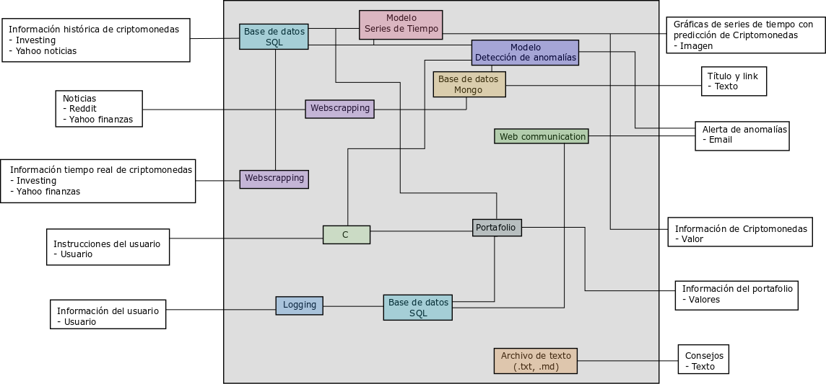
Diagrams

