Slide 1
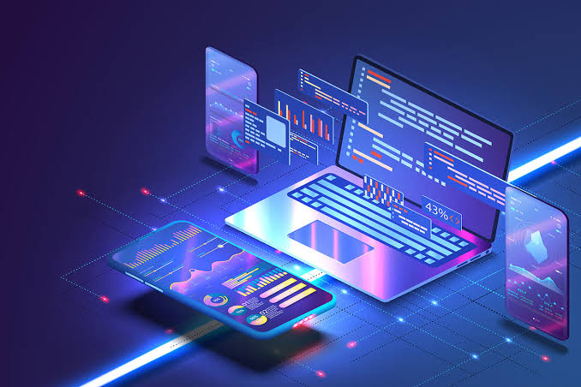
Chapter VI, Impact of Life: The Pros and Cons of Technology

Slide 2
The Benefits of Technological Advancement
The use of technology and science in human life has significantly impacted the realm of business, education, industry, work and almost all areas living. Let us explore the benefits and advantages of technological advancements in the varied aspects of Life

Slide 3

Technology in Business
Technology has created products and services, which allows competitive advantage for enterprises. Saving time and returning investments through mass production of goods and services have become very feasible for most of those who venture on investing resources. The fast delivery services has become an edge for every company that has the resources to mass-produce. Advancement in Technology has created a new economic environment that has also helped small businesses to gain a good position in the highly competitive market.

Slide 4

1.Technology guarantees increased productivity
Technology had a major impact in the modern workplace as it revolutionized the method by which businesses conduct daily activities. The automation of tasks resulted in over-all efficiency in production. Even small and medium-sized businesses (SMBs) are now able to create a workforce that is more efficient and innovative with technologies. Workplace tasks are performed using manufacturing tools that permit control of machinery using computers. This reduces costs for the production of goods as well as the delivery of services using software and devices.

Slide 5
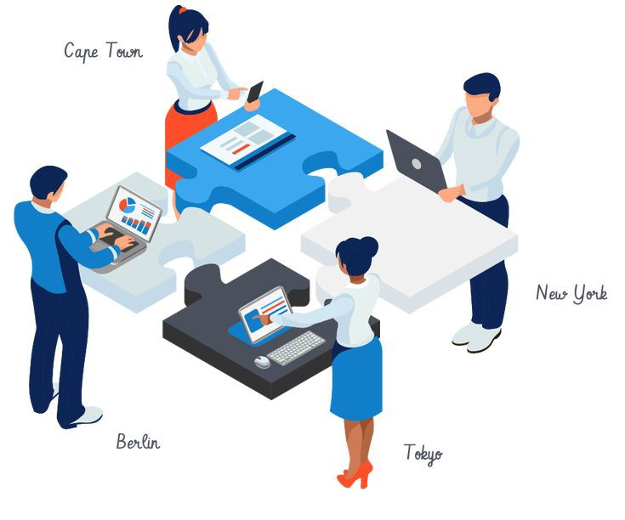
2. Technology facilities greater collaboration among wrokers
Business success requires collaboration among its workforce. Utilizing group messaging and team chats allows greater exchange of ideas among workers. Technology allows the use of greater innovative venues to bring workers together to collaborate and find solutions to problems and even create new products. Open sourced or free cloud-based note taking technologies can be accessed across varied devices in specific geolocation during virtual meetings.

Slide 6
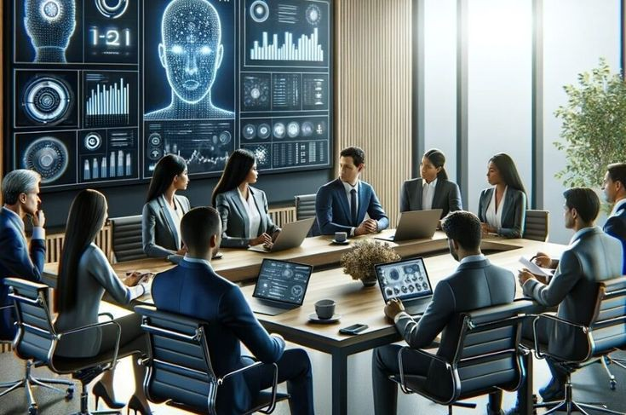
3. Technology simplifies business operation
Technologies enable businesses to manage their inflow and outflow in simplified ways. There are software and programs that are efficient for bookkeeping and auditing purposes. Accounting systems are now automated which are more precise and instant. Business operation and performance are easily monitored across the years as important data are stored in a remote and secured facility which is accessible anywhere.

Slide 7

4. Technology improves business database and file management
Technologies enable more efficient organizing and securing of customer and business files. This can be very essential to keeping company credibility and integrity while enabling easy and authorized access.
Whilst the data are being backed up and recovered, technology provides protection of data for peace of mind among entrepreneurs.

Slide 8
Advantages of Technology in Communication
Communication is essential in all human tasks on a daily basis. The exchange of ideas, securing of information and expression of feelings are facilitated by instantaneous and real-time communication. The fast-paced life that people experience everyday has paved way to the creation of mobile and smart phones.

Slide 9

1. Technology supports productive relationships
Emails and other messaging tools help keep us in touch with significant people demanding immediate performance of tasks. These communication tools facilitate efficient workflow, instant decision making as well as delivery of services. These are productive as technology allows effective communication solutions through open sharing of ideas and greater collaboration.

Slide 10

2. Technology changes the marketing platform
Any consumer who wants to avail products and services is directed onto website URLS (Uniform Resource Locator). This rapid development made innovations in marketing strategies custom-tailored to fit the needs of consumers who are equipped with mobile devices. This only means that people search answers for everyday questions through their computers, laptops, tablets and smartphones.

Slide 11

3. Technology increase global connectivity
The development of a macro-system of interconnected networks through the World Wide Web is a result of greater information resources, which are accessible to almost every netizen around the world. These communication technologies give everyone access to libraries, government sites, banks, schools and almost all institutions everywhere.

Slide 12

Globalization
This is how we refer to the 'World' at this time and this is how information technology has made a single interdependent system. The globalized world began to share homogeneity in the midst differences in language, history, culture, economy amongst all other aspects. A global point of view has been set to create an atmosphere of business and at the same time diplomatic ties. The global village was further connected by existing communication technologies.

Slide 13

Technology in Medicine
The healthcare industry is greatly benefiting from the advances in technology entirely meant for patient care and increasing lifespan.

Slide 14
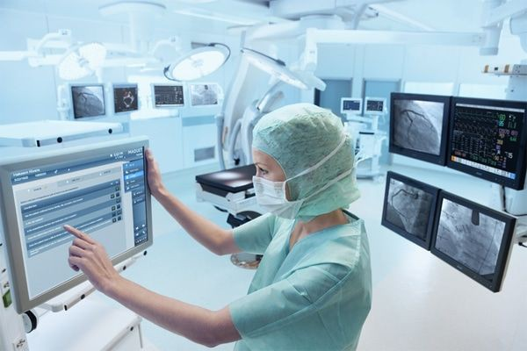
1. Technology keeps efficient patient records
Since most healthcare professionals use hand-held devices to keep real-time patient data also known as Electronic Health Records (EHRs) to replace outdated paper records. These records are used to check, monitor and share patient medical record and history. All of these patient data are secured in a centralized area for use in researches on medical breakthroughs. These valuable data are much needed especially in the fight against diseases like the Covid-19 pandemic of 2020.

Slide 15

2. Technology facilities better ways to fight disease
The continuous increase in population requires improved strategies to develop treatment plans, conduct medical researches, and monitor health epidemics to efficiently meet the increased demands on the healthcare system. These developments introduced the use of surgical robots assisting humans in the operating room. Robotic surgery is largely utilized to aid surgeons in ensuring precision, control and flexibility in performing complex procedures.

Slide 16
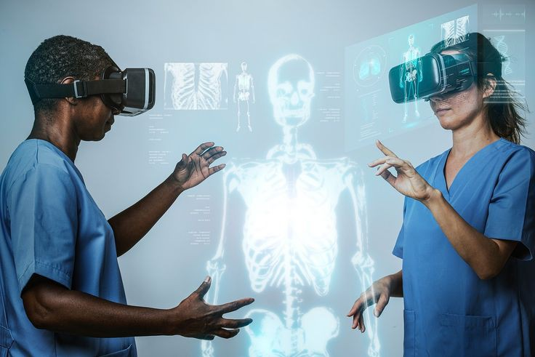
3. Technology for simulation
3D printing is considered very helpful in replicating specific organs, which prepares surgeons in the actual procedure. Surgeons can now work on 3D printed models to simulate different operation approaches before conducting actual surgery. This is also cost-effective to develop prosthetic limbs for orthopaedic patients. The same is also used in dental practice specifically in orthodontics to replicate problematic areas among dental patients.

Slide 17
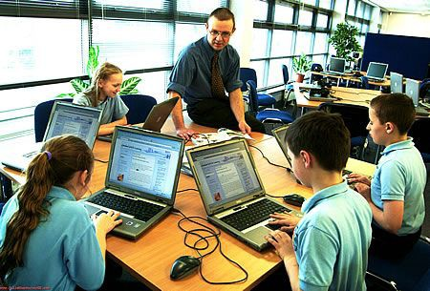
Technology in Education
Technologies used in the school system help enrich the learning environment of students. While it aims to improve academic performance through resources educational technologies also prepares learners to engage in research, design, evaluation and use of concepts in varied subjects and courses.

Slide 18
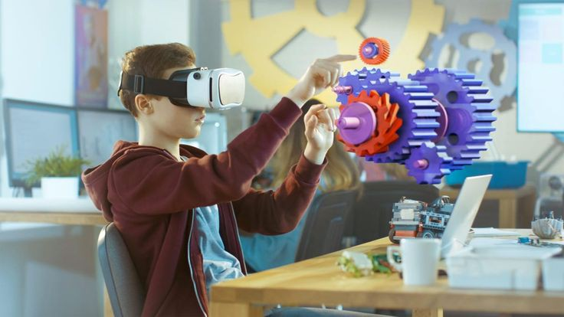
1. Technology motivates greater learning
Technology applied in education encourages and engages through sights and sounds which enhances individual learning through gamification. This promotes engagement as it allows students to work on set of activities and processes to solve given problems.

Slide 19

2. Technology makes teaching and learning paperless
Grading applications are available in mobile devices like those for iPad. These grading programs have completely changed the way teachers evaluate test and examinations in varied subjects. Electronic papers are marked electronically which greatly reduces the use of paper and school resources.

Slide 20

3. Technology facilities online learning
Technology facilitates interactive education through learning applications that students enjoy. It opened institutional boundaries, which permitted employment abroad through education that meets international standards.
Learning can now happen online through Learning Management Systems (LMS) and platforms which promote individual and team learning. Using the Internet, desktops, laptops and mobile devices, students can now access virtual learning environments. Collaboration among students is possible through interactive discussions. Teachers can use digital whiteboard to engage the learners. Learners' interests are enhanced in multitudes of ways through Word applications, blogs, games that can all be part of the teacher's resources to promote meaningful learning experience.

Slide 21

4. Technology supports special education
People with disabilities are provides assistive technology (AT) to accomplish school tasks that are difficult to perform due to their disability. Advancement in technology like iPads, learning Applications (Apps) helps Children with Autism (CWA) to communicate efficiently; deaf students can easily express themselves through mobile text messaging; those with visual impairment read texts through computer-generated voice from their computers.
All of these simplify learning and promote engagements among these types of learners. Through these resources, individuals with disabilities are able to perform functions that promote greater learning while participating in educational activities.

Slide 22
The Consequences of Technological Advancements
Technology has changed the human life and function. Technology has its downsides, as human lives have been technology-infused through time. It has sapped humans of scarce time and attention due to lack of healthy technology habits.

Slide 23
Technology in Business
The integration of technological resources in business comes with a price. It is expensive and high-maintenance. In addition, technology makes business data insecure, as records are stored in a centralized remote database. Hackers lurk everywhere in search for ways to challenge 'firewalls'. This is the case of most businesses, which fall prey to online theft. Breaches in security are highly probable as hackers are evolving along with technology and security systems are out-dated.

Slide 24
Furthermore, worker relationships are crucial to greater workplace productivity but it also has suffered due to disconnection' among employees. Over-dependence on technology extinguished f2f (face-to-face) interaction. In addition, as tasks are becoming more automated it is evident that workers feel that they are less involved in the creation of a final. This lead to the feeling of 'monotony', dissatisfaction and 'burnt out' among workers. All of these result to counter-productive behaviors among the workforce. Recent researches have shown how workers are more prone to frustration, stress, disengagement, fatigue and anxiety as work-life balance has been adversely affected by technology at the workplace.

Slide 25
Technology in Communication
This imbalance is a result of 'superficial communication' among teams using devices that are deficient of tone, emotion and empathy. Younger employees have not only lost their ability to converse spontaneously. Serious social difficulties and a low social well- being arise as these young workers have too little time interacting with co-workers in the same room because of technology-centric work culture.

Slide 26
Technology in Classroom
Although educational technologies have contributed much to the creation of meaningful learning environments, the same have posed significant problems to users. For one, these technologies have created distraction among learners. Smartphones and other mobile devices have enormously distracted students through entertainment and social media platforms.
Considering that everyone can be trained in the use of technology it is a fact that not every learner can afford devices that can facilitate online learning in virtual environments. Not all schools and students can afford to integrate technology in the classrooms. Many parents cannot provide laptops, tablets or iPads to their children.

Slide 27
Technology and Human Health
Prolonged use of computers, tablets, and mobile devices result to digital eye strain. Its symptoms include blurred vision, dry eyes, migraine or headaches, neck and back pain which can persist in varying degrees. Exposure to technological devices can also result to sleep problems in different ways because activities related to the use of mobile devices can highly stimulate brain activity.

Slide 28
Even mental health is adversely affected by technology specifically constant exposure to the social media. This exposure results to the feeling of inadequacy as we begin to compare our lives with the lives of significant others. Online users are highly affected by FOMO or the 'Feeling of Missing Out.' This proves that while social media connects us to the world, it also makes us susceptible to negative emotions. Heavier Internet use as revealed by recent studies triggers greater social isolation, depression, substance use, obesity and aggression.

