Slide 1

EARLY COMPUTING DEVICES

Slide 2
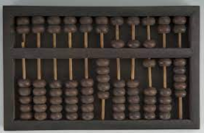
ABACUS
Tim Cranmer
around 2700 to 2300 B.C.E.
Used to perform mathematical functions.
Addition
Subtraction
Multiplication
Division

Slide 3
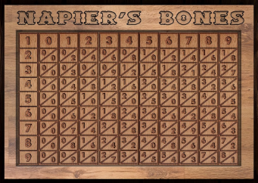
NAPIER’S BONE
John Napier
Napier published his version in 1617.
calculation of products and quotients of numbers.

Slide 4
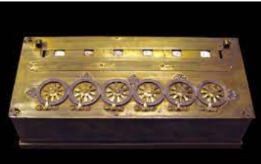
PASCALINE
Blaise Pascal
Between 1642 and 1644.
Addition and Subtraction

Slide 5
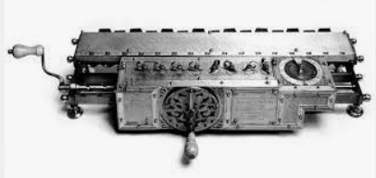
STEPPED RECKONER / LAIBRIZ WHEEL
Gottfried Wilhelm Leibniz
mid-1970s
calculating the engine of a class of mechanical calculators.

Slide 6
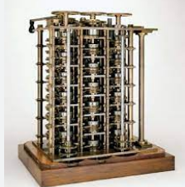
DIFFERENCE ENGINE
Charles Babbage
Year 1821
prepares numerical tables using a mathematical technique known as the method of difference.

Slide 7
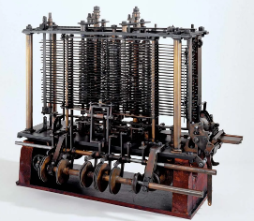
ANALYTICAL ENGINE
Charles Babbage
Year 1837
general-purpose, fully program-controlled, automatic mechanical digital computer.

Slide 8
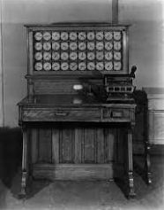
TABULATING MACHINE
Herman Hollerith
Year 1890
assist in summarizing information stored on punched cards.

Slide 9
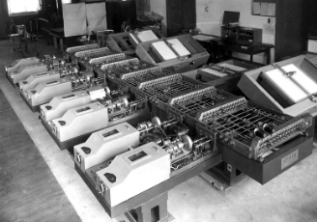
DIFFERENTIAL ANALYZER
Vannevar Bush
Year 1931
solves differential equations by simulating them on physical components.

Slide 10
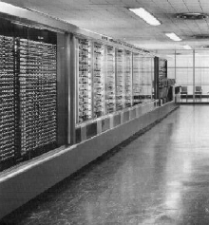
MARK I
Howard Aiken
August 7, 1944
Calculating massive mathematical tables.

