Slide 1


HTML Lists, Images, and Links

Slide 2
This lesson introduces students to three important HTML elements used in almost every website:
Quarter
Date
Lists
Images
Hyperlinks (Links)

Slide 3
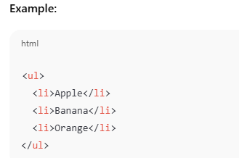
HTML Lists
Quarter
Date
HTML provides three types of lists:
A. Unordered List (Bulleted List)
This will show:
Apple
Banana
Orange

Slide 4
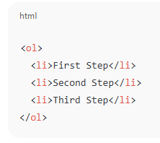
Ordered List (Numbered List)
Uses the <ol> tag (ordered list).
Example:
This will show:
First Step
Second Step
Third Step

Slide 5

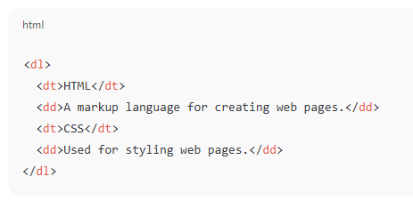
Description List (Definition List)
Used for terms and definitions.
Example:

Slide 6

HTML Images
mages are inserted using the <img> tag. It requires two important attributes:
src → location of the image
alt → text shown if the image fails to load
Attributes like width and height can resize the image.

Slide 7
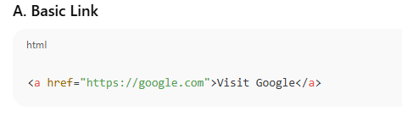
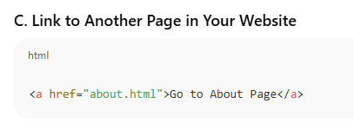
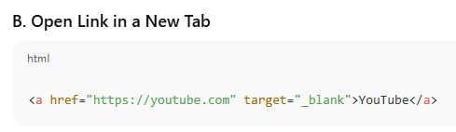
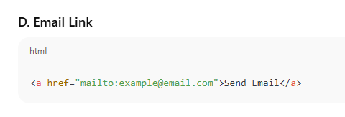
HTML Hyperlinks (Links)
Links use the <a> tag (anchor).

Slide 8
Summary of Lesson 3
Topic | Tags | Purpose
Lists | <ul>, <ol>, <li>, <dl>, <dt>, <dd> | Organizing content
Images | <img> | Display pictures
Links | <a> | Navigation and connectivity

Slide 9
HTML TABLES
Tables in HTML are used to display data in rows and columns.
They help organize information (like schedules, prices, grades, etc.)

Slide 10
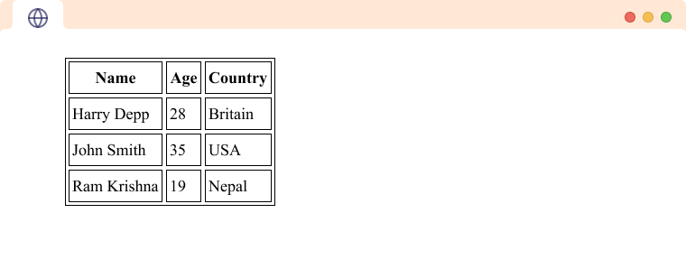
TABLES

Slide 11
Example in real life:
Class schedules
Price lists
Attendance sheets
Leaderboards

Slide 12
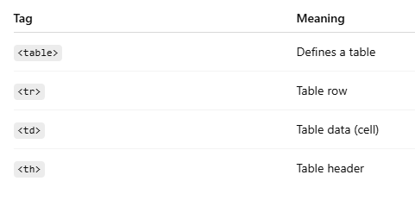
Basic Table Structure Essential Tags

Slide 13
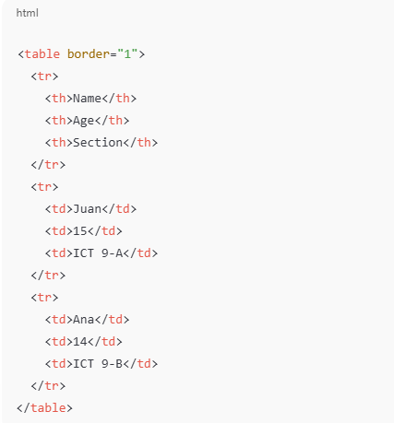
Basic Example

Slide 14
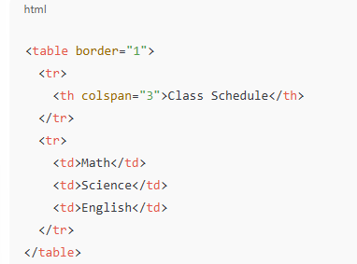
Table With colspan

Slide 15
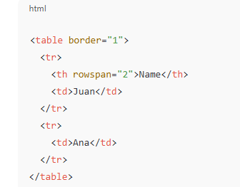
Table With rowspan

Slide 16
What is CSS?

Slide 17
What is CSS?
CSS is the language used to style and layout web pages—controlling colors, fonts, spacing, positioning, animations, and more.

Slide 18
CSS controls
It controls:
Colors
Fonts
Layout
Spacing
Animations
Responsive design

Slide 19
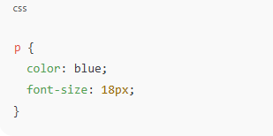
CSS Example

Slide 20
How CSS Is Applied
Inline — inside an HTML tag
Internal — inside <style> in HTML
External — linked .css file (best practice)

Slide 21
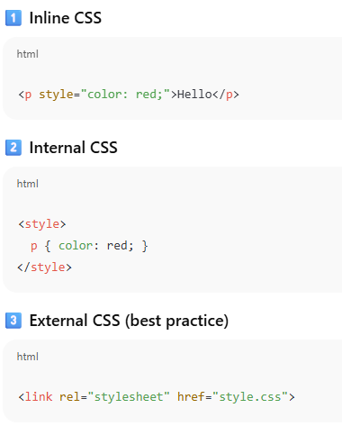
Ways to Use CSS

Slide 22
CSS Selectors
CSS selectors are patterns used in CSS to select and target specific HTML elements on a webpage, allowing for the application of styles to those elements. They are fundamental to styling web content and can be categorized into several types:

Slide 23

Common types:
Element selector

Slide 24

Class selector

Slide 25

ID selector

Slide 26

Universal selector

Slide 27
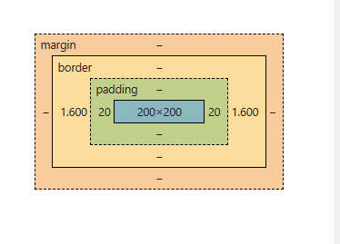
The Box Model
Properties:
margin, border, padding, width, height

Slide 28
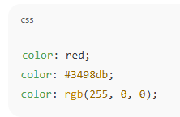
Colors & Units

Slide 29
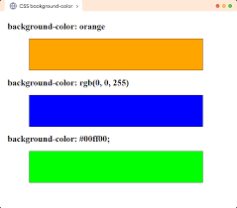
COLORS

Slide 30
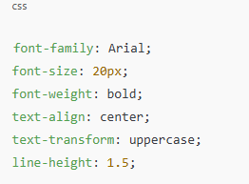
Fonts & Text Styling

Slide 31
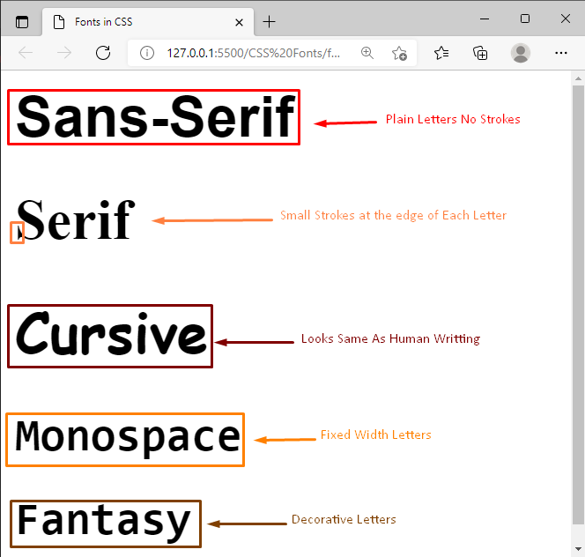
CSS FONTS

Slide 32
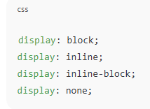
Display Property
Controls how an element behaves.

Slide 33
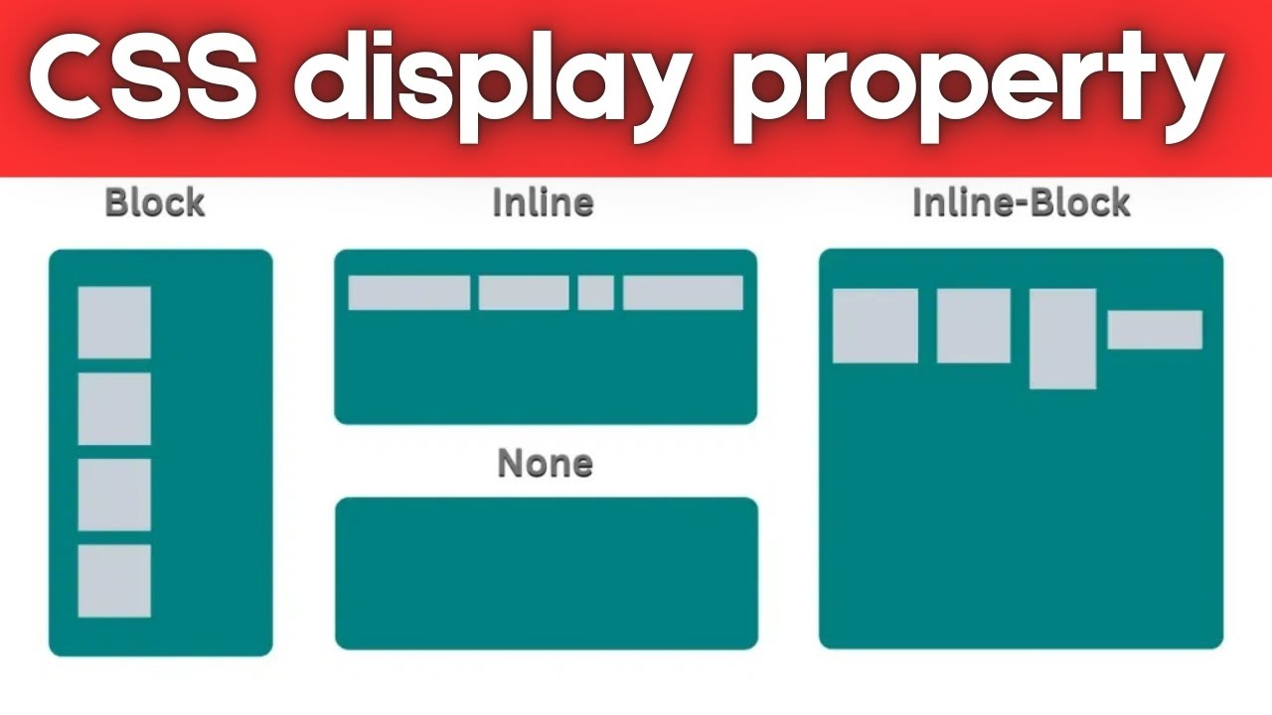
DISPLAY PROPERTY

Slide 34
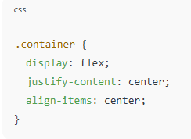
Flexbox Basics
Useful for aligning and distributing items

Slide 35
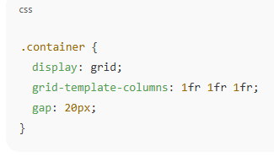
CSS Grid Basics
2D layout system.

Slide 36
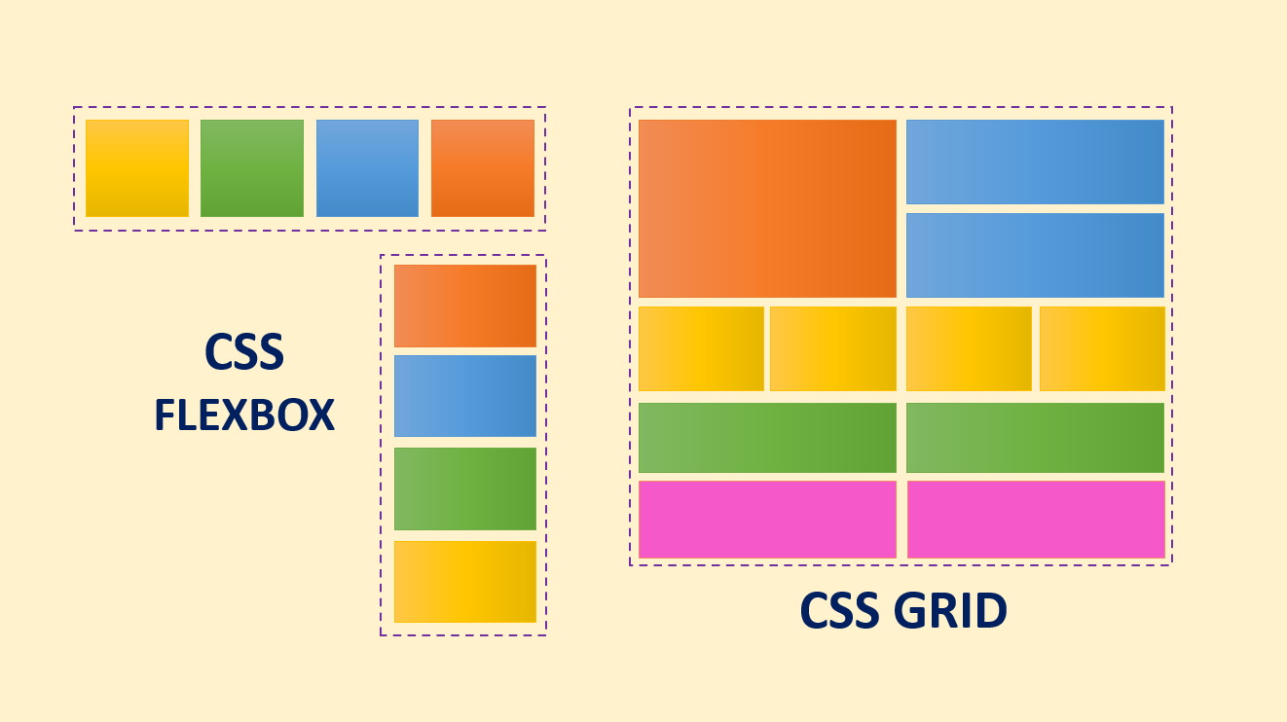

Slide 37
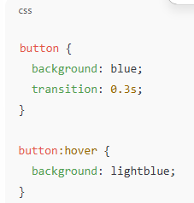
Transitions & Animations

Slide 38
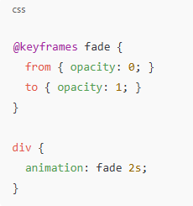
Animation example:

Slide 39
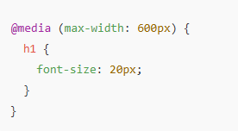
Responsive Design (Media Queries)

Slide 40
HTML CSS QUIZ

Slide 41
QUIZ QUESTION
Instructions:
Create an HTML and CSS webpage that demonstrates the following requirements.
Use only ONE of the following CSS selector types:
You will be given a Google Form link
where you must upload:
✔ A screenshot of your HTML output
✔ A screenshot of your CSS output
✔ Your HTML file (.html)
✔ Your CSS file (.css)

Slide 42
A.HTML
Use HTML
links,
Images,
List
tables

Slide 43
B. CSS Selector (choose ONE only):
Class Selector (.classname)
ID Selector (#idname)
Universal Selector (*)

Slide 44
C. Your web page must include:
Colors (text or background)
Font and Text Styling (font-size, font-family, text-align, etc.)
Flexbox layout
CSS Grid layout
One Transition
One Animation

Slide 45
D. Submission Requirements:
Submit your work before 5 PM today.
At the top of your HTML file, include an HTML comment with your Name and Section. Example:

