Slide 1
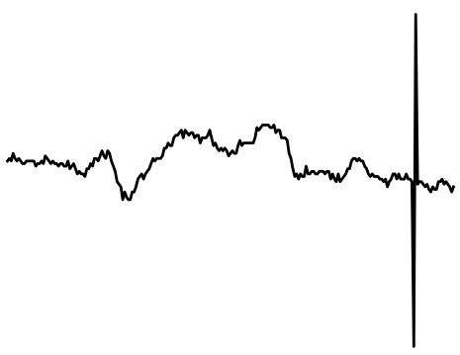
3 min NN Interval segment

Slide 2
HRV Time Domain Indices:
AVNN, SDNN
RMSSD, SDSD, HRV△, TINN
3 min NN Interval segment

Slide 3
Heart Rate (SCL)
Coupling Interval (CI)
Compensatory Pause (CP)
HRV Time Domain Indices:
AVNN, SDNN
RMSSD, SDSD, HRV△, TINN
3 min NN Interval segment

Slide 4

Heart Rate (SCL)
Coupling Interval (CI)
Compensatory Pause (CP)
HRV Time Domain Indices:
AVNN, SDNN
RMSSD, SDSD, HRV△, TINN
3 min NN Interval segment
Age (A)
Sex (S)

Slide 5
Heart Rate (SCL)
Coupling Interval (CI)
Compensatory Pause (CP)
HRV Time Domain Indices:
AVNN, SDNN
RMSSD, SDSD, HRV△, TINN
Turbulence Slope
3 min NN Interval segment
Age (A)
Sex (S)

Slide 6
ANS status

Slide 7
ANS status
Local condition

Slide 8
Local condition

