Slide 1




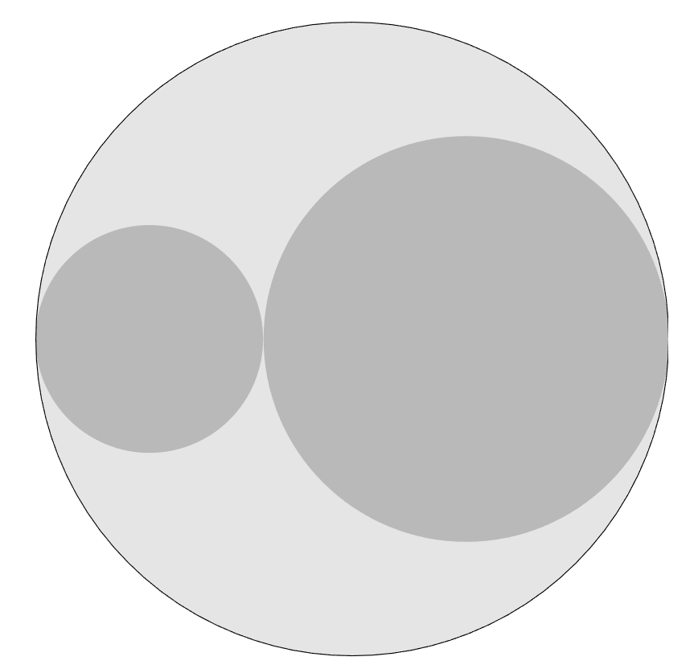

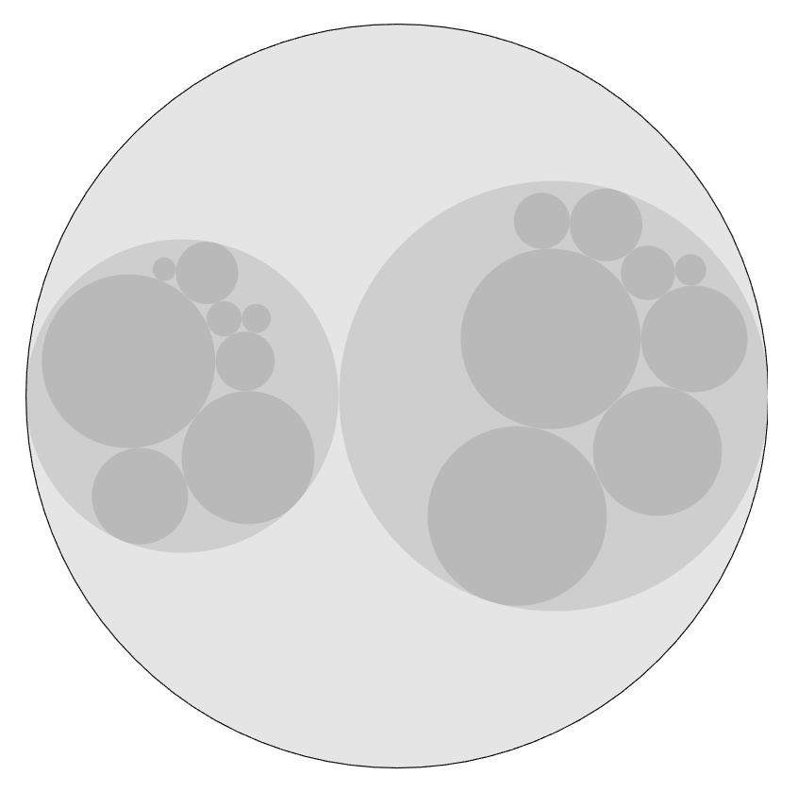
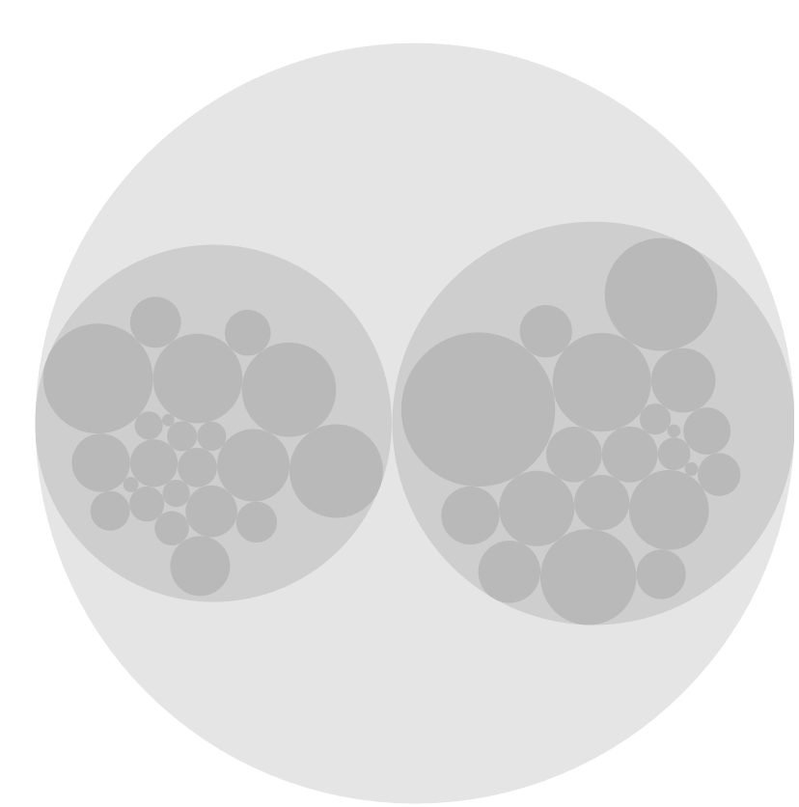


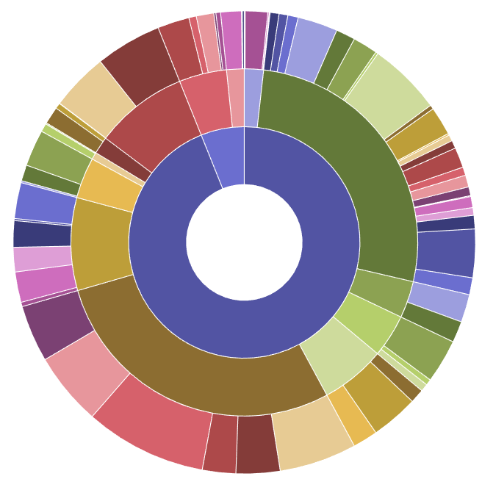











Legend :
W
M
Transport Accidents
Suicides
HIV
Liver
Cancers
Lung
Cancers
Breast
Cancers
Other
External
Causes
Liver
Disease
Digestive
System
Asthma
Tumours
System of Death in France
Breathing
System
Endocrine
system
Mental
Disorders
Circulatory
System
Nervous
System
Dementia
Use of
Alcohol
Stroke
Alzheimer
Heart attack
EPISODE IV
“A long time ago in a galaxy far far away called D3.js
A valiant DataScientist team went to explore the system of “Death in France”.
One question remained to be answered:
In this system, are men and women equal ?”

