Slide 1


TER Project
Juliette Sabatier
Raphael Pietrzak
Dylann Batisse
Margaux Schmied

Slide 2
Game elements
Board:
Years
Seasons
Cards
Energies
Players
Dice
Actions

Slide 3
Player’s choices
ChooseBonus
ChooseCardBetweenMultipleToGet
ChooseCardComeBackInHand
ChooseCardForInitHand
ChooseCardNariaLaProphetesse
ChooseCardToDelete
ChooseCardToSummon
ChooseCardToSummonForFree
ChooseUseDeDeLaMalice
ChooseCardToActivate
ChoosePlayerEnergyToCopy
ChooseDice
ChooseEnergyToCrystallize
ChooseEnergyToGet
ChooseEnergyToReduce
ChooseEnergyToThrow
ChooseNbDeplacementSeason
ChooseEnergyToReduce
ChooseNbDeplacementSeason
ChooseStayInTheSeason
ChooseGoToTheNextSeason
ChooseGoToThePreviousSeason
ChoosePlayerAction
ChooseSimilarEnergyToDelete
ChooseToKeepDrawnCard
ChooseToUseBonusCard
ChooseEnergyToThrow

Slide 4
Basic strategies
Choose First
Random
Pref Crystallize
Pref Card Point
Pref Invocation
Combos
Malus
Time Random
Time First
Time Crystallize
Time Invocation
Activate
Pref Permanent

Slide 5
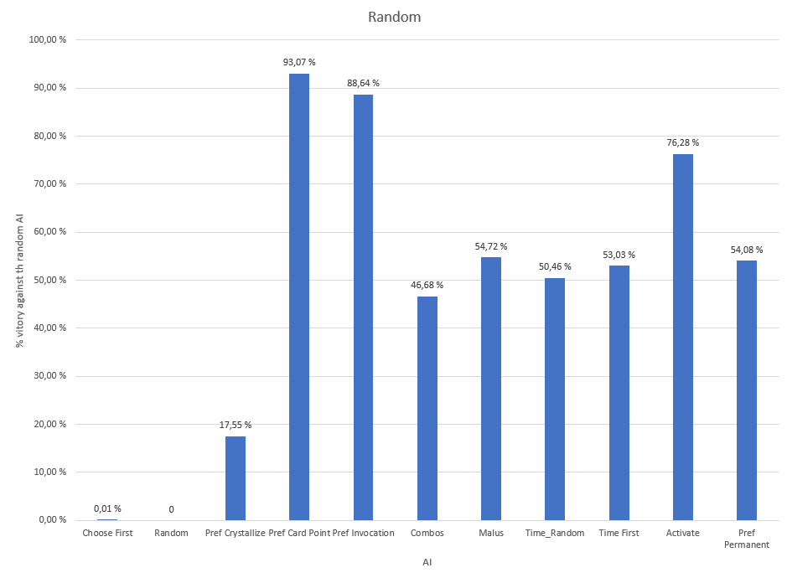
Basic strategies performances
10 000 Games – 1 vs 1

Slide 6
Compose strategies
Context
Strategy1(Strategy2())
Strategy1 (context1, Strategy2())

Slide 7
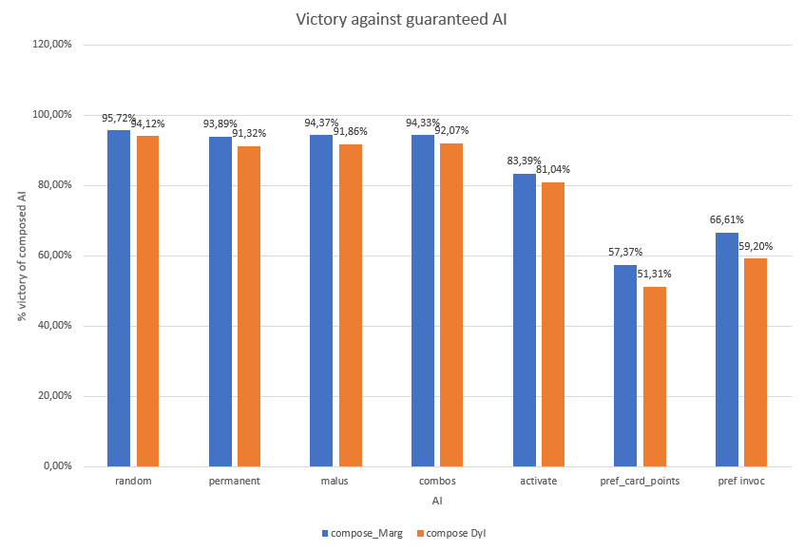
Compose strategies performances

Slide 8
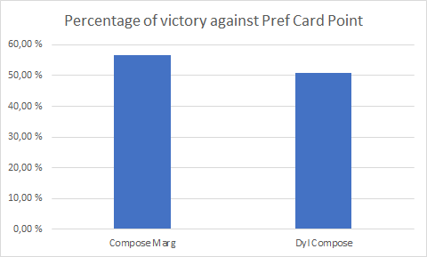
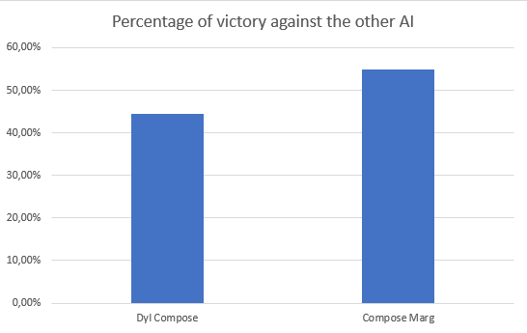
Compose strategies performances
56.55% - 50.84
44.15% vs 55.24

Slide 9
Ambitious AI Upgraded Guarantee
An AI that can adapt to the situation
Analyzes the game
Analyzes the strongest player
Tries to play against it
Limited by how it currently works
Copies the opponent's strategy
Can be improved in many ways
The analysis
New level of composition

Slide 10
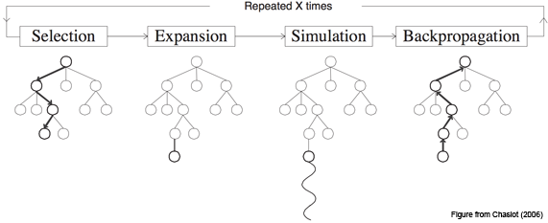
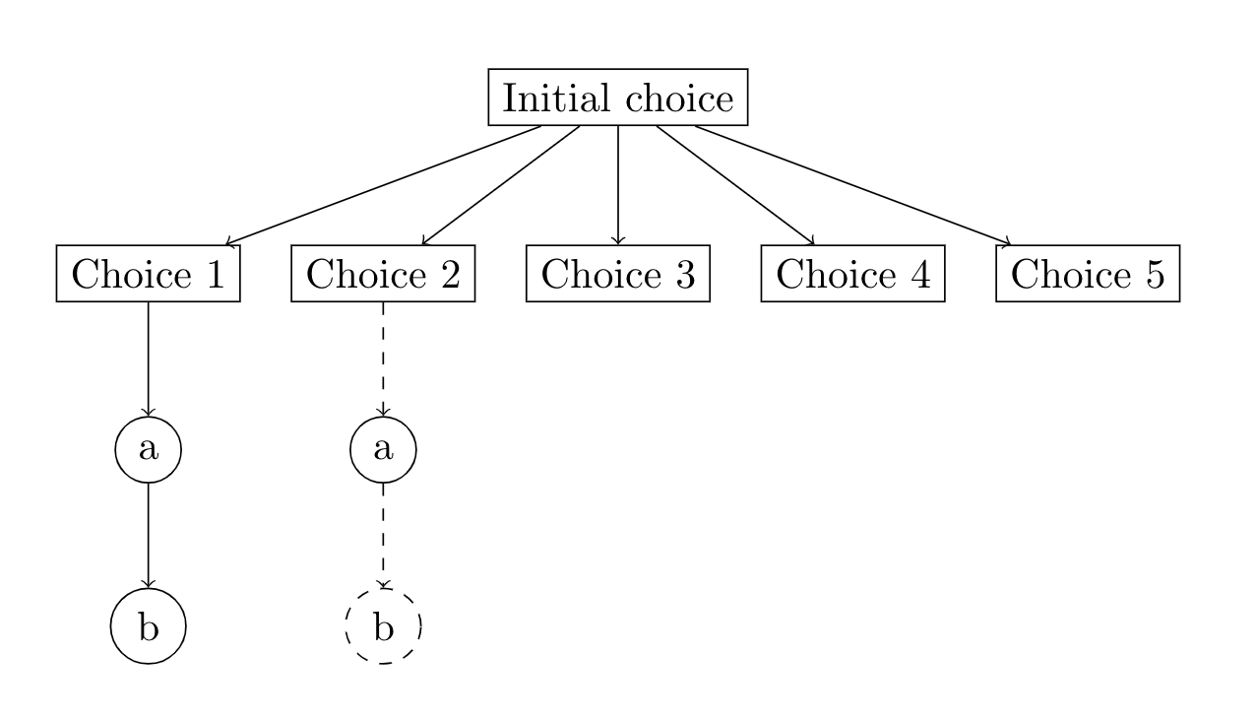
Ambitious AI Monte Carlo
Hand initialization
Choosing a die
Generating the player’s actions

Slide 11
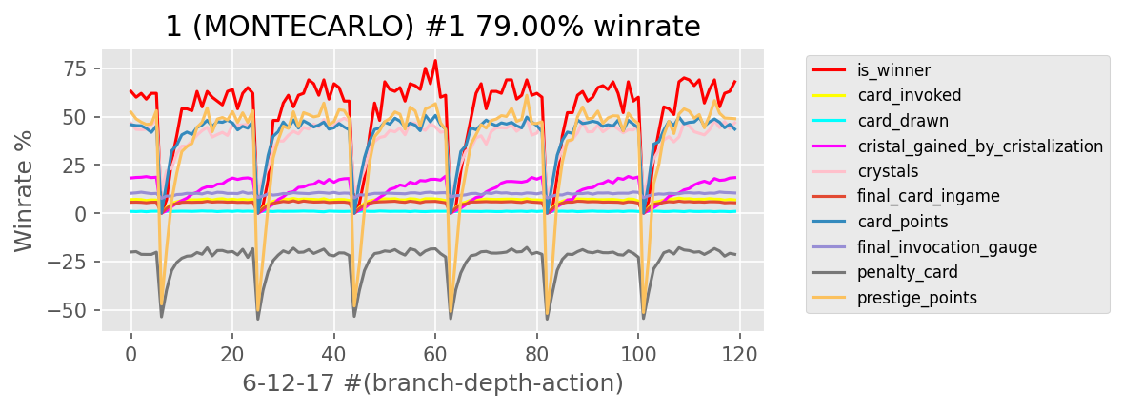
Monte Carlo Random Performances
In total 500 000 games
100 games for each parametres
Against Random

Slide 12
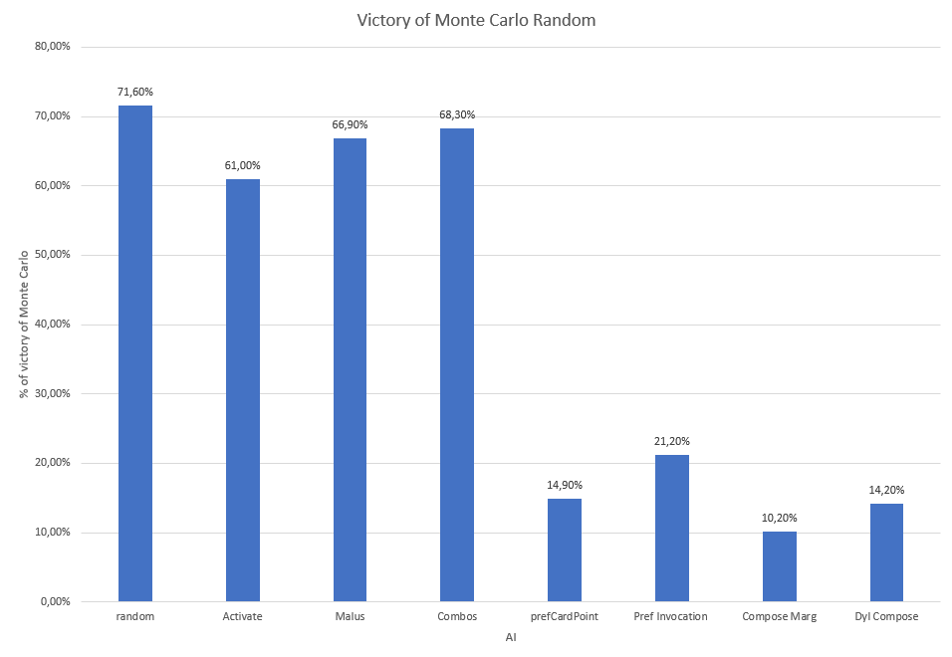
Monte Carlo Random Performances
1000 games

Slide 13
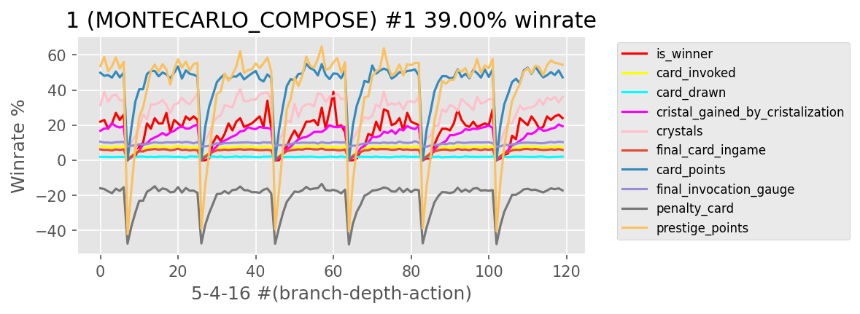
Monte Carlo Compose Performances
In total 500 000 games
100 games for each parametres
Against Pref Card Point

Slide 14
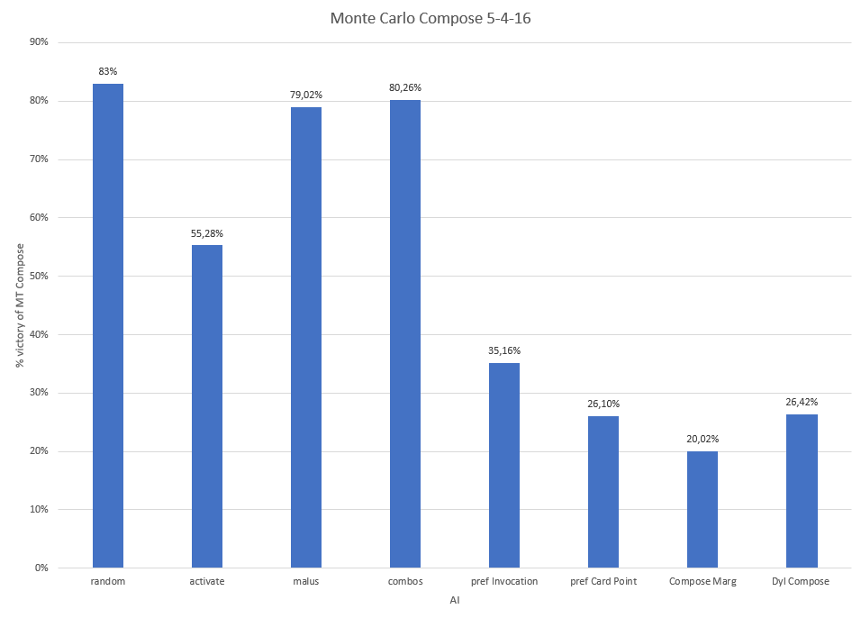
Monte Carlo Compose Performances
1000 games

Slide 15
Distribution of tasks
Juliette | Margaux | Dylann | Raphael
Composition | Monte Carlo | Monte Carlo | Adaptive
Pref Crystallize | Clone | Clone | Malus
 | Time | Combos | Pref Permanent
 | Pref Invocation | Activate
 | Compose Marg | Pref Card Point
 |  | Compose Dyl

Slide 16
Summary

Slide 17


