Slide 1
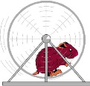
W rld R dent Raspi’ing
W rld R dent Racing

