Slide 1
Car prices estimate
Margherita Maraschini

Slide 2
Objective
Build a model to predict a price range of cars given the cars features provided in the input dataset

Slide 3
Agenda
Choice of the metric
Exploratory data analysis
Data cleaning and manipulation
Algorithm choice and tuning
Data splitting
1
2
3
4
5
Error analysis
Learning curves
Feature importance
Test results
Conclusions
6
7
8
9
10

Slide 4
Choice of the metric
Which error is worse than the other?

Slide 5
Choice of the metric
How to decide if an estimate is better than another?
Which type of error needs to be minimized?
It must be defined before any machine learning
It is a business choice: the choice of the metric

Slide 6
Choice of the metric
The relative error is more important than the absolute error
Chosen metric: absolute percentage error

Slide 7
Exploratory data analysis
Let’s get inspired!

Slide 8
Exploratory data analysis
# Column Non-Null Count Dtype
0 Make 11914 non-null object
1 Model 11914 non-null object
2 Year 11914 non-null int64
3 Engine Fuel Type 11911 non-null object
4 Engine HP 11845 non-null float64
5 Engine Cylinders 11884 non-null float64
6 Transmission Type 11914 non-null object
7 Driven_Wheels 11914 non-null object
8 Number of Doors 11908 non-null float64
9 Market Category 8172 non-null object
10 Vehicle Size 11914 non-null object
11 Vehicle Style 11914 non-null object
12 highway MPG 11914 non-null int64
13 city mpg 11914 non-null int64
14 Popularity 11914 non-null int64
15 MSRP 11914 non-null int64

Slide 9
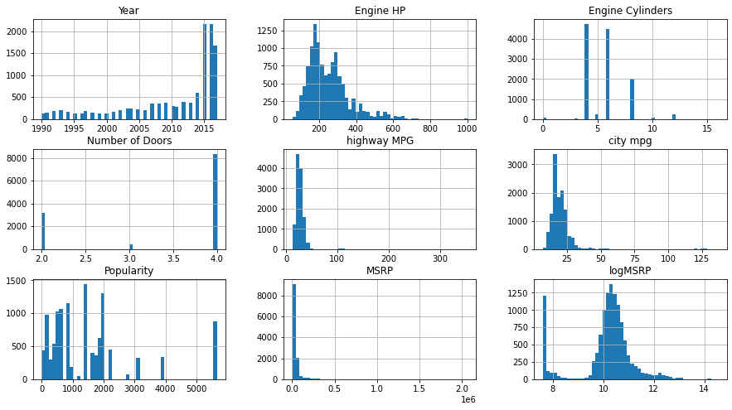
Exploratory data analysis

Slide 10
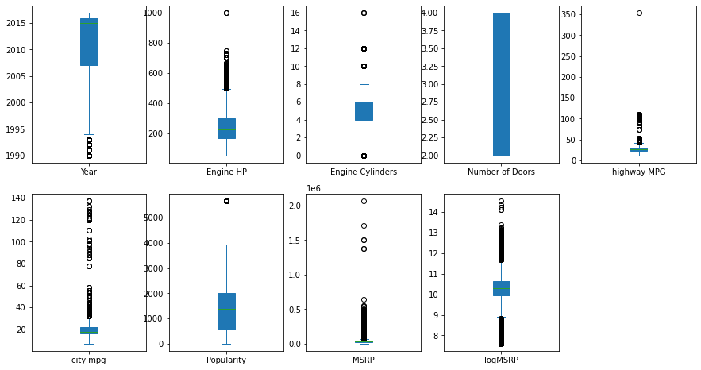
Exploratory data analysis

Slide 11
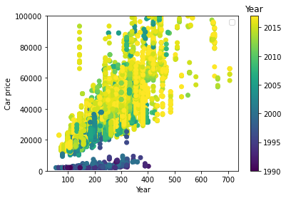
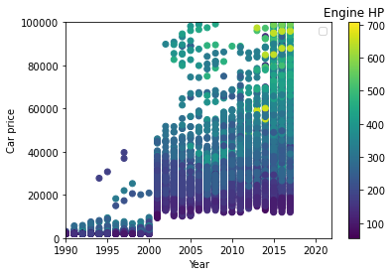
Exploratory data analysis

Slide 12
Data cleaning and manipulation
Let’s tidy up!

Slide 13
Data cleaning:
Change the number of doors from 3 to 2
Remove the typing error in highway MPG

Slide 14
Data cleaning – fill missing values:
Engine Fuel Type: only 3 are missing, filled with the average value of the same make and model, which is constant
Missing values for electric cars are filled with the average over electric cars only
Flex fuel with gas filled with the average value of the same Make / Model / Year
Engine HP, Engine Cylinders, highway MPG, city mpg, Number of Doors filled with the average value of the same Make / Model / Year / Engine Fuel (when possible)

Slide 15
Data manipulation:
Added target feature Log(MRPS)
One hot encoding for categorical variables

Slide 16
Data splitting
Independence is key

Slide 17
Data splitting:
Train Dataset 60%
Validation Dataset 20%
Test Dataset 20%
The splitting is performed randomly make by make

Slide 18
Choice of the algorithm and tuning
Which algorithm performs best?

Slide 19
Choice of the algorithm
Random Forest algorithm has been chosen for its simplicity and interpretability.
With more time I would test Neural Networks and Support vector machine algorithms

Slide 20
Tuning
Tested 2 loss functions (Absolute and RMSE): Similar results, computational cost is much lower for RMSE
Tested 2 target variables (MRPS and log(RMPS) ) The log target presents slightly better results
Tested 3 options of features: all (best result), all but make and model (slightly worse but much quicker), the 3 most important according to feature importance (poor results)
Tested several tree depths. 20 seems fine for all features.

Slide 21
Compare models
Algorithm | Validation Error | Computational cost (s)
RF – log target – Squared Error | 0.0716 | 9.1
RF – log target – Absolute Error | 0.0724 | 335
RF – price target – Squared Error | 0.0720 | 9.9
RF – log target – Squared Error 3 Features only | 0.095 | 1.3
RF – log target – Squared Error No Make and Model | 0.074 | 1.6

Slide 22
Learning curves
Is the algorithm working as it is supposed to?

Slide 23
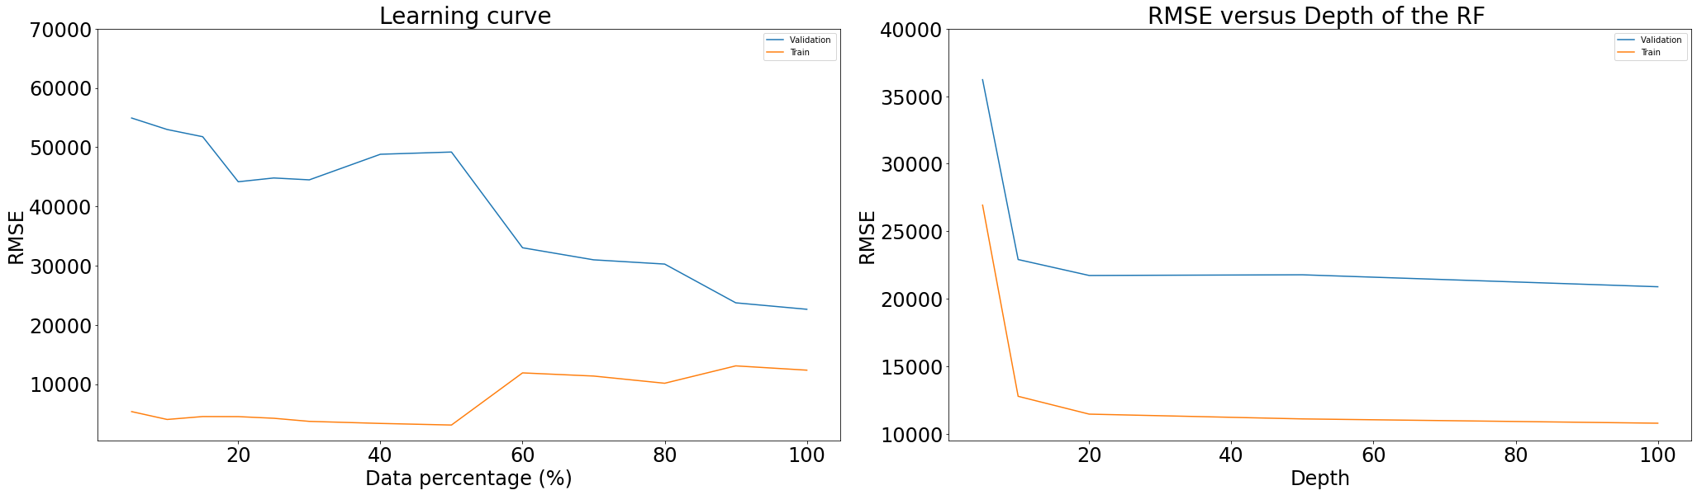
Learning curves

Slide 24
Error analysis
Where did we perform badly?

Slide 25
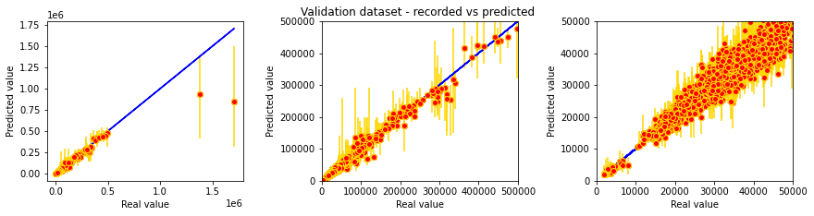
Validation results
The algorithm fails on expensive cars
With more time I would analyze and train the expensive brands separately

Slide 26
Feature importance
Which are the most influential parameters?

Slide 27
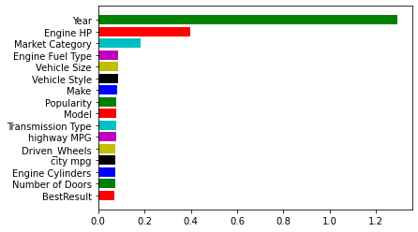
Feature importance

Slide 28
Final tests
Results on a brand new dataset

Slide 29
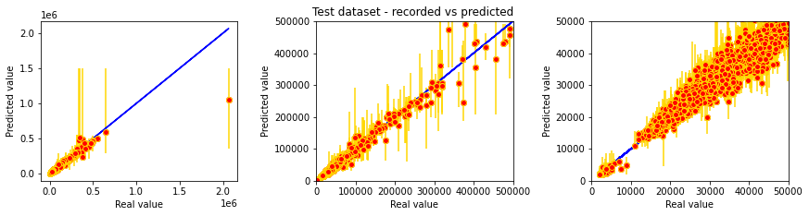
Test results
Mean average percentage error on test dataset: 0.704
Error bars represent the 90% confidence interval

Slide 30
Conclusions
The simple model implemented is able to estimate the value of a car and the confidence interval given the input features

Slide 31
Thank you

