Slide 1
FSDA Class of January 2023
Week 1 Assignment
Understanding Business Problems

Slide 2
Business Background
You are a Data Analyst at a large company named XYZ ltd that has a job description to provide insight about employees and management on how to implement HR strategy in order to have more productive employees. The company has 4000 employees with the currently attrition rate every year is 15% resulting in vacant position that need to be replaced with the talent that is available in the market.
Hence, the management has emailed you to understand what factors they should focus on, in order to reduce attrition. In other words, they want to know what changes they should make to their workplace, in order to get most of their employees to stay. Also, they want to know which of these variables is most important and needs to be addressed right away.

Slide 3
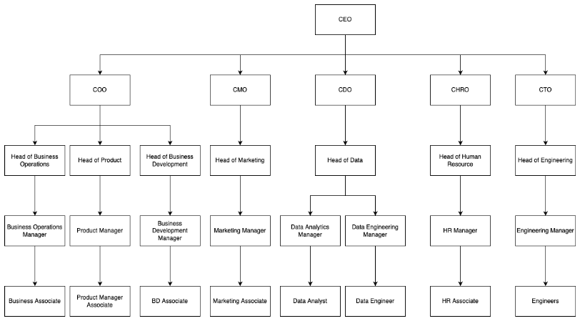
Organization Structure

Slide 4

Table of Contents
DARCI
Problem Statement
Objective
Root Cause
Hypothesis
Hypothesis Prioritization
Metrics Recommendation

Slide 5
DARCI
Role | Stakeholders
Decider | Head of Human Resource
Accountable | Head of Data
Responsible | Data Analyst
Consulted | Data Engineering, Human Resource Associate
Informed | Business Associate, PM Associate, BD Associate, Marketing Associate, Engineers

Slide 6

Problem Statement
How to reduce our attrition rate from 15% to 5% - 10% quarterly by end of year?

Slide 7

Objective
Reduce the attrition rate from 15% to 5% - 10% by end of year

Slide 8
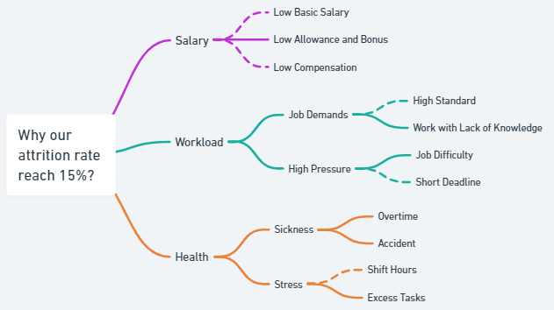
Root Cause – Issue Tree

Slide 9
Hypothesis
Possible Root cause | Hypothesis
Low allowance and bonus | If we increase salary by giving allowance and bonus based on their level and performance, the attrition rate will decrease by 5%
Accident | If we reduce the number of work accident into 50%, the employee attrition rate will decrease by 3%
Job Difficulty | If we reduce the job difficulty of the employee by looking at its capability, the attrition rate will decrease by 3%
Excess Tasks | Decreasing the number of tasks less than the average of completion time, will reduce the level of attrition by 3%
Overtime | If we reduce the number of overtime into 50%, the employee attrition rate will decrease by 5%
Work with Lack of Knowledge | If we do the annual employee training and achieve training completion rate of more than 90%, the employee attrition rate will decrease by 5%

Slide 10
Hypothesis - Prioritizations
Possible Root cause | Hypothesis | Prioritizations
Low allowance and bonus | If we increase salary by giving allowance and bonus based on their level and performance, the attrition rate will decrease by 5% | High : Because related with salary and performance
Accident | If we reduce the number of work accident into 50%, the employee attrition rate will decrease by 3% | Mid : Because the accident rate is clear
Job Difficulty | If we reduce the job difficulty of the employee by looking at its capability, the attrition rate will decrease by 3% | Mid : Because related with training
Excess Tasks | Decreasing the number of tasks less than the average of completion time, will reduce the level of attrition by 3% | Mid : Because related with company needs
Overtime | If we reduce the number of overtime into 50%, the employee attrition rate will decrease by 5% | High : Because related with health and salary
Work with Lack of Knowledge | If we do the annual employee training and achieve training completion rate of more than 90%, the employee attrition rate will decrease by 5% | High : Because related with performance and completion of task

Slide 11
Metrics Recommendation
Possible Root cause | Metrics | Metrics Function
Low Allowance and Bonus | Employee Satisfaction | Satisfaction is an important employee retention metric because satisfied employees are more likely to stay in their jobs than those who are unhappy
 | Pay Equity | Pay equity is a way to measure that your compensation strategy is … well, equitable (fair and impartial)
Accident | Accident Frequency Rate | A critical measure of safety performance
Job Difficulty | Task Performance | To see the indicator (%) of how easily and how quickly the employee can complete the task
Excess Tasks | Completion Rate | To see the percentage of employee completing a specific task
Overtime | AVR Overtime Hours | To see the average of overtime hours worked by employees in a given time period.
 | Absence Rate | The absence rate calculates the percentage of unplanned employee absences for sickness, personal emergencies or other unanticipated reasons.
Work with Lack of Knowledge | Training Completion Rate | To see the rate (%) of employees who completed a given training in the company

Slide 12
Thank You !

