Slide 1
Probing inflation, dark matter, dark energy, etc. using the Lyman-α forest
Pat McDonald
(CITA)
Collaborators: Uros Seljak, Anze Slosar, Alexey Makarov, Hy Trac, Daniel Eisenstein, Scott Burles, David Schlegel, Renyue Cen, Rachel Mandelbaum, all of SDSS

Slide 2
The Lyman-α forest is the Lyα absorption by neutral hydrogen in the intergalactic medium (IGM) observed in the spectra of high redshift quasars
A probe of large-scale structure

Slide 3
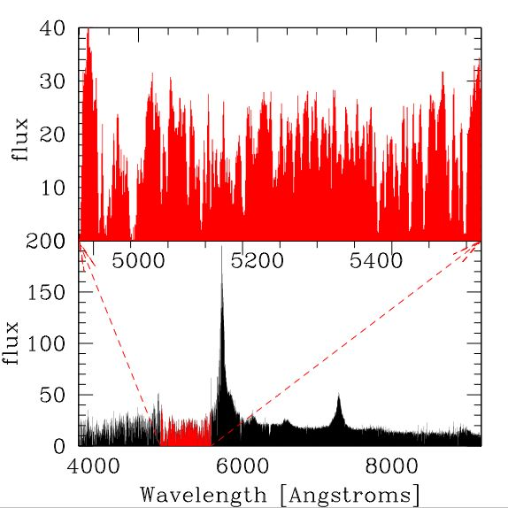
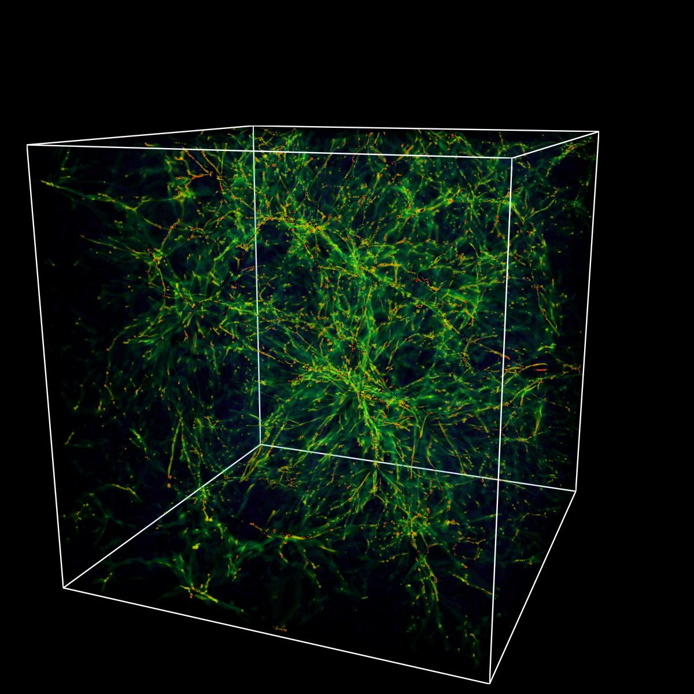
Ly-alpha forest
SDSS quasar
spectrum
25 Mpc/h
cube
Neutral
hydrogen
R. Cen
simulation of the IGM
z = 3.7 quasar

Slide 4

We obtain a redshift-space map of the density along our line of sight because absorption by gas at redshift z appears in an observed quasar spectrum at wavelength
Notes:
Spectra are a spatial map of the density field because…

Slide 5
Unique capabilities of the Lyman-alpha Forest
Best probe of large-scale structure at intermediate redshifts (z~3).
Best probe of relatively small scales while they are still relatively linear.

Slide 6
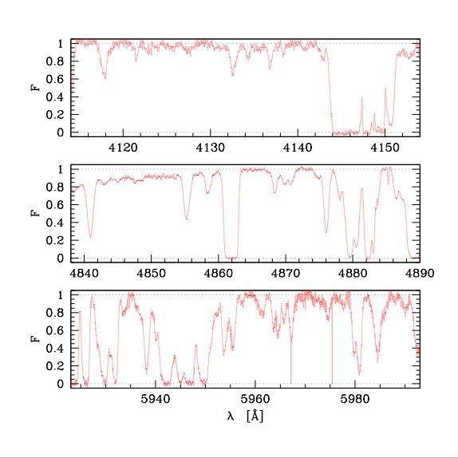

HIRES Spectra
(Rauch & Sargent)
Z~2
Z~3
Z~4
~25 Mpc/h
chunks
transmitted flux fraction

Slide 7
= 0.78 arcmin
These relations are qualitatively correct for typical allowed models and the relevant redshift range.

Slide 8
What can we constrain using the LyaF?
~100 kpc/h scales
  Warm dark matter
    Gravitinos
    Sterile neutrinos
    Dark matter from decays
  Sources of extra small-scale structure (e.g., primordial black holes)
~1 Mpc/h scales
  Inflation: running spectral index
  Light neutrino masses
  Anything else that affects power on this scale at z~3
>10 Mpc/h scales
  Dark energy & curvature: baryonic acoustic oscillations (future, McDonald & Eisenstein 2006)

Slide 9
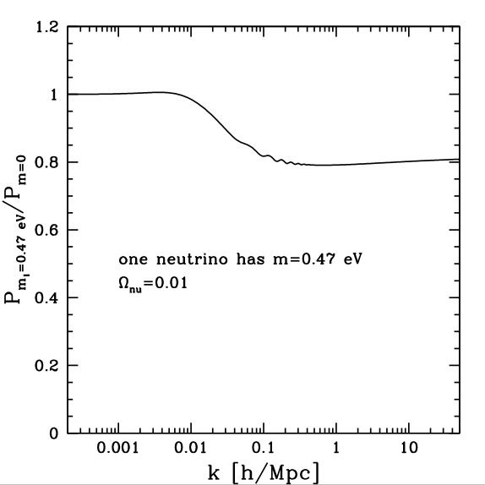
Effect of massive neutrinos (linear power)

Slide 10
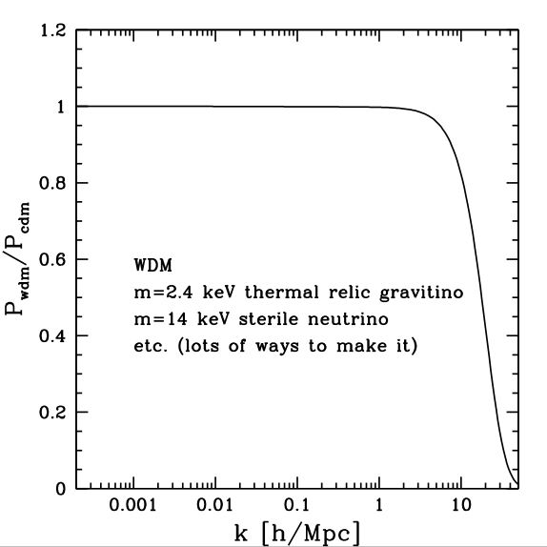
Effect of warm dark matter
linear power
masses model dependent

Slide 11
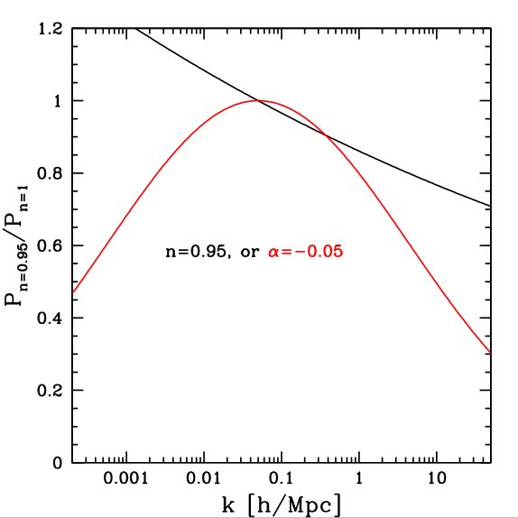

Effect of inflationary parameters (linear power)

Slide 12
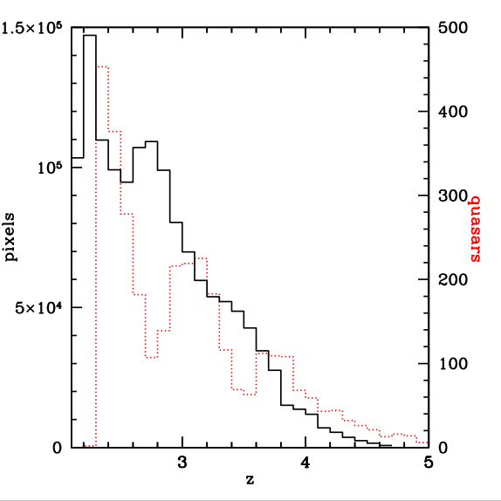
Past results: SDSS LyaF Data (McDonald 2006)
3300 spectra with z_{qso}>2.3
redshift distribution of quasars
1.4 million pixels in the forest
redshift distribution of Lyα forest pixels
Notes:
Better picture

Slide 13
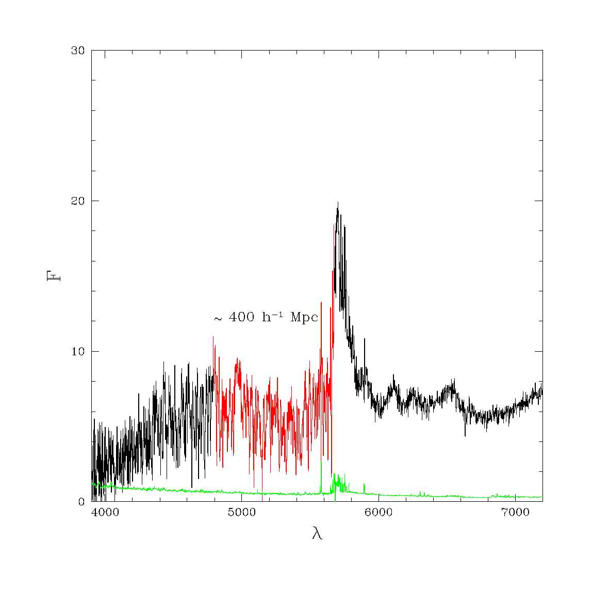
SDSS quasar spectra
Resolution typically 160 km/s (FWHM)
Pixel size 70 km/s
We use spectra with S/N>1, with a typical S/N≈4 (per pixel)
This is an unusually good one

Slide 14
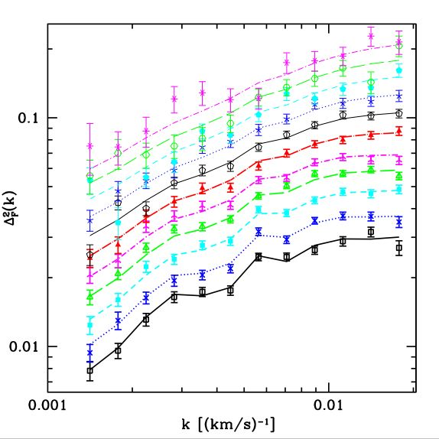
LyaF power from SDSS (McDonald et al. 2006)
Δ²(k) = π⁻¹ k P(k)
(0.01 s/km ~ 1 h/Mpc)
Colors correspond to redshift bins centered at z = 2.2, 2.4, …, 4.2 (from bottom to top)
1041<λ_{rest}<1185 Å
Computed using optimal weighting
Noise subtraction
Resolution correction
Background subtraction using regions with λ_{rest}>1268 Å
Error bars from bootstrap resampling
Code tested on semi-realistic mock spectra
HIRES/VLT data probes smaller scales

Slide 15
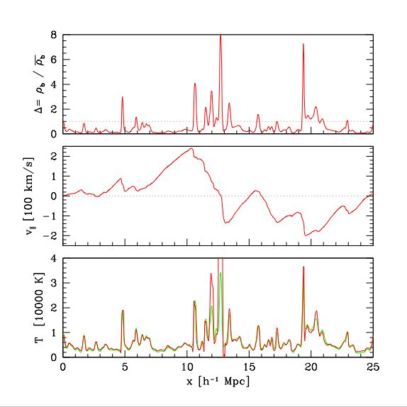
R. Cen simulation
gas density
velocity
temperature
Notes:
Should have dark matter!

Slide 16



Why is the Ly-alpha forest a good tracer of dark matter/initial conditions?
Photoionization equilibrium with a near-uniform ionizing background gives the neutral density (the gas is almost completely ionized).
Peculiar velocities change the position of the absorption.
Thermal broadening smoothes the observed features.

Slide 17
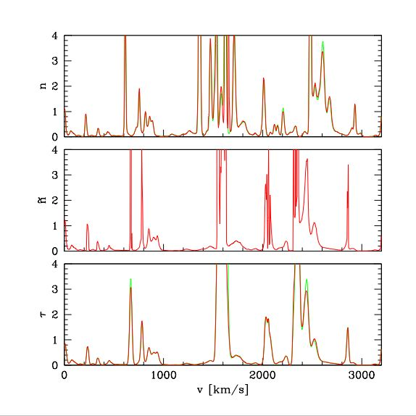
neutral density
applied peculiar velocities (redshift)
optical depth (applied thermal broadening)

Slide 18
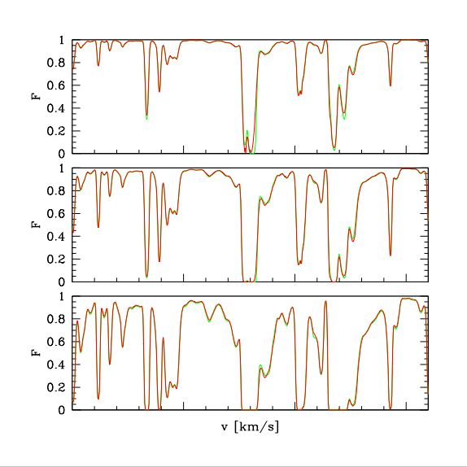
transmitted flux
z=2
z=3
z=4

Slide 19
The model fits!
χ² ≈ 185.6 for 161 d.o.f. (w/HIRES)
A single model fits the data over a wide range of redshift and scale
Wiggles from SiIII-Lyα cross-correlation
Helped some by HIRES data

Slide 20
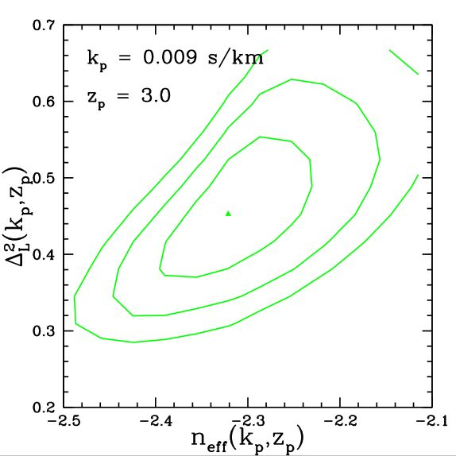
Linear Power Spectrum Constraint
(for LCDM-like power spectrum)
1, 2, and 3-sigma error contours for the amplitude and slope of the linear power spectrum at z=3.0 and k=0.009 s/km

Slide 21
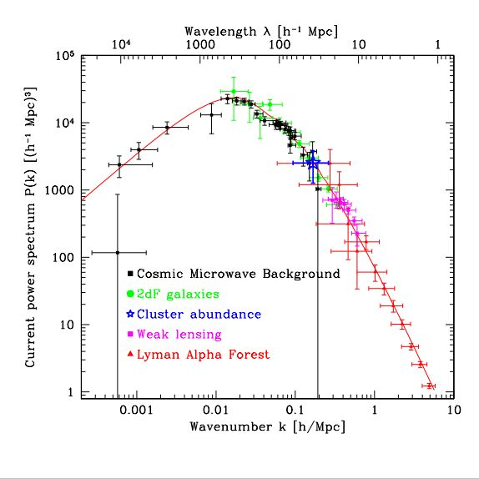

Scales of various LSS probes
The Lyα forest is great for determining the running of the spectral index, ,
because it extends our knowledge to small scales
We only report an amplitude and slope no band powers
(out of date figure by
Max Tegmark)

Slide 22



Basic linear power spectrum constraint from the LyaF:

Slide 23
SDSS Lyman-alpha forest
(McDonald, et al. 2005, 2006)
3300 quasars
2.1<z<4.3
Chi^2 code for cosmological parameter estimation (input linear power at z=3, output LyaF chi^2)
  www.cita.utoronto.ca/~pmcdonal/code.html
  Anze Slosar’s COSMOMC patch: www.slosar.com/aslosar/lya.html
SDSS DR5 has ~11000 high-z quasars!

Slide 24
Comprehensive cosmological parameter paper:
Seljak, Slosar, & McDonald (2006)
CMB: WMAP3, Boomerang-2k2, CBI, VSA, ACBAR
Galaxies: SDSS-main, SDSS-LRG (BAO), 2dF
SN: SNLS, Riess et al.
LyaF: SDSS, HIRES
Notes:
Journal version?

Slide 25
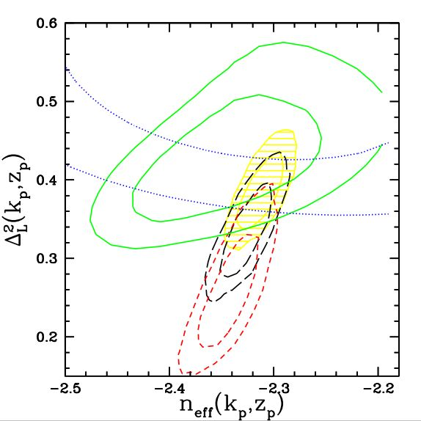
WMAP vs. LyaF (vanilla 6 parameters)
Linear amp. & slope constraints at z=3, k=0.009 s/km
Green: LyaF
Red: WMAP
Black: WMAP, SDSS-main, SN
Yellow: All
Blue: Viel et al. (2004) independent LyaF

Slide 26
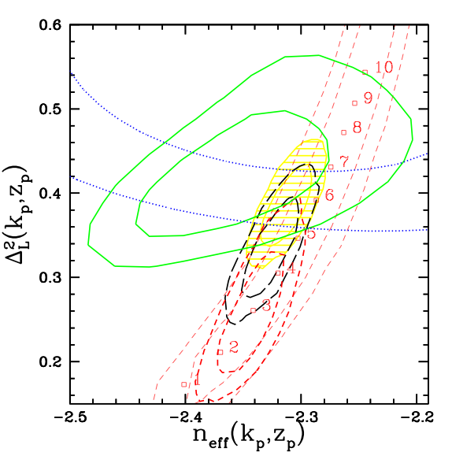
WMAP vs. LyaF
Extra light neutrinos (radiation)?
Green: LyaF
Red: WMAP, dashed allows extra neutrinos
Black: WMAP, SDSS-main, SN
Yellow: All
Blue: Viel et al. (2004) independent LyaF

Slide 27
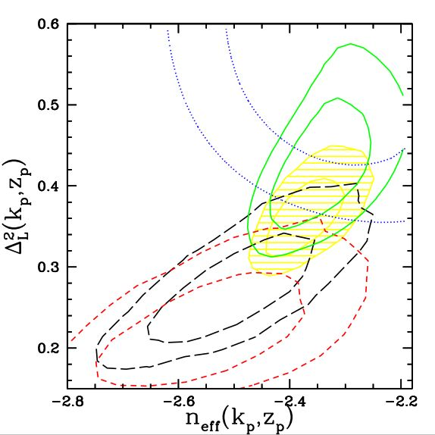
WMAP vs. LyaF (including running)
Linear amp. & slope constraints at z=3, k=0.009 s/km
Green: LyaF
Red: WMAP
Black: WMAP, SDSS-main, SN
Yellow: All
Blue: Viel et al. (2004) independent LyaF

Slide 28
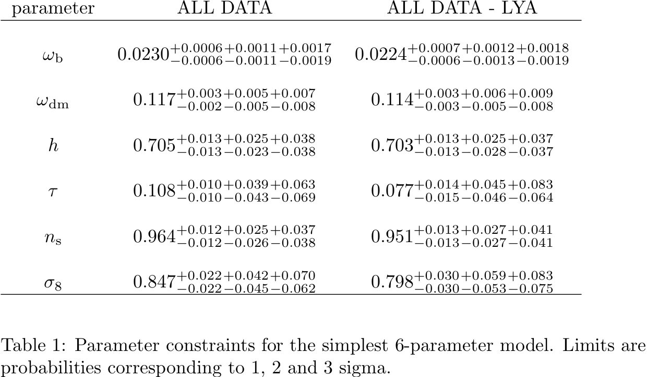
Notes:
WMAP3 only sigma8

Slide 29
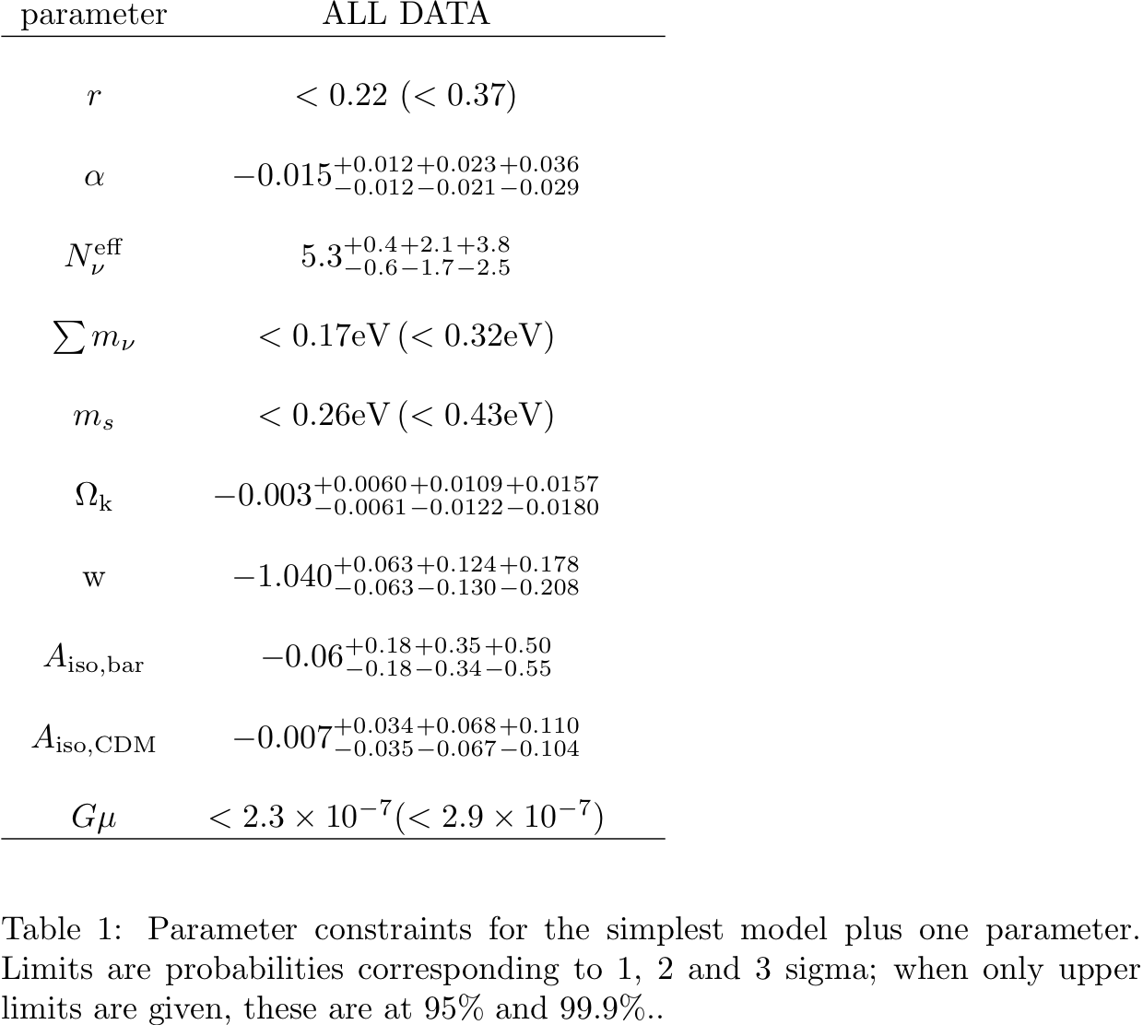
Running of spectral index
Sum of neutrino masses
Notes:
WMAP3 only alpha error
Scale for r
Difference between steriles

Slide 30
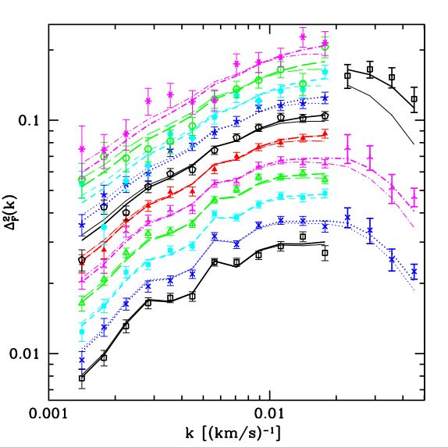
Warm Dark Matter constraints
Seljak, Makarov, McDonald, & Trac (2006)
Flux power spectrum
3000+ SDSS spectra
HIRES data probes smaller scales
Δ²(k) = π⁻¹ k P(k)
0.01 s/km ~ 1 h/Mpc
Colors correspond to redshift bins centered at z = 2.2, 2.4, …, 4.2 (from bottom to top)

Slide 31
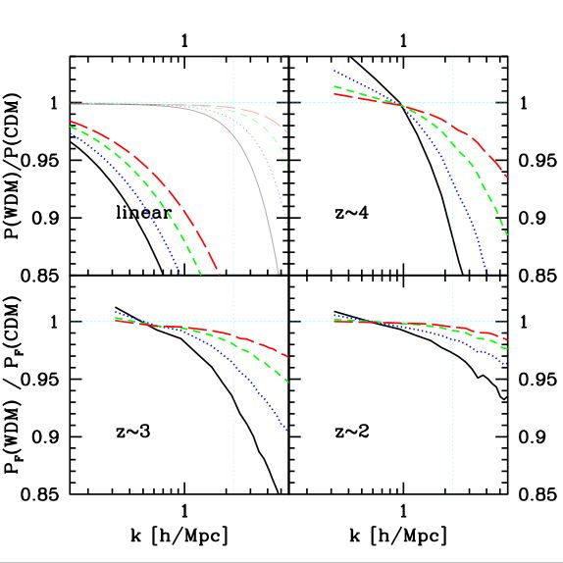
Warm Dark Matter constraints
Free-streaming erases power on small scales.
Simulate the LyaF power for different sterile neutrino masses:
6.5 keV, 10 keV, 14 keV and 20 keV
(1.3, 1.8, 2.4, 3.1 keV for traditional WDM)
At higher z, linear signal better preserved

Slide 32
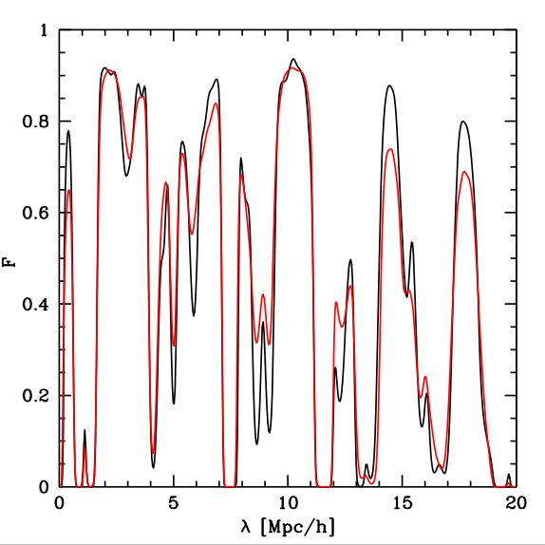
Black: CDM, Red: WDM
Easy to see by eye… and we have almost 50000 chunks of this length.

Slide 33
WDM constraints
Model independent: 50% power suppression scale restricted to k>18 h/Mpc (Gaussian rms smoothing ~<45 kpc/h)
Thermal relic (gravitino): mass>2.5 keV
Sterile neutrino: mass>14 keV
Agreement with other main LyaF group led by Viel (>~11 keV)

Slide 34
Why/if to believe it
Even though we are dealing with gas, the number of things that can go wrong is not infinite, and we have allowed for every problem anyone has thought of, unless it has been shown to be small.

Slide 35
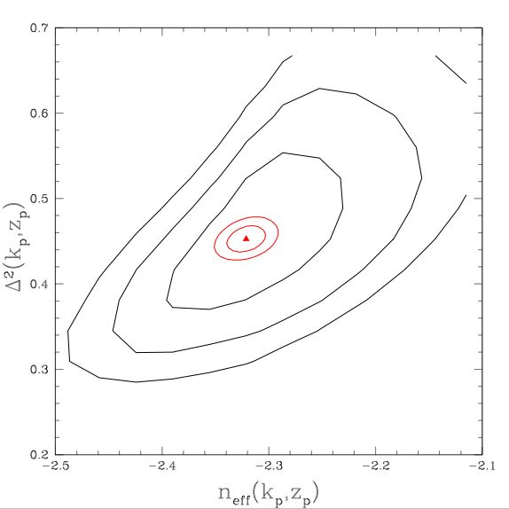
“Self calibration”
Errors +-0.01 on both parameters if modeling uncertainty is ignored:
Noise/resolution
Mean absorption
Temperature-density
Damping wings
SiIII
UV background fluctuations
Galactic winds
reionization

Slide 36
Near future from SDSS and other existing spectra
A factor of ~3 improvement in linear power spectrum errors using the SDSS bispectrum (breaks degeneracy with <F>, Mandelbaum 2003).
~4 times as many SDSS spectra for better statistical errors.
Better higher resolution measurements.
Three-dimensional clustering from pairs of quasars.

Slide 37
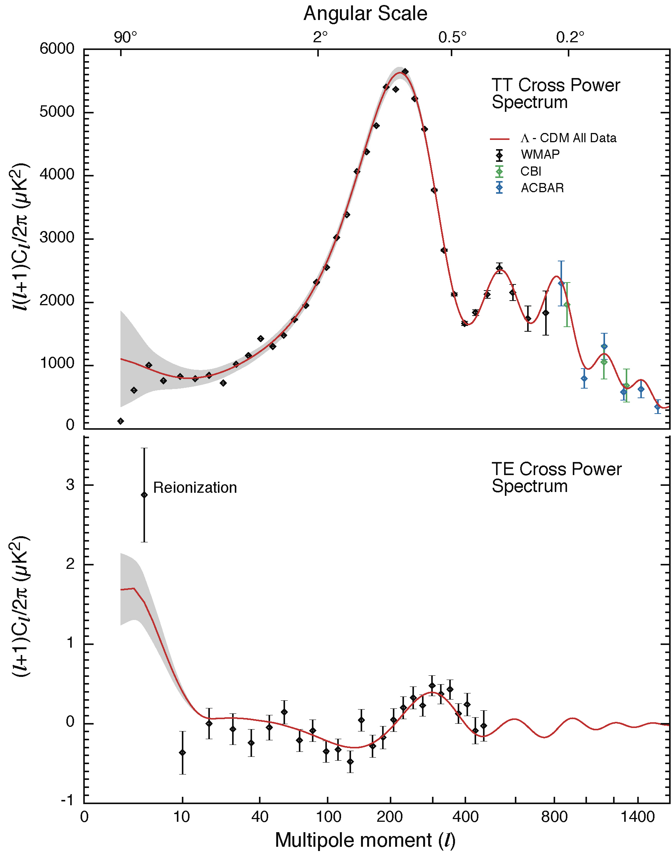
Baryonic acoustic oscillations
McDonald & Eisenstein, astro-ph/0607122
Standard ruler used to study dark energy and curvature
Observable in principle in any tracer of LSS
See Daniel Eisenstein’s webpage for basic explanation and movies.

Slide 38
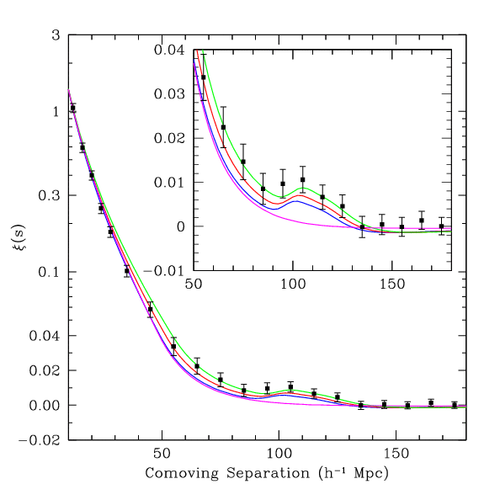
Large-scale correlations of SDSS luminous red galaxies (LRGs) (Eisenstein et al. 2005)
Before recombination:
  Universe is ionized, baryons & photons coupled, photon pressure
  Perturbations oscillate as acoustic waves.
  Sound horizon at recombination ~100 Mpc/h

Slide 39
Acoustic oscillations from the LyaF???
Great excitement about BAO lately because they represent a probe of dark energy, relatively free of systematics
Obviously you can in principle measure baryon acoustic oscillation scale from any tracer of LSS that probes the appropriate scale
Presumably no one had calculated how well you can do it in the future with LyaF because the standard linear theory+bias+Poisson noise prescription used for galaxies does not obviously apply
Also, LyaF is only good for probing z>2, while lower redshifts are generally better for dark energy (but curvature changes this)
However, huge galaxy surveys at z>2 are being discussed

Slide 40
High-z galaxies with WFMOS
Glazebrook et al. (2005) DETF white paper
Wide-field multi-object spectrograph on an 8 meter telescope
300 deg^2 at ~2.3<z<~3.3 (volume 1 (Gpc/h)^3)
600000 galaxies (flux limit R<24.5)
Measure H(z) to 1.8%, D_A(z) to 1.5%
(directly measure bump location in angle and velocity/redshift, proportional to s/D_A(z) and s H(z), where s is the sound horizon scale)
It turns out the LyaF can do better now with BOSS

Slide 41
Planned surveys would probe this 25 Mpc/h cube with ~8 galaxies… it shouldn’t take very many quasars to do just as well
(simulation:
R. Cen)
Notes:
How many degrees is this?

Slide 42
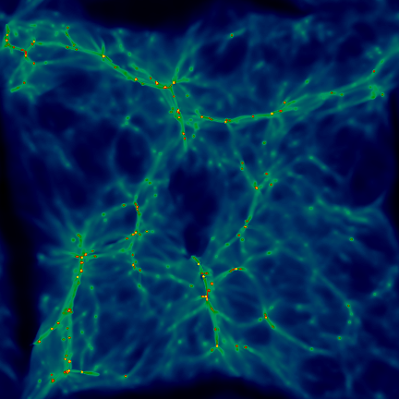
Numerical
Simulation of the IGM
(R. Cen)

Slide 43




Fisher matrix calculation
(Gaussian)
Minimum error on parameter is
For mean zero,
(Tegmark et al. 1997)
Need to compute covariance matrix and

Slide 44
LyaF Fisher matrix calculation
Brute force calculation in pixel space not practical.
Fourier space allows efficient computation.
Noise from small-scale structure included as ~aliased power.
Need predictions for the LyaF flux covariance matrix and its parameter dependence - already exist in McDonald (2003).

Slide 45
Observed power
Ideal 3D power
(perfectly sampled)
Resolution
Sampling noise
n=surface density of lines of sight
(analogous to galaxy shot noise)
Detector noise

Slide 46
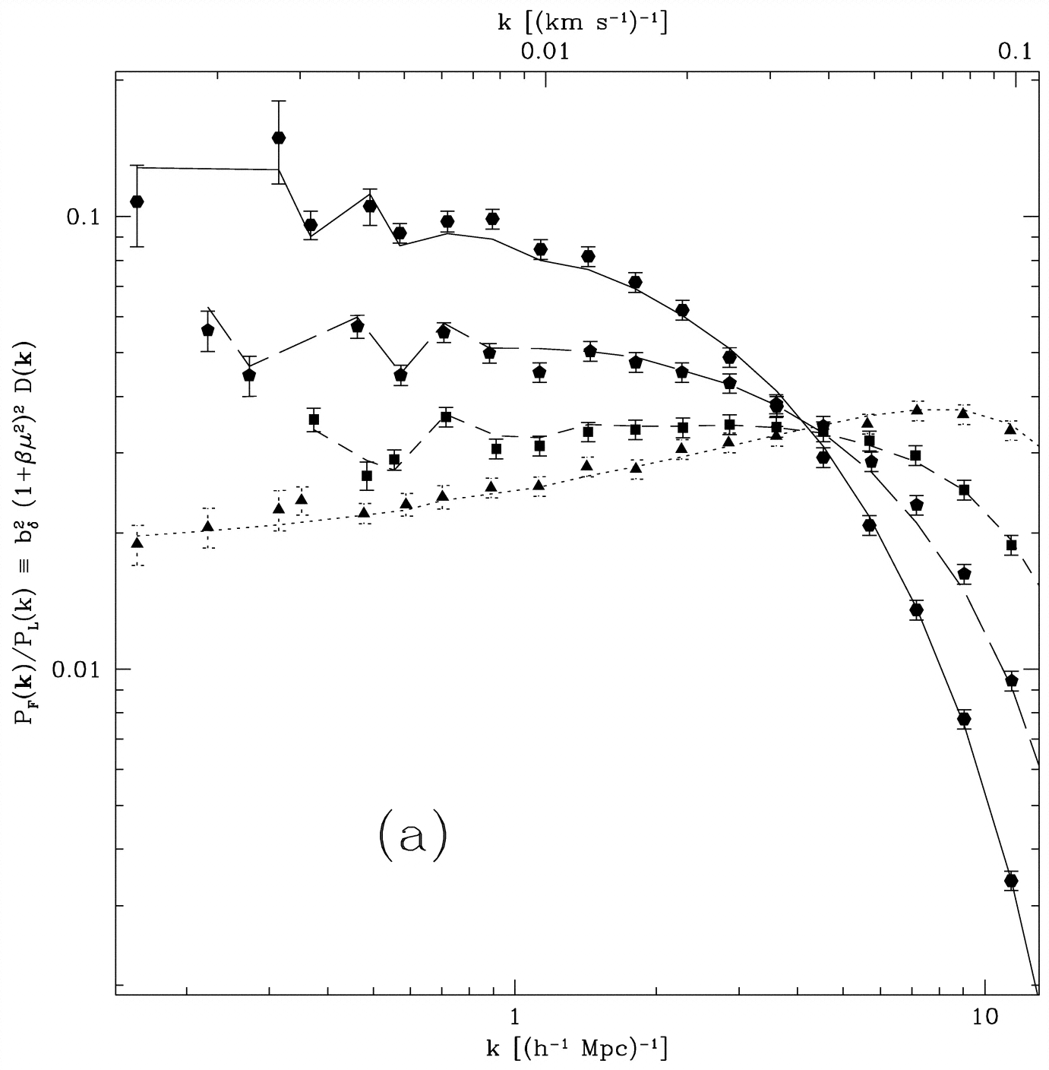

Simulated 3D flux power, relative to real-space linear theory (McDonald 2003)
Bottom to top on left:
mu=
0-0.25,
0.25-0.5,
0.5-0.75,
0.75-1.0

Slide 47
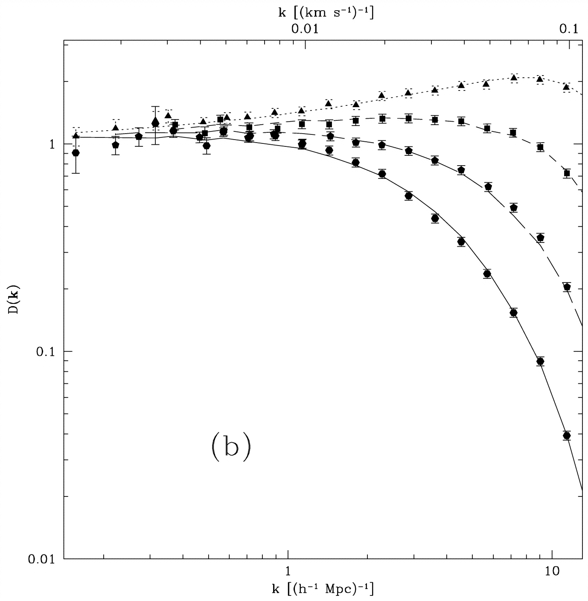
3D flux power, relative to redshift-space linear theory with fitted beta (McDonald 2003)
Top to bottom on right:
mu=
0-0.25,
0.25-0.5,
0.5-0.75,
0.75-1.0

Slide 48
Theory/fitting formula for redshift-space power
Linear theory on large scales
Non-linearity + pressure + fingers-of-god
Baryon wiggles simply modify P_L(k)

Slide 49
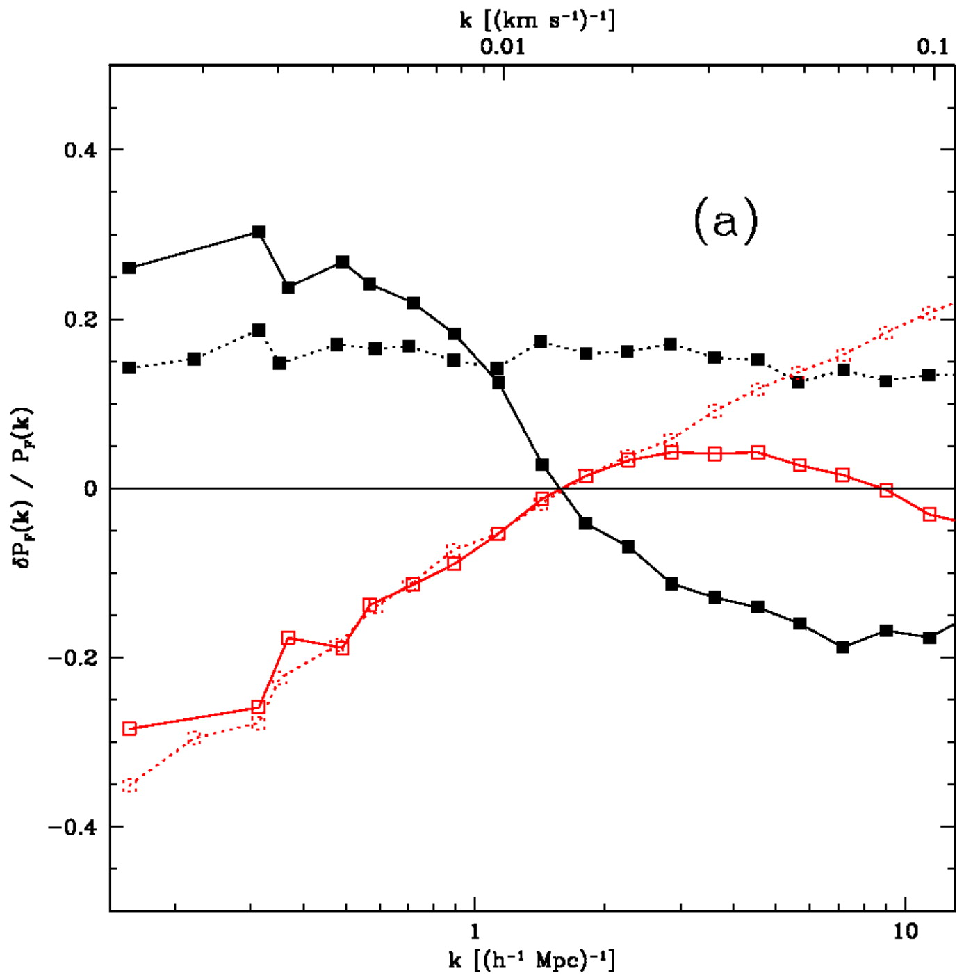
Parameter dependence of 3D flux power (McDonald 2003)
Black - increased amplitude
Red - increased slope
Solid - LOS
Dotted - transverse

Slide 50
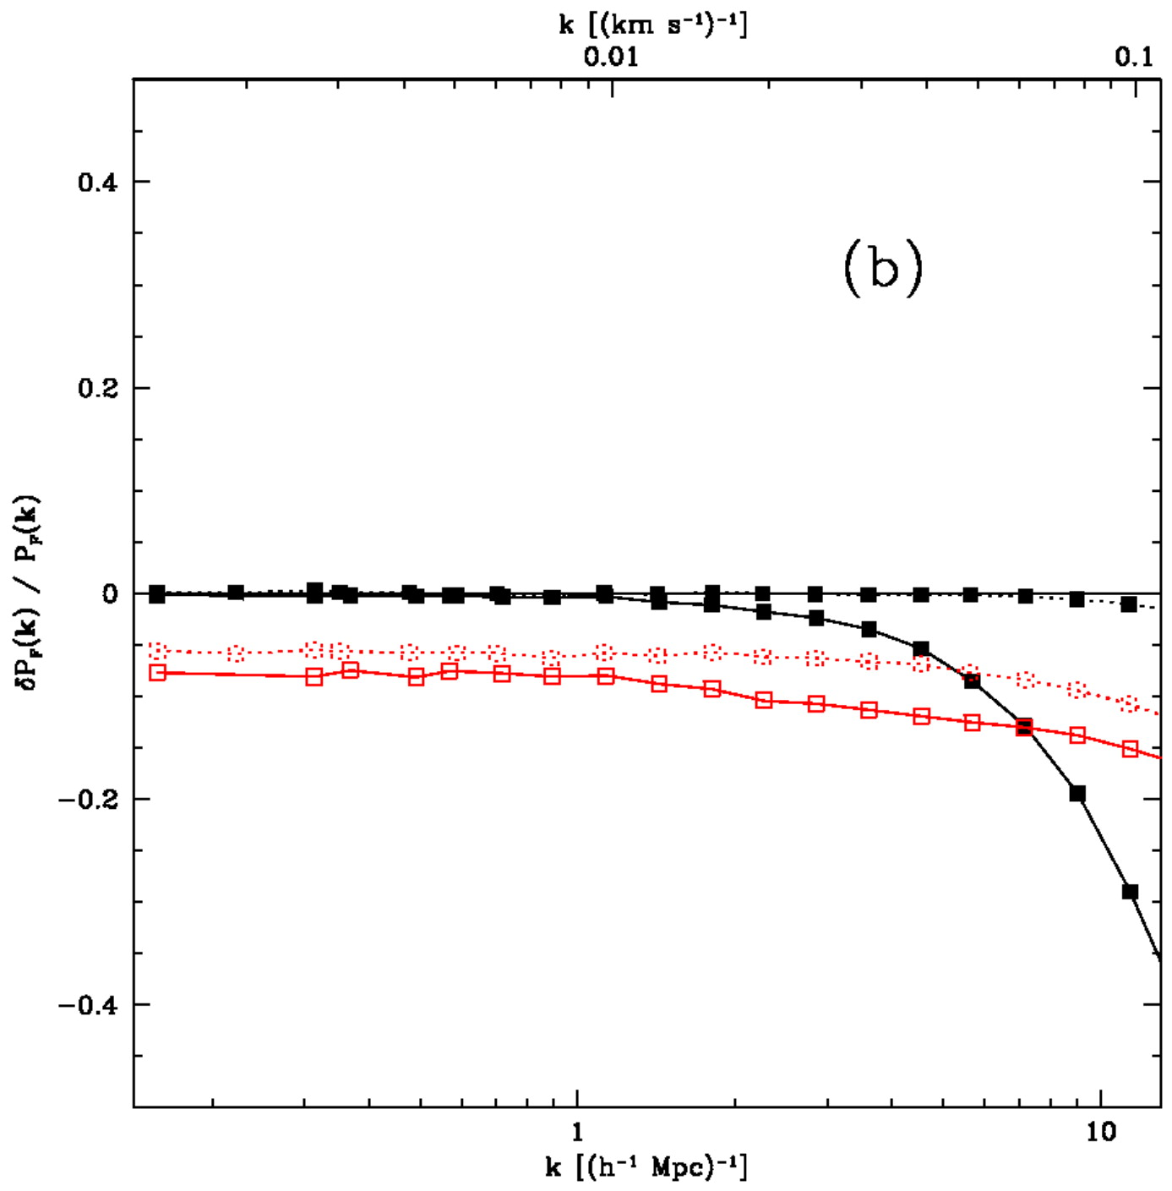
Parameter dependence of 3D flux power (McDonald 2003)
Black - increased temperature
Red - increased dependence of temperature on density (gamma-1)
Solid - LOS
Dotted - transverse

Slide 51
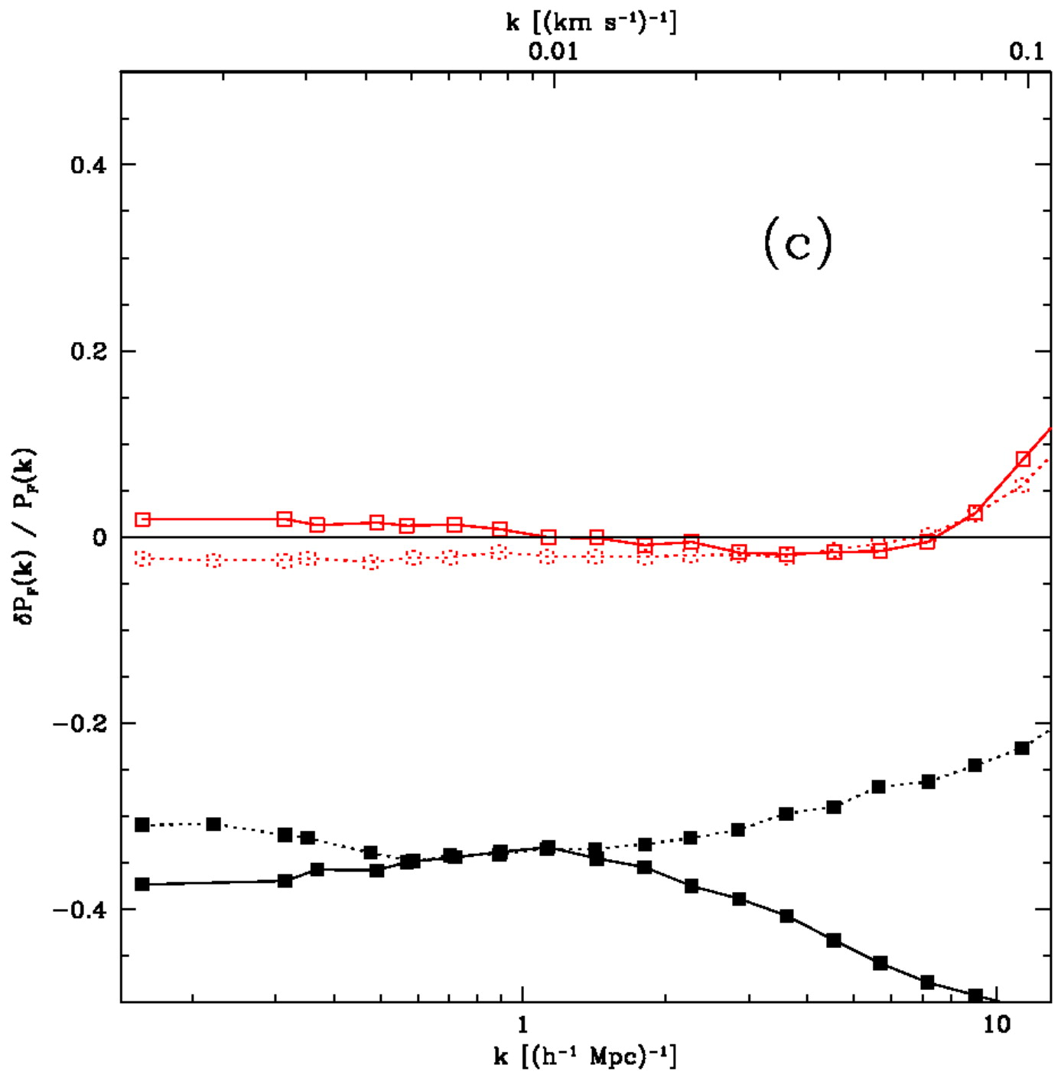
Parameter dependence of 3D flux power (McDonald 2003)
Black - increased <F>
Red - never mind (related to Jeans filtering)
Solid - LOS
Dotted - transverse

Slide 52
LyaF Fisher matrix calculation
Relevant survey parameters are
  Area (final errors will scale as 1/sqrt(Area))
  density of quasars
  Resolution of spectra
  Signal to noise of spectra

Slide 53
LyaF Fisher matrix calculation
Marginalize over
  amplitude of linear power
  Slope of linear power (n)
  temperature-density relation
  mean absorption level
  beta
Estimate error on D_A(z) and H(z) from baryon wiggle location by simply rescaling a fixed transfer function
Much larger errors when using a transfer function with Omega_b=0.001 means we’re really measuring the feature

Slide 54
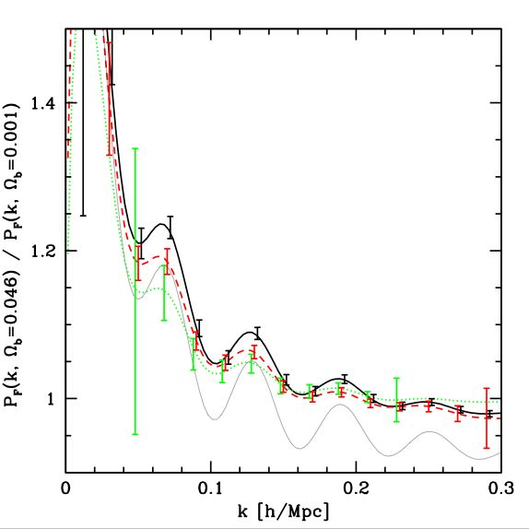
Future BAO: Measure 3D power
Band power measurement from a 2000 sq. deg. WFMOS-like survey
Black: radial
Green: transverse
Red: diagonal
Thin black: no ~aliasing

Slide 55
AS2/BOSS
(After SDSS II, Baryon Oscillation Spectroscopic Survey)
Proposed use of the SDSS telescope starting in Fall 2008
Basically a similar but deeper survey, aimed at BAO.
~20 z>2.2 quasars per sq. deg. at g<22
Better than 1.5% on D_A and H at z=2.5

Slide 56
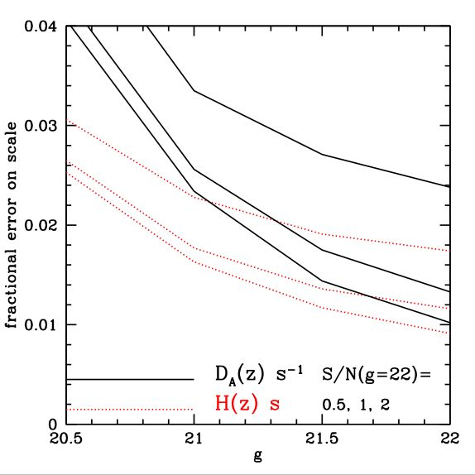
BOSS basic constraints
Lambda>3700
Z_q>2.3
g<22 gives ~20 per sq. deg., g<21gives 8 (Jiang et al.)

Slide 57
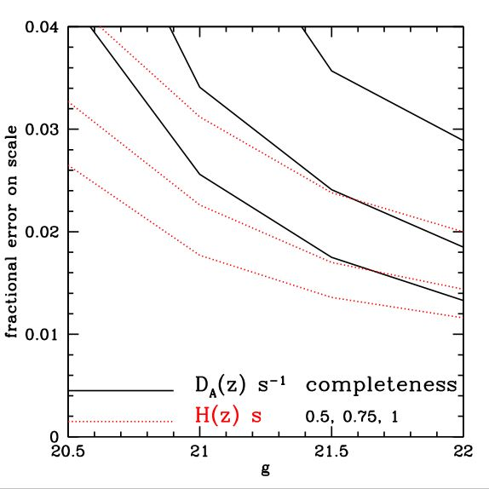
Effect of missing quasars
For S/N(g=22)=1.0
From bottom to top 100%, 75%, 50% of Jiang et al. expected quasars found (20, 15, and 10 at g=22)

Slide 58
Will it work?
Can always avoid auto-spectra to avoid systematics related to continuum.
Continua (or something) could still provide a lot of noise that hasn’t been included in Fisher matrix calculation
But we’ve measured this noise

Slide 59
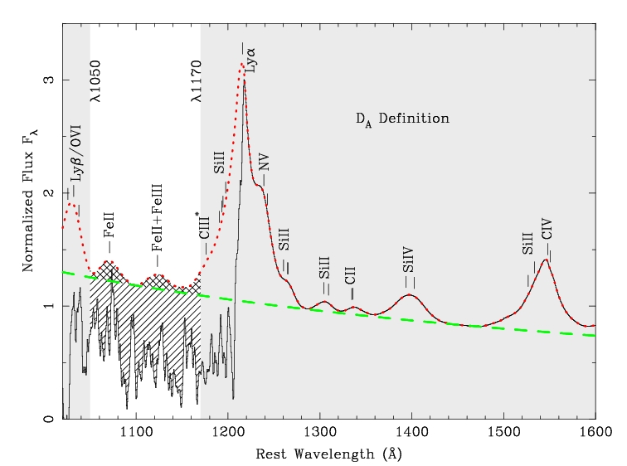
Fitting Continuum to the Ly alpha Forest (Nao Suzuki)

Slide 60
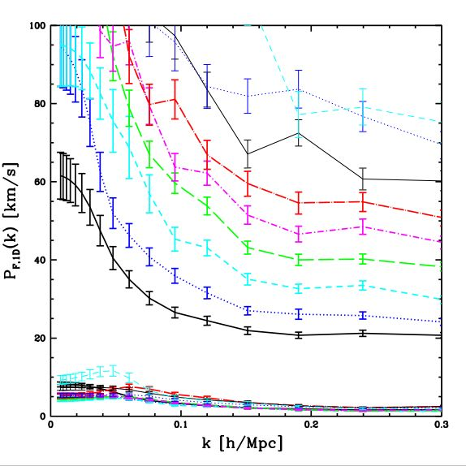
Large scale power vs. background (current SDSS)
Upper points 1041-1185
Lower points 1268-1380 AA
1409-1523 similar

Slide 61
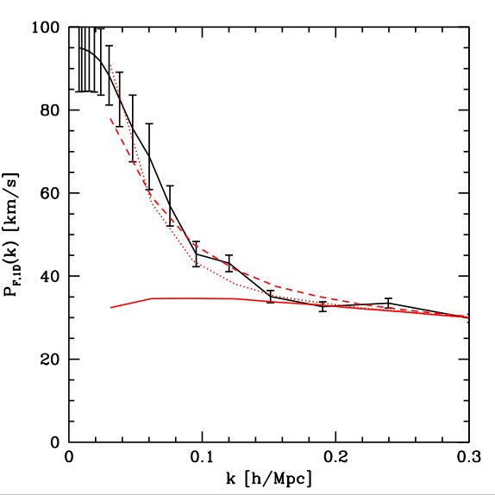
Large-scale power vs. model
Black: z=2.6 data
Solid red: theory
Dotted: P+=140 exp(-k 30)
Dashed: P+=80 exp(-k 20)
Basically know this is DLAs (Damped Lyman-alpha systems - rare object with column density so large that you can see very extended Lorentzian wings from the intrinsic absorption profile)

Slide 62
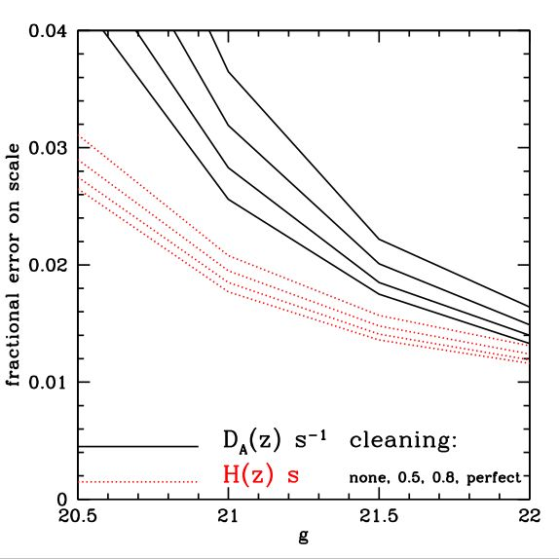
Effect of very large scale “noise”
Top to bottom shows removing none to all of this noise
For S/N(g=22)=1.0

Slide 63

Bottom line for BOSS
If everything goes well we will measure H(z~2.5) to 1.2%, D_A(z=2.5) to 1.3%
Combined with galaxies and Planck w_0 to +-0.1, w_a to +-0.4
LyaF doubles DETF figure of merit

Slide 64
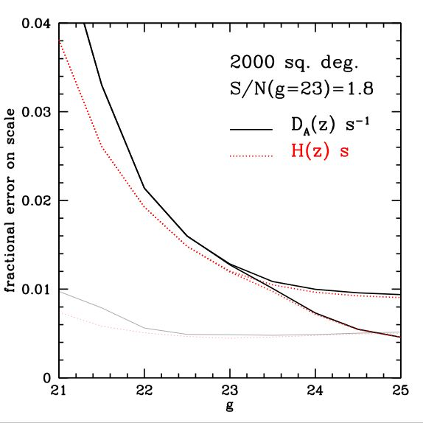
Results for WFMOS-like survey
Lower (thick) curves include LBGs

Slide 65
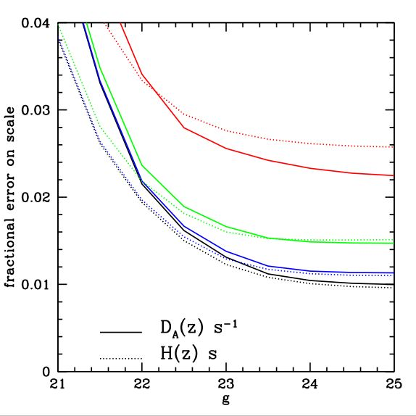
Constraints vs. resolution
R=
62.5,
125,
250,
2000

Slide 66
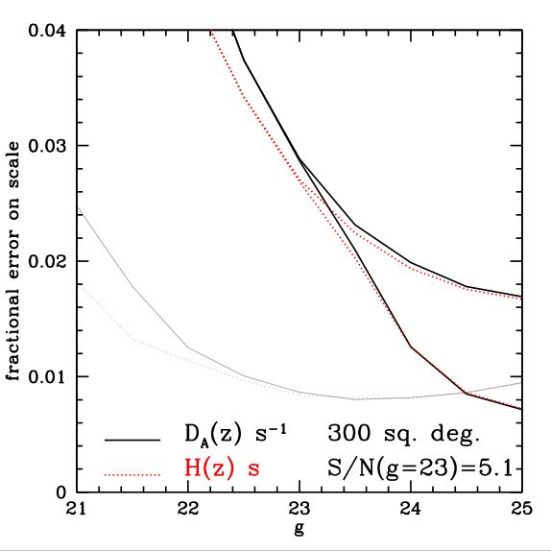
Results for deep WFMOS-like survey
(My conclusion before hearing about BOSS was basically that we really needed something like BOSS.)

Slide 67
BAO conclusions
Valuable as a probe of dark energy & curvature
Should be able to piggy-back on a low-z galaxy redshift survey at small marginal cost (BOSS)
Require ~10 quasars per sq. degree, but more is better (20 for BOSS)
Resolution and S/N requirements minimal
30 sq. deg. pilot study should be able to marginally detect wiggles
Proposed AS2/BOSS looks perfect

