Slide 1
Calcium Diffusion

Slide 2
Calcium Diffusion
Components affecting diffusion:
Calbindin (volume) – equally distributed throughout volume
PMCA (surface) – equally distributed across surface
SNARE (point) – single point on surface
VDCC (point) – single point on surface
Notes:
VDCC and SNARE are both point processes
VDCC point process has a source component
SNARE source component is negligible (SNARE sink is also pretty negligible) → it will act as a “probe”

Slide 3
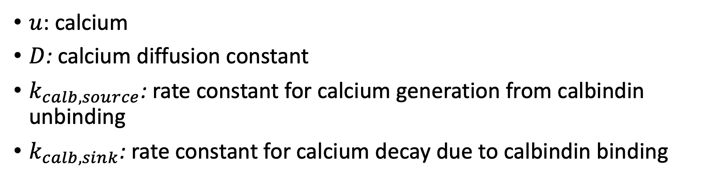
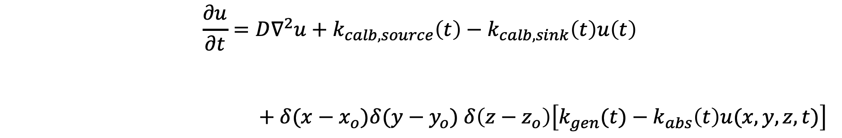
Volume Diffusion
$$\frac{∂u}{∂t}=D∇^{2}u+k_{calb, source}\left(t\right)−k_{calb, sink}\left(t\right)u\left(t\right)$$
$+ δ(x−x_{o})δ(y−y_{o})$ $δ\left(z−z_{o}\right)\left[k_{gen}(t)−k_{abs}\left(t\right)u(x,y,z,t)\right]$
unbound calcium in axon with time
diffusion
source
decay
point process(?)
$u$: calcium
$D$: calcium diffusion constant
$k_{calb, source}$: rate constant for calcium generation from calbindin unbinding
$k_{calb, sink}$: rate constant for calcium decay due to calbindin binding
Notes:
In the most general scenario, the point process can be anywhere in the volume or on the surface. If it is on the surface, it can be shown as here or absorbed in one of the boundary conditions on the next page (not both)

Slide 4
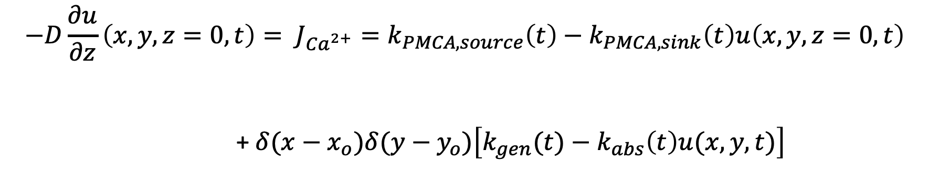
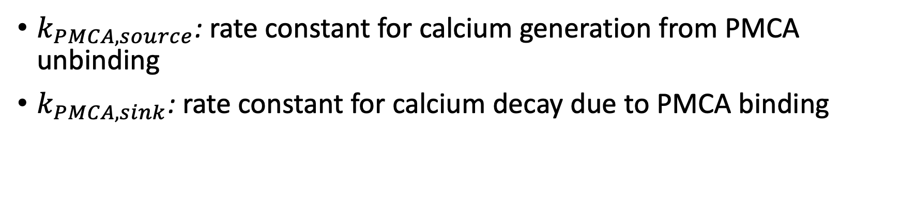
Surface Boundary Conditions
$$−D\frac{∂u}{∂z}\left(x,y,z=0,t\right)= J_{Ca^{2+}}=k_{PMCA, source}\left(t\right)−k_{PMCA, sink}\left(t\right)u\left(x,y,z=0,t\right)$$
+ $δ(x−x_{o})δ(y−y_{o})\left[k_{gen}(t)−k_{abs}\left(t\right)u(x,y, t)\right]$
calcium flux
source
decay
point process(?)
$k_{PMCA, source}$: rate constant for calcium generation from PMCA unbinding
$k_{PMCA, sink}$: rate constant for calcium decay due to PMCA binding

Slide 5
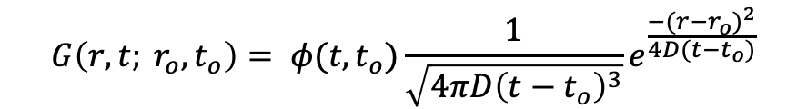
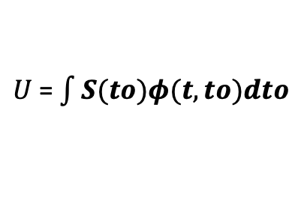
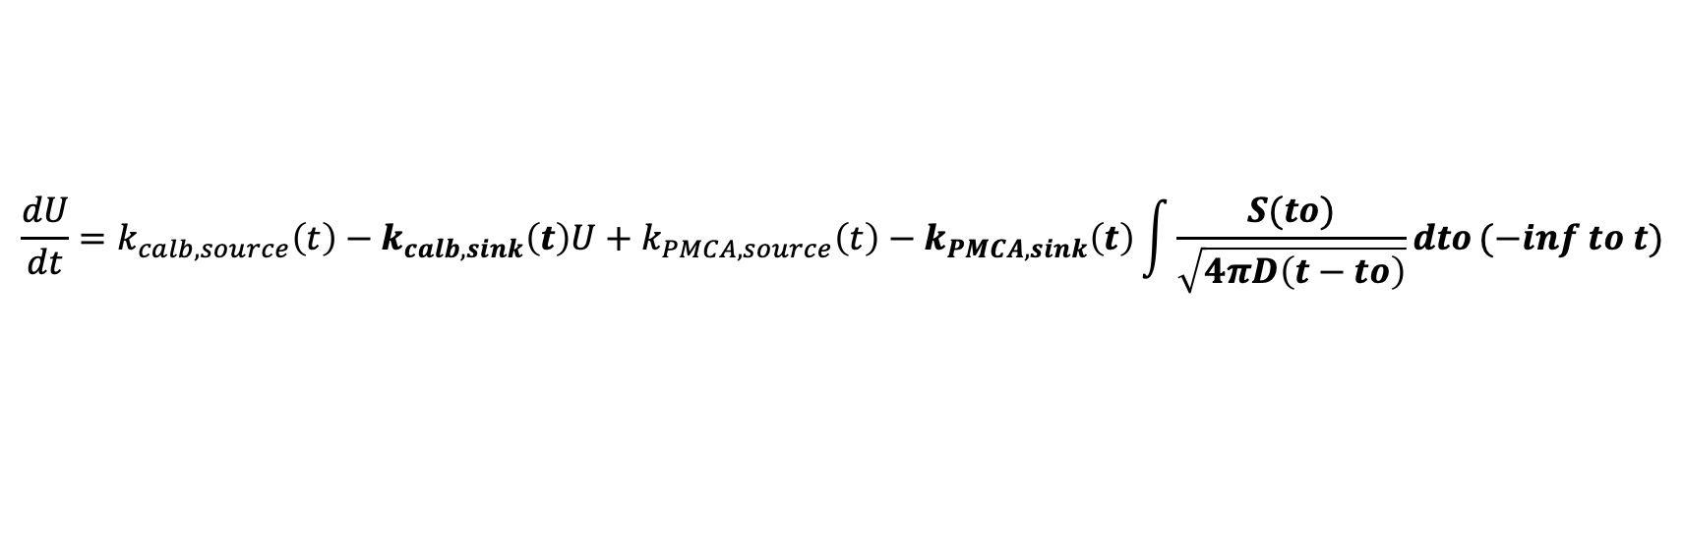
Modified Gaussian Diffusion
$$G\left(r,t; r_{o}, t_{o}\right)= φ(t,t_{o})\frac{1}{\sqrt{4πD{\left(t−t_{o}\right)}^{3}}}e^{\frac{−(r−r_{o})^{2}}{4D(t−t_{o})}}$$
Modified Gaussian diffusion kernel
Multiplier for sink and source terms
Gaussian diffusion kernel
$$\frac{dφ}{dt}=k_{calb, source}\left(t\right)−k_{calb, sink}\left(t\right)φ+k_{PMCA, source}\left(t\right)−k_{PMCA, sink}\left(t\right)\frac{φ}{\sqrt{4πD(t−to)}}$$
$$\frac{dU}{dt}=k_{calb, source}\left(t\right)−k_{calb, sink}\left(t\right)U+k_{PMCA, source}\left(t\right)−k_{PMCA, sink}\left(t\right)\int{\frac{S(to)}{\sqrt{4πD\left(t−to\right)}}dto}(−inf to t)$$
$U$ = $\int{S(to)φ(t,to)dto}$

Slide 6
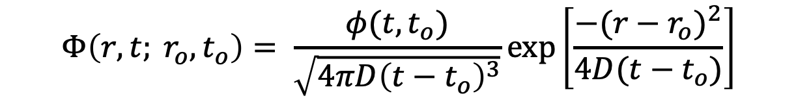

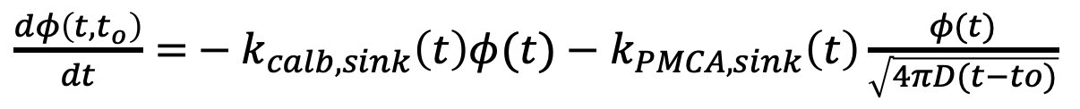

Prototypical 3D Diffusion Solution
$$Φ\left(r,t; r_{o}, t_{o}\right)= \frac{φ(t,t_{o})}{\sqrt{4πD{\left(t−t_{o}\right)}^{3}}}exp\left[\frac{−(r−r_{o})^{2}}{4D(t−t_{o})}\right]$$
$Φ\left(r,t; r_{o}, t_{o}\right)=$ $φ\left(t,t_{o}\right)G\left(r,t; r_{o}, t_{o}\right)$
Amount of input at certain location
Amount of input in volume
Gaussian diffusion kernel
$\frac{dφ\left(t,t_{o}\right)}{dt}=$ $k_{calb, source}\left(t\right)−k_{calb, sink}\left(t\right)φ(t)+k_{PMCA, source}\left(t\right)−k_{PMCA, sink}\left(t\right)\frac{φ(t)}{\sqrt{4πD(t−to)}}$
$\frac{dφ\left(t,t_{o}\right)}{dt}=$ $− k_{calb, sink}\left(t\right)φ(t)−k_{PMCA, sink}\left(t\right)\frac{φ(t)}{\sqrt{4πD(t−to)}}$
$$φ_{o}:amount input into volume$$
Notes:
- For a standard input, the amount in the volume doesn’t change. Here, it does

Slide 7

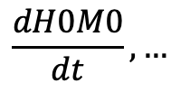
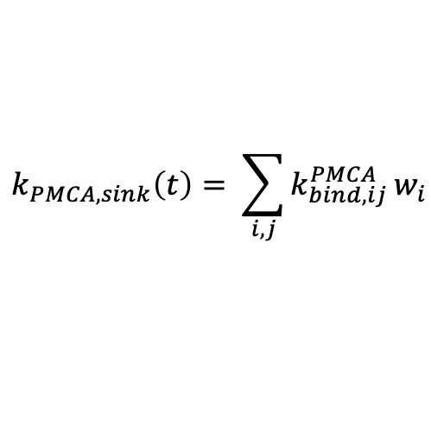
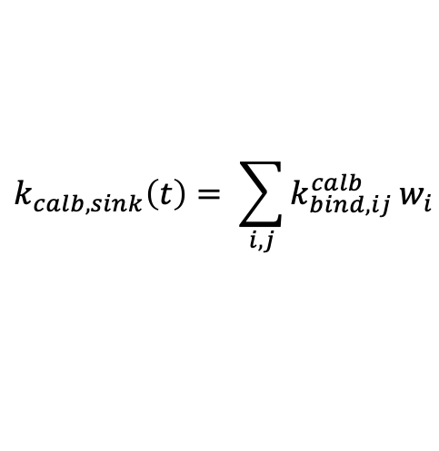
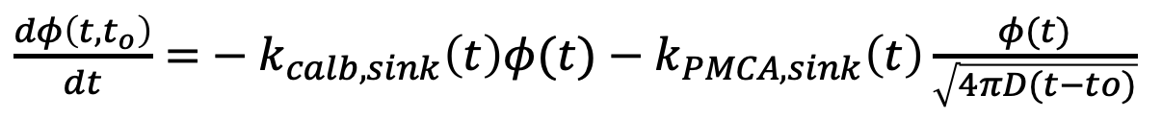
Calcium Diffusion
$Φ\left(r,t; r_{o}, t_{o}\right)=$ $φ\left(t,t_{o}\right)G\left(r,t; r_{o}, t_{o}\right)$
$\frac{dφ\left(t,t_{o}\right)}{dt}=$ $− k_{calb, sink}\left(t\right)φ(t)−k_{PMCA, sink}\left(t\right)\frac{φ(t)}{\sqrt{4πD(t−to)}}$
$k_{calb, sink}\left(t\right)$ and $k_{PMCA, sink}$ weighted based on current states of calbindin and PMCA
$$k_{calb, sink}\left(t\right)= \sum_{i,j}{k_{bind, ij}^{calb}}w_{i}$$
$$k_{PMCA, sink}\left(t\right)= \sum_{i,j}{k_{bind, ij}^{PMCA}}w_{i}$$
$$\frac{dH0M0}{dt},…$$

Slide 8

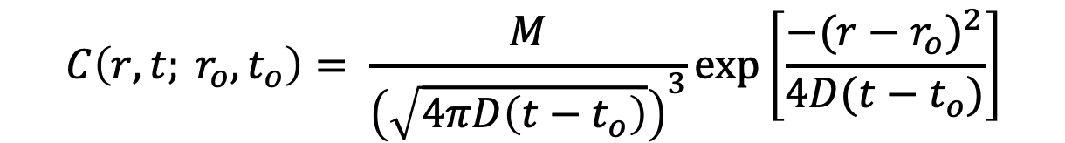
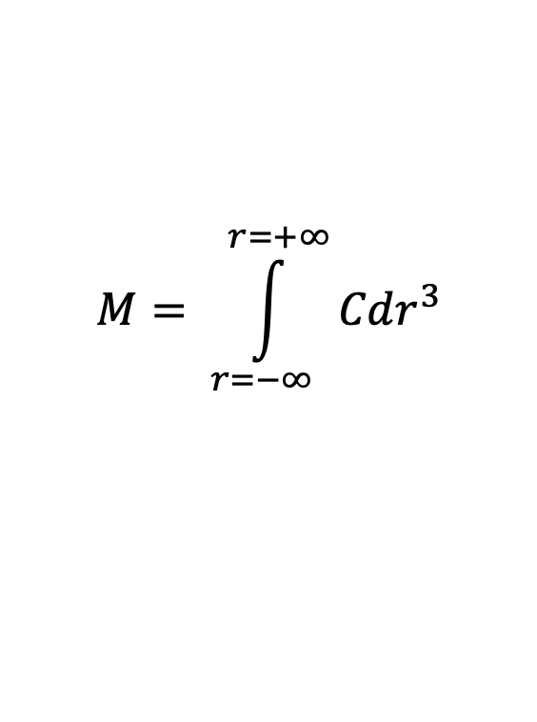
Prototypical 3D Diffusion Solution (No Sink)
$$C\left(r,t; r_{o}, t_{o}\right)= \frac{M}{{\left(\sqrt{4πD\left(t−t_{o}\right)}\right)}^{3}}exp\left[\frac{−(r−r_{o})^{2}}{4D(t−t_{o})}\right]$$
Initial Condition; M release at t = t₀ and r = r₀
$$C\left(r_{o}, t_{o}\right)=Mδ(r^{3})$$
$$M= \int_{r=−∞}^{r=+∞}{Cdr^{3}}$$
$$M is the total mass or moles released$$

Slide 9



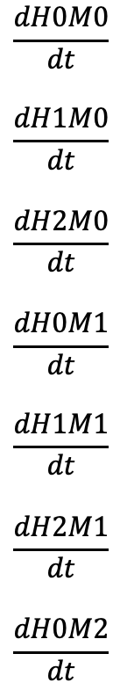

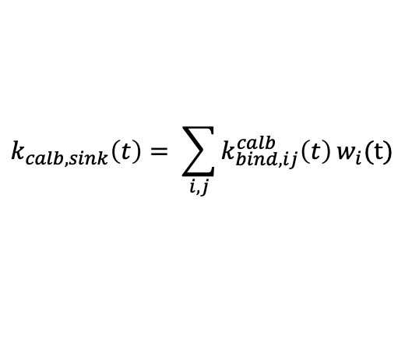
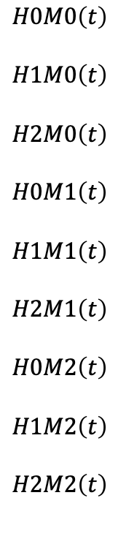
Diffusion Workflow
$$\frac{dH0M0}{dt}$$
$$\frac{dH1M0}{dt}$$
$$\frac{dH2M0}{dt}$$
$$\frac{dH0M1}{dt}$$
$$\frac{dH1M1}{dt}$$
$$\frac{dH2M1}{dt}$$
$$\frac{dH0M2}{dt}$$
$$H0M0\left(t\right)$$
$$H1M0\left(t\right)$$
$$H2M0\left(t\right)$$
$$H0M1\left(t\right)$$
$$H1M1\left(t\right)$$
$$H2M1\left(t\right)$$
$$H0M2\left(t\right)$$
$$H1M2\left(t\right)$$
$$H2M2\left(t\right)$$
$$k_{calb, sink}\left(t\right)= \sum_{i,j}{k_{bind, ij}^{calb}\left(t\right)}w_{i}(t)$$
$\frac{dφ\left(t,t_{o}\right)}{dt}=$ $− k_{calb, sink}\left(t\right)φ(t)$
$$IC:N_{Ca, bolus}$$
System of Differential Equations
$Φ\left(r,t; r_{o}, t_{o}\right)=$ $φ\left(t,t_{o}\right)G\left(r,t; r_{o}, t_{o}\right)$
$$Φ\left(r_{SNARE},t; r_{o}, t_{o}\right)$$

Slide 10
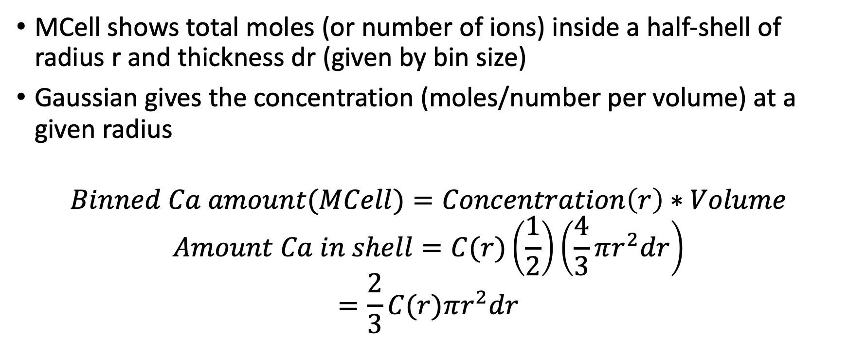
Conversion between MCell and Gaussian
MCell shows total moles (or number of ions) inside a half-shell of radius r and thickness dr (given by bin size)
Gaussian gives the concentration (moles/number per volume) at a given radius
$$Binned Ca amount(MCell)=Concentration\left(r\right)∗Volume$$
$$Amount Ca in shell=C(r)\left(\frac{1}{2}\right)\left(\frac{4}{3}πr^{2}dr\right)$$
$$=\frac{2}{3}C(r)πr^{2}dr$$

Slide 11

Series of Gaussians
VDCC’s at (x_{o}, y_{o}, z_{o}) with
x_{o} = d(VDCC – SNARE)
y_{o} = W/2
z_{o} = 0
Infinite in x direction and mirror to zero flux condition (semi-infinite) in y and z direction

Slide 12
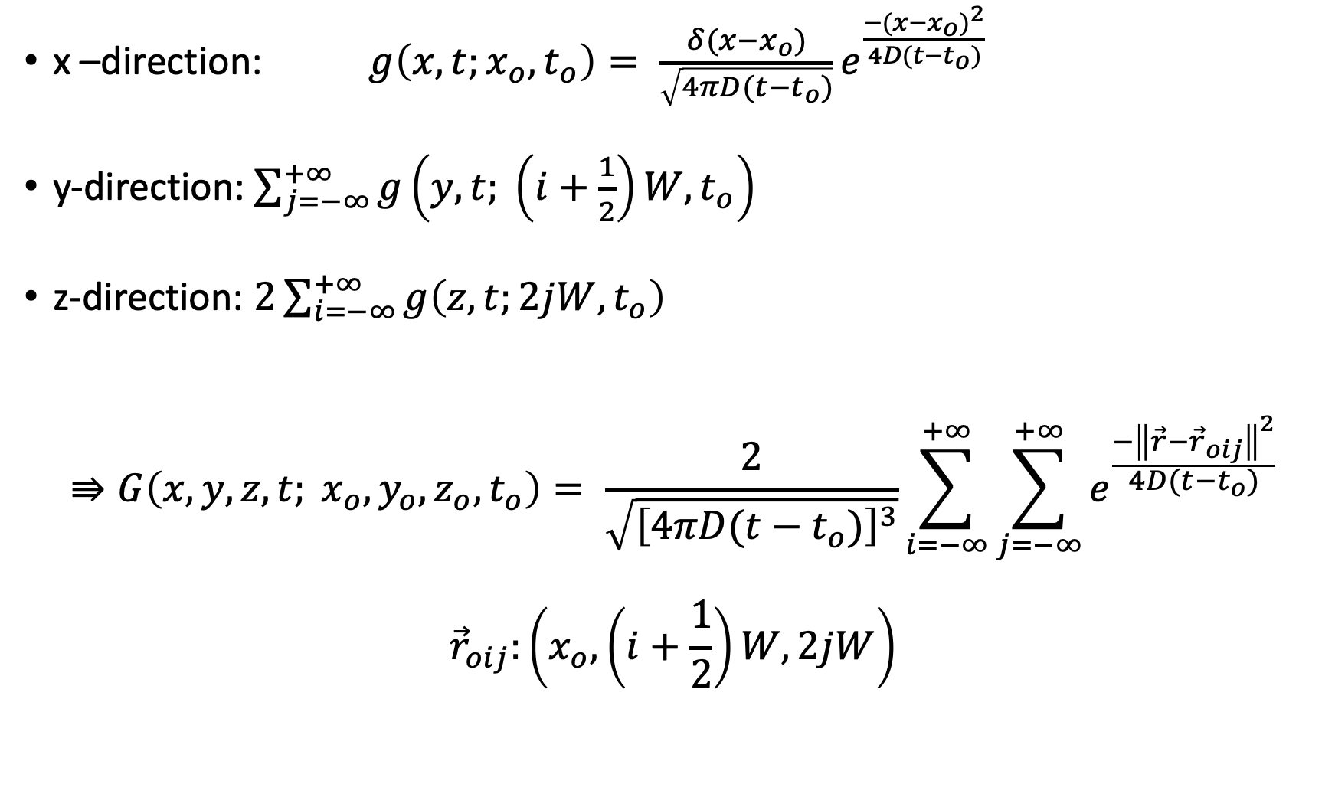
x –direction: $g\left(x, t;x_{o}, t_{o}\right)= \frac{δ(x−x_{o})}{\sqrt{4πD(t−t_{o})}}e^{\frac{−(x−x_{o})^{2}}{4D(t−t_{o})}}$
y-direction: $\sum_{j=−∞}^{+∞}{g\left(y, t; \left(i+\frac{1}{2}\right)W, t_{o}\right)}$
z-direction: $2\sum_{i=−∞}^{+∞}{g\left(z, t;2jW, t_{o}\right)}$
$$⇛G\left(x, y,z,t; x_{o}, y_{o},z_{o},t_{o}\right)= \frac{2}{\sqrt{{\left[4πD(t−t_{o})\right]}^{3}}}\sum_{i=−∞}^{+∞}{\sum_{j=−∞}^{+∞}{e^{\frac{−{\left\|\vec{r}−{\vec{r}}_{oij}\right\|}^{2}}{4D(t−t_{o})}}}}$$
$${\vec{r}}_{oij}:\left(x_{o}, \left(i+\frac{1}{2}\right)W, 2jW\right)$$

Slide 13
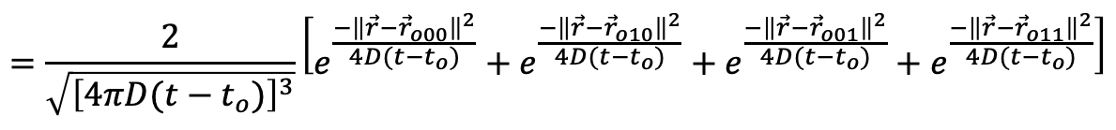
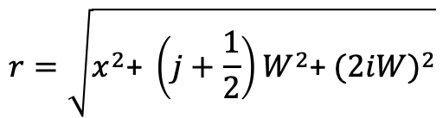
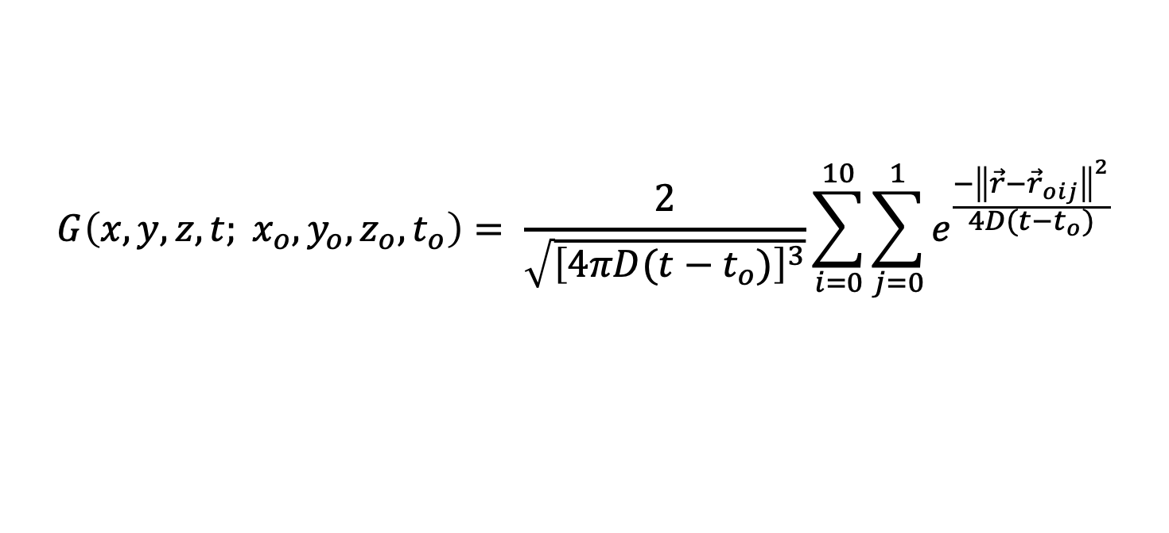


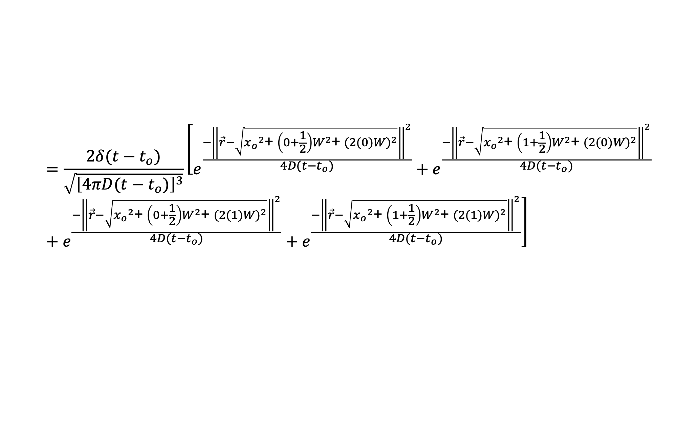
Example calculation
$$G\left(x, y,z,t; x_{o}, y_{o},z_{o},t_{o}\right)= \frac{2}{\sqrt{{\left[4πD(t−t_{o})\right]}^{3}}}\sum_{i=0}^{10}{\sum_{j=0}^{1}{e^{\frac{−{\left\|\vec{r}−{\vec{r}}_{oij}\right\|}^{2}}{4D(t−t_{o})}}}}$$
$r^{2}=x^{2}$+ $y^{2}$+ $z^{2}$
$r^{2}=x^{2}$+ ${\left(j+\frac{1}{2}\right)W}^{2}$+ ${(2iW)}^{2}$
$$=\frac{2}{\sqrt{{\left[4πD(t−t_{o})\right]}^{3}}}\left[e^{\frac{−{\left\|\vec{r}−{\vec{r}}_{o00}\right\|}^{2}}{4D(t−t_{o})}}+e^{\frac{−{\left\|\vec{r}−{\vec{r}}_{o10}\right\|}^{2}}{4D(t−t_{o})}}+e^{\frac{−{\left\|\vec{r}−{\vec{r}}_{o01}\right\|}^{2}}{4D(t−t_{o})}}+e^{\frac{−{\left\|\vec{r}−{\vec{r}}_{o11}\right\|}^{2}}{4D(t−t_{o})}}\right]$$
$$r=\sqrt{x^{2}\text{+ }{\left(j+\frac{1}{2}\right)W}^{2}\text{+ }{(2iW)}^{2}}$$
$$=\frac{2δ(t−t_{o})}{\sqrt{{\left[4πD(t−t_{o})\right]}^{3}}}\left[e^{\frac{−{\left\|\vec{r}−\sqrt{{x_{o}}^{2}\text{+ }{\left(0+\frac{1}{2}\right)W}^{2}\text{+ }{(2(0)W)}^{2}}\right\|}^{2}}{4D(t−t_{o})}}+e^{\frac{−{\left\|\vec{r}−\sqrt{{x_{o}}^{2}\text{+ }{\left(1+\frac{1}{2}\right)W}^{2}\text{+ }{(2(0)W)}^{2}}\right\|}^{2}}{4D(t−t_{o})}}+e^{\frac{−{\left\|\vec{r}−\sqrt{{x_{o}}^{2}\text{+ }{\left(0+\frac{1}{2}\right)W}^{2}\text{+ }{(2(1)W)}^{2}}\right\|}^{2}}{4D(t−t_{o})}}+e^{\frac{−{\left\|\vec{r}−\sqrt{{x_{o}}^{2}\text{+ }{\left(1+\frac{1}{2}\right)W}^{2}\text{+ }{(2(1)W)}^{2}}\right\|}^{2}}{4D(t−t_{o})}}\right]$$

Slide 14
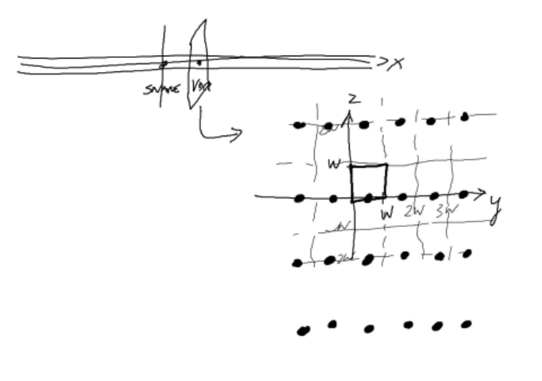

Slide 15
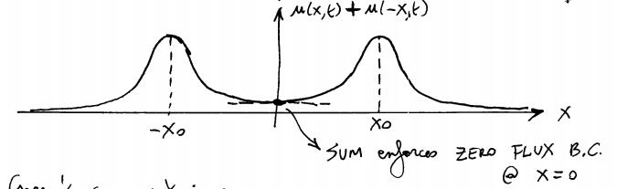
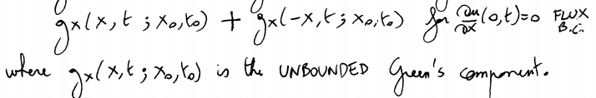
Semi-Infinite Gaussian
See lecture 11 (BENG 221) and APDE 11.3.9

Slide 16
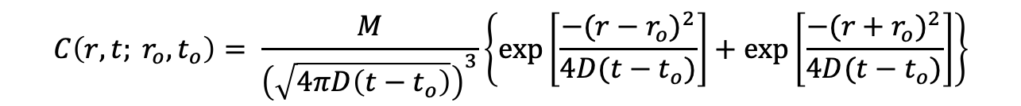
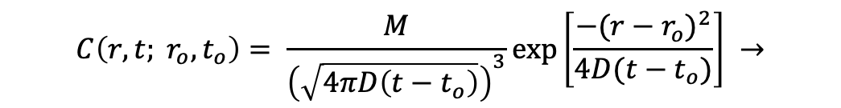
Semi-Infinite Gaussian (3D)
$$C\left(r,t; r_{o}, t_{o}\right)= \frac{M}{{\left(\sqrt{4πD\left(t−t_{o}\right)}\right)}^{3}}exp\left[\frac{−(r−r_{o})^{2}}{4D(t−t_{o})}\right] →$$
$$C\left(r,t; r_{o}, t_{o}\right)= \frac{M}{{\left(\sqrt{4πD\left(t−t_{o}\right)}\right)}^{3}}\left\{exp\left[\frac{−(r−r_{o})^{2}}{4D(t−t_{o})}\right]+exp\left[\frac{−(r+r_{o})^{2}}{4D(t−t_{o})}\right]\right\}$$

