Slide 1

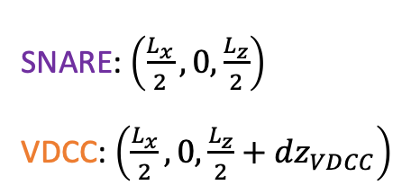




y
$$L_{y}$$
$$0$$
$$L_{z}$$
z
$$L_{x}$$
$$0$$
x
SNARE: $\left(\frac{L_{x}}{2}, 0,\frac{L_{z}}{2}\right)$
VDCC: $\left(\frac{L_{x}}{2}, 0,\frac{L_{z}}{2}+{dz}_{VDCC}\right)$

Slide 2





z
$$L_{z}$$
$$0$$
$$L_{x}$$
x
$$L_{y}$$
y
SNARE: $\left(\frac{L_{x}}{2},\frac{L_{y}}{2},0\right)$
VDCC: $\left(\frac{L_{x}}{2}+{dx}_{VDCC},\frac{L_{y}}{2},0\right)$

Slide 3
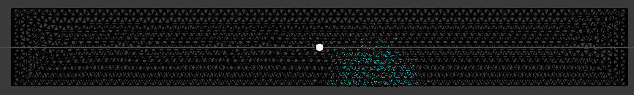
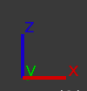

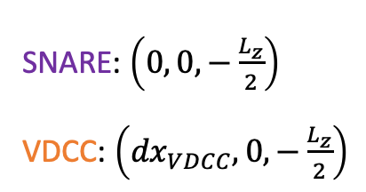



z
$$\left(0, 0,0\right)$$
x
$$L_{z}$$
$$L_{y}$$
$$L_{x}$$
y
SNARE: $\left(0, 0,−\frac{L_{z}}{2}\right)$
VDCC: $\left({dx}_{VDCC}, 0,−\frac{L_{z}}{2}\right)$

Slide 4
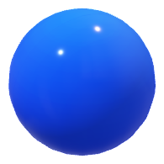
r_{rxn}

Slide 5
y
$$L_{y}$$
$$0$$
$$L_{z}$$
z
$$L_{x}$$
x

Slide 6
y
$$L_{y}$$
$$0$$
$$L_{z}$$
z
$$L_{x}$$
x

