Slide 1
Detailed Markov Model

Slide 2
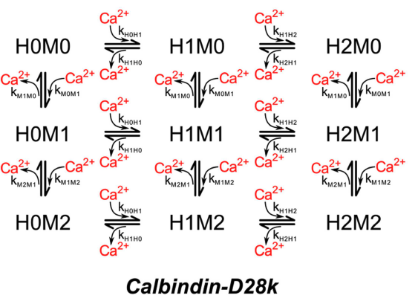
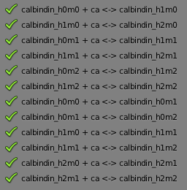
Calbindin
k₀ = k_{M0M1} = 17.4e7 M/s
k₁ = k_{M1M2} = 8.7e7 M/s
k₂ = k_{M1M0} = 35.8 1/s
k₃ = k_{M2M1} = 71.6 1/s
k₄ = k_{H0H1} = 2.2e7 M/s
k₅ = k_{H1H2} = 1.1e7 M/s
k₆ = k_{H1H0} = 2.6 1/s
k₇ = k_{H2H1} = 5.2 1/s
$\frac{M}{s}= \frac{mol}{L∙s}→vol\left(L\right)∙6.022e23\frac{1}{mol}∙\frac{mol}{L∙s}=\frac{number}{sec}$

Slide 3
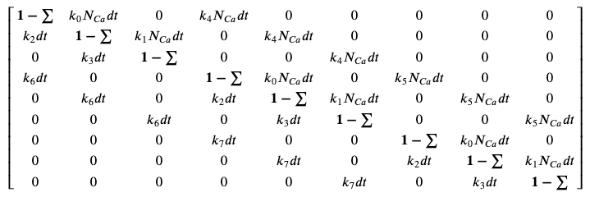
Calbindin Transitions
Transition Matrix
H0M0 H0M1 H0M2 H1M0 H1M1 H1M2 H2M0 H2M1 H2M2
H0M0
H0M1
H0M2
H1M0
H1M1
H1M2
H2M0
H2M1
H2M2

Slide 4
Calbindin Transitions
Transition Matrix
S0 S1 S2 S3 S4 S5 S6 S7 S8
S0
S1
S2
S3
S4
S5
S6
S7
S8

Slide 5
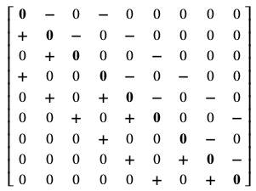
Calbindin Transitions
Transition affect the number of calcium due to binding and unbinding
00 01 02 10 11 12 20 21 22
00
01
02
10
11
12
20
21
22

Slide 6
Calbindin Markov
N calbindin total = 21284 (taken from initial concentration)
N calcium total = 5322 (baseline plus action potential average)
H0M0 H0M1 H0M2 H1M0 H1M1 H1M2 H2M0 H2M1 H2M2
S0
S1
S2
S3
S4
S5
S6
S7
S8
32% 16% 2% 27% 13% 1% 6% 3% 0%

Slide 7
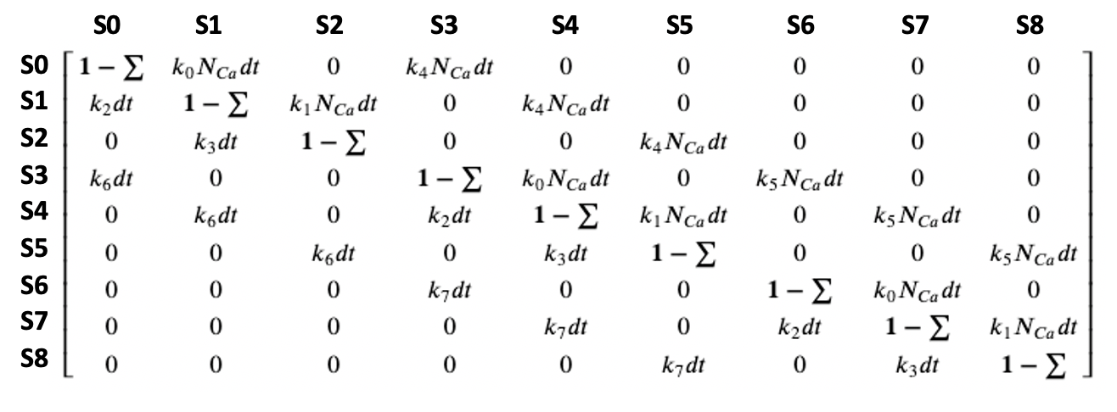



Calbindin Markov
$${1 −(k_{0}N_{Ca}∆t + k}_{4}N_{Ca}∆t)$$
S0
$${k_{4}N}_{Ca}∆t$$
S3
$$k_{0}N_{Ca}∆t$$
S1

Slide 8




Calbindin Markov
t0
[ N_{0, t0}, 0, 0, 0, 0, 0, 0, 0, 0 ]
[ 1 – (P₀₁ + P₀₃), P₀₁, 0, P₀₃, 0, 0, 0, 0, 0 ]
$$1 −(P_{01}+P_{03})$$
$$P_{03}$$
t0 + $∆t$
[ N_{0, t0} – (N₁ + N₃), N₁, 0, N₃, 0, 0, 0, 0, 0 ]
S0
S3
$$P_{01}$$
S1

Slide 9

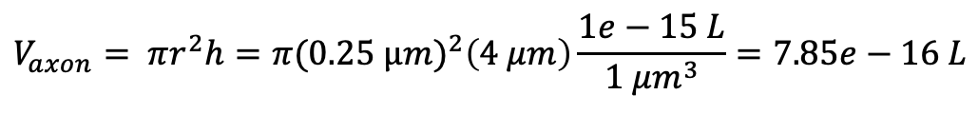
Calbindin Markov
$$V_{axon}= πr^{2}h=π(0.25 μ{m)}^{2}\left(4 μm\right)\frac{1e−15 L}{1 μm^{3}}=7.85e−16 L$$
$$k_{M0M1}=$$

Slide 10
Calbindin Markov

