Slide 1
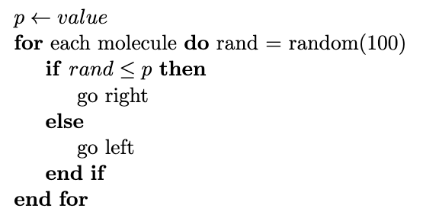
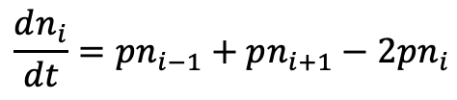
1D random walk
p
p
i-1
i
i+1
1-2p
For a system with equal diffusivity in all directions,
$$\frac{dn_{i}}{dt}=pn_{i−1}+pn_{i+1}−2pn_{i}$$

Slide 2
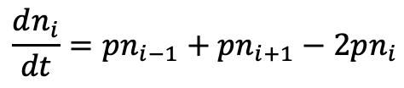
1D random walk
p
p
i-1
i
i+1
For a system with equal diffusivity in all directions, q = p
$$\frac{dn_{i}}{dt}=pn_{i−1}+pn_{i+1}−2pn_{i}$$

Slide 3
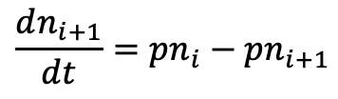
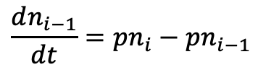
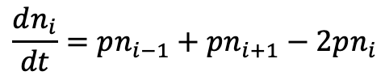
1D random walk, 3 locations
p: probability of moving one unit in either direction = $k∆t$
i-1
i
i+1
p
p
1-p
1-p
p
1-2p
p
$$\frac{dn_{i−1}}{dt}=pn_{i}−pn_{i−1}$$
$$\frac{dn_{i}}{dt}=pn_{i−1}+pn_{i+1}−2pn_{i}$$
$$\frac{dn_{i+1}}{dt}=pn_{i}−pn_{i+1}$$
Notes:
Shouldn’t really have a 1-p probability for diffusion: https://www.princeton.edu/~akosmrlj/MAE545_S2018/lecture17_slides.pdf
https://web.stanford.edu/class/archive/cs/cs279/cs279.1172/lectures/lecture10.pdf
https://www.sintef.no/globalassets/upload/ikt/9011/simoslo/evita/2007/lecture23.pdf

Slide 4
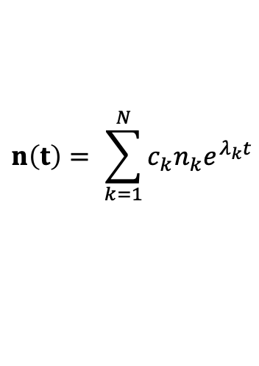
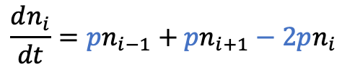

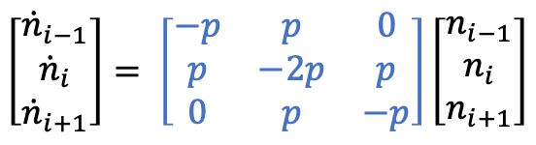
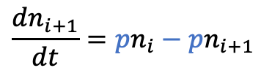
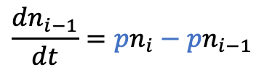
1D random walk, 3 locations
p: probability of moving one unit in either direction = $k∆t$
p
p
i-1
i
i+1
$$\left[\begin{matrix}{\dot{n}}_{i−1} \\ {\dot{n}}_{i} \\ {\dot{n}}_{i+1}\end{matrix}\right]= \left[\begin{matrix}−p & p & 0 \\ p & −2p & p \\ 0 & p & −p\end{matrix}\right]\left[\begin{matrix}n_{i−1} \\ n_{i} \\ n_{i+1}\end{matrix}\right]$$
$$\frac{dn_{i−1}}{dt}=pn_{i}−pn_{i−1}$$
$$\dot{n}\left(t\right)=A\left(t\right)n(t)$$
$$\frac{dn_{i}}{dt}=pn_{i−1}+pn_{i+1}−2pn_{i}$$
A n = 𝜆 n
$$\frac{dn_{i+1}}{dt}=pn_{i}−pn_{i+1}$$
$$n\left(t\right)= \sum_{k=1}^{N}{c_{k}n_{k}e^{λ_{k}t}}$$

Slide 5




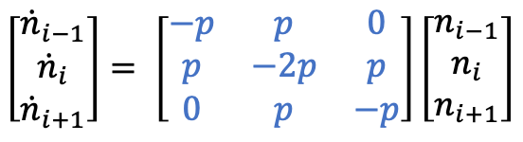


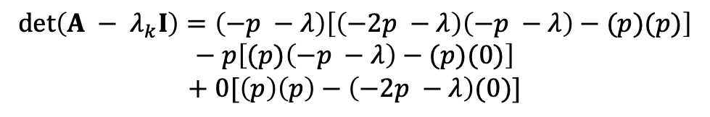
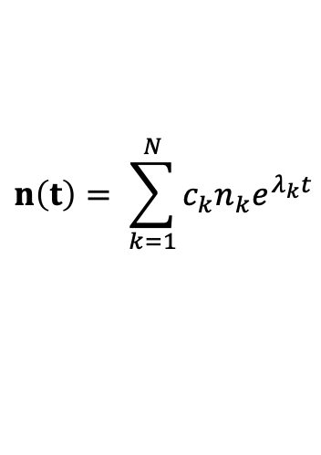
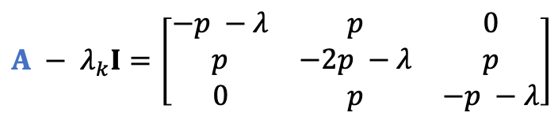
1D random walk
q = 1 - p
p
$$\left[\begin{matrix}{\dot{n}}_{i−1} \\ {\dot{n}}_{i} \\ {\dot{n}}_{i+1}\end{matrix}\right]= \left[\begin{matrix}−p & p & 0 \\ p & −2p & p \\ 0 & p & −p\end{matrix}\right]\left[\begin{matrix}n_{i−1} \\ n_{i} \\ n_{i+1}\end{matrix}\right]$$
i-1
i
i+1
Finding the eigenvalues
$$\dot{n}\left(t\right)=A\left(t\right)n(t)$$
$$A − λ_{k}I=\left[\begin{matrix}−p −λ & p & 0 \\ p & −2p −λ & p \\ 0 & p & −p −λ\end{matrix}\right]$$
Eigenmode solution
$$n\left(t\right)= \sum_{k=1}^{N}{c_{k}n_{k}e^{λ_{k}t}}$$
$$det\left(A − λ_{k}I\right)=\left(−p −λ\right)\left[\left(−2p −λ\right)\left(−p −λ\right)−(p)(p)\right]$$
$$− p\left[(p)\left(−p −λ\right)−(p)(0)\right]$$
$$+ 0[\left(p\right)\left(p\right)−\left(−2p −λ\right)(0)]$$
Eigenvalue equations
$$det\left(A − λ_{k}I\right)v=0$$
$$0=2p^{3}−2p^{2}−2λ^{2}p +λp^{2}−4pλ − λ^{3}−2λ^{2}$$
Eigendecomposition
For p = 0.5
$$Av= λv$$
$$0=2p^{3}−2p^{2}−2λ^{2}p +λp^{2}−4pλ − λ^{3}−2λ^{2}$$
$$AQ=QΛ$$
$$A=QΛQ^{−1}$$
$$λ=−2.28, −0.5, −0.22$$

Slide 6

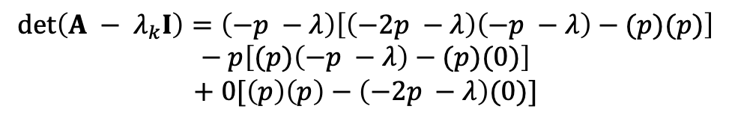


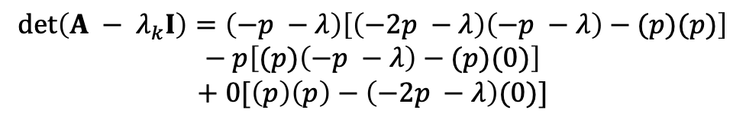
1D random walk
q = 1 - p
p
$$\left[\begin{matrix}{\dot{n}}_{i−1} \\ {\dot{n}}_{i} \\ {\dot{n}}_{i+1}\end{matrix}\right]= \left[\begin{matrix}−p & p & 0 \\ p & −2p & p \\ 0 & p & −p\end{matrix}\right]\left[\begin{matrix}n_{i−1} \\ n_{i} \\ n_{i+1}\end{matrix}\right]$$
Finding the eigenvalues
i-1
i
i+1
$$A − λ_{k}I=\left[\begin{matrix}−p −λ & p & 0 \\ p & −2p −λ & p \\ 0 & p & −p −λ\end{matrix}\right]$$
$$\dot{n}\left(t\right)=A\left(t\right)n(t)$$
$$det\left(A − λ_{k}I\right)=\left(−p −λ\right)\left[\left(−2p −λ\right)\left(−p −λ\right)−(p)(p)\right]$$
$$− p\left[(p)\left(−p −λ\right)−(p)(0)\right]$$
$$+ 0[\left(p\right)\left(p\right)−\left(−2p −λ\right)(0)]$$
Eigenmode solution
$$n\left(t\right)= \sum_{k=1}^{N}{c_{k}n_{k}e^{λ_{k}t}}$$
$$det\left(A − λ_{k}I\right)=\left(−p −λ\right)\left[\left(−2p −λ\right)\left(−p −λ\right)−(p)(p)\right]$$
$$− p\left[(p)\left(−p −λ\right)−(p)(0)\right]$$
$$+ 0[\left(p\right)\left(p\right)−\left(−2p −λ\right)(0)]$$
Eigenvalue equations
$$det\left(A − λ_{k}I\right)v=0$$
$$0=−3p^{2}λ−4pλ^{2}−λ^{3}=−λ(p+λ)(3p+λ)$$
Eigendecomposition
$$Av= λv$$
$$λ=0, −3p, −p$$
For p = 0.5
$$AQ=QΛ$$
$$A=QΛQ^{−1}$$
$$λ=0, −1.5, −0.5$$

Slide 7
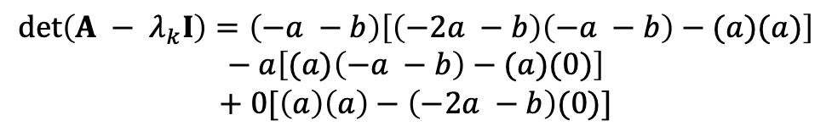

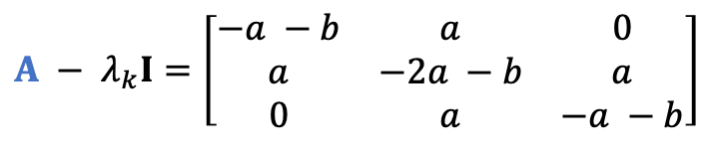


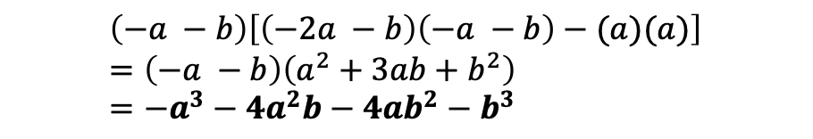
Finding the eigenvalues
$$A − λ_{k}I=\left[\begin{matrix}−a −b & a & 0 \\ a & −2a −b & a \\ 0 & a & −a −b\end{matrix}\right]$$
$$det\left(A − λ_{k}I\right)=\left(−a −b\right)\left[\left(−2a −b\right)\left(−a −b\right)−(a)(a)\right]$$
$$− a\left[(a)\left(−a −b\right)−(a)(0)\right]$$
$$+ 0[\left(a\right)\left(a\right)−\left(−2a −b\right)(0)]$$
$$\left(−a −b\right)\left[\left(−2a −b\right)\left(−a −b\right)−(a)(a)\right]=\left(−a −b\right)\left(a^{2}+3ab+b^{2}\right)=−a^{3}−4a^{2}b−4ab^{2}−b^{3}$$
$$− a\left[\left(a\right)\left(−a −b\right)−\left(a\right)\left(0\right)\right]=a^{3}+a^{2}b$$
$$0\left[\left(a\right)\left(a\right)−\left(−2a −b\right)\left(0\right)\right]=0$$
$$det\left(A − λ_{k}I\right)=−3a^{2}b−4ab^{2}−b^{3}$$

Slide 8
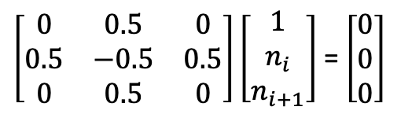



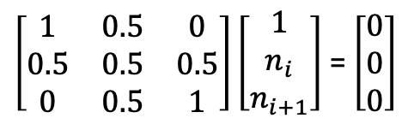
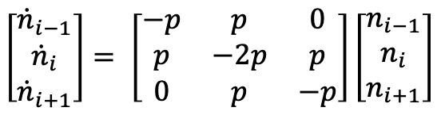


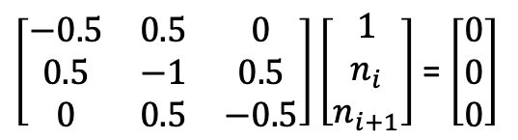


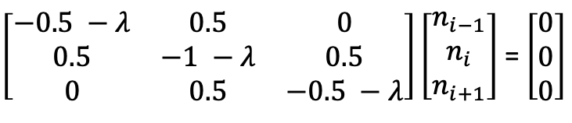

1D random walk – likely incorrect
q = 1 - p
p
$$\left[\begin{matrix}{\dot{n}}_{i−1} \\ {\dot{n}}_{i} \\ {\dot{n}}_{i+1}\end{matrix}\right]= \left[\begin{matrix}−p & p & 0 \\ p & −2p & p \\ 0 & p & −p\end{matrix}\right]\left[\begin{matrix}n_{i−1} \\ n_{i} \\ n_{i+1}\end{matrix}\right]$$
i-1
i
i+1
$$λ=−0.5$$
$$\dot{n}\left(t\right)=A\left(t\right)n(t)$$
$\left[\begin{matrix}0 & 0.5 & 0 \\ 0.5 & −0.5 & 0.5 \\ 0 & 0.5 & 0\end{matrix}\right]\left[\begin{matrix}1 \\ n_{i} \\ n_{i+1}\end{matrix}\right]$ = $\left[\begin{matrix}0 \\ 0 \\ 0\end{matrix}\right]$
$\left[\begin{matrix}−0.5 −λ & 0.5 & 0 \\ 0.5 & −1 −λ & 0.5 \\ 0 & 0.5 & −0.5 −λ\end{matrix}\right]\left[\begin{matrix}n_{i−1} \\ n_{i} \\ n_{i+1}\end{matrix}\right]$ = $\left[\begin{matrix}0 \\ 0 \\ 0\end{matrix}\right]$
$\left[\begin{matrix}0 & 0 & 0\end{matrix}\right]$^{T}
$$λ=0, −1.5, −0.5$$
Finding the eigenvectors (using scaled n-values)
$$λ=−1.5$$
$$λ=0$$
$\left[\begin{matrix}1 & 0.5 & 0 \\ 0.5 & 0.5 & 0.5 \\ 0 & 0.5 & 1\end{matrix}\right]\left[\begin{matrix}1 \\ n_{i} \\ n_{i+1}\end{matrix}\right]$ = $\left[\begin{matrix}0 \\ 0 \\ 0\end{matrix}\right]$
$\left[\begin{matrix}−0.5 & 0.5 & 0 \\ 0.5 & −1 & 0.5 \\ 0 & 0.5 & −0.5\end{matrix}\right]\left[\begin{matrix}1 \\ n_{i} \\ n_{i+1}\end{matrix}\right]$ = $\left[\begin{matrix}0 \\ 0 \\ 0\end{matrix}\right]$
$\left[\begin{matrix}1 & 0 & 1\end{matrix}\right]$^{T}
$\left[\begin{matrix}1 & 0 & 1\end{matrix}\right]$^{T}

Slide 9




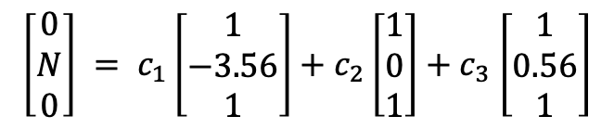

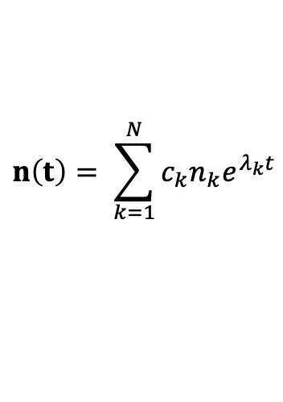

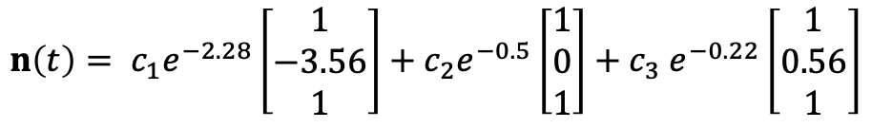
1D random walk – not updated
q = 1 - p
p
$$λ=−2.28$$
$\left[\begin{matrix}1 & −3.56 & 1\end{matrix}\right]$^{T}
i-1
i
i+1
$$λ=−0.5$$
$\left[\begin{matrix}1 & 0 & 1\end{matrix}\right]$^{T}
$$λ=−0.22$$
$\left[\begin{matrix}1 & 0.56 & 1\end{matrix}\right]$^{T}
Finding the general solution (using eigenvalues/vectors)
$$n\left(t\right)= \sum_{k=1}^{N}{c_{k}n_{k}e^{λ_{k}t}}$$
$$n\left(t\right)= c_{1}e^{−2.28}\left[\begin{matrix}1 \\ −3.56 \\ 1\end{matrix}\right]+c_{2}e^{−0.5}\left[\begin{matrix}1 \\ 0 \\ 1\end{matrix}\right]{+ c}_{3}e^{−0.22}\left[\begin{matrix}1 \\ 0.56 \\ 1\end{matrix}\right]$$
Use initial conditions to find solution (all N molecules start in position i)
$$\left[\begin{matrix}0 \\ N \\ 0\end{matrix}\right] = c_{1}\left[\begin{matrix}1 \\ −3.56 \\ 1\end{matrix}\right]+c_{2}\left[\begin{matrix}1 \\ 0 \\ 1\end{matrix}\right]{+ c}_{3}\left[\begin{matrix}1 \\ 0.56 \\ 1\end{matrix}\right]$$
Notes:
https://tutorial.math.lamar.edu/classes/de/RealEigenvalues.aspx
→ Left and right don’t appear to be independent as I have done it…

Slide 10
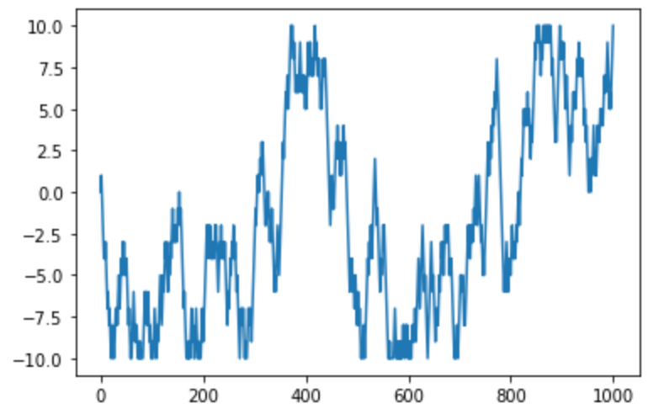
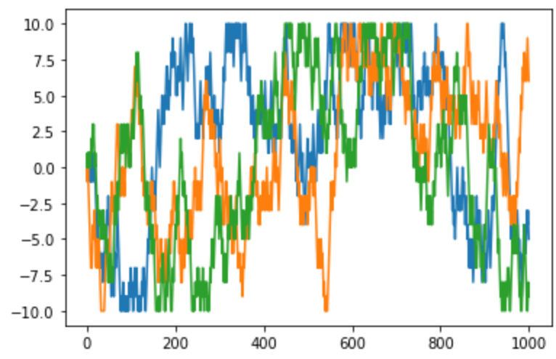
1D random walk
q = 1 - p
p
i-1
i
i+1
For a system with equal diffusivity in all directions, q = p = 0.5. 1000 time points in a range of x = [-10, 10]
1 molecule
3 molecules

Slide 11
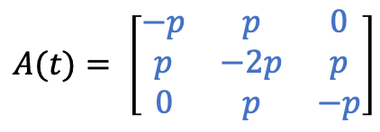
1D random walk, multiple locations
p
p
i-1
i
i+1
Top left and bottom right are –p, all other values on the diagonal are -2p, off-diagonals are p, everything else is 0.
$$A(t)= \left[\begin{matrix}−p & p & 0 \\ p & −2p & p \\ 0 & p & −p\end{matrix}\right]$$

Slide 12
Grid-free diffusion
Markovian model (1-D random walk)
Eigenmode analysis
Random walk modeled as Markov process
Flip a coin, move left or right
Can be scaled to more molecules
Requires a grid
Grid-free analysis

