Slide 1
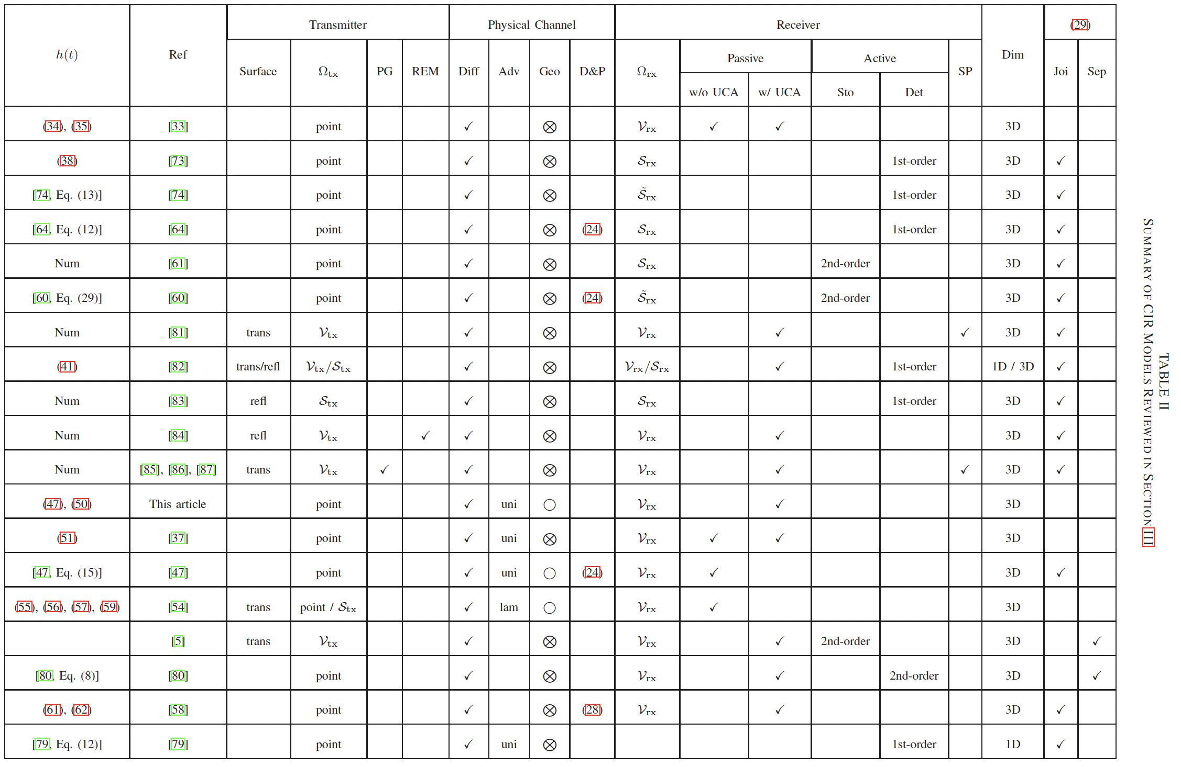
Ω_{tx}: transmitter type
PG: particle generation
REM:
Diff: diffusion
Adv: advection
Geo: bounded geometry
D&P: degradation/production
Ω_{tx}: receiver type
Sto: stochastic reaction
Det: deterministic
SP: signaling pathways
Dim: dimension

