Slide 1
*Everyone speaks for 1:15 - 1:45 minutes
-- Margot + Keshav
Problem + Goal
Dataset
-- Jinlong
VAE
BERT
-- Geeling (beginning) + Anshuman (ending)
Results - VAE
Results - BERT
Results - VAE + BERT + Conclusion

Slide 2
Sentence Generation and Classification with Variational Autoencoder and BERT
Geeling Chau, Anshuman Dewangan, Jin-Long Huang, Keshav Rungta, Margot Wagner

Slide 3
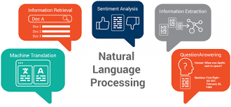

Introduction
Natural-language generation: transformation of structured data into natural language, in this case using AI techniques
Current SOTA: GPT-3 by OpenAI -- 175 billion parameters (May 2020)
Problem: text generation can tend to be contradictory
Goal: generate text responses with different levels of contradictoriness
Notes:
Margot
However, the generated text can suffer from being
contradictory with itself or contradicting with historical facts. There is no current system to detect
whether a language model is generating text that is sensible or measure how much it potentially
contradicts with other sources. Thus, it is important that we explore this topic of building a model to
identify contradictory sentences as a starting point for incorporating logical soundness and a measure
of contradiction to our language models.

Slide 4
The Dataset
“Contradictory, My Dear Watson” by Kaggle:
Over 12k unique pairs
Stanford Natural Language Inference (SNLI) :
Over 570k unique pairs
Given a sentence pair (a premise and a hypothesis) there are 3 ways they could be related: “This church choir sings to the masses as they sing joyous songs from the book at a church.”
One sentence entails the other (entailment)
The church is filled with song.
The sentences are neutral but related (neutral)
The church has cracks in the ceiling.
One sentence contradicts the other (contradiction)
A choir singing at a baseball game.

Slide 5
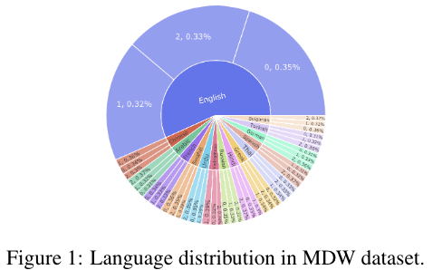
Data Processing
Kaggle MDW:
Kaggle dataset contains sentences from many
languages
Since only 56% of them are in English, we translate all of them to English using the pytransgoogle library provided by Google Translate API
SNLI:
Used HuggingFace Datasets (🤗Datasets) to process the original dataset to work with our original dataloader one for MDW.

Slide 6
The Goal
Create 1 variational autoencoder that generates a hypothesis given a premise with no regard for class label
Metric: BLEU scores compared to dataset
Create 3 variational autoencoders, one for each class, to generate a hypothesis given a premise of that label
Metric: BLEU scores compared to dataset and accuracy score when passed through BERT classifier
Create a conditional variational autoencoder that generates a hypothesis given a premise and class label
Metric: BLEU scores compared to dataset and accuracy score when passed through BERT classifier
Notes:
Margot

Slide 7
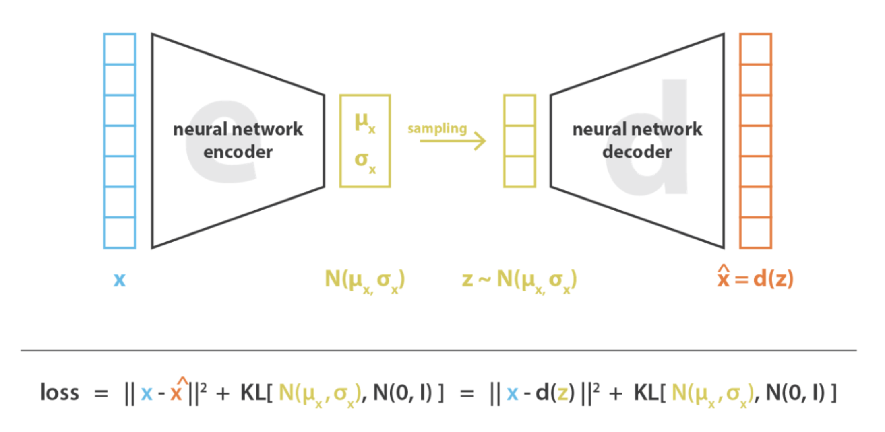
Hypothesis Generation -- Variational Autoencoder (VAE)
Variational autoencoder (VAE): generative version of basic autoencoder
LSTM encoder and decoder
Encoder
Input: premise sentence
Output: embedding in Gaussian latent space
Decoder
Input: embedding
Output: hypothesis sentence
Reparameterization trick to enable backprop

Slide 8
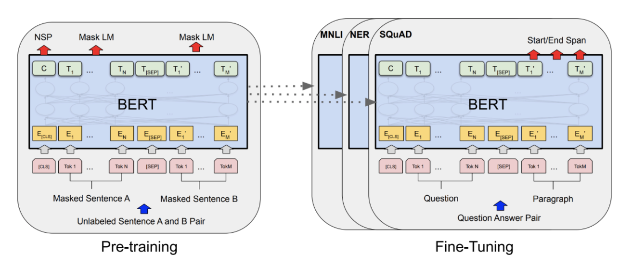
Hypothesis Classification -- BERT
We used pretrained BERT provided by 🤗
Bidirectional representation
Attention mechanism
Input: concatenated sentence pairs
Output: sentence relationship class

Slide 9
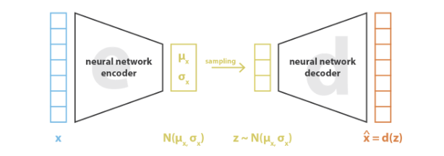
~ Results ~
Variational AutoEncoder (VAE) Sentence Generator
A man is holding a child.
The man is a professional musician.
The man is sitting on a couch.

Slide 10
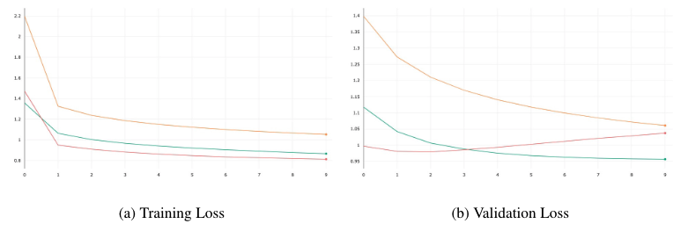
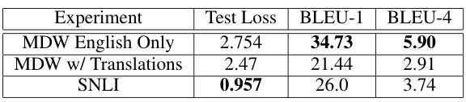
VAE HP Tuning + Data Augmentation
Learning Rate: 5e-4
Data Augmentation
5e-5
5e-4
5e-3

Slide 11
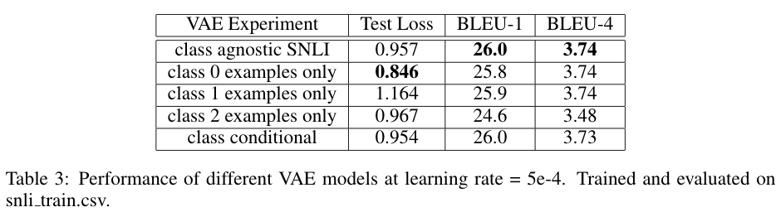
How close can we get our generated sentences to be?
Class Agnostic
A man in a black hat opens his mouth -> a man is looking at a camera
A young infant cries while having his or her pajamas button -> a man is standing outside
Notes:
Fairly similar test loss + BLEU scores across all models.
Training on the largest dataset, we already got sensical sentences

Slide 12
How close can we get our generated sentences to be?
Class Agnostic
Class Specific
0: entail
1: neutral
2: contra
A man and a child are laughing at each other.
Predicted Entailment: A man is holding a child
A man talking into a microphone with a woman standing next to him.
Predicted Neutral: The man is a professional musician
A man wearing a white shirt and a blue jeans reading a newspaper while standing.
Predicted Contradiction: The man is sitting on the couch.
Notes:
Some specific examples

Slide 13
How close can we get our generated sentences to be?
Class Agnostic
Class Specific
0: entail
1: neutral
2: contra
Class Conditional
A man on a bicycle rides past a park, with a group of people in the background.
Predicted Contradiction: The man is sitting on the couch.
Notes:
We have sentences very similar to each other

Slide 14
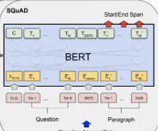
~ Results ~
BERT Classification of Premise + Hypothesis Pairs
0: Entailment
A man and a child are laughing at each other + Two people are laughing

Slide 15
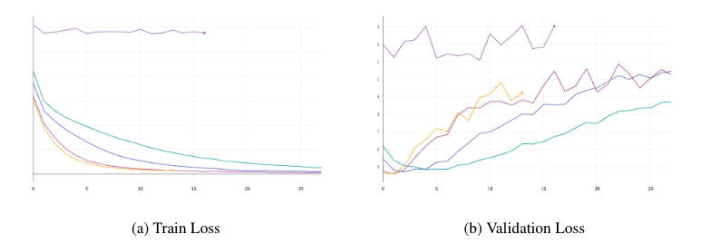
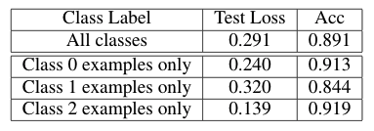
BERT HP Tuning + Baseline Accuracy
Learning Rate: 5e-5
Baseline Accuracy:
5e-3 5e-6 1e-5 3e-5 5e-5

Slide 16
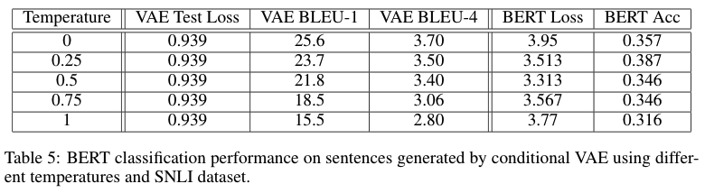
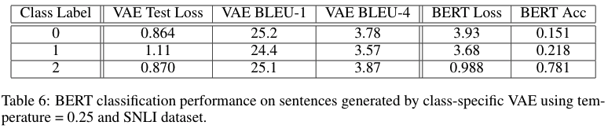
How much of the logic did our generation models learn to produce?
Varying Temperature:
Varying Class Label:

Slide 17
Architecture Changes?
What we tried:
Use encoder output as decoder hidden state for initial time step only
Use encoder output concatenated with hypothesis as decoder input
Use encoder output as decoder hidden and cell state at every time step
Use encoder output as decoder hidden state only at every time step
Use encoder output concatenated with decoder hidden state as decoder hidden state at every time step
Future work:
Can generate synonyms for various words in sentences
Use concatenated (premise, hypothesis) pair as encoder input
Use BERT instead of LSTM for encoder/decoder

Slide 18
Appendix

Slide 19
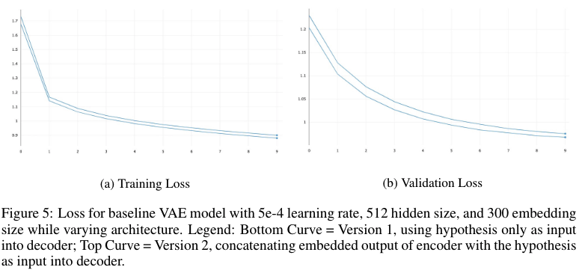
Architecture Changes

Slide 20
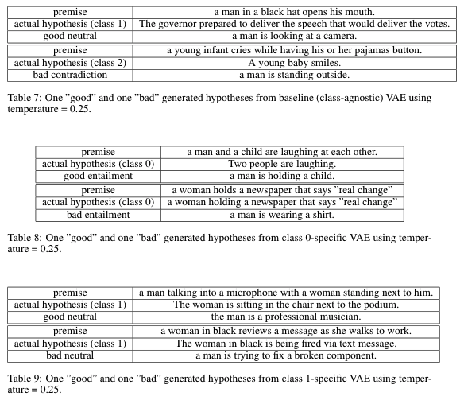

Slide 21
