Slide 2
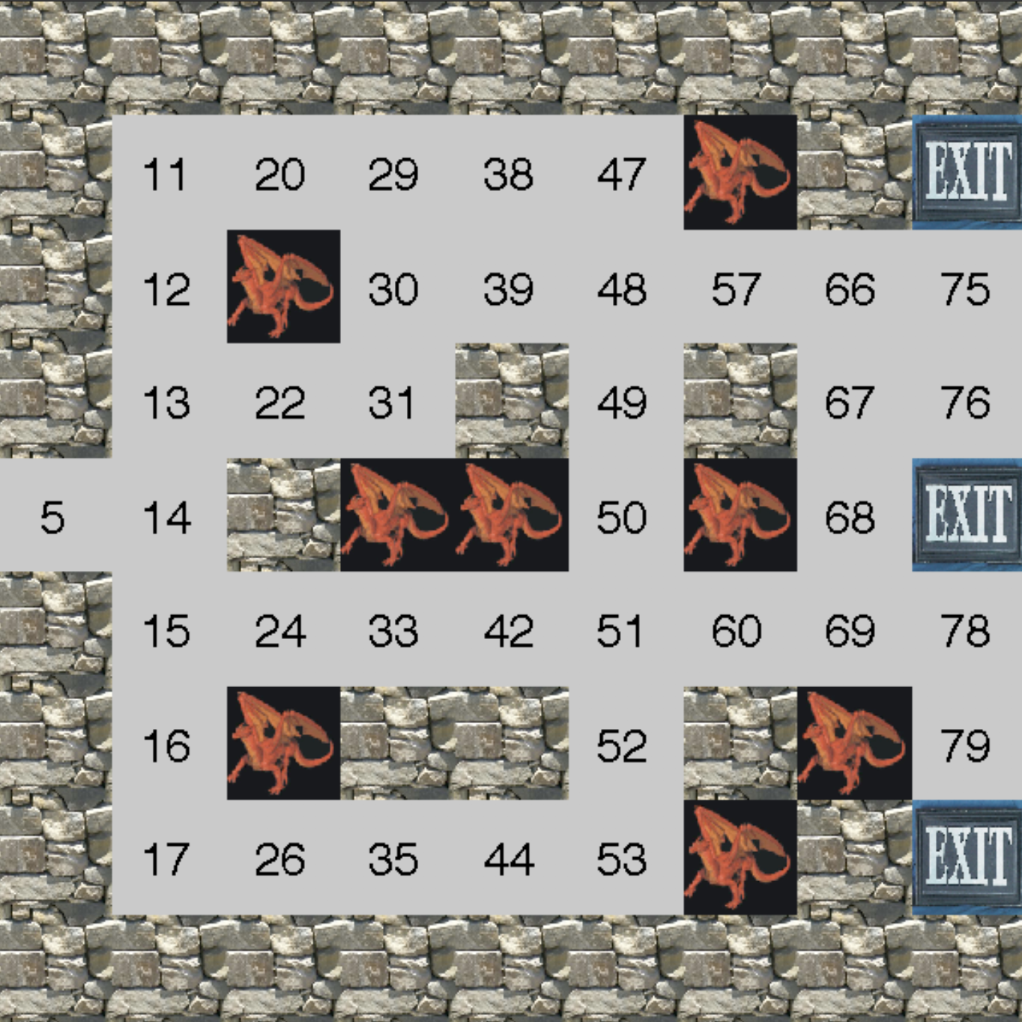

Slide 3
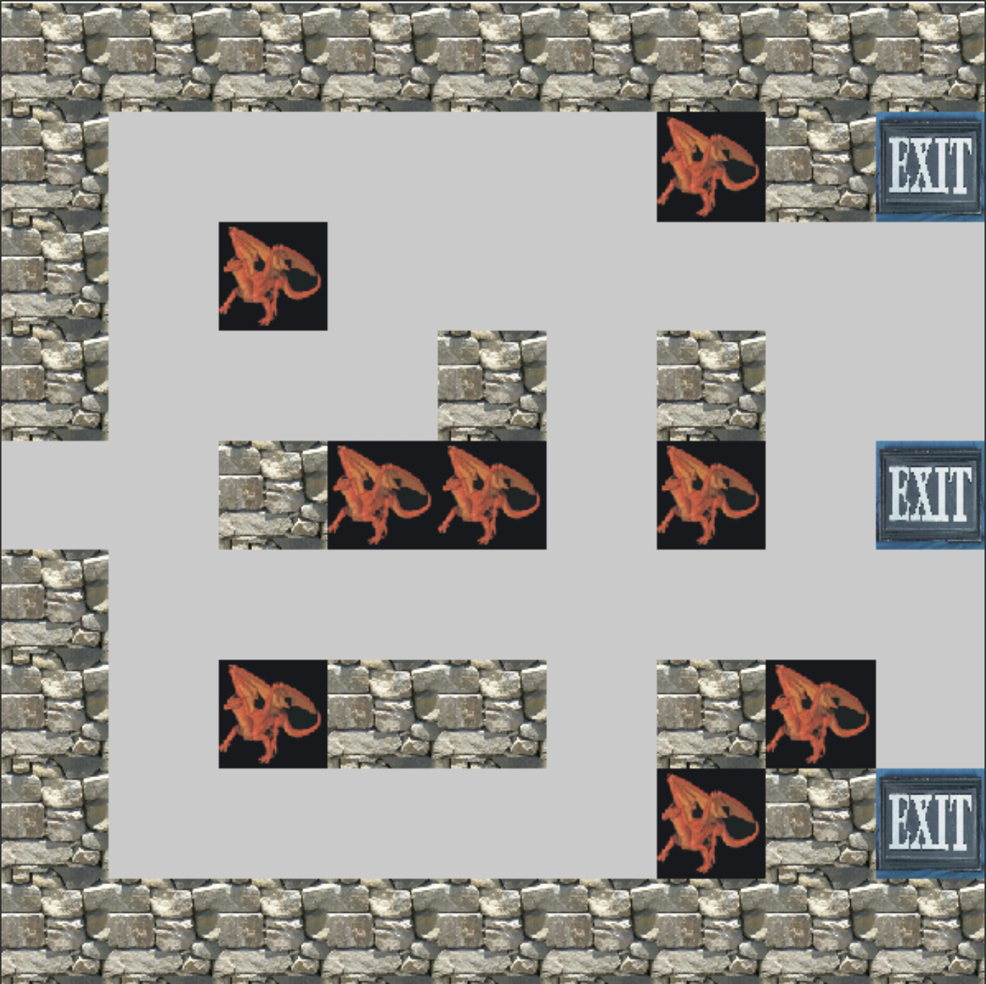

Slide 5
65.77
67.14
77.85
77.84
72.48
-100
+100
55.88
-100
70.31
81.34
83.05
84.88
96.87
98.72
54.92
50.48
59.67
80.96
97.04
98.73
53.51
54.15
-100
-100
61.78
-100
88.22
+100
52.50
43.94
51.09
61.01
71.79
73.95
85.18
97.57
43.77
-100
70.35
-100
88.41
47.95
48.77
48.15
59.39
60.17
-100
+100

