Slide 1
Protobuf
In blackstar

Slide 2
Introduction
What is Protobuf and protobuf-net? Basic, generic and surrogate examples with code, specs and schema.

Slide 3
What is protobuf and protobuf-net
Protobuf
Method of serializing structured data
It is binary efficient and fast
Requires you to define the schema
Protobuf-net
Uses protobuf to write data
Follows typical .Net patterns
Has different API crates proto schema for you

Slide 4
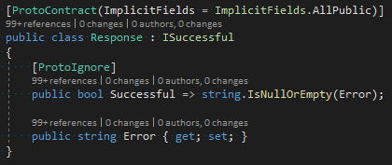


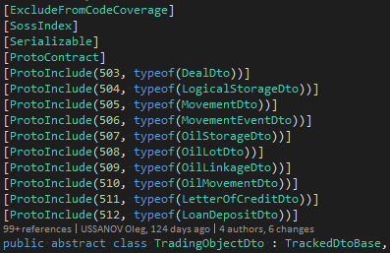
Basic example
Base
Schema
Include
Spec
Spec and include Id’s must be unique. Per subtree, but tests require globally.

Slide 5
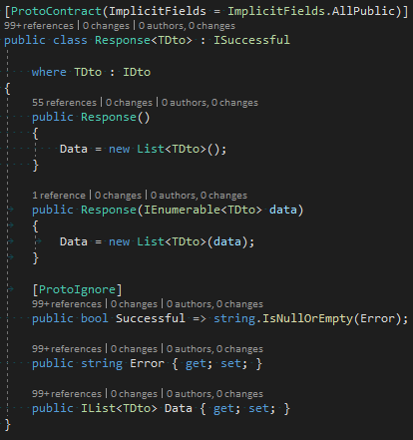

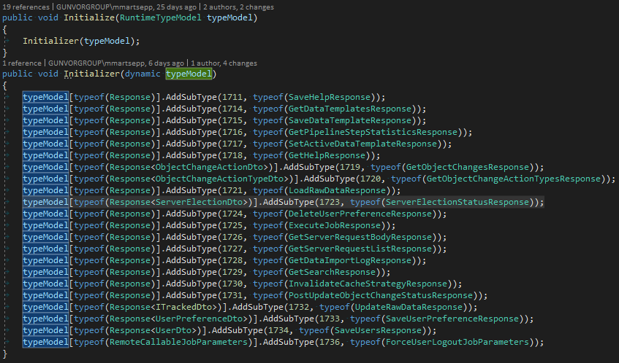
Generic example, Slide 1
Spec
Generic class

Slide 6
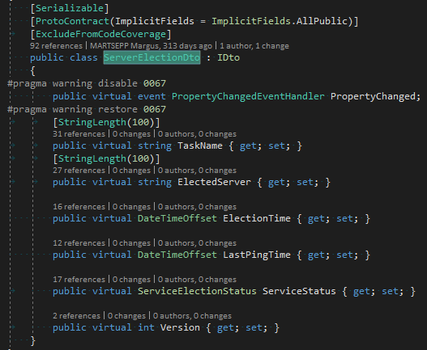
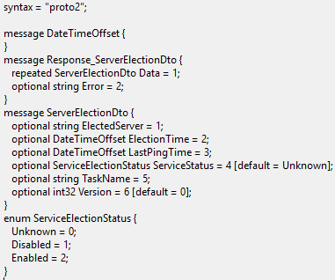
Generic example, Slide 2
Schema
Type parameter
Collections items are serialized. Null and empty collections yield same result

Slide 7

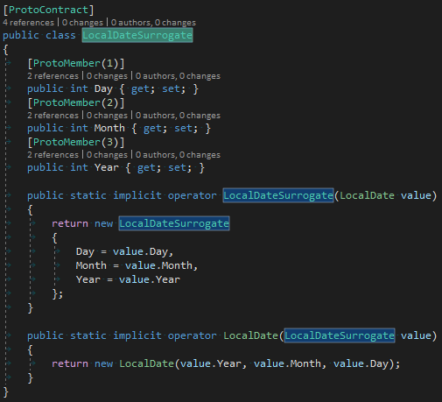
Basic surrogates
Takes the resposibility of defining proto contract for a specific type
Spec
Manages what and how are properties stored

Slide 8
Limitations
Single parent. Open ended generics require defining every used combination. Long enums. JsonSurrogate and ProtoSurrogate. Nulls inside collections.

Slide 9
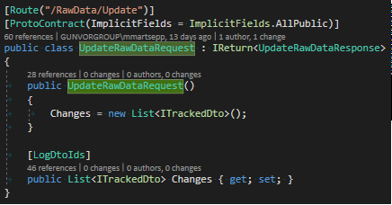
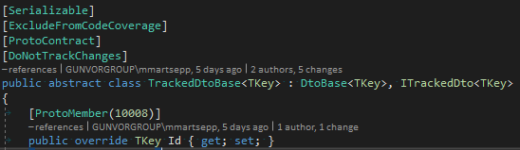

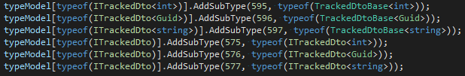
Single parent
Code
Used by Interfaces
Generic Id is defined in DtoBase<>, protobuf spec uses ITrackedDto<>
Interfaces need spec if they are used as parameter types inside a contract
Spec

Slide 10


Open ended generics
Spec
You need to define spec for all the instances and their parent tree
Type parameter

Slide 11

Boolean default value override
If you override the default value to true then you need to use default value attribute as nothing is sent over
Type parameter

Slide 12
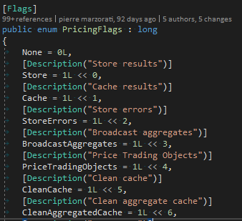

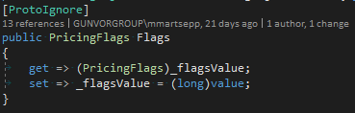
Type long enums
Code
Type parameter
Our version 2.4.3 does not support it, but Marc Gravell added support for it to V3

Slide 13
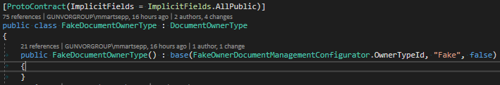
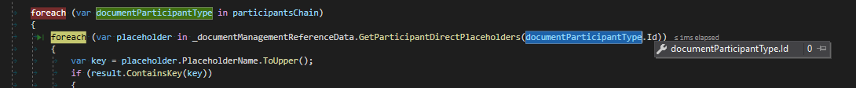
Public parameterless constructors
Proper base class constructors still need to be called
Type parameter

Slide 14
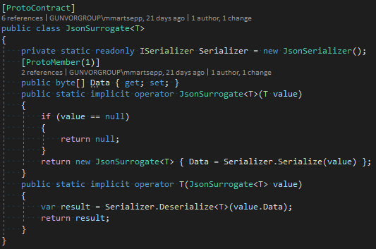

JsonSurrogate
Alternative, if type is not proto friendly
Generally should be avoided
Spec
Schema

Slide 15
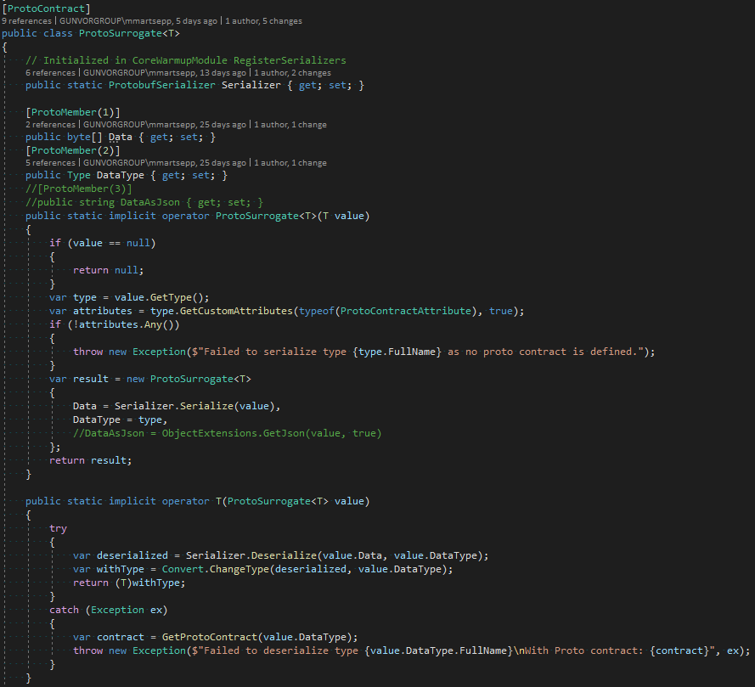
ProtoSurrogate
It is like a promice that data itself is proto serilizable, but it is stored inside an ‘object’
Spec
During development, in case of errors, it might me useful to include Json to have better exceptions

Slide 16

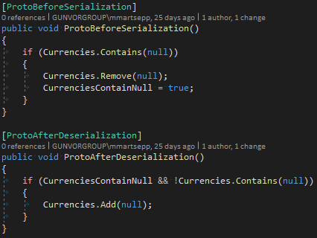
Nulls inside collections
Protobuf does not sent null values
Code example

Slide 17

Tests
IReturn<>, Response, Resonse<>, ITrackedDto implementors define a proto contract.
All protobuf keys and type and subtype pairs are unique.
Contracts serialize without loss of properties

