Slide 1
VTThrift Project Explanation
Jessie and Howie

Slide 2
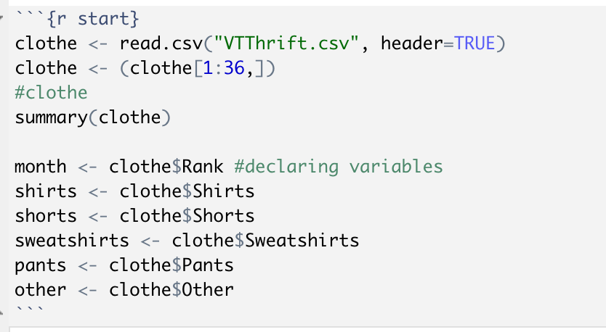
Chunk 1 : {r start}
Setup Chunk
Reads CSV with our randomized data , which should be replaced with your inventory data
Gives a statistical summary including mean , median , 1st and 3rd percentile , min , max
Declares each column of the excel a variable in R Studio

Slide 3
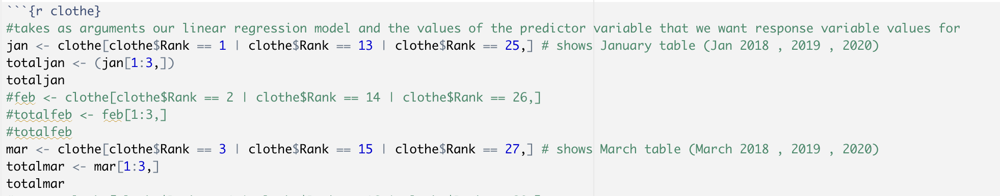
Chunk 2 : {r clothe}
Combines all respective months together
Example – Jan 2018 , Jan 2019 , Jan 2020 Inventory is all geared together to predict the following years of January
Rank System (1-36 for each month)
1 = Jan 2018 , 36 = Dec 2020

Slide 4
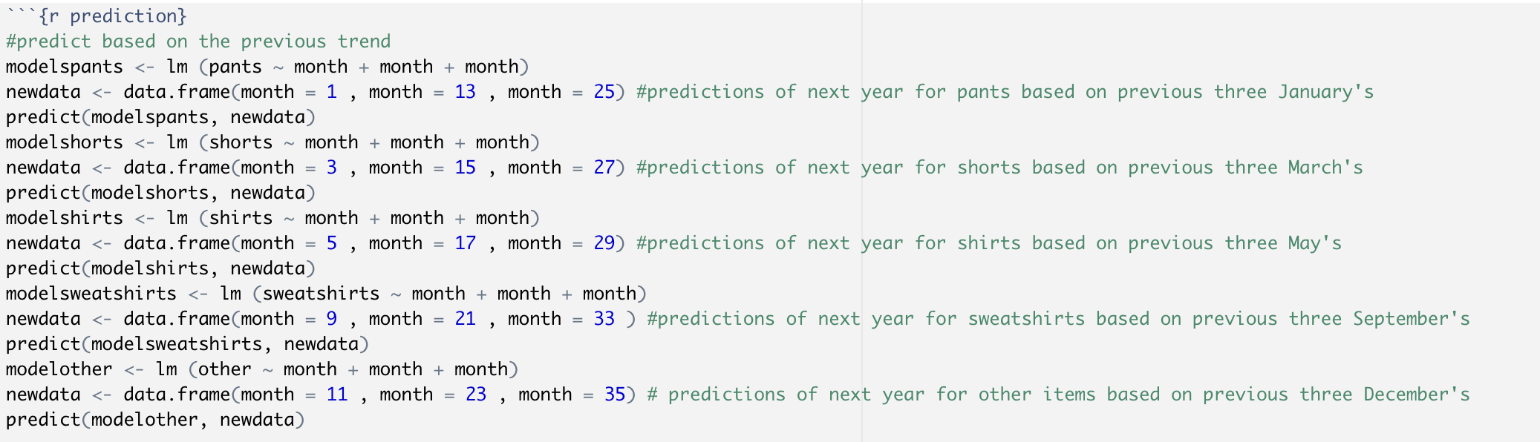
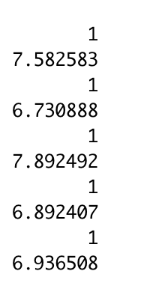
Chunk 3 : {predict}
The predict function is used to help find the certain clothing items predict value for the following year based of previous years.
Example – finding the predicted value of shorts based of March 2018 , 2019 , and 2020 is 6.73088

Slide 5
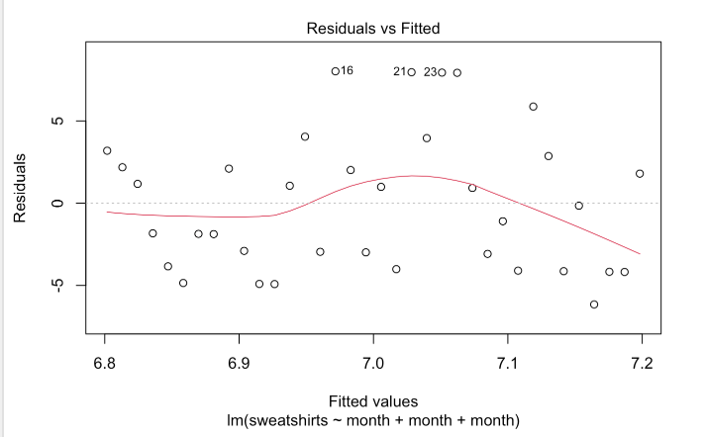
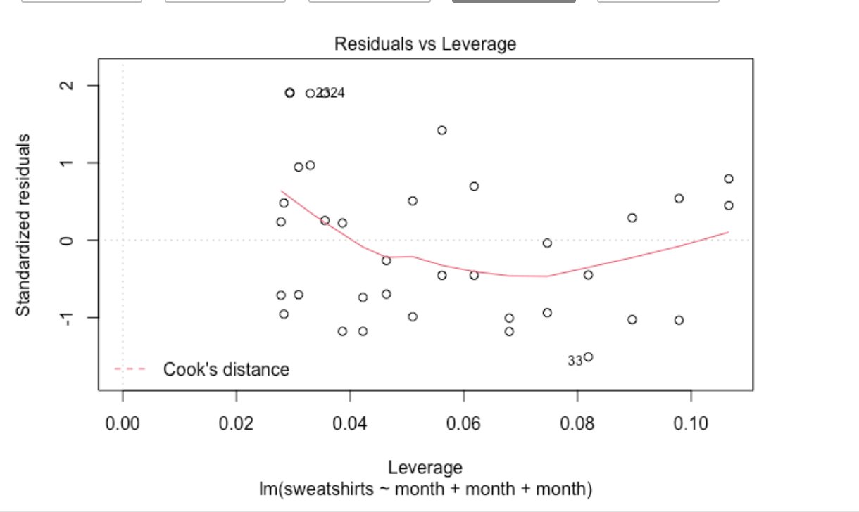
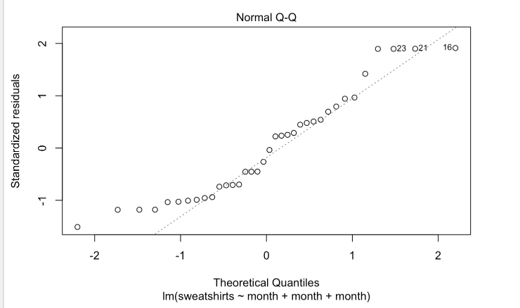
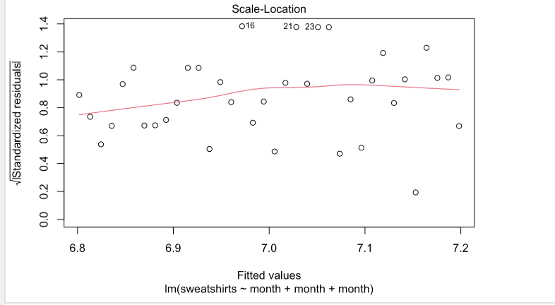
Chunk 4 : {plots}

Slide 6
Definitions
Residuals vs Fitted - Linearity is assumed when red line is close to the dotted line #
Normal Q-Q - normality is assumed when points fall along a reference line (45 degree line)#
Scale-location vs Standard residuals - when red line is roughly horizontal across the homoscedasticity - assumption with random sample of data can't be shown through the plot
Residuals vs Leverage - helps determine outlier in chart , look for points that don't follow the trend
Linearity: The relationship between X and the mean of Y is linear.
Homoscedasticity: The variance of residual is the same for any value of X.
Independence: Observations are independent of each other.
Normality: For any fixed value of X, Y is normally distributed."

Slide 7
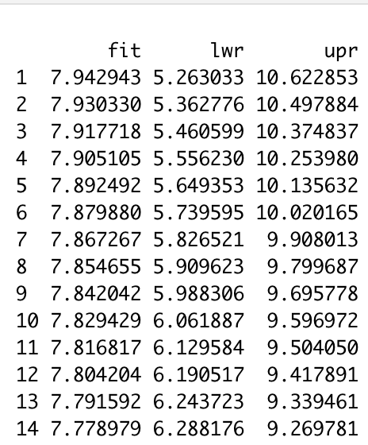
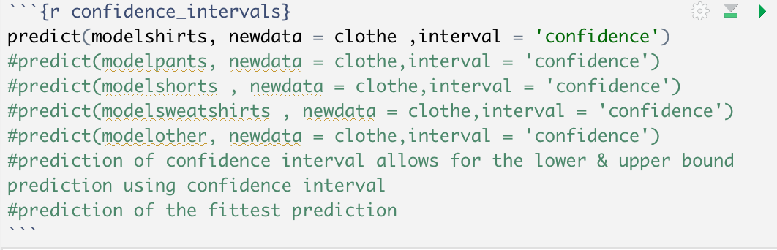
Chunk 5 : {confidence_intervals}
Predicts the range of fitted (predicted) values (lower and upper limit) for a clothing item
Example modelshirts – predicted value (lower and upper) while also giving a predicted values for each month ranging from January 2018 - Dec 2020.

Slide 8
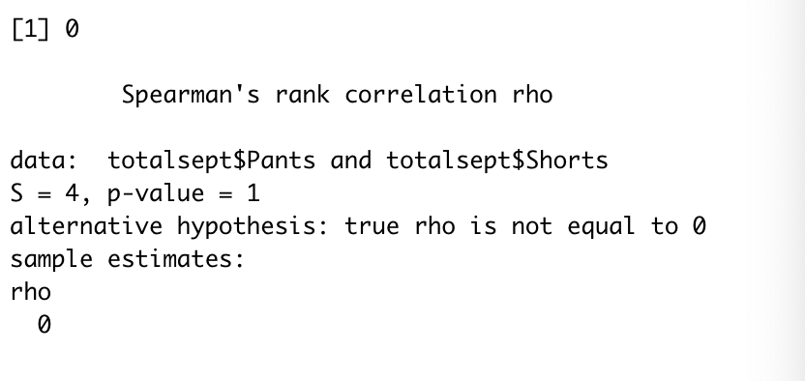
Chunk 6 : {correlation}
The Spearman correlation takes a particular month and compares two clothing items from that month.
It is helpful to compare two items and see the relationship between the two.
The example I used is comparing the month of September’s pant and shorts
Based on the output it defines the correlation , inverse relationship would have a negative output , compared to a direct relationship with a positive , and no relationship is marked with an zero.

