Slide 1
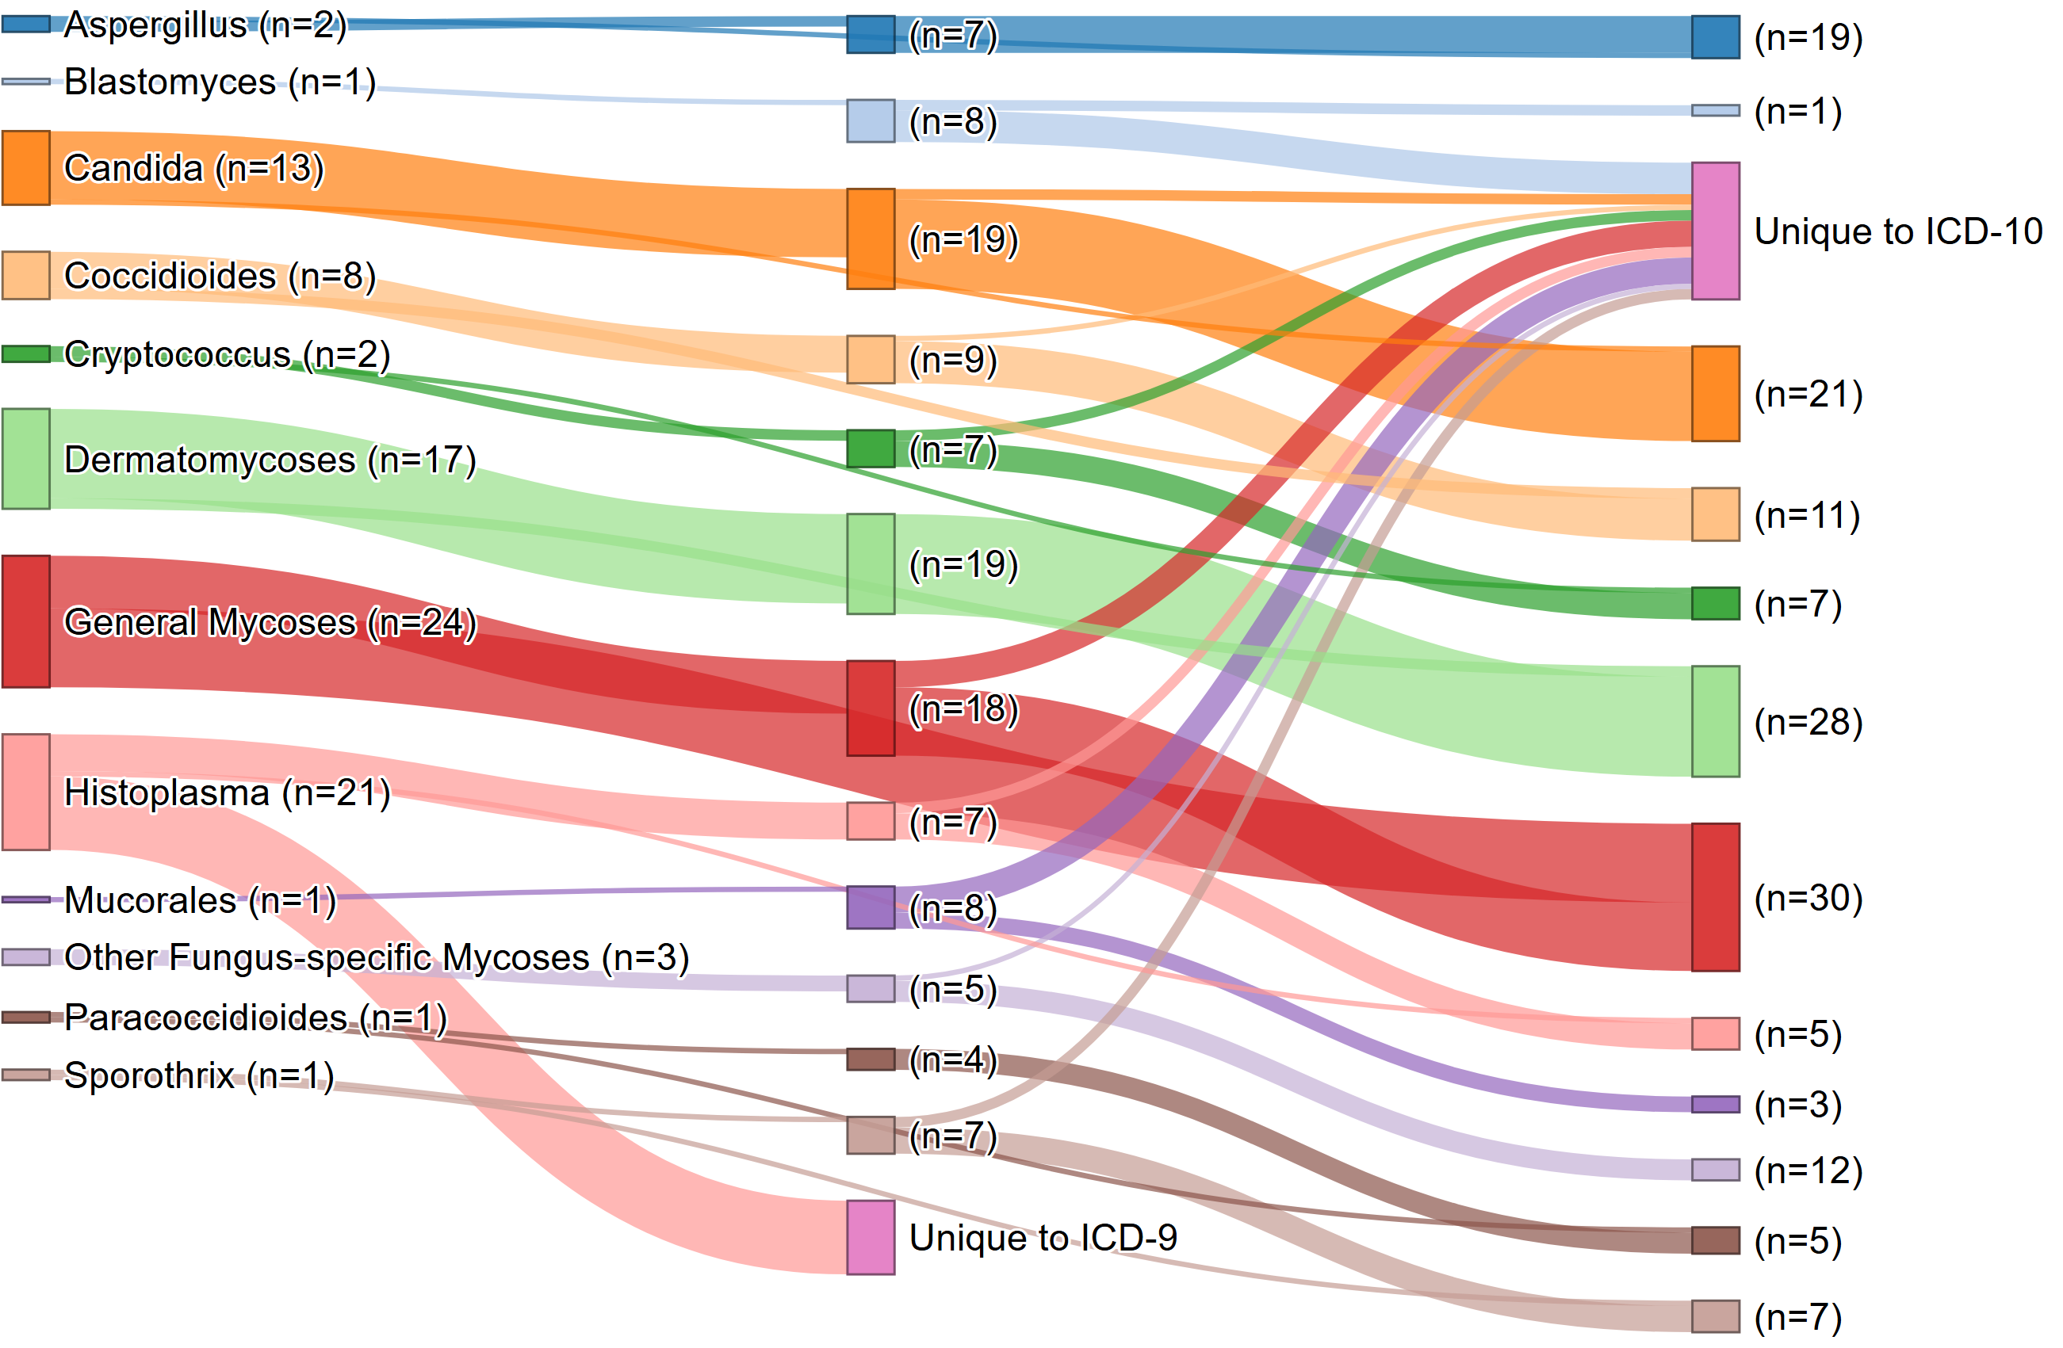
Fungal Disease Codes by ICD Version – Forward Matching
ICD-9
ICD-10
ICD-11
Supplemental Figure 25. Summary ICD Code Mapping: Best Match Forward Summary Sankey Network
Nodes represent individual Major Fungal Groups across versions (ICD-9, -10, -11), connected by links indicating mapping pairs with the highest match score, with ties. Primary mapping utilized a stepwise strategy requiring a minimum cumulative match score of 45 out of 100 points. To capture complex relationships, a “skip-link” strategy was employed for pairs that either failed the initial threshold or exceed the stepwise score by ≥ 10 points. Codes with unlinked nodes (“Orphan” codes) represent version-specific entries that did not meet the minimum match criteria in either strategy and are indicated by a pink node with text indicating the ICD version(s) to which codes are unique.Summary Sankey Network visualizing the overall changes in mycoses representation by the twelve major fungal groups where each node column represents a different ICD version, node represents each unique major fungal group, and each link represents one fungal code match pair. Codes that were unique to ICD-9 included 14 codes from Histoplasma only. Codes that were unique to ICD-10 came from every major fungal group except Dermatomycoses and Paracoccidioides. In addition, the “unique to ICD-10” node contains four codes that had continuity between ICD-9 and ICD-10 but were eliminated in ICD-11 (Figure S1- S24).
Movable copy of this figure can be found at https://github.com/marhiahcmontoya/Fungal-ICD-Code-Mapping-Project/tree/ad2b8649621393e2f044cda209a95f35e61cb597/Supplemental_Figures_S25_S26

Slide 2
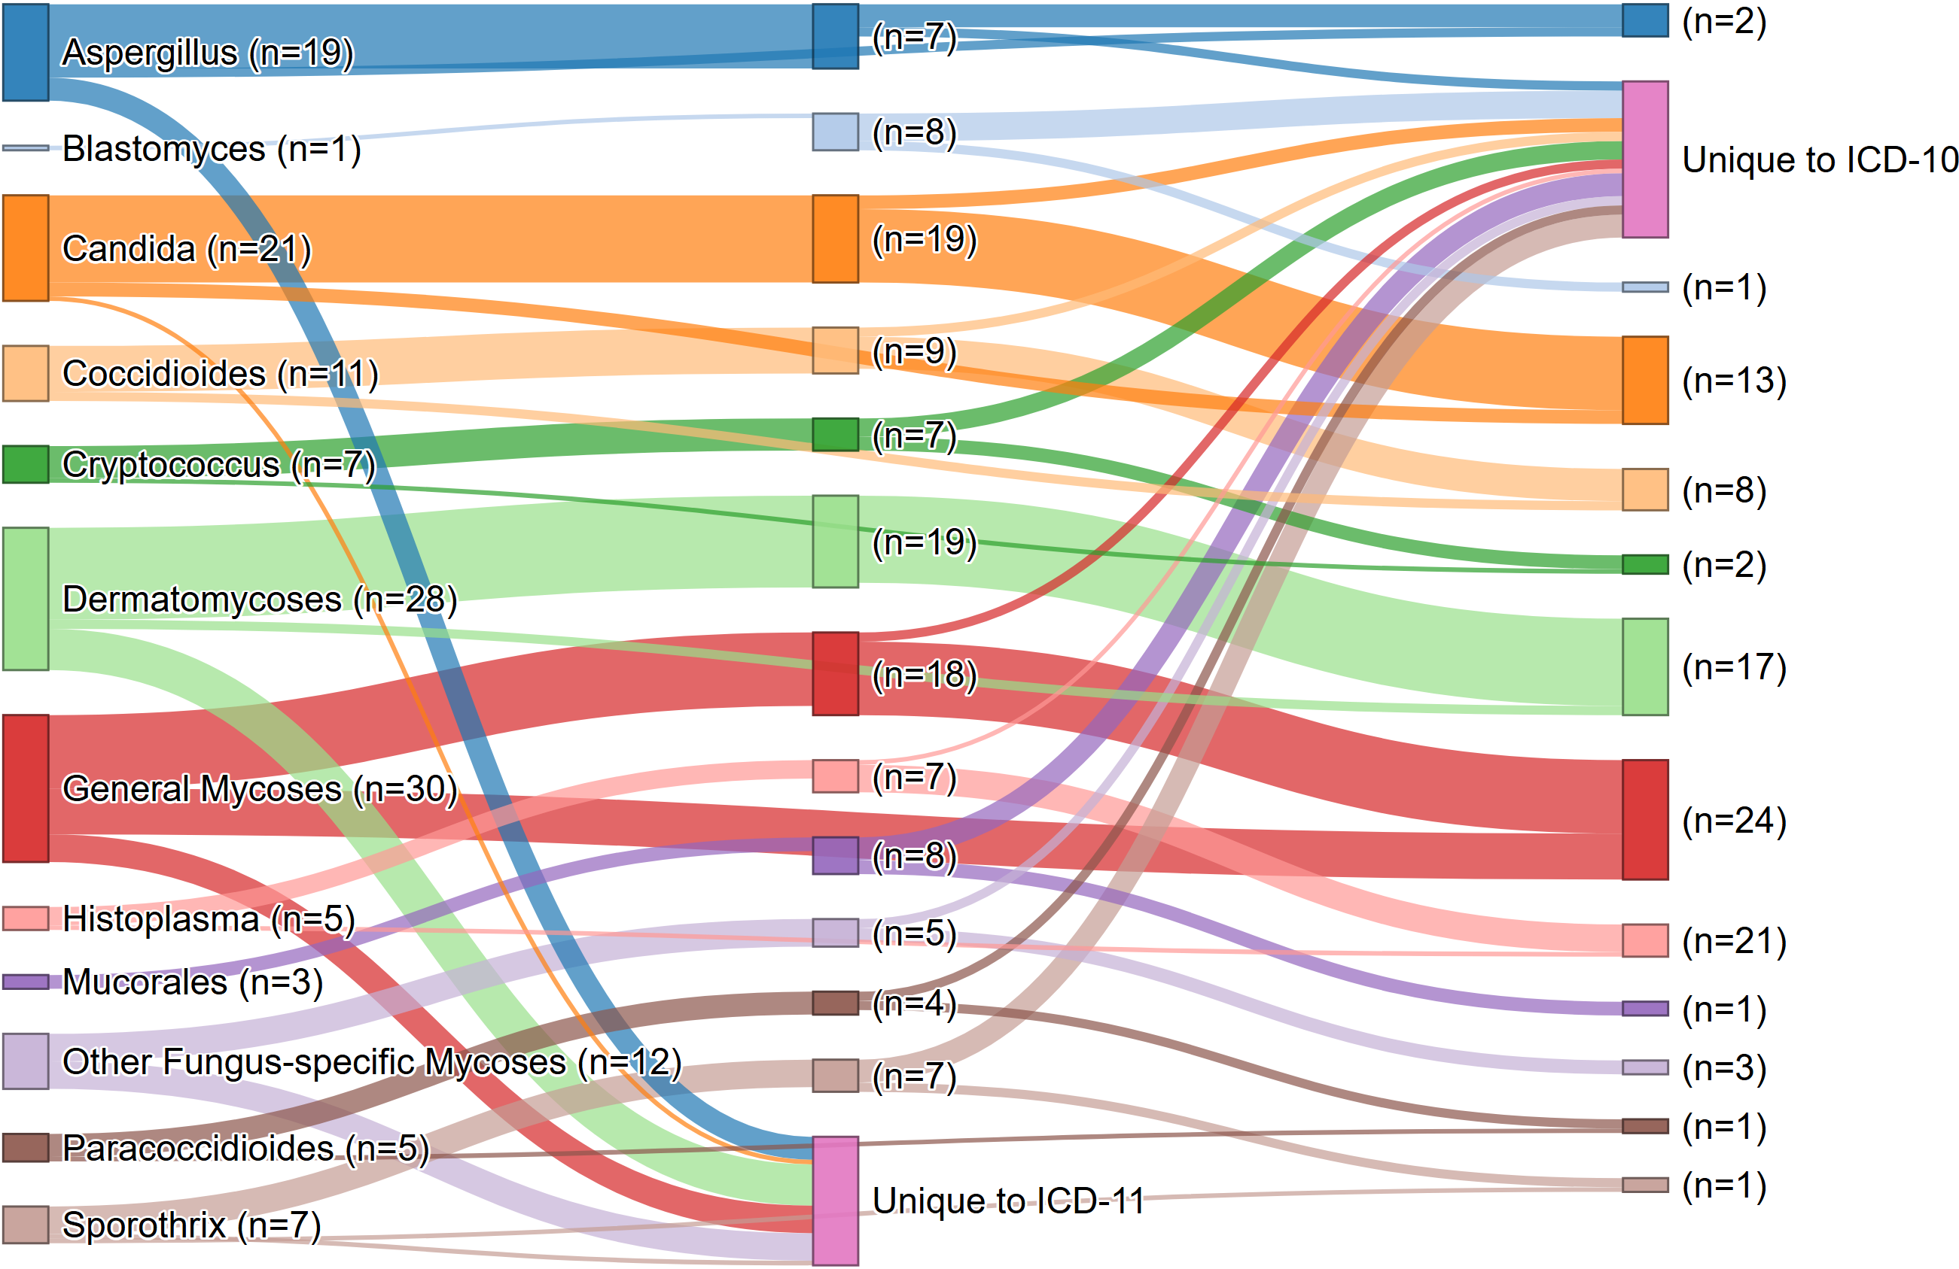
Fungal Disease Codes by ICD Version – Reverse Matching
ICD-11
ICD-10
ICD-9
Supplemental Figure 26. Summary ICD Code Mapping: Best Match Reverse Summary Sankey Network
Nodes represent individual Major Fungal Groups across versions (ICD-11, -10, -9), connected by links indicating mapping pairs with the highest match score, with ties. Primary mapping utilized a stepwise strategy requiring a minimum cumulative match score of 45 out of 100 points. To capture complex relationships, a “skip-link” strategy was employed for pairs that either failed the initial threshold or exceed the stepwise score by ≥ 10 points. Codes with unlinked nodes (“Orphan” codes) represent version-specific entries that did not meet the minimum match criteria in either strategy and are indicated by a pink node with text indicating the ICD version(s) to which codes are unique. Summary Sankey Network visualizing the overall changes in mycoses representation by the twelve major fungal groups where each node column represents a different ICD version, node represents each unique major fungal group, and each link represents one fungal code match pair.
Movable copy of this figure can be found at https://github.com/marhiahcmontoya/Fungal-ICD-Code-Mapping-Project/tree/ad2b8649621393e2f044cda209a95f35e61cb597/Supplemental_Figures_S25_S26

