Slide 1
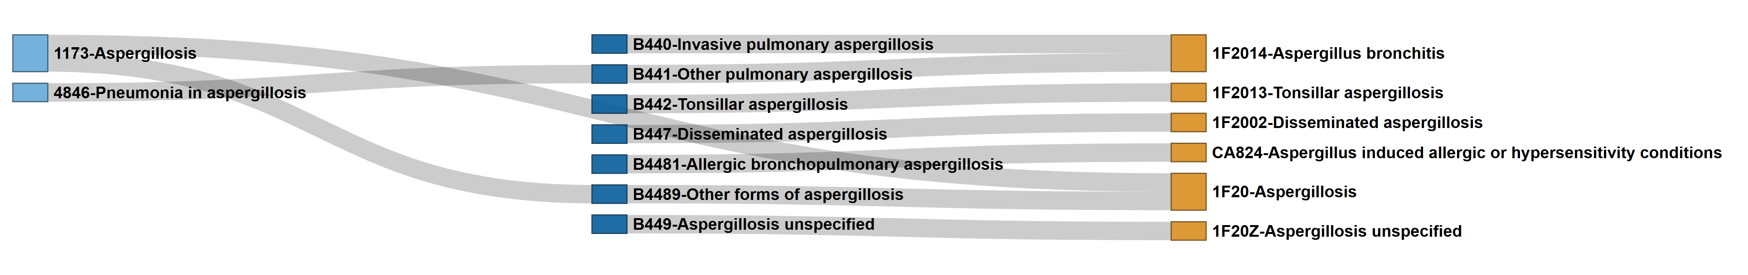
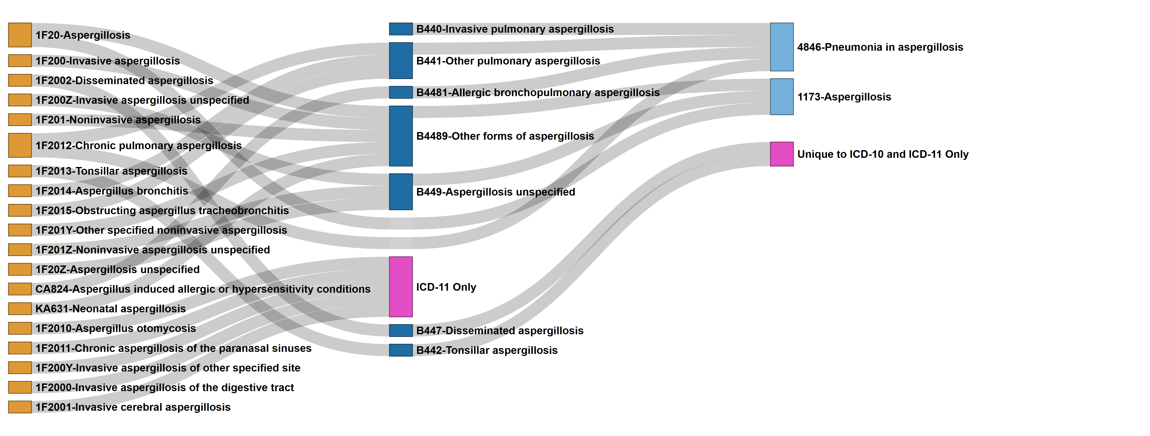
Forward Mapping Aspergillus ICD Codes
ICD-9
ICD-10
ICD-11
Supplemental Figure 1. Aspergillus ICD Code Mapping: Best Match Forward Sankey Network
Nodes represent individual ICD codes across versions (ICD-9, -10, -11), connected by links indicating mapping pairs with the highest match score, with ties. Primary mapping utilized a stepwise strategy requiring a minimum cumulative match score of 45 out of 100 points. To capture complex relationships, a “skip-link” strategy was employed for pairs that either failed the initial threshold or exceed the stepwise score by ≥ 10 points. Codes with unlinked nodes (“Orphan” codes) represent version-specific entries that did not meet the minimum match criteria in either strategy and are indicated by a pink node with text indicating the ICD version(s) to which it is unique. Light Blue Nodes: ICD-9, Dark Blue Nodes: ICD-10, and Yellow Nodes: ICD-11
ICD-11
Reverse Mapping Aspergillus ICD Codes
ICD-10
ICD-9
Supplemental Figure 2. Aspergillus ICD Code Mapping: Best Match Reverse Sankey Network
Nodes represent individual ICD codes across versions (ICD-11, -10, -9), connected by links indicating mapping pairs with the highest match score, with ties. Primary mapping utilized a stepwise strategy requiring a minimum cumulative match score of 45 out of 100 points. To capture complex relationships, a “skip-link” strategy was employed for pairs that either failed the initial threshold or exceed the stepwise score by ≥ 10 points. Codes with unlinked nodes (“Orphan” codes) represent version-specific entries that did not meet the minimum match criteria in either strategy and are indicated by a pink node with text indicating the ICD version(s) to which it is unique. Light Blue Nodes: ICD-9, Dark Blue Nodes: ICD-10, and Yellow Nodes: ICD-11

Slide 2
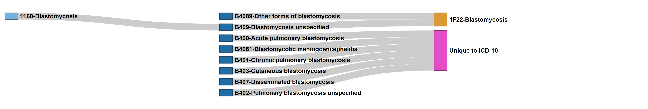
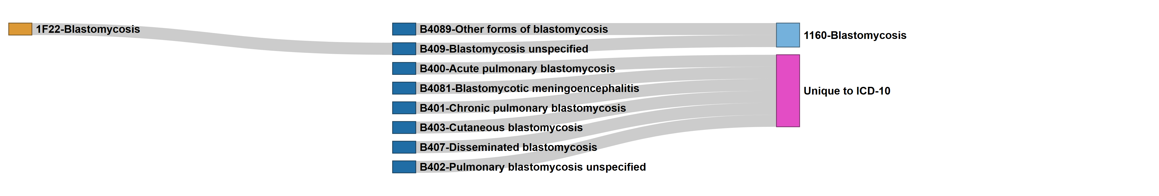
Forward Mapping Blastomyces ICD Codes
ICD-9
ICD-10
ICD-11
Supplemental Figure 3. Blastomyces ICD Code Mapping: Best Match Forward Sankey Network
Nodes represent individual ICD codes across versions (ICD-9, -10, -11), connected by links indicating mapping pairs with the highest match score, with ties. Primary mapping utilized a stepwise strategy requiring a minimum cumulative match score of 45 out of 100 points. To capture complex relationships, a “skip-link” strategy was employed for pairs that either failed the initial threshold or exceed the stepwise score by ≥ 10 points. Codes with unlinked nodes (“Orphan” codes) represent version-specific entries that did not meet the minimum match criteria in either strategy and are indicated by a pink node with text indicating the ICD version(s) to which it is unique. Light Blue Nodes: ICD-9, Dark Blue Nodes: ICD-10, and Yellow Nodes: ICD-11
Reverse Mapping Blastomyces ICD Codes
ICD-11
ICD-10
ICD-9
Supplemental Figure 4. Blastomyces ICD Code Mapping: Best Match Reverse Sankey Network
Nodes represent individual ICD codes across versions (ICD-11, -10, -9), connected by links indicating mapping pairs with the highest match score, with ties. Primary mapping utilized a stepwise strategy requiring a minimum cumulative match score of 45 out of 100 points. To capture complex relationships, a “skip-link” strategy was employed for pairs that either failed the initial threshold or exceed the stepwise score by ≥ 10 points. Codes with unlinked nodes (“Orphan” codes) represent version-specific entries that did not meet the minimum match criteria in either strategy and are indicated by a pink node with text indicating the ICD version(s) to which it is unique. Light Blue Nodes: ICD-9, Dark Blue Nodes: ICD-10, and Yellow Nodes: ICD-11

Slide 3
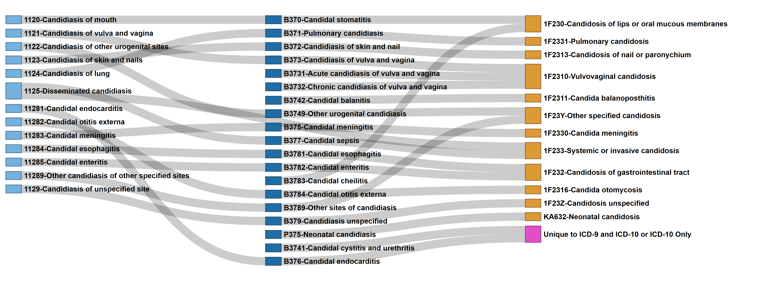
Forward Mapping Candida ICD Codes
ICD-9
ICD-10
ICD-11
Supplemental Figure 5. Candida ICD Code Mapping: Best Match Forward Sankey Network
Nodes represent individual ICD codes across versions (ICD-9, -10, -11), connected by links indicating mapping pairs with the highest match score, with ties. Primary mapping utilized a stepwise strategy requiring a minimum cumulative match score of 45 out of 100 points. To capture complex relationships, a “skip-link” strategy was employed for pairs that either failed the initial threshold or exceed the stepwise score by ≥ 10 points. Codes with unlinked nodes (“Orphan” codes) represent version-specific entries that did not meet the minimum match criteria in either strategy and are indicated by a pink node with text indicating the ICD version(s) to which it is unique. Light Blue Nodes: ICD-9, Dark Blue Nodes: ICD-10, and Yellow Nodes: ICD-11

Slide 4
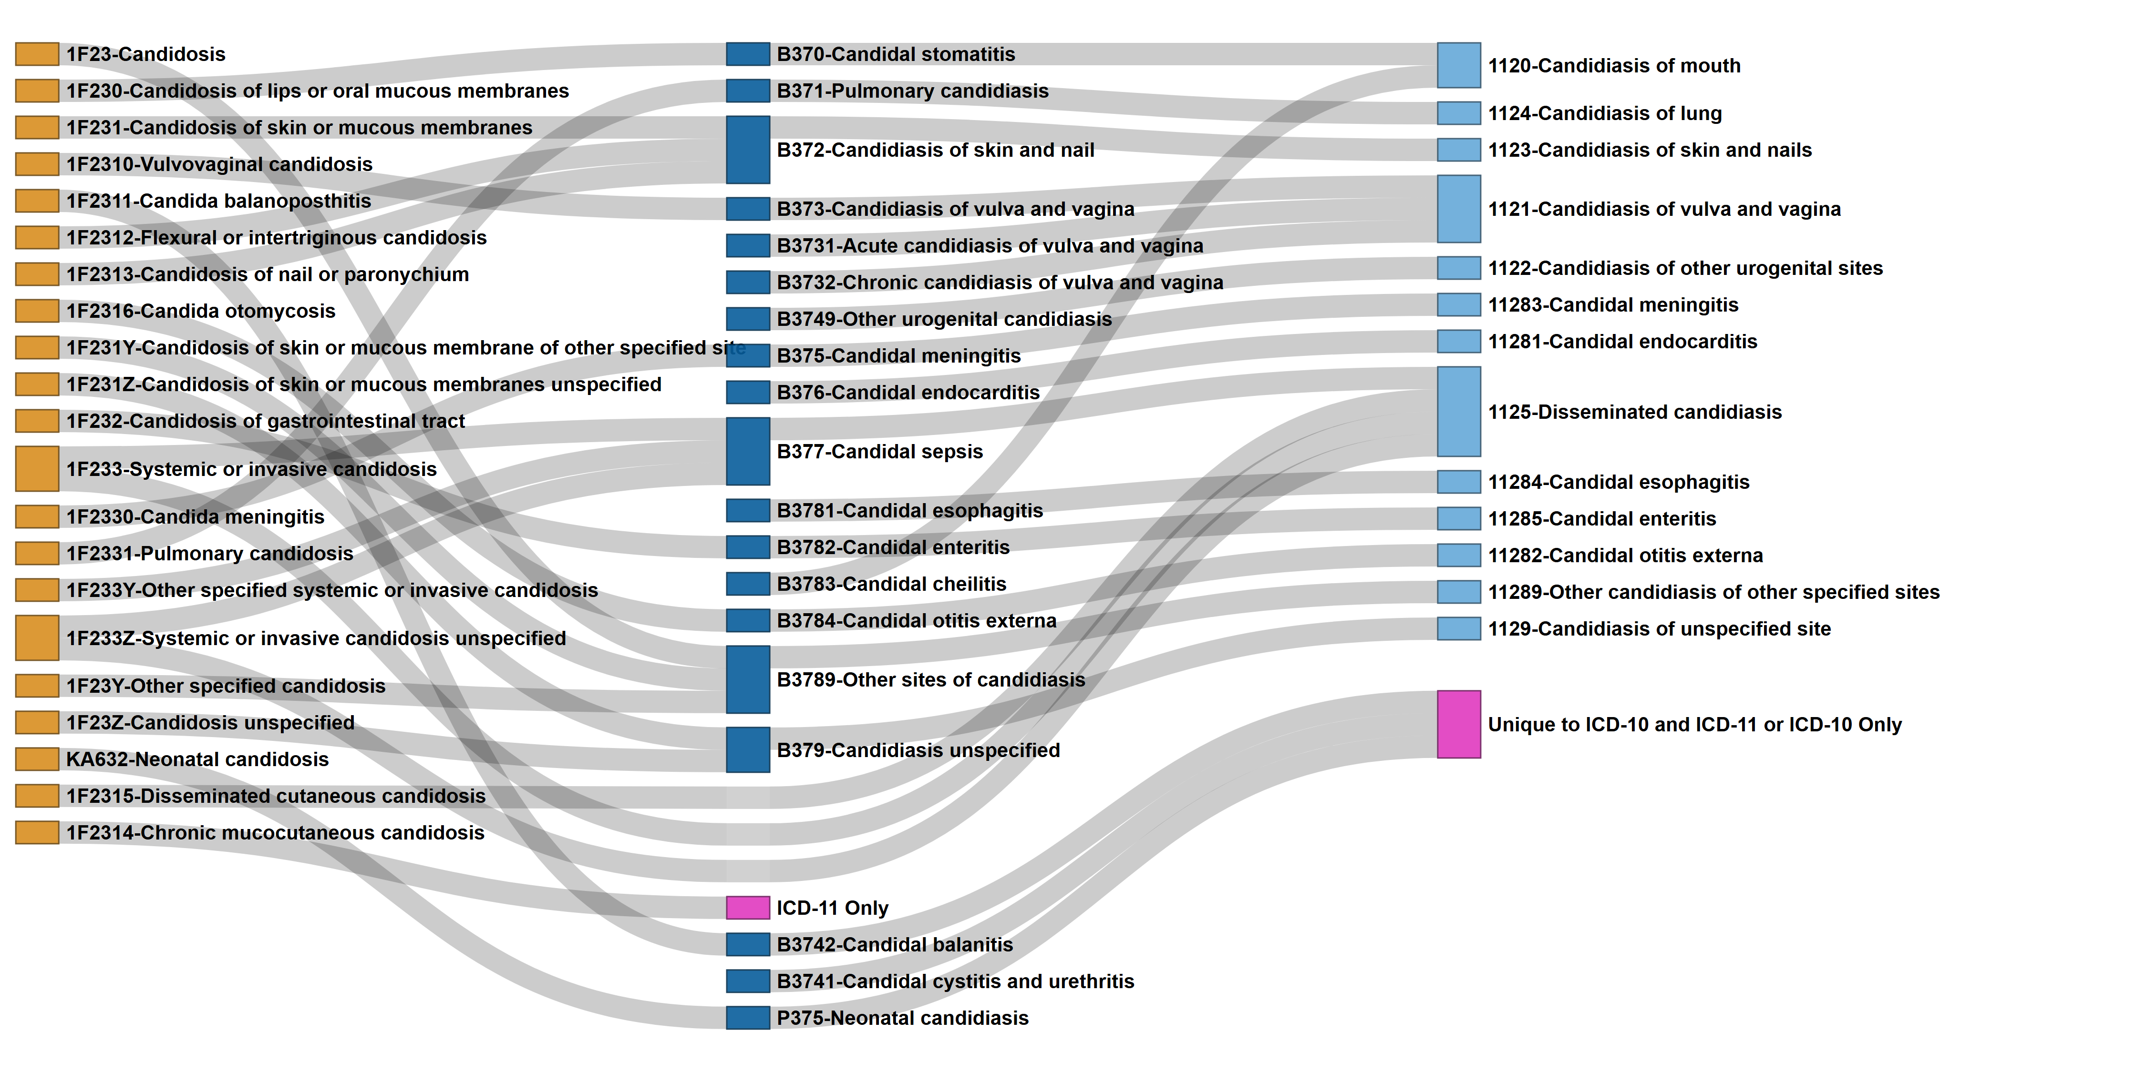
Reverse Mapping Candida ICD Codes
ICD-11
ICD-10
ICD-9
Supplemental Figure 6. Candida ICD Code Mapping: Best Match Reverse Sankey Network
Nodes represent individual ICD codes across versions (ICD-11, -10, -9), connected by links indicating mapping pairs with the highest match score, with ties. Primary mapping utilized a stepwise strategy requiring a minimum cumulative match score of 45 out of 100 points. To capture complex relationships, a “skip-link” strategy was employed for pairs that either failed the initial threshold or exceed the stepwise score by ≥ 10 points. Codes with unlinked nodes (“Orphan” codes) represent version-specific entries that did not meet the minimum match criteria in either strategy and are indicated by a pink node with text indicating the ICD version(s) to which it is unique. Light Blue Nodes: ICD-9, Dark Blue Nodes: ICD-10, and Yellow Nodes: ICD-11

Slide 5
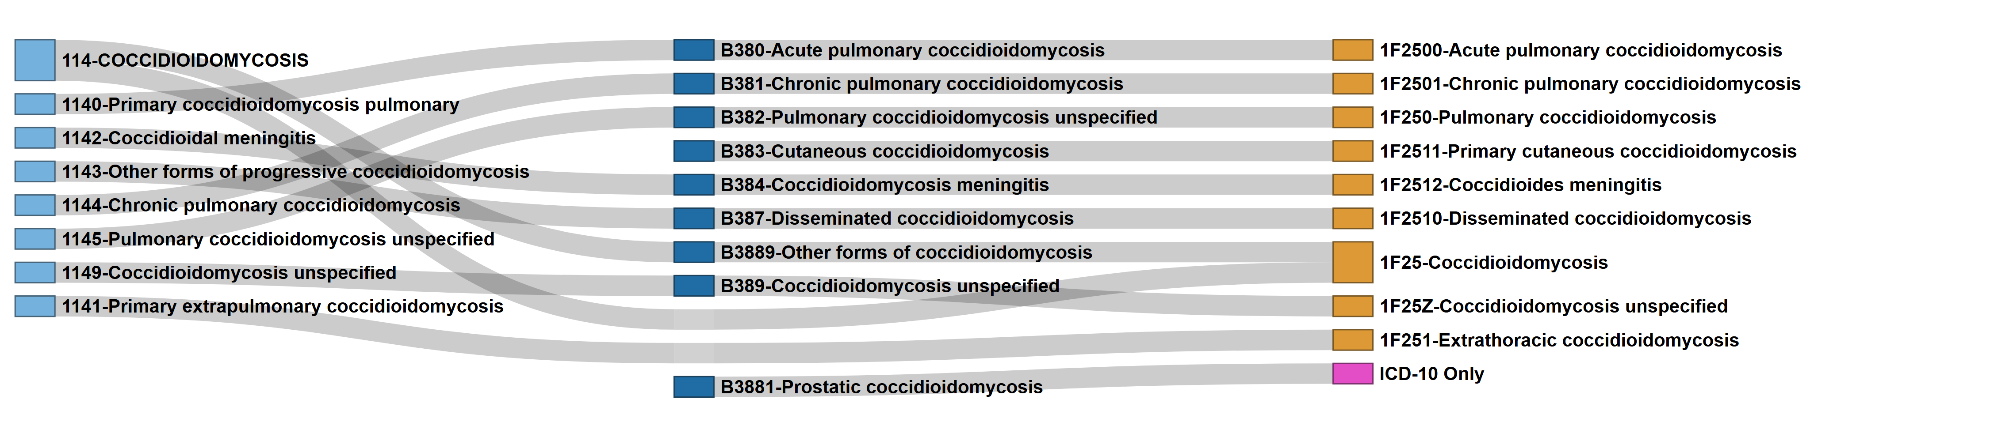
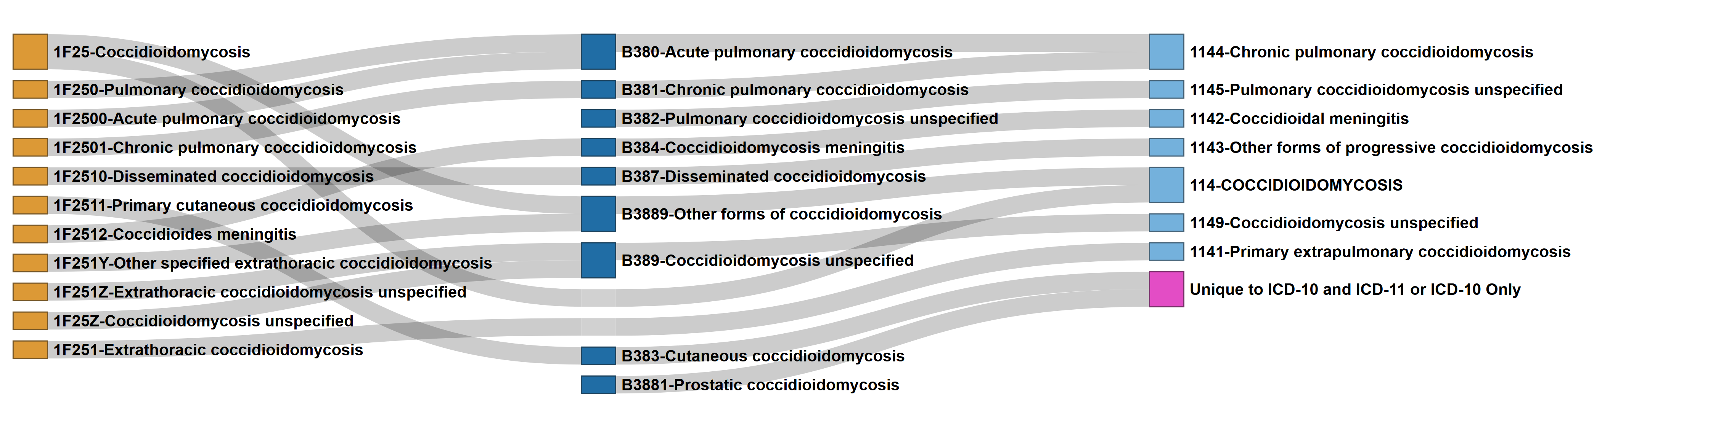
Forward Mapping Coccidioides ICD Codes
ICD-9
ICD-10
ICD-11
Supplemental Figure 7. Coccidioides ICD Code Mapping: Best Match Forward Sankey Network
Nodes represent individual ICD codes across versions (ICD-9, -10, -11), connected by links indicating mapping pairs with the highest match score, with ties. Primary mapping utilized a stepwise strategy requiring a minimum cumulative match score of 45 out of 100 points. To capture complex relationships, a “skip-link” strategy was employed for pairs that either failed the initial threshold or exceed the stepwise score by ≥ 10 points. Codes with unlinked nodes (“Orphan” codes) represent version-specific entries that did not meet the minimum match criteria in either strategy and are indicated by a pink node with text indicating the ICD version(s) to which it is unique. Light Blue Nodes: ICD-9, Dark Blue Nodes: ICD-10, and Yellow Nodes: ICD-11
Reverse Mapping Coccidioides ICD Codes
ICD-11
ICD-10
ICD-9
Supplemental Figure 8. Coccidioides ICD Code Mapping: Best Match Reverse Sankey Network
Nodes represent individual ICD codes across versions (ICD-11, -10, -9), connected by links indicating mapping pairs with the highest match score, with ties. Primary mapping utilized a stepwise strategy requiring a minimum cumulative match score of 45 out of 100 points. To capture complex relationships, a “skip-link” strategy was employed for pairs that either failed the initial threshold or exceed the stepwise score by ≥ 10 points. Codes with unlinked nodes (“Orphan” codes) represent version-specific entries that did not meet the minimum match criteria in either strategy and are indicated by a pink node with text indicating the ICD version(s) to which it is unique. Light Blue Nodes: ICD-9, Dark Blue Nodes: ICD-10, and Yellow Nodes: ICD-11

Slide 6
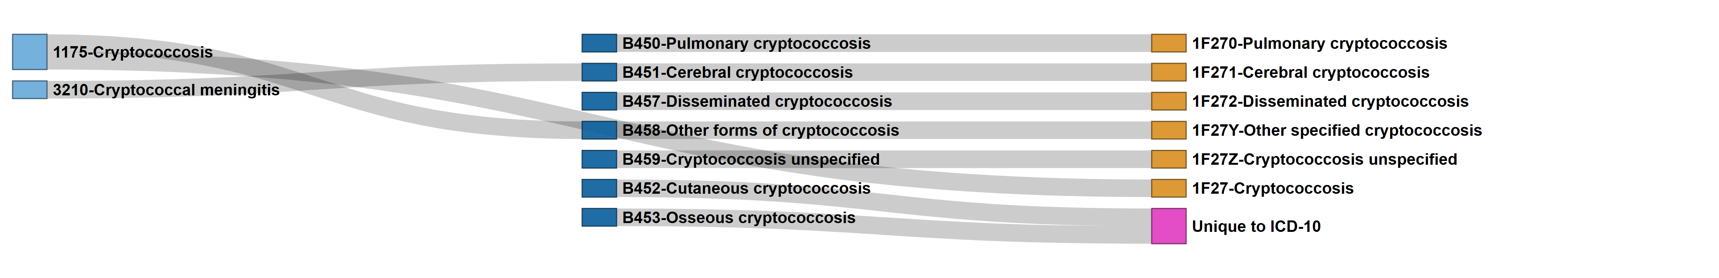
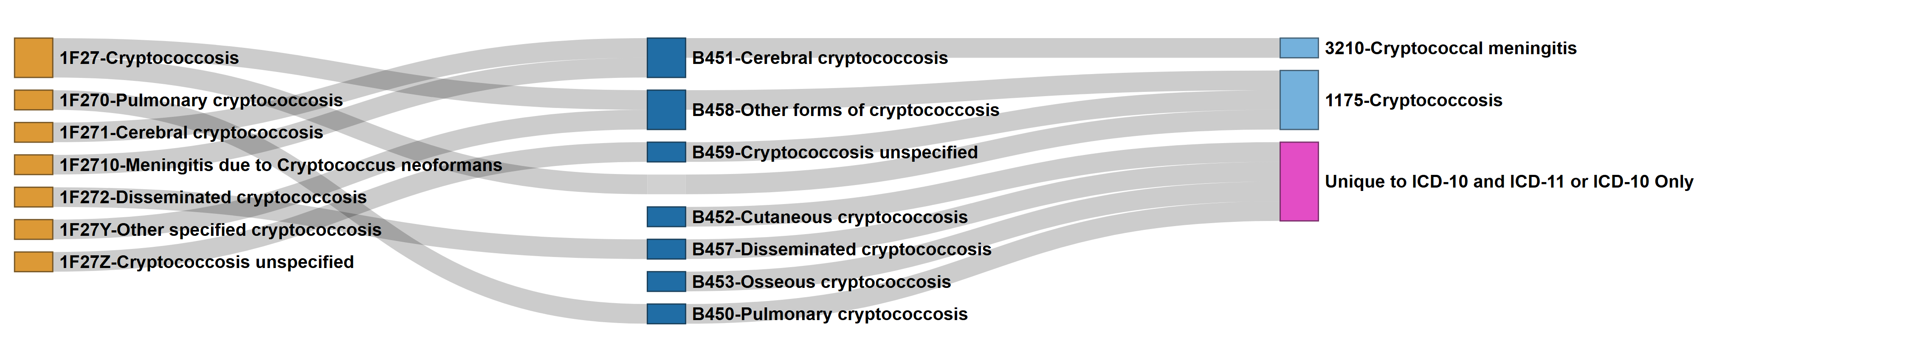
Forward Mapping Cryptococcus ICD Codes
ICD-9
ICD-10
ICD-11
Supplemental Figure 9. Cryptococcus ICD Code Mapping: Best Match Forward Sankey Network
Nodes represent individual ICD codes across versions (ICD-9, -10, -11), connected by links indicating mapping pairs with the highest match score, with ties. Primary mapping utilized a stepwise strategy requiring a minimum cumulative match score of 45 out of 100 points. To capture complex relationships, a “skip-link” strategy was employed for pairs that either failed the initial threshold or exceed the stepwise score by ≥ 10 points. Codes with unlinked nodes (“Orphan” codes) represent version-specific entries that did not meet the minimum match criteria in either strategy and are indicated by a pink node with text indicating the ICD version(s) to which it is unique. Light Blue Nodes: ICD-9, Dark Blue Nodes: ICD-10, and Yellow Nodes: ICD-11
Reverse Mapping Cryptococcus ICD Codes
ICD-11
ICD-10
ICD-9
Supplemental Figure 10. Cryptococcus ICD Code Mapping: Best Match Reverse Sankey Network
Nodes represent individual ICD codes across versions (ICD-11, -10, -9), connected by links indicating mapping pairs with the highest match score, with ties. Primary mapping utilized a stepwise strategy requiring a minimum cumulative match score of 45 out of 100 points. To capture complex relationships, a “skip-link” strategy was employed for pairs that either failed the initial threshold or exceed the stepwise score by ≥ 10 points. Codes with unlinked nodes (“Orphan” codes) represent version-specific entries that did not meet the minimum match criteria in either strategy and are indicated by a pink node with text indicating the ICD version(s) to which it is unique. Light Blue Nodes: ICD-9, Dark Blue Nodes: ICD-10, and Yellow Nodes: ICD-11

Slide 7
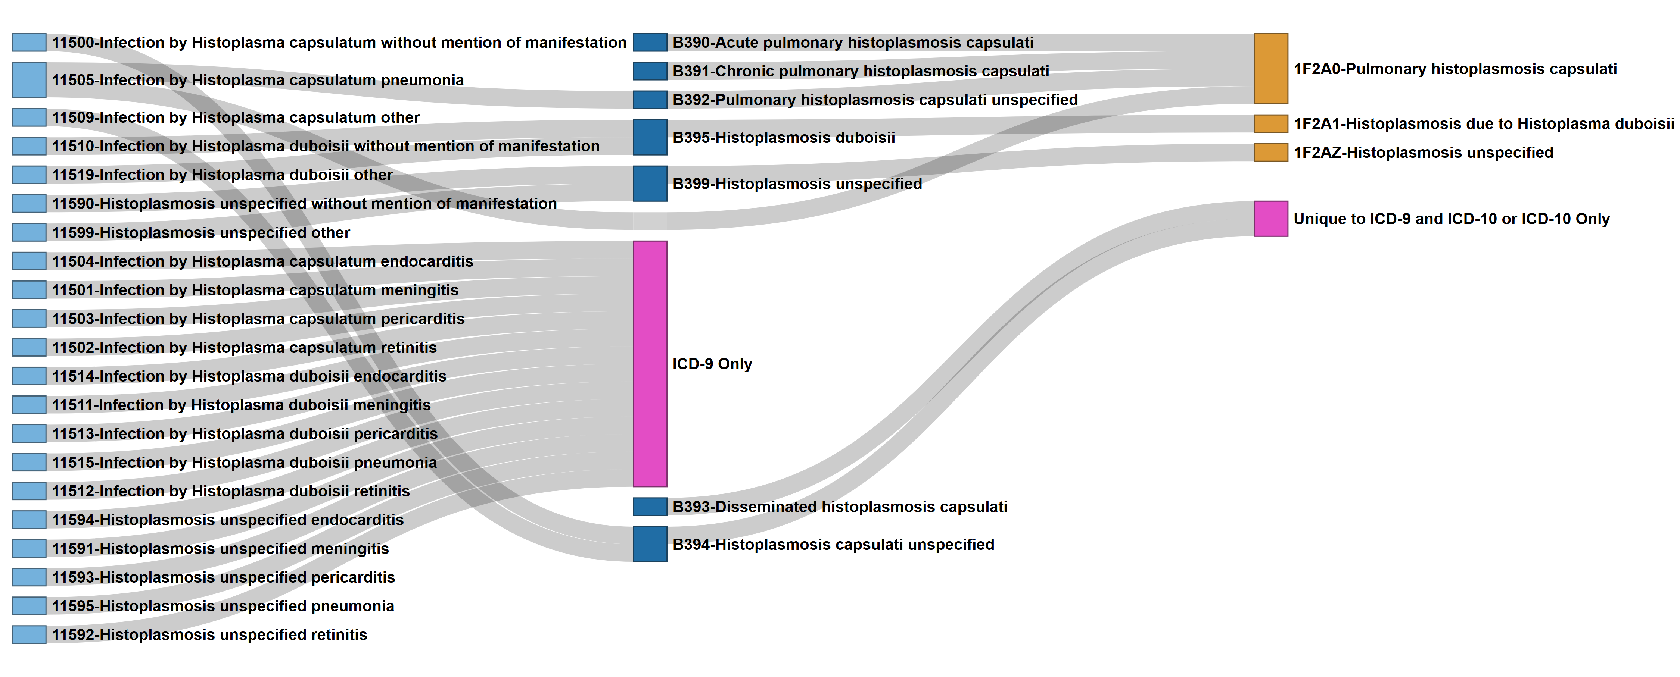
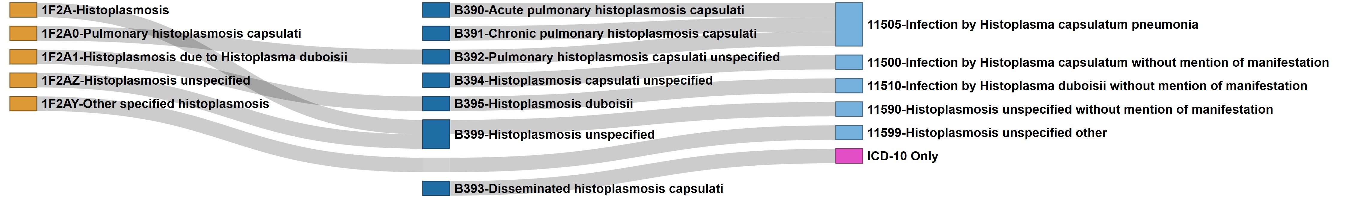
ICD-9
Forward Mapping Histoplasma ICD Codes
ICD-11
ICD-10
Supplemental Figure 11. Histoplasma ICD Code Mapping: Best Match Forward Sankey Network
Nodes represent individual ICD codes across versions (ICD-9, -10, -11), connected by links indicating mapping pairs with the highest match score, with ties. Primary mapping utilized a stepwise strategy requiring a minimum cumulative match score of 45 out of 100 points. To capture complex relationships, a “skip-link” strategy was employed for pairs that either failed the initial threshold or exceed the stepwise score by ≥ 10 points. Codes with unlinked nodes (“Orphan” codes) represent version-specific entries that did not meet the minimum match criteria in either strategy and are indicated by a pink node with text indicating the ICD version(s) to which it is unique. Light Blue Nodes: ICD-9, Dark Blue Nodes: ICD-10, and Yellow Nodes: ICD-11
ICD-11
ICD-10
Reverse Mapping Histoplasma ICD Codes
ICD-9
Supplemental Figure 12. Histoplasma ICD Code Mapping: Best Match Reverse Sankey Network
Nodes represent individual ICD codes across versions (ICD-11, -10, -9), connected by links indicating mapping pairs with the highest match score, with ties. Primary mapping utilized a stepwise strategy requiring a minimum cumulative match score of 45 out of 100 points. To capture complex relationships, a “skip-link” strategy was employed for pairs that either failed the initial threshold or exceed the stepwise score by ≥ 10 points. Codes with unlinked nodes (“Orphan” codes) represent version-specific entries that did not meet the minimum match criteria in either strategy and are indicated by a pink node with text indicating the ICD version(s) to which it is unique. Light Blue Nodes: ICD-9, Dark Blue Nodes: ICD-10, and Yellow Nodes: ICD-11

Slide 8
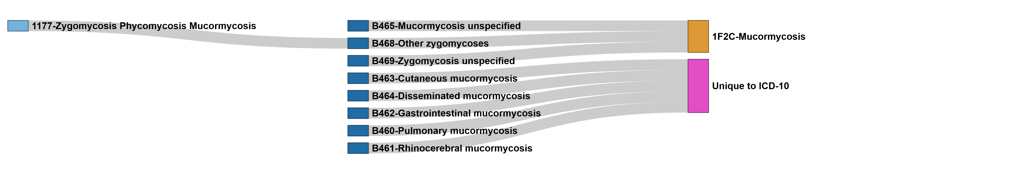
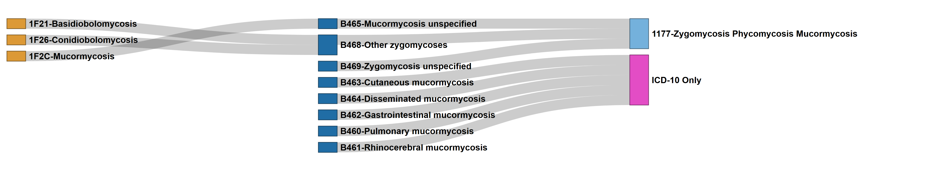
Forward Mapping Mucorales ICD Codes
ICD-9
ICD-10
ICD-11
Supplemental Figure 13. Mucorales ICD Code Mapping: Best Match Forward Sankey Network
Nodes represent individual ICD codes across versions (ICD-9, -10, -11), connected by links indicating mapping pairs with the highest match score, with ties. Primary mapping utilized a stepwise strategy requiring a minimum cumulative match score of 45 out of 100 points. To capture complex relationships, a “skip-link” strategy was employed for pairs that either failed the initial threshold or exceed the stepwise score by ≥ 10 points. Codes with unlinked nodes (“Orphan” codes) represent version-specific entries that did not meet the minimum match criteria in either strategy and are indicated by a pink node with text indicating the ICD version(s) to which it is unique. Light Blue Nodes: ICD-9, Dark Blue Nodes: ICD-10, and Yellow Nodes: ICD-11
Reverse Mapping Mucorales ICD Codes
ICD-11
ICD-10
ICD-9
Supplemental Figure 14. Mucorales ICD Code Mapping: Best Match Reverse Sankey Network
Nodes represent individual ICD codes across versions (ICD-11, -10, -9), connected by links indicating mapping pairs with the highest match score, with ties. Primary mapping utilized a stepwise strategy requiring a minimum cumulative match score of 45 out of 100 points. To capture complex relationships, a “skip-link” strategy was employed for pairs that either failed the initial threshold or exceed the stepwise score by ≥ 10 points. Codes with unlinked nodes (“Orphan” codes) represent version-specific entries that did not meet the minimum match criteria in either strategy and are indicated by a pink node with text indicating the ICD version(s) to which it is unique. Light Blue Nodes: ICD-9, Dark Blue Nodes: ICD-10, and Yellow Nodes: ICD-11

Slide 9
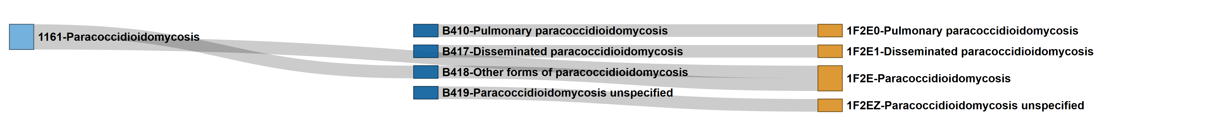
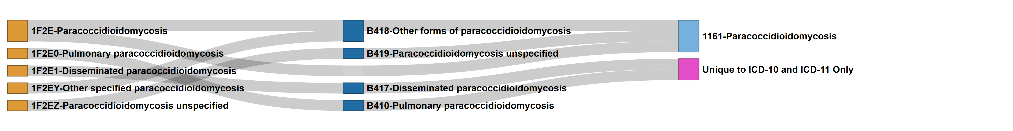
Forward Mapping Paracoccidioides ICD Codes
ICD-9
ICD-10
ICD-11
Supplemental Figure 15. Paracoccidioides ICD Code Mapping: Best Match Forward Sankey Network
Nodes represent individual ICD codes across versions (ICD-9, -10, -11), connected by links indicating mapping pairs with the highest match score, with ties. Primary mapping utilized a stepwise strategy requiring a minimum cumulative match score of 45 out of 100 points. To capture complex relationships, a “skip-link” strategy was employed for pairs that either failed the initial threshold or exceed the stepwise score by ≥ 10 points. Codes with unlinked nodes (“Orphan” codes) represent version-specific entries that did not meet the minimum match criteria in either strategy and are indicated by a pink node with text indicating the ICD version(s) to which it is unique. Light Blue Nodes: ICD-9, Dark Blue Nodes: ICD-10, and Yellow Nodes: ICD-11
Reverse Mapping Paracoccidioides ICD Codes
ICD-11
ICD-10
ICD-9
Supplemental Figure 16. Paracoccidioides ICD Code Mapping: Best Match Reverse Sankey Network
Nodes represent individual ICD codes across versions (ICD-11, -10, -9), connected by links indicating mapping pairs with the highest match score, with ties. Primary mapping utilized a stepwise strategy requiring a minimum cumulative match score of 45 out of 100 points. To capture complex relationships, a “skip-link” strategy was employed for pairs that either failed the initial threshold or exceed the stepwise score by ≥ 10 points. Codes with unlinked nodes (“Orphan” codes) represent version-specific entries that did not meet the minimum match criteria in either strategy and are indicated by a pink node with text indicating the ICD version(s) to which it is unique. Light Blue Nodes: ICD-9, Dark Blue Nodes: ICD-10, and Yellow Nodes: ICD-11

Slide 10
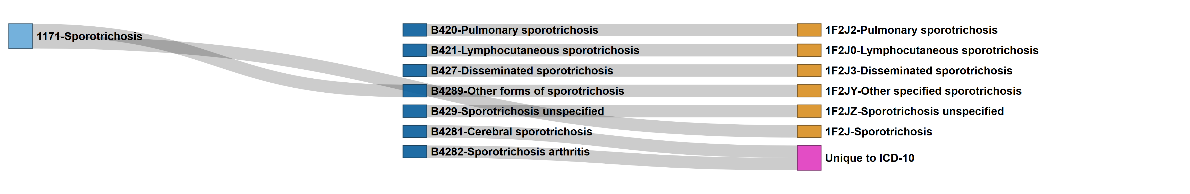
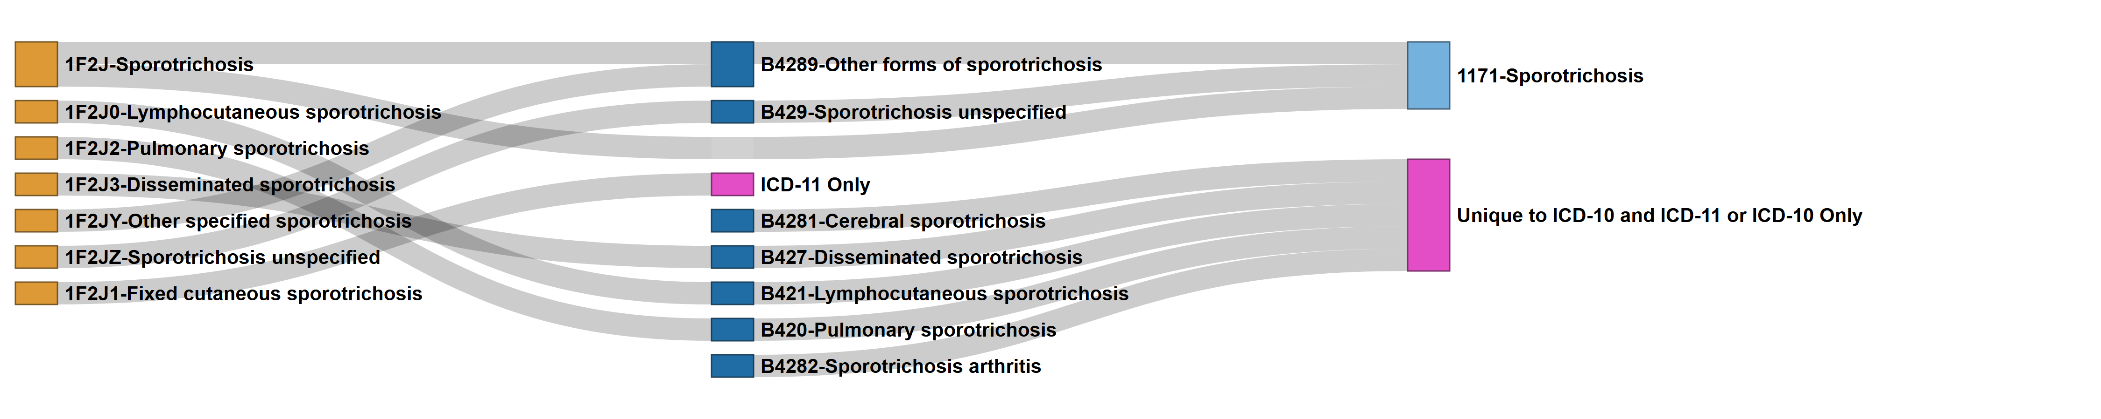
Forward Mapping Sporothrix ICD Codes
ICD-9
ICD-10
ICD-11
Supplemental Figure 17. Sporothrix ICD Code Mapping: Best Match Forward Sankey Network
Nodes represent individual ICD codes across versions (ICD-9, -10, -11), connected by links indicating mapping pairs with the highest match score, with ties. Primary mapping utilized a stepwise strategy requiring a minimum cumulative match score of 45 out of 100 points. To capture complex relationships, a “skip-link” strategy was employed for pairs that either failed the initial threshold or exceed the stepwise score by ≥ 10 points. Codes with unlinked nodes (“Orphan” codes) represent version-specific entries that did not meet the minimum match criteria in either strategy and are indicated by a pink node with text indicating the ICD version(s) to which it is unique. Light Blue Nodes: ICD-9, Dark Blue Nodes: ICD-10, and Yellow Nodes: ICD-11
Reverse Mapping Sporothrix ICD Codes
ICD-11
ICD-10
ICD-9
Supplemental Figure 18. Sporothrix ICD Code Mapping: Best Match Reverse Sankey Network
Nodes represent individual ICD codes across versions (ICD-11, -10, -9), connected by links indicating mapping pairs with the highest match score, with ties. Primary mapping utilized a stepwise strategy requiring a minimum cumulative match score of 45 out of 100 points. To capture complex relationships, a “skip-link” strategy was employed for pairs that either failed the initial threshold or exceed the stepwise score by ≥ 10 points. Codes with unlinked nodes (“Orphan” codes) represent version-specific entries that did not meet the minimum match criteria in either strategy and are indicated by a pink node with text indicating the ICD version(s) to which it is unique. Light Blue Nodes: ICD-9, Dark Blue Nodes: ICD-10, and Yellow Nodes: ICD-11

Slide 11
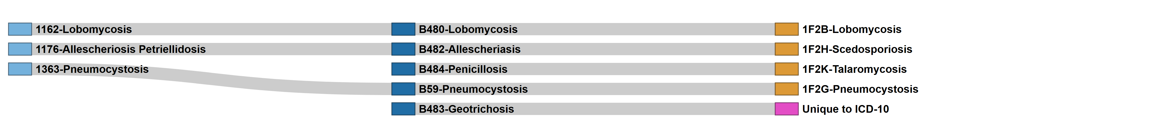
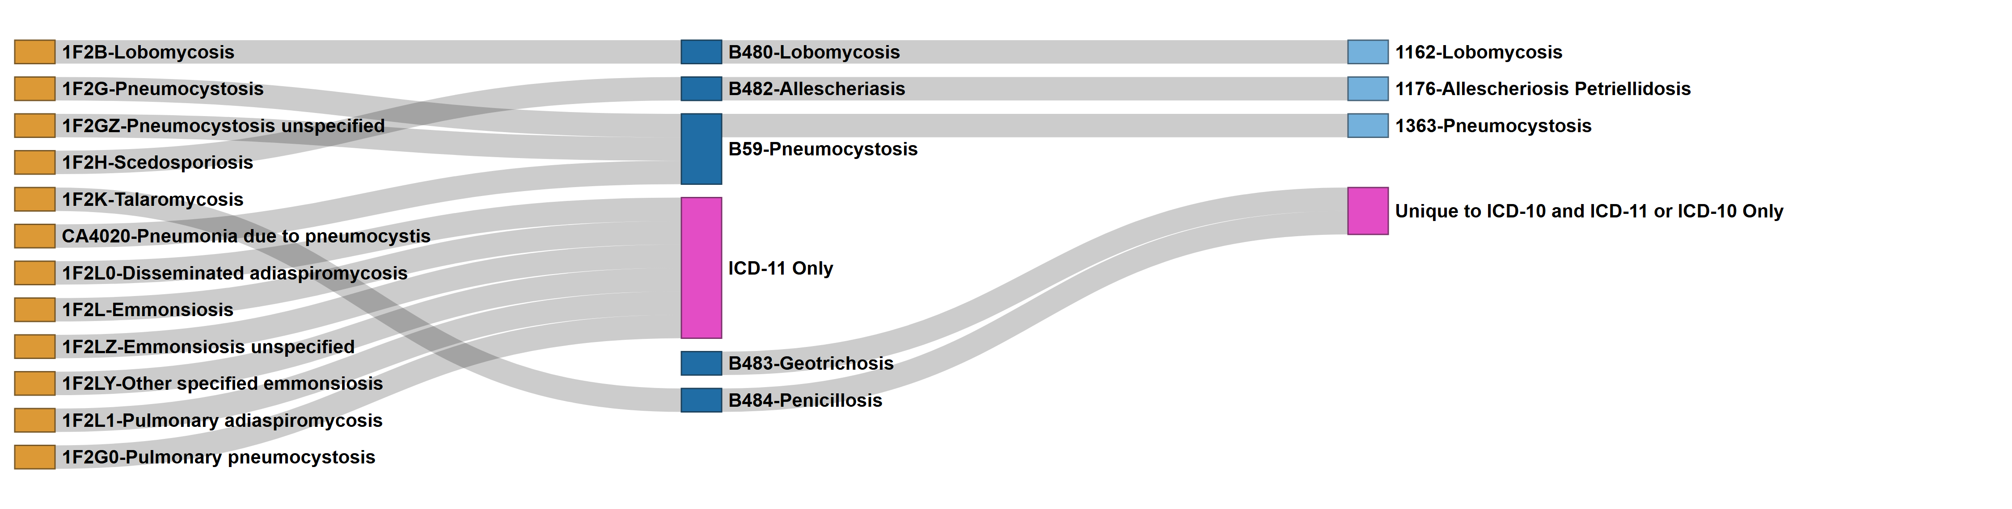
Forward Mapping Other Fungus-Specific Mycoses ICD Codes
ICD-9
ICD-10
ICD-11
Supplemental Figure 19. Other Fungus-specific Mycoses ICD Code Mapping: Best Match Forward Sankey Network
Nodes represent individual ICD codes across versions (ICD-9, -10, -11), connected by links indicating mapping pairs with the highest match score, with ties. Primary mapping utilized a stepwise strategy requiring a minimum cumulative match score of 45 out of 100 points. To capture complex relationships, a “skip-link” strategy was employed for pairs that either failed the initial threshold or exceed the stepwise score by ≥ 10 points. Codes with unlinked nodes (“Orphan” codes) represent version-specific entries that did not meet the minimum match criteria in either strategy and are indicated by a pink node with text indicating the ICD version(s) to which it is unique. Light Blue Nodes: ICD-9, Dark Blue Nodes: ICD-10, and Yellow Nodes: ICD-11
Reverse Mapping Other Fungus-Specific Mycoses ICD Codes
ICD-11
ICD-10
ICD-9
Supplemental Figure 20. Other Fungus-specific Mycoses ICD Code Mapping: Best Match Reverse Sankey Network
Nodes represent individual ICD codes across versions (ICD-11, -10, -9), connected by links indicating mapping pairs with the highest match score, with ties. Primary mapping utilized a stepwise strategy requiring a minimum cumulative match score of 45 out of 100 points. To capture complex relationships, a “skip-link” strategy was employed for pairs that either failed the initial threshold or exceed the stepwise score by ≥ 10 points. Codes with unlinked nodes (“Orphan” codes) represent version-specific entries that did not meet the minimum match criteria in either strategy and are indicated by a pink node with text indicating the ICD version(s) to which it is unique. Light Blue Nodes: ICD-9, Dark Blue Nodes: ICD-10, and Yellow Nodes: ICD-11

Slide 12
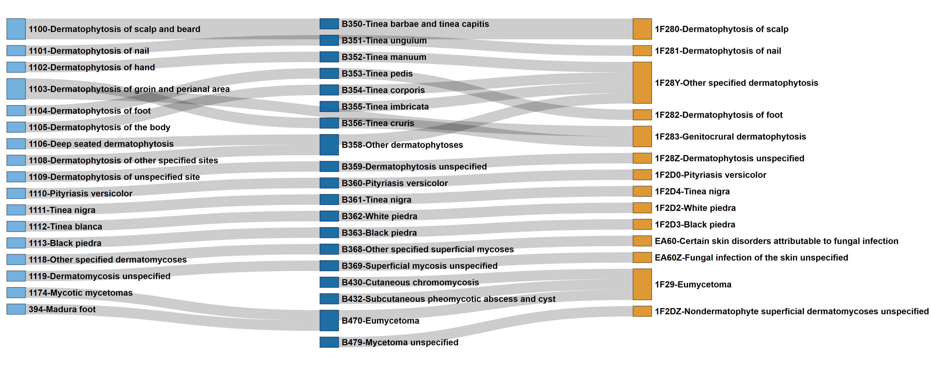
Forward Mapping Dermatomycoses ICD Codes
ICD-9
ICD-10
ICD-11
Supplemental Figure 21. Dermatomycoses ICD Code Mapping: Best Match Forward Sankey Network
Nodes represent individual ICD codes across versions (ICD-9, -10, -11), connected by links indicating mapping pairs with the highest match score, with ties. Primary mapping utilized a stepwise strategy requiring a minimum cumulative match score of 45 out of 100 points. To capture complex relationships, a “skip-link” strategy was employed for pairs that either failed the initial threshold or exceed the stepwise score by ≥ 10 points. Codes with unlinked nodes (“Orphan” codes) represent version-specific entries that did not meet the minimum match criteria in either strategy and are indicated by a pink node with text indicating the ICD version(s) to which it is unique. Light Blue Nodes: ICD-9, Dark Blue Nodes: ICD-10, and Yellow Nodes: ICD-11

Slide 13
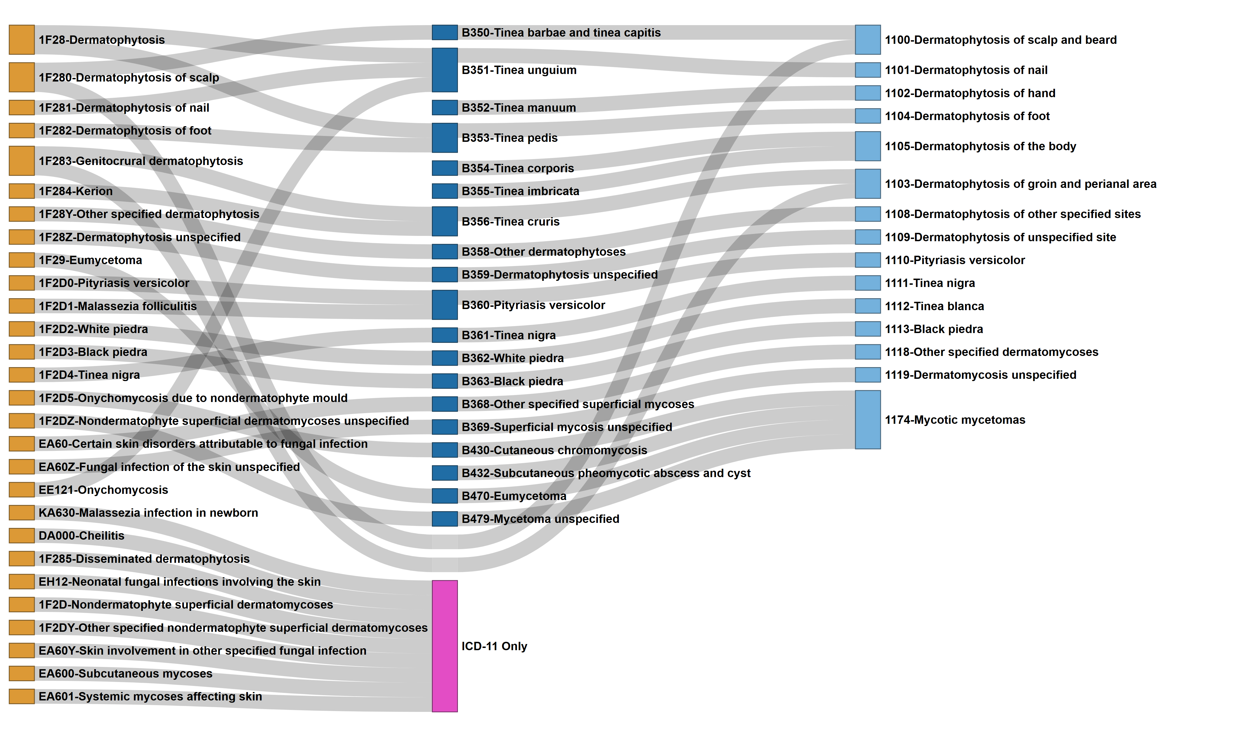
Reverse Mapping Dermatomycoses ICD Codes
ICD-11
ICD-10
ICD-9
Supplemental Figure 22. Dermatomycoses ICD Code Mapping: Best Match Reverse Sankey Network
Nodes represent individual ICD codes across versions (ICD-11, -10, -9), connected by links indicating mapping pairs with the highest match score, with ties. Primary mapping utilized a stepwise strategy requiring a minimum cumulative match score of 45 out of 100 points. To capture complex relationships, a “skip-link” strategy was employed for pairs that either failed the initial threshold or exceed the stepwise score by ≥ 10 points. Codes with unlinked nodes (“Orphan” codes) represent version-specific entries that did not meet the minimum match criteria in either strategy and are indicated by a pink node with text indicating the ICD version(s) to which it is unique. Light Blue Nodes: ICD-9, Dark Blue Nodes: ICD-10, and Yellow Nodes: ICD-11

Slide 14
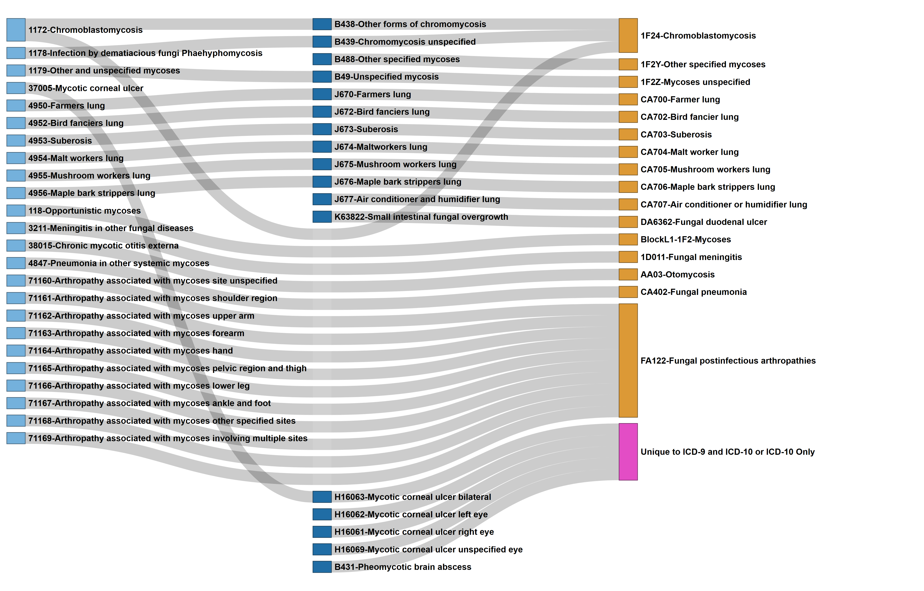
Forward Mapping General Mycoses ICD Codes
ICD-9
ICD-10
ICD-11
Supplemental Figure 23. General Mycoses ICD Code Mapping: Best Match Forward Sankey Network
Nodes represent individual ICD codes across versions (ICD-9, -10, -11), connected by links indicating mapping pairs with the highest match score, with ties. Primary mapping utilized a stepwise strategy requiring a minimum cumulative match score of 45 out of 100 points. To capture complex relationships, a “skip-link” strategy was employed for pairs that either failed the initial threshold or exceed the stepwise score by ≥ 10 points. Codes with unlinked nodes (“Orphan” codes) represent version-specific entries that did not meet the minimum match criteria in either strategy and are indicated by a pink node with text indicating the ICD version(s) to which it is unique. Light Blue Nodes: ICD-9, Dark Blue Nodes: ICD-10, and Yellow Nodes: ICD-11

Slide 15
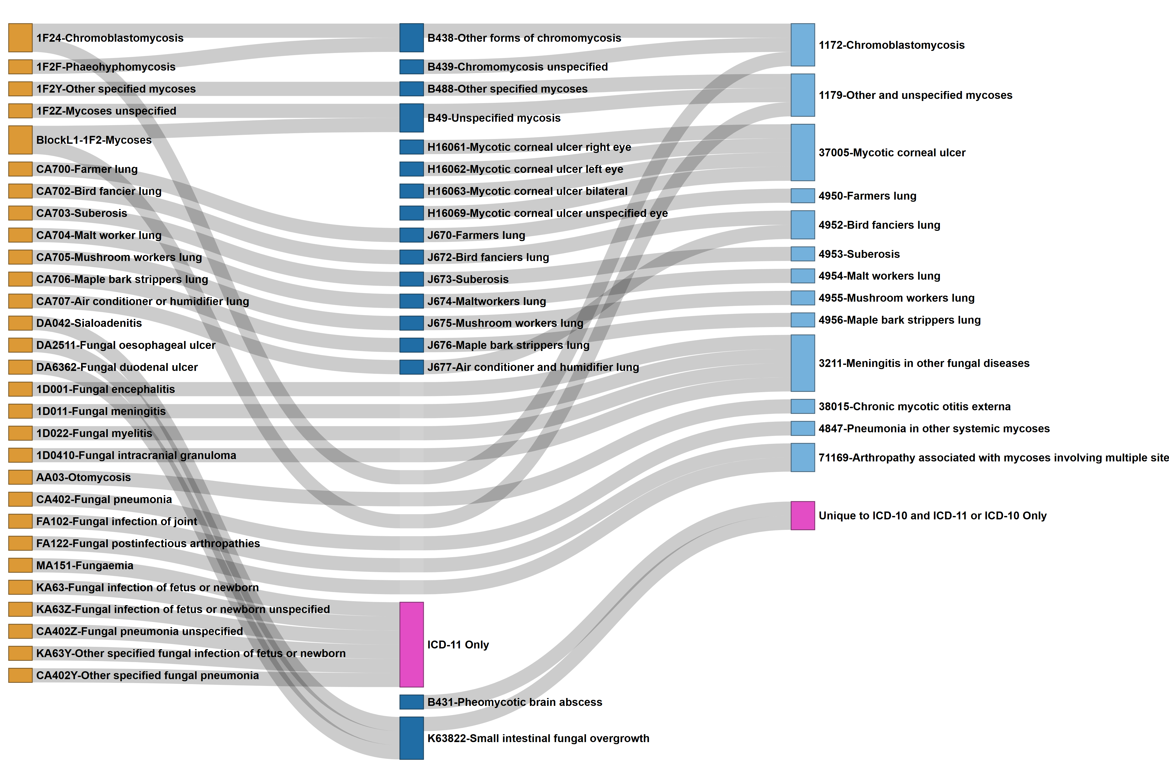
Reverse Mapping General Mycoses ICD Codes
ICD-11
ICD-10
ICD-9
Supplemental Figure 24. General Mycoses ICD Code Mapping: Best Match Reverse Sankey Network
Nodes represent individual ICD codes across versions (ICD-11, -10, -9), connected by links indicating mapping pairs with the highest match score, with ties. Primary mapping utilized a stepwise strategy requiring a minimum cumulative match score of 45 out of 100 points. To capture complex relationships, a “skip-link” strategy was employed for pairs that either failed the initial threshold or exceed the stepwise score by ≥ 10 points. Codes with unlinked nodes (“Orphan” codes) represent version-specific entries that did not meet the minimum match criteria in either strategy and are indicated by a pink node with text indicating the ICD version(s) to which it is unique. Light Blue Nodes: ICD-9, Dark Blue Nodes: ICD-10, and Yellow Nodes: ICD-11

