Slide 1
What If: Luna! Mare Crisium
Jonathan Poock
Alex Bermudez
April 20th, 2009

Slide 2
Overview

Slide 3
Game Concept
Original concept: top-down action game
Basic controls / play, complex events
Randomly generated content, a la roguelikes
Some content generated in a directed manner via game tree search

Slide 4
Actual Implementation
Current iteration of the game shares more in common with vertical bullet-hell shmups than adventure games
More emphasis on twitch movement than careful planning
Events simple, but results of events change gameplay significantly

Slide 5
Game Components
Player
Lunar rover
Three item slots, presence / absence of items help to direct event generation
Enemies
Unique behavior patterns / abilities
Other rovers
Turrets
Tanks

Slide 6
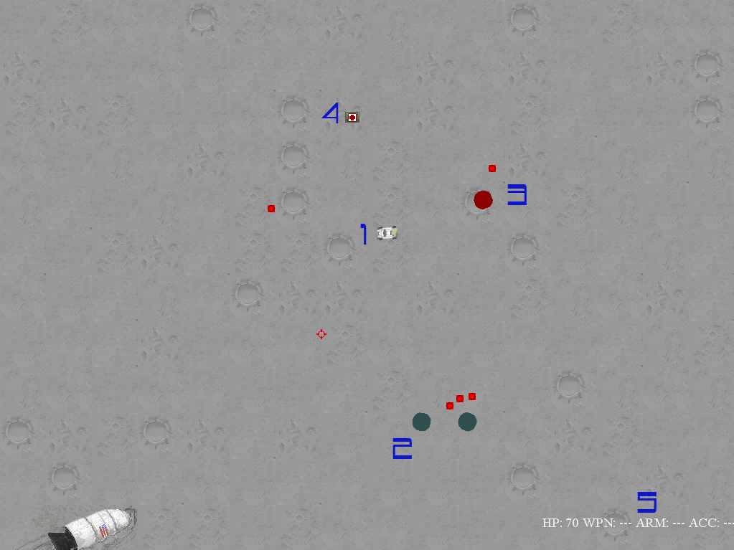
Legend 1. Player 2. Enemy (Turret) 3. Enemy (Rover) 4. Item 5. UI / Status
In-game screenshot

Slide 7
AI Methods

Slide 8
Finite State Machine
Enemy behaviors use a simple state machine to determine action
States encapsulate behavior with discrete links to next possible state
States:
Guard, retToGuard, stationary, inactive, seek, avoid

Slide 9
Finite State Machine
Each enemy type uses a different chain of states
Tanks guard
Rovers seek
Turrets are stationary

Slide 10
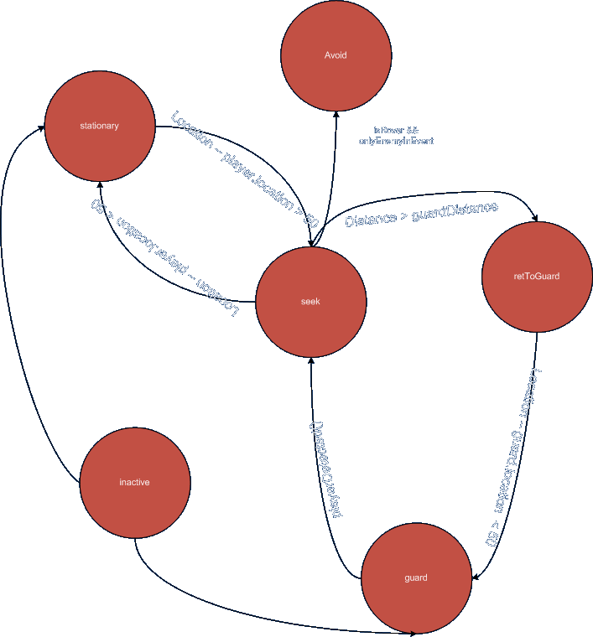
Example state graph

Slide 11
Event Generation Game Tree Search
Use a game tree to determine which events should be generated based on player state
If tree choices are maximized, the event that will lead to the best chance for necessary item will be selected
If choices are minimized, events that will never generate an item will be prioritized

Slide 12
Event Generation Game Tree Search
Goal of this method: provide directed random generation
Allows for modifiable difficulty
Still maintains random elements
With a simple tree, performance is similar to simply selecting only event that will generate item

Slide 13
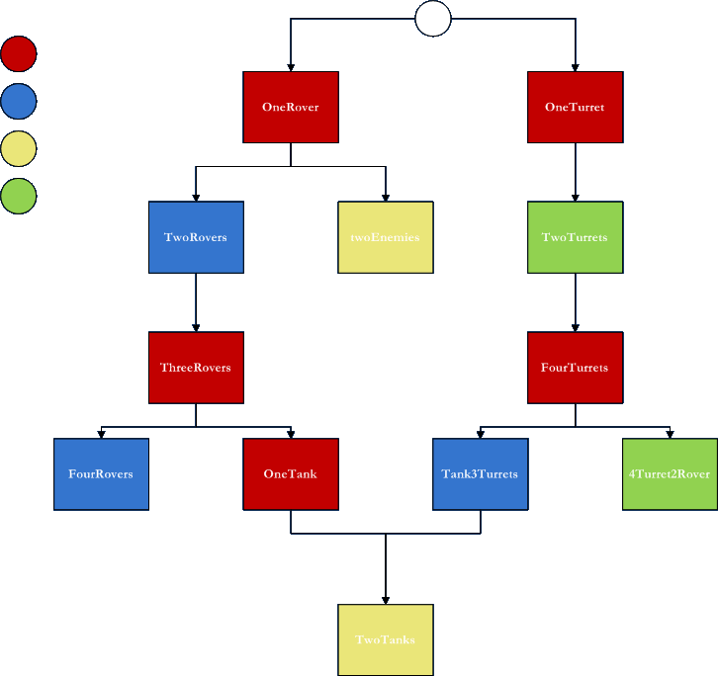
Health
Weapon
Armor
Accessory
event tree generated from a priori knowledge

Slide 14
1. Find all events that satisfy goal
2. For each goal event, generate the path in reverse until an eligible event can be found
Event generation algorithm – assuming up through the second tier of events have been spawned and the goal is Armor – maximize mode

Slide 15
3. Generate directed spawn list
4. Determine maxEvents number of events (by weighted random in directed list, choosing highest chance event (either uniquely or up to maxEvent copies) (ex. maxEvents = 5)
5 (opt.). If selection algorithm does not simply take maxEvents copies of the highest-chance event, pad maxEvents –spawnList.Count events with events chosen from all possible (ex.)

Slide 16
1. Find all events that do satisfy goal and associated paths / leading event
2. Find all events that do not satisfy goal and are eligible to be spawned
3. Remove common items and items that can produce a goal.
Event generation algorithm – assuming up through the second tier of events have been spawned and the goal is Accessory– minimzation mode

