Slide 1

Introduction to R Pt. 2
Data exploration

Slide 2
Recap
R is an object-oriented programming language
Functions are actions which we want to apply to our objects
filter(data_frame)
Dplyr is a package containing useful functions to tidy data %>%
Save objects in R using <-
new_df <- filter(data_frame)
Notes:
An object is anything we make in R, list, data frame, vector (a single string of the same data type)
Load packages to get extra, documented functions
Dplyr uses different syntax slightly l

Slide 3
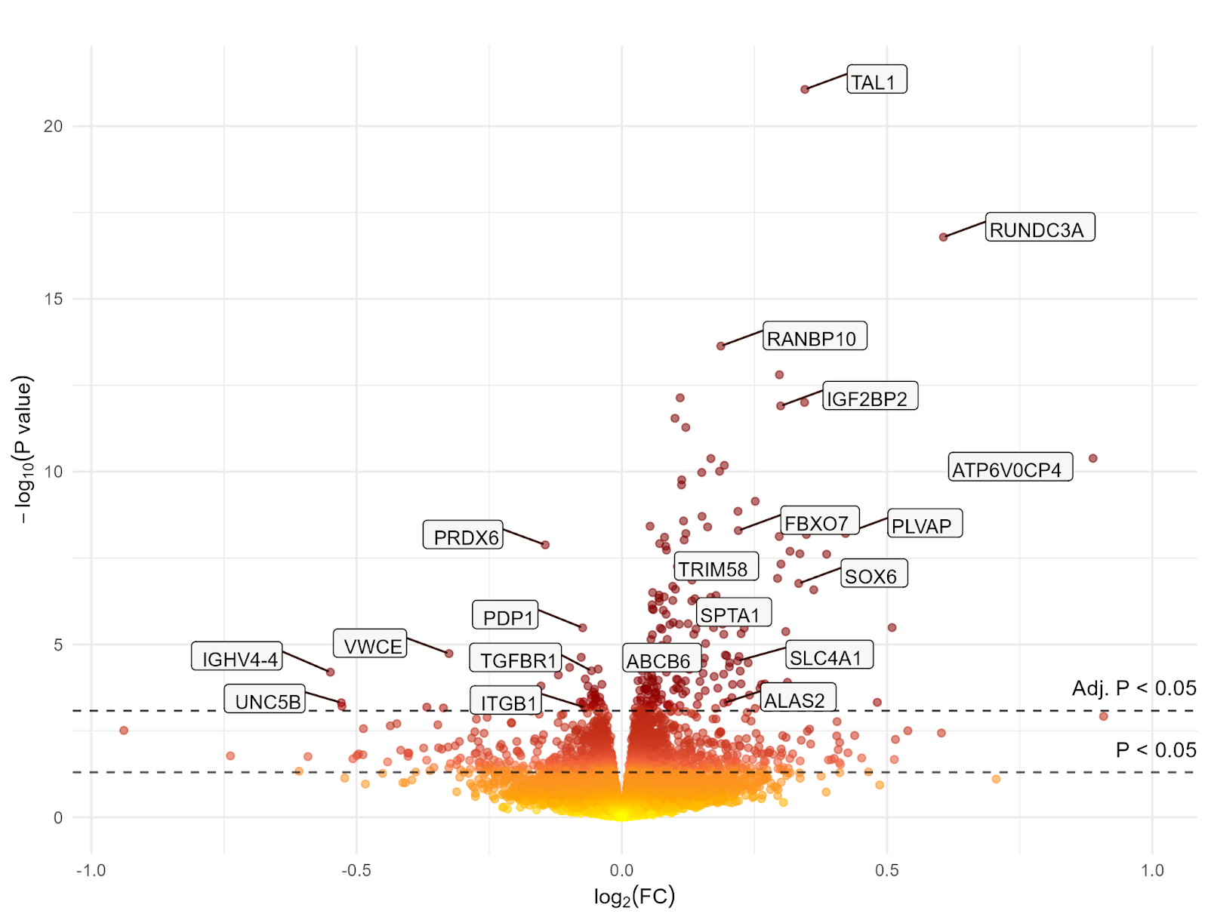
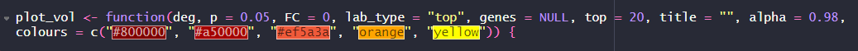
Functions
Arguments are the inputs or settings that control how a function behaves.
They are specified by the user when calling the function.
There are two types:
- Mandatory arguments: must be provided by the user.
- Optional arguments: have default values; if not specified, the default is used.
mean(x, na.rm = FALSE)
x is mandatory.
na.rm is optional, default is FALSE.
Notes:
Mandatory args, the object.
X - dataframe
Na.rm – na removal, optional as it has a default value which it will use if you don’t specify one
For help/more details use ?(function)
Eventually you will be able to write your own little functions

Slide 4


Explore in R

Slide 5
Data frame wide format
Wide format:
Repeated measures or time points appear as separate columns instead of rows
Multiple columns per sample
sample_id | incidence_1999 | incidence_2000
1467 | 0.2 | 0.27
8732 | 0.05 | 0.09
Change
0.07
0.04
Notes:
More like in excel
Summary calculations done in a new column

Slide 6
Data frame tidy structure (R)
Long format:
If there are multiple observations from the same sample or subject, then there would be multiple rows per sample
sample_id | incidence | year
1467 | 0.2 | 1999
8732 | 0.05 | 1999
1467 | 0.27 | 2000
8732 | 0.09 | 2000
Notes:
This is the 'tidy way of storing data
# Refer to columns as variables, rows are observations (long format)
Works best with ggplot and other functions
Note use group_by function

Slide 7
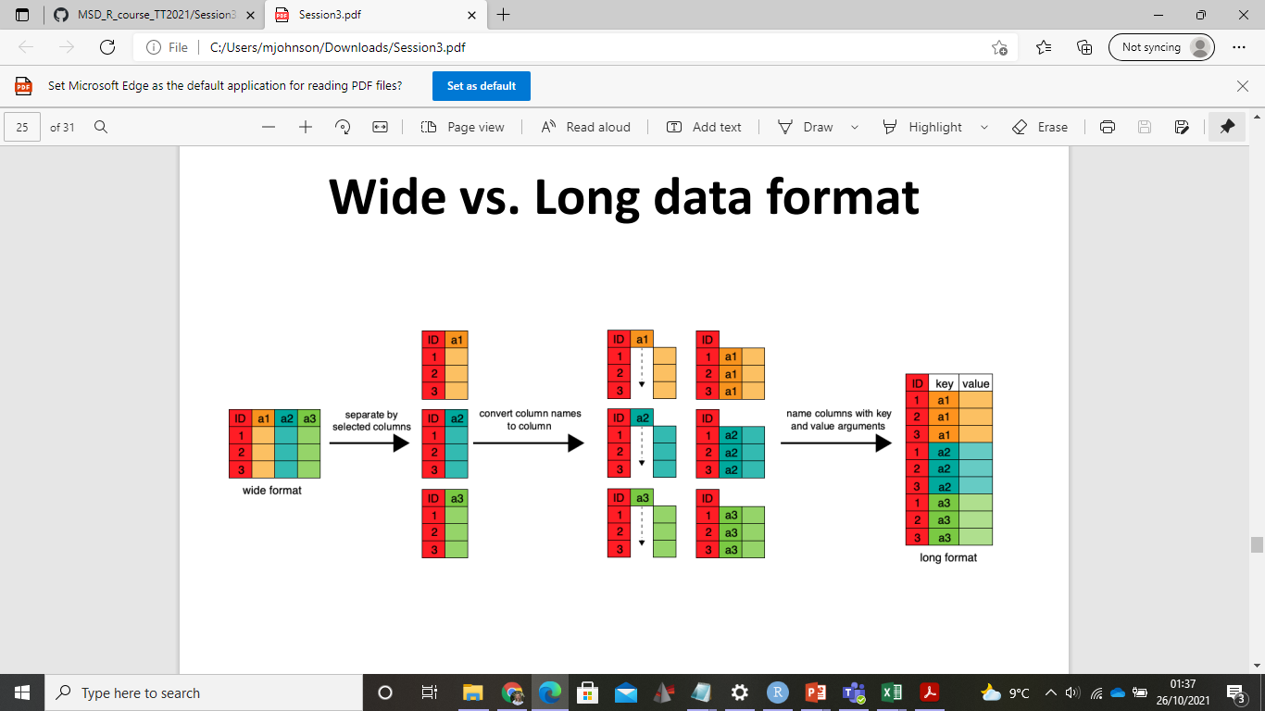
Wide vs Long format data
I try to set up my data in excel as long format data when I can – good for plotting
However, you can convert between the two using R ☺
Pivot_wider/longer or dcast/melt or gather/tidy https://ademos.people.uic.edu/Chapter8.html
http://www.sthda.com/english/wiki/tidyr-crucial-step-reshaping-data-with-r-for-easier-analyses
Notes:
You need to know what ‘key’ you are splitting them by
Data in csv is already in long format

Slide 8
Explore in R

Slide 9
Summarising data (1)
In excel we use formulae to summarise data at the end of tables
In R we can also summarise our data, save it as a separate object using (<-)
Or add a new column to the data frame using dplyr:mutate
Notes:
Short term, it is easier in excel, long term it is much faster in R > more possibilities to plot and analyse your data
Like in Excel you can perform calculations, the difference being instead of appending them we save them as a data frame

Slide 10
Summarise – Find the mean
We can summarise data most simply by subsetting either a column or row
Base R uses functions such as mean() to calculate averages
E.g. mean(dataframe$colname)

Slide 11
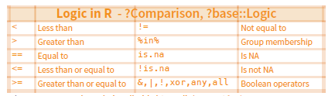
Summarize and filter
We can also filter columns and rows based on logical conditions
For example, if I wanted to find the mean number of deaths for one country
1) subset condition of interest (rows) 2) then select variable to summarise (column)
Notes:
e.g country, and both sex, then summarise num of deaths

Slide 12
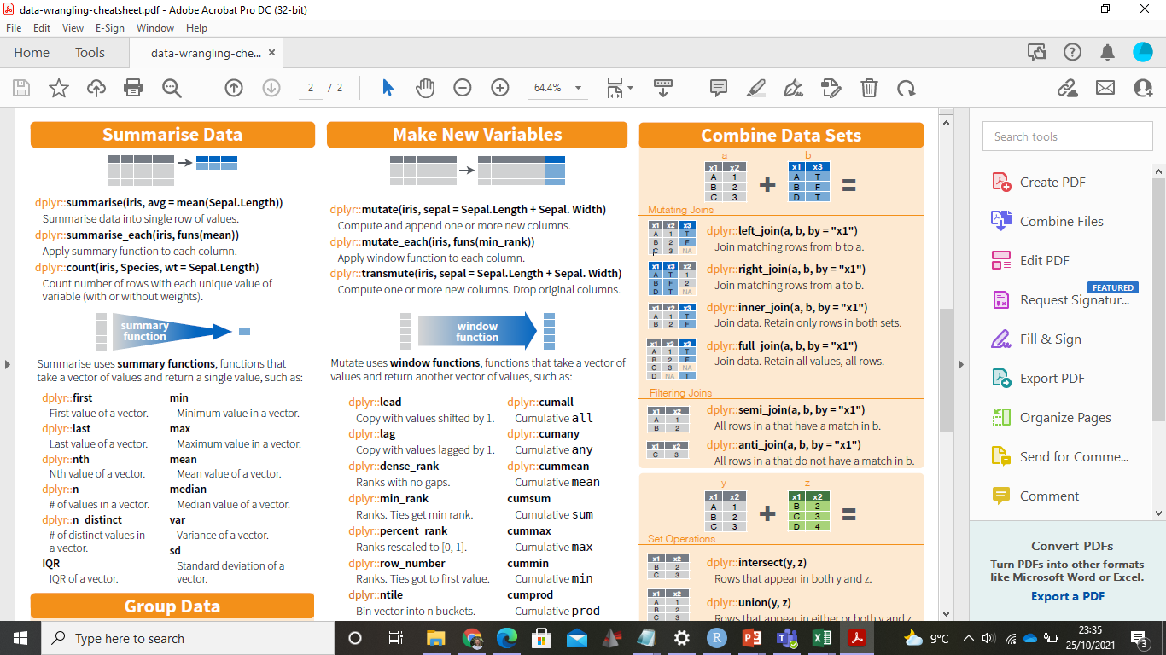
Summarise data (2)
In dplyr, we can subset rows using filter() or group_by() functions
Pipe %>% filtered table into summarise function
Pick operation to perform
E.g data %>% filter(condition == TRUE) %>% summarise(average = mean(colname))
Notes:
Lots of functions you can try
Summarise mean, sd etc.

Slide 13
Explore in R

Slide 14
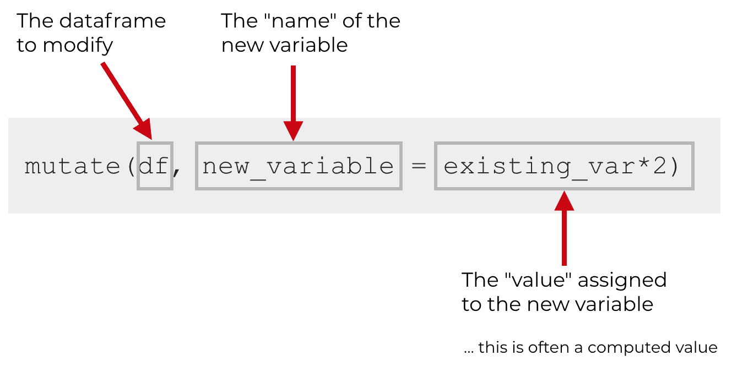
Tidy data - Mutate new column
Often, we want to calculate a new variable, such as fold change between two time points or summarise a value
When you use mutate(), you need typically to specify 3 things:
the name of the data frame you want to modify
name of the new variable that you’ll create
the formula/value you will assign to the new variable
Notes:
In my data, I would like to calculate the amount of Vi IgA antibody purified, and the percentage of Vi IgA purified
Steps:
Subset data frame using [ ] or filter for logical conditions
Calculate new values
Save results as a new column in data frame using dplyr::mutate

Slide 15
Explore in R

Slide 16
Plotting - Basics
http://www.sthda.com/english/wiki/ggplot2-essentials
For plotting data we will use the ggplot package
Plot = data + Aesthetics + Geometry.
data is a data frame
Aesthetics is used to indicate x and y variables. It can also be used to control the color, the size or the shape of points, the height of bars, etc…..
Geometry defines the type of graphics (histogram, box plot, line plot, density plot, dot plot, ….)
Notes:
Now that our data is in good shape and all the variables are computed, we’re ready to try some plotting ☺

Slide 17
Explore in R

