Slide 1
Research Paper Review 1. Communication-Efficient Massive UAV Online Path Control: Federated Learning Meets Mean-Field Game Theory. 2. Distributed Federated Learning for Ultra-Reliable Low Latency vehicular communication 3. A V2X-based Privacy Preserving Federated Measuring and Learning System
CW27CY25

Slide 2
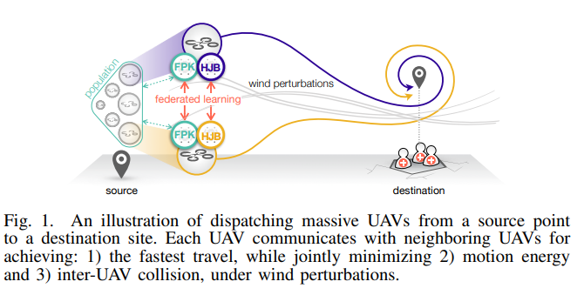
Paper-1: Communication-Efficient Massive UAV Online Path Control: Federated Learning Meets Mean-Field Game Theory (MFG)
Problem:
In this paper, To solve the following issues when massive of UAVs from source to destination in a windy environment.
To minimize UAVs travel time
To minimize motion energy
To avoid UAVs collision
Solution/Implementation:
There are 2 ways to solve the problem
Mean Field Game (MFG) theory framework consist NN based Hamilton-Jacobi-Bellman (HJB) and Fokker-Planck-Kolmogorov (FPK) equations
Federated Learning based MFG, this approach ensures data privacy . FL-MFG based UAVs shares only local models instead share states of the UAVs.
Solution/Implementation - Algorithm:
HJB Control Algorithm | MFG Control Algorithm | FL MFG Control Algorithm
UAVs share state (acceleration, Velocity, Location) and each UAVs are uses NN (HJB & MPK) algorithm to calculate optimal actions. |  | Leaders UAVs shares the model to the Swam UAVs and vice-versa
Communication cost is very high due to share the states (larger size samples) of the UAVs each other. Data privacy is the biggest concerns |  | It reduces the communication cost due to share models (less in size). Make sure data privacy

Slide 3
Paper : 2 – Distributed Federated Learning for Ultra-Reliable Low Latency vehicular communication
Problem:
“The Joint Power and Resource Allocation (JPRA) for ultra-reliable low latency communication in vehicular network”
“Vehicle took lots of transmission power consumption to communicate each other due to high latency and not reliable”
High latency – long delay to send/transmit the message/payload from vehicle to vehicle and it resultant to missing the critical\extreme events are collision, blind spot in autonomous vehicle.
Solution / implementation:
Extreme Value theory – analyze and extreme the queue length value with predefined threshold queue length.
To learn the extreme event, samples are IID over vehicles, a noval distributed approach based on FL is proposed to estimate the tail distribution of the queue length

Slide 4
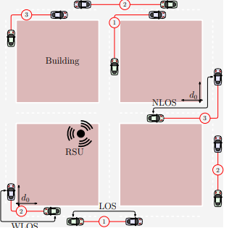
Centralized Learning Algorithm (CEN)
All vehicles are continuously uploading the queue length samples to RSU.
The number of vehicles increases, the sample size grows and so the vehicle access to the RSU causing congestion resulting in increased network latency.
RSU Side: Machine Learning Model Algorithm. using Maximum Likelygood Estimation and stochastic variance reduced gradient descent to find the optimal GPD parameters.
RSU share the GPD parameters to all vehicles.

Slide 5
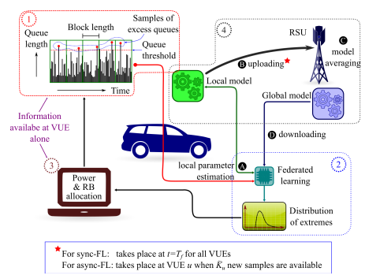
Synchronization / Asynchronization FL Algorithm
Sync-FL :
In synchronous approach, the predefine time interval all the vehicles share the trained local models(many epochs based on the algorithm) to the RSU simultaneously.
RSU do average all vehicle’s local models and obtained the global model. It will be download to all vehicles simultaneously.
The simultaneous transmissions to the RSU by all vehicles degrades the Vehicle - RSU data rates and thus, introduces significant delays to ongoing V2V communication.
Async-FL:
Each vehicle must wait until predefined K number of Queue length samples- collected.
Once K number of samples reached in a vehicle, the local model evaluate and share the model to RSU.
In RSU, the newly received local model is averaged out with the existing local models of other vehicles, and the updated global model send to the vehicle.
The delay of the upload and download models is very low

Slide 6
Results & Future Focus Research
Results :
FL enables the proposed method to estimate the tail distribution of queues with an accuracy that is close to a centralized solution with up to 79 % reductions in the amount of exchanged data.
Furthermore, the proposed method yields up to 60% reductions of VUEs with large queue lengths
Future:
Future extension of this work is to study FL in the presence of non-IID training data.

Slide 7
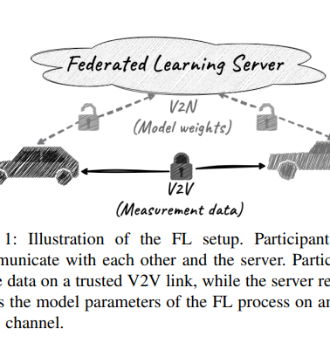
Paper : 3 – A V2X-based Privacy Preserving Federated Measuring and Learning System
Problem:
In this paper,
FL measurement – V2V communication
FL Learning - V2N communication
The ML model in vehicle as well as server and it trains with non- IID data sets (like AV’s real time data) to evaluate the capability of proposed system in terms of performance and Privacy.
Non-IID data can cause performance issues and open the way for privacy threats for the FL system.
The non-IID nature of the data might disclose information about a vehicle’s route revealing the origins and destinations of the passengers. In the case of commercial vehicles, that would mean that the whole supply chain of a company might be exposed
FedAvg

Slide 8
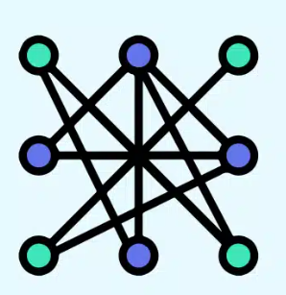


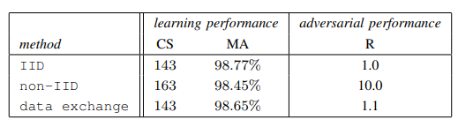
Solution/Implementation:
FedAvg – FL
Server
FL Server initiates communication round c=3 (e.g.)
FL Clients are exchange (V2V) the training data sets (MNIST)
FL clients/participant ran exactly 1 epoch (forward & backward propagation) of training
Finally, participant upload the new weight matrix to the server.
FL server aggregates the participant weight matrix and resultant/new global model download to each participant. (This is one communication round . C=1)
Results:
Proposed learning scheme improves the learning performance and, at the same time, mitigates the possible passive eavesdropping attacks against private information in V2X communication systems.
AVs shall incorporate the real-time data exchanged on V2V into their training dataset to make it more independently and identically distributed (IID)
v1
v2
v10
52410 – Samples
0-9 digits (classification)
Overrepresentation bit – 50% ( Particular digit – like ‘5’ or ‘7’)
MNIST data sets

Slide 9
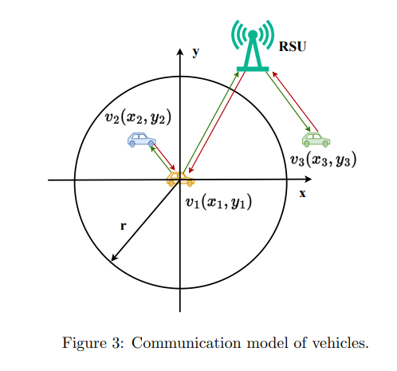
Paper - 4: Mobility-Aware Decentralized Federated Learning with Joint Optimization of Local Iteration and Leader Selection for Vehicular Networks
Problem:
MDFL - Mobility-aware Decentralized Federated Learning Framework.
➔ Near by vehicles train FL model collaboratively and decentralized manner.
Local iteration and leader selection joint optimization problem (LSOP) to improve the training efficiency of MDFL
For problem solving, we first reformulate LSOP as a decentralized partially observable Markov decision process (Dec-POMDP), and then develop an effective optimization algorithm based on multi-agent proximal policy optimization (MAPPO) to solve Dec-POMDP.
Objective: we verify the performance of the proposed algorithm by comparing it with other algorithms

Slide 10
Solution/Implementation:

