Slide 1
Credit Recovery & Debt Collection Analysis
Power BI Project Presentation
Notes:
Introduce the project: a Power BI analysis of loan recovery, overdue amounts, customers and collection agents.

Slide 2
Project Overview
Goal: track how much debt is being recovered, where overdue amounts sit, and how collection agents perform.
1
2
3
Credit Recovery
Customer Analysis
Agent Analysis
Overall KPIs, region and loan-type view
Outstanding balance, account status, days past due
Per-agent loans, targets and overdue amounts
Notes:
The report has three dashboard pages, each answering a different business question.

Slide 3
Data & Tools
Fields used
Tools & approach
Region
Loan_Type
Microsoft Power BI for modelling and dashboards
Slicers for Region, Loan Type, Account Status and Agent
Donut, column, combo, area and Sankey-style visuals
KPI cards for accounts, loan amount, recovered, overdue and outstanding
Account_Status
Loan_Amount
Amount_Recovered
Amount_Overdue
Collection_Target
Outstanding_Balance
Days_Past_Due
Agent
Notes:
Dataset covers about 4,000 loan accounts across 5 regions and 5 loan types.

Slide 4
Headline KPIs
4K
3bn
304.03M
Total Accounts
Total Loan Amount
Total Recovered
90.51M
388.67M
Total Overdue
Total Outstanding
Notes:
Five headline numbers from the Credit Recovery dashboard. Total recovered is roughly 10% of the 3.04bn loan book.

Slide 5
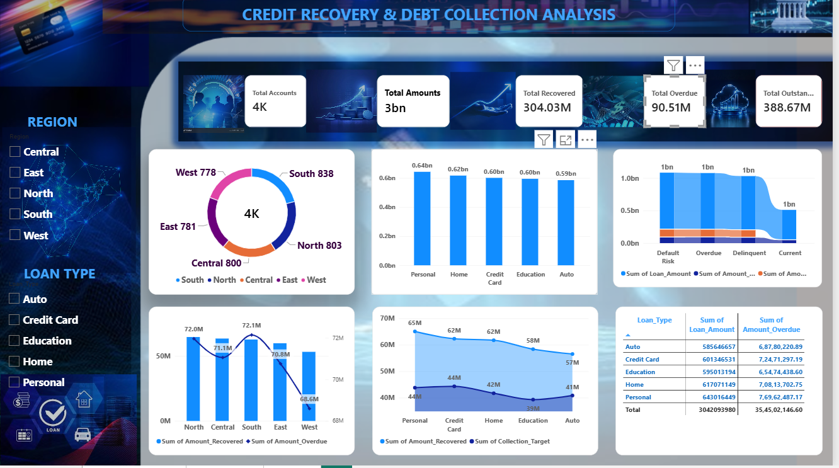
Credit Recovery Dashboard
Accounts are evenly spread: South 838, North 803, Central 800, East 781, West 778
Personal loans are the largest book (0.64bn); Auto the smallest (0.59bn)
Overdue is highest in South (72.1M) and North (72.0M), lowest in West (68.6M)
Slicers filter every visual by region and loan type
Notes:
Walk through the donut (accounts by region), the loan amount by type, and the overdue-by-region combo chart.

Slide 6
Recovery vs Target by Loan Type
Recovery beats target in every loan type; Personal loans carry the most overdue (76.96M).
Notes:
Values read from the dashboard's area chart and overdue table.

Slide 7
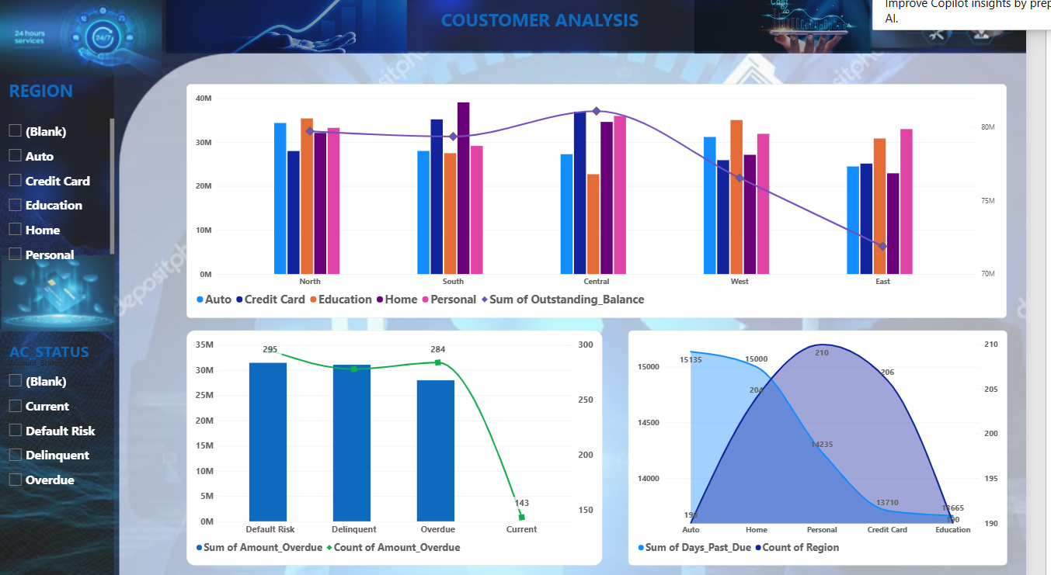
Customer Analysis
Central has the highest outstanding balance (~81M); East the lowest (~72M)
Default Risk, Delinquent and Overdue accounts each hold roughly 28-31M overdue
Auto and Home loans have the most days past due (~15,000)
Notes:
Figures are read from the chart axes, so they are approximate.

Slide 8
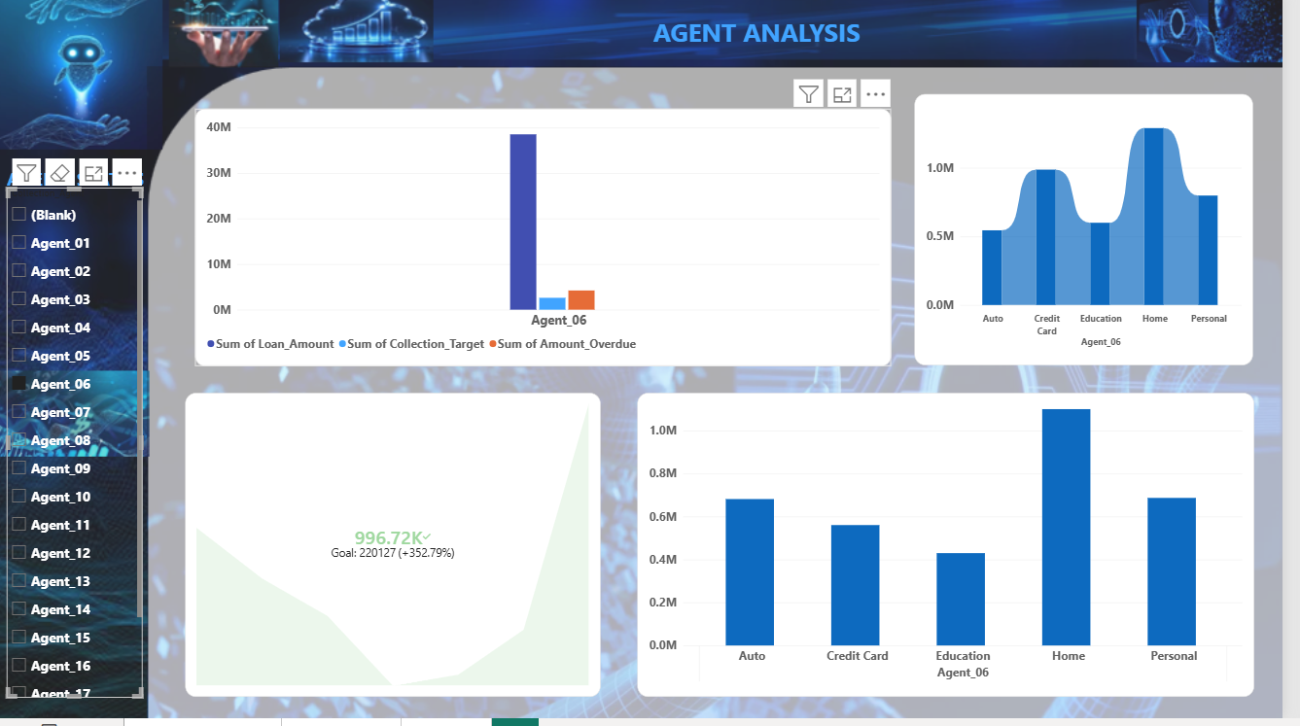
Agent Analysis
Agent slicer drills into any agent's loans, targets and overdue
Agent_06: recovery of 996.72K against a goal of 220,127 (+352.79%)
Home loans give Agent_06 the highest recovery
Notes:
Agent_06 is the agent selected in the screenshot.

Slide 9
Conclusion & Next Steps
Findings
Next steps
Recovery exceeds targets in all loan types
Overdue is spread evenly across regions
Overdue is concentrated in Default Risk and Delinquent accounts
Prioritise Default Risk and Delinquent accounts
Focus on Personal and Credit Card overdue
Share best practice from top agents

Slide 10
Thank You
Questions?

