Slide 1

Are houses affordable?
Are houses affordable?
Are houses affordable?

Slide 2
Are houses affordable?
Are houses affordable?
Are houses affordable?

Slide 3
Are houses affordable?
Using data from https://www.kaggle.com/datasets/samuelcortinhas/uk-median-house-prices-and-salary-19752020
Are houses affordable?

Slide 4
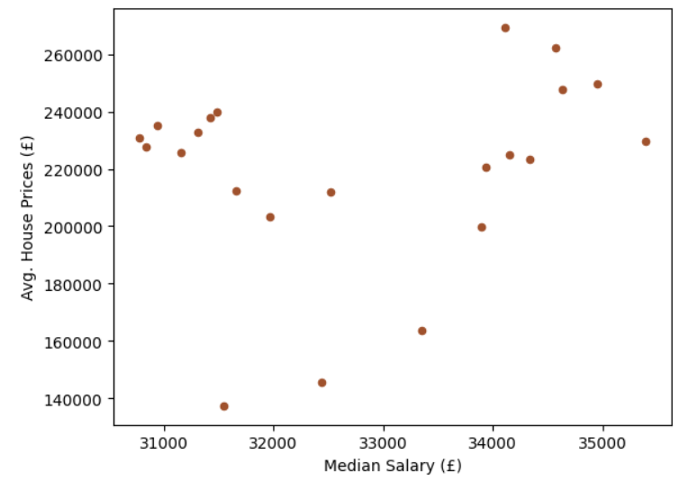
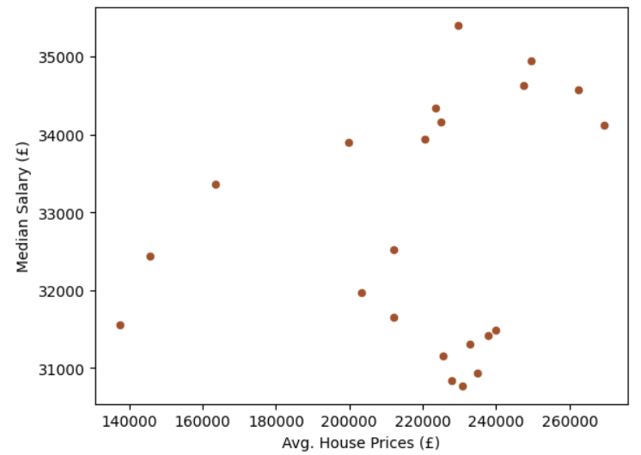
Scatter graphs
No correlation as far as I can tell?
(Both of these graphs are the same with the axis switched)
Notes:
Scatter graphs did not show a correlation but because there’s so many other factors that can influence, I decided to plot again

Slide 5
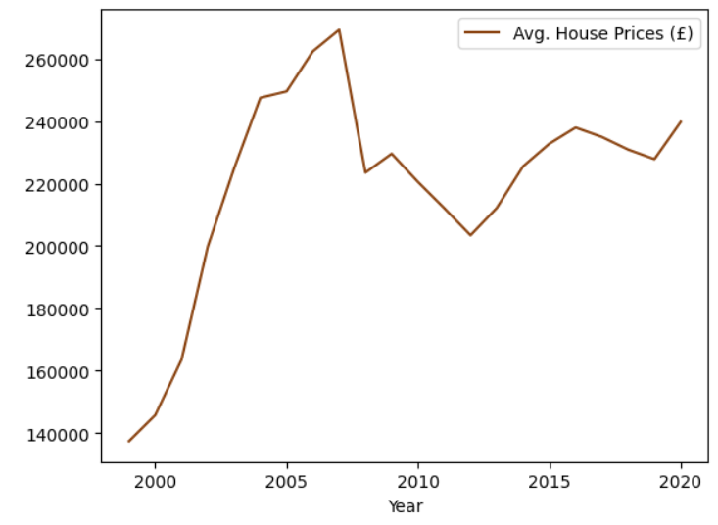
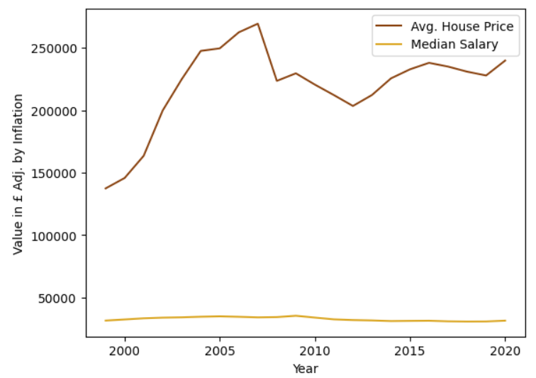
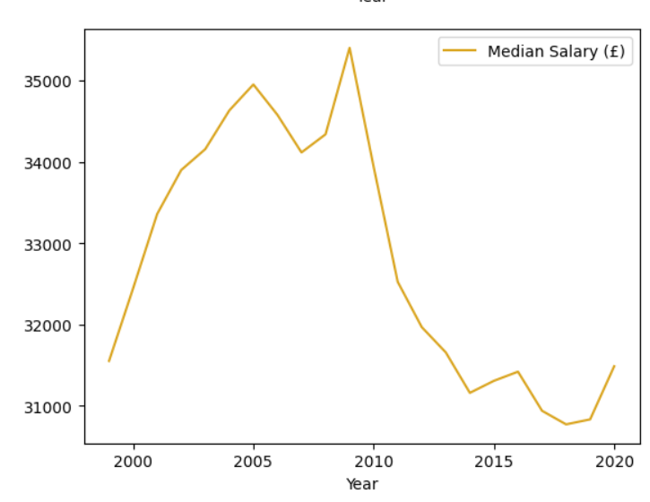
Line Graph To see changes over time
Notes:
Plotted a line graph to see what I’m working with but due to the difference in data ranges, the information regarding salary was difficult to analyse in this graph. I also did 2 separate line graphs to look at and while they look similar, because the money ranges are SO different, I don’t think it’s the most accurate to go off

Slide 6
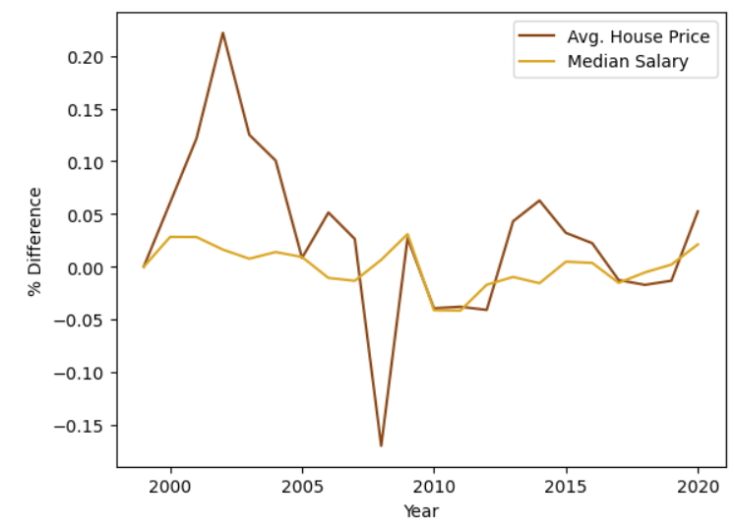
Percentage Difference
Housing Price Boom
This is a more accurate representation of change over time
2008 Market crash
Notes:
So I plotted this to understand the changes in a way that can be compared with a higher accuracy. And then from here needed to look at homeowner data to understand if changes impacted the amount of homeowners

Slide 7
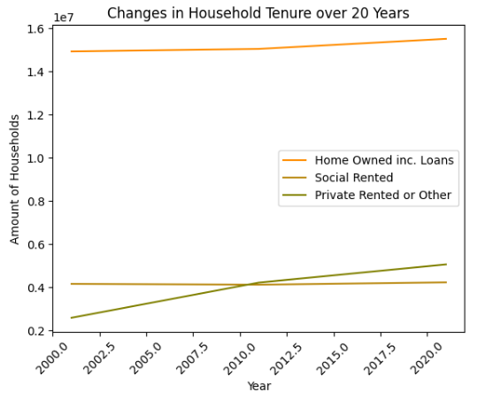
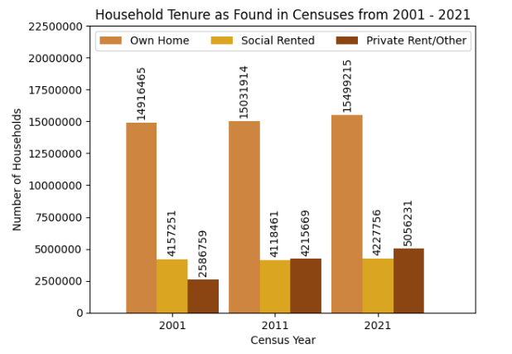
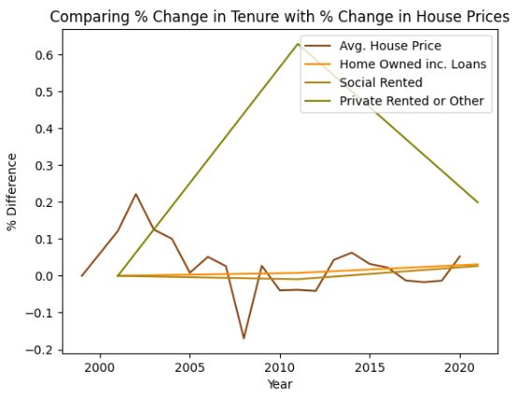
How does market volatility affect tenure?
data from the Office for National Statistics (Census 2001, 2011, 2021)
Notes:
Census data plotted. Line graph on following slide.

Slide 8
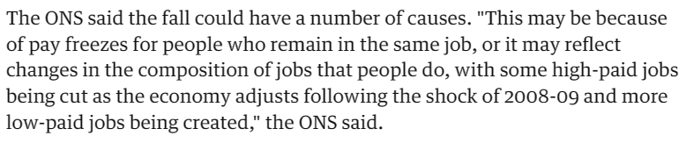
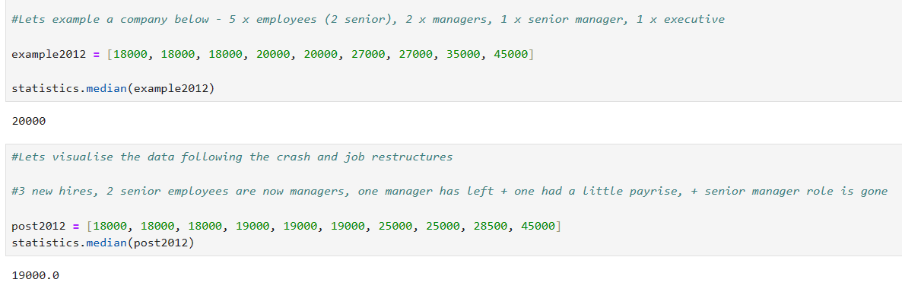



<- median salary data
https://www.ons.gov.uk/employmentandlabourmarket/peopleinwork/earningsandworkinghours/articles/changesinrealearningsintheukandlondon/2013-02-13
Overall saying salaries are not decreasing, it is just the data skew
As we can see, in this example, nobody’s income has decreased BUT the median has decreased by £1,000 due to the restructure
Nobody:
Notes:
So now we can see that the decline may be due to the data skew – I thought it would be best to look at the income in more detail to understand what’s going on

Slide 9
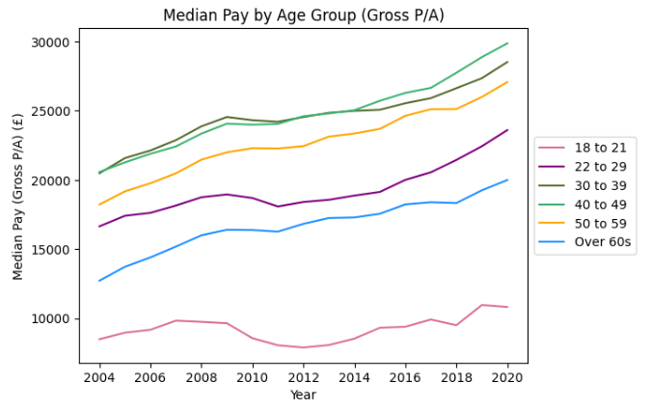

Let’s look at income in more detail…
the graph below uses data from the office for national statistics
significant difference in income for each age group
*would impact mortgage eligibility and therefore affordability for a home
I worked out an estimate of how much each range could be lent using:
From https://www.mortgagecalculator.uk/affordability/
(multiplied all the median pay data by 3 and 4.5)

Slide 10
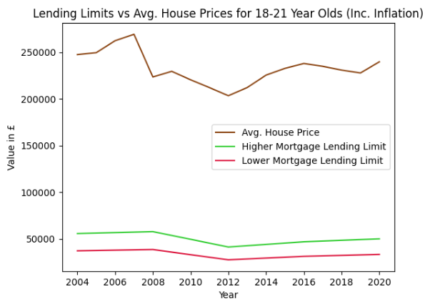
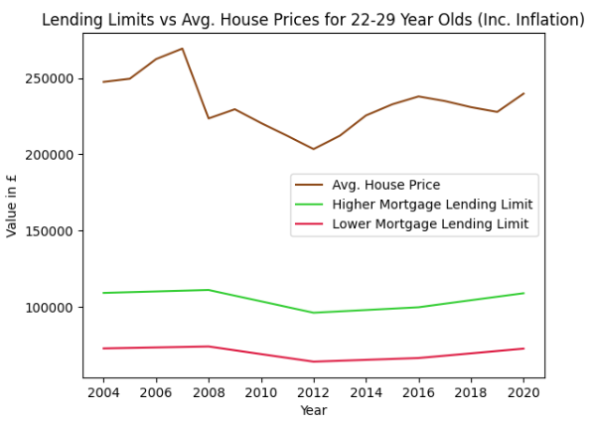
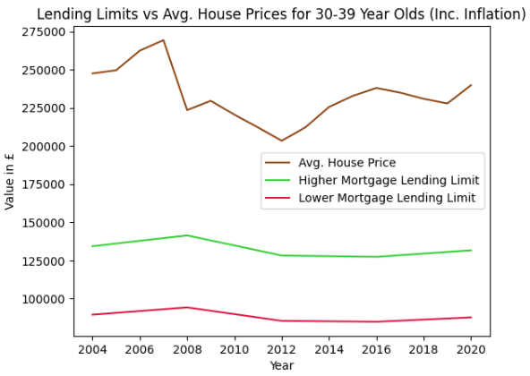

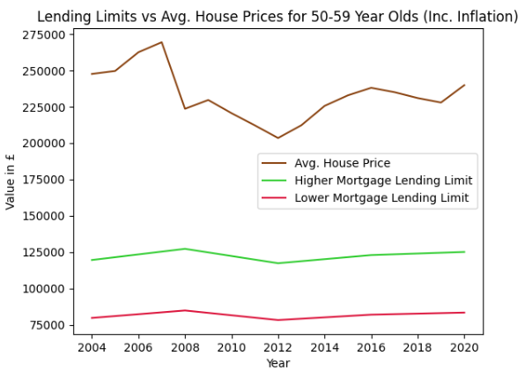
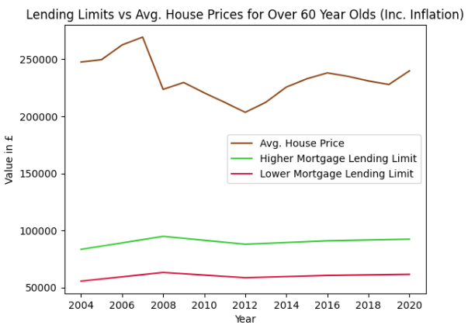
I used the BOE inflation calculator and plotted the mortgage eligibility…
Notes:
And as you can see there is still a massive gap between the house prices and highest lending limit

Slide 11

From the data that we’ve seen…
We can conclude that the average person probably can’t afford to buy a house on their own ☹

