Slide 1


AI-Powered Groundwater Planner
Saving Lahore's Water — one drop at a time.

Slide 2
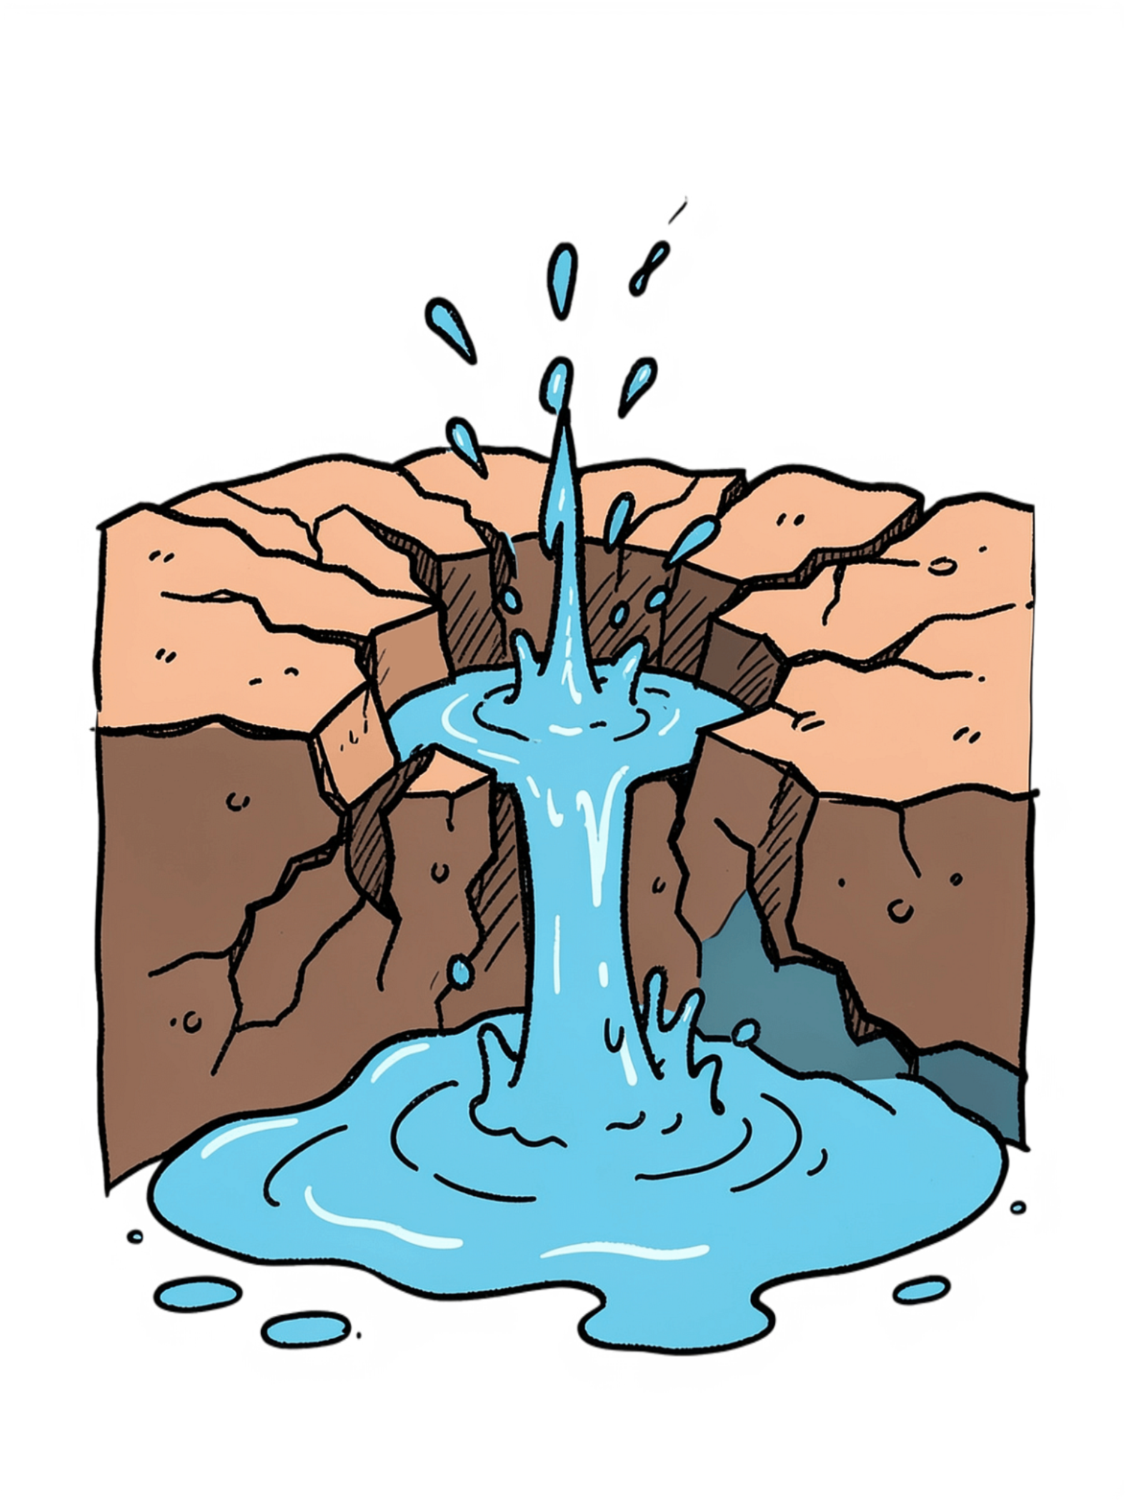
The Problem
🕰️ 20 Years Ago
📉 Today
Water was only 31 feet deep underground.
Water is now 79 feet deep — and going down fast.
⚠️ By 2040
If nothing changes, no water left for Lahore.

Slide 3




Where I Got This Data
Government Records
Satellite Pictures
Official water records from Punjab.
Photos of the city taken from space.
1,500 Water Pumps
Rain & Soil Studies
Real measurements from wells all over the city.
Data on where rain goes into the ground.

Slide 4
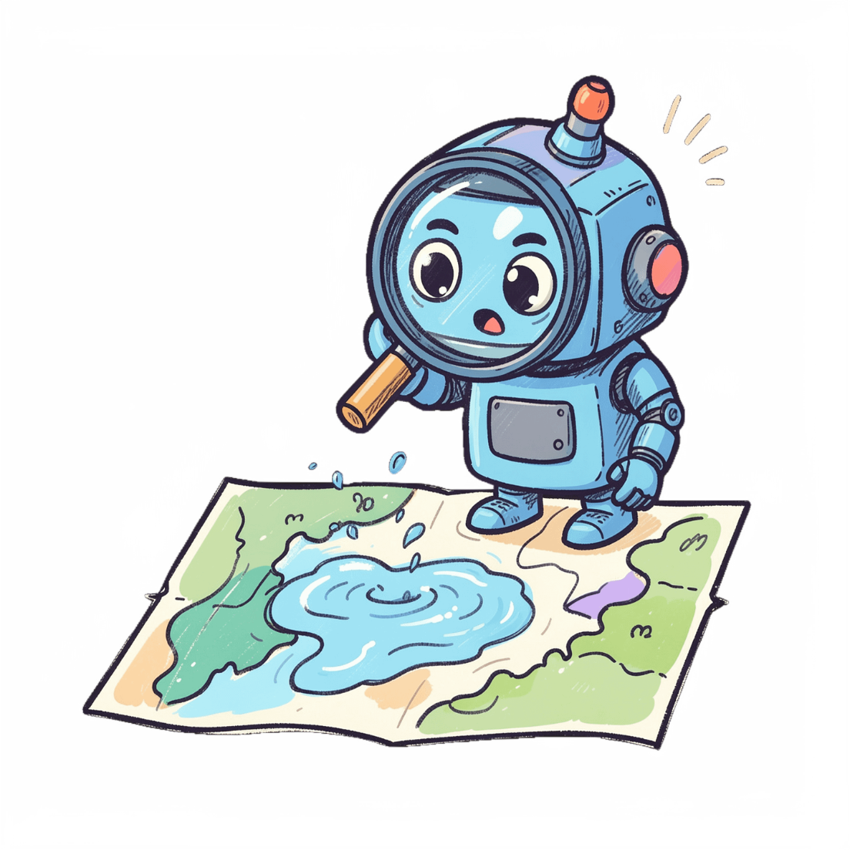

My Solution
AI watches the water
It checks water levels every day — automatically.
Finds danger zones
Shows exactly where water is running out.
Finds safe zones
Spots the best places to catch rain water.
Makes a city plan
Helps leaders decide what to do next.

Slide 5

How It Works
1. Collect Data
3. Generate Maps
4. City Planning
2. Train AI
Simple steps — powerful results for the whole city.

Slide 6
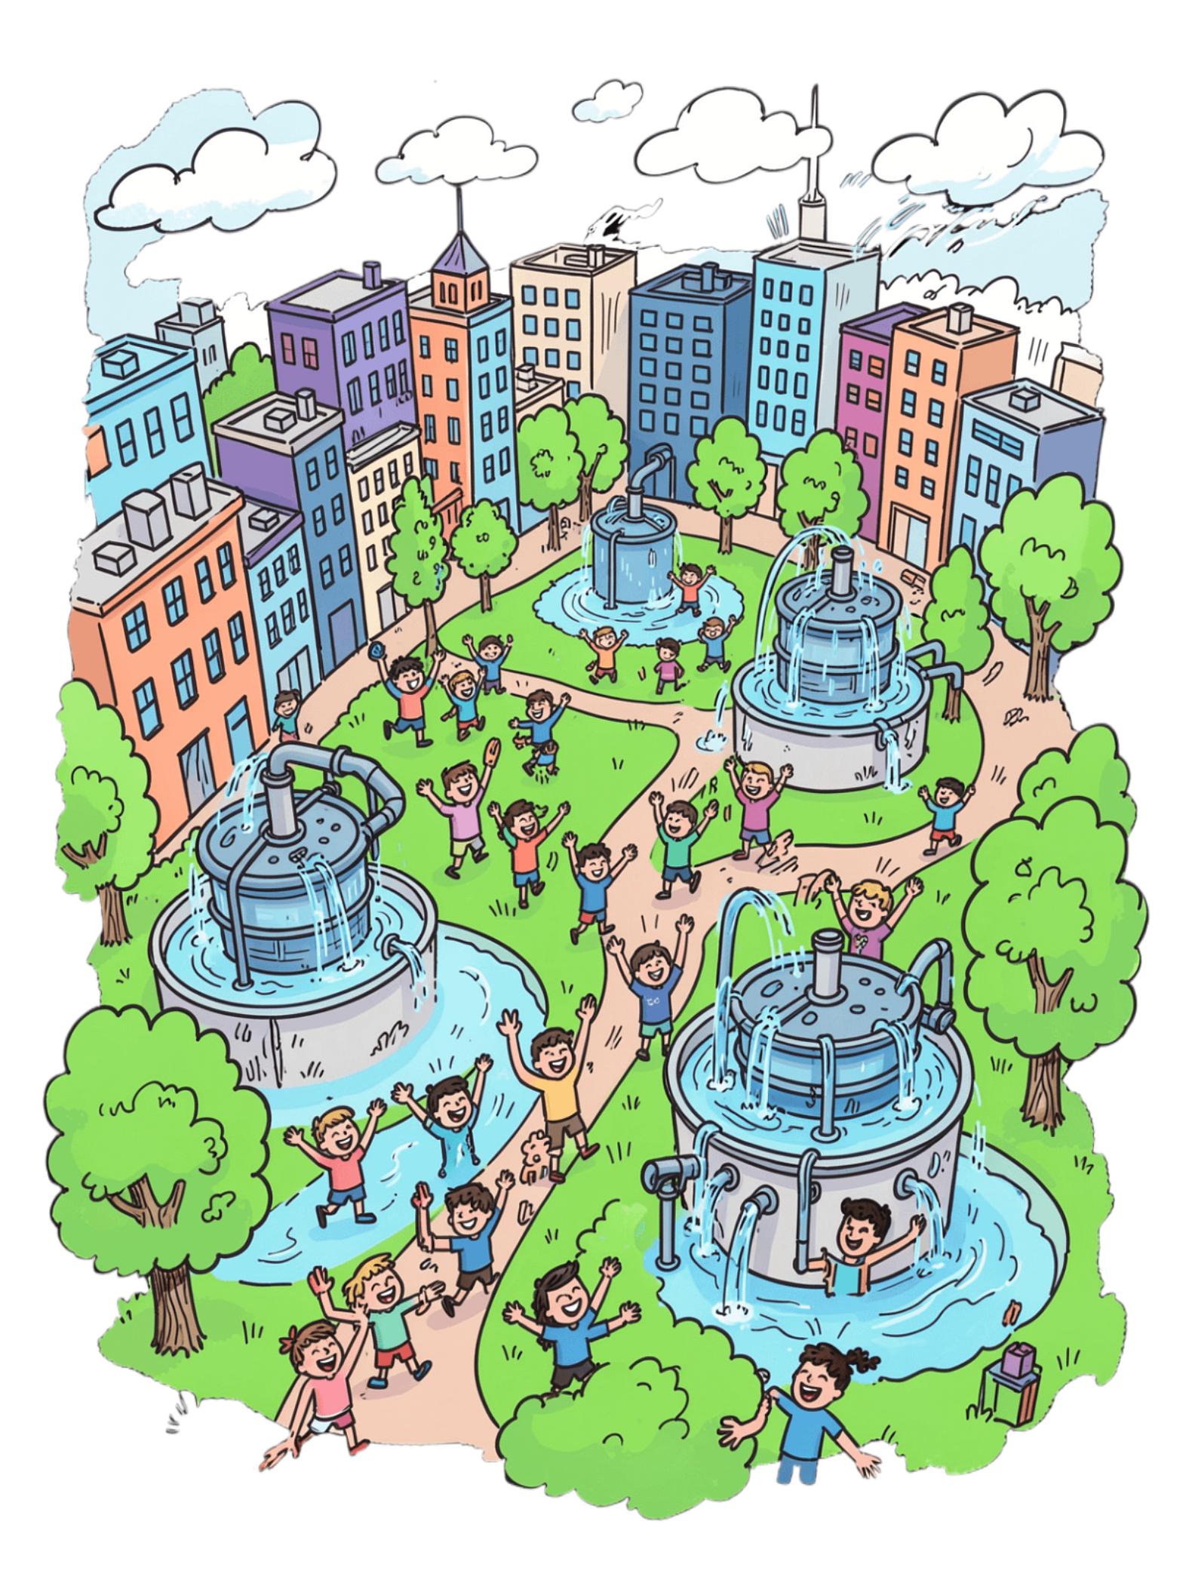
Why This Matters
10
36B
Extra Years
Litres Saved
More years of clean water for Lahore.
Rain water we can catch and store.
100+
Other Cities
This tool can help cities around the world.

