Slide 1
PYTHON INTRODUCTION
DevOps SummerSchool 2023

Slide 2
What will we learn today?
01
02
03
Python Introduction
Packages
Requirements file
05
06
04
Deploy applications
Hands on!
Running a python app

Slide 3

What is Python?
Scripting language
Interpreted
-Dynamic typing
Utilities: numpy, numeric,scipy
Google web search extension
Hardware testing (Intel, Cisco)
Open
Source
Object
Oriented

Slide 4
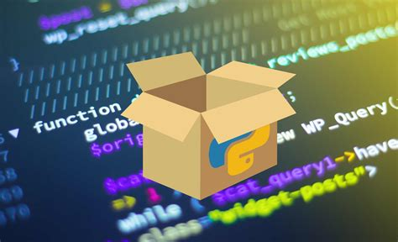
Packages
Packages are a fundamental concept in Python for organizing and structuring code.
They group related modules and provide a hierarchical structure for better code management.
Packages in python vs include in C/C++ :
-> Packages provide a systematic approach to manage namespaces, avoid naming conflicts, and promote code reusability.
-> Include enables code modularization, easy integration of external components, and improved code maintainability.

Slide 5
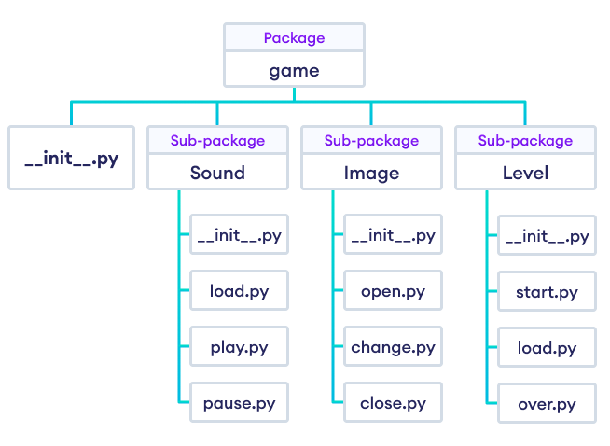
PACKAGES
Advantages
Packages break code into smaller modules => each module focuses on a specific task.
- Packages manage complexity as projects grow => easier to update or expand code.
- Modules can be reused in various projects => saves time and reduces redundancy
- Encourages modular documentation and testing => improves understanding and quality.

Slide 6

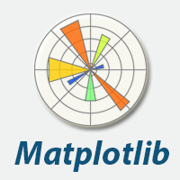
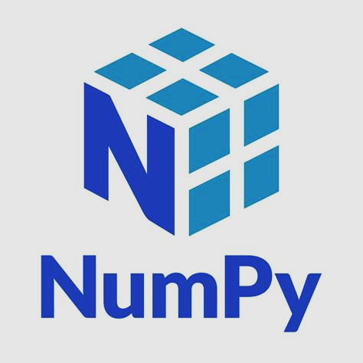








PACKAGES – popular python packages
Web framework for building web applications. (lightweight)
Numerical computations and multidimensional array manipulations.
Plotting and data visualization.
Web framework for building web applications.
Mapping of the HTTP protocol onto Python’s object –oriented semantics.
Data analysis and manipulation through DataFrames.

Slide 7
Package installation
pip package_name
Requirements
File
default package manager (install, update packages).
fetches the package from the Python Package Index (PyPI) and installs it + dependencies.
a simple text file that lists the required packages and their specific versions.
a simple text file that lists the required packages and their specific versions => consistent installations across different environments.

Slide 8
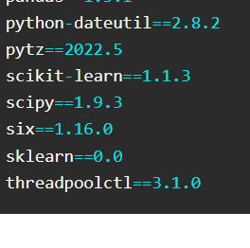
Requirements file
The purpose of a requirements file is to define the dependencies for a Python project.
It ensures that all the required packages are installed in the correct version, making it easier to reproduce the project environment.
The syntax of a requirements file is simple, with each line specifying a single package.
The line usually includes the name of the package and the version we want to install.
If for some package the version is written after “>=“ it means the package should be installed in any version equal to or greater than the version given in the requirements file.

Slide 9
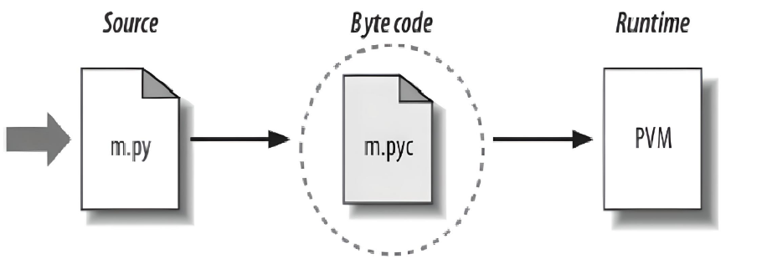
Python runtime execution
source code is translated to byte code, which is then run by the Python Virtual Machine.
when we run the source code for the second time, python will load the byte code, skips the compilation step unless we have not change the code.
variable types are determined during runtime. Objects carry their types with them, and operations are resolved based on the types at runtime.

Slide 10
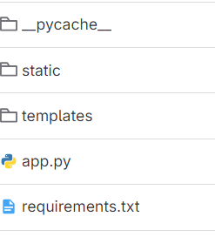
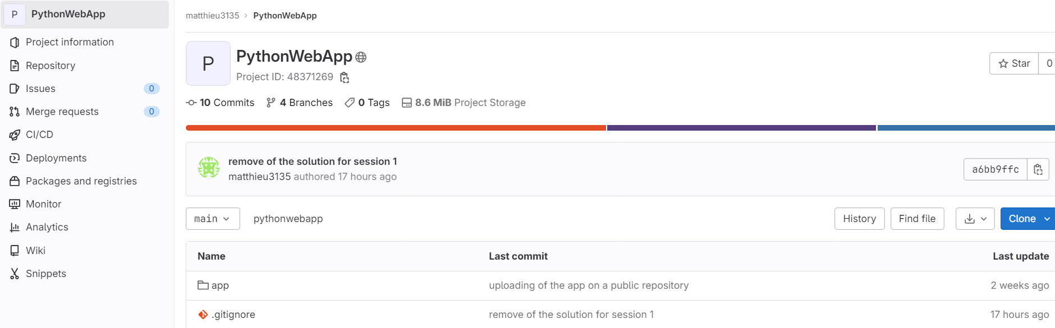
Deploy applications
Use version control systems like Git to track changes and collaborate with others.
Organize your web app with static files like CSS, JS, and images.
Create the requirements file

Slide 11

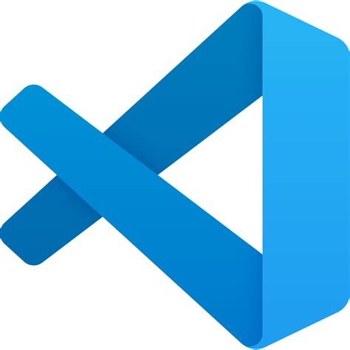
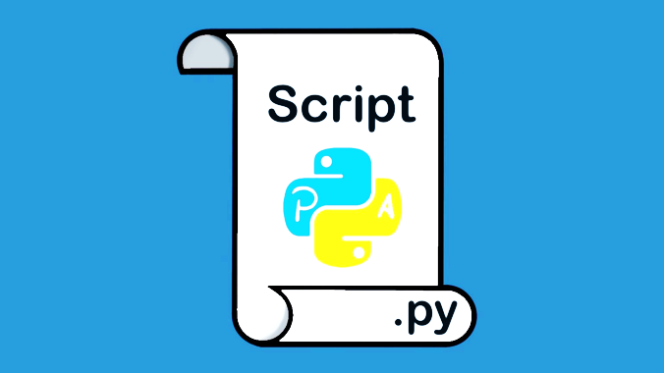
Run a python app
IDEs
Python Scripts
Command line
a more comprehensive development environment for Python. They include features like code editors, debugging tools, and project management capabilities.
Python scripts can be run by directly executing the script file using the 'python' command. !!! ensure that the script has the necessary executable permissions
using the 'python' command followed by the name of the script file

Slide 12


Bonus – service files
[Unit]
Description=my_app
After=network.target
[Service]
ExecStart= home/student/ilinca/pyhonapp/app.py
WorkingDirectory= home/student/ilinca/app
User=ilinca_nechita
Group=summerschool
Restart=always
[Install]
WantedBy=multi-user.target
Commands to execute:
sudo systemctl start my_app
sudo systemctl stop my_app
sudo systemctl restart my_app
sudo systemctl enable my_app
configuration files used by systemd, an init system widely used in many Linux distributions;
define how a service should be managed, including start, stop, and restart procedures;
advantages: improved manageability, automatic restarting of services on failure, and integration with other systemd features like logging and monitoring.

Slide 13

Q&A

Slide 14
Little exercise
Operations
+/-/*
Package
Add one or two packages (numpy- maybe calculate log/sqrt/power) or Matplotlib for plotting results.
Req
file
Build a simple python calculator and try to run it using more than one method.
Create a requirements file with the packages you used.

Slide 15
Template for the script P.S: you can add more than 3 operations & anything that seems unclear, feel free to ask!!
# import numpy as np
# import matplotlib.pyplot as plt
#define functions for each arithmetical operation, like: def power(x, y):
return np.power(x, y)
print("Select operation:")
#print(“number_operation. Name_of_operation")
choice = input("Enter choice (1/2/3): ")
if choice == '1':
# call the function for the operation
elif choice == '2':
# call the function for the operation
elif choice == '3':
# call the function for the operation
else:
print("Invalid input")
exit()
print(f"{operation} result: {result}")

