Slide 1


University of Belgrade · Faculty of Agriculture
Chemical characterisation of essential oils and machine learning analysis of molecular substructures associated with antimicrobial activity against Salmonella Typhimurium for food industry applications
Doctoral Defense
Student: Maria Lagerholm
Mentors: Prof Dr Viktor Nedović, Prof Dr Mirjana Pešić
2026
Bridging phytochemistry & AI
Notes:
Good morning everyone. Today I'll be presenting my doctoral research on essential oils and how we can use machine learning to get a better understanding of what drives their antimicrobial activity, specifically against Salmonella.
This work combines lab experiments with computational analysis. It was done at the Faculty of Agriculture, University of Belgrade, in collaboration with other faculties and universities.

Slide 2



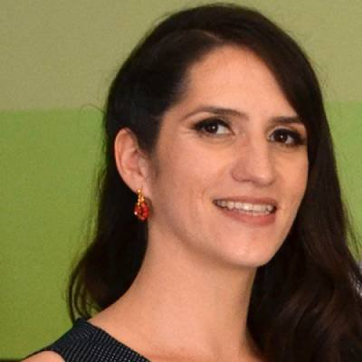













Acknowledgments
With gratitude to all collaborators who contributed to this research
Prof Dr Viktor Nedović
Faculty of Agriculture, UB
Prof Dr Mirjana Pešić
Faculty of Agriculture, UB
Dr Ana Salević
Faculty of Agriculture, UB
Dr Ana Kalušević
Institute of Meat Hygiene
Dr Steva Lević
Faculty of Agriculture, UB
Dr Milena Pantić
Faculty of Agriculture, UB
Prof Dr Miomir Nikšić
Faculty of Agriculture, UB
Dr Miloš Jovanović
Faculty of Organizational Sciences
Dr Marija Kuzmanović
Faculty of Organizational Sciences
Dr Dejan Pljevljakušić
Institute Dr Josif Pančić
Dr Katarina Šavikin
Institute Dr Josif Pančić
Prof Dr Nataša Milosavljević
Faculty of Agriculture, UB
Prof Dr Ivan Mijaković
Chalmers & DTU
Prof Dr Jens Nielsen
BioInnovation Institute & Chalmers
Prof Dr Aleksej Zelezniak
Chalmers & Vilnius
Dr Jan Zrimec
NIB Slovenia & Chalmers
Filip Buric
Chalmers University
Bridging phytochemistry & AI
Notes:
Before we start, I want to thank everyone who helped make this work possible.
My mentors at the Faculty of Agriculture for guiding me through this journey. The experimental team here in Belgrade who helped with the laboratory work. Our collaborators at the Faculty of Organizational Sciences for the computational side. The Institute for Medicinal Plants team for their botanical expertise. And my supervisors during international mobility at Chalmers University and other institutions, who brought computational biology knowledge to this project.

Slide 3
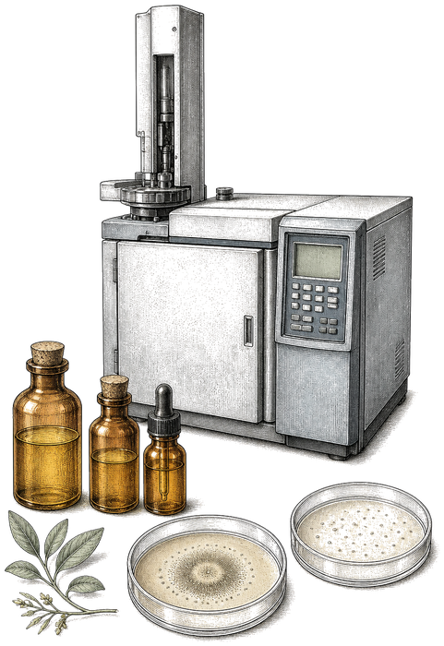
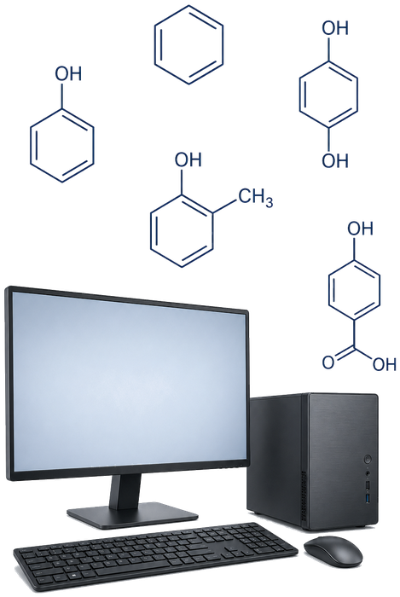
Research Roadmap
PHASE I: FOUNDATION
Experimental Lab Work
GC MS profiling and bioactivity validation of 4 commercial EOs; development of calcium alginate delivery systems.
Outcome: Encapsulation Strategy
PHASE II: DATA DRIVEN ANALYSIS
Machine Learning & Meta Analysis
Decoding molecular drivers of antimicrobial activity through large scale data mining.
Outcome: Molecular Insight
Bridging phytochemistry & AI
Notes:
Here's how today's presentation is organized.
First, Phase I: the experimental work. We characterized commercial essential oils and suggested a way to preserve and deliver them using encapsulation in biodegradable material.
Then Phase II: the machine learning part. We collected and analysed data to figure out what molecular structures are potentially involved in the antimicrobial activity of plant essential oils.
I'll walk you through the experiments, explain the gap we found that led us to the computational work, and then show you what the machine learning revealed.

Slide 4
Why?
Why did we focus on Salmonella?
Major foodborne pathogen · food safety model · survives in food · inflammation · test bed for new antimicrobials
Why study essential oils in 2026?
Plant chemical innovation · complex bioactive mixtures · ML & CRISPR · engineered microbes · beyond extraction
Why machine learning?
Hundreds of compounds · impractical individual testing · patterns across many oils
Bridging phytochemistry & AI
Notes:
Why study essential oils in 2026? Because plants have already done a lot of chemical innovation for us. Essential oils are complex mixtures of bioactive molecules derived from plants, and today we have tools such as machine learning, synthetic biology, and CRISPR based genome editing. If we can understand which plant molecules are useful, we may later be able to produce them in engineered microbes instead of relying only on extraction from plants.
Why did we focus on Salmonella? Because it is a major foodborne pathogen and an important model for food safety research. It can survive in foods, cause intestinal infection, trigger strong inflammation, and develop resistance to antibiotics. Historically, Salmonella infections caused serious outbreaks. Today, sanitation and hygiene allow us to control it much better, but it remains a useful target for testing new antimicrobial strategies.
Why machine learning? There are hundreds of compounds in essential oils. Testing them one by one is impractical. Machine learning allows us to find patterns across many oils at once.

Slide 5
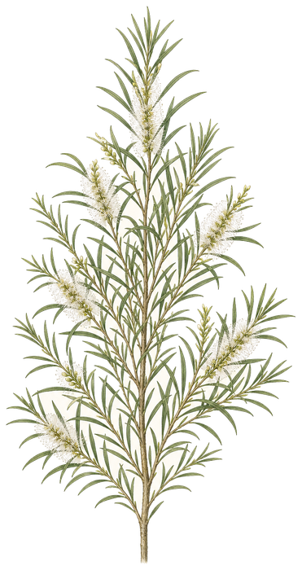
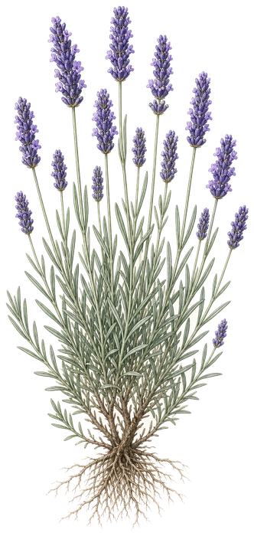
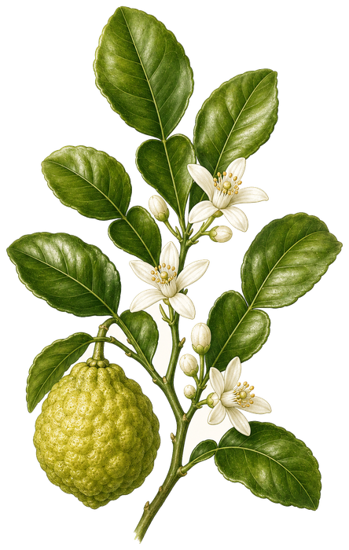
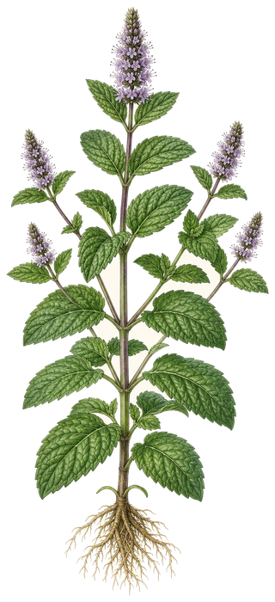
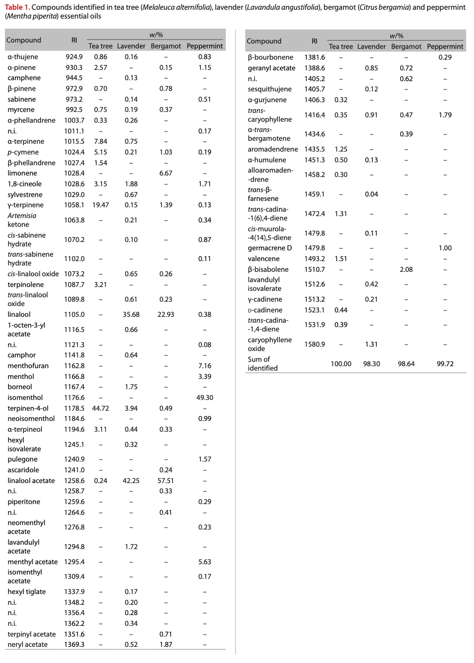
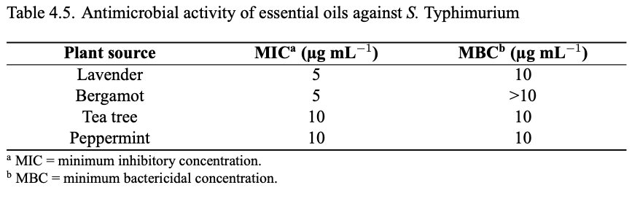
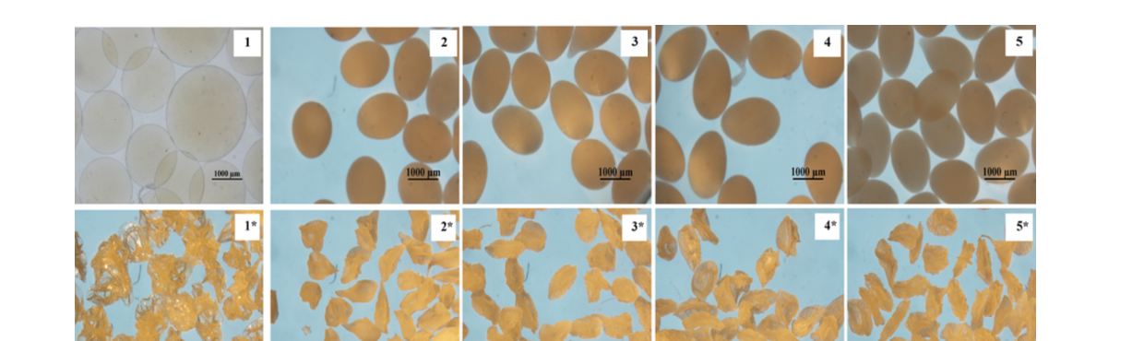
PHASE I
Lab Experiments
Tea tree
terpinen-4-ol
Lavender
linalyl acetate
Bergamot
linalyl acetate
Peppermint
isomenthol
01 · Chemotyping
GC MS
Four oils · >98% volatiles
02 · Bioactivity
MIC & antioxidants
S. Typhimurium · DPPH / ABTS
03 · Delivery
Alginate beads
2.0 to 1.4 mm
RESEARCH GAP
Absence of a computational way to map active chemical motifs to plants, so we no longer need to test compounds one by one in the lab.
Bridging phytochemistry & AI
Notes:
We started in the lab, using GC-MS to profile four essential oils: tea tree, lavender, bergamot, and peppermint. In each one we identified over 98% of the volatiles. Tea tree was mainly terpinen-4-ol (45%), lavender and bergamot were rich in linalool and linalyl acetate, and peppermint was mostly isomenthol (49%).
Next we tested antimicrobial activity against Salmonella Typhimurium ATCC 14028. Lavender and bergamot inhibited growth at 5 µg/mL, while tea tree and peppermint required 10 µg/mL. For antioxidant activity we used DPPH and ABTS: peppermint was the strongest antioxidant (23 mmol TE/L by DPPH), tea tree the weakest (8 mmol TE/L). Activity remained measurable after 12 months of storage.
The problem is that raw oils evaporate and are hard to dose. So we encapsulated them into calcium alginate beads by electrostatic extrusion, a solvent free method. The wet beads are unstable, so we freeze dried them. Empty beads shrank from about 2.0 mm to 1.4 mm, roughly 30%, and stayed approximately spherical.
The research gap is not that bioactive compounds were unknown. For many years we learned which molecules work mainly by empirical laboratory testing, compound by compound and oil by oil. What was missing is a computational way to map chemical motifs linked to activity back to plants, so that this knowledge can be reached more systematically and with less labour. Now that the technology allows it, machine learning can help us leave that purely empirical path behind and prioritise what to test next. That is why we move to the computational part of the work.

Slide 6
01 · CHEMOTYPING
GC MS profiling
Four commercial oils · >98% of volatiles identified
Tea tree : Terpinen-4-ol · 45%
Lavender : Linalyl acetate · 42%
Bergamot : Linalyl acetate · 58%
Peppermint : Isomenthol · 49%
Bridging phytochemistry & AI
Notes:
We started in the lab, using GC-MS to profile four essential oils: tea tree, lavender, bergamot, and peppermint. In each one we identified over 98% of the volatiles. Tea tree was mainly terpinen-4-ol (45%), lavender and bergamot were rich in linalool and linalyl acetate, and peppermint was mostly isomenthol (49%).

Slide 7
Click image to go back

Slide 8
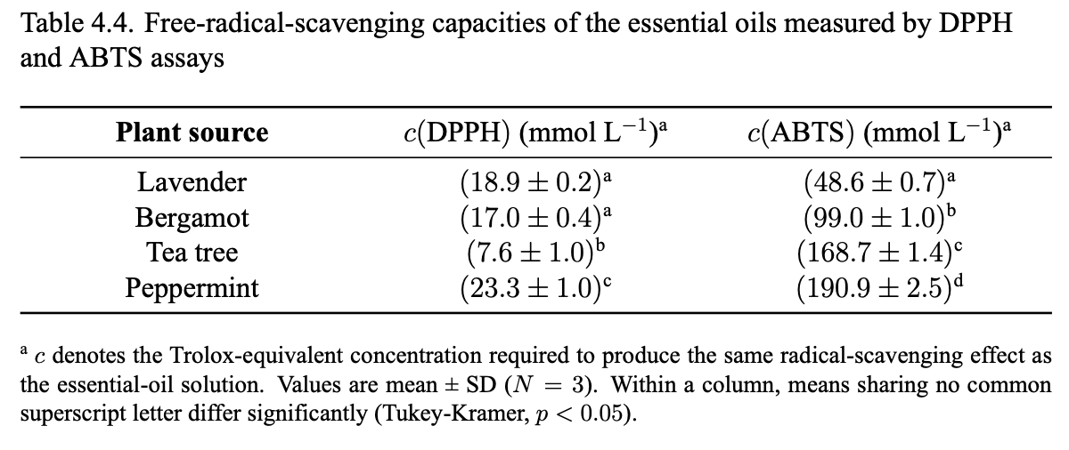
02 · BIOACTIVITY
S. Typhimurium ATCC 14028
Antimicrobial · MIC
Antioxidant · mmol TE/L
Oil | DPPH | ABTS
Tea tree | 8 | 169
Lavender | 19 | 49
Bergamot | 17 | 99
Peppermint | 23 | 191
5
µg/mL
Lavender · Bergamot
10
µg/mL
Tea tree · Peppermint
Table 4.4
MIC table 4.5
Fresh oils · still measurable after 12 months
Bridging phytochemistry & AI
Notes:
Next we tested antimicrobial activity against Salmonella Typhimurium ATCC 14028. Lavender and bergamot inhibited growth at 5 µg/mL, while tea tree and peppermint required 10 µg/mL. For antioxidant activity we used DPPH and ABTS: peppermint was the strongest antioxidant (23 mmol TE/L by DPPH), tea tree the weakest (8 mmol TE/L). Activity remained measurable after 12 months of storage.

Slide 9
Click image to go back

Slide 10
Click image to go back

Slide 11
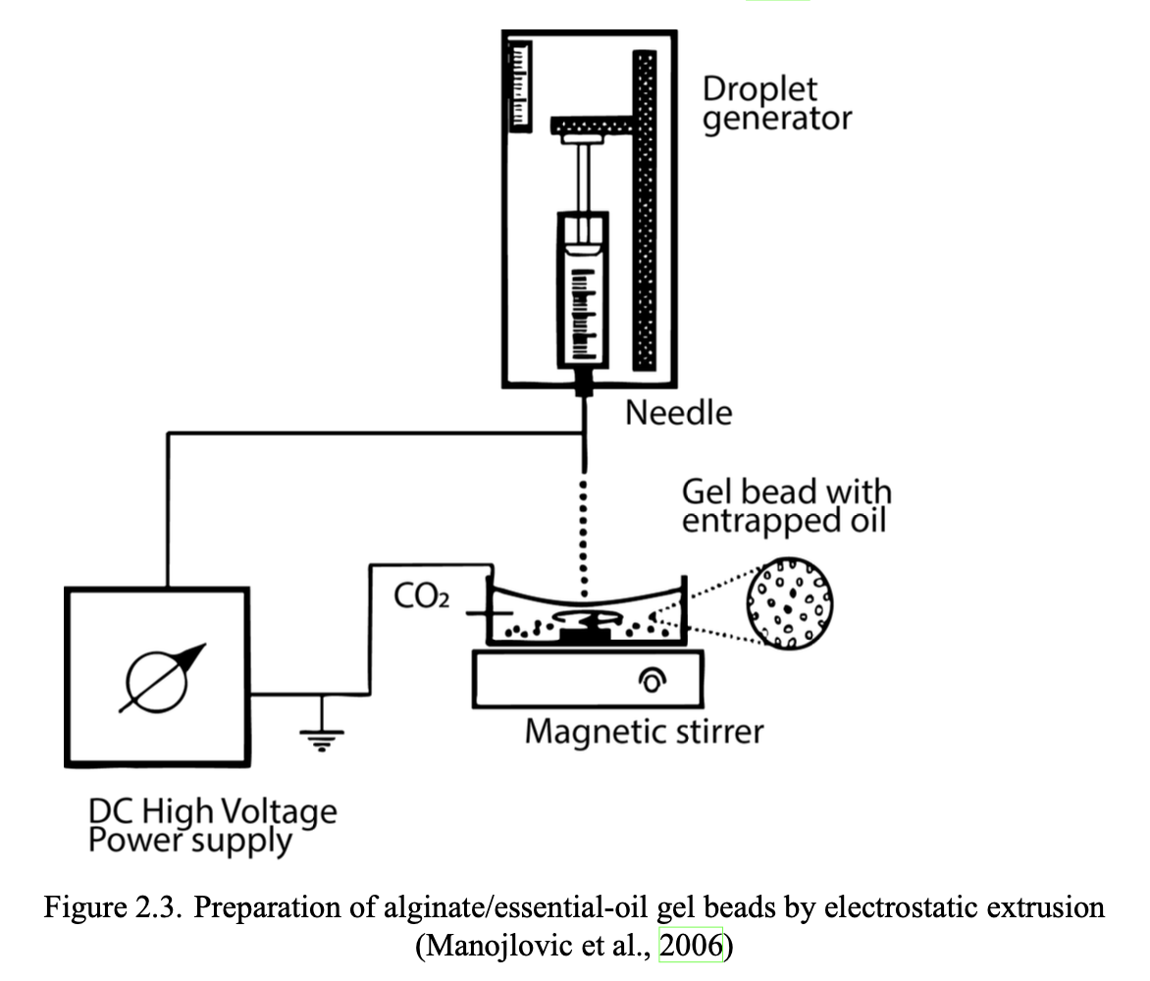
03 · DELIVERY
Calcium alginate encapsulation
Before (top) and after (bottom) freeze drying
Electrostatic extrusion · solvent free · freeze dried for stability
2.0 mm wet → 1.4 mm dry (~30% shrinkage)
Empty beads stayed approximately spherical after freeze drying.
Electrostatic extrusion
Bridging phytochemistry & AI
Notes:
The problem is that raw oils evaporate and are hard to dose. So we encapsulated them into calcium alginate beads by electrostatic extrusion, a solvent free method. The wet beads are unstable, so we freeze dried them. Empty beads shrank from about 2.0 mm to 1.4 mm, roughly 30%, and stayed approximately spherical.
The research gap is not that bioactive compounds were unknown. For many years we learned which molecules work mainly by empirical laboratory testing, compound by compound and oil by oil. What was missing is a computational way to map chemical motifs linked to activity back to plants, so that this knowledge can be reached more systematically and with less labour. Now that the technology allows it, machine learning can help us leave that purely empirical path behind and prioritise what to test next. That is why we move to the computational part of the work.

Slide 12
Click image to go back

Slide 13
Click image to go back

Slide 14
PHASE II
Machine Learning
A four step pipeline from literature oils to interpretable motifs
1
2
3
4
Collect data
Published EO studies · composition + anti Salmonella labels · majors >10%
171 oils · 87 / 84
Encode molecules
Names → SMILES → binary Morgan fingerprints
bits · molecular features
Model & rank
L1 logistic regression + permutation feature importance
PFI · key bits
Check literature
Compare selected motifs with known EO bioactivity
validate
OUTCOME
A reusable pipeline: the same approach can guide which compounds to test next in the lab.
Bridging phytochemistry & AI
Notes:
Here we built a four step pipeline.
Step 1: We collected data on 171 essential oils from published studies, including their composition and whether they were classified as active against Salmonella. The set was nearly balanced: 87 active and 84 inactive oils. Only major constituents above 10% were included.
Step 2: We converted the chemical names into Morgan fingerprints. These are binary codes that represent molecular features. Each chemical becomes a specific pattern of ones and zeros, where a one indicates the presence of a particular feature.
Step 3: We trained an L1-regularised logistic regression model and then used permutation feature importance to determine which molecular features mattered most.
Step 4: We compared our findings with what is already known from the essential oil literature.
The main outcome is the machine learning pipeline we developed. The same approach can be used to identify molecular features linked to other biological activities and to decide more efficiently what should be tested next in the laboratory.

Slide 15
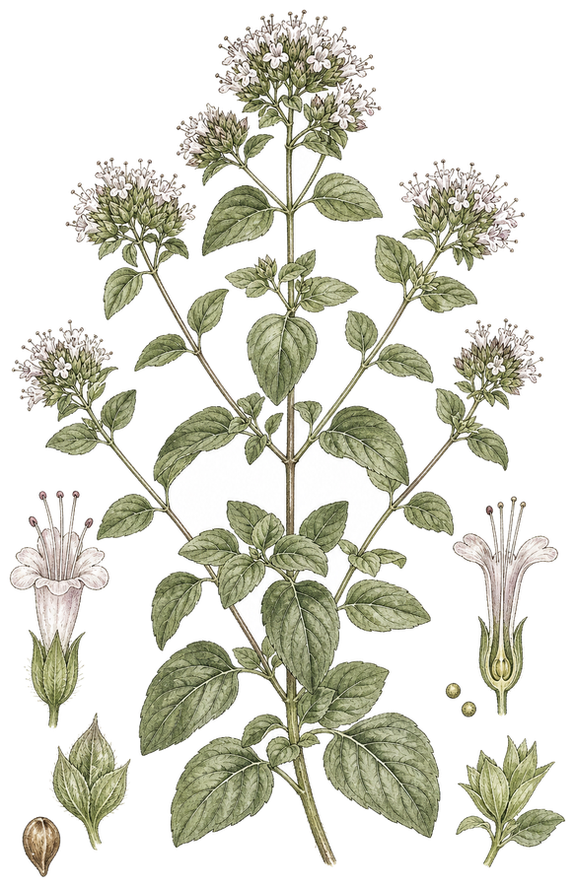
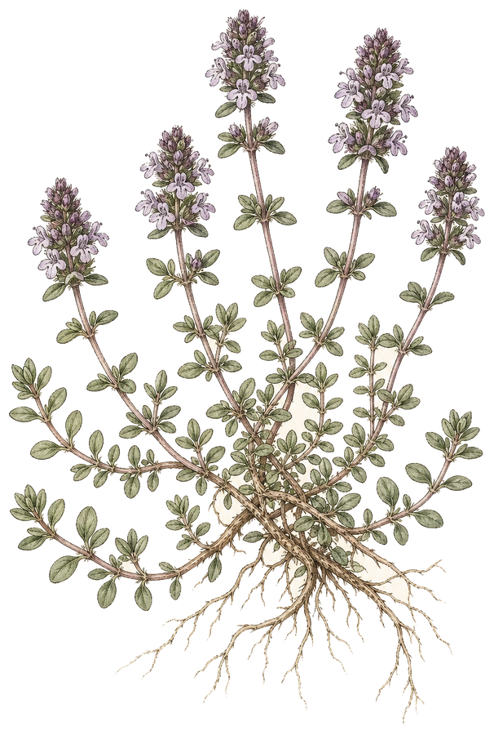
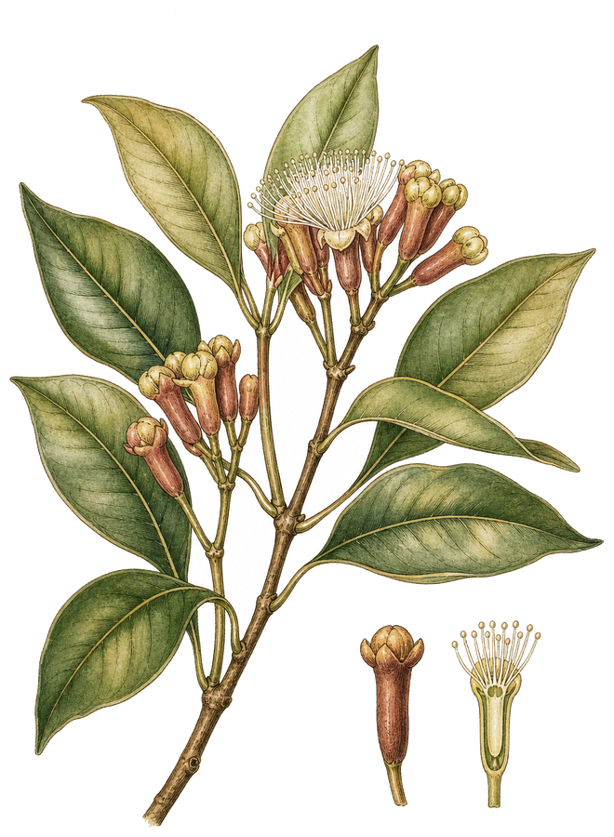
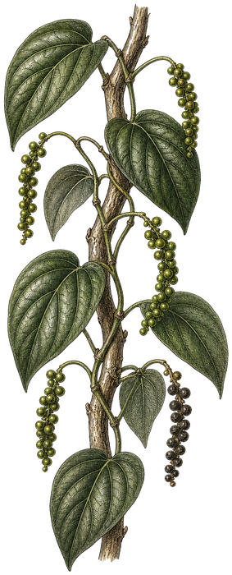
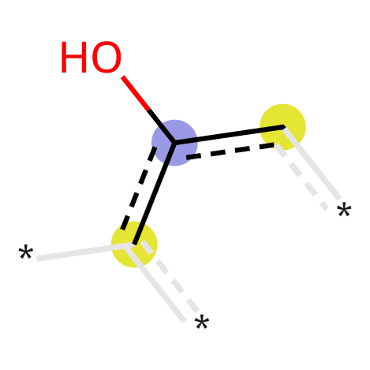
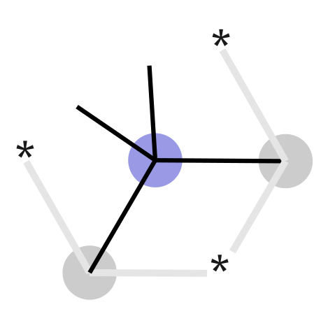
Machine Learning Insights
FEATURE SELECTION
Metric | Train | Test
Accuracy | 0.84 | 0.81
ROC AUC | 0.91 | 0.88
Sensitivity | 0.87 | 0.83
Specificity | 0.82 | 0.80
F1 score | 0.85 | 0.82
2048 Morgan bits
KEY FEATURE CONFIRMED
Phenolic OH on an aromatic ring is strongly associated with anti Salmonella activity.
The model reproduces this well known essential oil chemistry, confirming it predicts correctly.
682 present in data
337 uncorrelated
10 key bits
PFI threshold: ROC AUC drop of at least 0.01
Oregano
carvacrol · Bit 1607 positive
Wild thyme
thymol · Bit 1607 positive
Clove
eugenol · Bit 1607 positive
Black pepper
β-pinene · Bit 549 negative
Bridging phytochemistry & AI
Notes:
We first encoded the molecules using 2048-bit Morgan fingerprints, which is a standard setting. After removing the fragments that were never present in our dataset, we were left with 682 descriptors.
Then we removed one member of each highly correlated pair (|r| > 0.95), reducing the number of descriptors to 337. After that, we ranked the remaining descriptors by permutation feature importance, keeping only those whose shuffling lowered ROC AUC by at least 0.01. Exactly ten descriptors passed this threshold.
To evaluate the model, we used repeated stratified five fold cross validation with 100 repeats. The area under the curve was 0.88, meaning the model ranked active oils above inactive ones very well. About 88% of the time, a randomly chosen active oil received a higher predicted probability than a randomly chosen inactive oil. Under Hosmer's scale, this is excellent discrimination, although it remains internal validation on our dataset, not an external holdout set. We also used 1000 bootstrap samples to estimate uncertainty around the regression coefficients, not to validate predictive performance.
The training accuracy was 0.84 and the test accuracy was 0.81, so the gap was small. That suggests the model generalised well and was not simply memorising the training data. Test sensitivity was 0.83 and specificity 0.80.
Based on this, we could interpret the selected features more confidently. Phenolic structures, especially those encoded by Bit_1607, were strongly associated with activity against Salmonella, while branched bicyclic hydrocarbons, such as Bit_549, were associated with inactivity. This is an associative model finding, not a claim of molecular causation. Partial dependence analysis showed that when strong positive bits were absent the predicted probability was about 0.45, and when they were present it rose to as high as about 0.95.
Interestingly, none of the four essential oils we tested experimentally was rich in phenolic compounds. Instead, they were dominated by oxygenated monoterpenes. This helps explain why their activity was modest compared with the phenolic rich oils reported by Soković and colleagues, who documented that carvacrol and thymol containing oils, which differ only in hydroxyl orientation on the benzene ring, showed MICs as low as 0.5 µg/mL against S. Typhimurium.
Carvacrol and thymol are signature compounds of plants such as wild thyme and oregano, which are common in Serbia and traditionally used in foods and medicines. Similar antibacterial effects have also been reported for eugenol, another phenolic compound found predominantly in clove oil, which acts on the bacterial membrane and can induce oxidative stress through reactive oxygen species.
This supports our logistic regression analysis, in which bits encoding an aromatic hydroxyl group receive the strongest positive weights. It is also a reminder of why protecting and studying our local flora is important.

Slide 16
Limitations
Experimental
1. Only four commercial oils
Limited chemotypic coverage; one production batch each.
2. Encapsulation was morphological
No release kinetics, retained bioactivity, or food matrix tests.
3. Single pathogen strain
Only S. Typhimurium ATCC 14028; no clinical isolates or biofilms.
Computational
1. Heterogeneous literature data
MIC protocols, media, and strains vary across sources.
2. Internal validation only
Repeated stratified CV; no external holdout set.
3. Candidates, not confirmed mechanisms
Highlighted substructures still need wet lab confirmation.
Bridging phytochemistry & AI
Notes:
Like every study, this work has limitations that should be considered. In the experimental phase, we tested only four commercial essential oils and one Salmonella Typhimurium strain. We focused mainly on bead morphology and did not evaluate release kinetics, biological activity after encapsulation, or performance in food systems.
In the computational phase, the dataset came from published studies that used different experimental protocols, and only major compounds present above 10% were included. Although the model performed well, it was evaluated only by internal repeated stratified cross validation, with bootstrapping used to estimate coefficient uncertainty rather than predictive performance. The identified molecular features should therefore be viewed as promising candidates that require confirmation in future laboratory experiments.

Slide 17
Future Directions
From broader wet lab work to a closed AI to lab loop
Experimental
1. More oils & microorganisms
Analyse a larger set of essential oils and microbes
2. Different encapsulation systems
Explore alternative carriers beyond alginate beads
3. Real food applications
Test formulations in actual food systems
Computational
1. Extend the pipeline
Apply the same approach with modern AI methods
2. Graph nets & molecular LMs
Richer models of chemical structure and activity
3. Active learning
Predictions guide the next laboratory experiments
Predict → Test → Retrain → repeat
Goal: continuous AI and lab feedback for faster discovery
Bridging phytochemistry & AI
Notes:
This work opens several directions for future research, both experimentally and computationally.
On the experimental side, we would like to analyse a larger number of essential oils and microorganisms, explore different encapsulation systems, and test our formulations in real food applications.
On the computational side, the same pipeline can be extended using modern AI methods such as graph neural networks, molecular language models, and active learning, where predictions guide the next laboratory experiments.
Ultimately, the goal is to create a continuous feedback loop between AI and laboratory validation, making the discovery of new plant derived antimicrobials faster and more efficient.

Slide 18
Thank you
I welcome your questions
Bridging phytochemistry & AI
Notes:
That concludes my presentation. I hope I have shown how combining experimental work with machine learning can help us better understand what drives the antimicrobial potential of plant essential oils and guide future discoveries of active molecular sites.
Thank you very much for your attention, and I will be happy to answer any questions.

