Slide 1
Remote Health Monitoring for Critically ill patient

Slide 2
Presented By
Farhana Sultana
2013-2-60-046
Nahida Islam
2013-3-60-049
Maria Yasmin Nila
2013-2-60-047
Supervised By
Dr. Ahmed Wasif Reza
Associate Professor & Chairperson
Department of Computer Science & Engineering

Slide 3
Presentation Outline
Background
Literature Review
Problem Statement
Objectives
Design & Methodology
Results & Discussion
Conclusion
Future Work
Potential Application
References
Demonstration

Slide 4
Background
Biosensor
Health
Care
Internet of Things

Slide 5
Background(CONT).
Internet of things on HealthCare
Remotes monitoring
Reduce the health care expense
Instant remedy and result
To have a knowledge owns health condition

Slide 6
Biosensor?
Background(CONT).
As many definitions as workers in the field!
I favor:
“a device that utilizes biological components e.g. enzymes to indicate the amount of a biomaterial”

Slide 7
Motivation
Background(CONT).
Quality of health care service
Difficult to monitor own bio-status
In need of emergency medical assistance

Slide 8
Literature review
paper[1] deal only with heart beat sensor and it is not cost efficient
Paper [2]deals with patient monitoring system but their system is not portable

Slide 9
Problem Statements
Inefficient e-health care services
Numerous standalone devices
Unavailability of complete portable health care system
Inconvenient doctor’s appointment

Slide 10
Objectives
To develop an efficient and cost effective wearable device based on medical service for the patient
To monitor patient’s current health condition

Slide 11
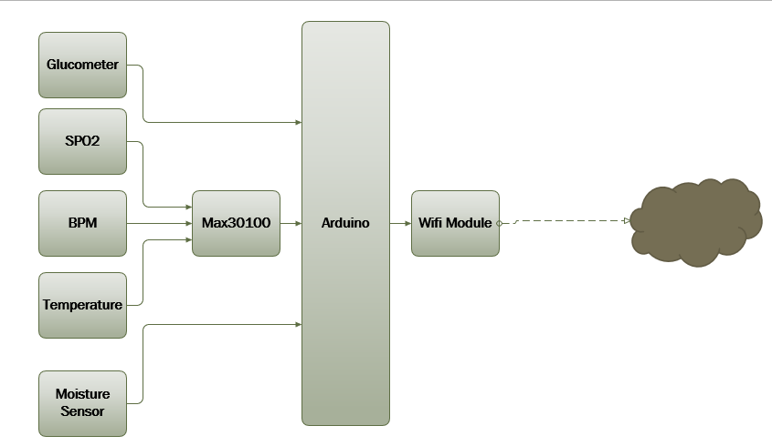
Design and Methodology
Block Diagram of Our Project

Slide 12
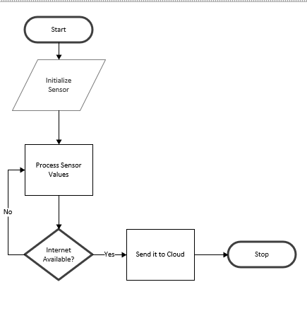
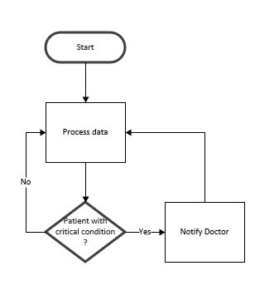
Design and Methodology(CONT).
Flow Chart for the complete design methodology

Slide 13
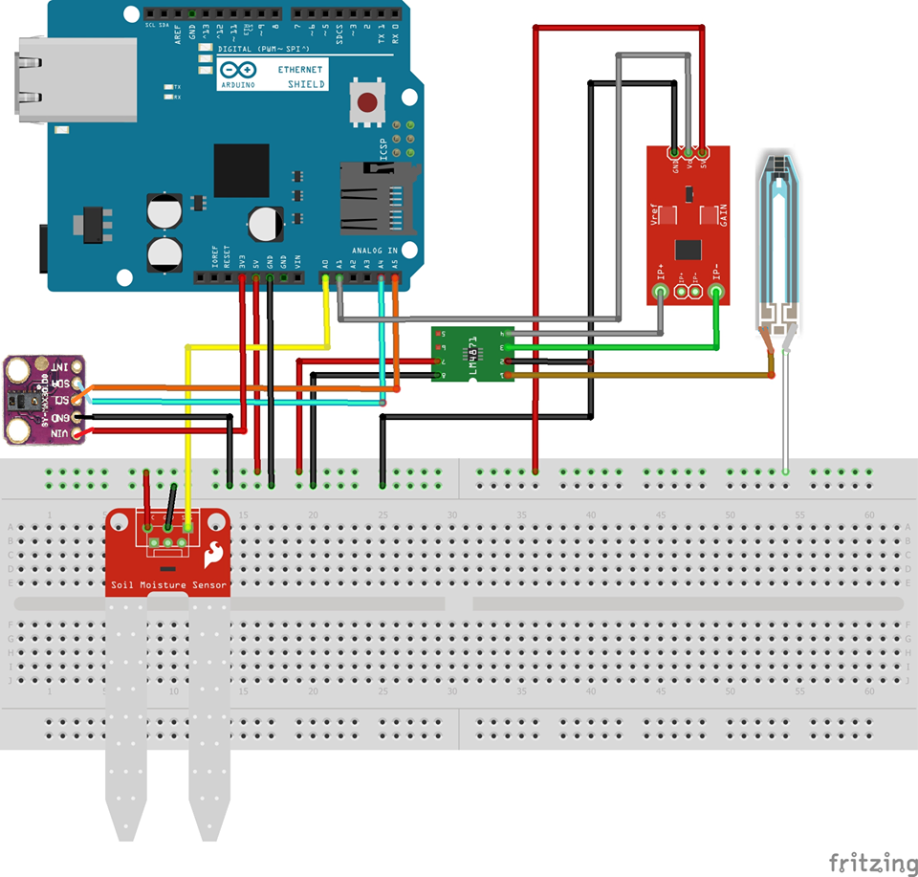
Design and Methodology(CONT).
Hardware Connection of Our Project

Slide 14
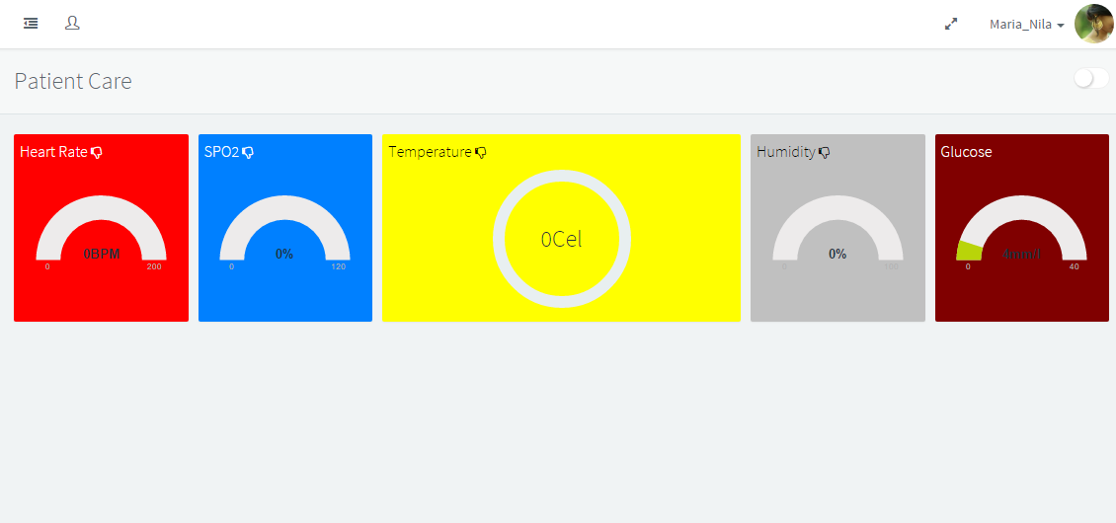
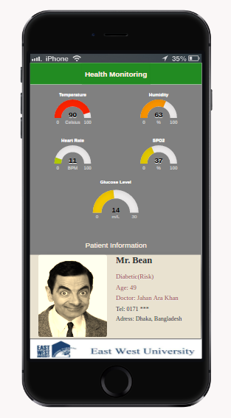
Results and Discussion

Slide 15
Conclusion
developed a complete hardware system for identifying (heart rate, temperature, oxygen saturation) at a time as well as sugar level and skin moisture
can monitor a patient’s health condition

Slide 16
Future Work
we want to include different types of Bio sensor to monitor the patient bio status
Electrocardiogram(ECG) sensor
Electroencephalography(EEG) sensor

Slide 17
Potential Application
Wearable device
Medical station

Slide 18
References
[1] Bhoomika.B.K, Dr. K N Muralidhara, “Secured Smart Healthcare Monitoring System Based on IOT”, IJARCSMS, ISSN: 2321-81 Volume: 3 Issue: 7 4958-4961 JULY 2015.
[2] Ms. Neeta V Desai, Saniya Ansari. “Review of Patient Monitoring System with Wireless” IJCSIT ISSN: 2277 128X Volume 5, Issue 1, January 2015
[3] Gennaro Tartarisco, Giovanni Baldus, Daniele Corda, Rossella Raso, Antonino Arnao, Marcello Ferro, Andrea Gaggioli, Giovanni Pioggia, “Personal Health System architecture for stress monitoring and support to clinical decisions”, Computer CommunicationsVol.35, pp.1296– 1305, 2012.
[4] Franca Delmastro, “Pervasive communications in healthcare”, Computer Communications Vol.35, pp.1284– 1295,2012. Aruna Devi.S et al. / International Journal of Computer Science & Engineering Technology (IJCSET) ISSN: 2229-3345 Vol. 7 No. 03 Mar 2016 72
[5] Jongyoon Choi, Beena Ahmed and Ricardo Gutierrez-Osuna, Development and valuation of an Ambulatory Stress Monitor Based on Wearable Sensors, IEEE transactions on information technology in biomedicine, vol. 16, no. 2, March 2012

Slide 19
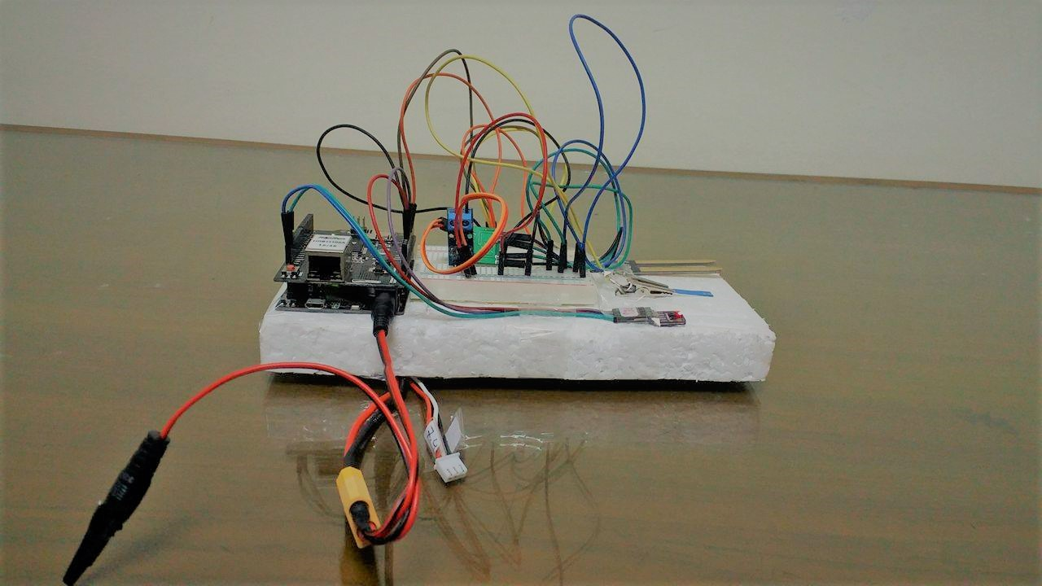
Demonstration

Slide 20
Thank You ☺

Slide 21
Any Question??

