Slide 1
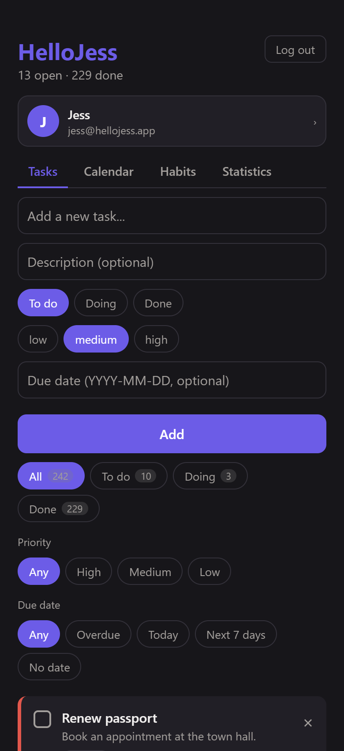
HelloJess
Task and habit tracker: backend, web and mobile
Node.js + Express + MongoDB | React (Vite) | React Native (Expo)
TaskFlow subject, bonuses B1 to B4
Notes:
Welcome. HelloJess is a task and habit tracker built for the TaskFlow subject, with all four bonuses. It has one backend and two clients: a web app and a mobile app. This presentation walks through every section: first the backend, then the web app, then the mobile app, then the profile feature we just added.

Slide 2
What is HelloJess?
OVERVIEW
Tasks
Habits
Insights
Title, status, description, due date, priority
Filters and a counter per status
Edit, delete, overdue highlighting
Recurring things you do day by day
Tick a day, untick a day
One completion per habit per day
Calendar with a colour per status
GitHub-style activity heatmap
Weekly and monthly completion rate
Bonuses implemented
B1
B2
B3
B4
+
Priority, filters, counters
Second entity: Habit
Activity heatmap
Completion statistics
Calendar and profile
HelloJess
2
Notes:
HelloJess lets a user register, manage their own tasks, track recurring habits day by day, and see their activity on a calendar, a heatmap and completion statistics. Everything is private per user and enforced by the API.

Slide 3
Architecture
OVERVIEW
Web app
React 19, TypeScript, Vite
React Router, axios
HTTP + JSON
/api/...
Express API
MongoDB
Node.js 22+
routes, middleware,
controllers, services
zod validation, JWT auth
Mongoose
users, tasks,
habits, habitevents
(via Mongoose)
▶
▶
Mobile app
React Native, Expo SDK 57
React Navigation, AsyncStorage
Authorization: Bearer <JWT> on every request except register, login and /health
HelloJess
3
Notes:
Three pieces share one backend. The web and mobile apps only display data and send requests over HTTP with JSON. All rules live in the API, so both clients always behave the same. The API talks to MongoDB through Mongoose.

Slide 4
Technology stack
OVERVIEW
Backend
Web
Node.js 22+, Express 5, MongoDB + Mongoose 9
zod 4 validation, bcryptjs (12 rounds), jsonwebtoken (HS256)
dotenv, cors; tests with node --test
React 19, TypeScript, Vite
React Router 7, axios
Token in localStorage
Mobile
Data and tools
React Native 0.86, Expo SDK 57
React Navigation 7 (native stack)
AsyncStorage, runs in Expo Go
MongoDB Community Server, Compass to browse
Git and GitHub for the repository
Type checks with tsc, production build with Vite
HelloJess
4
Notes:
These choices keep the project simple: Node's built-in test runner means no extra test dependency, zod gives precise validation messages, and Expo lets one code base run on iOS and Android.

Slide 5
Backend: how a request travels
BACKEND
app.js
routes/
middleware
controllers/
services/
models/
CORS, JSON body, mounts /api routes
URL + method to a controller, with middleware
validate(schema) then requireAuth
read the request, call a service, send the response
business rules and database queries
Mongoose schemas for each collection
▶
▶
▶
▶
▶
POST /api/tasks { "title": "Buy milk", "status": "todo" }
-> validate(taskCreateSchema) : 422 if title empty, status unknown, date impossible
-> requireAuth : 401 if no valid token, else req.user
-> taskController.createTask : calls taskService.createTask(req.user.id, data)
-> taskService / Task model : saves with owner = req.user.id -> 201 + the task
HelloJess
5
Notes:
A request goes through layers, each with one job. app.js sets up Express. Routes map URLs to controllers. Middleware validates input and checks the login. Controllers talk HTTP. Services hold the business rules and database queries. Models describe the data.

Slide 6
Backend: folder map
BACKEND
Path (backend/src) | Role
config/env.js, config/db.js | Settings from environment variables; MongoDB connection with Mongoose
models/ | User, Task, Habit, HabitEvent schemas
schemas.js | All zod validation schemas, one per request
middleware.js, security.js | validate() and requireAuth; password hashing and tokens
controllers/, routes/ | auth, tasks, habits, stats, calendar: one controller and one router each
services/app.js, services/server.js | Build the Express app and mount /api routes; connect to MongoDB then listen
services/*Service.js | taskService, habitService, statsService, calendarService
statsCalculations.js, calendarEvents.js | Pure functions (no database): heatmap, completion rate, calendar events
utils/dates.js | Calendar dates and time-zone conversion
test/ | 60 unit tests
HelloJess
6
Notes:
Every file has a clear place. config reads settings, models define the data, schemas.js holds all validation rules, middleware.js and security.js handle input checking and login, controllers and routes are one file per resource, and services contain the logic. Pure calculation modules are separate so they can be unit-tested without a database.

Slide 7
Backend: configuration and startup
BACKEND
// config/env.js
export const config = {
port: Number(process.env.PORT ?? 8000),
mongodbUri: process.env.MONGODB_URI
?? "mongodb://127.0.0.1:27017/hellojess",
corsOrigin: process.env.CORS_ORIGIN ?? "*",
secretKey: process.env.SECRET_KEY ?? "dev-secret",
};
// services/app.js
app.use(cors(...)); app.use(express.json());
app.get("/health", ...);
app.use("/api/auth", authRouter);
app.use("/api/tasks", taskRouter);
app.use("/api/habits", habitRouter);
app.use("/api/stats", statsRouter);
app.use("/api/calendar", calendarRouter);
server.js
Connects to MongoDB (config/db.js)
Then listens on 0.0.0.0:8000 so a phone on the same Wi-Fi can reach it
Error handling in app.js
Unknown URL: 404 { detail: "Not Found" }
Malformed JSON: 400
Mongoose validation: 422 with per-field messages
Anything else: logged, then 500
HelloJess
7
Notes:
env.js reads PORT, MONGODB_URI, CORS_ORIGIN, SECRET_KEY and the token lifetime with safe defaults. server.js connects to MongoDB first and only then starts listening, so the API never accepts requests it cannot serve. app.js mounts the five routers and the error handlers.

Slide 8
Backend: data model
BACKEND
User (users)
Task (tasks)
email (unique), name, hashed_password, created_at
The hash is never returned by the API
owner, title (1-120), status: todo | doing | done
description, dueDate (YYYY-MM-DD or null)
priority: low | medium | high, completedAt
Habit (habits)
HabitEvent (habitevents)
owner, name (1-100), description (0-500)
A habit is recurring; a one-off task is not a habit
owner, habit, date (YYYY-MM-DD)
Unique index on (habit, date): one completion per day
HelloJess
8
Notes:
Four collections. Every model removes internal fields when sent as JSON: the id is exposed as id, and owner and the password hash are never sent. Due dates and habit dates are plain YYYY-MM-DD text, so they never shift with time zones. A unique index stops a habit being recorded twice for the same day.

Slide 9
Backend: validation
BACKEND
Rules
// 422 Unprocessable
{
"detail": "Validation failed",
"errors": [
{ "field": "title",
"message": "title must not be empty" },
{ "field": "dueDate",
"message": "dueDate must be a valid date" }
]
}
Title trimmed, 1 to 120 characters
Status exactly todo, doing or done
Due date must be a real date: 2026-02-30 is refused
Email must be a valid address
Name required, up to 100 characters
Unknown fields are stripped (no forged owner)
Query parameters (filters, tz, ranges) validated too
Other error codes
400 email already registered, malformed JSON
401 not logged in or bad credentials
404 not found (or not yours)
500 unexpected, logged server-side
HelloJess
9
Notes:
Each request has one zod schema in schemas.js. The validate middleware runs it against the body or query and replaces it with the cleaned values. Invalid input returns 422 with one clear message per field, which the web and mobile apps display. Unknown fields such as owner or completedAt are ignored, so a client cannot forge them.

Slide 10
Backend: authentication and security
BACKEND
Register / login
JWT issued
Client stores it
requireAuth
bcrypt hash (12 rounds) stored, never the password
▶
HS256, subject = user id, 7 days
▶
localStorage on web, AsyncStorage on mobile
▶
Bearer token decoded, user loaded, else 401
Ownership
Token checks (tested)
Every service query includes the user id
Someone else's task, habit or event: 404, as if it did not exist
owner cannot be changed through the API
Tampered, expired, wrong-secret and alg: none tokens are rejected
Id-based tokens, with legacy email tokens still accepted
Set a strong SECRET_KEY outside development
HelloJess
10
Notes:
Passwords are hashed with bcrypt and only the hash is stored. Login returns a signed JWT whose subject is the user id. requireAuth decodes it and loads the user. The most important rule: every query is scoped to the logged-in user, and a resource that belongs to someone else behaves exactly like one that does not exist.

Slide 11
Backend: services (business logic)
BACKEND
Service | What it does
taskService | List with filters (status, priority, due range, no date), count by status, create, read, update, delete. Stamps and clears completedAt when the status changes to or from done
habitService | CRUD for habits and dated events; optionally returns the days each habit was done in a range; deleting a habit deletes its events; adding an existing day returns the existing event
statsService + statsCalculations | Loads completed tasks and habit events, then builds the heatmap and the completion rates with pure functions
calendarService + calendarEvents | Loads tasks and habit events for a period and turns them into coloured calendar events, carrying overdue tasks onto today
HelloJess
11
Notes:
Controllers stay thin. The services decide how things work: for example taskService stamps completedAt when a task becomes done and clears it when it leaves done. habitService treats adding the same day twice as a no-op. Statistics and calendar use pure functions that take plain data, which is why they are easy to unit-test.

Slide 12
Backend: the API
BACKEND
Endpoint | Purpose
POST /api/auth/register | POST /api/auth/login | Create an account; log in. Both return { access_token, user }
GET /api/auth/me | PATCH /api/auth/me | Current user; edit name and email
GET /api/tasks (?status &priority &dueFrom &dueTo &noDueDate) | Your tasks, filtered
GET /api/tasks/count | { total, todo, doing, done }
POST /api/tasks | GET, PATCH, DELETE /api/tasks/:id | Create; detail, partial edit, delete
GET, POST /api/habits | GET, PATCH, DELETE /api/habits/:id | Habits (deleting removes their events)
GET, POST /api/habits/:id/events | DELETE .../events/:date | Mark or unmark a day
GET /api/calendar?from&to&tz | Calendar events for a period (max 62 days)
GET /api/stats/heatmap?from&to&tz | Daily activity (max 366 days)
GET /api/stats/completion?period&count&tz | Completion rate per week or month
HelloJess
12
Notes:
These are all the endpoints. Everything except register, login and health needs the Bearer token. The task list takes filters as query parameters, and the stats and calendar endpoints take a time zone so days are computed where the user lives.

Slide 13
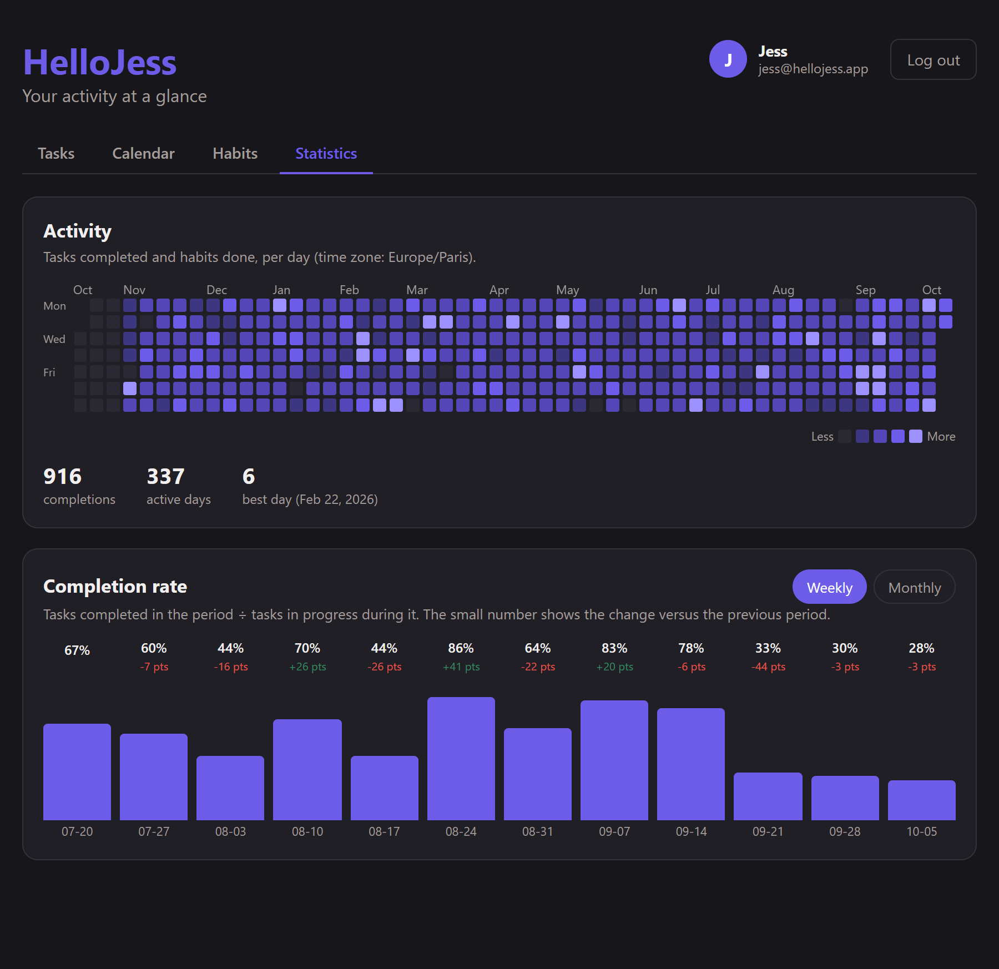
Statistics: the heatmap (B3)
BACKEND
One entry per day
tasks: tasks completed that day
habits: habit completions that day
total = tasks + habits
level 0 to 4 = ceil(total / max x 4), 0 if total is 0
Time zones
Days are calendar days in the user's zone (tz)
23:30 UTC on 1 March = 2 March in Paris, 1 March in New York
HelloJess
13
Notes:
The heatmap returns one entry per day, including empty days. total is completed tasks plus habit completions. level goes from 0 to 4: zero when nothing happened, otherwise the ceiling of total over the busiest day times four. Days are computed in the user's time zone, so a task finished at 23:30 UTC counts for the next day in Paris.

Slide 14
Statistics: completion rate (B4)
BACKEND
completed
workload
rate
change
tasks whose completion day falls in the period
created on or before the last day, and not completed before the first day
completed / workload, between 0 and 1, or null when workload is 0
rate minus the previous period's rate (null if either is null)
▶
▶
▶
Example
Periods
A task created before the week and finished during it counts in completed and workload
A task created mid-week and still open counts only in workload
Weeks run Monday to Sunday; months are calendar months
Known limit: reopening a task clears its completion date
HelloJess
14
Notes:
For each week or month we count completed tasks and the workload, meaning the tasks that were in play during that period. The rate is completed over workload. If there is no workload the rate is null and not zero, because a rate cannot be measured on zero tasks. The change compares with the previous period.

Slide 15
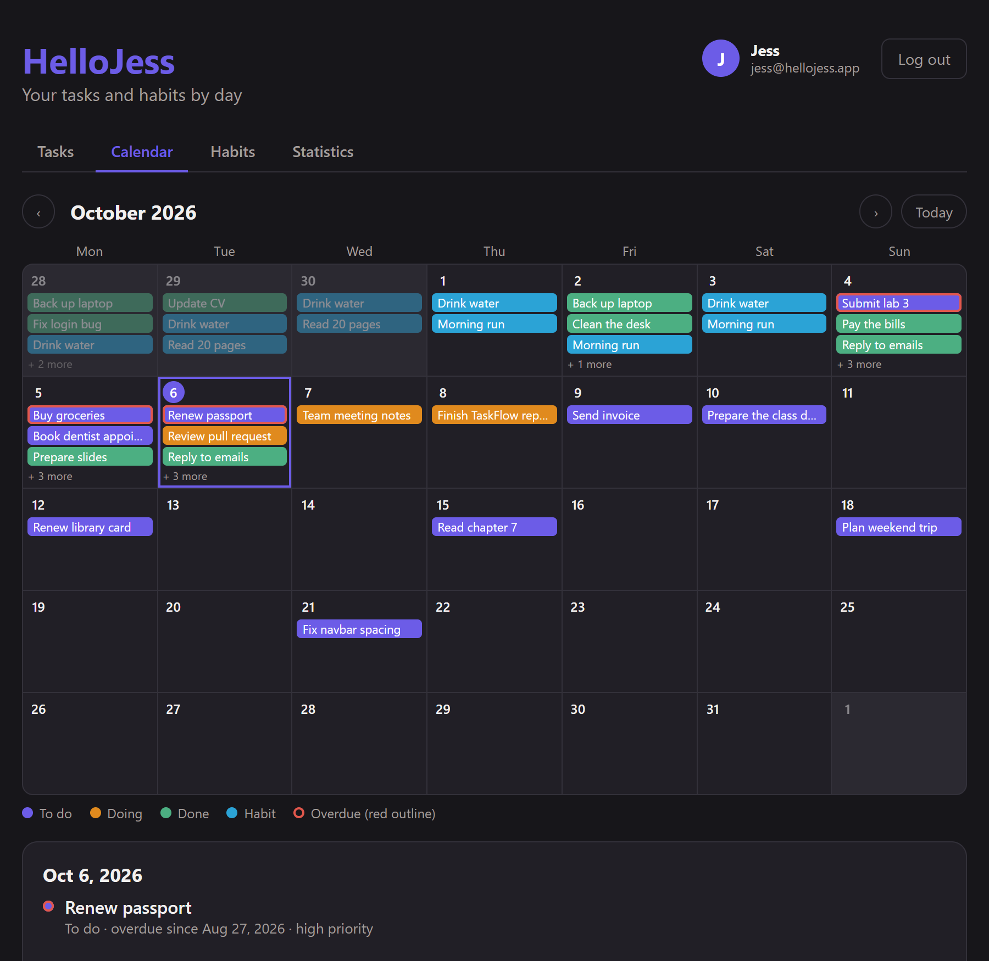
The calendar
BACKEND
To do
Open task on its due date (or creation day)
Doing
Open task on its due date (or creation day)
Done
On the day the task was completed
Habit
A habit completion on its day
Overdue
Status colour with a red outline; carried onto today if due before the visible grid
HelloJess
15
Notes:
The calendar endpoint turns tasks and habit completions into events. Open tasks appear on their due date, or on the day they were created if they have no due date, so a new task always shows up. Overdue tasks keep their status colour with a red outline, and overdue tasks from before the visible grid are carried onto today so they are never hidden.

Slide 16
Dates and time zones
BACKEND
Civil dates (YYYY-MM-DD)
toCivilDate(instant, timeZone)
Due dates and habit dates have no time and no zone
Validity check includes leap years
addDays, daysBetween, eachDay, start and end of week and month
Converts a moment to the calendar day in a zone with Intl
Each instant converted, never "+24 hours"
Daylight-saving days of 23 or 25 hours are handled
toCivilDate(new Date("2026-03-01T23:30:00Z"), "Europe/Paris") // "2026-03-02"
toCivilDate(new Date("2026-03-01T23:30:00Z"), "America/New_York") // "2026-03-01"
isValidCivilDate("2026-02-30") // false
HelloJess
16
Notes:
Dates are a classic source of bugs. Due dates are civil dates with no time, so they never shift. For statistics, each instant is converted to a calendar day in the user's time zone using Intl, instead of adding 24 hours, which keeps daylight-saving days of 23 or 25 hours correct.

Slide 17
Tests
BACKEND
Test file | Covers
dates.test.js | Leap years, weeks, months, zones, daylight saving
schemas.test.js | Validation of tasks, habits, profile, queries
security.test.js | Hashing, id and legacy tokens, tampered or expired
stats.test.js | Heatmap levels, completion rates, change
calendar.test.js | Event types, overdue carry-over, undated tasks
60
unit tests passing
cd backend
npm test
End-to-end API scenarios, browser runs of web and mobile, type checks and production build all pass
HelloJess
17
Notes:
Sixty unit tests run with Node's built-in runner and need no database because the logic being tested is in pure functions. Beyond unit tests, the API and both clients were exercised end to end against throwaway databases and in a browser, including error cases.

Slide 18
Web app: structure
WEB
File (web/src) | Role
App.tsx, main.tsx | Router: /login, /register, /, /tasks/:id, /calendar, /habits, /stats, /profile; RequireAuth redirects to /login
api.ts | axios client (VITE_API_URL + /api, 10 s timeout, token header), errorMessages(), API types
context/AuthContext.tsx | Current user; login, register, updateProfile, logout; token in localStorage
components/ | AppHeader (nav + user chip), TaskItem, CalendarView, Heatmap, CompletionChart, ErrorList
pages/ | Login, Register, Tasks, TaskDetail, Calendar, Habits, Stats, Profile
utils/dates.ts | Local date helpers (today, formatting)
HelloJess
18
Notes:
The web app is a React single-page app. App.tsx declares the routes and wraps private pages in RequireAuth. api.ts is the single axios client: it adds the Bearer token, has a 10-second timeout and turns API errors into readable messages. AuthContext keeps the logged-in user for every page.

Slide 19
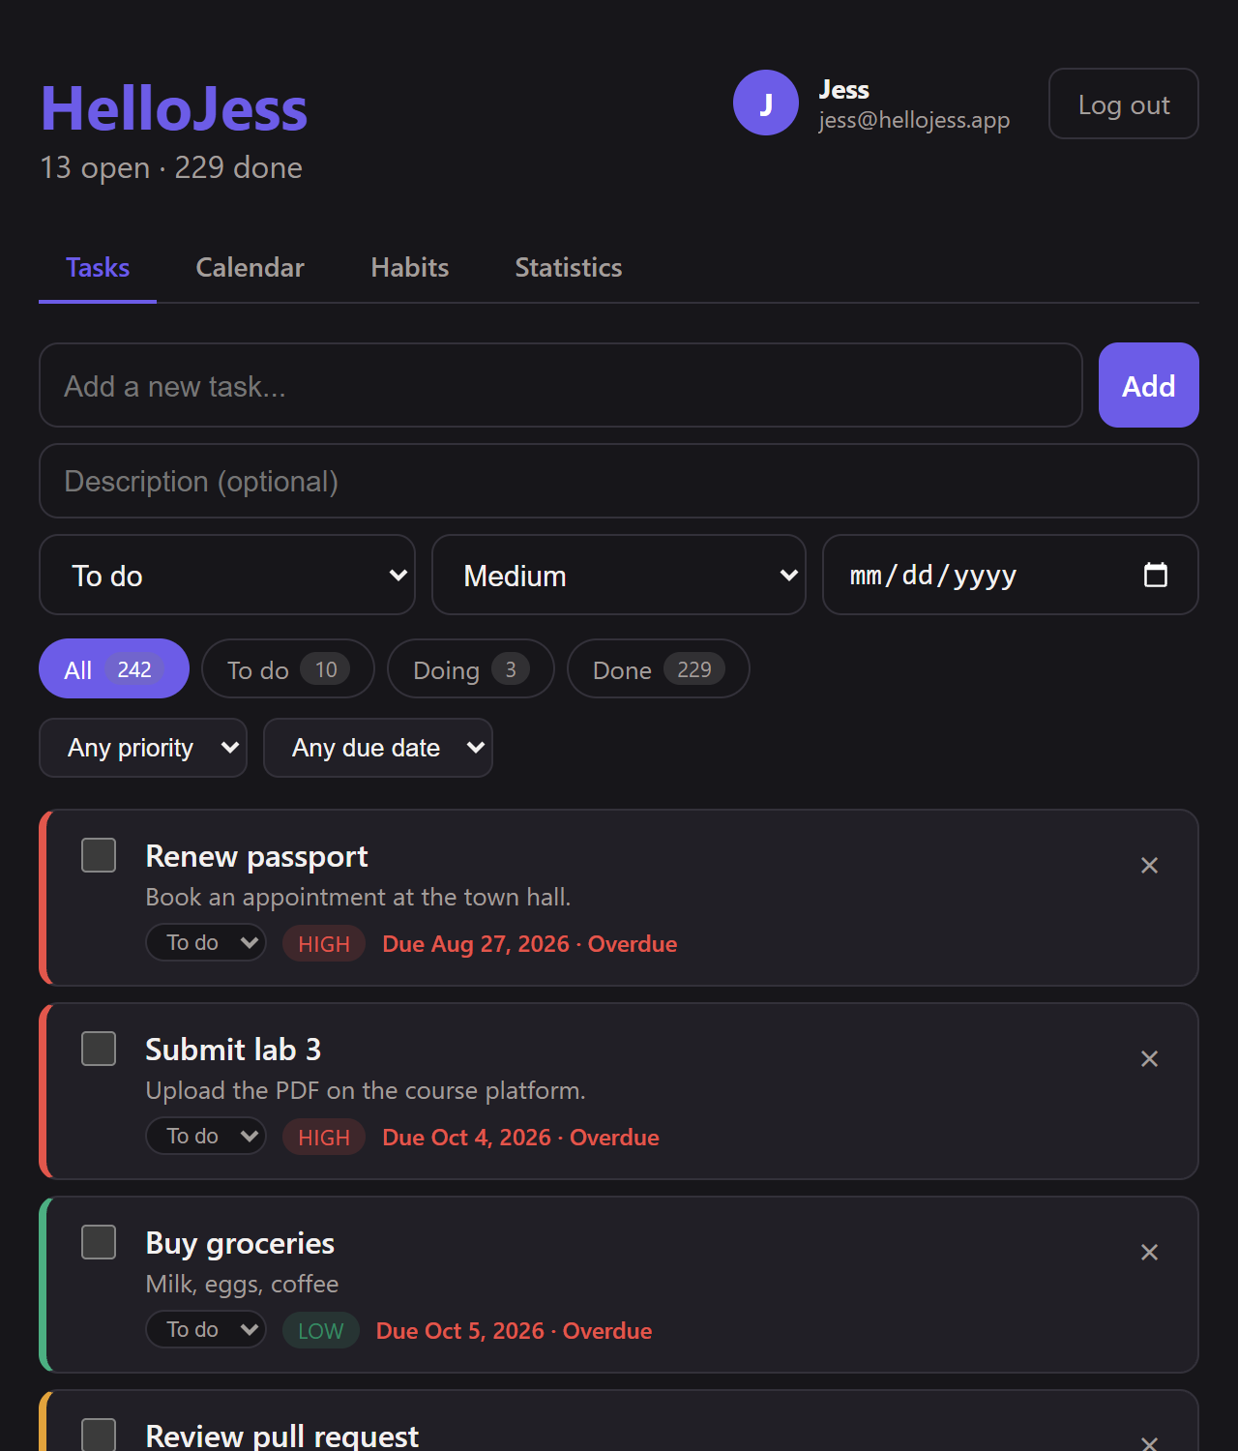
Web: the tasks page
WEB
What you can do
Add a task: title, status, description, due date, priority
Messages appear under the form when something is invalid
Filter by status, priority, due date (overdue, today, next 7 days, no date)
Counter per status: to do, doing, done
Tick a task or change its status in place
Overdue tasks are flagged in red
HelloJess
19
Notes:
This is the home page. At the top, the add-task form shows validation messages from the API. Below, filters by status, priority and due date, a counter per status, and the list. Each row has a checkbox and a status selector, and overdue tasks are highlighted in red. Clicking a title opens the detail page.

Slide 20
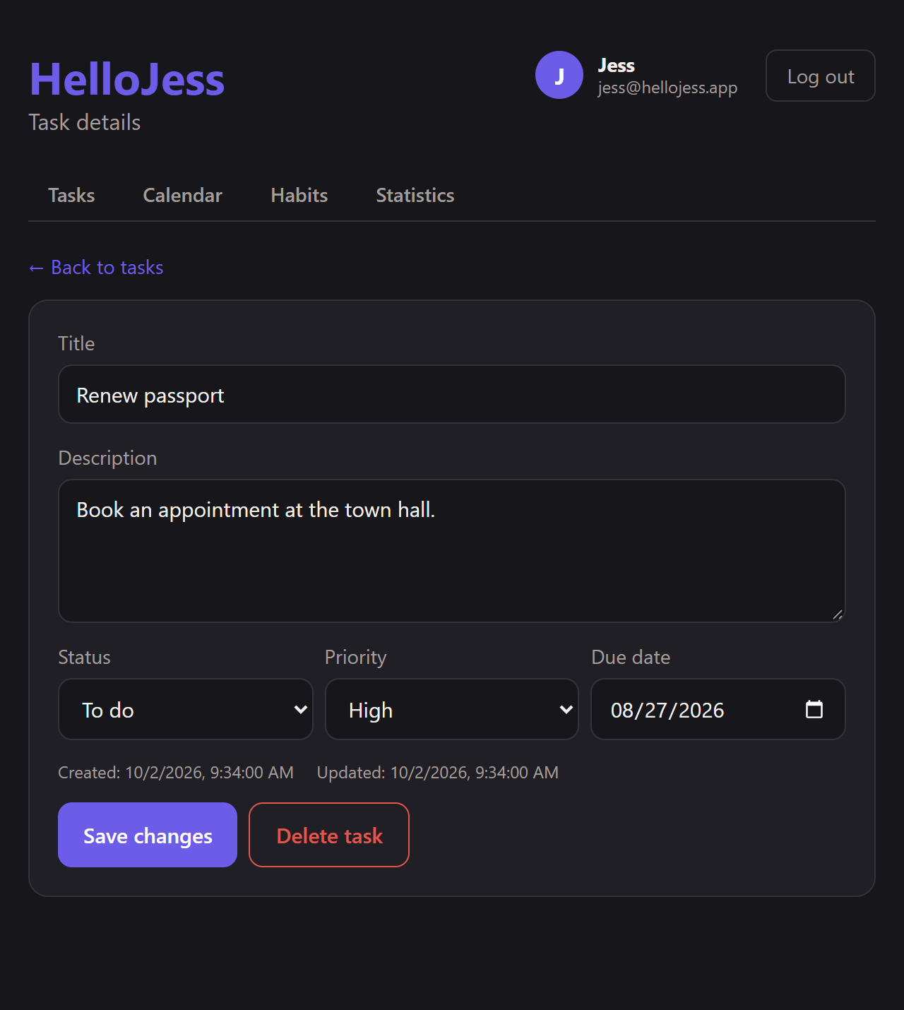
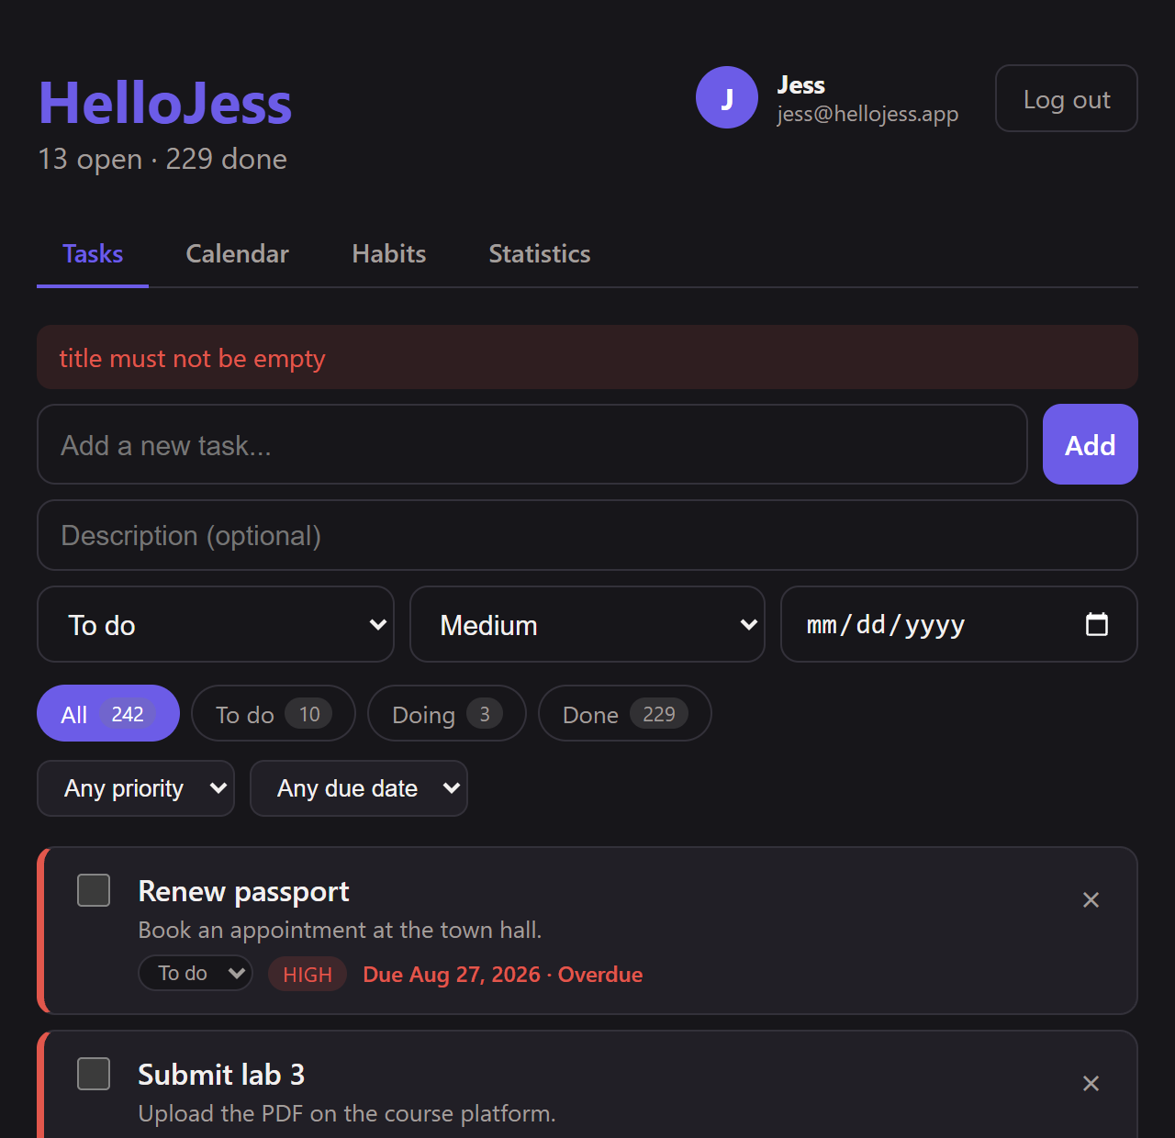
Web: task detail and validation
WEB
Task detail and edit
Validation messages (empty title)
HelloJess
20
Notes:
The detail page shows every field of one task and lets you edit or delete it. Validation errors come straight from the API and are shown next to the form, for example an empty title.

Slide 21
Web: the calendar
WEB
Reading it
Colour = status of the task
Red outline = overdue
Click a day to list its events
Overdue tasks from earlier months are carried onto today
Tasks without a due date show on the day they were added
HelloJess
21
Notes:
A month grid with coloured events, previous and next month navigation, and the list of the selected day's events underneath. Colours: purple to do, orange doing, green done, blue habits, red outline for overdue.

Slide 22
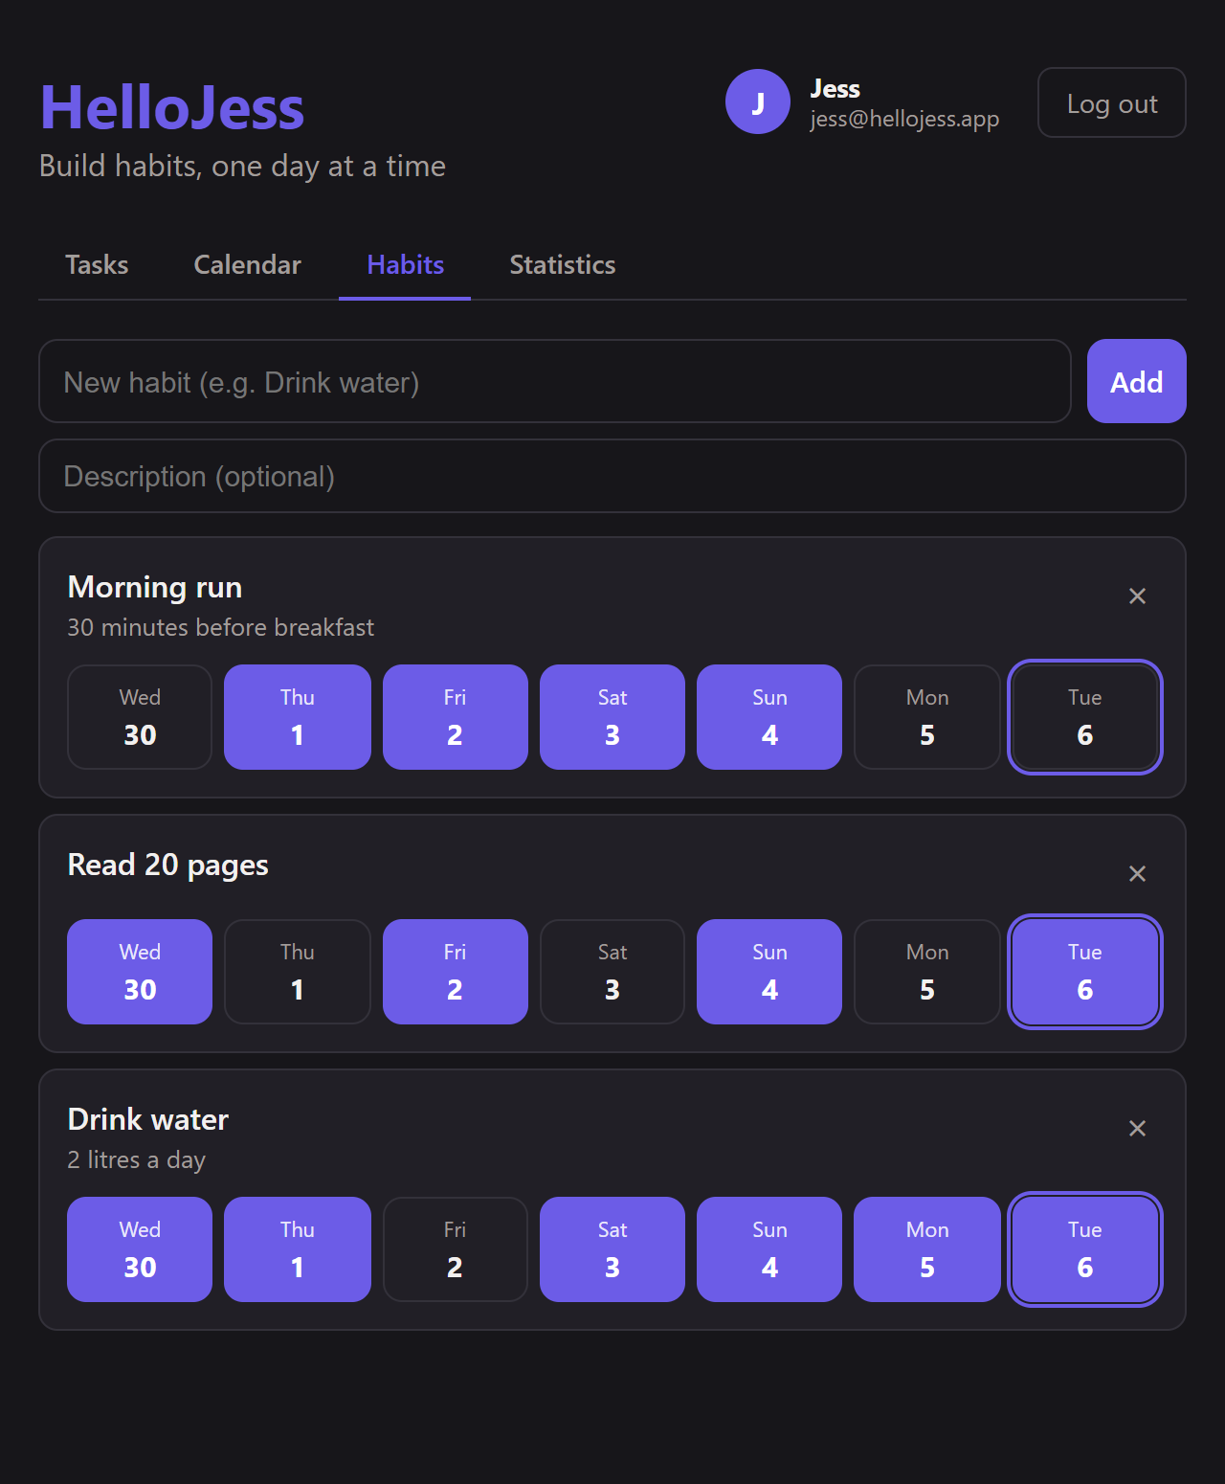
Web: habits and statistics
WEB
Habits: last 7 days per habit
Statistics: heatmap and completion rate
HelloJess
22
Notes:
Habits shows each habit with the last seven days as buttons: click to record or remove a completion. Statistics shows the summary numbers, the heatmap of the last 52 weeks and the completion chart, weekly or monthly.

Slide 23
Mobile app: structure
MOBILE
File (mobile) | Role
App.tsx | AuthProvider + navigator; spinner while the saved session is checked
src/api.ts | axios (EXPO_PUBLIC_API_URL + /api, 10 s timeout), types, clear error messages
context/AuthContext.tsx | Same role as web; token in AsyncStorage
screens/ | Tasks, TaskDetail, Calendar, Habits, Stats, Profile, Login, Register
components/ | TopNav, Chip, ErrorList, Heatmap, CompletionChart
utils/ | calendar grid, date names, confirmations
Logged out
Login
Register
Logged in
Tasks, TaskDetail
Calendar, Habits, Stats
Profile
HelloJess
23
Notes:
The mobile app has the same features as the web app and uses the same API. A native stack navigator shows Login and Register when logged out, and Tasks, TaskDetail, Calendar, Habits, Stats and Profile when logged in.

Slide 24
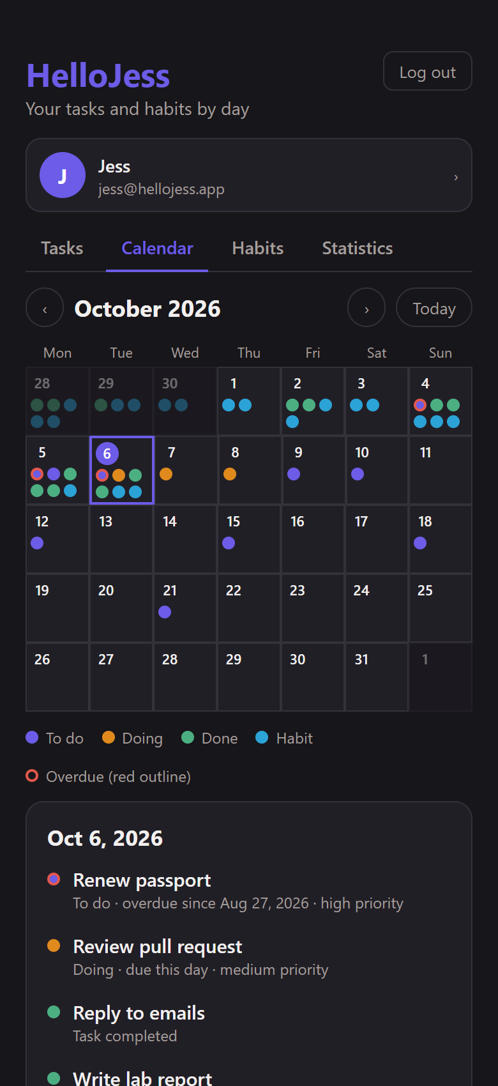
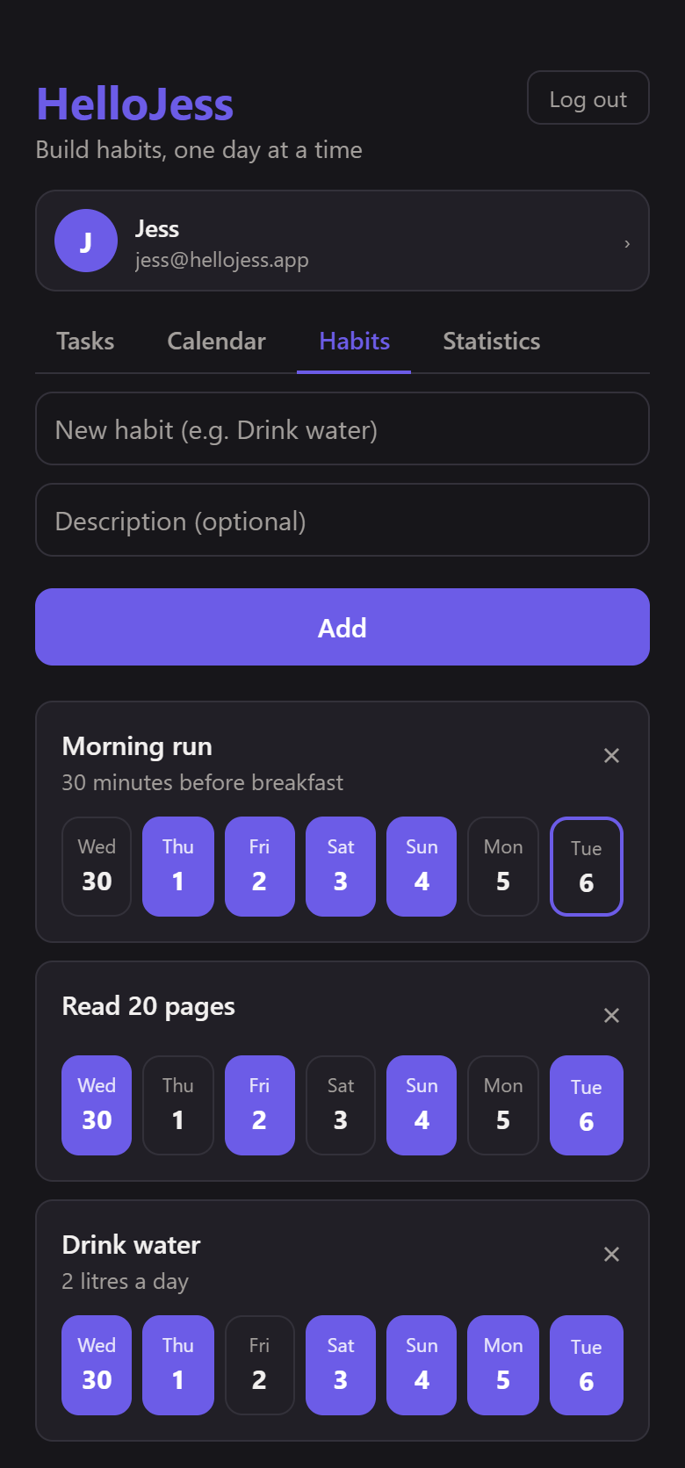
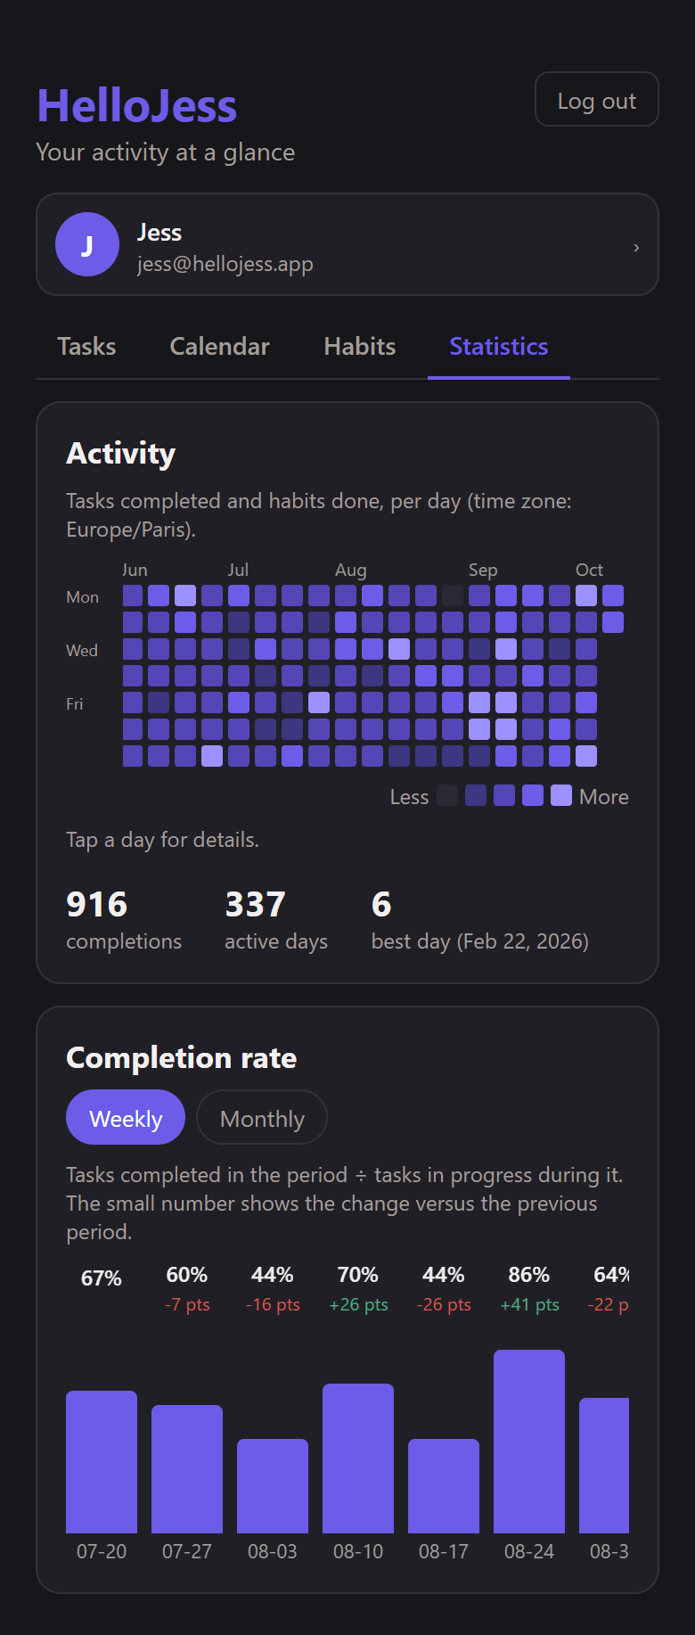
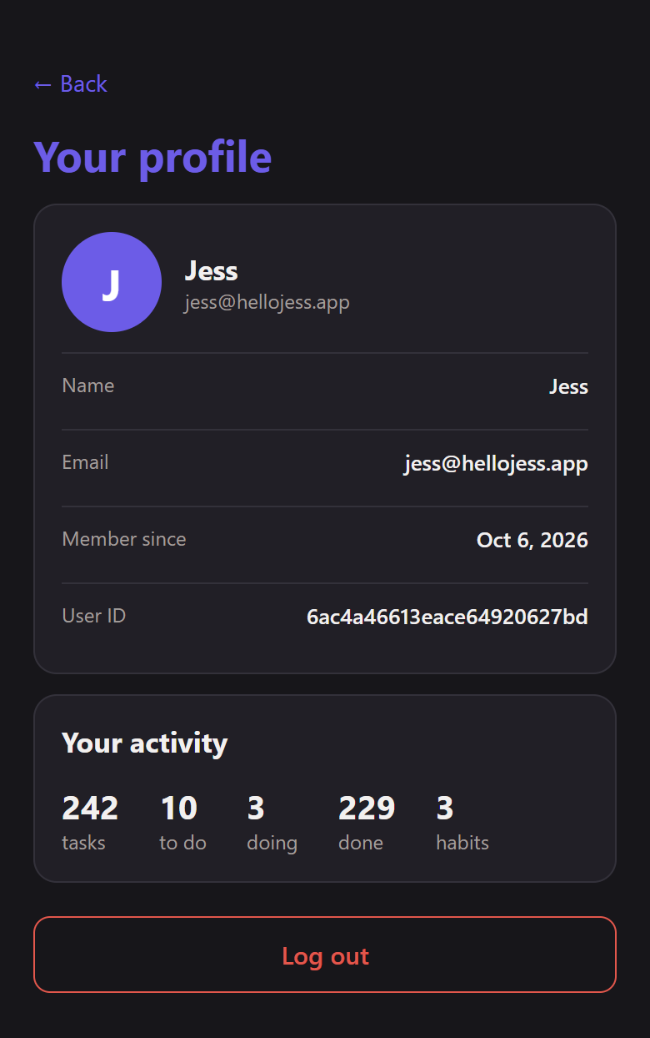
Mobile: the screens
MOBILE
Profile
Tasks
Calendar
Habits
Statistics
HelloJess
24
Notes:
From left to right: tasks with filters and counters, the calendar, habits with day cells to tap, statistics with a scrollable heatmap and completion bars, and the profile.

Slide 25
Mobile: what is different
MOBILE
Reaching the API
Failing clearly
EXPO_PUBLIC_API_URL must be the computer's LAN IP
Example: http://192.168.1.250:8000
Update it if the network or IP changes
10-second timeout instead of an endless spinner
The error message shows which URL could not be reached
Storage and navigation
Running it
Token in AsyncStorage
Native stack navigation
Confirmations work on phone and in the browser
npx expo start, then scan the QR code with Expo Go
Phone and computer on the same Wi-Fi
Backend listens on all interfaces
HelloJess
25
Notes:
A phone cannot reach localhost, so the app needs the computer's LAN address in mobile/.env. A request that cannot connect times out after ten seconds and the error names the URL. Date names are written by hand so the app does not depend on Intl support on the device.

Slide 26
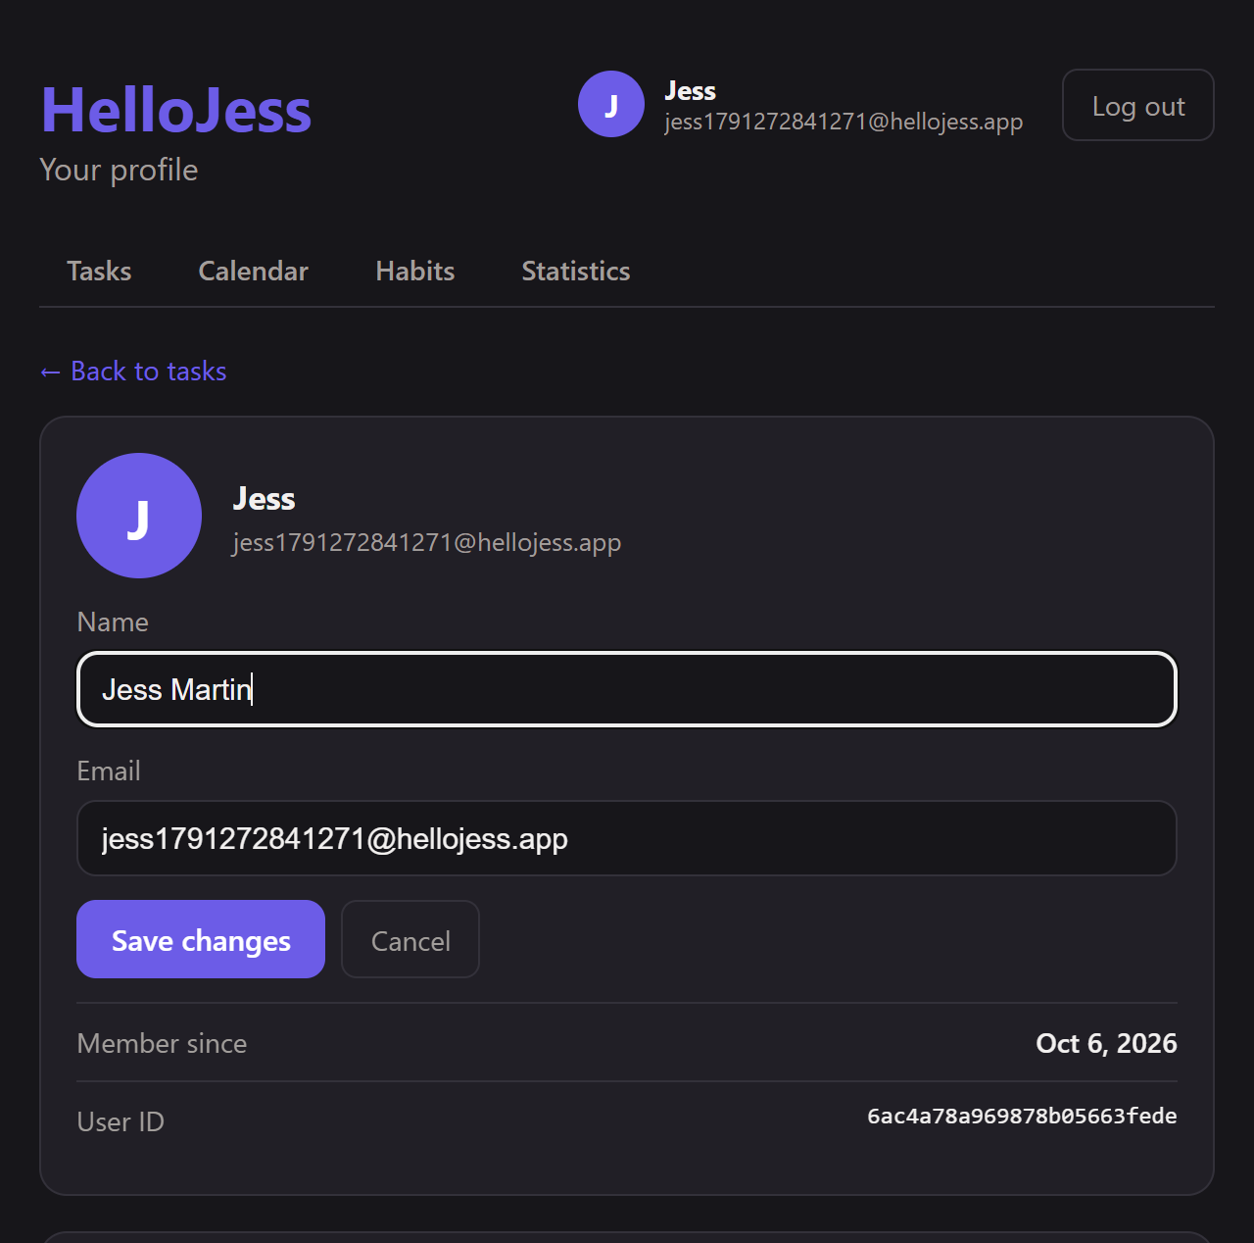
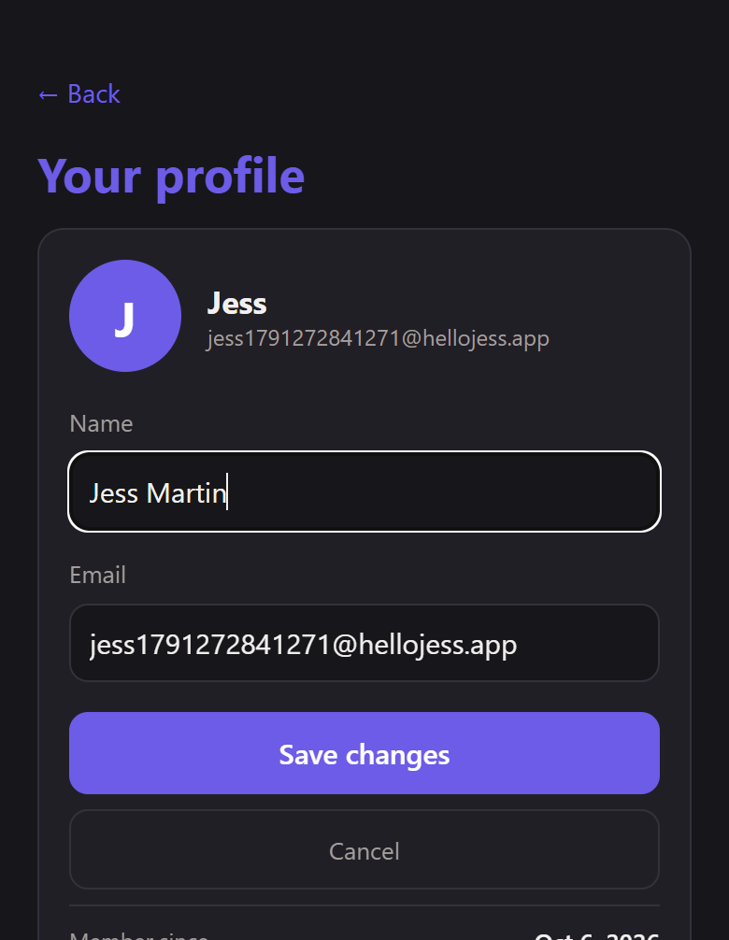
Profile: see and edit your account
PROFILE
Shows
Name, email
Member since
User ID
Tasks by status
Habit count
Mobile: editing the profile
Web: editing the profile
HelloJess
26
Notes:
The logged-in user's name and email are shown at the top of every screen. Clicking or tapping them opens the profile, which shows the account details and an activity summary. Edit profile opens a form to change the name and email. Errors, like an email already used, stay in the form so you can correct them.

Slide 27
Profile editing: end to end
PROFILE
Edit profile
PATCH /api/auth/me
Validate (zod)
Save user
Fresh token + user
Form opens, pre-filled
▶
{ name, email }
▶
422 with per-field messages
▶
400 if the email is taken
▶
client stores it, screens update
Design choices
Verified
Token subject is the user id, so an email change never logs you out
Old email-based tokens are still accepted
Only name and email can change; password, id and dates cannot
27 API checks: success, duplicate email, invalid email, blank name, forbidden fields, old token
Browser runs on web and mobile: cancel, each error, success, header update, reload, login with new email
HelloJess
27
Notes:
The key design choice is that the token holds the user id and not the email. So changing the email never invalidates a session or orphans data, and tasks and habits stay linked to the same user. Only name and email can be edited, and the schema ignores every other field.

Slide 28
TaskFlow requirements and bonuses
SUMMARY
Item | Where it lives
MVP: register, login, own tasks, add, detail, edit, delete | auth + task controllers and services; Tasks and TaskDetail pages and screens
Validation with clear messages | zod schemas, 422 per field, shown in both clients
Persistence and authorization | MongoDB; every query scoped to the logged-in user
B1 priority, filters, counters | Task.priority; filters on GET /api/tasks; GET /api/tasks/count
B2 second entity | Habit and HabitEvent with dated completions
B3 heatmap | GET /api/stats/heatmap; Heatmap component (web and mobile)
B4 completion statistics | GET /api/stats/completion; CompletionChart; unit-tested calculations
Extra | Calendar with status colours and overdue carry-over; profile page with editing
HelloJess
28
Notes:
Everything in the mandatory part and all four bonuses are implemented, plus a calendar and an editable profile.

Slide 29
Running the project
SUMMARY
Backend
Web
Mobile
cd backend
npm install
npm run dev
# API on :8000
npm test
cd web
npm install
npm run dev
# http://localhost:5173
cd mobile
npm install
npx expo start
# scan the QR code
# with Expo Go
Requires Node 22+ and a running MongoDB. Settings in backend/.env (PORT, MONGODB_URI, CORS_ORIGIN, SECRET_KEY); web/.env (VITE_API_URL); mobile/.env (EXPO_PUBLIC_API_URL).
HelloJess
29
Notes:
Three terminals: the backend on port 8000, the web app on 5173, and Expo for the phone. MongoDB must be running. On the phone, remember to set the LAN address in mobile/.env.

Slide 30
Limits and next steps
SUMMARY
Known limitations
Possible next steps
Reopening a completed task clears its completion date, so past statistics lose it
No password change or account deletion yet
Tokens last 7 days and cannot be revoked early
SECRET_KEY has a development default
Password change and account deletion
Token refresh and revocation
Push reminders for due tasks
Deploy the API and publish the apps
Thank you
HelloJess
30
Notes:
A few honest limits, and natural next steps. Thank you.

