Slide 1




Diabetes
Progression Analysis
Short presentation for a non-specialist decision-maker
442
patients
11
variables
Statistical analysis in R

Slide 2

1. The Question and the Data
Main question
Which patient characteristics are associated with diabetes progression, and how well can we predict progression using linear regression models?
Key descriptive statistics
Variable | Mean | Median | Range
Progression | 152.13 | 140.5 | 25 - 346
Age | 48.52 | 48 | 19 - 79
BMI | 26.38 | 25.7 | 18 - 42.2
Blood pressure | 94.6 | 93 | 62- 133
Dataset: 442 patients, 11 variables
Outcome: progression (quantitative measure of diabetes progression one year after baseline)
Predictors: age, sex, BMI, bp, s1, s2, s3, s4, s5, s6
Type of data: observational (not experimental)

Slide 3
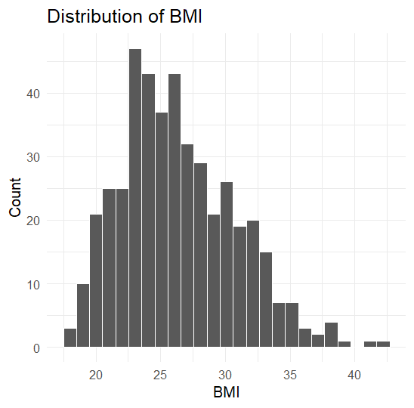
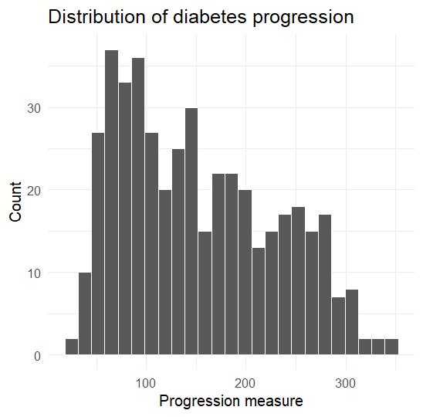
2. Most Important Patterns in the Data
Progression shows a right-skewed distribution
Values vary considerably, ranging from 25 to 346
BMI is moderately right-skewed
Most patients have BMI values between 20 and 30

Slide 4
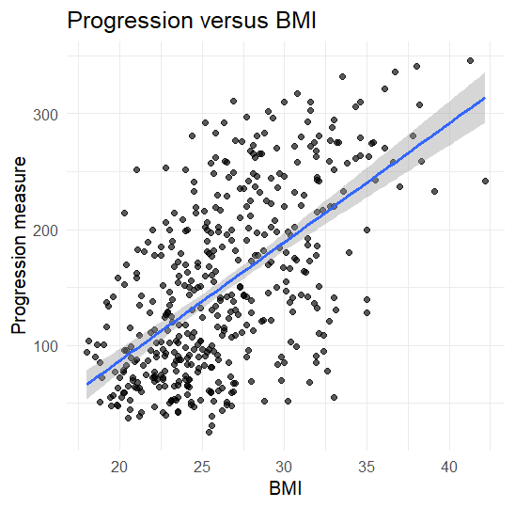
3. Main Regression Findings
Simple linear regression (BMI)
Multiple linear regression
(BMI, blood pressure and s5)
Predictor | Coefficient | P-value | Interpretation
BMI | 6.500 | <0.001 | Higher BMI is associated with higher progression, holding the other predictors constant.
Blood pressure | 0.903 | <0.001 | Higher blood pressure is associated with higher progression, holding the other predictors constant.
s5 | 49.577 | <0.001 | Higher s5 is associated with higher progression, holding the other predictors constant.
Correlation r = 0.5865 (moderate positive)
R² = 0.344
Progression tends to be higher for patients with higher BMI.
R² = 0.480 The model explains 48.0% of the variation in progression in this dataset.

Slide 5

4.What the Results Mean in Practical Terms
Better prediction fit with multiple variables
Potential for targeting higher- risk patients
Multiple factors matter
Diabetes progression is associated with more than one patient characteristic, including BMI, blood pressure and s5.
Using several predictors provides a better explanation of progression (48%) compared with using BMI alone (34%).
These factors could help identify patients who may require closer monitoring and support, subject to further validation.

Slide 6
5.Uncertainty, Limitations and Conclusions
Main sources of uncertainty or limitation
What can we conclude
Observational data: results show associations, not causation.
Possible confounding variables not included in the dataset.
Measurement error in predictors or outcome.
Linear regression may not capture all relevant relationships.
Residual diagnostics suggest possible non-linearity, so model assumptions require further checking.
Findings may not generalize to other populations or settings.
BMI, blood pressure and s5 are positively associated with diabetes progression.
The multiple regression model explains about 48% of the observed variation in this sample.
These factors may help guide further research into diabetes progression, but the model requires validation before practical use.
What we should not conclude
We cannot claim that BMI, blood pressure or s5 cause diabetes progression.
The model does not explain all factors affecting progression.
The results should not be used as a clinical diagnostic tool without further evidence.

