Slide 1
Module-5 Database Directory Layout

Slide 2
Module Objective:
Installation Directory Layout
Overview of Installation Directory & Demo
Database Directory Layout
Overview of Database Directory & Demo
Base Directory
Overview of Base Directory & Demo

Slide 3
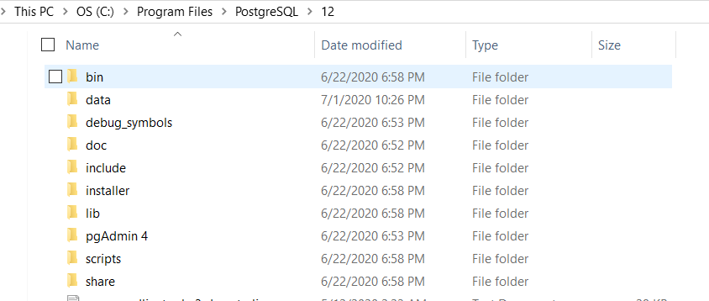
Installation Directory Layout
PostgreSQL is typically installed to /usr/local/pgsql or /var/lib/pgsql on linux.
C:\Program Files\PostgreSQL\<version number> on windows.

Slide 4
Cont… Installation Directory Layout
bin-> programs(createdb, initdb,createuser,etc)
data -> Data Directory
Doc --> Documentation
Include --> Header Files
Installer -> Installer files
Scripts --> scripts like runpsql, serverctl vbscript files
Share -> Sample configuration files
pgadmin - pgadmin files.

Slide 5
Database Directory Layout
Directory Name | Description
Base | Subdirectory containing per-database subdirectories
Current_logfiles | File recording the log file(s) currently written to by the logging collector
Global | Subdirectory containing cluster-wide tables, such as pg_database,pg_tablespace,pg_index etc
pg_commit_ts | Subdirectory containing transaction commit timestamp data= 9.5 and later ,. track_commit_timesta
pg_dynshmem | Subdirectory containing files used by the dynamic shared memory subsystem
pg_logical | Subdirectory containing status data for logical decoding
pg_multixact | Subdirectory containing multitransaction status data (used for shared row locks)
pg_notify | Subdirectory containing LISTEN/NOTIFY status data
pg_replslot | Subdirectory containing replication slot data

Slide 6
Cont..1 -Database Directory Layout
Directory Name | Description
pg_serial | Subdirectory containing information about committed serializable transactions
Log | All error logs kept in this directory.
pg_snapshots | Subdirectory containing exported snapshots
pg_stat | Subdirectory containing permanent files for the statistics subsystem
pg_stat_tmp | Subdirectory containing temporary files for the statistics subsystem
pg_subtrans | Subdirectory containing subtransaction status data
pg_tblspc | Subdirectory containing symbolic links to tablespaces
pg_twophase | Subdirectory containing state files for prepared transactions
pg_wal | Subdirectory containing WAL (Write Ahead Log) files

Slide 7
Cont..2 -Database Directory Layout
Directory Name | Description
pg_xact | Subdirectory containing transaction commit status data, transaction metadata logs
Pg_ident.conf | User name maps are defined in the ident map file. user name map can be applied to map the operating system user name to a database user.
postgresql.auto.conf | A file used for storing configuration parameters that are set by ALTER SYSTEM
postmaster.opts | A file recording the command-line options the server was last started with
postmaster.pid | A lock file recording the current postmaster process ID (PID), cluster data directory path, postmaster start timestamp, port number, Unix-domain socket directory path (empty on Windows), first valid listen_address (IP address or *, or empty if not listening on TCP), and shared memory segment ID (this file is not present after server shutdown)
PG_VERSION | A file containing the major version number of PostgreSQL

Slide 8
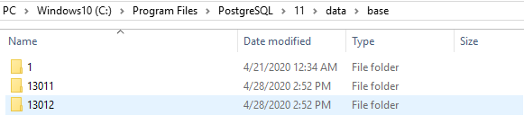
Base_Directory
Contains databases, that represented as directories named after their object identifier (OID).
Template 1 always has oid 1.
Syntax to find oid of database : Select oid,datname from pg_database;

Slide 9
Thank you. ☺

