Slide 1




Bus crews: cover every trip at the lowest cost
A timetable of trips is fixed; we choose which driver does which trips, legally, as cheaply as possible.
Bus drivers
Airline crew pairing
Train crew rostering
Delivery drivers
Same structure everywhere: chains of tasks, legal limits, a cost per crew member
Group M · Bus crew scheduling · Member A (Atifa) · slide 1
Notes:
Every morning a bus company has a fixed timetable: hundreds of trips between its terminals. Each trip needs a driver, and our job is to decide which driver does which trips. The rules are legal ones: shifts can't be too long, and a driver can't drive for too long. Airlines solve exactly the same problem for pilots and cabin crew, so what we show today carries over. We built two exact models and a fast heuristic, and tested them on fifteen benchmark timetables.
Optional: a free-licence photo of a bus terminal can be added on the right; credit it on the slide.

Slide 2
One driver is worth 10 hours of waiting
Inputs | Trips (start, end, from, to) between terminals
A duty | One driver's chain of trips: each leaves from where the last arrived, at least 10 min later
Rule 1: spread | First departure to last arrival ≤ L (e.g. 7 h)
Rule 2: driving | Total driving ≤ W = 0.75 L
Cost of a duty | $300 + $0.50 per minute of spread (waiting is paid)
Goal | Every trip covered exactly once, at minimum total cost
$300 ÷ $0.50/min
600 min
= 10 hours of paid waiting
So it is worth making drivers wait a lot to avoid hiring one more.
Group M · Bus crew scheduling · Member A (Atifa) · slide 2
Notes:
A duty is one driver's day: a chain of trips, each leaving from where the previous one arrived, with at least ten minutes to turn around. Two legal limits: the whole shift, first departure to last arrival, is at most L, and the driving inside it is at most W. Each duty costs three hundred dollars plus fifty cents for every minute of the shift, so waiting time is paid. The key number is the ratio: one extra driver costs as much as six hundred paid minutes, ten hours. So it is worth making drivers wait a lot to avoid hiring one more. Keep that in mind for the next slide.

Slide 3
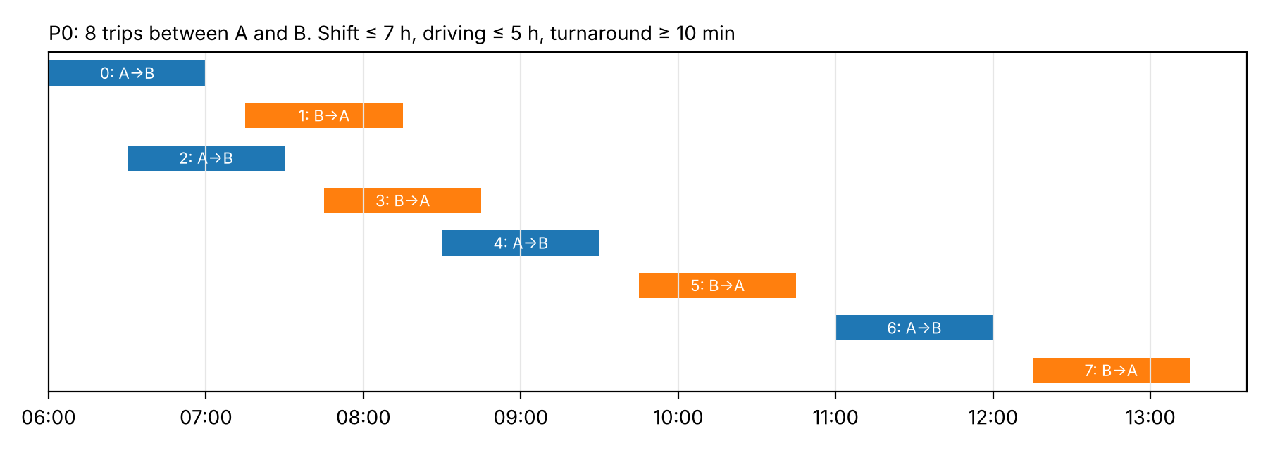
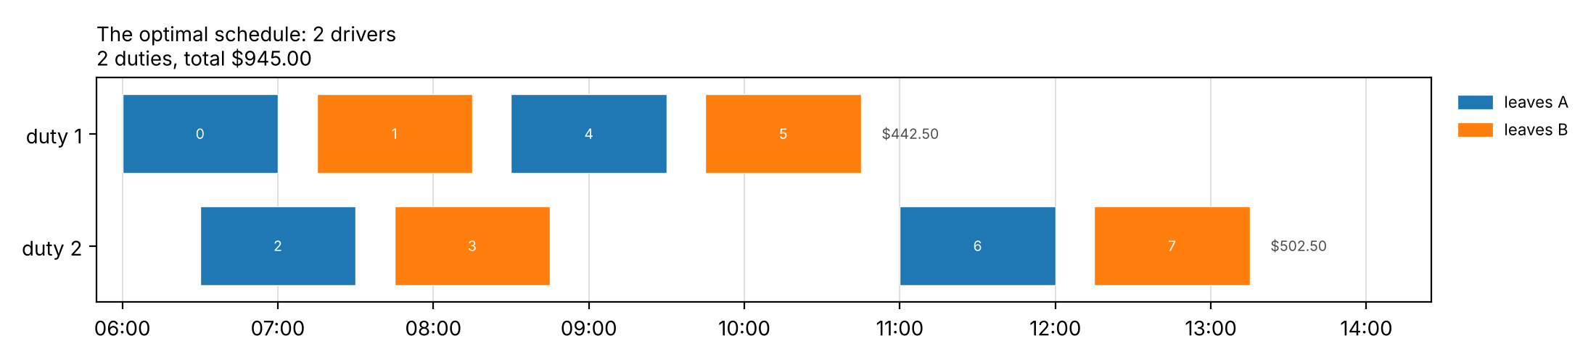
P0: can you find the 2-driver schedule? One driver is impossible
8 one-hour trips between A and B · shift ≤ 7 h · driving ≤ 5 h
Why not 1 driver?
Trips 0 and 2 overlap
8 h of driving > 5 h allowed
$945
2 drivers: {0, 1, 4, 5} $442.50 + {2, 3, 6, 7} $502.50, proven optimal
Group M · Bus crew scheduling · Member A (Atifa) · slide 3
Notes:
Show the timetable first, pause, then reveal the schedule.
Here is our smallest example, P0: eight one-hour trips between terminals A and B. Take ten seconds: how few drivers can cover them? (pause) One driver is impossible, for two reasons: trips 0 and 2 overlap, and the eight trips add up to eight hours of driving, more than the five allowed. (reveal) Two drivers are enough. The first does 0, 1, 4 and 5; the second does 2, 3, 6 and 7. Total cost nine hundred and forty-five dollars, and that is proven optimal: both our models and a brute-force search agree. Even on eight trips, the obvious greedy approach gets this wrong, as Maria will show you later.

Slide 4
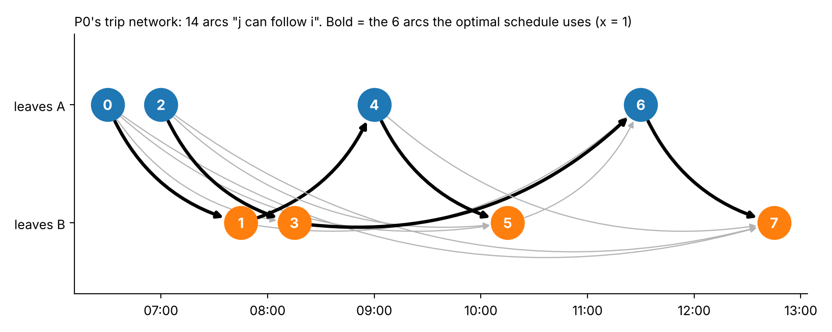
Model 1 writes a schedule as chains of trips (arc-flow)
x
1 if the same driver does j right after i (one per arrow)
u, v
1 if a trip starts / ends a duty
T
when the duty started (spread ≤ L)
Arrow i → j: j leaves where i arrives, ≥ 10 min later. Bold: the 6 arrows of the optimal schedule.
D
driving so far (≤ W)
Every trip: one way in, one way out → the chosen arrows form chains, one chain per driver
Group M · Bus crew scheduling · Member A (Atifa) · slide 4
Notes:
Model 1 starts from the trip network. An arrow from i to j means j can follow i: it leaves from where i arrives, at least ten minutes later. P0 has fourteen such arrows. For each arrow the model decides yes or no, and every trip gets exactly one way in and one way out, either another trip or the start or end of a duty. The yes arrows join into chains, and each chain is one driver. Here the six bold arrows form the two duties from the previous slide. To enforce the legal limits, two numbers travel along each chain: T remembers when the duty started, and D adds up the driving.

Slide 5
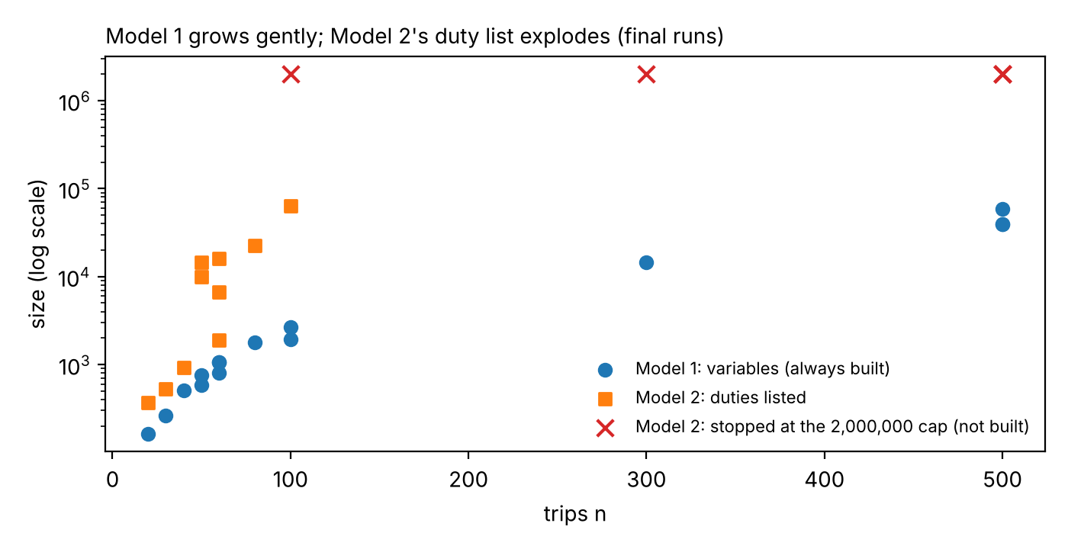
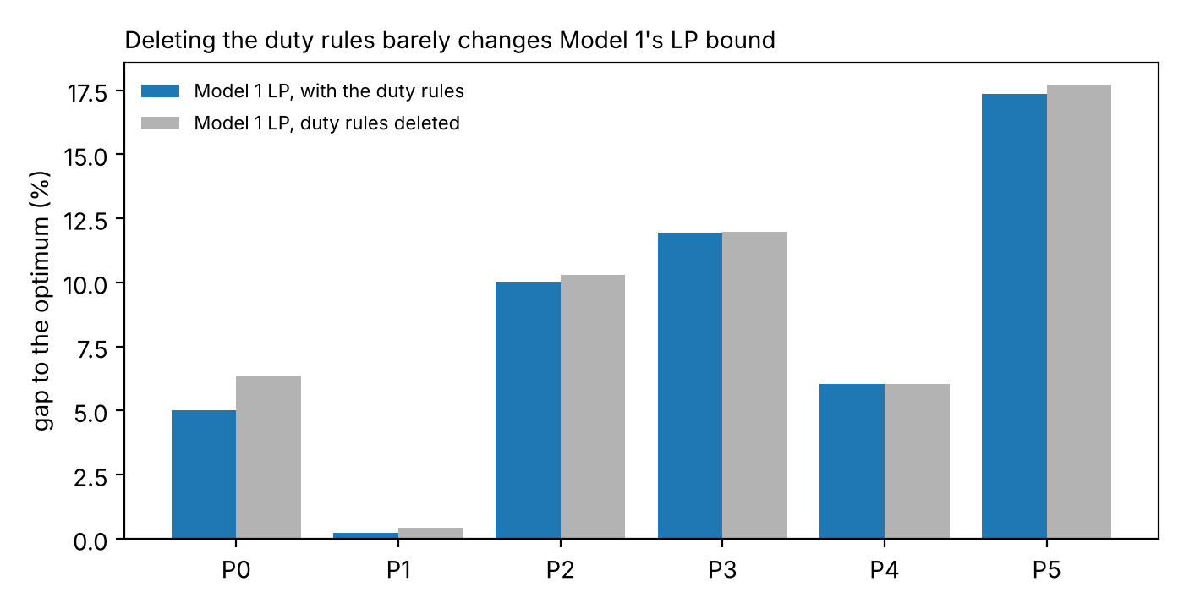
Model 1 is small and always buildable, but its LP almost forgets the duty limits
Strength: size
Weakness: the LP bound
Under 60,000 variables at 500 trips; Model 2 not built on 5 of 15
Deleting rules (4)-(7) barely moves it (P0-P5); not at all on P3, P4
The rules that make the problem hard only bite once the solver branches
Group M · Bus crew scheduling · Member A (Atifa) · slide 5
Notes:
Model 1's strength is its size. It grows with the number of arrows, not with the number of possible duties, so it can always be built: even at five hundred trips it has under sixty thousand variables, and it was built on all fifteen benchmark instances while Model 2 could not be built on five. Its weakness is on the right. If we solve its linear relaxation, the quick lower bound the solver relies on, and then delete the duty-limit rules completely, the bound hardly moves. On two prototypes it does not move at all. In other words, the relaxation almost forgets the shift and driving limits, and the solver has to recover them by branching. Amani will now show a model that is the opposite: a much stronger bound, at the price of size.
Backup if asked: exact arc reduction as next step: 56,669 of 153,818 arcs (36.8%) can never be used because the pair alone breaks L or W.

Slide 6
Model 2 writes a schedule as a menu of whole working days
Example P0: 8 trips, 2 terminals
The menu: 6 of the 40 legal duties (● = duty covers the trip)
Trip | Route | Time
0 | A → B | 06:00–07:00
1 | B → A | 07:15–08:15
2 | A → B | 06:30–07:30
3 | B → A | 07:45–08:45
4 | A → B | 08:30–09:30
5 | B → A | 09:45–10:45
6 | A → B | 11:00–12:00
7 | B → A | 12:15–13:15
Trip | Duty 1 | Duty 2 | Duty 3 | Duty 4 | Duty 5 | Duty 6
trip 0 | ● | ● | ●
trip 1 | ● | ●
trip 2 |  |  |  | ● | ●
trip 3 |  |  | ● | ●
trip 4 | ●
trip 5 | ● |  |  |  | ●
trip 6 |  |  | ● | ● | ●
trip 7 |  |  |  | ● | ● | ●
cost | $442.50 | $367.50 | $480 | $502.50 | $502.50 | $330
min Σ cost(p)·z(p) subject to Σ z(p) over duties containing trip i = 1 for every trip i (8)
z(p) ∈ {0, 1}: 1 if duty p is used · all work rules are inside the menu, so no big-M
Gurobi picks duties 1 and 4:
2 drivers, $945
Group M · Bus crew scheduling · Member B (Amani) · slide 6
Notes:
Model 1 builds each driver's day step by step. Model 2 does the opposite: first we write down every legal working day - every chain of trips that respects the work rules. For our 8-trip example there are exactly 40. Each day becomes one yes/no variable with its cost: 300 dollars for the driver plus 50 cents per minute. The only constraint says: every trip is in exactly one chosen day - constraint (8). All the work rules are inside the menu, so there are no big-M constraints and no time variables. Here Gurobi picks these two days: 945 dollars, the same optimum as Model 1.
LIKELY QUESTIONS: What if you remove constraint (8)? - nothing has to be covered, so the optimum is no drivers at $0. How do you know no duty is missing? - every shorter piece of a legal duty is legal, so a search that extends legal pieces trip by trip reaches every duty exactly once (we check: 40 on P0, equal to brute force).

Slide 7
Model 2 has the stronger bound, but its menu explodes with longer duties
Model 2's LP bound equals the optimum on all 10 instances it could build; Model 1's is 84–98 % of it. Points on the cap: Model 2 not built.
Group M · Bus crew scheduling · Member B (Amani) · slide 7
Notes:
Why bother with a huge menu? Because its LP relaxation is much stronger. Theorem 3 says every LP solution of Model 2 can be turned into an LP solution of Model 1 with the same cost - so Model 2's bound is never weaker. On the example: Model 1's LP says 898 dollars, Model 2's says 945 - already the optimum. A bound that tight means the solver barely has to branch: in our final runs, Model 2 solved every model it could build at the very first node. The price is the menu itself. A longer working day fits more trips, and every extra trip multiplies the number of possible days. With 100 trips, going from 8 to 10 hours of spread takes us from sixty thousand duties to more than two million - past our memory guard, so the model cannot even be built. Model 1 never has this problem.
LIKELY QUESTIONS: Then why not always use Model 2? - when |P| explodes it cannot be built at all, and building it costs time before Gurobi even starts. What if L doubles? - |P| can only grow (every duty that was legal stays legal), so Model 2 may become unbuildable; Model 1 only gets more arcs.

Slide 8
Same optimum – and the stronger bound wins, until the menu cannot be built
10 of 10
Model 2 models that could be built: proven optimal at the root node, at most 0.9 s end to end
5 of 15
never built: 3–75 s spent listing duties, then the menu passed 2 million
* No optimum is known where Model 2 was not built: there the gap is measured to the best schedule found, which overstates it.
Group M · Bus crew scheduling · Member B (Amani) · slide 8
Notes:
First, correctness: on every instance both models solve, they give the same cost, and an independent checker - written without looking at either model - confirms every schedule. Now bound against speed. Model 2's dots sit at zero gap: its LP already equals the optimum, so all ten models it could build were solved at the first node, in under a second. Model 1's LP is 2 to 16 percent below the optimum, so it must branch - on the larger instances until the 120-second limit. The stronger bound wins - but only where the menu exists. On 5 of our 15 instances, Model 2 spent up to 75 seconds listing duties and never started.
LIKELY QUESTIONS: Is it fair that Model 2 gets an extra build budget? - both get the same two limits; the equal-budget column shows who solves within 120 s end to end. How do you know "optimal" is really optimal? - every cost is a multiple of $0.50, so a gap below $0.50 leaves no better schedule, and the checker recomputes it.

Slide 9
Benchmark: realistic bus timetables, from instant to impossible, chosen by a written rule
Every model is fast
4
The models differ clearly
6
No model finishes
5
both models optimal in under 1 s
Model 1 takes 3.5 s to the 120 s limit; Model 2 always under 0.6 s
Model 1 times out; Model 2 cannot be built (> 2 million duties)
Class | Inst. | Trips n | Terminals | Duty length | Duties |P| | Model 1 (s) | Model 2 (s)
Easy | 4 | 20–60 | 2–3 | 6–8 h | 371–6,650 | 0.0–0.7 | 0.01–0.05
Medium | 2 | 50–60 | 3 | 6–10 h | 1,911–9,982 | 3.5–6.7 | 0.02–0.06
Hard | 1 | 60 | 2 | 8 h | 16,064 | 38.6 | 0.12
Time limit | 8 | 50–500 | 2–3 | 6–10 h | 14,599–63,633 · > 2 M | limit | 0.11–0.60 · 5 not built
Chosen by a written rule fixed before the final runs (issue #1): spread across sizes · ≥ 2 where Model 2 cannot be built · ≥ 15 in total (15 of 43 candidates; 2 by the fill-up). Limitation: W = 0.75 L ties the two duty limits.
Group M · Bus crew scheduling · Member B (Amani) · slide 9
Notes:
Our instances imitate real timetables: buses shuttle between terminals all day, busier in the morning and evening peaks, and their trips are pooled so drivers can change bus; each instance can be rebuilt from its seed. We vary the number of trips, the number of terminals and the length of a working day, and keep prices fixed, so difficulty comes from the timetable. A pilot run sorted the candidates into easy, medium, hard and time-limit; it showed too few easy ones, so we added smaller timetables before any final run. Then a written rule - fixed in our decision log before any final run - picked the final set: spread across sizes, at least two instances where Model 2 cannot be built, and at least 15 in total. So the benchmark contains instances both models solve instantly, instances where they differ clearly, and instances no model finishes.
LIKELY QUESTIONS: Did you pick instances to make your models look good? - no: a rule fixed before the final runs picked them; every candidate and its class is listed in `SELECTION.md`. What makes an instance hard? - mostly trips per duty (set by L and W), then connections per trip and n (H8).

Slide 10
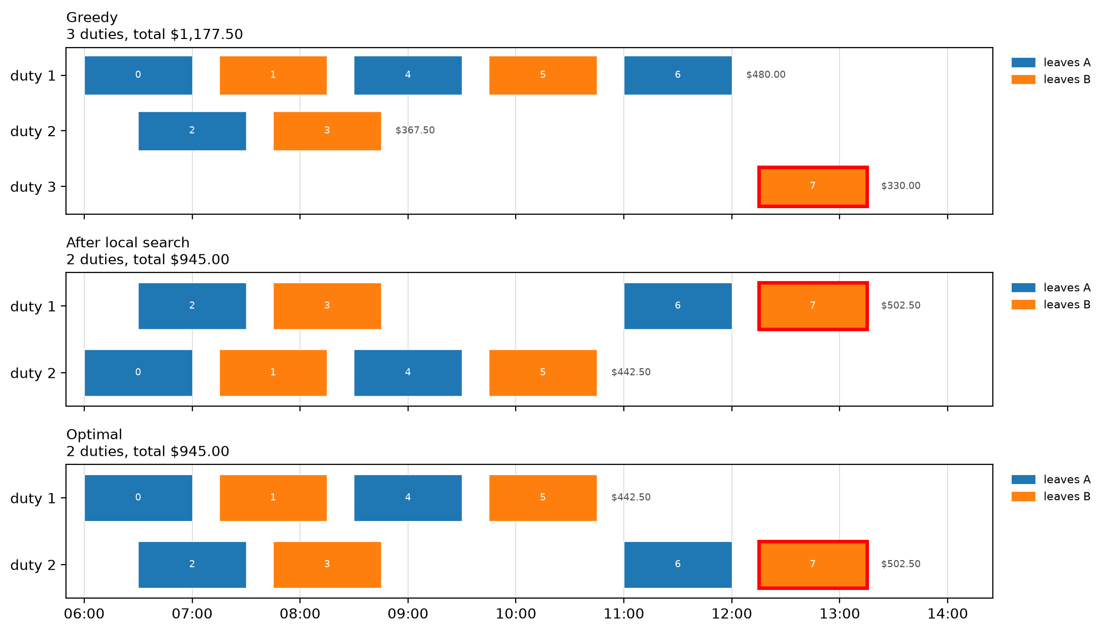
Greedy strands trip 7; swap-then-merge saves a whole driver ($232.50)
What the move pair is worth (P0)
 | Greedy | After LS | Change
Drivers | 3 × $300 | 2 × $300 | −$300
Paid time | $277.50 | $345.00 | +$67.50
Total | $1,177.50 | $945.00 | −$232.50
1 driver = $300 = 10 h of paid waiting
Move trip 6 first (costs more alone), then merge trip 7: one driver fewer.
On the benchmark: a median 2.4 % above the optimum.
Group M · Bus crew scheduling · Member C (Maria) · slide 10
Notes:
Before any solver runs, we build a schedule by hand-style rules. Greedy takes the trips in time order and gives each one to the driver who waits least. On our 8-trip example that looks clever until trip 6: greedy gives it to driver 1, who is then at the 5-hour driving limit. Trip 7 now has nowhere to go, and greedy hires a third driver for one single trip: $1,177.50. Local search fixes it with a pair of moves: first move trip 6 to driver 2 - alone that costs *more* - then attach trip 7 to driver 2. One driver fewer: $945, the optimum. The lesson: a driver costs $300, as much as 10 hours of paid waiting, so it is worth waiting a lot to save one.
LIKELY QUESTIONS: Why accept a move that makes things worse? - only together with the merge that follows; the pair is evaluated as one move and must save at least $0.50. Does local search always reach the optimum? - no: on the benchmark it stays a median of 2.4 % above the optimum (10 instances where SP proves it; max 11.3 %); it stops at the first schedule no single move can improve (a local optimum).

Slide 11
The heuristic gives both models a complete start; it rarely changes the result
Timetable
up to 500 trips
Greedy
shortest wait first
Local search
swap-then-merge
Complete start
Model 1: x, u, v, T, D
Model 2: z
Gurobi
“User MIP start
produced solution”
≤ 0.43 s
heuristic time, up to 500 trips
2.4 %
median above the optimum
25 / 25
Wins: n = 500 ended 3.9 % cheaper; an n = 50 proof was 29 % faster.
Losses: two quick proofs got slower, one bound got weaker — a different start, a different search tree.
starts accepted by Gurobi
Group M · Bus crew scheduling · Member C (Maria) · slide 11
Notes:
Why build a heuristic if we have two exact models? Because it is almost free - under half a second even with 500 trips - and it is always a legal schedule. That lets us give Gurobi a *complete* start: for Model 1 we translate the duties into every variable - arcs, start and end markers, spread and driving times; for Model 2 we switch on exactly the duty columns we used. Gurobi accepted the start every time. Did it help? Rarely. Model 1 gained clearly twice: a 500-trip instance ended 4 percent cheaper, and one 50-trip proof was 29 percent faster. Most runs were ties, and three were worse - two proofs took longer because the start sent the search down a different path. On one 500-trip instance the half-second heuristic alone beat two minutes of plain Model 1. But a start only improves the *upper* side. Model 1's gap stays open because its *lower* bound is weak, and Model 2 is solved at the root node anyway - there is nothing left for a start to do.
LIKELY QUESTIONS: How do you know Gurobi used the start? - we read the log line and compare its objective with the heuristic cost (`start_accepted`, 25 of 25). Why was AF+S worse on three instances? - a different first incumbent sends branch-and-bound down a different tree; on instances that are proved in seconds that variation is larger than the benefit of the start (performance variability, one seed); on the third, the schedule was the same but the bound at the time limit was weaker for the same reason. Why a complete start, not a partial one? - a partial start makes Gurobi solve a sub-MIP to complete it, which can fail; a complete one is checked in one step.

Slide 12
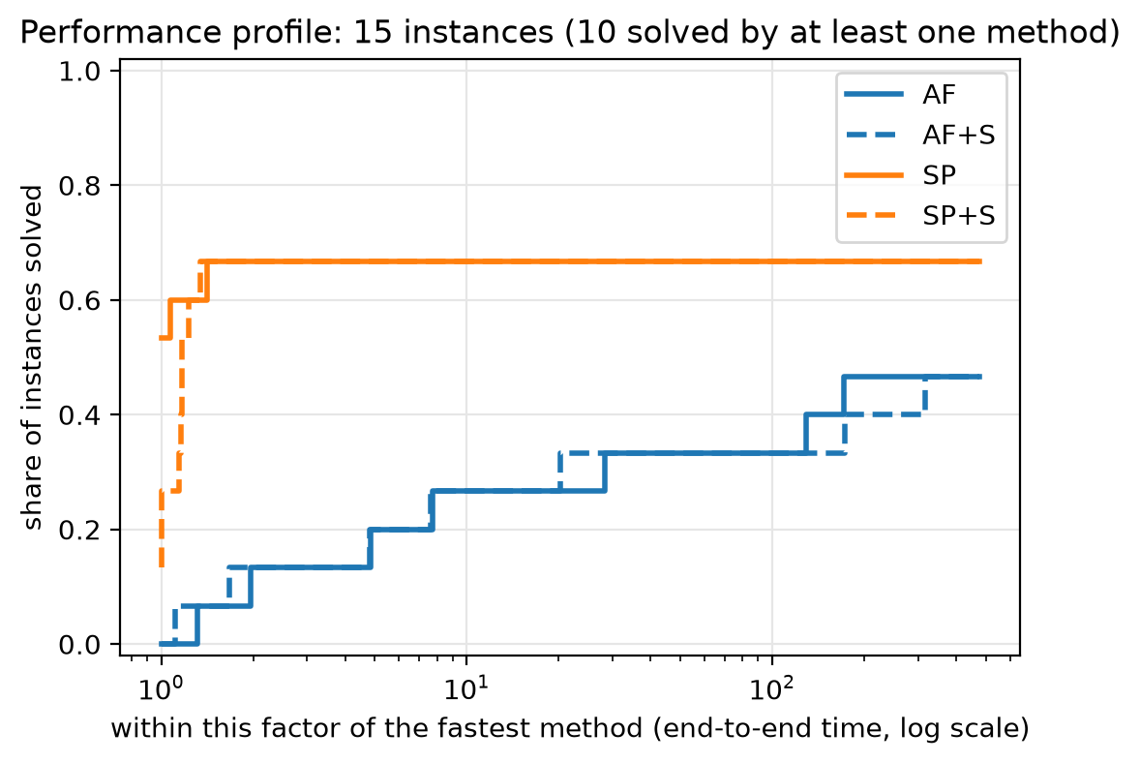
Model 2 wins whenever it can be built; Model 1 is the only option beyond that
10 / 15
7 / 15
5 / 15
3 / 3
Model 2 proved the optimum, each under 1 s
Model 1 proved the optimum (n ≤ 60)
Model 2 not built: more than 2 million duties
Model 1 time limits already at the optimum
Group M · Bus crew scheduling · Member C (Maria) · slide 12
Notes:
So which model wins? On our benchmark, the answer depends on one question: can Model 2 be built? When it can, it wins clearly. It proved the optimum on every instance it could build, each in under a second, because its LP bound already *is* the optimum - Gurobi does not need to branch at all. Model 1 proved optimality only up to 60 trips; from 50 trips on it can hit the 2-minute limit, with gaps from 5 to 27 percent that grow with size. But look closer: where we know the true optimum, Model 1 had already *found* it - it just could not *prove* it. The gap is the weak bound, not a bad schedule. And Model 2 has a cliff: with long duties or many trips the menu passes two million duties and we cannot even build it. There Model 1 is the only exact model that still runs. So the practical rule: try Model 2 first; if the menu explodes, use Model 1 with the heuristic start and report its gap honestly.
LIKELY QUESTIONS: Is the comparison fair? - same machine, same 120 s + 120 s limits, 4 threads, same parameters, recorded in env.txt and in every row. Why is the gap of AF large even when its schedule is good? - the gap is (incumbent − bound) / incumbent; AF's LP is 1.9-15.8 % below the optimum (A12), so the gap overstates how far the schedule is from optimal. What about the equal-budget column? - end-to-end time counts SP's enumeration and build too: SP's worst end-to-end is still 0.9 s where it is built; where it is not, it spends 3-75 s discovering that the menu is too big.

Slide 13
Two different failures: Model 1 runs out of time from 80 trips, Model 2's menu stops fitting from 100
Model 1: 8 of 15 time-outs
always built; every instance from n = 80 (and one n = 50) stops at 120 s with a 5–27 % gap
Model 2: 5 of 15 not built
optimal on all 10 it builds, at the root node; never built at n = 100 with 10 h duties or at n ≥ 300
Use the menu while it fits.
Next step: column generation – build only the duties worth adding.
Group M · Bus crew scheduling · Member B (Amani) · slide 13
Notes:
This chart separates two kinds of failure that are easy to confuse. Orange means the model was built but did not finish in time. Grey means the model could not even be built. Model 1 - always buildable - fails in orange: from 80 trips, and once already at 50 trips with long duties, it runs out of time. Model 2 fails in grey: once the menu passes two million duties, it never starts. Where Model 2 can be built, it wins - Model 1 was faster only on the tiniest timetables, by thousandths of a second. So our recommendation is simple: use the menu while it fits; when it does not, you need Model 1 - or, as a next step, column generation, which builds only the duties that are worth adding instead of all of them.
LIKELY QUESTIONS: Why are build failures not counted as timeouts? - they are different causes and different fixes (memory vs search); mixing them would make Model 2 look slow when it was never run. What is column generation? - start with a few duties and add only those with negative reduced cost; the pricing problem is a shortest path with spread and driving limits on the acyclic trip graph.

Slide 14
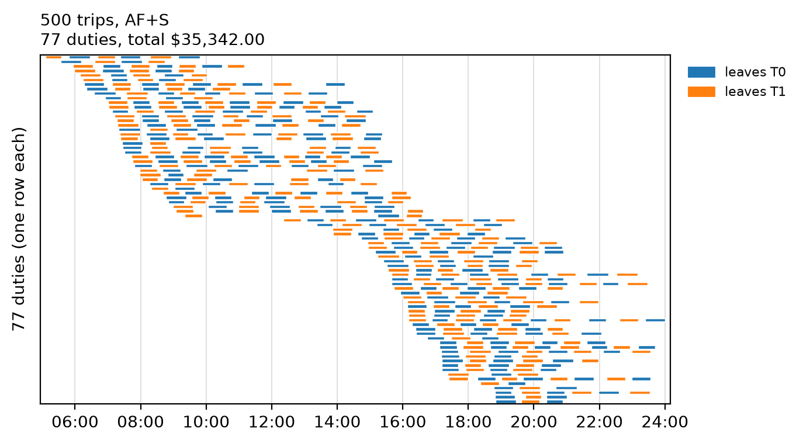
Theory held for the bounds and the cliff; the start and the build share surprised us
 | We expected | Verdict | Evidence
H1 | Model 1's LP ≤ Model 2's LP | confirmed | 10 / 10; Model 2's LP = optimum
H2 | Naive big-M is a little weaker | confirmed: no gap | identical on 15 / 15
H3 | Model 2: fewer nodes, faster | confirmed | faster on 6 / 7, 1 node each
H4 | Model 2's build share grows | not confirmed | falls 72 % → 32 %
H5 | Model 2 becomes unbuildable | confirmed | 5 / 15 not built; Model 1: 0
H6 | The start helps Model 1 more | not confirmed | median 2.6 % vs 2.6 %
H8 | Trips per duty matter more than n | cannot be decided | rank corr. 0.84 vs 0.83
Largest instance: 500 trips, 77 drivers, $35,342
Model 1 with the start, proven gap 23.1 %; every duty re-checked by the independent checker.
H7 (reduced-cost fixing) was withdrawn in plan v1.5; H9 and H10 were optional and not run.
Limits: one generator family, one machine, one seed per configuration; the driving limit is tied to the spread.
Next: column generation — generate only duties that can improve the solution (a shortest path with two resources), so Model 2 keeps its bound without listing millions of duties.
Group M · Bus crew scheduling · Member C (Maria) · slide 14
Notes:
Here is what the theory predicted and what we measured. First, the bounds: Theorem 3 says Model 2's LP is at least as strong as Model 1's - it held on every instance, and Model 2's LP was exactly the optimum every time. The naive big-M version gave the very same LP bound as our tight one. Second, size: Model 2 failed to build on 5 of 15 instances, Model 1 never. Third, speed: where both proved the optimum, Model 2 needed one node and was faster on 6 of 7. Two predictions failed. The heuristic start did not help Model 1 more than Model 2: it was a clear gain only twice, and mostly a tie. On the right is the largest one: 500 trips covered by one legal schedule, checked trip by trip. Limits of our study: one generator family, one machine, one seed per configuration, and the driving limit tied to the spread. What next? Instead of writing Model 2's whole menu, generate only the duties that can improve the solution - column generation. Its pricing problem is a shortest path with two resources on our trip network: Model 2's strength without its explosion.
LIKELY QUESTIONS: Why is H4 not confirmed? - the build share falls as |P| grows (72 % → 32 %, median 48 %), because the root LP grows faster than the build: from 371 to 63,633 duties the solve time grows about 100 times (0.006 → 0.61 s), the enumeration + build only about 9 times (0.03 → 0.29 s). The build cost shows its weight only as the cliff (H5), not as a rising share (B13). Would the conclusions change with another seed? - possibly in the numbers, not in the direction; we used one seed per configuration (§10.10 limitation). Do the results hold for real timetables? - only for this generator's family; we say so. Why column generation and not a bigger computer? - |P| grows exponentially with trips per duty; more memory buys only a little more n.

