Slide 1




Bus crews: cover every trip at the lowest cost
A timetable of trips is fixed; we choose which driver does which trips, legally, as cheaply as possible.
Bus drivers
Airline crew pairing
Train crew rostering
Delivery drivers
Same structure everywhere: chains of tasks, legal limits, a cost per crew member
Group M · Bus crew scheduling · Member A (Atifa) · slide 1
Notes:
Every morning a bus company has a fixed timetable: hundreds of trips between its terminals. Each trip needs a driver, and our job is to decide which driver does which trips. The rules are legal ones: shifts can't be too long, and a driver can't drive for too long. Airlines solve exactly the same problem for pilots and cabin crew, so what we show today carries over. We built two exact models and a fast heuristic, and tested them on fifteen benchmark timetables.
Optional: a free-licence photo of a bus terminal can be added on the right; credit it on the slide.

Slide 2
One driver is worth 10 hours of waiting
Inputs | Trips (start, end, from, to) between terminals
A duty | One driver's chain of trips: each leaves from where the last arrived, at least 10 min later
Rule 1: spread | First departure to last arrival ≤ L (e.g. 7 h)
Rule 2: driving | Total driving ≤ W = 0.75 L
Cost of a duty | $300 + $0.50 per minute of spread (waiting is paid)
Goal | Every trip covered exactly once, at minimum total cost
$300 ÷ $0.50/min
600 min
= 10 hours of paid waiting
So it is worth making drivers wait a lot to avoid hiring one more.
Group M · Bus crew scheduling · Member A (Atifa) · slide 2
Notes:
A duty is one driver's day: a chain of trips, each leaving from where the previous one arrived, with at least ten minutes to turn around. Two legal limits: the whole shift, first departure to last arrival, is at most L, and the driving inside it is at most W. Each duty costs three hundred dollars plus fifty cents for every minute of the shift, so waiting time is paid. The key number is the ratio: one extra driver costs as much as six hundred paid minutes, ten hours. So it is worth making drivers wait a lot to avoid hiring one more. Keep that in mind for the next slide.

Slide 3
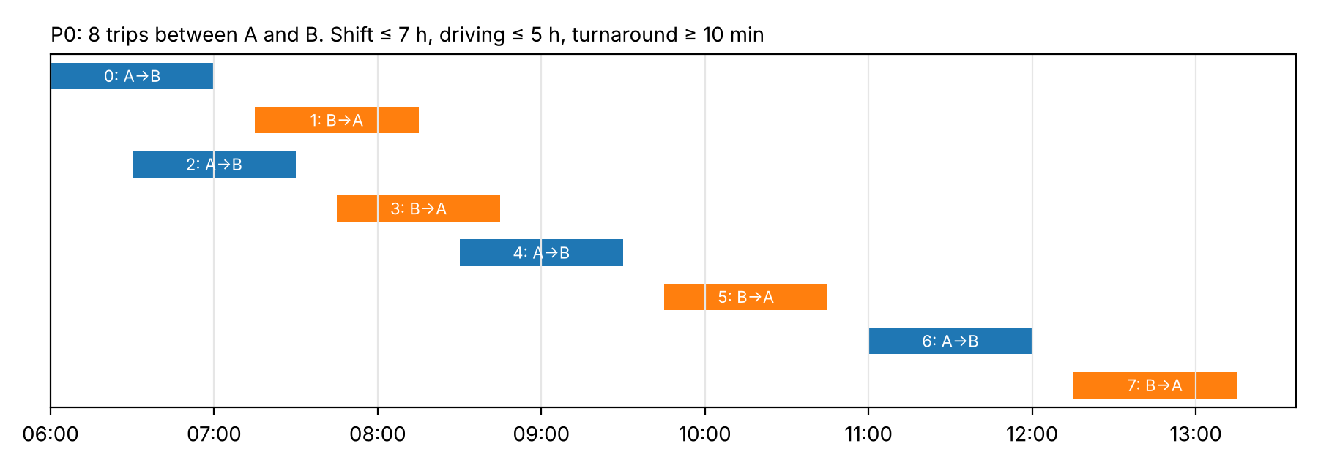
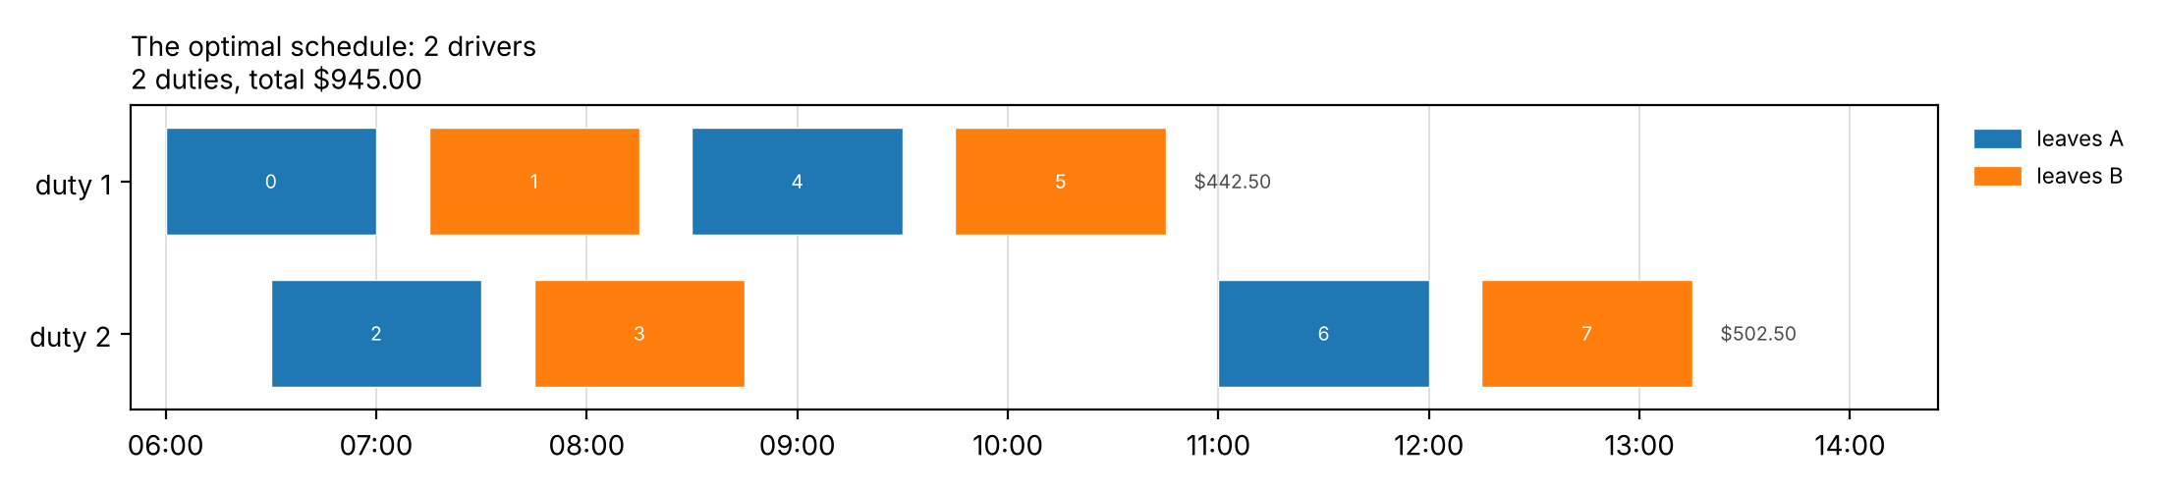
P0: can you find the 2-driver schedule? One driver is impossible
8 one-hour trips between A and B · shift ≤ 7 h · driving ≤ 5 h
Why not 1 driver?
Trips 0 and 2 overlap
8 h of driving > 5 h allowed
$945
2 drivers: {0, 1, 4, 5} $442.50 + {2, 3, 6, 7} $502.50, proven optimal
Group M · Bus crew scheduling · Member A (Atifa) · slide 3
Notes:
Show the timetable first, pause, then reveal the schedule.
Here is our smallest example, P0: eight one-hour trips between terminals A and B. Take ten seconds: how few drivers can cover them? (pause) One driver is impossible, for two reasons: trips 0 and 2 overlap, and the eight trips add up to eight hours of driving, more than the five allowed. (reveal) Two drivers are enough. The first does 0, 1, 4 and 5; the second does 2, 3, 6 and 7. Total cost nine hundred and forty-five dollars, and that is proven optimal: both our models and a brute-force search agree. Even on eight trips, the obvious greedy approach gets this wrong, as Maria will show you later.

Slide 4
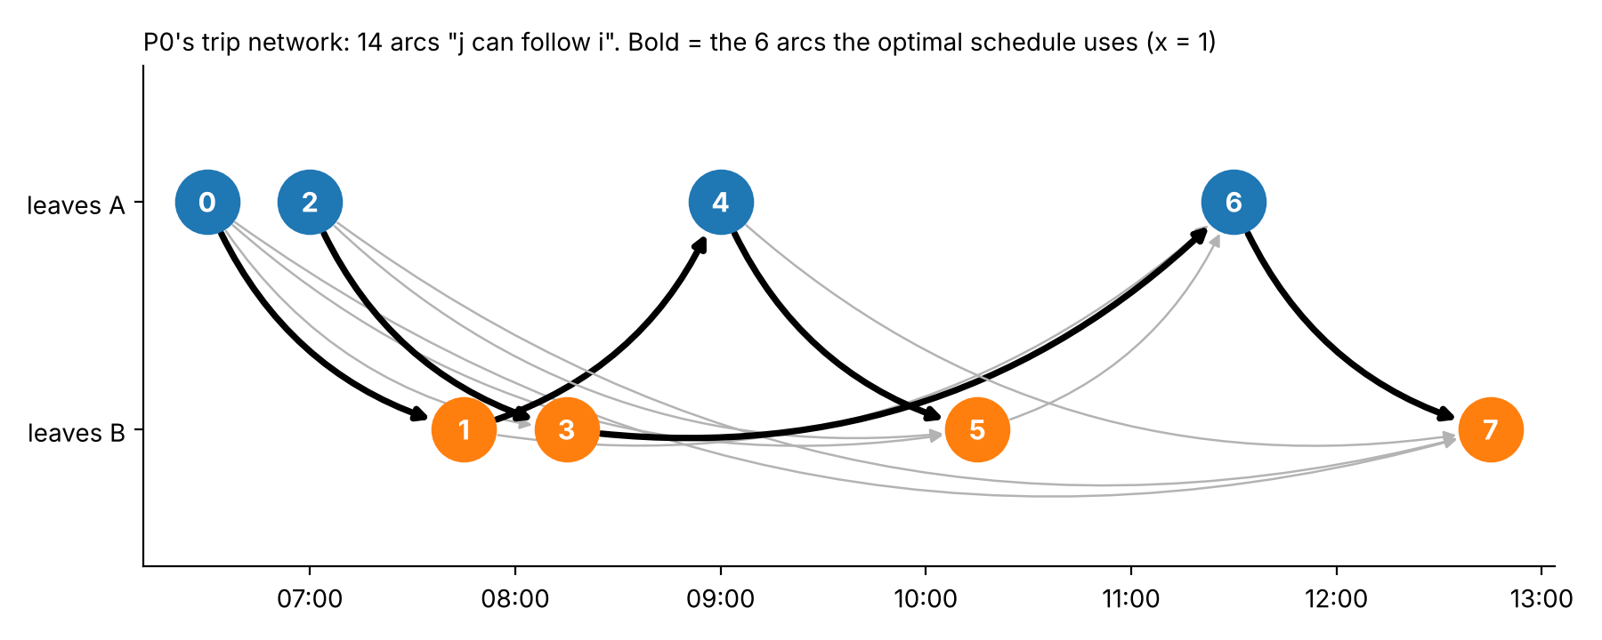
Model 1 writes a schedule as chains of trips (arc-flow)
x
1 if the same driver does j right after i (one per arrow)
u, v
1 if a trip starts / ends a duty
T
when the duty started (spread ≤ L)
Arrow i → j: j leaves where i arrives, ≥ 10 min later. Bold: the 6 arrows of the optimal schedule.
D
driving so far (≤ W)
Every trip: one way in, one way out → the chosen arrows form chains, one chain per driver
Group M · Bus crew scheduling · Member A (Atifa) · slide 4
Notes:
Model 1 starts from the trip network. An arrow from i to j means j can follow i: it leaves from where i arrives, at least ten minutes later. P0 has fourteen such arrows. For each arrow the model decides yes or no, and every trip gets exactly one way in and one way out, either another trip or the start or end of a duty. The yes arrows join into chains, and each chain is one driver. Here the six bold arrows form the two duties from the previous slide. To enforce the legal limits, two numbers travel along each chain: T remembers when the duty started, and D adds up the driving.

Slide 5
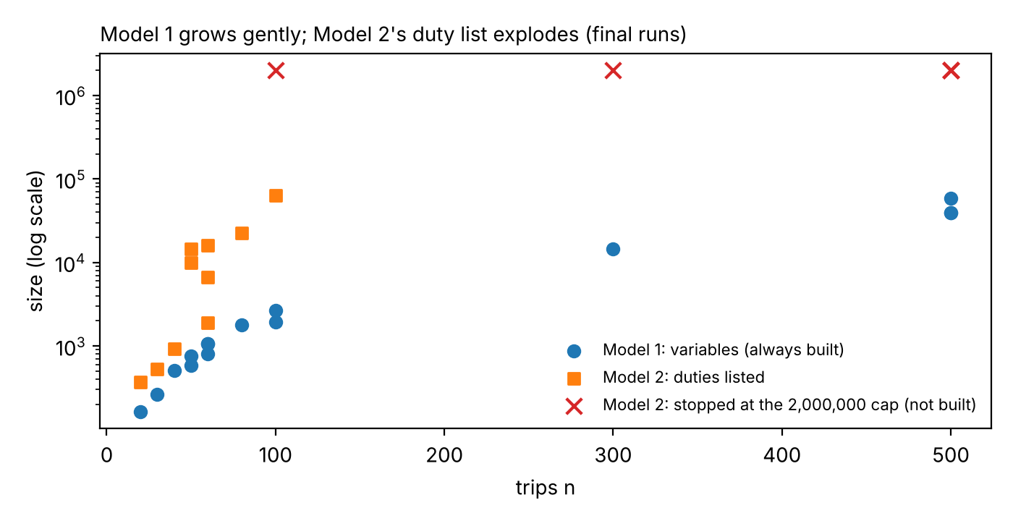
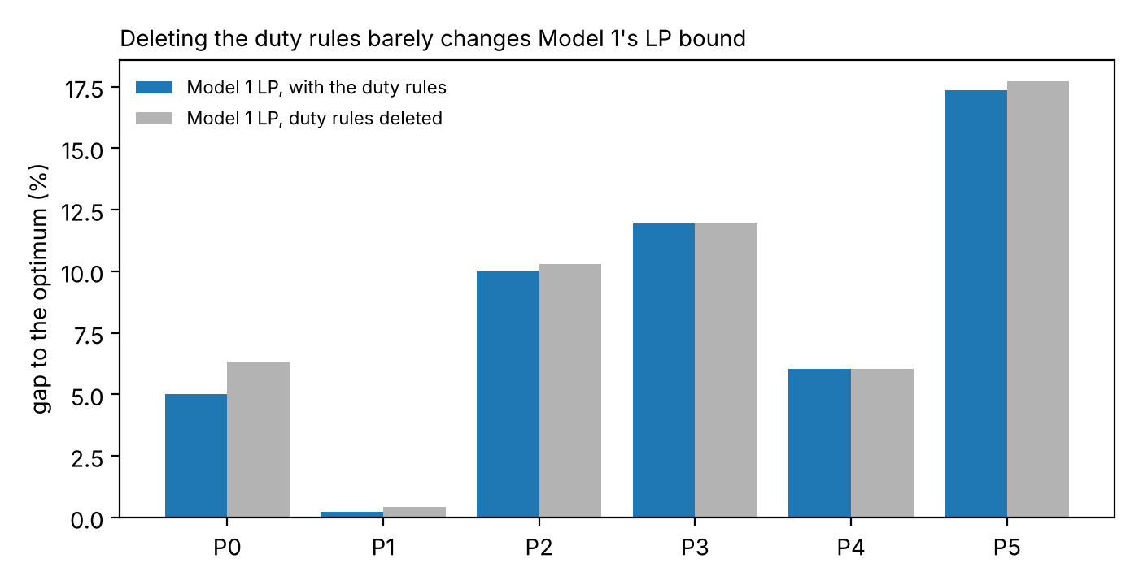
Model 1 is small and always buildable, but its LP almost forgets the duty limits
Strength: size
Weakness: the LP bound
Under 60,000 variables at 500 trips; Model 2 not built on 5 of 15
Deleting rules (4)-(7) barely moves it (P0-P5); not at all on P3, P4
The rules that make the problem hard only bite once the solver branches
Group M · Bus crew scheduling · Member A (Atifa) · slide 5
Notes:
Model 1's strength is its size. It grows with the number of arrows, not with the number of possible duties, so it can always be built: even at five hundred trips it has under sixty thousand variables, and it was built on all fifteen benchmark instances while Model 2 could not be built on five. Its weakness is on the right. If we solve its linear relaxation, the quick lower bound the solver relies on, and then delete the duty-limit rules completely, the bound hardly moves. On two prototypes it does not move at all. In other words, the relaxation almost forgets the shift and driving limits, and the solver has to recover them by branching. Amani will now show a model that is the opposite: a much stronger bound, at the price of size.
Backup if asked: exact arc reduction as next step: 56,669 of 153,818 arcs (36.8%) can never be used because the pair alone breaks L or W.

Slide 6
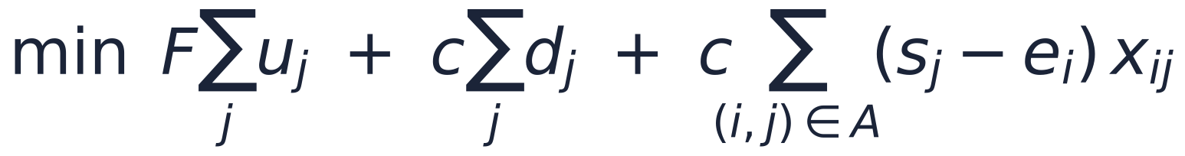
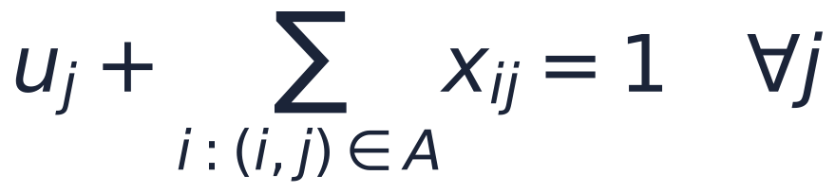
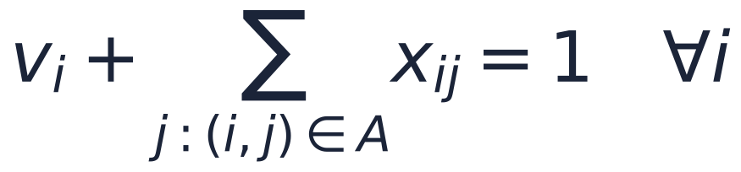
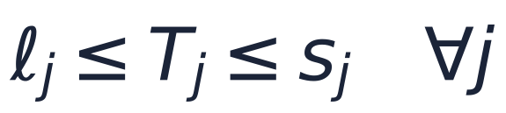
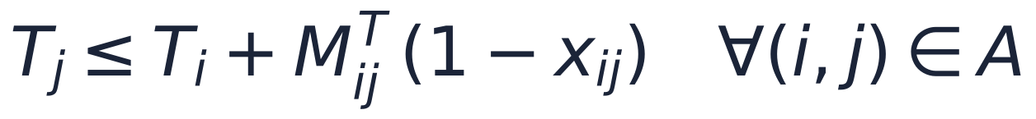
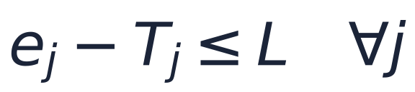

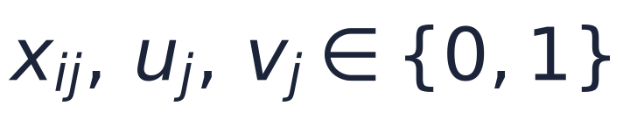
Backup: Model 1 in full — (1)–(2) build chains, (3)–(7) enforce limits
Big-M per arrow i → j: M^T = s_j − ℓ_i, M^D = U_i, where ℓ_j = max(first start, e_j − L) and U_j = min(W, e_j − first start). Size: |A| + 4n variables, 3n + 2|A| rows.
Cost: $300 per duty + total driving (a constant) + paid waiting on the arrows used
(1)
c1_pred — each trip starts a duty or has exactly one trip before it
(2)
c2_succ — each trip ends a duty or has exactly one trip after it
(3)
bounds — a duty starts no later than its first trip
(4)
c4_Tchain — if j follows i, T can only decrease along the chain
(5)
c5_spread — spread limit: j ends at most L after its duty started
(6)
c6_Dchain — if j follows i, driving so far grows by j's length
(7)
bounds — driving limit: without (7) nothing caps D
yes / no decisions; T and D are numbers
Theorem 3: LP(Model 1) ≤ LP(Model 2). Held on all 10 instances where Model 2 was built; Model 2's LP = the optimum on all 10, Model 1's is 1.9–15.8 % below.
Group M · Bus crew scheduling · Member A (Atifa) · backup
Notes:
Backup slide, shown only if asked.
Why is (7) needed? D adds up the driving along the chain through (6), but only (7) caps it: D_j ≤ U_j ≤ W. Without (7) a duty could drive any number of hours and still look legal.
Why is (4) needed? It ties each trip's T to the start of its duty. Without it T could be set freely, so (5) would not stop a 14-hour duty.
Why is the big-M s_j − ℓ_i valid? When the arrow is unused, T_j ≤ s_j and T_i ≥ ℓ_i, so the row can never cut off a real schedule (Theorem 2). The naive M gave exactly the same LP bound (H2), because the LP leaves these rows slack.
Theorem 3: every fractional Model 2 solution can be turned into a fractional Model 1 solution with the same cost, but not the other way round, so Model 1's LP bound is never higher.

