Slide 1
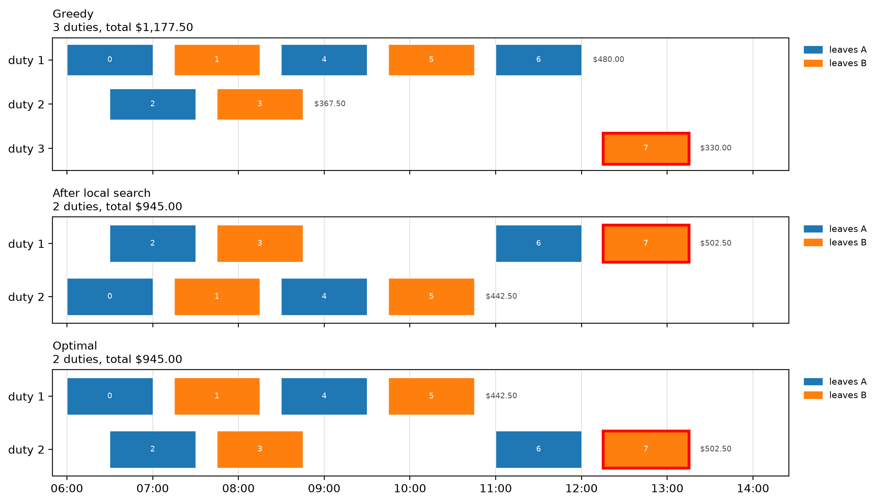
Greedy strands trip 7; swap-then-merge saves a whole driver ($232.50)
What the move pair is worth (P0)
 | Greedy | After LS | Change
Drivers | 3 × $300 | 2 × $300 | −$300
Paid time | $277.50 | $345.00 | +$67.50
Total | $1,177.50 | $945.00 | −$232.50
1 driver = $300 = 10 h of paid waiting
Move trip 6 first (costs more alone), then merge trip 7: one driver fewer.
On the benchmark: a median 2.4 % above the optimum.
Group M · Bus crew scheduling · Member C (Maria) · slide 10
Notes:
Before any solver runs, we build a schedule by hand-style rules. Greedy takes the trips in time order and gives each one to the driver who waits least. On our 8-trip example that looks clever until trip 6: greedy gives it to driver 1, who is then at the 5-hour driving limit. Trip 7 now has nowhere to go, and greedy hires a third driver for one single trip: $1,177.50. Local search fixes it with a pair of moves: first move trip 6 to driver 2 - alone that costs *more* - then attach trip 7 to driver 2. One driver fewer: $945, the optimum. The lesson: a driver costs $300, as much as 10 hours of paid waiting, so it is worth waiting a lot to save one.
LIKELY QUESTIONS: Why accept a move that makes things worse? - only together with the merge that follows; the pair is evaluated as one move and must save at least $0.50. Does local search always reach the optimum? - no: on the benchmark it stays a median of 2.4 % above the optimum (10 instances where SP proves it; max 11.3 %); it stops at the first schedule no single move can improve (a local optimum).

Slide 2
The heuristic gives both models a complete start; it rarely changes the result
Timetable
up to 500 trips
Greedy
shortest wait first
Local search
swap-then-merge
Complete start
Model 1: x, u, v, T, D
Model 2: z
Gurobi
“User MIP start
produced solution”
≤ 0.43 s
heuristic time, up to 500 trips
2.4 %
median above the optimum
25 / 25
Wins: n = 500 ended 3.9 % cheaper; an n = 50 proof was 29 % faster.
Losses: two quick proofs got slower, one bound got weaker — a different start, a different search tree.
starts accepted by Gurobi
Group M · Bus crew scheduling · Member C (Maria) · slide 11
Notes:
Why build a heuristic if we have two exact models? Because it is almost free - under half a second even with 500 trips - and it is always a legal schedule. That lets us give Gurobi a *complete* start: for Model 1 we translate the duties into every variable - arcs, start and end markers, spread and driving times; for Model 2 we switch on exactly the duty columns we used. Gurobi accepted the start every time. Did it help? Rarely. Model 1 gained clearly twice: a 500-trip instance ended 4 percent cheaper, and one 50-trip proof was 29 percent faster. Most runs were ties, and three were worse - two proofs took longer because the start sent the search down a different path. On one 500-trip instance the half-second heuristic alone beat two minutes of plain Model 1. But a start only improves the *upper* side. Model 1's gap stays open because its *lower* bound is weak, and Model 2 is solved at the root node anyway - there is nothing left for a start to do.
LIKELY QUESTIONS: How do you know Gurobi used the start? - we read the log line and compare its objective with the heuristic cost (`start_accepted`, 25 of 25). Why was AF+S worse on three instances? - a different first incumbent sends branch-and-bound down a different tree; on instances that are proved in seconds that variation is larger than the benefit of the start (performance variability, one seed); on the third, the schedule was the same but the bound at the time limit was weaker for the same reason. Why a complete start, not a partial one? - a partial start makes Gurobi solve a sub-MIP to complete it, which can fail; a complete one is checked in one step.

Slide 3
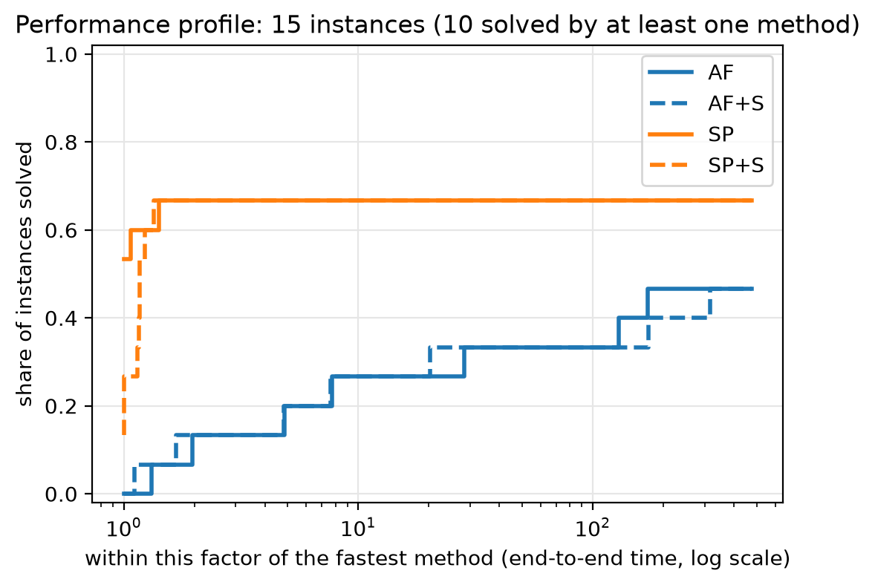
Model 2 wins whenever it can be built; Model 1 is the only option beyond that
10 / 15
7 / 15
5 / 15
3 / 3
Model 2 proved the optimum, each under 1 s
Model 1 proved the optimum (n ≤ 60)
Model 2 not built: more than 2 million duties
Model 1 time limits already at the optimum
Group M · Bus crew scheduling · Member C (Maria) · slide 12
Notes:
So which model wins? On our benchmark, the answer depends on one question: can Model 2 be built? When it can, it wins clearly. It proved the optimum on every instance it could build, each in under a second, because its LP bound already *is* the optimum - Gurobi does not need to branch at all. Model 1 proved optimality only up to 60 trips; from 50 trips on it can hit the 2-minute limit, with gaps from 5 to 27 percent that grow with size. But look closer: where we know the true optimum, Model 1 had already *found* it - it just could not *prove* it. The gap is the weak bound, not a bad schedule. And Model 2 has a cliff: with long duties or many trips the menu passes two million duties and we cannot even build it. There Model 1 is the only exact model that still runs. So the practical rule: try Model 2 first; if the menu explodes, use Model 1 with the heuristic start and report its gap honestly.
LIKELY QUESTIONS: Is the comparison fair? - same machine, same 120 s + 120 s limits, 4 threads, same parameters, recorded in env.txt and in every row. Why is the gap of AF large even when its schedule is good? - the gap is (incumbent − bound) / incumbent; AF's LP is 1.9-15.8 % below the optimum (A12), so the gap overstates how far the schedule is from optimal. What about the equal-budget column? - end-to-end time counts SP's enumeration and build too: SP's worst end-to-end is still 0.9 s where it is built; where it is not, it spends 3-75 s discovering that the menu is too big.

Slide 4
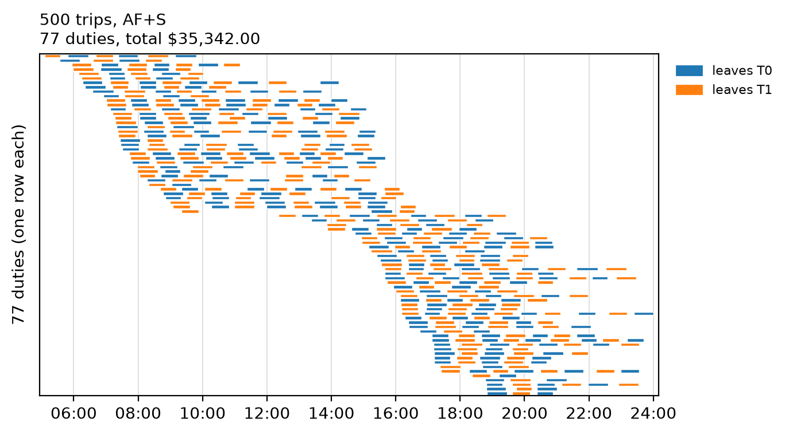
Theory held for the bounds and the cliff; the start and the build share surprised us
 | We expected | Verdict | Evidence
H1 | Model 1's LP ≤ Model 2's LP | confirmed | 10 / 10; Model 2's LP = optimum
H2 | Naive big-M is a little weaker | confirmed: no gap | identical on 15 / 15
H3 | Model 2: fewer nodes, faster | confirmed | faster on 6 / 7, 1 node each
H4 | Model 2's build share grows | not confirmed | falls 72 % → 32 %
H5 | Model 2 becomes unbuildable | confirmed | 5 / 15 not built; Model 1: 0
H6 | The start helps Model 1 more | not confirmed | median 2.6 % vs 2.6 %
H8 | Trips per duty matter more than n | cannot be decided | rank corr. 0.84 vs 0.83
Largest instance: 500 trips, 77 drivers, $35,342
Model 1 with the start, proven gap 23.1 %; every duty re-checked by the independent checker.
H7 (reduced-cost fixing) was withdrawn in plan v1.5; H9 and H10 were optional and not run.
Limits: one generator family, one machine, one seed per configuration; the driving limit is tied to the spread.
Next: column generation — generate only duties that can improve the solution (a shortest path with two resources), so Model 2 keeps its bound without listing millions of duties.
Group M · Bus crew scheduling · Member C (Maria) · slide 14
Notes:
Here is what the theory predicted and what we measured. First, the bounds: Theorem 3 says Model 2's LP is at least as strong as Model 1's - it held on every instance, and Model 2's LP was exactly the optimum every time. The naive big-M version gave the very same LP bound as our tight one. Second, size: Model 2 failed to build on 5 of 15 instances, Model 1 never. Third, speed: where both proved the optimum, Model 2 needed one node and was faster on 6 of 7. Two predictions failed. The heuristic start did not help Model 1 more than Model 2: it was a clear gain only twice, and mostly a tie. On the right is the largest one: 500 trips covered by one legal schedule, checked trip by trip. Limits of our study: one generator family, one machine, one seed per configuration, and the driving limit tied to the spread. What next? Instead of writing Model 2's whole menu, generate only the duties that can improve the solution - column generation. Its pricing problem is a shortest path with two resources on our trip network: Model 2's strength without its explosion.
LIKELY QUESTIONS: Why is H4 not confirmed? - the build share falls as |P| grows (72 % → 32 %, median 48 %), because the root LP grows faster than the build: from 371 to 63,633 duties the solve time grows about 100 times (0.006 → 0.61 s), the enumeration + build only about 9 times (0.03 → 0.29 s). The build cost shows its weight only as the cliff (H5), not as a rising share (B13). Would the conclusions change with another seed? - possibly in the numbers, not in the direction; we used one seed per configuration (§10.10 limitation). Do the results hold for real timetables? - only for this generator's family; we say so. Why column generation and not a bigger computer? - |P| grows exponentially with trips per duty; more memory buys only a little more n.

