Slide 1
Design of a CPU FPGA-Based in Verilog

Slide 2
01
What is our project?

Slide 3
What is our project?
designing a microcontroller based on Verilog with a 25 MHz frequency and 16-bit operating system, and the foundation of our project is to build the microcontroller from the universal NAND gate.

Slide 4
What we are using
RISC CPU architecture
Verilog Hardware description language.
open-source, simple, and elegant instruction set architecture making it ideal choice for educational and FPGA-based projects.

Slide 5
What is Microcontroller?

Slide 6
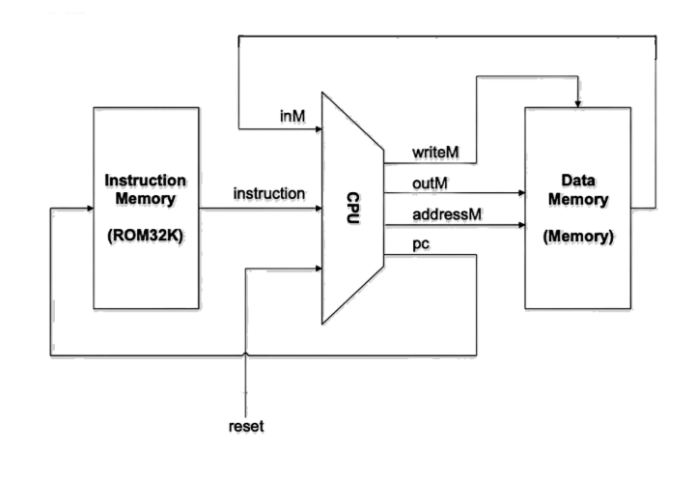
Microcontroller
It is a small computer used in embedded systems designed to do a specific task and it includes a memory, CPU, and i/o ports all in a single chip.

Slide 7
NAND gate is the foundation of our project

Slide 8
Why we choose NAND gate
Least Power Consumption
Transistor Size
Relationship between Power, Size, and Frequency
Parallel Pmos and Series Nmos

Slide 9
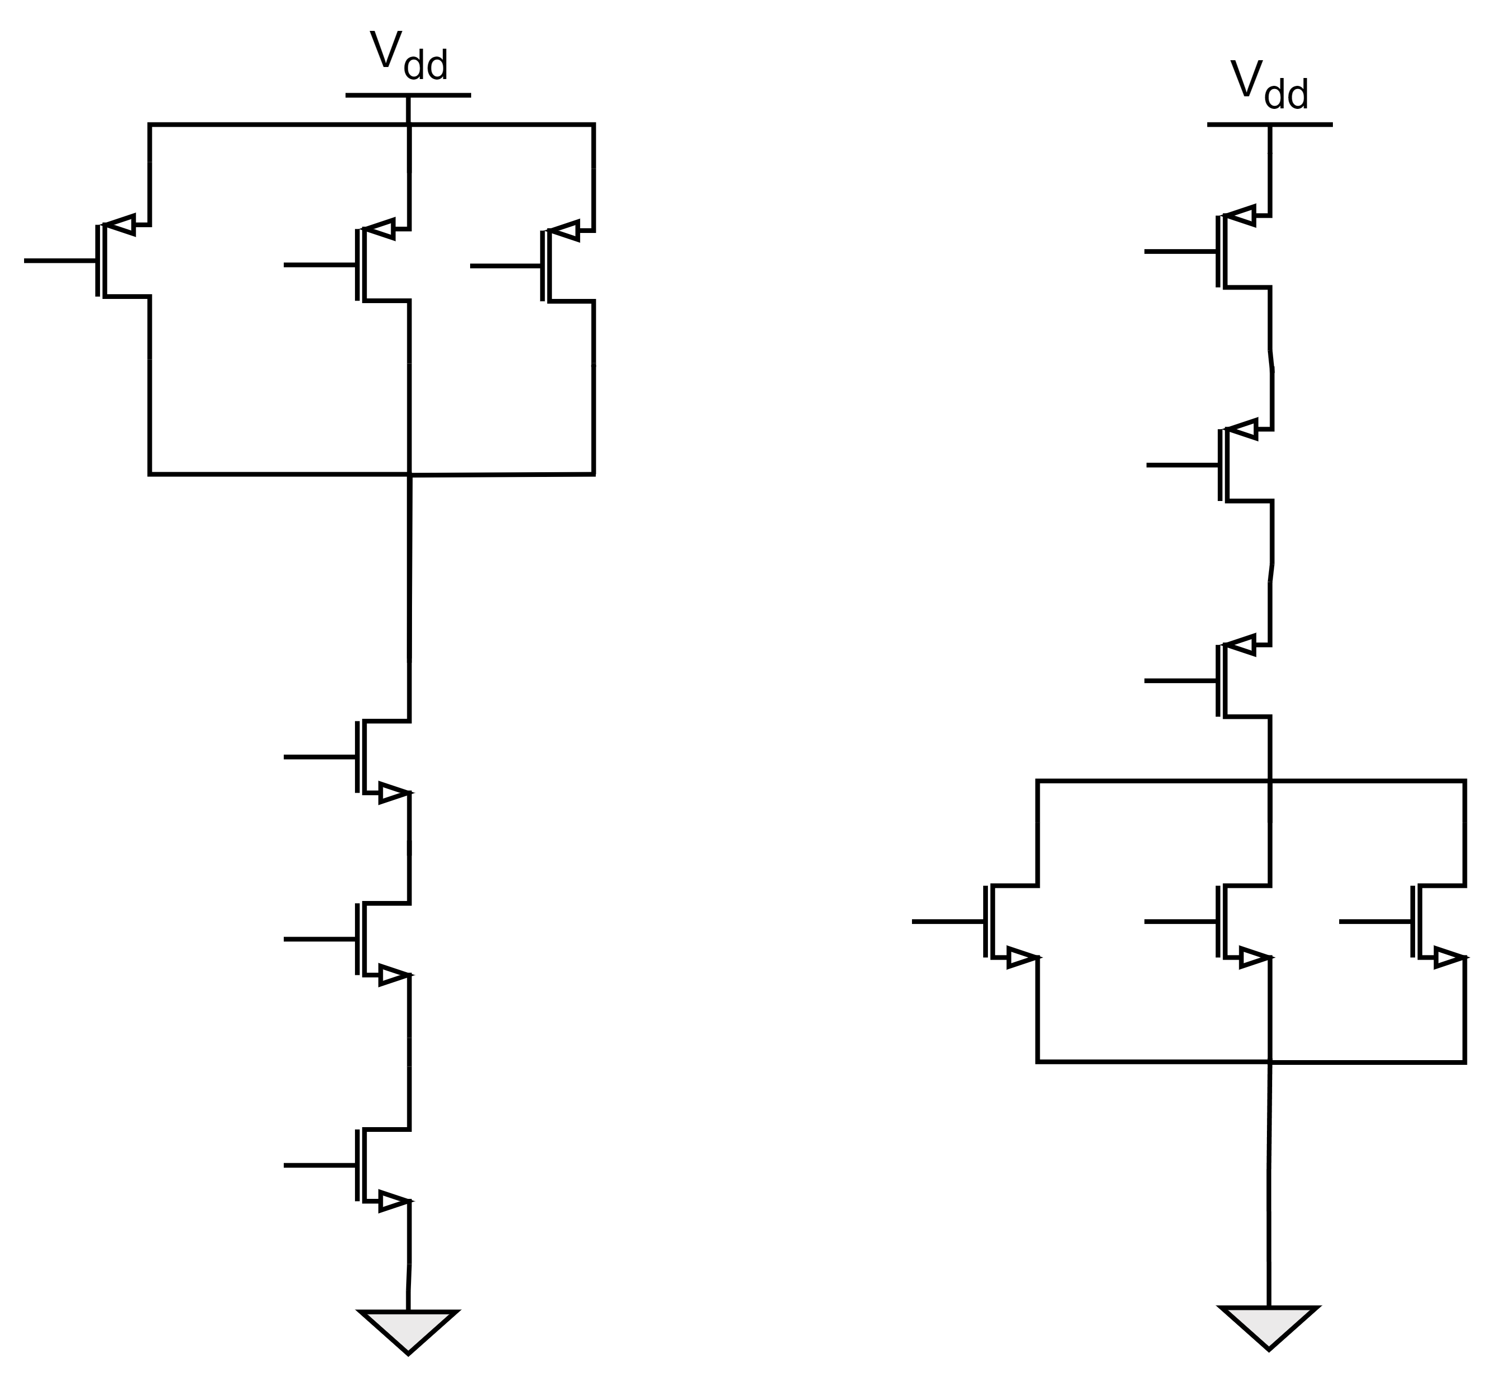
Why NAND not NOR gate

