Slide 1



CLEMSON TIGERS
DEATH VALLEY STADIUM NAMING RIGHTS
Copyright © 2024. The contents of this document are confidential. The information may also be legally privileged. This document is shared in trust, for the sole purpose of review by the intended viewer.

Slide 2
agenda
Executive summary
STADIUM NAMING RIGHTS MARKET RATE
VALUATION METHODOLOGY
TOP POTENTIAL CORPORATE PARTNERS
PARTNERSHIP Benefits
PROSPECTIVE PARTNERS METHODOLOGY
Copyright © 2024. The contents of this document are confidential. The information may also be legally privileged. This document is shared in trust, for the sole purpose of review by the intended viewer.

Slide 3



EXECUTIVE SUMMARY
TOP SPONSORS FOR THE NAMING RIGHTS DEAL OF DEATH VALLEY STADIUM HAVE BEEN DETERMINED THROUGH CLUSTERING TECHNIQUES.
AAV FOR DEATH VALLEY NAMING RIGHTS:
$3,100,000
THE TOTAL WAS ACHIEVED BY USING A COMBINATION OF MACHINE LEARNING MODELS
Copyright © 2024. The contents of this document are confidential. The information may also be legally privileged. This document is shared in trust, for the sole purpose of review by the intended viewer.
Notes:
The total was achieved by using a combination of ml model and a hedonic-pricing benchmark valuation approach

Slide 4





CLEMSON TIGERS FOOTBALL
NUMBERS OF THE LAST DECADE
RANKINGS
The Tigers were the highest ranked ACC team 8 times
Year | 2014 | 2015 | 2016 | 2017 | 2018 | 2019 | 2020 | 2021 | 2022 | 2023
Clemson | 16 | 1 | 2 | 1 | 2 | 1 | 1 | 3 | 4 | 9
Highest ACC rank | 1 | 1 | 2 | 1 | 2 | 1 | 1 | 3 | 4 | 3
VIEWERSHIP
Viewership average is the highest among other ACC teams
M
M
M
Conference Championship Games
National Championship Games
TITLES AND APPEARANCES
Since the implementation of College Football Playoff
7
Played
7
Won
4
Played
2
Won
Copyright © 2024. The contents of this document are confidential. The information may also be legally privileged. This document is shared in trust, for the sole purpose of review by the intended viewer.
Notes:
Clemson consistently appeared among the top football teams in the country for the last decade. Besides that, they also won one title in 1981. A stadium naming rights deal can help Clemson to maintain this consistency since it would support their athletic program and on the other hand, it would also provide benefits for the sponsor in terms of exposure and engagement

Slide 5
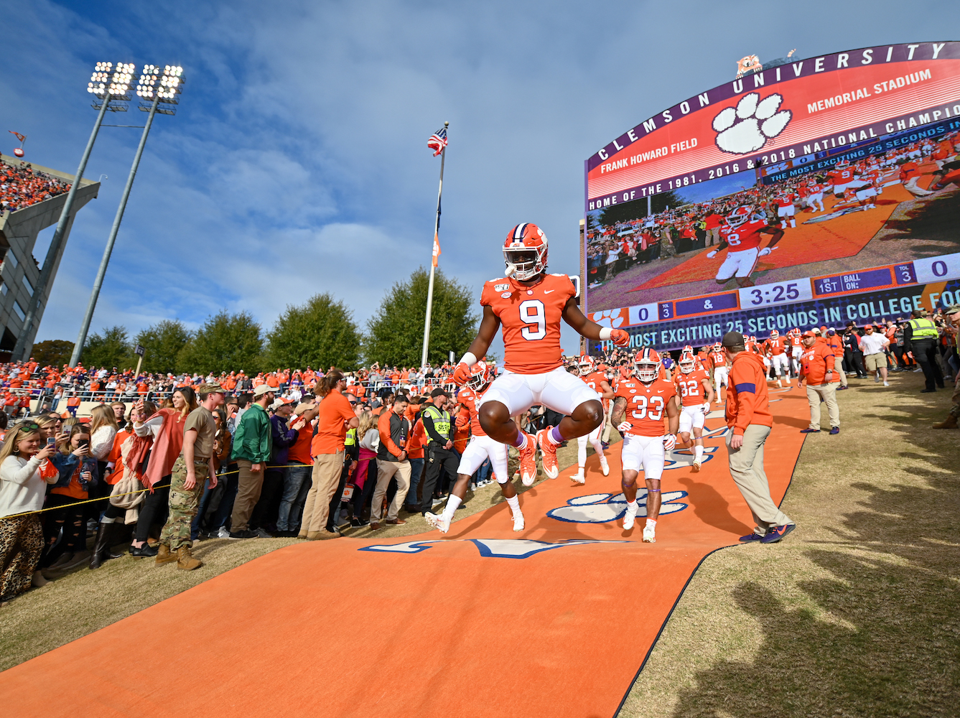
VALUATION ANALYSIS
Copyright © 2024. The contents of this document are confidential. The information may also be legally privileged. This document is shared in trust, for the sole purpose of review by the intended viewer.

Slide 6





















STADIUM NAMING RIGHTS AAV
VARIABLES USED TO EVALUTE AAV
HOW CLEMSON’S AAV COMPARE TO OTHER KNOWN DEALS
Stakes Score
Opponent Viewership/Game
School City Population
Bowl Appearances
Team 1 AP
$3,100,000
Copyright © 2024. The contents of this document are confidential. The information may also be legally privileged. This document is shared in trust, for the sole purpose of review by the intended viewer.
Notes:
The final variables used to get to the deal value…
This model considers the kind of games that Clemson plays, and who are their opponents, how many important games they are playing, etc…
How many of these games are going to drive attendance, how many of these games are going to drive viewership
Looking back a couple of years you can have a better picture of the stakes of games that this school is playing
If they are playing high stakes games, that draws attention and viewership
All of that brings exposure to the sponsor and drives the value of the deal up

Slide 7
VALUATION METHODOLOGY
MODELS TESTED
FEATURE SELECTION
Ridge Regression
Lasso Regression
PCA (Principal Component Analysis)
PCA was used to identify the variables that explain 90% of the variance of the AAV value
AAV PREDICTION
PCA
Gradient Boosting
KNN (K-Nearest Neighbors)
Linear Regression
After running the models with the selected variables, Gradient Boosting had the best performance
18
variables
5
variables
Train/Test Models
AAV
90% TRAIN
10% TEST
Copyright © 2024. The contents of this document are confidential. The information may also be legally privileged. This document is shared in trust, for the sole purpose of review by the intended viewer.
Notes:
To do this valuation I used the viewership data and some additional data points I got about the school city population, stadium capacity
Then I combined the data by teams
Many of these variables are colinear, so I tested a few models to select the features a would use for the final prediction model.
I used Ridge and Lasso regression which are regression models that are regularization methods where they penalize large coefficients by adding a penalty term that helps you not to overfit the model, meaning that the model will be able to add some flexibility on the training data, so for example, if there is an outlier, the model will not be as sensitive to the outlier.
The main difference between Ridge and Lasso regression is the way they shrink the coefficients. Ridge regression can reduce all the coefficients by a small amount, while Lasso can reduce some features more than others and hence can eliminate those features. Ridge regression is used to avoid Overfitting while Lasso Regression can be used for feature selection.
PCA – principal component analysis and what it does is reduces the variables in a way that you still have important information. Identify important variables that explain most variance.
Once I had the features, I started the predictions. Tried the PCA itself but when predicting with PCA works better with linear data
I also tried the KNN, which identifies the most similar observation from the one you are trying to predict and predicts the target value for the new data point by averaging the values of its nearest neighbors
The model that worked the best was Gradient Boosting that is a model that starts with a weak model that doesn’t have much predictable power, and then it keeps adding models to the residuals of the previous model trying to correct the errors. It then combines the predictions of multiple weak learners through weighted averaging. Gradient Boosting gradually improves the overall model's predictive accuracy. Gradient Boosting was the model with the lowest mean squared error

Slide 8
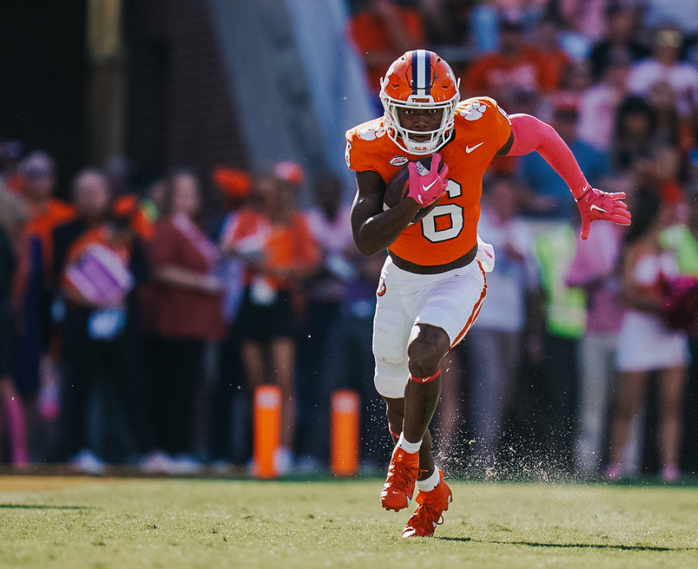
POTENTIAL SPONSOR ANALYSIS
Copyright © 2024. The contents of this document are confidential. The information may also be legally privileged. This document is shared in trust, for the sole purpose of review by the intended viewer.
Notes:
Now that I identified the deal value for Clemson at 3.1 million, let’s take a look at the sponsors

Slide 9
POTENTIAL SPONSORS
Industry | Automotive | Health Care | Financial Services
Location | Greenville, SC | Greenville, SC | Spartanburg, SC
Revenue | $28.7 billion | $6 billion | $2.06 billion
Employees | 44,925 | 10,344 | 1,385
Clemson Alumni | 458 | 728 | 12
Copyright © 2024. The contents of this document are confidential. The information may also be legally privileged. This document is shared in trust, for the sole purpose of review by the intended viewer.
Notes:
Used the number of alumni working in these companies to determine if it was a fit

Slide 10


POTENTIAL SPONSORS
1 in 5
Individuals interested in the ACC also shares an interest in cars and motoring in the Southeast.
Industry | Automotive | Health Care | Financial Services
Location | Greenville, SC | Greenville, SC | Spartanburg, SC
Revenue | $28.7 billion | $6 billion | $2.06 billion
Employees | 44,925 | 10,344 | 1,385
Clemson Alumni | 458 | 728 | 12
Values align on excellence, innovation, diversity, sustainability, and community responsibility
Michelin has already shown interest in American sports and partnering with Clemson could be an opportunity to expand its presence in the market.
Copyright © 2024. The contents of this document are confidential. The information may also be legally privileged. This document is shared in trust, for the sole purpose of review by the intended viewer.
Notes:
Most of Clemson’s fanbase is in the Southeast where people who follow the ACC are also interested in Michelin’s industry
Shown interest in American Sports other than motorsports by being the official tire supplier for the Buffalo Bills

Slide 11
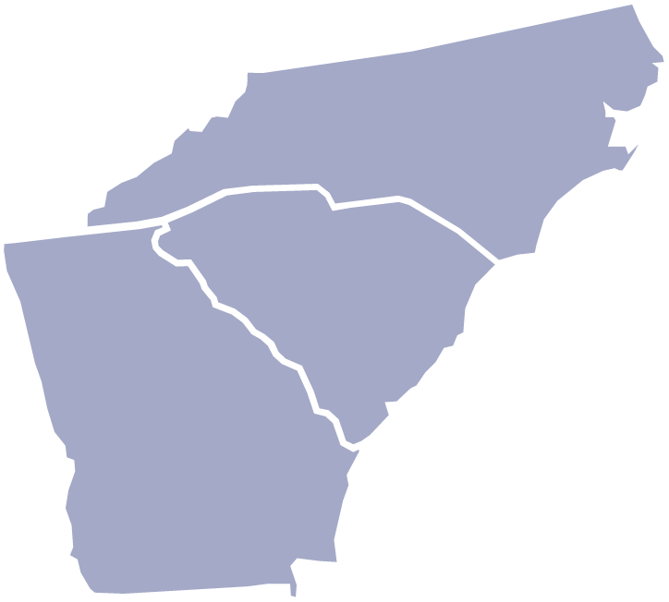



BENEFITS
LOCAL EXPOSURE
NORTH CAROLINA
14,296
Interior and Exterior Stadium Signage
Dedicated suite for Michelin to use with prospective clients and/or employees
GEORGIA
12,110
SOUTH CAROLINA
99,592
75% of Clemson Alumni lives in South Carolina, North Carolina and Georgia
Copyright © 2024 Navigate. The contents of this document are confidential. The information may also be legally privileged. This document is shared in trust, for the sole purpose of review by the intended viewer.
Notes:
Alumni base close by, which can identify with Michelin and help build brand awareness among locals

Slide 12

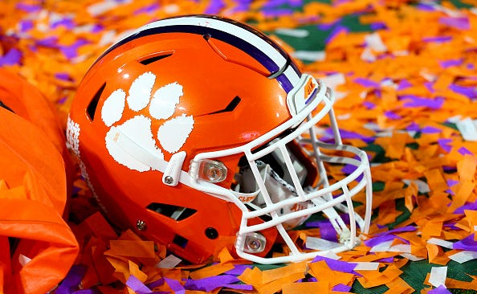



BENEFITS
NATIONAL EXPOSURE
Mentions on national broadcast during games. The Greenville-Anderson-Spartanburg broadcast market consistently ranks among the top five college football television markets
ALUMNI
170,000+
Dedicated posts on Clemson’s Tiger social media
Clemson football fans were ranked as the most-engaged fans in the country
Clemson has over 800k followers on social media and ranks #2 on YouTube followers among other P5 schools
Clemson’s fanbase is the 19th biggest in the country with over 4 million fans
Copyright © 2024. The contents of this document are confidential. The information may also be legally privileged. This document is shared in trust, for the sole purpose of review by the intended viewer.
Notes:
By WalletHub. This metric measures the number of Twitter followers and Facebook “Likes” (on each team’s official accounts) per capita.

Slide 13

BENEFITS
Research
The two institutions can work together on research projects related to materials science, automotive engineering, and sustainable mobility. This could involve joint research grants, collaborative research projects, or the sharing of resources and expertise.
Innovation
Clemson and Michelin can collaborate on the development of innovative technologies or processes related to tire manufacturing, recycling, or sustainable transportation.
Copyright © 2024. The contents of this document are confidential. The information may also be legally privileged. This document is shared in trust, for the sole purpose of review by the intended viewer.
Notes:
Michelin has partnered with Clemson University and the University of South Carolina to create an independent study course that provides students with real-world experience in industrial sustainability.
Clemson and Michelin have conducted research on the impact of tire pressure on soil compaction in South Carolina
They can keep these projects going and like this not only athletes but also students at Clemson can benefit from the partnership

Slide 14

POTENTIAL SPONSORS METHODOLOGY
COMPANIES DATABASE
Location
Greenville-Anderson-Spartanburg
Revenue
Above $5M
Density-based spatial clustering
Cluster
Industry
# of alumni
TOP INDUSTRIES WITH STADIUM NAMING RIGHTS DEALS ACROSS DIVISON I
Copyright © 2024. The contents of this document are confidential. The information may also be legally privileged. This document is shared in trust, for the sole purpose of review by the intended viewer.
Notes:
On average, for the already known deals, the AVV is 3.2% of the revenue. I filtered again the revenue for above 100M, which the AAV would correspond to 3% of the revenue
Other clustering used:
K-Means Clustering, Hierarchical Clustering, Agglomerative Clustering

Slide 15
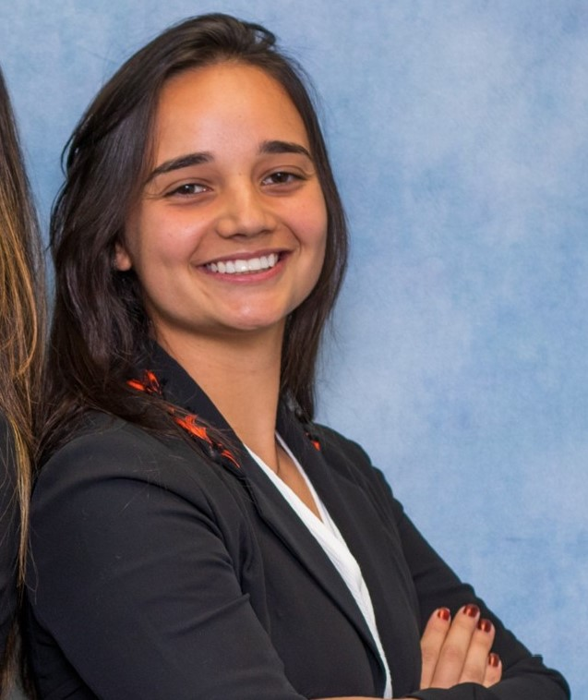
MARIA ALICE F. VIEIRA
mariaalicefv@hotmail.com
Copyright © 2024. The contents of this document are confidential. The information may also be legally privileged. This document is shared in trust, for the sole purpose of review by the intended viewer.

