Slide 1
Nike Sales Data Analysis
Data Cleaning • Aggregation • Visualization

Slide 2
Dataset Overview
Nike Sales dataset with 2,500 transactions across 6 Indian cities
2,500
13
6
12
Rows
Columns
Regions
Products
Order_ID • Gender_Category • Product_Line Product_Name • Size • Units_Sold • MRP
Discount_Applied • Revenue • Order_Date Sales_Channel • Region • Profit

Slide 3
Problems Found in the Raw Data
5,283 total data quality issues identified across 9 categories
1
Inconsistent Region names
bengaluru, Hyd, hyderbad
497 rows
2
Mixed Size column
Clothing (M, L, XL) + Shoe sizes in one column
2,500 rows
3
Mixed date formats
YYYY-MM-DD, DD-MM-YYYY, YYYY/MM/DD
1,884 rows
4
Negative Units Sold
Units_Sold = -1
205 rows
5
Missing & inconsistent MRP
Same product, different prices
1,254 rows
6
Missing Discount
66.7% of discounts are NaN
1,668 rows
7
Discount over 100%
Values like 1.1, 1.25 (110%-125%)
180 rows
8
Broken Revenue
Zeros and negative values
2,387 rows
9
Negative Profit
578 rows with losses
578 rows

Slide 4
Cleaning: Region Names & Size Column
🗺️ Fix Region Names
👟 Split Size Column
Problem: Same city with different spellings bengaluru → Bangalore Hyd, hyderbad → Hyderabad Method: Dictionary mapping with .replace()
Problem: Clothing sizes (M, L, XL) and shoe sizes (6, 7, 8...) mixed in one column Solution: Split into two new columns: • clothing_sizes (text: M, L, XL) • Shoe_Size (numeric: 6, 7, 8...)
❌ Before
✅ After
Region: bengaluru, Hyd, hyderbad, Bangalore... Size: M, 7, L, 11, XL, 9...
Region: Bangalore, Hyderabad, Delhi, Mumbai... clothing_sizes: M, L, XL Shoe_Size: 6, 7, 8, 9, 10, 11

Slide 5
Cleaning: Dates & Negative Values
📅 Fix Mixed Date Formats
➖ Fix Negative Values
Problem: 3 different date formats in the same column • 2024-03-09 (YYYY-MM-DD) • 04-10-2024 (DD-MM-YYYY) • 2024/09/12 (YYYY/MM/DD) Solution: pd.to_datetime() with format='mixed' and dayfirst=True for correct interpretation
Problem: Data entry typos created negative numbers • Units_Sold: 205 rows with -1 • Profit: 578 rows with negative values Solution: Convert all negatives to positive using .abs() — treats them as typos where a minus sign was accidentally added

Slide 6
Cleaning: MRP Grouping by (Gender, Name, Line)
1,254 rows had missing prices + the same product had wildly different prices across rows
💡 Why not just use the product name?
In the real world, pricing depends on more than just the product name. An "Air Jordan" for Kids is cheaper than an "Air Jordan" for Men. Solution: Group by 3 columns together — Gender + Product Line + Product Name Then take the first valid price for each unique combination and apply it to all matching rows.
❌ Before
✅ After
Kids + Training + SuperRep Go → ₹9,671 Kids + Training + SuperRep Go → ₹6,819 (different!) Men + Training + SuperRep Go → NaN (missing!)
Kids + Training + SuperRep Go → ₹9,671 Kids + Training + SuperRep Go → ₹9,671 (consistent!) Men + Training + SuperRep Go → ₹6,820 (filled!)

Slide 7
Cleaning: Reverse Engineering Method
Instead of filling missing values with 0 or the average, we mathematically reconstructed them
Step 1
Step 2
Step 3
Step 4
Fill missing Discounts with 0 Cap discounts at 99% max (prevents division by zero)
Reverse-engineer Revenue Revenue = Profit / 0.35 (only for broken rows)
Reverse-engineer Units Sold Units = Revenue / (MRP × (1 - Discount)) (only for broken rows)
Sanity check: if Units rounds to 0 but Revenue > 0, force Units = 1
💡 Why is this method better?
The Profit column had zero missing values. By assuming a 35% profit margin, we used the only complete column to mathematically derive the missing Revenue and Units Sold — instead of guessing with zeros or averages.

Slide 8
After Cleaning — Results
0
0
0
0.99
Missing Values (core columns)
Negative Units Sold
Negative Profit
Max Discount
Before vs After Summary
Before
After
Missing Values (core)
5,283
0
Negative Units Sold
205
0
Inconsistent Regions
497 rows
6 clean cities
Mixed date formats
3 formats
1 standard format
Zero Units + Revenue
767 rows
0 rows

Slide 9
Aggregations
Key Performance Indicators
💰
📈
👟
Total Revenue
Total Profit
Total Units Sold
$20,273,368
$4,104,284
16,777.0

Slide 10
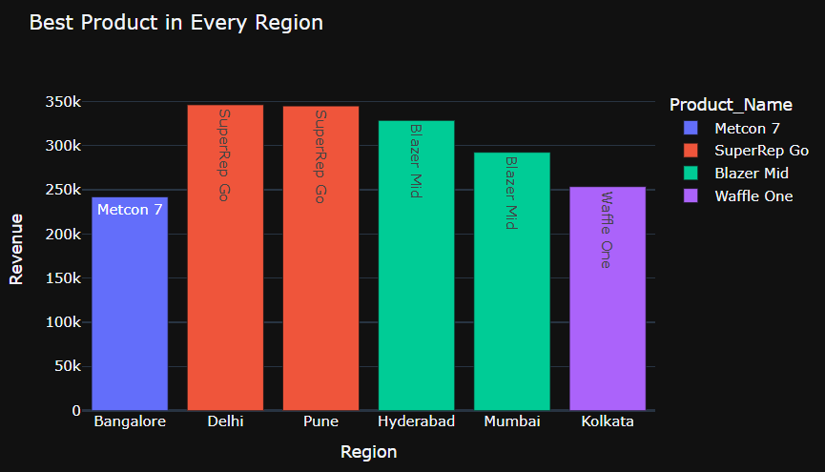
Best Product in Every Region
Each region has a different top-selling product based on total revenue

Slide 11
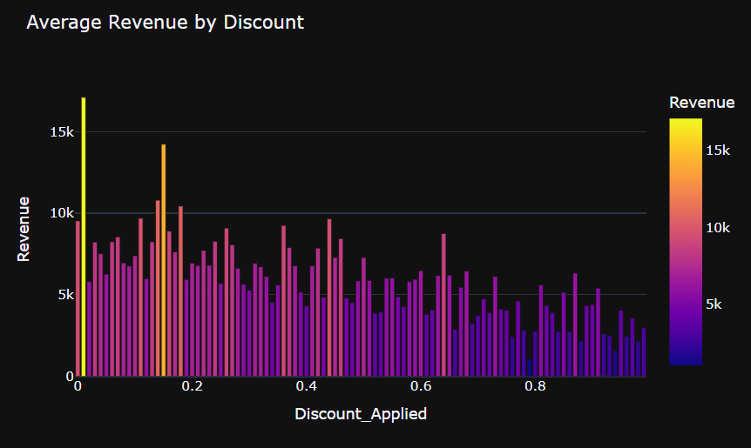
Average Revenue by Discount
Impact of discount levels on average revenue per transaction

Slide 12
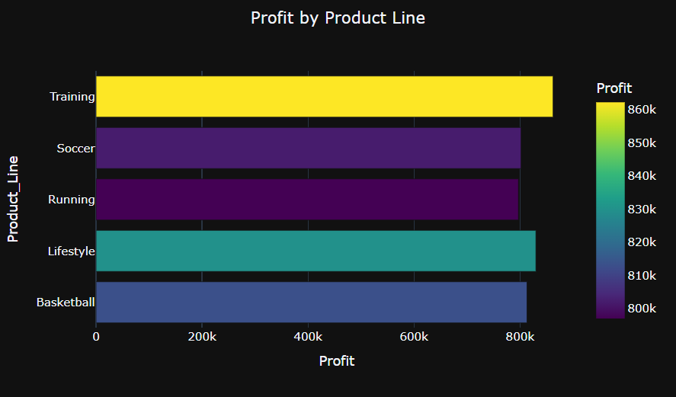
Profit by Product Line
Total profit generated by each product category

Slide 13
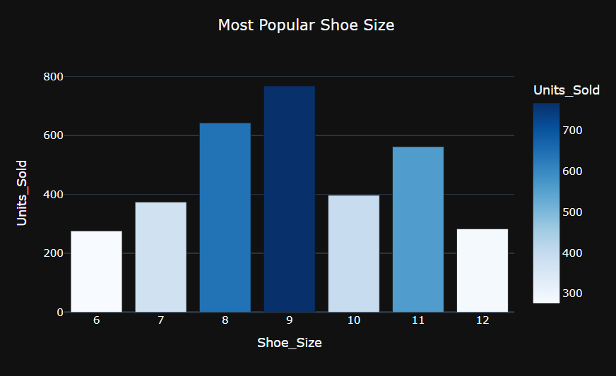
Most Popular Shoe Size
Distribution of units sold across shoe sizes

Slide 14
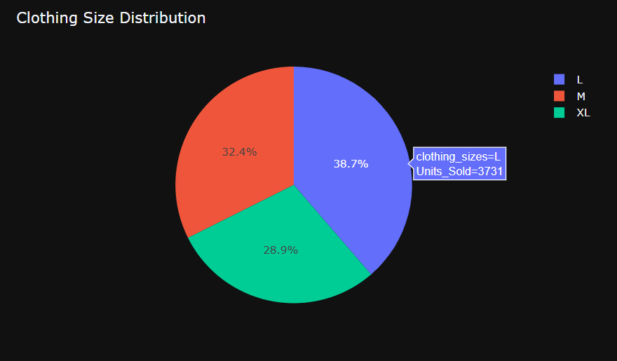
Clothing Size Distribution
Proportion of sales across clothing sizes (M, L, XL)

Slide 15
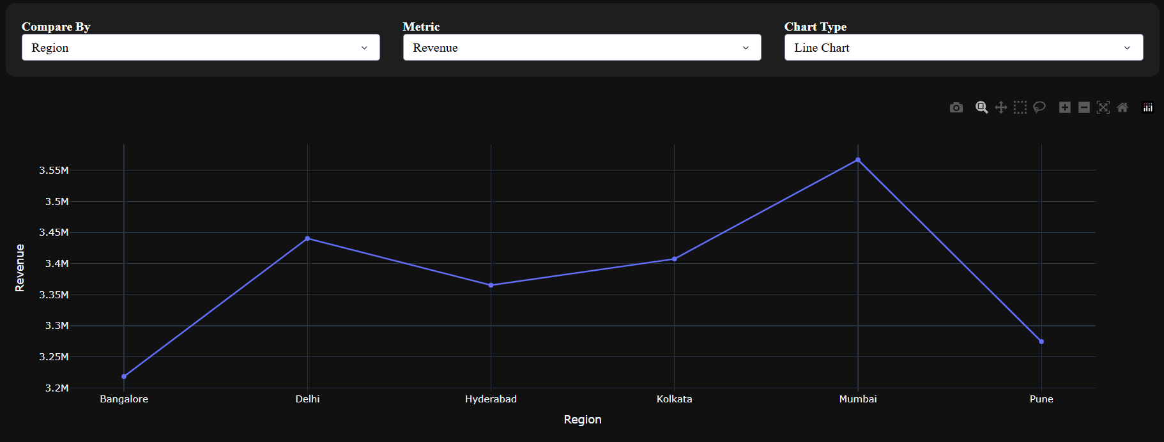
Revenue by Region
Total revenue contribution from each city

Slide 16
Interactive Dashboard
Built with Plotly Dash — a fully interactive web-based analytics dashboard
🎯 Compare By
📊 Metrics
📈 Chart Types
Region, Gender, Product Name, Product Line, Sales Channel, Year
Revenue, Profit, Units Sold
Bar Chart, Pie Chart, Line Chart, Scatter Plot
How it works
The user selects any combination of comparison dimension, metric, and chart type using dropdown menus. The dashboard instantly re-renders the visualization using a Dash callback function, enabling real-time exploratory data analysis without writing any code.

Slide 17
Key Insights
Cleaned 5,283 data quality issues across 9 categories
Used advanced 3-column grouping for accurate price correction
Reverse-engineered missing Revenue & Units from Profit
Built an interactive Dash dashboard for real-time analysis
Thank You

