Slide 1

FIFA 21
DATA ANALYSIS FINDINGS
Group 2 : Carlos Ruiz / Maria Bollain / Ying Wang

Slide 2

Content
Executive summary
Problem definition
Data reading
Data cleaning
Exploratory data analysis
Data processing
Data modeling
Machine learning
Conclusions
Methodology

Slide 3
Executive summary
In this project, we perform an analysis of the FIFA 21 dataset that we have been provided with; more specifically, we work with different scenarios where we use both with “release clause” and “wage” to compare the market value across players in different selections.
Here we provide a summary of the key findings that we provide further information over the presentation.

Slide 4
Executive summary
The players with higher value are not necessarily the ones with higher wages (that cost more money to the club).
If we keep the “release clause” and the outliers, we have a higher r2 coefficient, compared where we get rid of the “release clause” and remove the outliers.
Overall scores and potential scores resemble more a “normal distribution”, whereas “wage” behaves more like a left-skewed and “total stats” like a right-skewed distribution
From the multicollinearity graph, we find that market value of the player is highly correlated to wage (0.82) and release clause (0.98).

Slide 5
2. Problem definition
With this dataset, we have focused on providing the answer to these two questions:
Rank players by market value and compare with wages.
Predict the market value using linear regression.

Slide 6
3. Data reading
We get a total of 107 columns and we spent some time doing research on the abbreviations:
OVA = overall scores
BOV = best overall
POT = potential scores
GK = goalkeeping
W/F = weak foot
SM = skilled moves
IR = international reputation
CF = center forward
Notes:
Dataframe also included “hyperlink” columns with the player_photo, club_logo and flag_photo

Slide 7
4. Data cleaning
"attacking" = sum ("crossing","finishing","heading_accuracy","short_passing","volleys")
"skill" = sum ("dribbling","curve","fk_accuracy","long_passing","ball_control")
"movement" = sum ("acceleration","sprint_speed","agility","reactions","balance")
"power" = sum ("shot_power","jumping","stamina","strength","long_shots")
"mentality" = sum ("aggression","interceptions","positioning","vision","penalties","composure")
"defending" = sum ("marking","standing_tackle","sliding_tackle")
"goalkeeping" = sum ("gk_diving","gk_handling","gk_kicking","gk_positioning","gk_reflexes")
"total_stats" = sum ("attacking","skill","movement","power","mentality","defending","goalkeeping")
"base_stats" = sum ("pac","sho","pas","dri","def","phy")

Slide 8
4. Data cleaning
drop_columns = ["position","player_photo","club_logo","flag_photo","team_&_contract","joined","contract",
"crossing","finishing","heading_accuracy","short_passing","volleys",
"dribbling","curve","fk_accuracy","long_passing","ball_control",
"acceleration","sprint_speed","agility","reactions","balance",
"shot_power","jumping","stamina","strength","long_shots",
"aggression","interceptions","positioning","vision","penalties","composure",
"marking","standing_tackle","sliding_tackle",
"gk_diving","gk_handling","gk_kicking","gk_positioning","gk_reflexes",
"base_stats","w/f","sm","pac","sho","pas","dri","def","phy","hits",
"ls","st","rs","lw","lf","cf","rf","rw","lam","cam","ram","lm","lcm",
"cm","rcm","rm","lwb","ldm","cdm","rdm","rwb","lb","lcb","cb","rcb","rb","gk","gender"]

Slide 9
4. Data cleaning
NaN values:
club 23 —> fill with “unknown”
loan_date_end 16215 —> drop column
attacking_work_rate 89 —> drop rows
defensive_work_rate 89 —> drop rows
Notes:
# column `loan_date_end` has a large number of NaN values (16,215), so we decide to remove it.

Slide 10
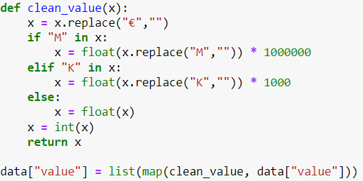
4. Data cleaning
Columns that are objects and should be numerical:
height, weight, value, wage, release_clause, weak_foot, skilled_moves, international_reputation, hits
Notes:
We also transformed height and weight, height from inch to cm, and weight to kgs from lbs.

Slide 11
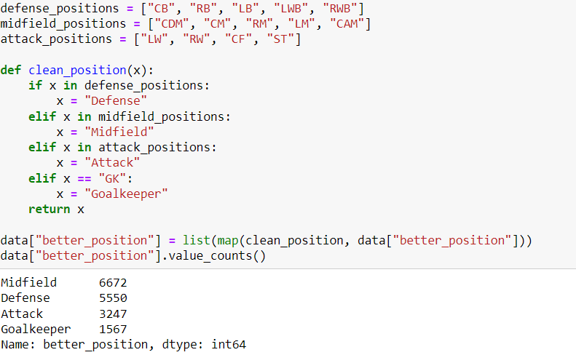
4. Data cleaning
Better position column: a lot of abbreviations.

Slide 12
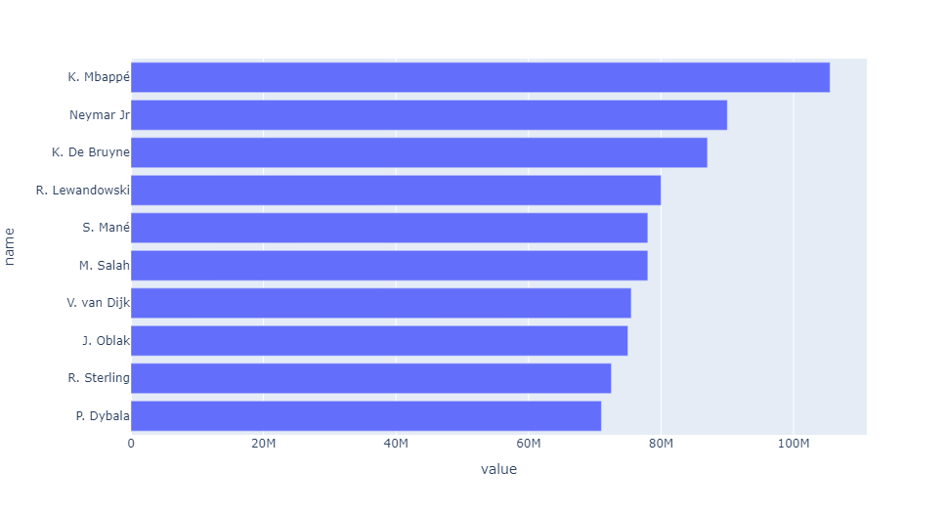
5. EDA: Key findings - Golden players
Top 10 players ordered by value

Slide 13
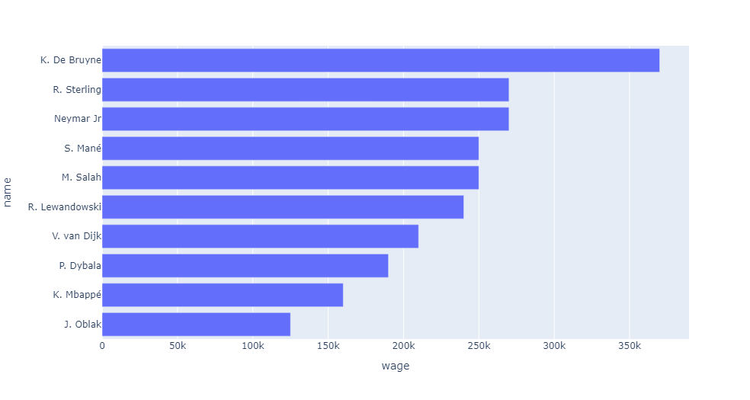
5. EDA: Key findings - Golden players
Top 10 players ordered by wages

Slide 14
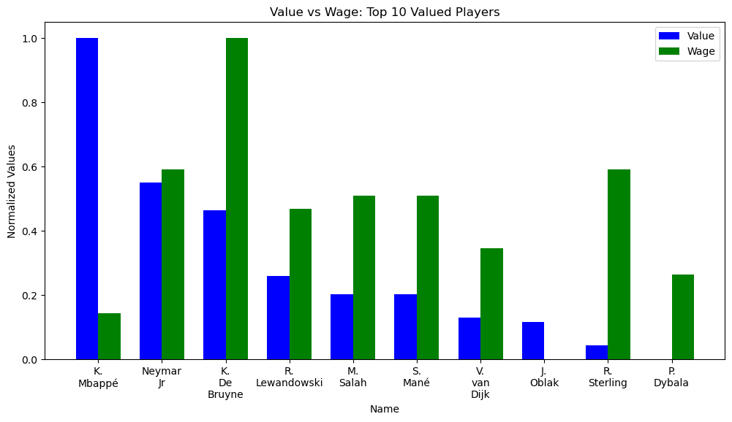
5. EDA: Key findings - Golden players
The players with higher value are not necessarily the ones with higher wages (that cost more money to the club).

Slide 15
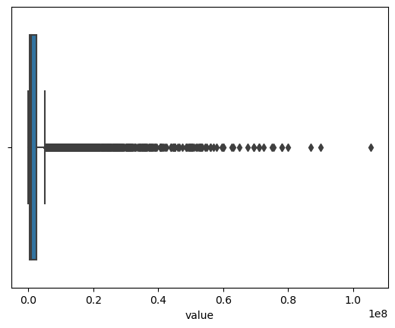
5. EDA: Key findings - value distribution
Mean: 1,450,565
Min: 0
25%: 350,000
50%: 725,000
75%: 1,500,000
Max: 27,000,000
Huge number of outliers!!!
Also a lot of outliers in wage and release clause

Slide 16
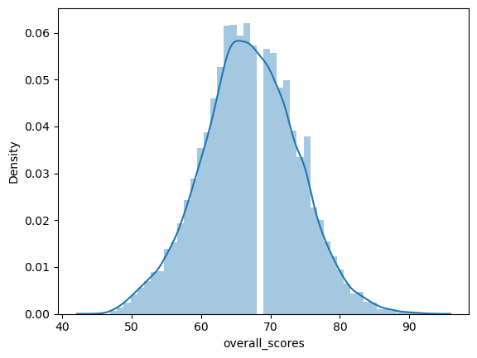
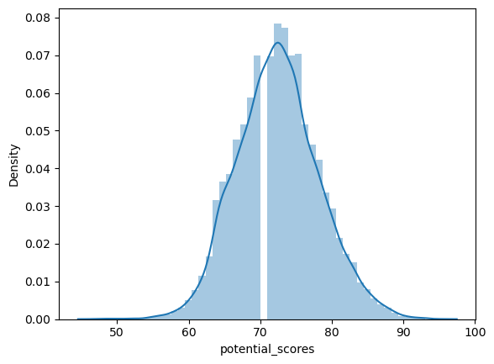
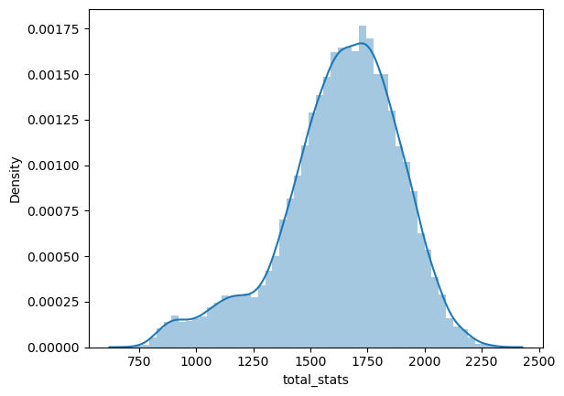
5. EDA: Density graphs
+- normal distribution

Slide 17
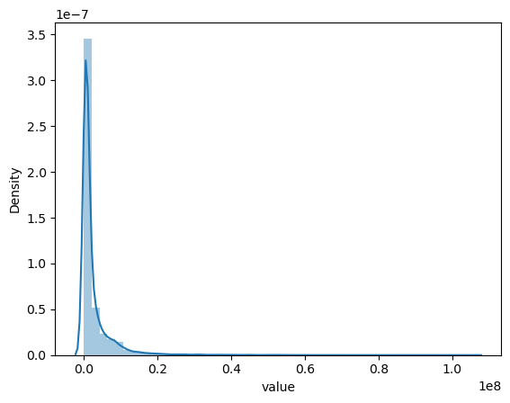
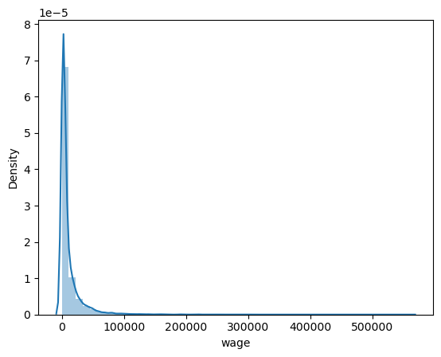
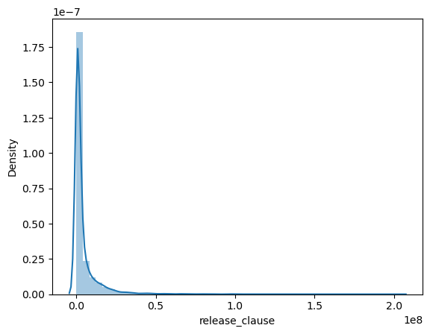
5. EDA: Density graphs
Highly left skewed

Slide 18
5. EDA: Correlation between variables: multicollinearity
We find that the features that are most correlated with the target are "release_clause" (0.98) and "wage" (0.82).
Total stats are the sum of "Attacking", "Skill", "Movement", "Power", "Mentality", "Defending" and "Goalkeeping", so we decide to get rid of them as they are variables that show high multicollinearity themselves.
“Best overall” and “overall” scores also show a really high correlation, 0.99.

Slide 19
6. Data processing
Here is the initial multicollinearity analysis that we get…

Slide 20
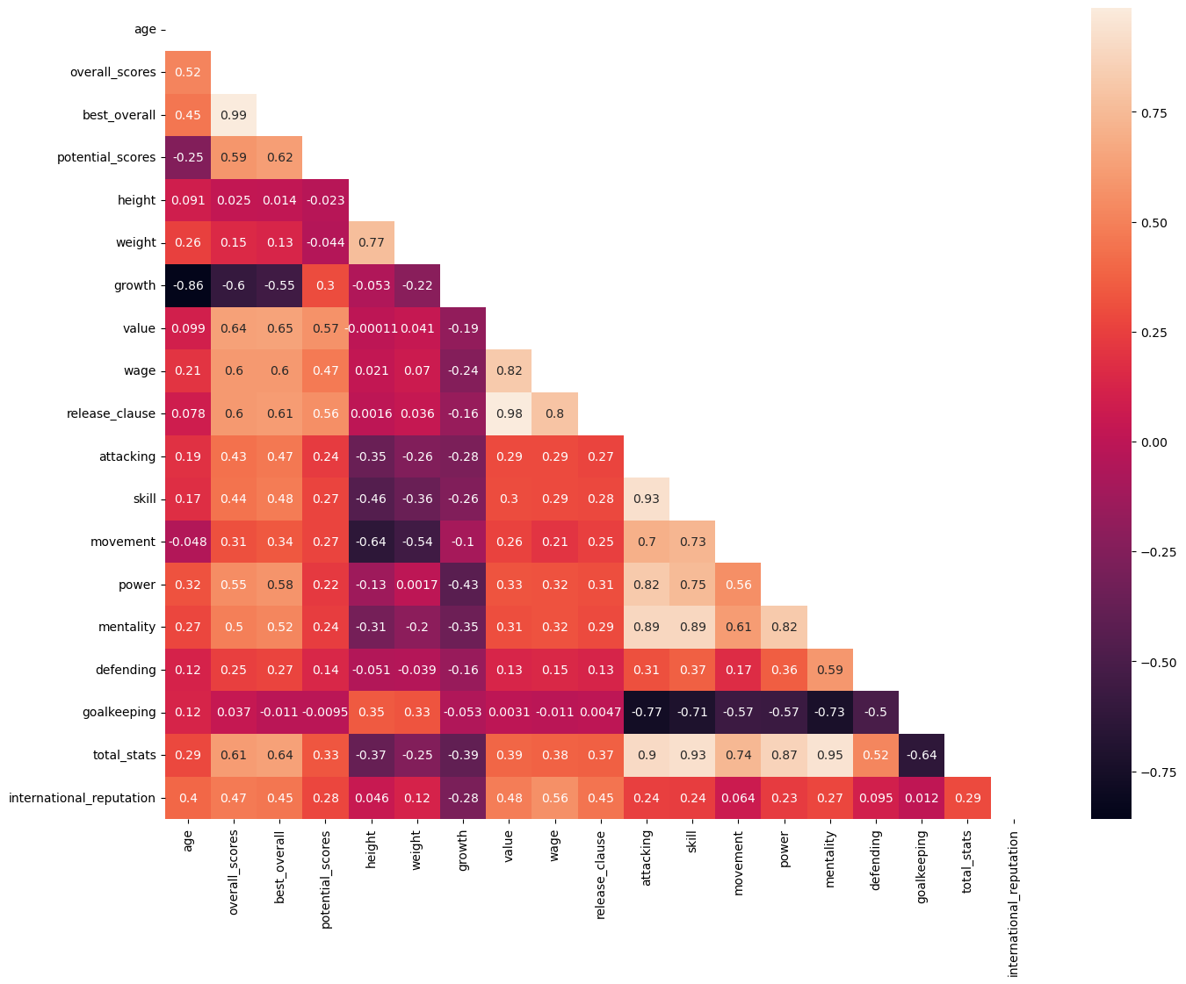
Drop columns:
"Best_overall"
"Growth"
""Attacking"
"Skill"
"Movement"
"Power"
"Mentality"
"Defending"
"Goalkeeping"

Slide 21
6. Data processing
And this is the new one that we get…

Slide 22
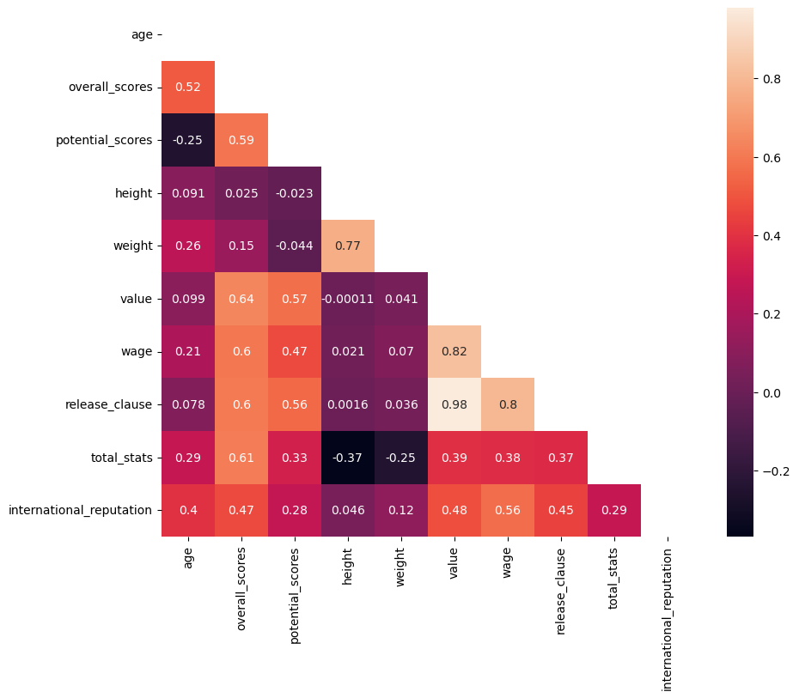
Multicollinearity
From the graph, we find that market value of the player is highly correlated to wage (0.82) and release clause (0.98).

Slide 23
7. Modeling - Linear Regression
X-y split
Separate numerical and categorical data and more processing
Concat into final dataset
Train-test split
Apply linear regression
Model validation
Try different models
Final decision with model

Slide 24
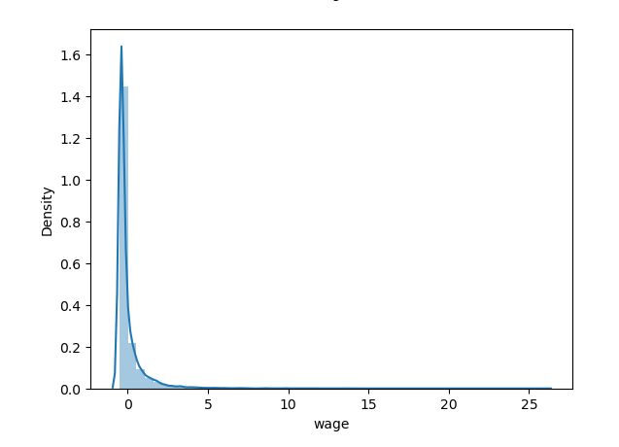
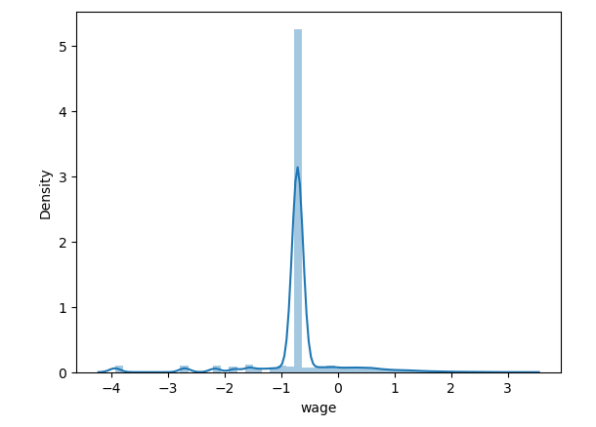
Machine Learning: transformations - numericals
Based on the distribution plots, we used log transformation to `wage` and `release_clause`
Before log transformation VS After log transformation

Slide 25
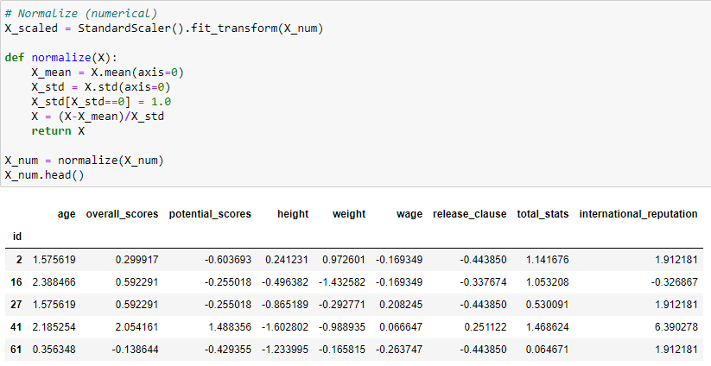
Machine Learning: Standardization - numericals

Slide 26
Machine Learning: transformations - categoricals
COLUMN | UNIQUE VALUES | ACTION
name | 16092 | Drop column
nationality | 167 | Keep the top nationalities, group the rest into other
club | 907 | Drop column
position | 4 | Keep
foot | 2 | Keep
attacking_work_rate | 3 | Drop column
defensive_work_rate | 3 | Drop column

Slide 27
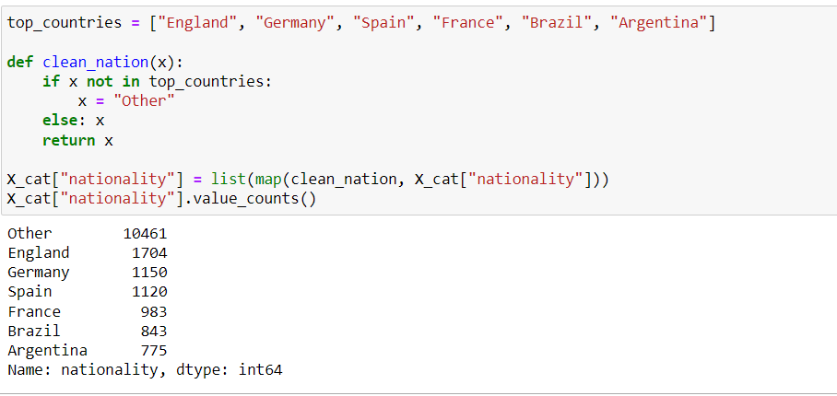
Machine Learning: transformations - categoricals
Apply get dummies

Slide 28
Different models - metrics
Description | Scenario | r2 | adjusted r2 | mse | rmse | mae
With wage and release_clause and no removing outliers | A | 0.9725337218 | 0.9725030531 | 805836061008 | 897683.7199 | 447639.9012
With release_clause, without wage and no removing outliers | B | 0.9716063963 | 0.9715763625 | 833042963945 | 912711.8735 | 465650.1525
With wage, without release_clause and no removing outliers | C | 0.7400586937 | 0.7397837367 | 7626445670117 | 2,761,602.01 | 1,444,970.17
With wage and release_clause and removing outliers | D | 0.623302951 | 0.6227224771 | 261289735368 | 511,165.08 | 265,334.22
With release_clause, without wage and removing outliers | E | 0.6184826613 | 0.6179869339 | 674,059,705,433.26 | 821,011.39 | 413,704.37
With wage, without release_clause and removing outliers | F | 0.6045195049 | 0.6040182975 | 1,606,708,888,227.77 | 1,267,560.21 | 829,364.98

Slide 29
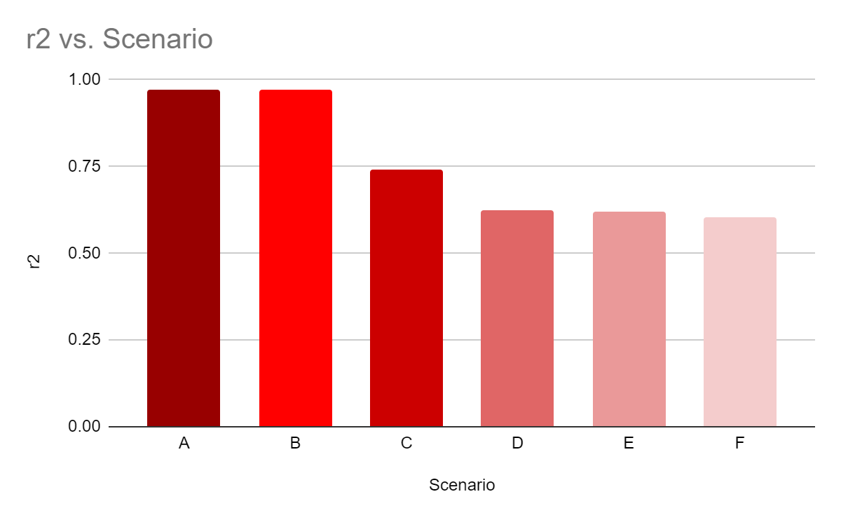
R2 coefficient, release clause and outliers
From our findings, we see that if we keep the “release clause” the outliers, we have a higher r2 coefficient (r2 = 0.9725), compared where we get rid of the “release clause” and keep the outliers (r2 = 0.7400).

Slide 30
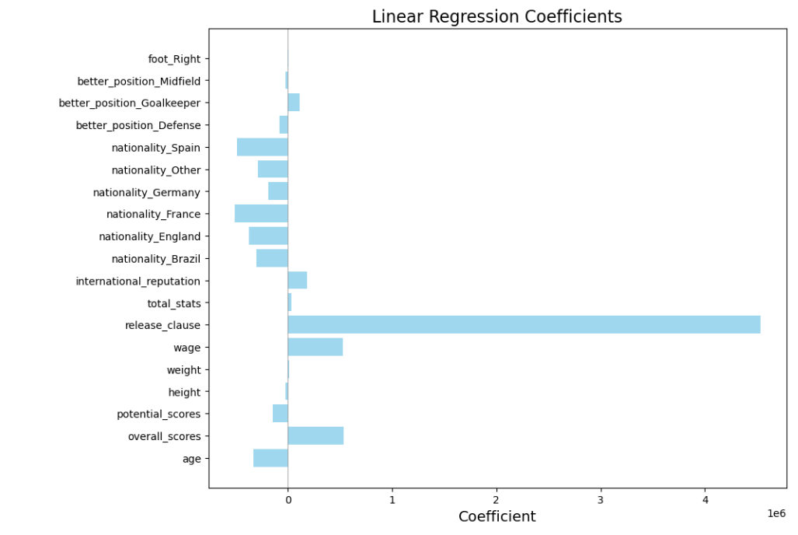
Interpretation for model results
Intercept: 2.906.693
Coefficients:
age : -333.696
overall_scores : 532.967
potential_scores : -144.272
height : -21.010
weight : 8.866
wage : 529.293
release_clause : 4.531.966
total_stats : 35.330
international_reputation : 184.612
nationality_Brazil : -305.620
nationality_England : -377.411
nationality_France : -510.246
nationality_Germany : -190.868
nationality_Other : -287.273
nationality_Spain : -489.241
better_position_Defense : -78.842
better_position_Goalkeeper : 111.112
better_position_Midfield : -26.354
foot_Right : 7.606

Slide 31
Conclusions and limitations
Takeovers for future FIFA data analysis:
Highlight the top players for their outstanding performances over a discrete season.
Build a top football team with conditions as such budget, location, etc.
Due to time boundaries, we did not enter into these two applications:
Decide when to transfer a player.
Decide the best replacement for a transferred player.
Had to spend some time finding out the meaning of some abbreviations and finding that total stats were already a sum of variables like “attacking”, “skills”, and “power”, as well as finding out the meaningful variables to our model.
Also, we encountered very high errors and model overfitting issues.

Slide 32
Methodology
Sample size: 17.125 observations
Source: Kaggle
Link to the data source:
https://www.kaggle.com/datasets/ekrembayar/fifa-21-complete-player-dataset?select=fifa21_male2.csv
Link to the github repository
https://github.com/Yinguin/data_mid_bootcamp_project_FIFA_MoneyBall/blob/master/FIFA.ipynb

